Slide 1

Chassis introduction
Natalie Kuldell
February 14th, 2012

Slide 2
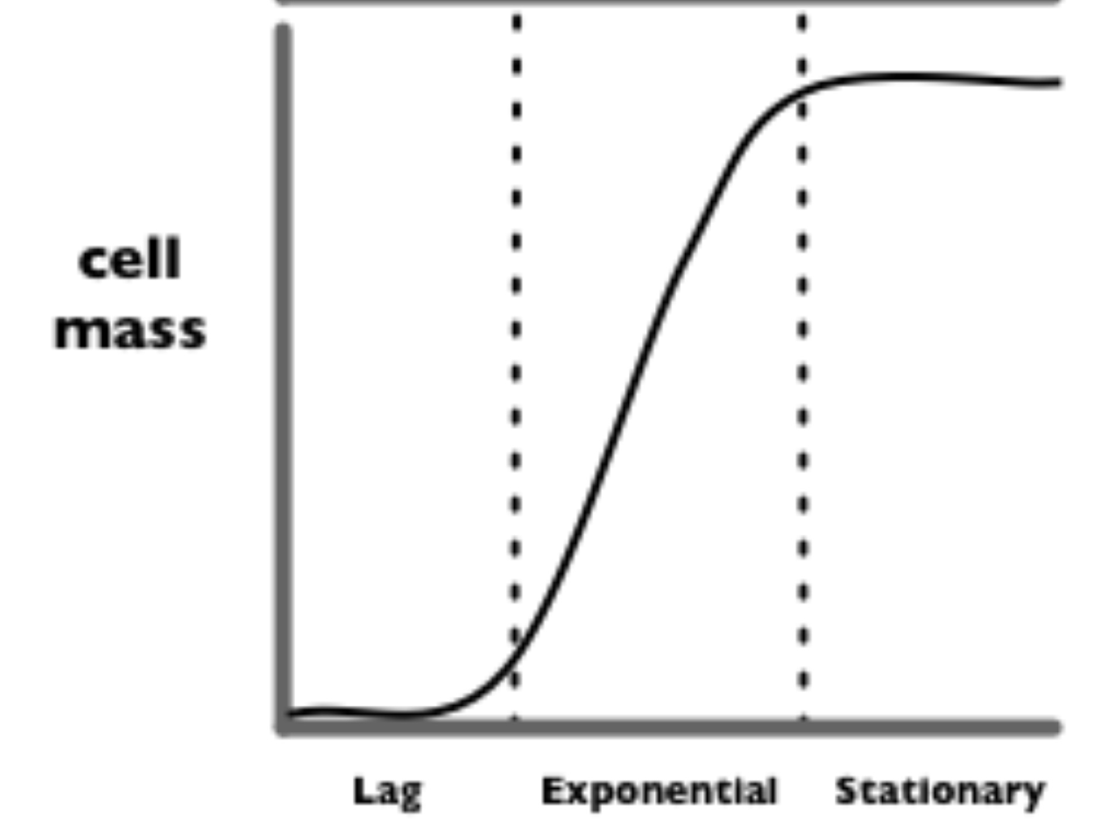
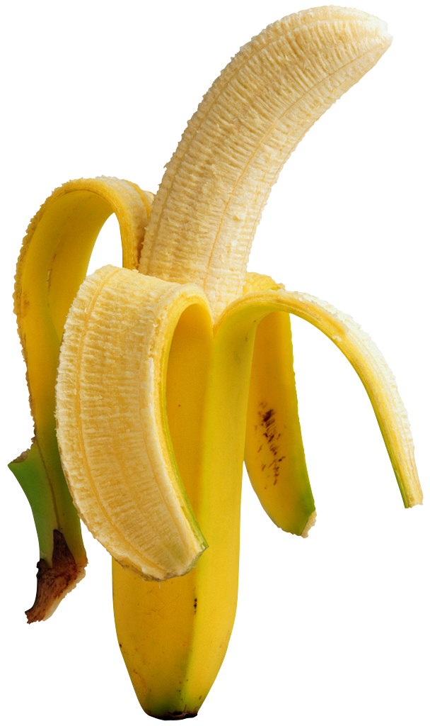
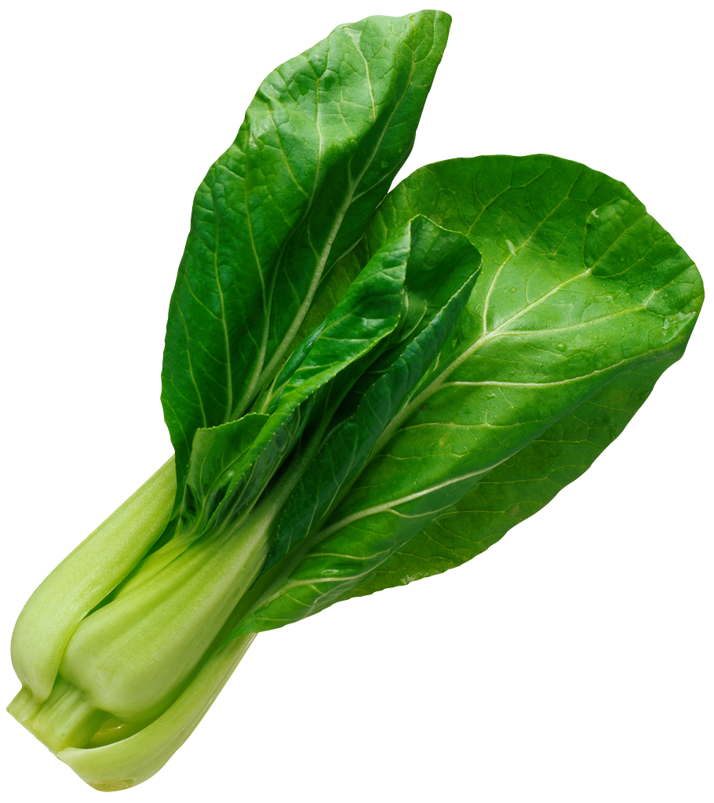


“Eau d’coli”
“stationary”
cell density
“log”
saGD
WGD
“lag”
iaGD
BGD
time
Notes:
http://parts.mit.edu/movies/iGEM2006_MIT.mov

Slide 3
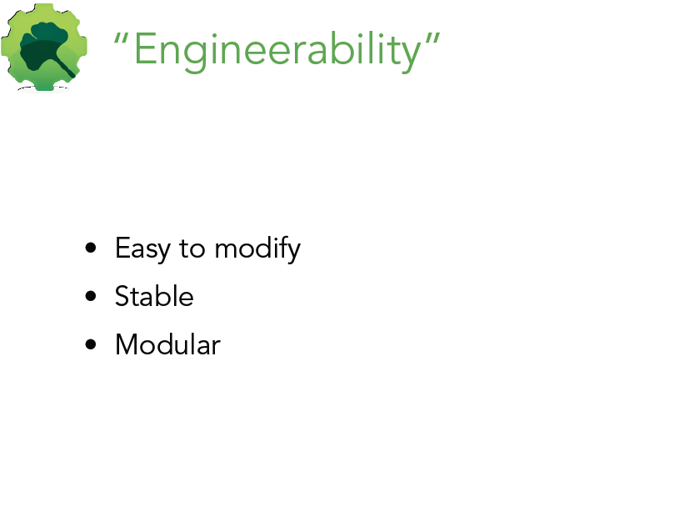
Next slides from Barry Canton, Ginkgo BioWorks

Slide 4
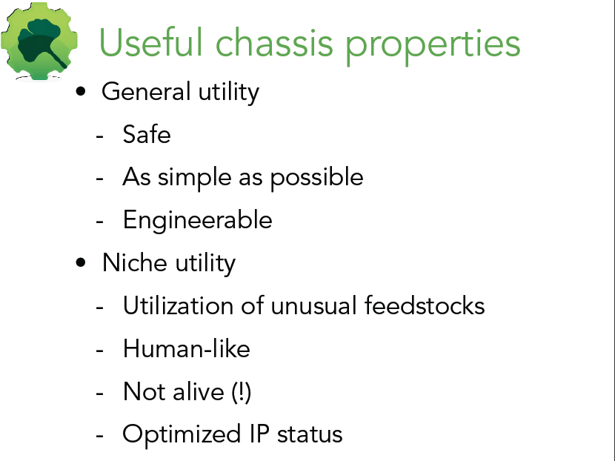

Slide 5
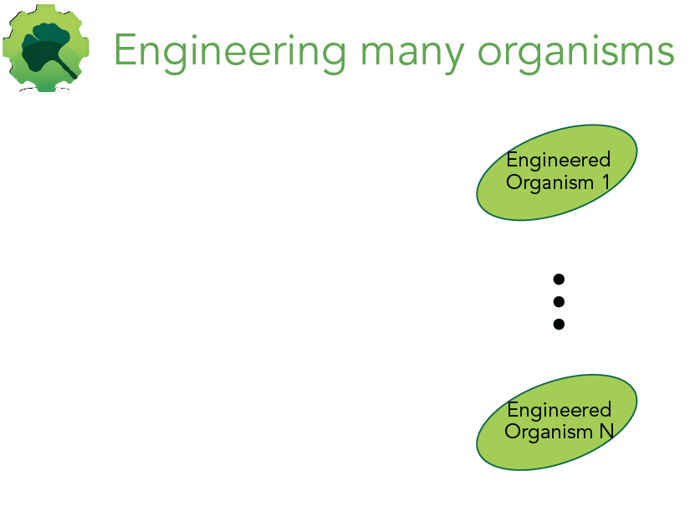

Slide 6
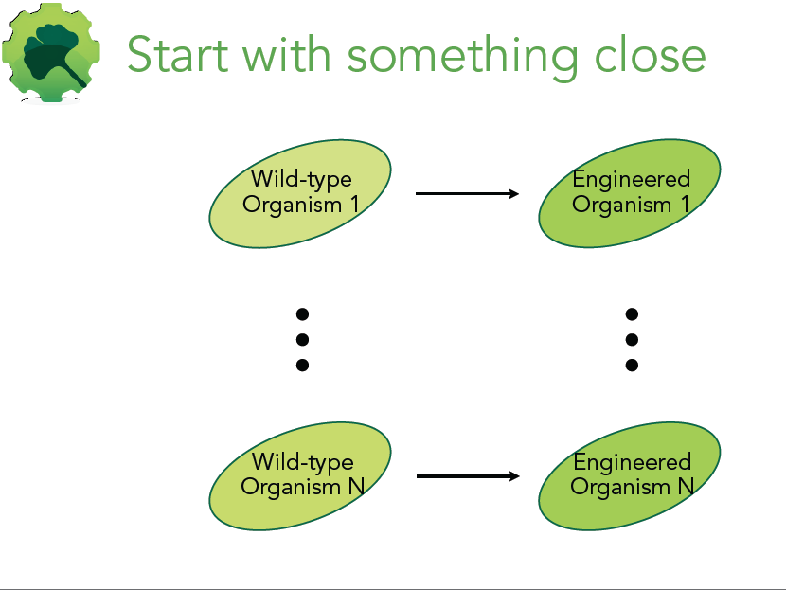

Slide 7
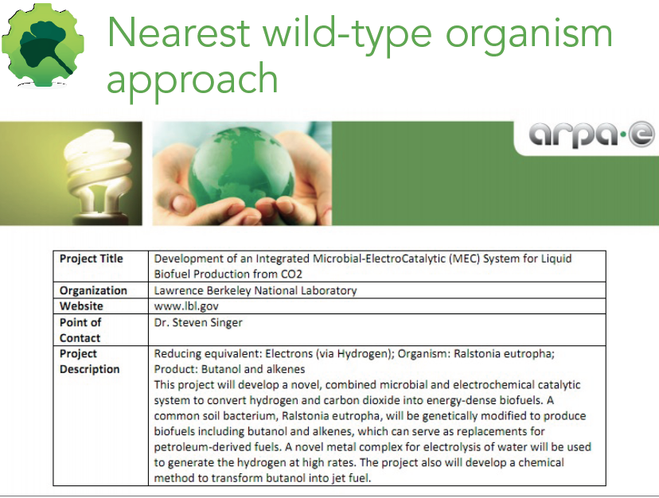

Slide 8
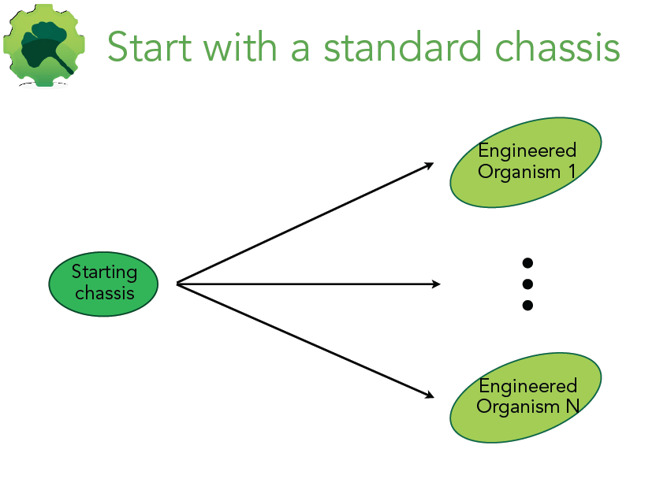

Slide 9
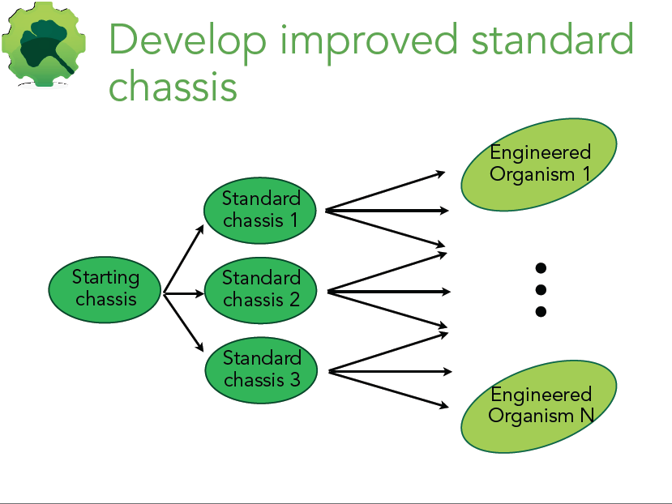

Slide 10
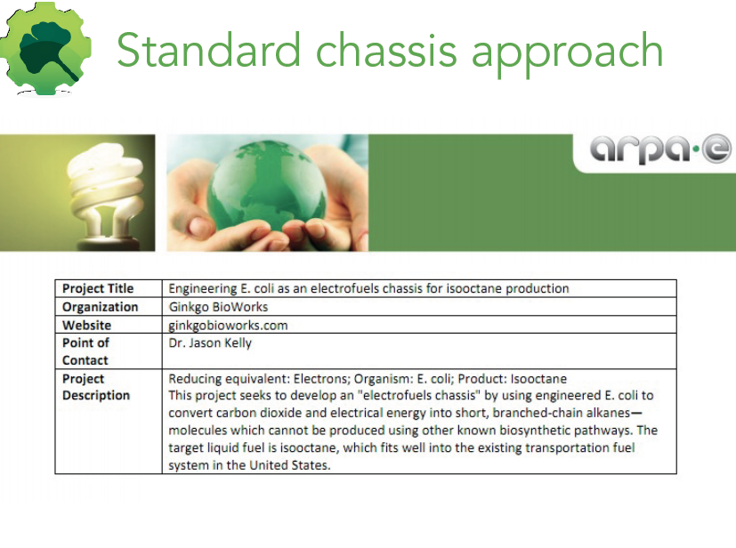

Slide 12
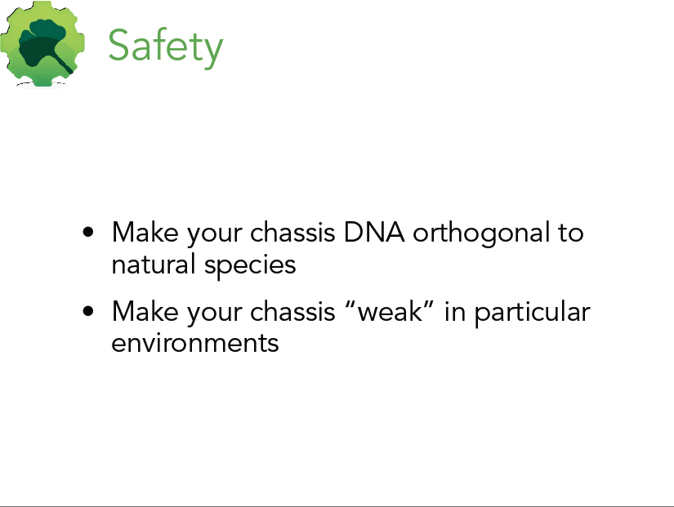

Slide 13
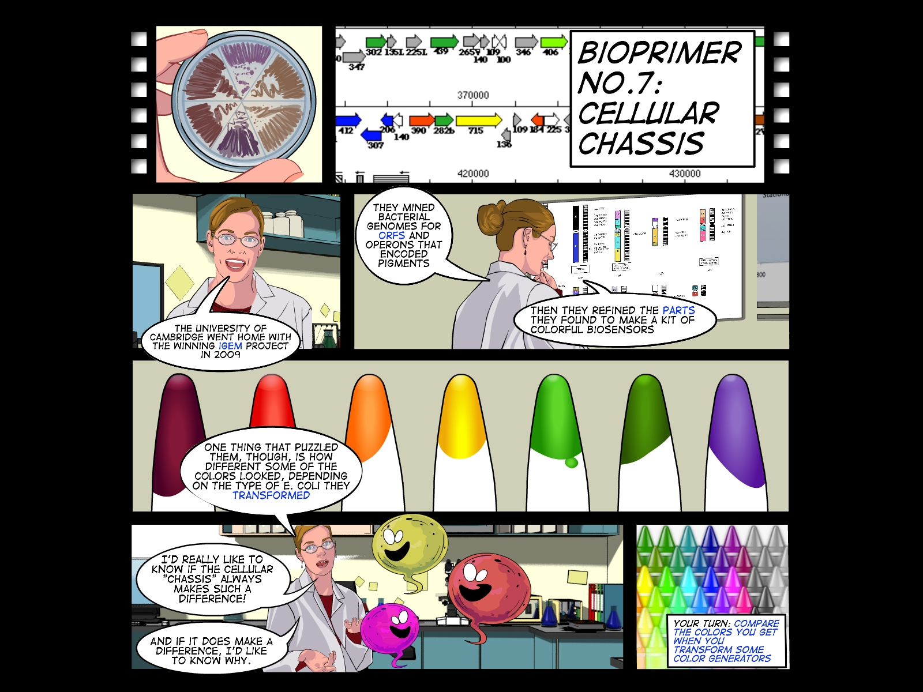

Slide 14
