Slide 1

SynBio, Biotech and You?
UW Presents:
Notes:
Hey everyone! We’d like to thank you all for coming down to our workshop. I’m sure you’re all wondering what this is all about- well, we’re here to help you guys look at things you’ve learned in class about biotech and a very new science known as synthetic biology and how it’s being applied into the real world.
We’ve all read the textbook, so we want you guys to explore new views and new ways of looking at one situation. Before we start, let us introduce ourselves: Introduce…We will all be here throughout this workshop.

Slide 2
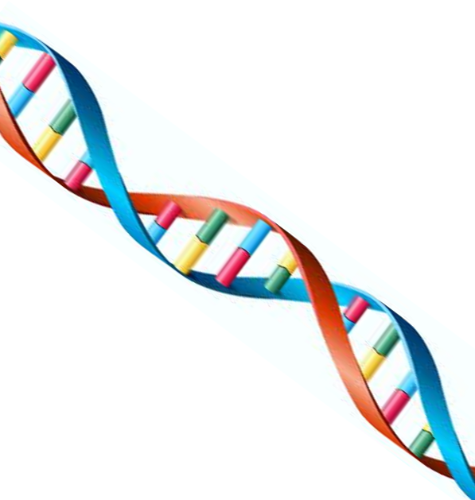
Workshop Topics
What is synthetic biology?
iGEM: Who are we?
GMOs and Health Canada regulations
Biofuels: an alternative source or another passive trend?
Pharmaceuticals: changing drug processes?
Future careers/academic endeavours
Notes:
Okay so first, let’s look at what we have planned for this workshop in terms of topics:
What is synthetic biology?
Who is iGEM? What do we do?
We’ve all heard about GMOs, so now we’re going to discuss this in depth with current Health Canada regulations and do a hands on activity
Next we’ll look at biofuels as an alternative fuel source
Pharmaceuticals and how synbio is helping to change normal drug processes
And we know you’re all interested in knowing what future career paths/academic endeavours are available for individuals pursuing biotechnology

Slide 3
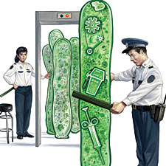
Synthetic Biology
What is it?

Slide 4
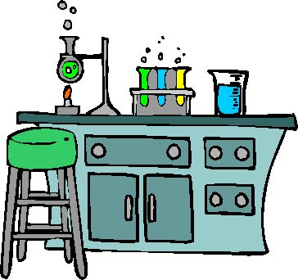
Synthetic Biology
Extension of biotechnology
Applies engineering principles of standardization to biological systems
Notes:
-Synthetic biology is actually just an extension of biotechnology. We still use genetic engineering concepts, so stuff like; promoters, RBS a GOI, manipulating bacteria such as E.coli to obtain certain proteins and metabolites. It’s all the same!
-What’s different? Is we’re adding a new aspect…and that is the engineering principle of standardization.
-What does that mean? Essentially, you have standard parts, let’s say, for a promoter or for a GOI, if I call that part p_honeydew (promoter honey dew), then if I look it up on the parts registry then its whole sequence will be listed for everyone to see and use- for free
-Why is this great? Because it takes time to figure out specific promoters and sequences because there are many factors that need to be taken into consideration when cloning and expressing things like proteins. Instead of scientists spending lots of time figuring that out, they already have that ‘standard part’ at their disposal! So now they can spend more time on things like innovation and creating new technologies

Slide 5
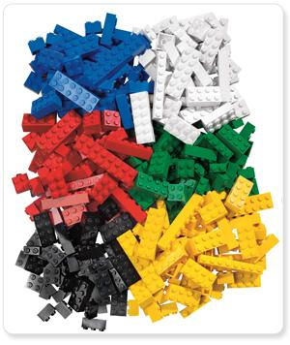
Synthetic Biology
BioBricks: defined genetic "parts" that are encoded with specified functions
Combining them to create new genetic parts, and therefore new BioBricks
Lego analogy
Notes:
-Now these standard parts are what are known as ‘BioBricks’, it’s like lego, but using genetic parts instead
-Think of synthetic biology as being a lego analogy, you stick pieces of lego together to make one thing, that can be a car, or those parts can be broken down and re-built into making a boat? Or those parts can be put together to make a bicycle?

Slide 6
iGEM
Who are we?
International
Genetically
Engineered
Machines
Notes:
-Now that you guys have a general idea on what exactly synbio is, let’s just briefly talk about UW iGEM
-We are the: International Genetically Engineered Machines team at UW, does the engineering part of the name make more sense now?

Slide 7
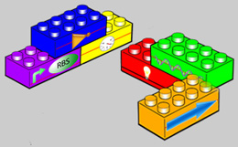
UW iGEM
Interdisciplinary undergraduate-driven group spanning the faculties of Science, Mathematics, and Engineering
iGEM competition relies heavily on the emerging field of synthetic biology
Notes:
-iGEM spans through many faculties in the whole undergraduate span of our university, ranging from the sciences (in biology, biotechnology, biomedical sciences) to mathematics (mathematical physics) to engineering (systems design engineering and software engineering)
-This competition relies on designing a project that relies very heavily on the emerging field of synbio, so it’s very parts-based

Slide 8
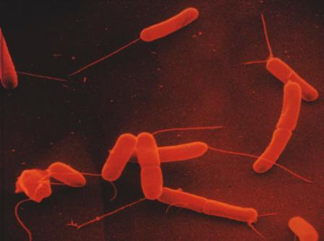
Cool Past Projects
iGEM Jamboree
Notes:
-Now, we thought it would be really neat to look at previous projects from different years just so you can get an idea of what has been done at the iGEM Jamboree, held by MIT (Massachusetts Institute of Technology) every year

Slide 9
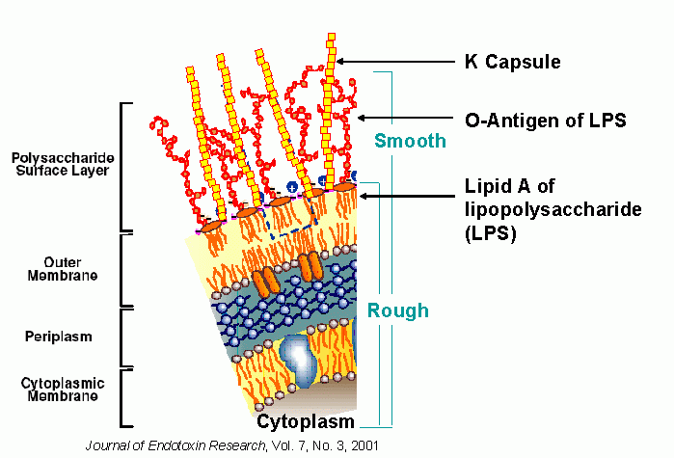
UC Berkeley 2007, BactoBlood
    Engineered E.coli to express hemoglobin substitute and inject into humans as a universal blood source
Notes:
-Now we all know that the only current way to receive blood is through a human donation
-Well, UC Berkeley developed something known as Bactoblood
-Essentially they engineered E.coli so that it would be able to express hemoglobin (oxygen carrier molecule found in humans) that would be able to act as a universal blood source

Slide 10
University of Waterloo 2010, Staphiscope
    Detection of the concentration of pathogenic S.Aureus in the body through the use of genetically engineered E.coli for early diagnostic testing
Notes:
Finally, last year UW created what is known as the Staphiscope
-This was working towards creating a new diagnostic method of detecting staphlococcus aureus (causes numerous infections/diseases) that are found inside the body and looking at the concentration of staph found in the blood to determine the location and severity of the infection
-This was done by using a genetically engineered E.coli that would detect these concentrations

Slide 11
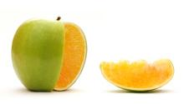
GMOs
What is it, Facts, and Regulations
Notes:
Now we’ve all heard about GMOs, stigmas associated with them, scares in the media, your parents talking about them, but what does it actually mean? What regulations are associated with allowing a GMO out into the market for consumption by Canadians?

Slide 12

What is a GMO?
Genetically
Modified
Organism
GM is a special set of technologies that alter the genetic makeup of organisms such as animals, plants, or bacteria
Notes:
These organisms can be plants, animals or cells, normally we manipulate these organisms for some sort of benefit; such as in food processing increasing crop yields or in industries, trying to isolate a certain enzyme for a chemical/biological process somewhere else

Slide 13
Interesting Facts About GMOs
Majority of these crops:
  herbicide- and insect-resistant soybeans, corn, cotton, canola, and alfalfa
  Sweet potato resistant to a virus that could decimate most of the African harvest
  Rice with increased iron and vitamins that may alleviate chronic malnutrition in Asian countries
  Variety of plants able to survive weather extremes
Notes:
Read off statistics, add comments if you wish

Slide 14

Positives:
Enhanced taste and quality
Increased nutrients, yields, and stress tolerance
Improved resistance to disease, pests, and herbicides
Increased food security for growing populations
New products and growing techniques
Notes:
Now each new technology has its positives and negatives. What are some common positive aspects of GMOs? Well:
They can enhance the taste & quality of your food that you are modifying, make something sweeter if it naturally tastes bitter?
As mentioned in the earlier slide, certain grains of rice have been enhanced to include more nutrients, this is ideal for populations where a certain food is a staple, for example in asia, high-starchy rices are a staple food in that area. Also, increasing yields of crops to make them energetically and environmentally more efficient, resourceful and productive. Also giving a stress tolerance, for example being able to withstand temperatures/climates where these crops normally would not have been to have grown
Many farmers have to use harsh chemical pesticides and herbicides so that their crops can be resistance to disease and pests. By intrinsically including an insect-resistant crop, the use of these harsh chemicals will not be needed, it would be better for the environment as a whole
There is currently a food shortage in the world, with our increasing population we do not have that much land on which to grow crops on. Since GMOs can provide higher yield crops, we can produce more output per unit land
Through the use of GMOs, we can create new products that have never been seen before that could be beneficial to us, as well as cultivating new growing techniques

Slide 15

Negatives:
Potential human health impacts:
Potential environmental impacts:
Violation of natural organisms' intrinsic values
Tampering with nature by mixing genes among species
Notes:
Now for the negatives.
As we know, there could be certain allergans that could be introduced into the GMO without realizing it. As well, common practice in cloning and expression is to include an antibiotic resistance marker onto the vector being used so that it can be selected for later on. If these bacterium are accidentally released into the environment it could be very dangerous as we would be releasing an antibiotic resistant strain of bacteria. That is why, in order for a GMO to be out into the market, it must be removed
As GMO are being more widely used, there is a possibility of having an unintended transfer of transgenes through cross-pollination that might cause unknown effects on the organism
One of the main negative reasons behind GMOs is that these genes are not naturally found in the organism, so some individuals view it as taking away the organisms true value, the way it is naturally found in nature
One other negative is that tampering with natural organisms found in the environment by mixing genes from other species is very unnatural to do and some individuals feel that it should not be done

Slide 16
Regulations
The safety assessment of foods developed using genetic modification includes:
  How the food crop was developed, including the molecular biological data which characterizes the genetic change
  Composition of the novel food compared to non-modified counterpart foods
  Nutritional information compared to non-modified counterparts
  Potential for introducing new toxins
  Potential for causing allergic reactions
Notes:
These are just some regulations that are used to safely assess foods developed using genetic modification:
Read list

Slide 17
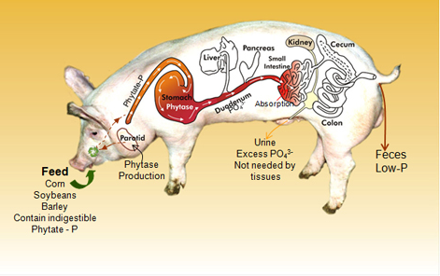
The Enviropig™
Genetically enhanced line of Yorkshire pigs with the capability of digesting plant phosphorus more efficiently than conventional Yorkshire pigs
Short 3 minute presentation in groups of 5-6

Slide 18
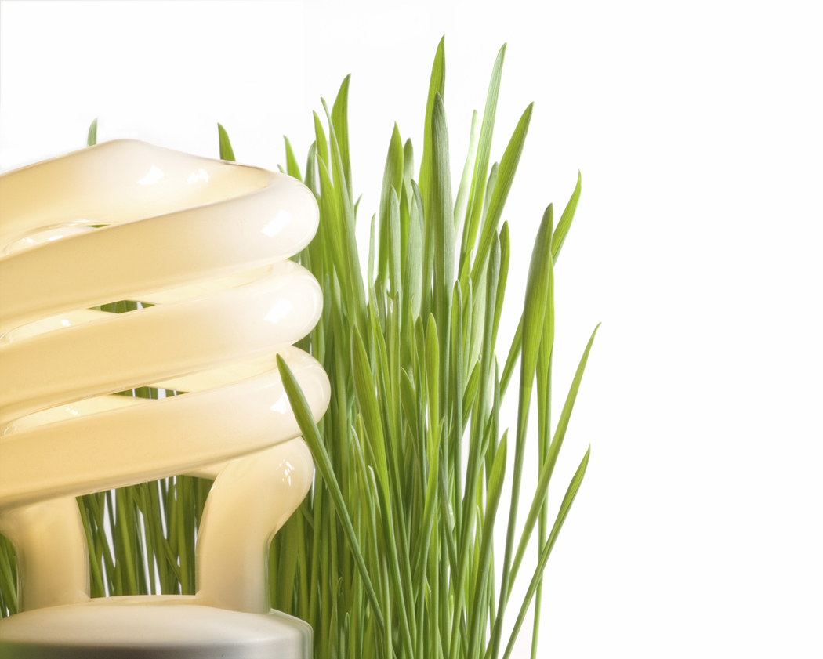
Convince us whether this technology is sustainable?
Short 4-5 minute presentation in groups of 5-6

Slide 19
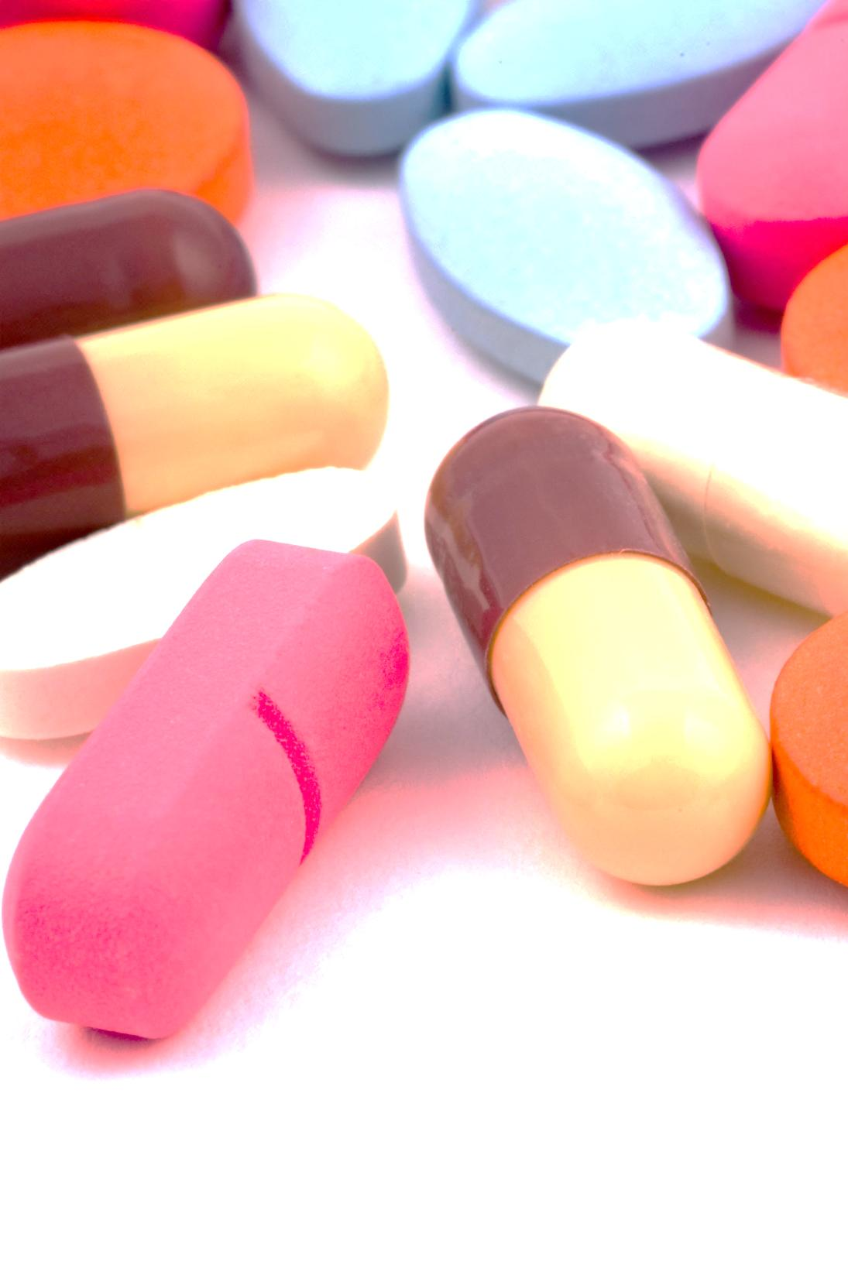

Industries
Pharmaceuticals and Biofuels

Slide 20
Pharmaceuticals: Biosynthesis
Potential for providing therapeutics with the individualized components (synthetic biology)
Efficient and precise targeting drug delivery systems
Tightly regulated genetic systems designed for highly specific tasks
  ie. killing viruses serving as blood substitutes or removing molecular debris in organs like the brain
Notes:
-So remember talking about synbio being like the lego analogy? Okay we’re going to keep that in mind for these two industries. Synthetic biology has shown to have potential in providing therapeutics that can have individualized components…meaning what? It means that we can add pieces together at our will to create a sort of ‘customized’ metabolic pathway that biologically synthesizes a drug of our choice or in fancy words a drug delivery system
-These genetic systems are extremely complex with many components, but having the ability to pick and chose standardized BioBricks to add into a certain part of the pathway can create a more specific system that can be tweeked more more easily, for example killing a viruses serving as blood substitutes or removing molecular debris in organs like the brain

Slide 21
Biosynthesis
Potential to be used in recombinant production of pharmaceuticals
Synbio can create automonous circuits for the production of these key metabolites, to allow small, individual reactions to be added into new pathways
Expression of these pathways can be carefully adjusted through the individual components to optimize production and limit toxic by-products
Notes:
-Now that we have this possibility of ‘tweaking’ we can create recombinant pharmaceuticals in a completely different way
-Now we can add small individual reactions into new pathways, or take out certain parts of a pathway
-These can then be expressed at certain levels of the individual components and we can optimize the production and limit any toxic by-products that are made in the process!

Slide 22
Biofuels: first generation
Bioalcohols: Produced using fermentation with microorganisms and enzymes
Food shortages around the world
U.S. does not have the production capabilities to meet its goals currently
Biofuel production offsets its total energy content.
Notes:
-Fermentation is an anerobic (doesn’t require oxygen) to produce energy in the cell
-If there is a surge in the biofuel industry this could cause food shortages worldwide, is used for humans/animals
-US does not have the production capabilities to meet its goals currently , must be significant breakthroughs in technology related to biofuels
-Biofuel production offsets its total energy content; There is about 54% total energy represented in 1 gallon of ethanol, which is further offset by the 24% required to grow corn

Slide 23
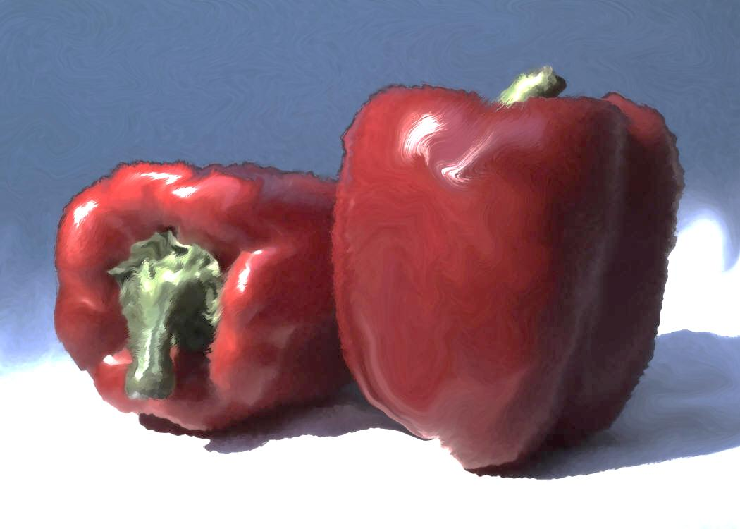
Biofuels
Second generation biofuels:
  Use non-food crops!
  Common feedstocks include waste biomass, stalks of wheat, corn and wood, lignocellulose
  Providing a cheap and vast feedstock supply
Notes:
-Well, now we’re going to talk about second generation biofuels, why are these starting to gain attention around the world?
-These use non-food crops!
-So then what do they use as their energy source? Well, the most common feedstocks are waste biomass, stalks of wheat, corn, wood and lignocellulose
-Providing a cheap and vast feedstock supply, , the energy and environmental benefits

Slide 24
Biofuels
Synthetic biology has the opportunity to come into play, create an efficient ‘superbug’
Look for promising metabolic pathways, inserting corresponding genes for yielding ideal results
Like lego analogy, mix and match to create the optimal pathway
Notes:
Enter synthetic biology! Synthetic biology has the opportunity to come into and play and create genetically modified organisms with metabolic pathways that have been tweaked to perform these tasks
-Look for promising metabolic reactions and start from scratch inserting corresponding genes into E.coli or yeast by combining metabolic pathways until they yield ideal results, like lego remember!

Slide 25
Make your own pathway

Slide 26

Academic Futures
At the University of Waterloo:
  Honours Biology; specialization in Molecular Biology and Biotechnology
  Science and Business; specialization in Biotechnology
  Biotechnology/Economics
  Biotechnology/CA
  Biochemistry; minor in Biotechnology
  iGEM!
Notes:
So, now that we’ve talked about what’s out there in the industry and Canada, what can you do as students going into university as a degree?
List

Slide 27
Careers
Genetic Counselling
Genetic Nursing
Gene testing/Gene therapy
Pharmaceutical industry and suppliers:
  Pharmacogenetics
Bioinformatics:
  Statistics, mathematics, computer science and programming
Bioprocessing
Biomedical engineering
Biological Systems engineering
Marketing and sales
Patent law
Bioethics
Forensics:
  courtroom, field, labwork
Notes:
-Genetic Counselling: is the process by which patients or relatives, at risk of an inherited disorder, are advised of the consequences and nature of the disorder, the probability of developing or transmitting it, and the options open to them in management and family planning in order to prevent, avoid
-Genetic Nursing: A genetic nurse is a registered nurse with special education and training in genetics who cares for individuals, families, and communities at risk for or affected by genetic diseases, or diseases or conditions with a genetic component.
-Gene testing/Gene therapy: is the insertion, alteration, or removal of genes within an individual's cells and biological tissues to treat disease. It is a technique for correcting defective genes that are responsible for disease development
-Pharmacogenetics: the study or clinical testing of genetic variation that gives rise to differing response to drugs,
-Bioinformatics: entails the creation and advancement of databases, algorithms, computational and statistical techniques and theory to solve formal and practical problems arising from the management and analysis of biological data
-Bioprocessing: any process that uses complete living cells or their components (e.g., bacteria, enzymes, chloroplasts) to obtain desired products
…there are a few more left, go over systems engineering, marketing, sales, patent law and bioethics on your own, just quickly go into google and search it so you know for the presentation

Slide 28
THE END
Thank you for coming!

