Slide 1
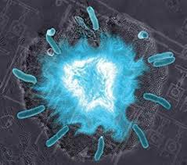
Flashing Bacteria
Morgan Haskell
Coby Turner

Slide 2
What We Wanted To Do
University of California in San Diego
Biological synchronized clocks
Flash to keep time
Oscillator controlled by chemicals and temperature
Quorum sensing = synchronized flashing
Quorum Sensing
Have made synthetic switches
Individual bacteria only
Not together
Movie
http://blogs.discovermagazine.com/80beats/2010/01/21/video-fluorescent-bacteria-keep-time-like-a-clock/

Slide 3
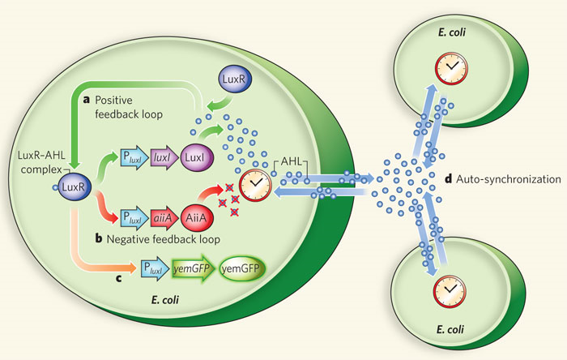
How It Works
luxI fromV. fischeri, AiiA from B. thurigensis, and yemGFP
Under control of three identical luxI promoters
luxI synthase enzymatically produces AHL (Acyl-homoserine lactone)
Diffuses and mediates intercellular coupling
Binds to LuxR
luxR-AHL complex = transcriptional activator for luxI promoter
AiiA negatively regulates promoter
Degradation of AHL
AHL degraded by AiiA after accumulation
Swept away by fluid flow in chamber
Not enough inducer to activate expression from luxI promoter
After time, promoters return to inactivated state
AiiA production decreases = AHL accumulation
Burst from promoters
At certain density = burst of light
High density = light
Burst of transcription of luxI promoters
Increased levels of luxI, AiiA, and green fluorescent protein (GFP)
Low density = nothing

Slide 4
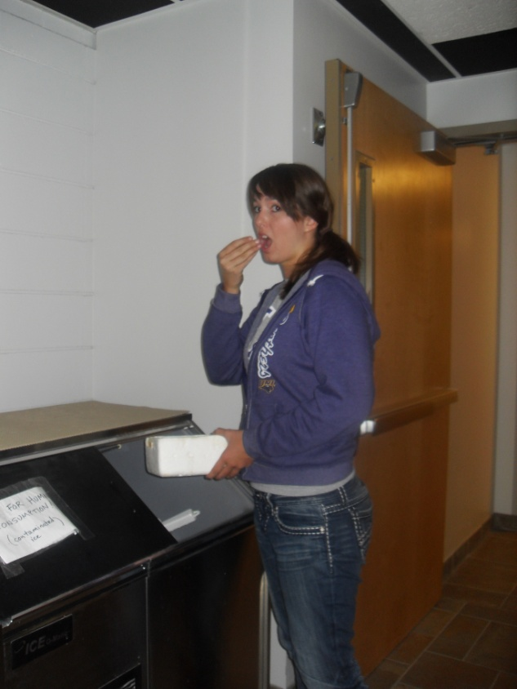
Failure From Day One
Transformed E. coli with each biobrick part
BBa_ J37015 (AHL &GFP) – Lux Superpart
BBa_ J06504 – Cherry fluorescent protein
Little to no growth (9/16)
Second transformation
Little to no growth on plates
Left in incubator all night
Lots of growth! (9/21)
Attempted overnight cultures
Put in incubator instead of shaker! (9/27 & 28

Slide 5
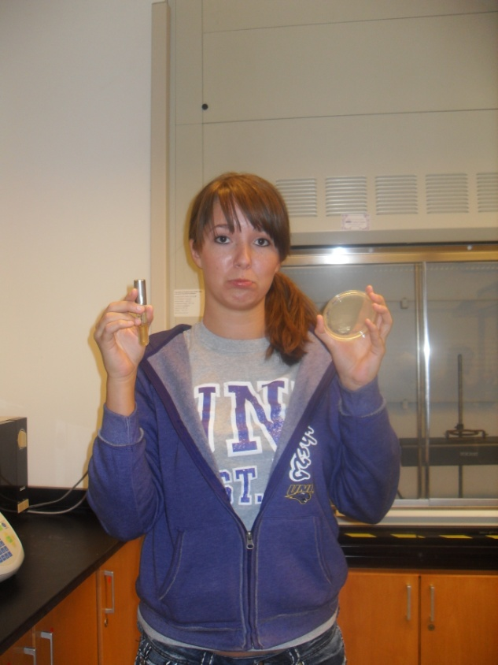
Continuing To Fail
Transformed a third time
J37015 (Lux Superpart), AiiA, and Lux promoter
Group 9 transformed RFP.
Lux promoter & superpart had colonies
AiiA and RFP did not
Overnight cultures of Lux superpart & promoter
Growth happened! (9/28)
Mini preps of superpart & promoter
Used old & new overnight cultures

Slide 6
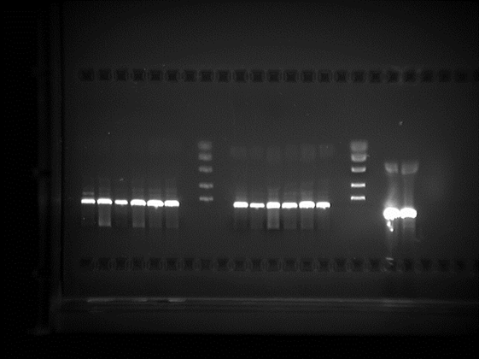
Next Steps
Ordered primers for Lux superpart
beginning primer (Lucy)
end primer (Ricky)
Fred & Ethel – primers without prefix & suffix (9/30)
Ethel was too small
Digest 14 mini-prep tubes
Lux Superpart, Lux Promoter, RFP
Enzymes E & S
Ran electrophoresis gel
Digestion didn’t work right
Should have seen two bands for plasmid & vector
May need higher gel concentration
But DNA was present
Repeat digestion
Check all functional enzymes(10/5)

Slide 7
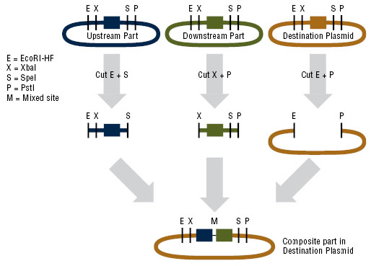

Slide 8
Digestion Failure
Second digest & electrophoresis gel
Check functionality of enzymes
Should have seen two bands for every part
At 714 bp & 2079bp (RFP), 55bp & 2079bp (promoter), & 2613bp & 2079bp (superpart)
Super part might be to close together
Promoter should have been easiest to seperate
RFP had a ghost band
May be too small to show up
Digest again
With control(10/7)

Slide 9
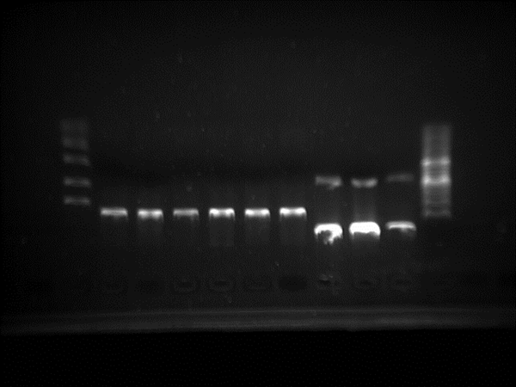
Digestion Failure
Third digestion & gel
Check functionality of enzymes using the lux promoter & control from group 11
Xpe1 and Spe1
Control worked
Promoter didn’t show up
Thought we were looking at band at 700 bp but should have been 55 bp
Will need a higher gel concentration for better resolution
Digest & run gel at 1.7% (10/12)

Slide 10
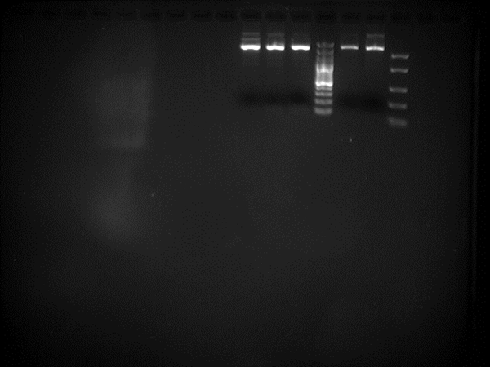
Digestion Failure
Fourth digest of superpart & promoter
Promoter: used more DNA, no water
Made two separate mastermixes
Accidently added loading to one tube before incubation
Oops!
Saw faint 55 bp bands for promoter
Superpart didn’t digest
Didn’t see two bands at 2079bp & 2613bp
Attempted to order from iGEM
Superpart (10/14)

Slide 11
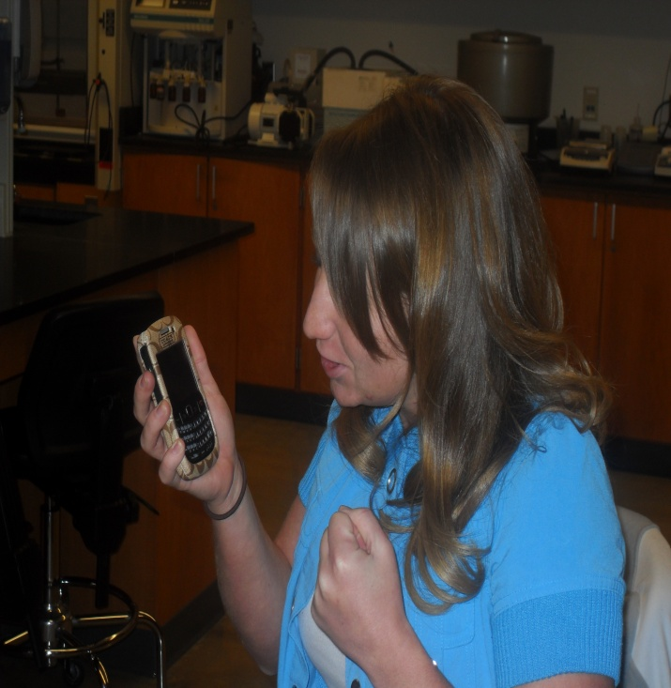
IGEM Difficulties
IGEM
“didn’t have our address”
Phone number was wrong
Busy with Jamboree
While Waiting…. made overnight cultures
Left glycerol stocks out of freezer too long!
Plated & found still alive!
Plated promoter glycerol stock & made overnight cultures of promoter part (10/20)
Mini-preps of R0062 (promoter) were prepared (10/21)

Slide 12
IGEM Difficulties
Weeks after original order…
Plated parts that came from iGEM
Ordered AiiA
Mixed up part numbers – oops!
Promoter part instead of AiiA
Dissolved primers (10/26)
Prepared overnight cultures of superpart & promoter from ordered parts (10/27)
Mini-preps of superpart from ordered part
Made glycerol stocks (10/28)

Slide 13
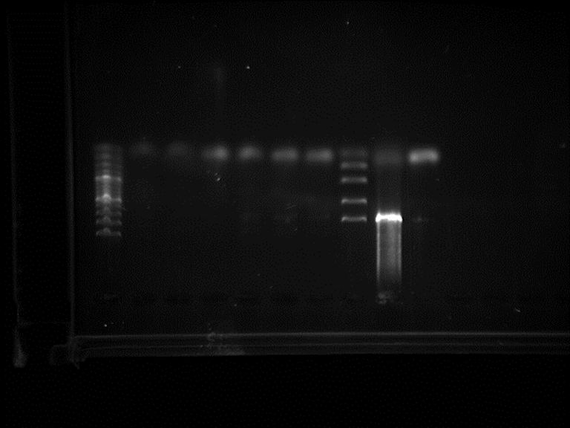
Getting Back on Track…ish
Plated J04450 (RFP) from group 13
Made overnight cultures
Ran PCR of J37015 (Lux Super part)
Amplify out the GFP
Ran gradient PCR overnight
Put in fridge next day (11/2)
Electrophoresis gel of PCR products
0.8% agarose gel
a) there was no/not enough DNA
b) the primers weren’t right
c) wrong/no plasmid
Primers ordered for RFP
(GAATTCGCGGCCGCTTCTAG) 5’ – AAAGAGGAGAAATACTAGAT – 3’ beginning primer = Chips
(TACTAGTAGCGGCCGCTGCAG) 5’ – TATAAACGCAGAAAGGCCCA – 3’ end primer = Salsa
Controlled by different promoter…oops!
Will need to ligate to Lux promoter(11/4)
Mini-preps of J04450 (RFP)
Glycerol stocks & dissolved primers (11/9)

Slide 14
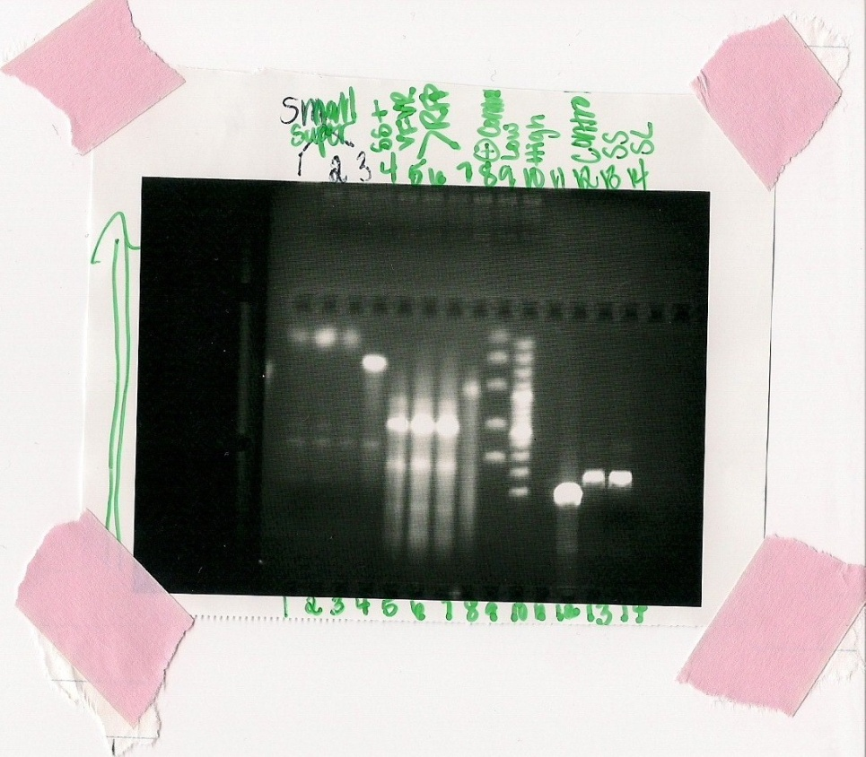
PCR Failure
PCR of J37015 (Lux super part) & J04450 (RFP)
Gradient PCR
Amplify parts & check Lucy and Ricky
Stored in fridge(11/11)
Digestion of J37015 (Lux super part) & Electrophoresis
Digested part and PCR products from previous PCR
PCR didn’t work again for super part
RFP amplified
Need to check sequence to see if we got the right band
Parts registry has no bp size
Not sure if right
Sent off superpart to be sequenced(11/16)

Slide 15
Nearing The End
Digestion of lux promoter & electrophoresis gel
Ligate it together with RFP PCR product
Had ghost bands around 200 bp
Too large
Had the Promoter sent out to be sequenced
Never got sent in(11/18)

Slide 16

Biobrick Failure
Lux Superpart sequencing
Is Super Crap
Part was bad
From day 1…

Slide 17
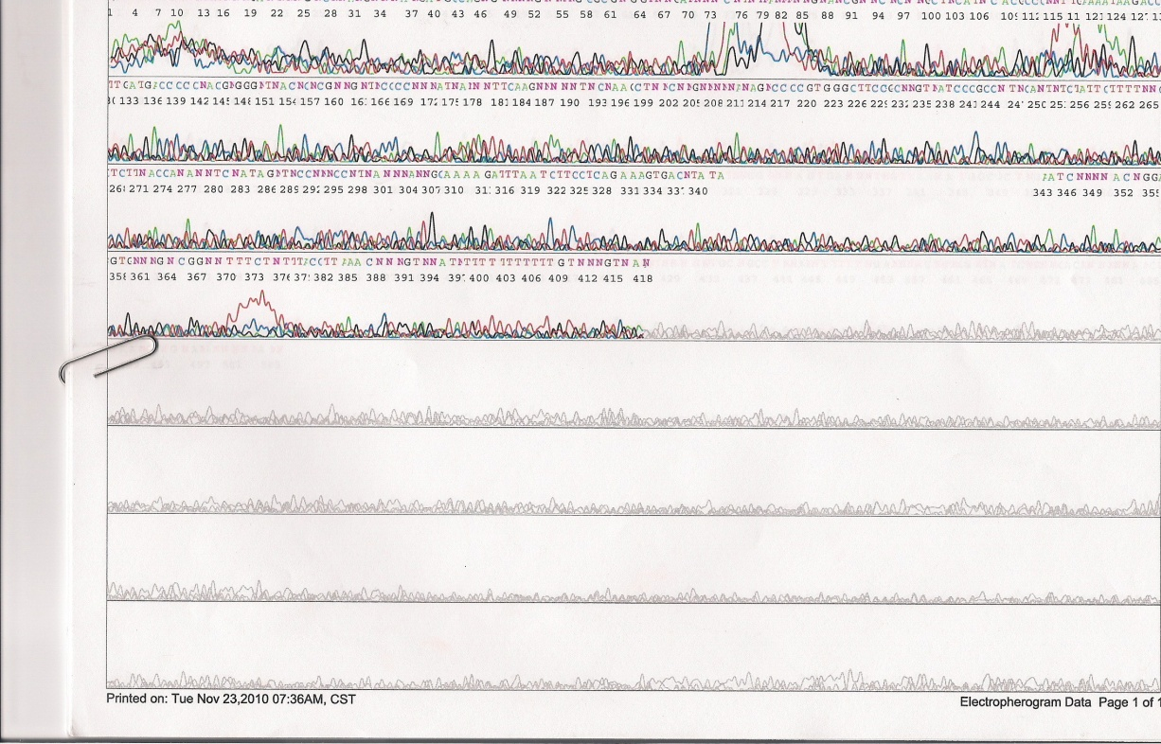
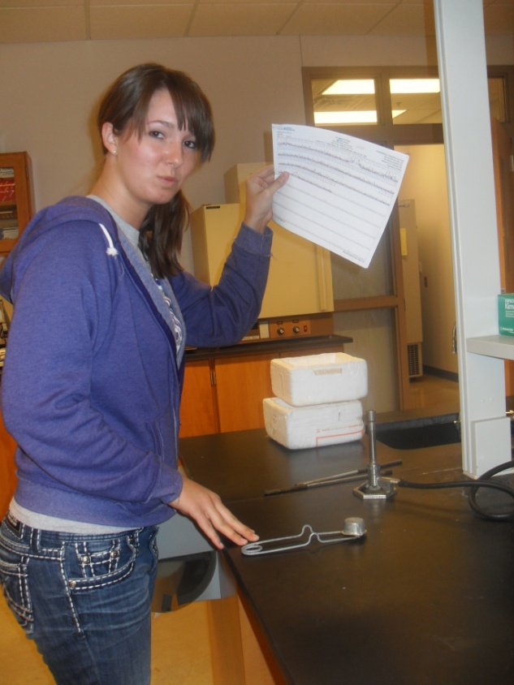

An Angry Morgan

Slide 18
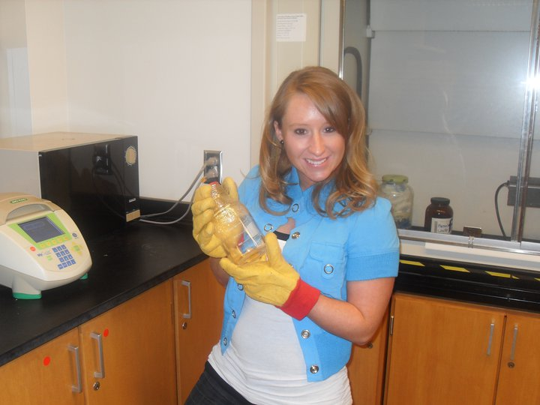
In conclusion…
list of accomplishments 1. can make and run gel 2. can do digestions 45 to be exact 3. can do mini-preps 20 to be exact 4. pipetting skills have improved 5. Got red glowing bacteria!!
that we got from group 13 ☺
6. masters of getting ice
7. learned how to use the shaker
8. learned how to PCR
9. learned how to design our own primers
10. learned how to transform

Slide 19
In conclusion cont…
things we didn't accomplish 1. obtaining our superpart...our superpart was super crap 2. cutting out GFP with PCR 3. ligating superpart with RFP 4. obtaining AiiA 5. creating our positive and negative feedback loops 6. making bacteria flash like fireflies

Slide 20
In conclusion cont…
things we could improve on 1. paying closer attention to details
Shaker not incubator
Know right bp size
Get part order numbers correct
Keep caps on tubes during centrifuge
2. having parts sequenced beforehand
3. learning how to take pictures with the imaging machine

