Slide 1
A synthetic Gene-metabolic Oscillator
Reviewed by Fei Chen

Slide 2
Background
Autonomous oscillations in gene expression are found in metabolic, cardiac, and neuronal systems.
Such oscillators have important biological roles, as well as very interesting dynamics.
Integration of oscillatory regulation with metabolism is a key aspect of natural oscillators.
Replication of such oscillatory networks could be very useful for a range of synthetic biology applications.

Slide 3
System Goals
Main goal: Construction of an metabolically controlled oscillatory circuit.
Conceptual Design: Two inter-converting metabolite pools, catalyzed by two enzymes.
Uses metabolic flux as a control factor in system-wide oscillation.

Slide 4
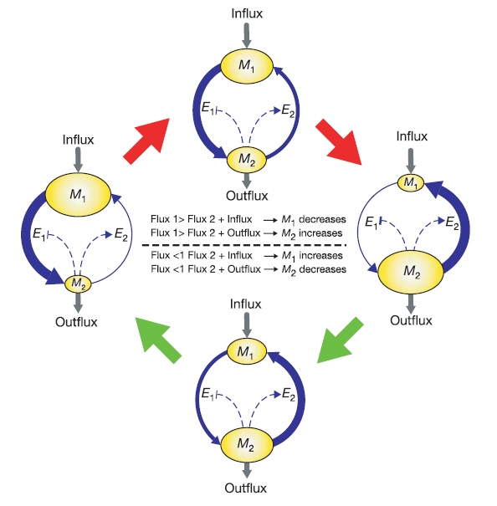
Oscillatory Dynamics
Two metabolite pools (M1, M2), catalyzed by two enzymes (E1, E2).
E1 negatively regulated by M2, and E2 positively regulated by M2.
If input flux is low, M2 does not accumulate sufficiently fast to cause a large swing in gene expression; steady state can be reached.
Metabolic physiology —› gene expression cycle.

Slide 5
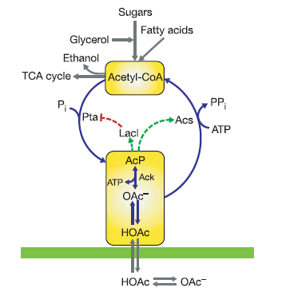
Implementation
The system uses the acetate pathway in E. Coli.
Acetyl CoA is M1, Acetyl Phosphate (AcP) is M2.
Acetyl CoA is converted to AcP by Phosphate Acetyltransferase (Pta) (E1).
Enzyme acetyl-CoA Synthase (AcS) is induced in the presence of Acetate. (E2)
AcP in M2 is the signaling molecule. Activates glnAp2 promoter.
glnAp2 controls expression of AcS, also produces lacI repressor. This represses the Pta gene.
Obtain same network as our model.

Slide 6
Characterization
Characterization via GFP ligated downstream of a plasmid born LacI-repressible tac promoter.
Acs, LacI, Pta, and the GFP were all fused with a degradation tag.
Oscillation behavior was shown to be insensitive to degradation of GFP. GFP reporter is indicative of the dynamics of the system.
Characterized system parameters with computational models.
Verified computational model through system influx variation.

Slide 7
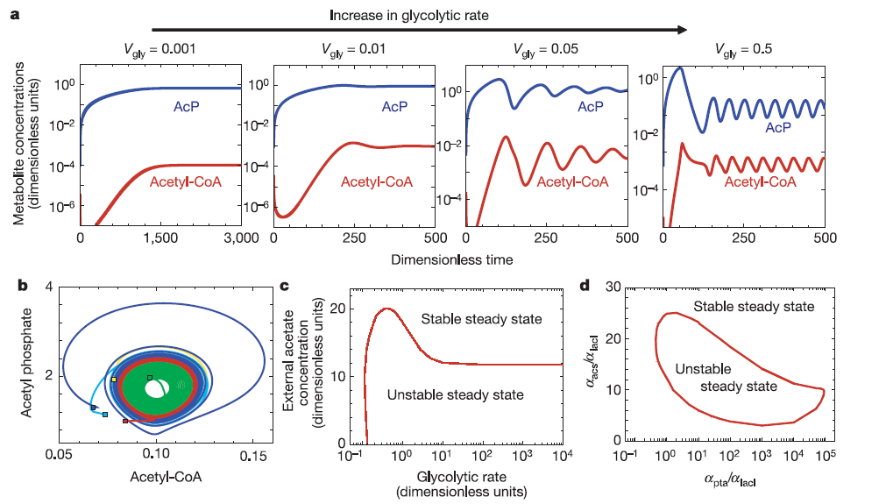
Results: Computational Characterization

Slide 8
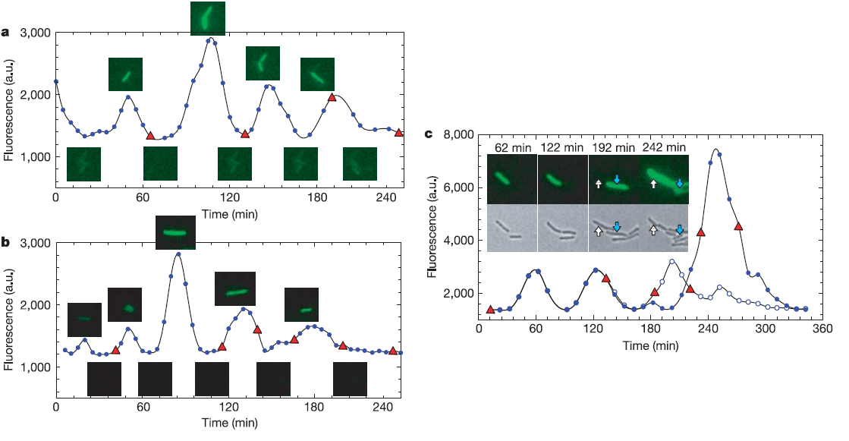
Results: Flourescence Microscopy
Periodic oscillations observed
Period: 45 min ± 10 min
Amplitude of oscillations vary
Daughter cells show uneven fluorescence.
Comparison between sibling cells show skipped or delayed peaks.

Slide 9
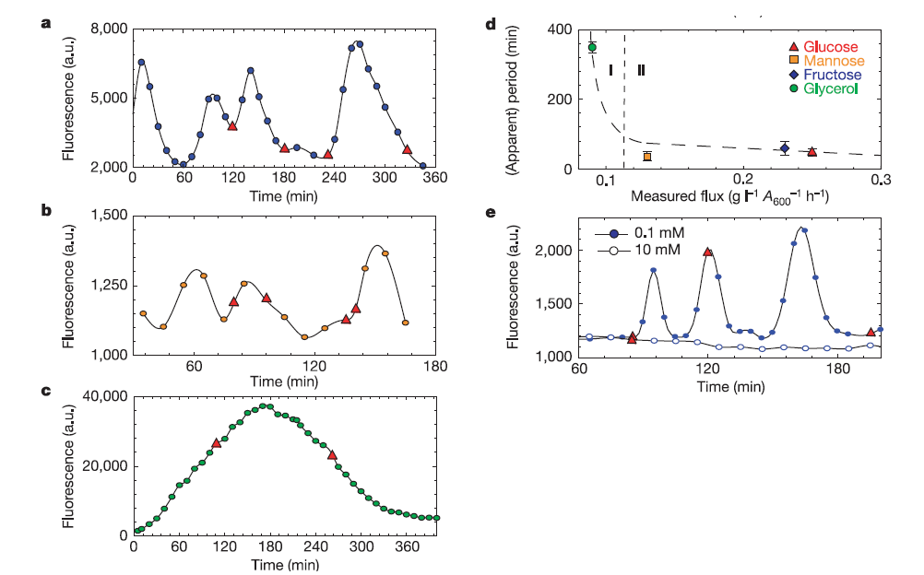
Results: Flux Sensitive Oscillation
Flux directly correlated to oscillation period.
High levels of external acetate suppressed oscillation.

Slide 10
Discussion
Successful demonstration of metabolic regulation of oscillatory circuit.
Oscillation is generated by input of metabolic flux. (Acetyl CoA).
High concentrations of acetate suppresses oscillation. Maintains concentration of acetyl phosphate higher than dynamic range of promoter response.
Accumulation of acetate produced by cell will move cell out of oscillatory cycle.
Intrinsic noise could explain observed experimental variations. (Amplitude of Oscillator)
Uncorrelated with cell division, suggests noise is entirely from gene expression.

Slide 11
References:
All figures and pictures taken from: Fung E, Wong WW, Suen JK, Bulter T, Lee SG, and Liao JC. A synthetic gene-metabolic oscillator. Nature 2005 May 5; 435(7038) 118-22. doi:10.1038/nature03508 pmid:15875027. PubMed HubMed [metabolator]

