Slide 1
Modularity of a carbon-fixing protein organelle
Bonacci, Teng, Afonso, Niederholtmeyer, Grob, Silver, Savage
PNAS - November 17, 2011
Shelley Ackerman & Donnie Turlington
20.385 Journal Club I
Notes:
Donnie

Slide 2
Types of Bacterial Microcompartments (BMCs)
CB – CO₂ fixing carboxysomes
PDU – 1,2-propanediol utilization microcompartment
Ethanol-amine utilization microcompartment
BMC protein domains appear in about 20% of bacteria
Possibly a large and diverse group of BMCs we have not yet accounted for
Notes:
Researchers decided to focus on studying the CBs – they were BMCs discovered and characterized
Have the biggest future potential given the important of carbon fixing across many fields including synthetic biology
CB was the first BMC discovered and it is still used as a model system
Shell is made of about 800– protein hexamers and 12 pentamers at the verticies
Inside this particular shell are RuBisCO and carbonic anhydrase
They are brought into the shell by protein-protein interactions with the shell of shell interaction mediators
Donnie

Slide 3
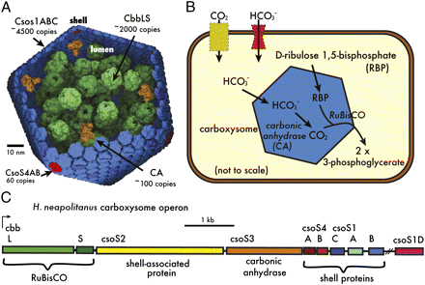
Wild Type System
Notes:
Halothiobacillus neapolitanus (all genes in single operon)
So why does this exist in nature?
It is a central part of the carbon concentrating mechanism, the CCM
Inorganic carbon, is actively transported into the cell
it then passively disfuses across the CB membrane, and if it is bicarbonate it is converted into CO2 by carbonic anhydrase
Normally RuBisCO has a low affinity and a low selectivity for CO2 against O2
in the CCM it is believed that the elevated levels of CO2 allow RuBisCO to fix CO2 near its Vmax with high specificity
It is believed, but not proven in this system that specific types of proteins, notebly CsoS1D forms larger pores and acts as a gate, suggesting an ability to separate CO2 and O2
Donnie

Slide 4
Their Original System
Goal: to present a genetic system for the expression of functional BMCs.
create CBs in E. Coli from H. neapolitanus
Show that synthetic CBs contain proper proteins
Modularize a CB system
9 genes from H. neapolitanus and placed into E. Coli
Used IPTG inducible plasmid (pNS3)
Notes:
Halothiobacillus neapolitanus was used in part to its Cb gene location s being all on a single operon
Tested with RuBisCO coding genes removed – without it, forms shell well but the shell is empty, suggests shell can be loaded with other things
Donnie

Slide 5
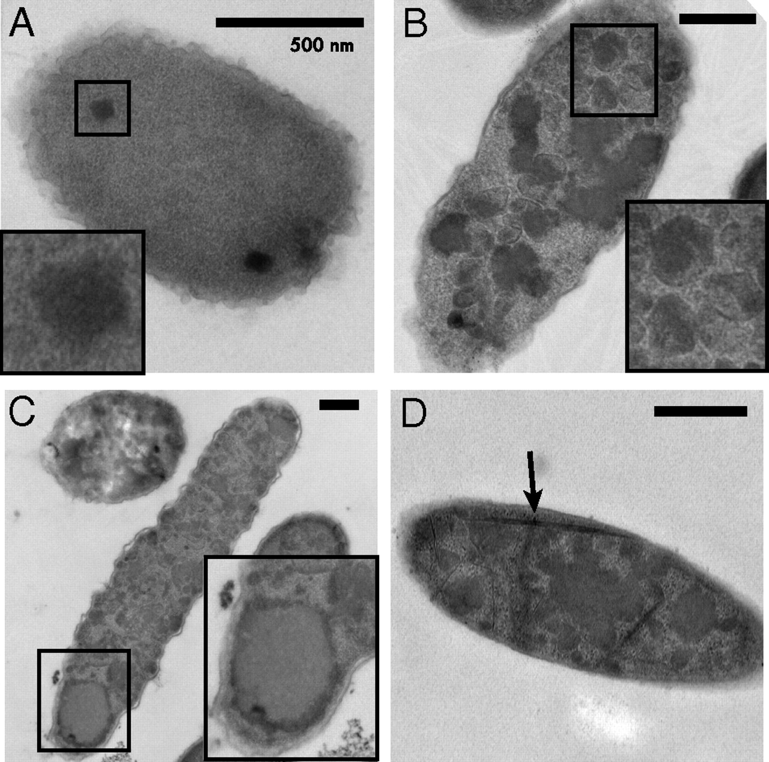
HnCB Expression Increases with Higher IPTG Concentrations
0 μM
50 μM
High Induction
200 μM
Notes:
Shelley
A – as seen in the image, there are virtually no CBs with no IPTG present.
B – a higher concentration resulted in more CBs developed
C – highest level of expression compared to A and B
D – high induction results in the development of filaments – this is one of the errors found in the system – indicating problems with the protein’s stoichiometry
Method used: Electron microscopy of carboxysomes in vivo

Slide 6
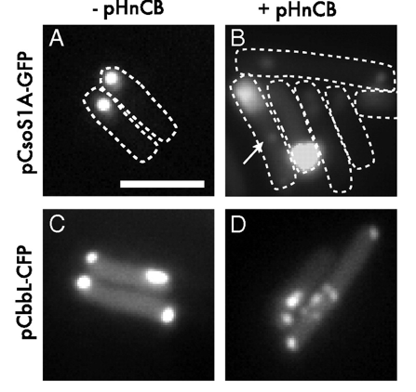
Functional Carboxysomes Assemble Correctly in vivo
Notes:
Shelley
Fluorescence Microscopy was used to identify carboxysome compartments both with and without HnCB present.
CBs were assembled within E. Coli with labeled cargo – both GFP and CFP were used
CsoS1A – major shell protein – fused with C terminal GFP (green)
CbbL – large subunit of RuBisCo – fused with C terminal CFP (cyan blue)
Both cloned into IPTG inducible, KanR vector (which was good for cotransformation with pNS3 plasmid)
Cso1A-GFP w/o HnCB resulted in large polar foci – could be because of runaway formation of protein aggregates
CbbL-CFP w/ HnCB resulted in decrease in inclusion body signal and distinct foci throughout cytoplasm
Without the 9 gene system, the proteins self assemble at the poles into inclusion bodies – addition of the 9 gene system results in slight dots indicating assembly of microcompartments desired

Slide 7
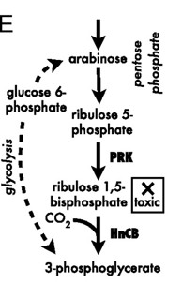
Carbon Fixation measured in 9-Gene System using Pentose Phosphate Pathway
Key Metabolites:
Ribulose 1,5-bisphosphate
Carbon dioxide
3-phosphoglycerate
Notes:
Heterotrophic host catabolizing sugar was incapable of carrying out complete Co2 fixing cycle – therefore, used this to test levels of fixation.
Shelley
Naturally, CBs undergo carbon fixation through the Calvin-Benson-Bashom cycle
Carbon dioxide is fixed with D-ribulose 1,5-bisphosphate to yield two molecules of 3-phosphoglycerate
E. Coli naturally undergoes the pentose phosphate pathway, covering arabinose to D-ribulose 5-phosphate
PRK expression yields irreversible buildup of D-ribulose 1,5-bisphosphate
Coexpression of RuBisCO results in rescue of growth via conversion to 3-phosphoglycerate

Slide 8
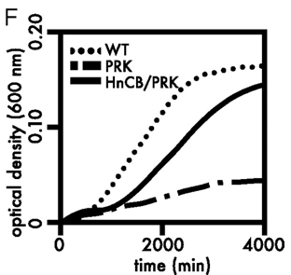
HnCB Expression Results in Creation of Carbon Fixing Functional CBs
Notes:
Interesting to notice is the large time scale
Lag phase cells – similar to what was found in wild type, though
Used to express carbon fixation in the system
Shelley
Growth regimen testing expression of Wild Type, PRK and HnCB+PRK.
With arabinose and bicarbonate present, PRK expression in log-phase cells led to large time increase compared to WT – consistent with what was found in D-ribulose 1,5-bisphosphate toxicity
Coexpression led to rescue of growth as described earlier – production of 3-phosphoglycerate
Cultures had exponential growth rates like WT with longer lag phase (from having to produce and express both PRK and HnCB)
This shows that expression can be used to create functional BMCs like the WT would normally do

Slide 9
Assessing & Redesigning the System
Problems with 9-Gene System:
Error Rate in Assembly
Heavy IPTG Dependence
What’s Next? Bring in 10th Gene: CsoS1D
Goal: See how addition of protein affects CB function and structure
Notes:
Shelley
Problems with current 9 gene system:
Large error rate in assembly
Heavy IPTG Dependence
CsoS1D: discovered recently and located just outside core operon
Thought to play a strong role in shell permeability for CBs

Slide 10
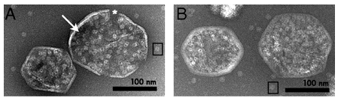
pHnCBS12D Results in Smaller Error in Assembly than pHnCB
Shell Defect
Low-Density Lumen
pHnCB Plasmid
pHnCBS1D Plasmid
Notes:
Shelley
Images of purified particles using negative-stain EM
Slightly smaller CBs seen with pHnCBS1D plasmid than with the pHnCB plasmid. Much fewer problems in assembly in B than A

Slide 11
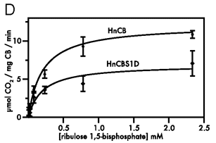
HnCBS1D results in faster and higher levels of carbon fixation
Notes:
Shelley
Carbon fixation activity was measured as a function of concentration of ribulose 1,5-bisphosphate
HnCB showed a higher rate of carbon fixation than HnCBS1D. This could be due to a few different things.
1 – The carboxysomes formed with the 10-gene system were smaller than those assembled in the 9-gene system.
2 – With the addition of another protein, it could take longer for the carbon dioxide to diffuse through for HnCBS1D than with HnCB.

Slide 12
Carbon Fixation in 10-Gene System Verified in vitro
Recorded 2-phosphoglycerate dependent NADH oxidation in coupled enzyme reaction system
Created Michaelis-Menten Model
Similar K_{M} values for pHnCB & pHnCBS1D
V_{Max} two fold higher for pHnCB CB’s
Notes:
Shelley

Slide 13
What was accomplished?
Successfully moved a CB
Proved that the CBs were still functioning
Modified and heavily improved operon
adding tenth gene, CsoS1D
This was only tested in vitro, not in vivo
Notes:
from a natural host to an organism with no natural BMC mechanism
Checked for correct proteins and CO2 uptake from cell
Donnie

Slide 14
Significance
Modularity
standardized parts
compartmentalization
Importance of Carbon Fixation
Future applications
targeting different assembly systems
Improvements:
Optimization of the operon for specific hosts
Shell structure and permeability research
CsoS1D a minor component of shell structure
Possible Importance
Notes:
Applications of carbon fixation
Overall were able to find and control an operon and move it from a native host into an unrelated host
The CBs were stable even with RuBisCO removed
Unsure of the significance of CsoS1D at this point, even though its application greatly improved the shell structure it could have been due to the interaction with other proteins as well
Donnie

Slide 15
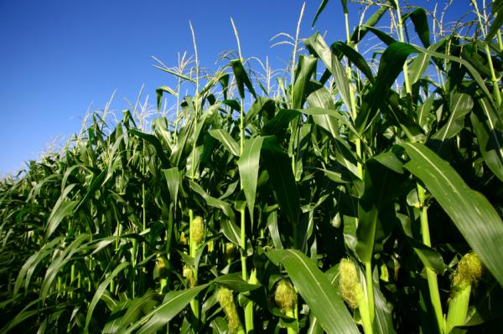
Future Applications
Plant adaptations
Biofuels
Molecular chassis
Nanotechnology
Future Research:
Identification of necessary genes
Improved understanding of shell formation
Development of cargo targeting system
http://www.news.stanford.edu
Notes:
RuBisCO is often a rate limiting step in photosynthesis
because of Photorespiration, so use the CBs to allow RuBisCO to react only with CO2 in order to increase its efficiency
Could also develop plants with lower water and nitrogen use, improving yields
Improve metabolic processes in a way similar to organelles by preventing losses of intermediates between enzymatic steps
Nanotech wants to create molecular systems that are self assembling and can be loaded with cargo and assembled ex vivo, this could be a more general system
Donnie

Slide 16
Works Cited
Talaro, Kathleen P., Foundations in Microbiology, sixth edition. 2008 McGraw-Hill Companies.
Bonacci, Walter, Teng, Pho K., Afonso, Bruno, Niederholtmeyer, Henrike, Grob, Patricia, Silver, Pamela A., Savage, David F. Modularity of a carbon-fixing protein organelle, PNAS,.Jan 10, 2012, Vol. 109, no.2.

Slide 17
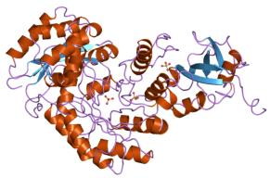
RuBisCo
Ribulose-1,5-bisphosphate carboxylase oxygenase
Major part of the Calvin cycle
The rate of RuBisCO increases with increases in CO₂ concentration (also affected by temperature, water, nitrogen availability, ect.)
Poor specificity for CO₂
Photosynthesis is single largest natural regulator of CO₂ in our atmosphere, a good understanding is necessary for any climate impact studies.
http://upload.wikimedia.org/wikipedia/commons/7/79/PDB_3rub_EBI.jpg

Slide 18
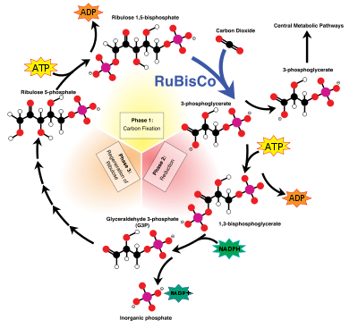
Calvin-Benson-Basham cycle
http://en.wikipedia.org/wiki/Calvin_cycle
Notes:
Include chemical structures of the important things
Only occurs in photosynthetic organisms

