Slide 1
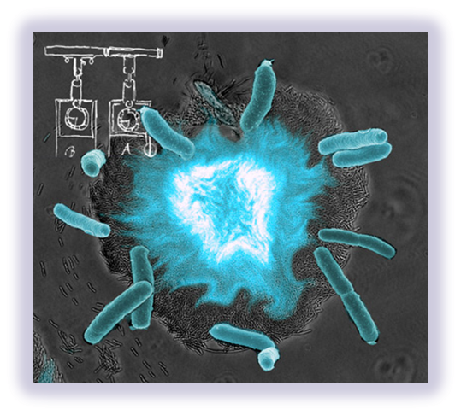
Oscillating Fluorescence in E. coli
Morgan Haskell
Coby Turner
Dan Karkos

Slide 2
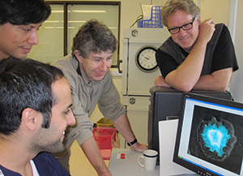
Jeff Hasty and team
University of California in San Diego
Biological synchronized clocks
Flash to keep time
Oscillator controlled by chemicals and temperature
Quorum sensing = synchronized flashing
Quorum Sensing
Have made synthetic switches
Individual bacteria only
Do not flash together
http://blogs.discovermagazine.com/80beats/2010/01/21/video-fluorescent-bacteria-keep-time-like-a-clock/

Slide 3
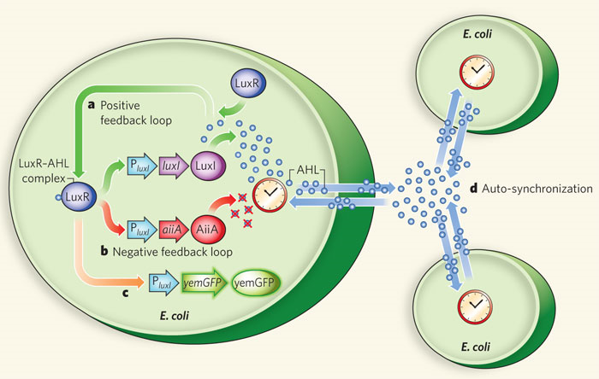
How It Works
luxI fromV. fischeri, AiiA from B. thurigensis, and yemGFP
Under control of three identical luxI promoters
luxI synthase enzymatically produces AHL (Acyl-homoserine lactone)
Diffuses and mediates intercellular coupling
Binds to LuxR
luxR-AHL complex = transcriptional activator for luxI promoter
AiiA negatively regulates promoter
Degradation of AHL
AHL degraded by AiiA after accumulation
Swept away by fluid flow in chamber
Not enough inducer to activate expression from luxI promoter
After time, promoters return to inactivated state
AiiA production decreases = AHL accumulation
Burst from promoters
Density
At high density = burst of light
Burst of transcription of luxI promoters
Increased levels of luxI, AiiA, and green fluorescent protein (GFP)
Low density = nothing
http://www.nature.com/nature/journal/v463/n7279/extref/nature08753-s1.pdf
Notes:
We placed the luxI (from V. fischeri), aiiA (from B. Thurigensis) and yemGFP genes under the control of three identical copies of the luxI promoter. The LuxI synthase enzymatically produces an acyl-homoserine lactone (AHL), which is a small molecule that can diffuse across the cell membrane and mediates intercellular coupling. It binds intracellularly to the constitutively produced LuxR, and the LuxR–AHL complex is a transcriptional activator for the luxI promoter³⁶. AiiA negatively regulates the promoter by catalysing the degradation of AHL³⁷. This network architecture, whereby an activator activates its own protease or repressor, is similar to the motif used in other synthetic oscillator designs^{30, 31, 32} and forms the core regulatory module for many circadian clock networks^{13, 38, 39}. Furthermore, theoretical work has shown how the introduction of an autoinducer in similar designs can potentially lead to synchronized oscillations over a population of cells^{40, 41}
Supplementary Movies 1–2). The dynamics of the oscillations can be understood as follows. Because AHL is swept away by the fluid flow and is degraded by AiiA internally, a small colony of individual cells cannot produce enough inducer to activate expression from the luxI promoter. However, once the population reaches a critical density, there is a ‘burst’ of transcription of the luxI promoters, resulting in increased levels of LuxI, AiiA and green fluorescent protein (GFP). As AiiA accumulates, it begins to degrade AHL, and after a sufficient time, the promoters return to their inactivated state. The production of AiiA is then attenuated, which permits another round of AHL accumulation and another burst of the promoters
http://www.nature.com/nature/journal/v463/n7279/full/nature08753.html

Slide 4
What We Are Going To Do
Make them flash
We can make bacteria glow, but how to make them flash?
AHL degradation is key
High density
Check each biobrick part
Positive feedback loop, negative feedback loop, & fluorescent protein gene
GFP = Green
On selective antibiotic plates
Combine positive loop with fluorescent protein together
Two plasmids
Transform into E. coli
Check for fluorescence
Make new biobrick part
Our color
Orange biobrick
Add luxI promoter
On selective antibiotic plates
On mixture antibiotic plates = flash
Create our own biobrick??
Obtain an organism with fluorescent protein
Transform in E. coli
Grow and check intensity

Slide 5
Option 1 – two plasmids
Obtain plasmid BBa_J37015 (AHL & GFP)
Cut out GFP
Ligate with BBa_K156009 (AiiA) = two plasmids not three
Transform bacteria with the two new plasmids
Grow overnight containing the antibiotics needed
Monitor intensity of fluorescence
Obtain Bba_J37015 (AHL & GFP)
Remove GFP
Transform three separate plasmids into E. coli
Grow overnight containing antibiotics needed
Check intensity

Slide 6
Option 2 – three plasmids
Obtain BBa_ J37015 (AHL & GFP)
Transform into E. coli.
Grow with Ampicillin overnight
Black light
Obtain BBa_K156009 (AiiA)
Add luxI promoter
Transform into E. coli
Grow on different antibiotic overnight
Kanamycin or Chloramphenicol
LVA tagged = degrade faster
No black light
Obtain BBa_C0060 (orange fluorescent protein)
Attach antibiotic resistance gene
Kanamycin or Chloramphenicol
Transform into E. coli
Grow overnight
Check for plasmid
Black light

Slide 7
Option 3 – in case of color failure
Create our own fluorescent color
Build biobrick from an organism
Check to see if it functions in E. coli
Cut out piece & ligate with BBa_J37015 (AHL)
GFP cut out
Transform into E. coli
Grow overnight
Check intensity

Slide 8
Option 4 – just for fun
Grow one culture with orange fluorescent protein
Grow the second with a different color fluorescent protein
Combine the two cultures on one plate, and see if there are the two colors showing up

Slide 9
Problem
Certain density and flow of nutrients
University of California in San Diego
Used for a microbial “clock” = biological sensors
Used a feeding mechanism
Flow of nutrients, waste exit, large in size
Monitored continuously
Can we grow on petri dish or liquid suspension?
May have to design a larger apparatus
Sends signals out to surrounding colonies at certain densities and then will glow
May not glow for more than a few minutes/hours
Need to be able to maintain flow of nutrients and waste removal
LVA tagged biobrick
Degrade aiiA protein faster

Slide 10
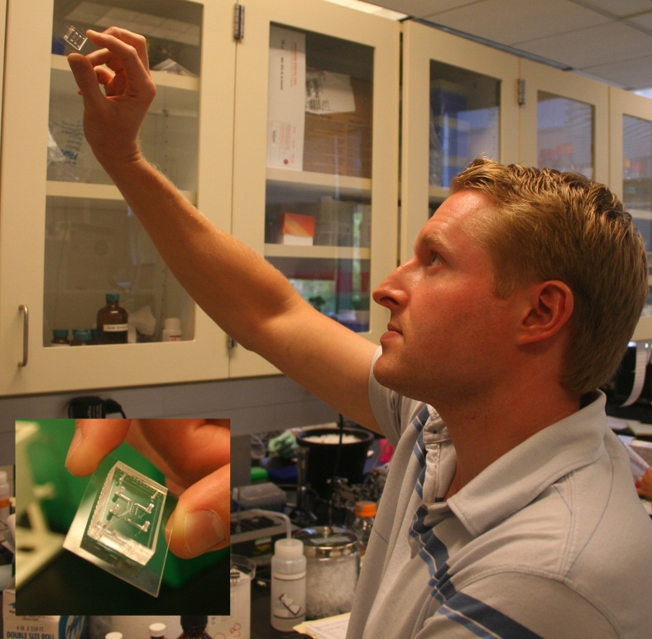
Microfluidic Device
100 um chamber
37C
0.95 um high
Monolayer parallel pattern
Around 100 minutes
Fluorescent burst propagates in the left and right
AiiA negatively regulates the promoters to catalyze the degradation of AHL
Will repeat next 100 minutes at original location
http://www.nature.com/nature/journal/v463/n7279/extref/nature08753-s1.pdf

Slide 11
Amounts of Bacteria
1:1,000 dilution overnight culture grown in 50 ml LB (10 g l⁻¹ NaCl)
antibiotics 100 μg ml⁻¹ ampicillin (Amp) and 50 μg ml⁻¹ kanamycin (Kan)
Grown approximately 2 h. Cells reached an A_{600 nm} of 0.05–0.1, and were spun down and concentrated in 5 ml of fresh media with surfactant concentration of 0.075% Tween20 (Sigma-Aldrich) before loading in a device.
http://www.nature.com/nature/journal/v463/n7279/full/nature08753.html
Notes:
V. fischeri, AiiA from B. thurigensis, and yemGFP

Slide 12
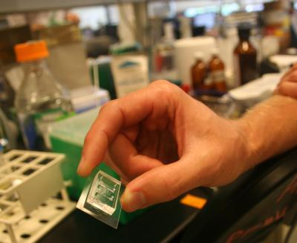
Accession Numbers
BBa_J37015 (Prey Molecule Generator [AHL] plus GFP Reporter)
BBa_C0060 (Autoinducer inactivation enzyme-AiiA from Bacillus, hydrolyzes acetyl homoserine lactone)
BBa_K156009 (Orange Fluorescent Protein)

Slide 13
Primers
BBa_J37015 (AHL & GFP)
(gaattcgcggccgcttctag) 5’- tccctatcagtgattagaga -3’ beginning primer
(ctgcagcggccgctactagta) 5’-tttctcctct -3’end primer
BBa_C0060 (AiiA)
(gaattcgcggccgcttctag) 5’- atgacagtaaagaagcttta -3’ beginning primer
(ctgcagcggccgctactagta) 5’- ttattaagctactaaagcgt -3’ end primer from very end
(ctgcagcggccgctactagta) 5’- gcagctatatattcagggaa -3’ end primer from end of AiiA gene
BBa_K156009 (Orange Fluorescent Protein)
(gaattcgcggccgcttctag) 5’- atgaacctgtccaaaacgt -3’ beginning primer
(ctgcagcggccgctactagta) 5’- ctttttctttttctttttgg -3’ end primer

