Slide 1
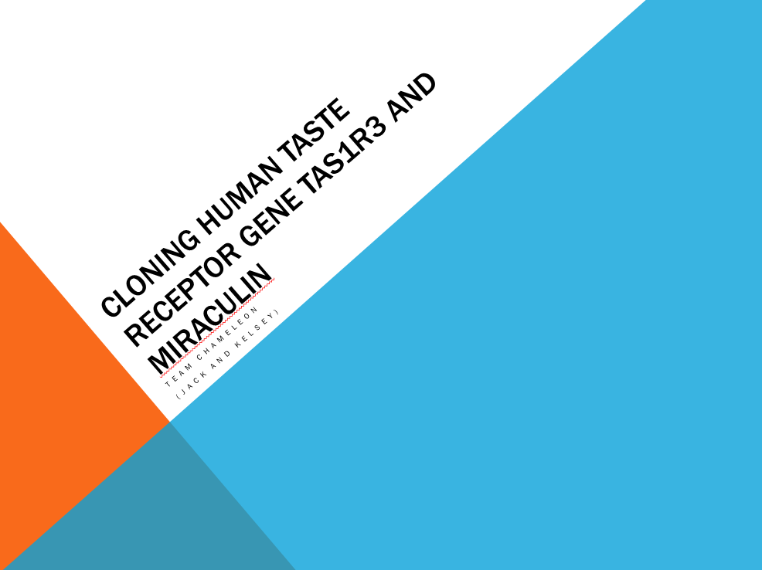
Cloning Human Taste Receptor Gene TAS1R3 and Miraculin
Team Chameleon
(Jack and Kelsey)

Slide 2
The Prequel
Miraculin is a taste-altering protein already present in the BioBricks library
No one has been able to test if they have successfully produced functional miraculin
... UNTIL NOW!

Slide 3
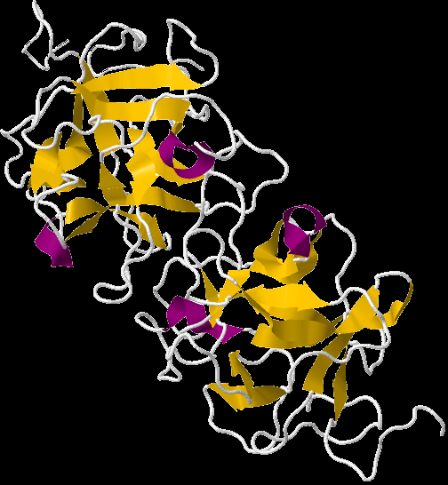
Miraculin works by binding to sweet taste receptors. This changes the shape of the receptors and causes sweet receptors to be activated by acids.
Protein structure of miraculin
Notes:
Detailed mechanism remains unknown

Slide 4
Taste Receptors
There are no taste receptors in the BioBricks library
Two candidate genes
TAS1R3
T1R3

Slide 5
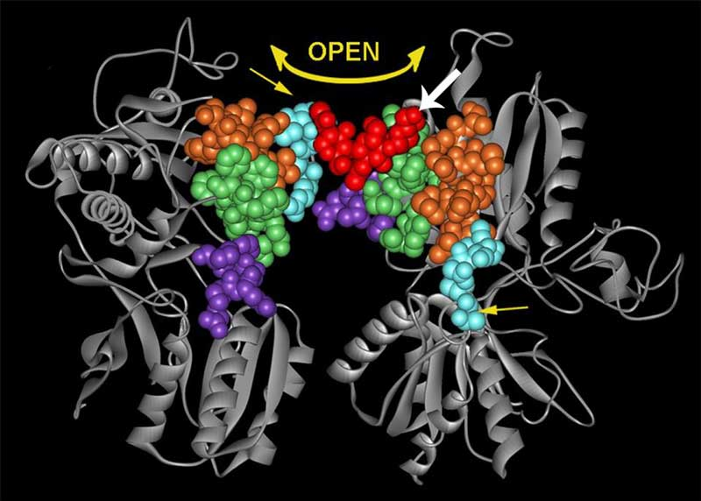
T1R3 complex

Slide 6

Primers and Problems
Our gene contains no introns
BUT there are 3 PstI restriction sites in our gene

Slide 7
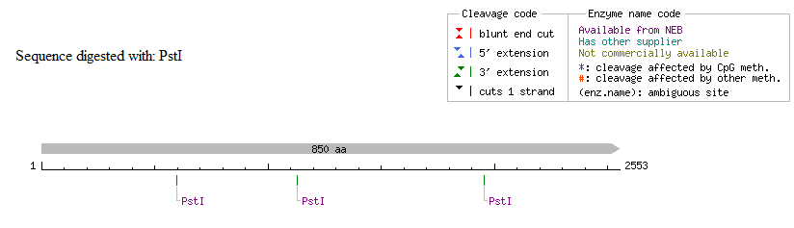
Restriction Sites
Restriction enzyme: PstI
3 restriction sites

Slide 8
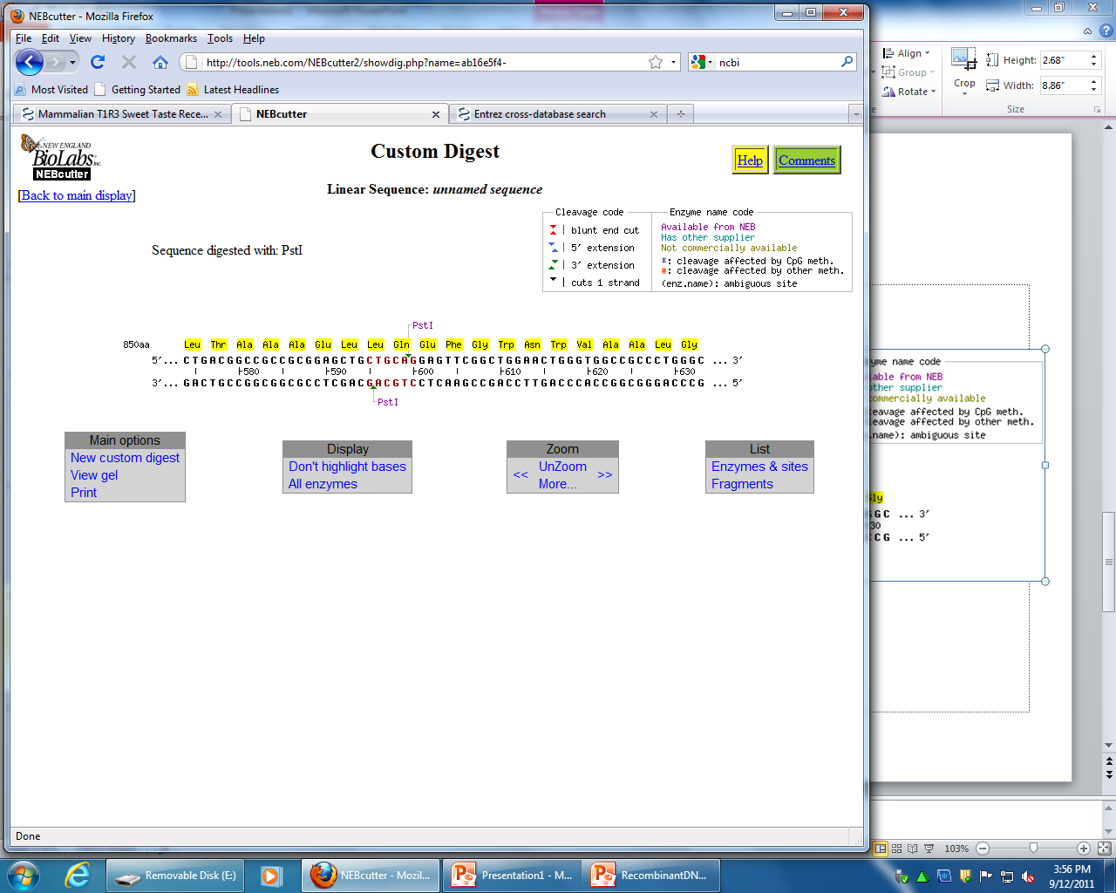
Restriction Sites

Slide 9
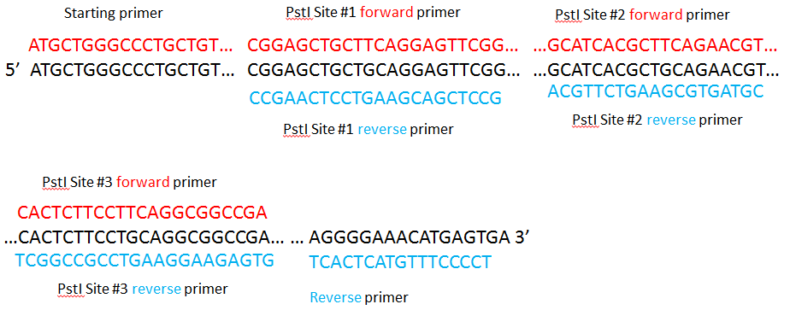
8 primers

Slide 10
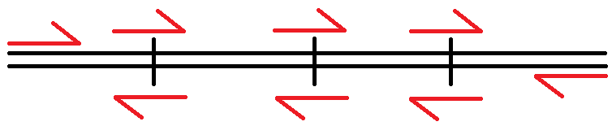
Primers
C
E
G
A
5’
3’
3’
5’
H
B
D
F
A: ΔG = -0.29
B: ΔG = +0.2
C: ΔG = -0.37
D: ΔG = -0.95
E: ΔG = -0.57
F: ΔG = -1.11
G: ΔG = -0.19
H: ΔG = -0.83

Slide 11
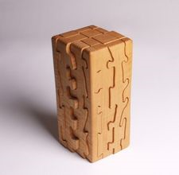
Putting the Pieces Back Together
Once we have individually amplified the four fragments of our gene with mutated PstI sites, we will use PCR to amplify the fragments back together in sets of two

Slide 12
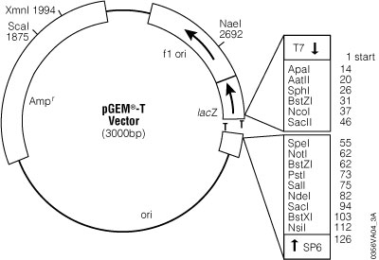
Vector
Once our gene has been amplified into entirety, we will insert it into a T-vector
From the T-vector, we will amplify our gene with BioBrick compatible primers and then insert it into the BioBrick promoter vector

Slide 13

Promoters
pBAD strong (Bba_K206000)
Induced by L-arabinose
PAI + LasR -> Luxl (Bba_K266000)
Induced by PAI + LasR
pCpxR (Bba_K135000)
CpxR responsive promoter
Induced by binding to hydrophobic surfaces

Slide 14
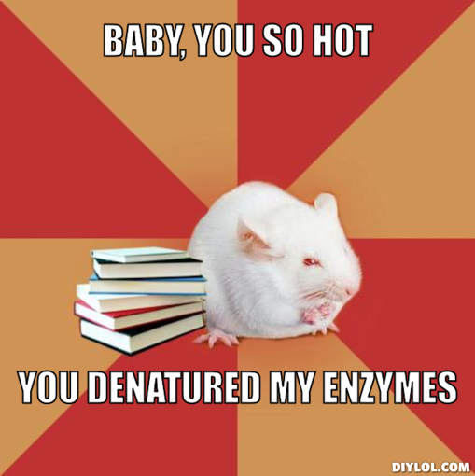
Testing…
We need a way to test that the sweet taste receptor and Miraculin compounds bind to one another without denaturing the proteins

Slide 15

But How?
To solve this problem, we elect to perform SDS-PAGE analysis under native gel conditions
Unfortunately, we have not yet found the native conditions for the T1R3 protein but search efforts are still underway

Slide 16
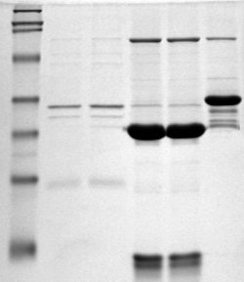
SDS-PAGE
SDS-PAGE will allow us to observe the molecules individually, and then potentially bound together
Using this procedure, we will be able to determine by protein size if we were successful in synthesizing a functional T1R3 receptor

Slide 17

Questions

