Slide 1

BACTOBLOOD
Researchers
Arthur Yu • Austin Day • David Tulga • Hannah Cole • Kristin Doan • Kristin Fuller • Nhu Nguyen • Samantha Liang • Vaibhavi Umesh • Vincent Parker
Teaching Assistants
Amin Hajimorad • Farnaz Nowroozi • Rickey Bonds
Advisors
John Dueber • Christopher Anderson • Adam Arkin • Jay Keasling
UC BERKELEY
Creating a Red Blood Cell Substitute

Slide 2
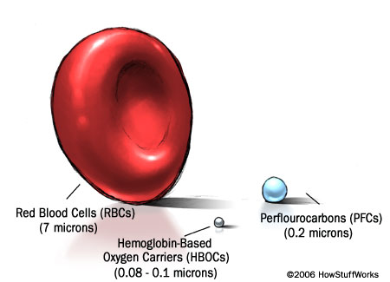
Artificial Blood Substitutes
The Need
Supply shortage, especially in
developing countries
PFC limitations
HBOC limitations
Benefits of Bactoblood
Universally compatible
Disease-free
Inexpensive
Ability to be stored for a prolonged period
Rapid production in emergency situations
Notes:
Kristin’s making this slide tonight

Slide 3

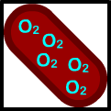
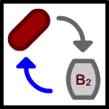


Human Practice Considerations
What makes a system novel and non-obvious?
the functional integration of all the devices into a single system (e.g. Bactoblood)
Tension between open source and patentability
P_{iron}
What is patentable: the part or the application of the part?
the combination of parts that provide a function (device)
Notes:
Kristin’s making this slide tonight

Slide 4
Human Practice Considerations
What makes a system novel and non-obvious?
the functional integration of all the devices into a single system (e.g. Bactoblood)
P_{iron}

Slide 5
Human Practice Considerations
What makes a system novel and non-obvious?
the functional integration of all the devices into a single system (e.g. Bactoblood)
P_{iron}
Conventional Method
Prove novel and non-obvious
Future of Patenting?
Possibilities Unknown
vs.
P_{iron}

Slide 6
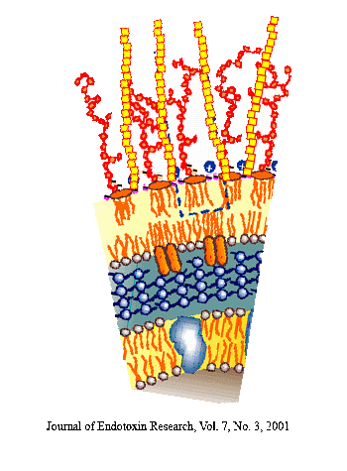
The Chassis
Protect Recipient
from E. coli
Protect E.coli from
Immune System
Lipopolysaccharide
(LPS)
K1:O16 capsule
Pili and Flagella
P_{iron}
tonB gene

Slide 7
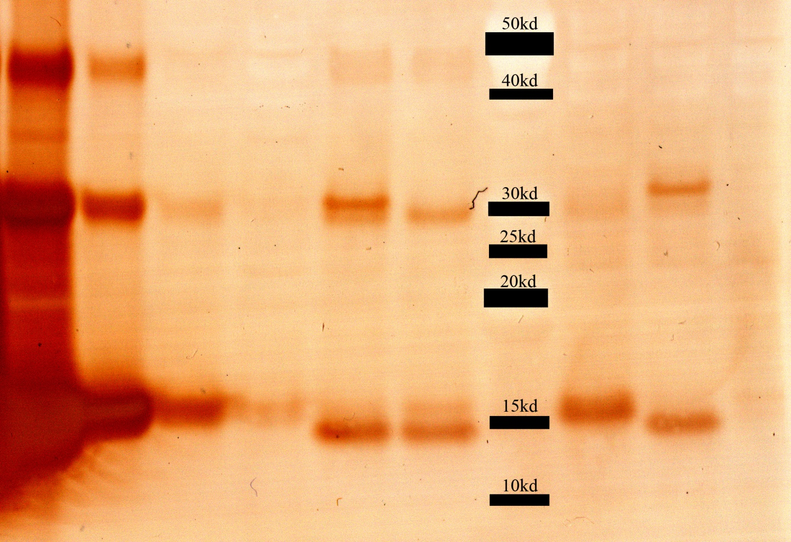
Expression of Human Hemoglobin
Dimeric HbA
P_{iron}
Monomeric HbA

Slide 8
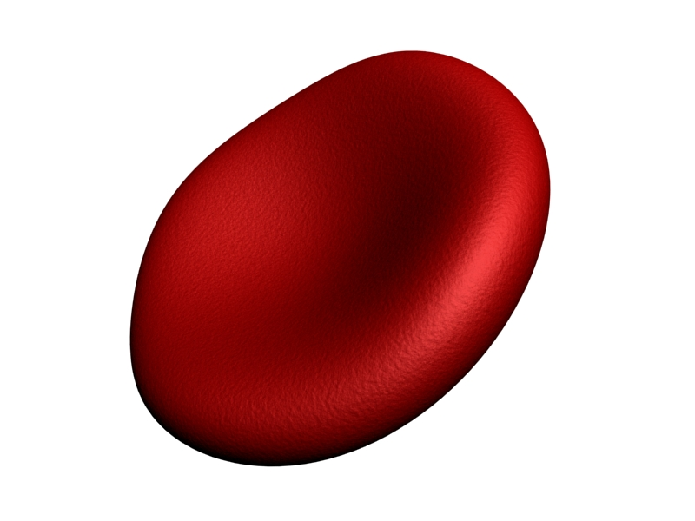
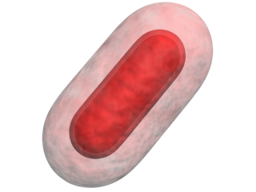
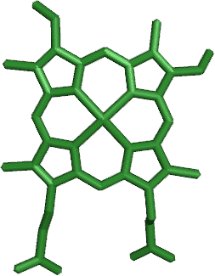
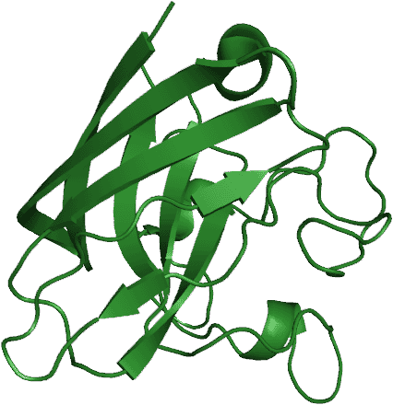
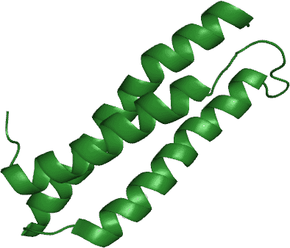
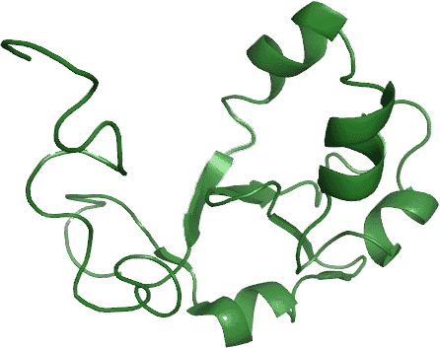
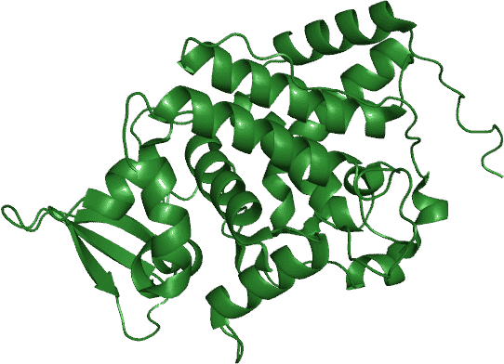
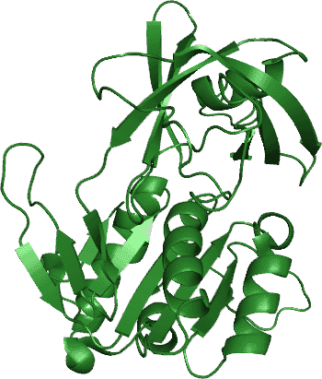
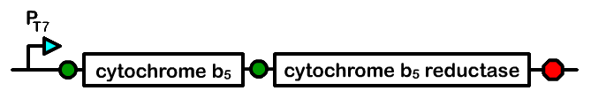
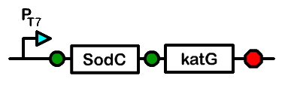
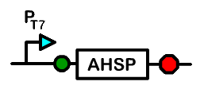
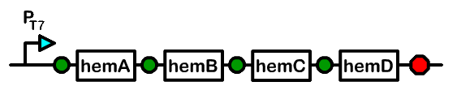
System Components
Heme
Antioxidants
Alpha Hemoglobin Stabilizing Protein
Cytochome b5 / Cytochrome b5 Reductase
P_{iron}
Notes:
In addition to constructing hemoglobin expression devices, we also constructed various devices that aid in increasing expression levels and maintaining functional hemoglobin.
We made following devices in an attempt to “steal” the solutions that natural red blood use to address the problems that come with using hemoglobin as an oxygen carrier.
Since we need to make loads of hemoglobin, we need loads of heme. Therefore we relieved the major bottlenecks in E. Coli’s natural heme biosynthesis pathway by supplementing those genes in our system.
To prevent improper folding and to increase the yield of functional hemoglobin, we’ve included the natural chaperone, alpha hemoglobin stabilizing protein.
To remove clear out damaging free radicals that come about during oxygen binding and unbinding, we’ve added the major antioxidant enzymes that are normally present in red blood cells.
And to restore non-functional methemoglobin back to a functional state, we’ve imported human cytochrome b5 and cytochrome b5 reductase, which should do the trick.
Just as these problems are solved in red blood cells, these problems would be solved in analogous ways for our bacto blood cell.

Slide 9
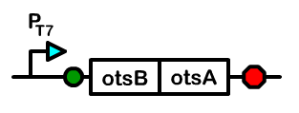
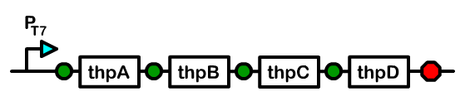
Freeze Drying
Bactoblood can be stockpiled and easily transported
2 desiccation devices which prevent cell damage
Trehalose
Hydroxyectoine
P_{iron}
2 genes from e. coli genome
Four genes from
Streptomyces chrysomallus
Both help cells recover after freeze-drying
Notes:
Mention that it’s a high school project

Slide 10
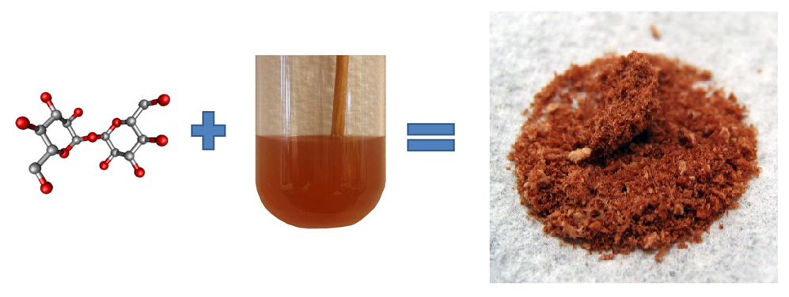
Freeze Drying
Actual Lyophilized Bactoblood
Trehalose
Bactoblood Culture
P_{iron}

Slide 11
The Controller
Directs copy number and transcription of system devices
pSC101 Derived Plasmid
(low copy)
T7 Polymerase
pir genes
Iron-inducible promoter
P_{iron}
Bacterial Artificial Chromosome (single copy)
Biosynthetic Operons
T7 Promoters
pir dependent R6K Origin

Slide 12
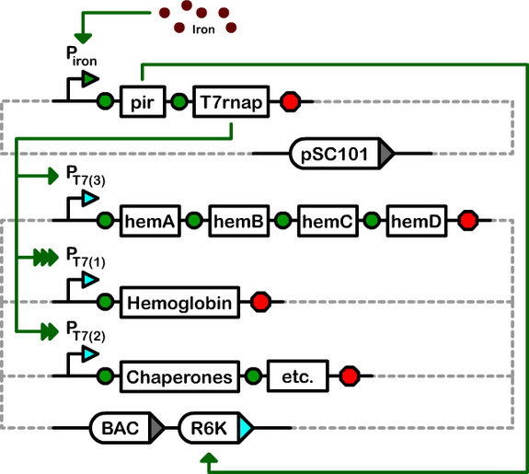
The Controller
P_{iron}

Slide 13
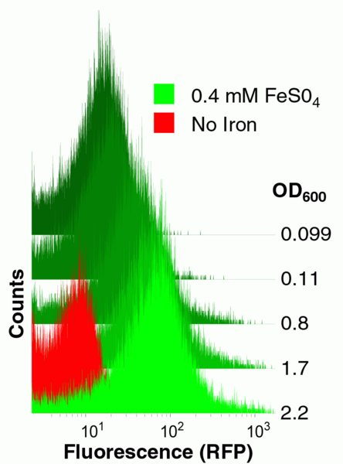
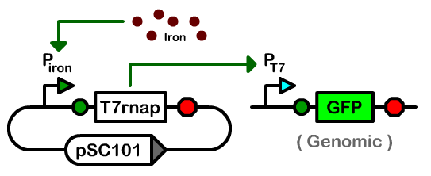
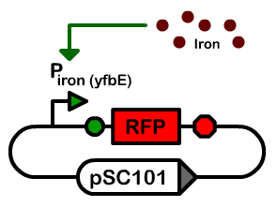
Controller Part Characterization
T7 RNA Polymerase
Iron Promoter, yfbE
P_{iron}
Only composite part with the weakest rbs and a GTG start
codon showed iron-dependent GFP production

Slide 14
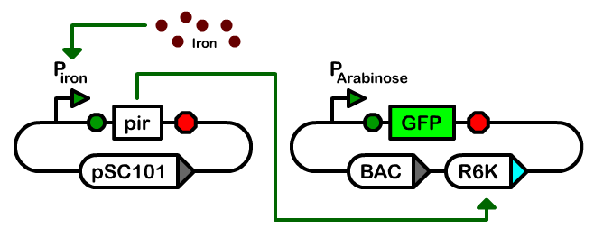
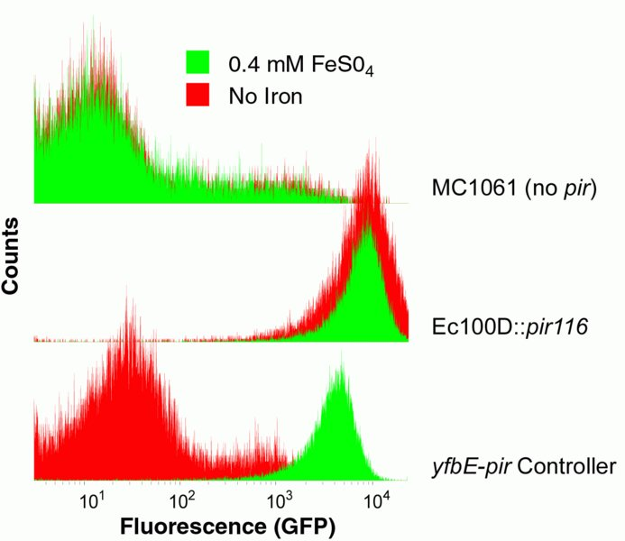
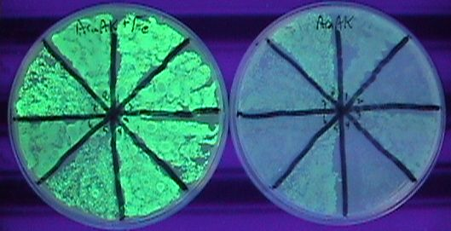
Copy Number Device Assays
GFP Cytometry
As copy number increases, so does the amount of GFP
Low copy number
No pir
High copy number
P_{iron}
Pir genes
Iron-dependent copy number
Pir+Controller
Induced with Iron
No Iron

Slide 15
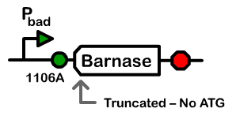
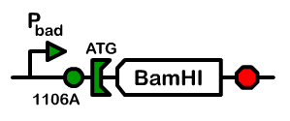
Genetic Kill Switch
Prevents chance of infection or unwanted proliferation
When induced, cells degrade their own DNA
P_{iron}
Notes:
Stops growth after hemoglobin has been made

Slide 16
Kill Switch Growth Assays
# of colonies
P_{iron}
P_{iron}
- Arabinose
+ Arabinose
- Arabinose
+ Arabinose

Slide 17
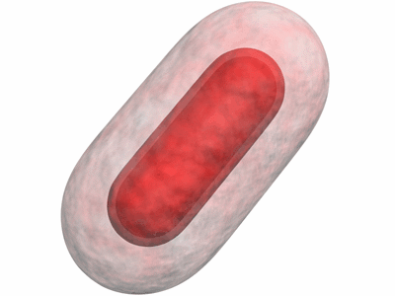
Phenotype of Dead Cells
Cells Don’t Lyse
Proteins Remain Intact
Empty Sack of Protein
Without Arabinose
With Arabinose
P_{iron}

Slide 18
Making Comprehensive Systems
Bactoblood Devices
Hemoglobin
Create devices to address specific aspects
Peroxide Damage Control
Heme
Freeze-Drying
Controller
Genetic Kill Switch
Notes:
Emphasize why we should get best system

Slide 19
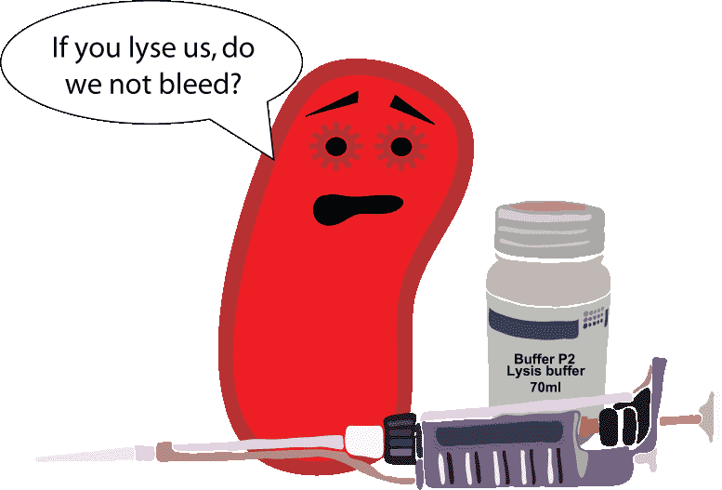
Acknowledgements
The Arkin and Keasling Labs
Kate Spohr, Kevin Costa and Gwyneth Terry
SynBERC
The Camille and Henry Dreyfus Foundation

