Slide 1
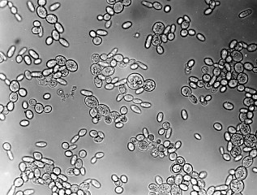
Biomathematical Modeling: The Deletion of HMO1 and its Effect on Cold Shock Reaction in S. cerevisiae
Lauren Magee & Lucia Ramirez
Department of Mathematics and Biology
Loyola Marymount University
May 7, 2015

Slide 2
Significance Table from Anova Test
ANOVA | WT | HMO1
p < 0.05 | 2378 (38%) | 903 (14.6%)
p < 0.01 | 1527 (25%) | 337 (5.4%)
p < 0.001 | 860 (14%) | 69 (1.1%)
p < 0.0001 | 460 (7%) | 18 (0.3%)
B-H p < 0.05 | 228 (4%) | 39 (0.6%)
Bonferroni p < 0.05 | 228 (4%) | 8 (0.1%)

Slide 3
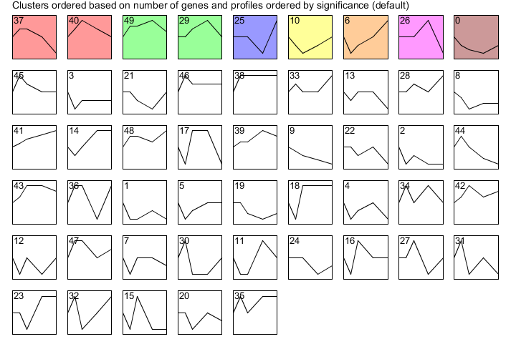
All Stem Profiles: wild type

Slide 4
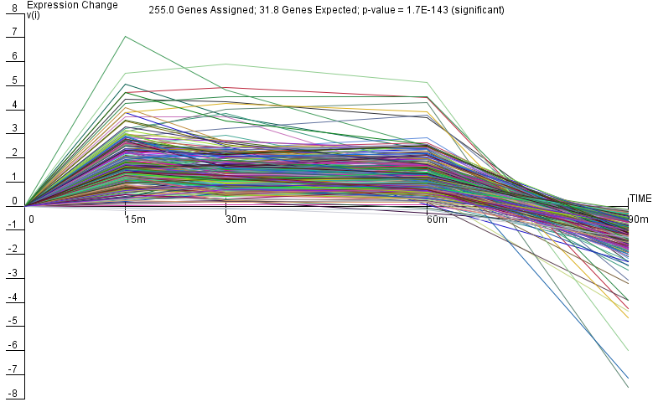
Wt_Profile #37

Slide 5
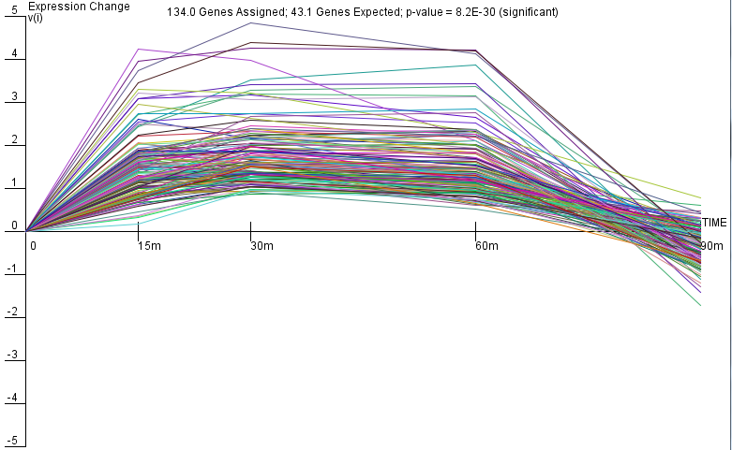
Wt_Profile #40

Slide 6
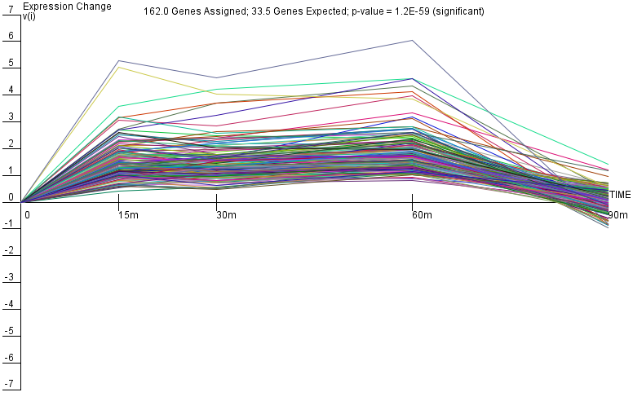
Wt_Profile #49

Slide 7
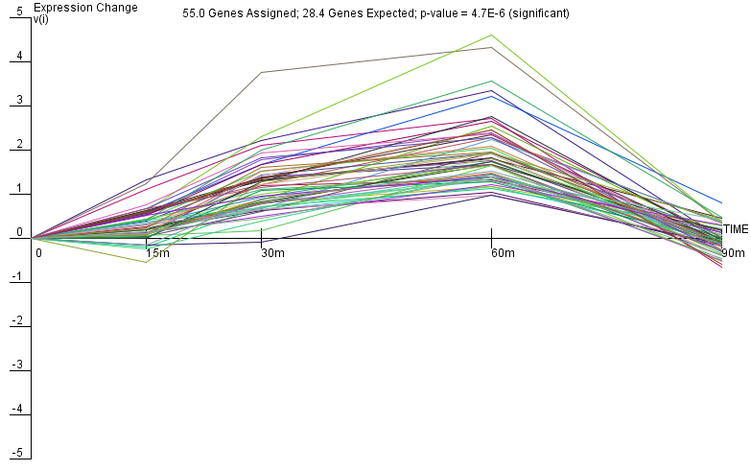
Wt_Profile #29

Slide 8
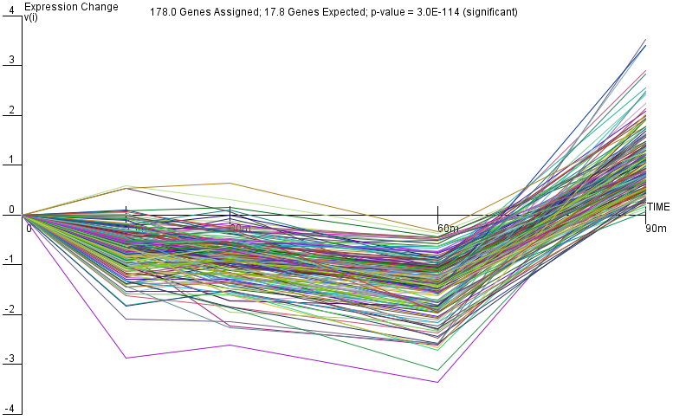
Wt_Profile #25

Slide 9
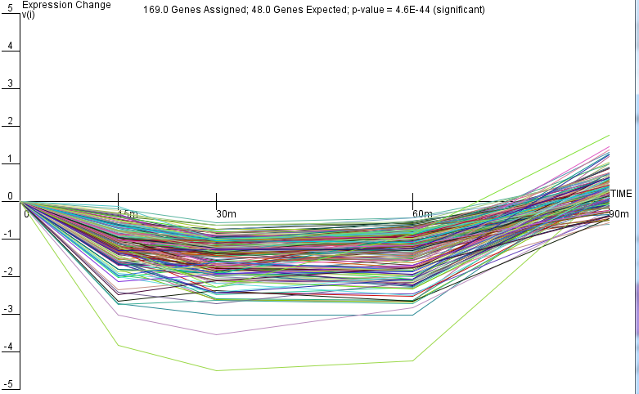
Wt_Profile #10

Slide 10
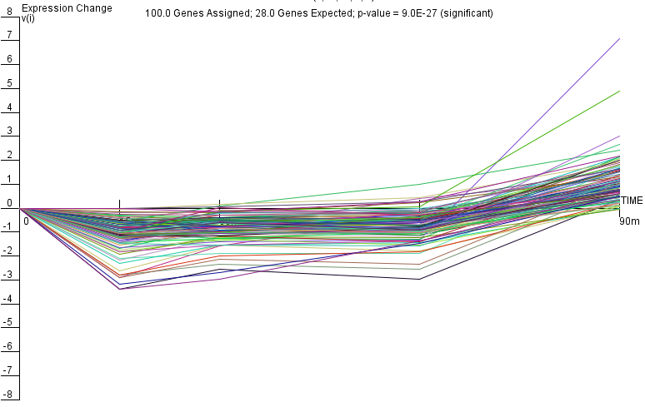
Wt_Profile #6

Slide 11
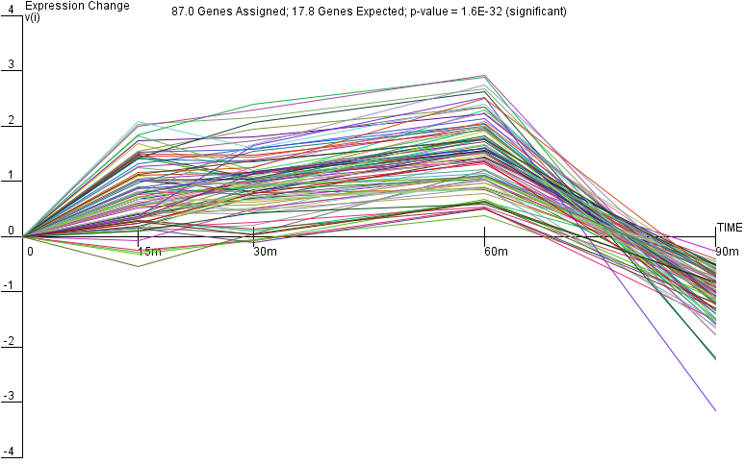
Wt_Profile #26

Slide 12
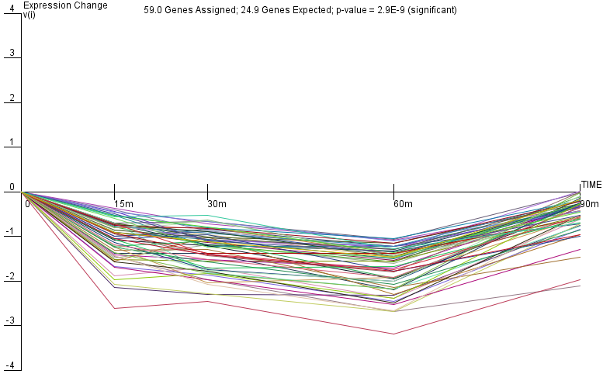
Wt_Profile #0

Slide 13
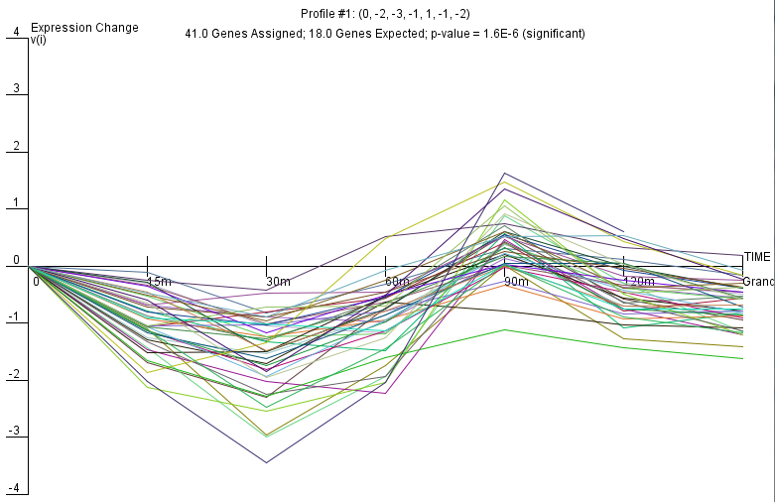
HMO1_Profile #1
Only DNA binding evidence

Slide 14
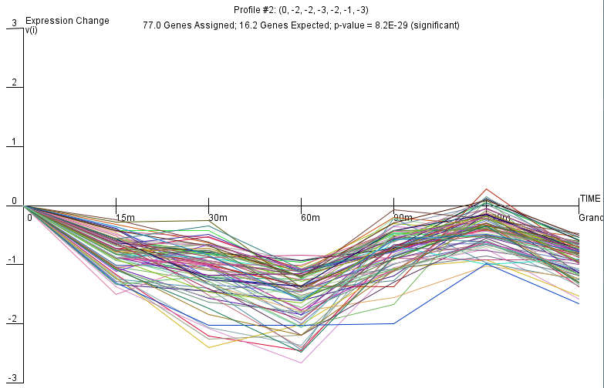
HMO1_Profile #2
DNA binding and expression evidence

Slide 15
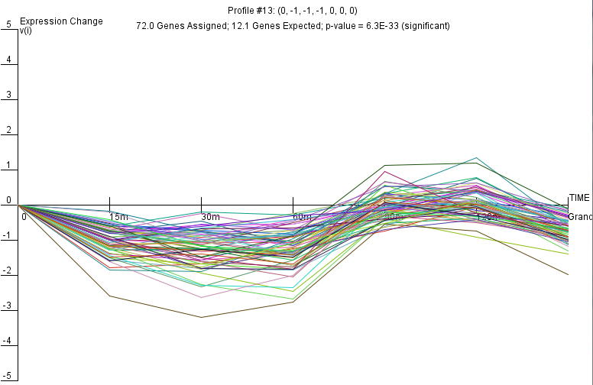
HMO1_Profile #13

Slide 16
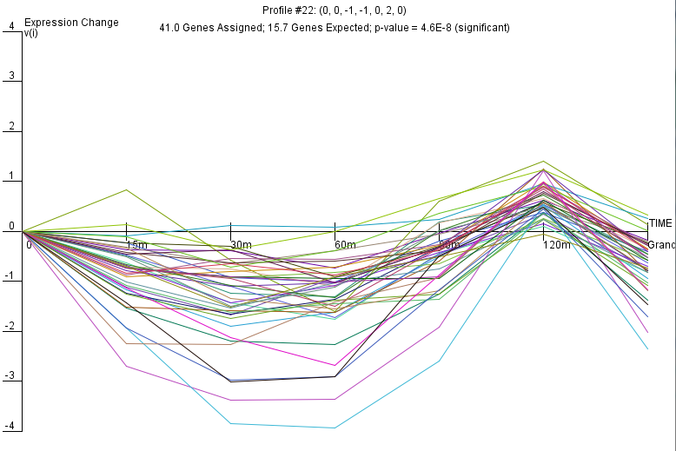
HMO1_Profile #22

Slide 17
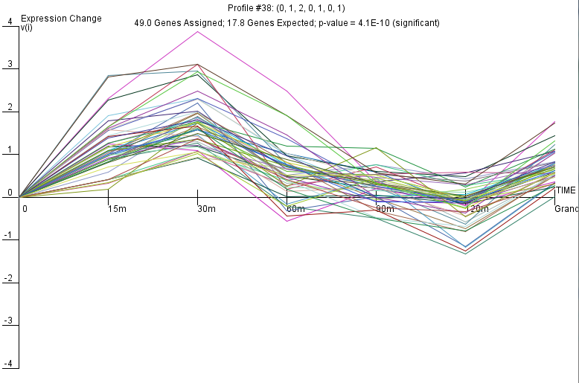
HMO1_Profile #38

Slide 18
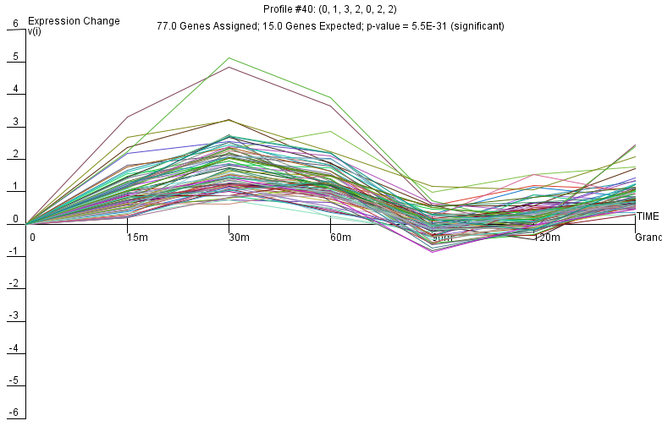
HMO1_Profile #40

Slide 19
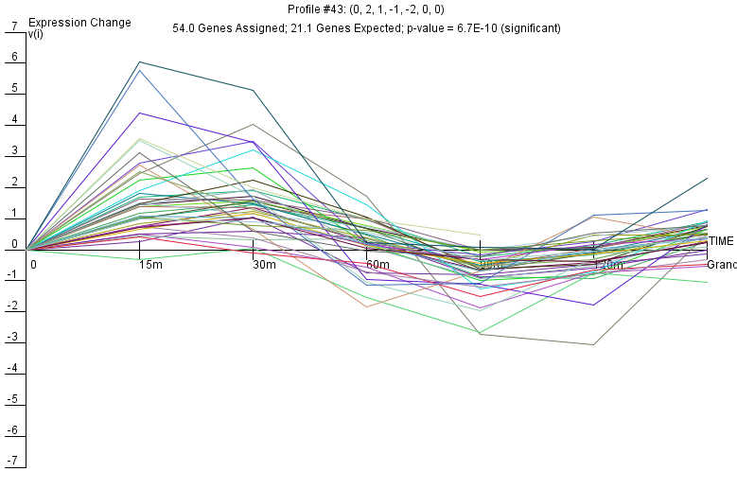
HMO1_Profile #43

Slide 20
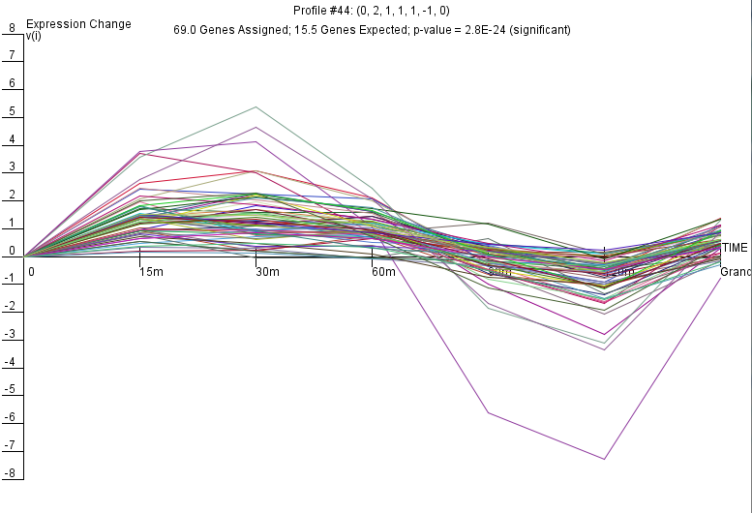
HMO1_Profile #44

Slide 21
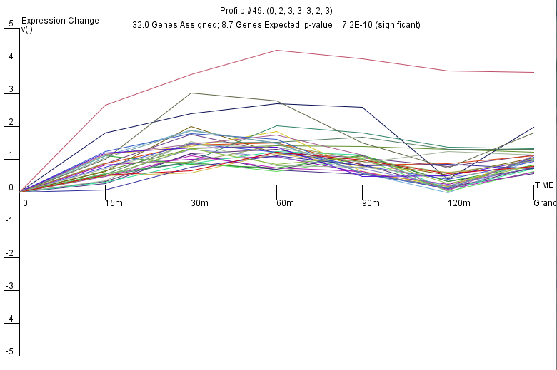
HMO1_Profile #49

Slide 22
*DNA binding plus expression evidence

Slide 23
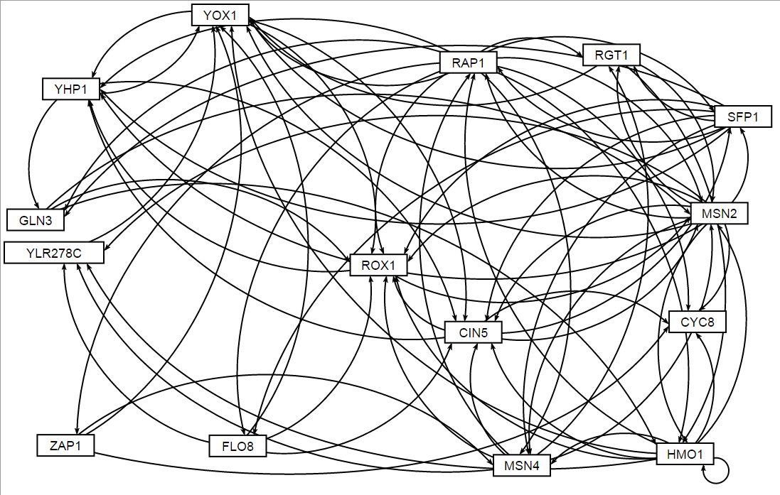
Gene regulatory Network HMO1_profile43
*GRNsight software

Slide 25
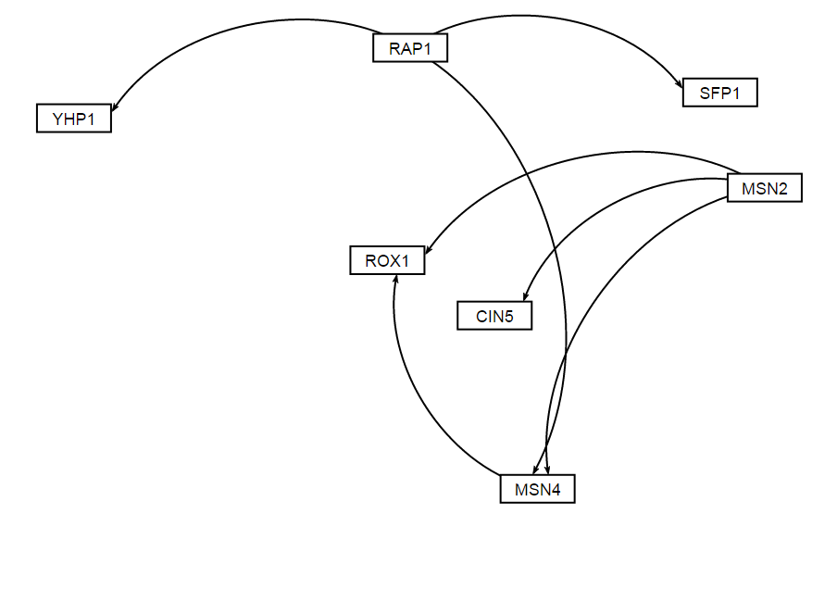
Gene regulatory Network HMO1_profile43

Slide 27
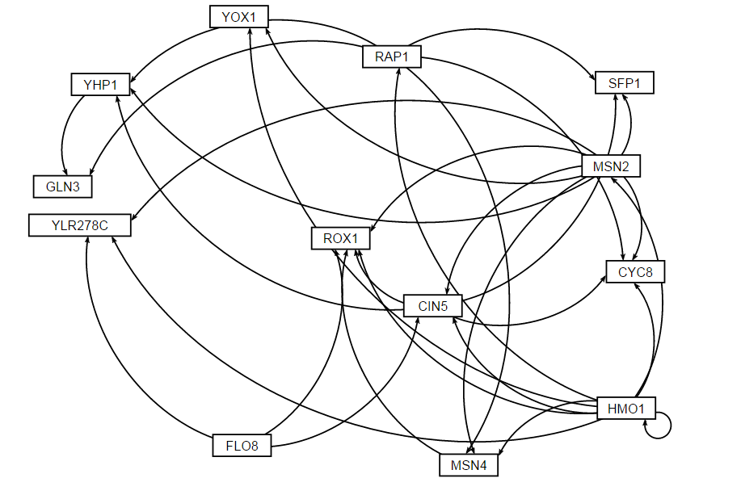
Gene regulatory Network HMO1_profile43

Slide 28
Change in Expression after modifying fix_b?
Fixed b = fix_b set to 1
Estimated b = fix_b set to 0

Slide 29
Gene regulatory Network HMO1_profile43

Slide 30
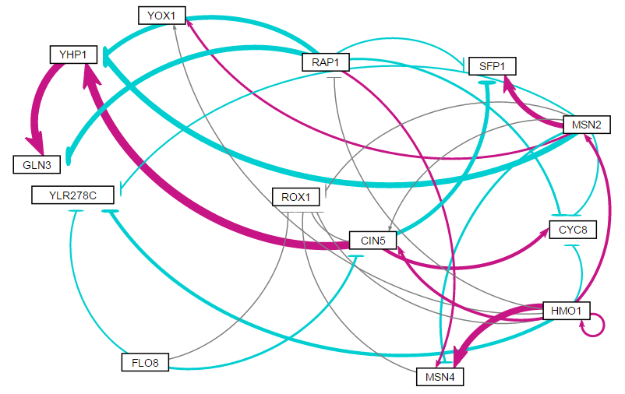
Estimated b: weighted network

Slide 31
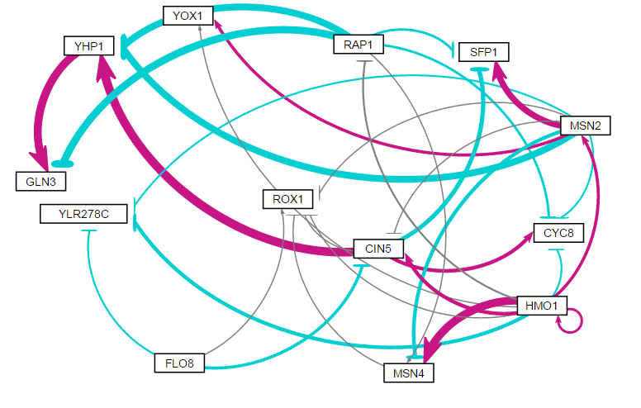
Fixed b: weighted network

Slide 32
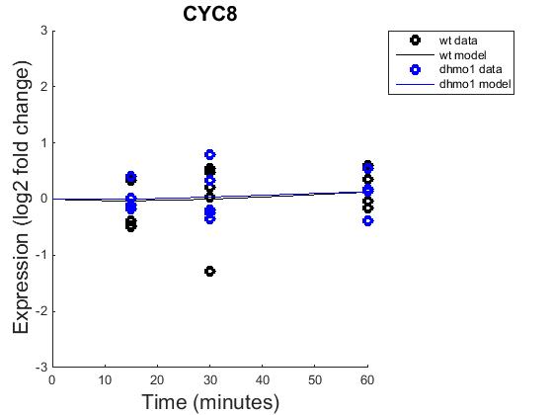
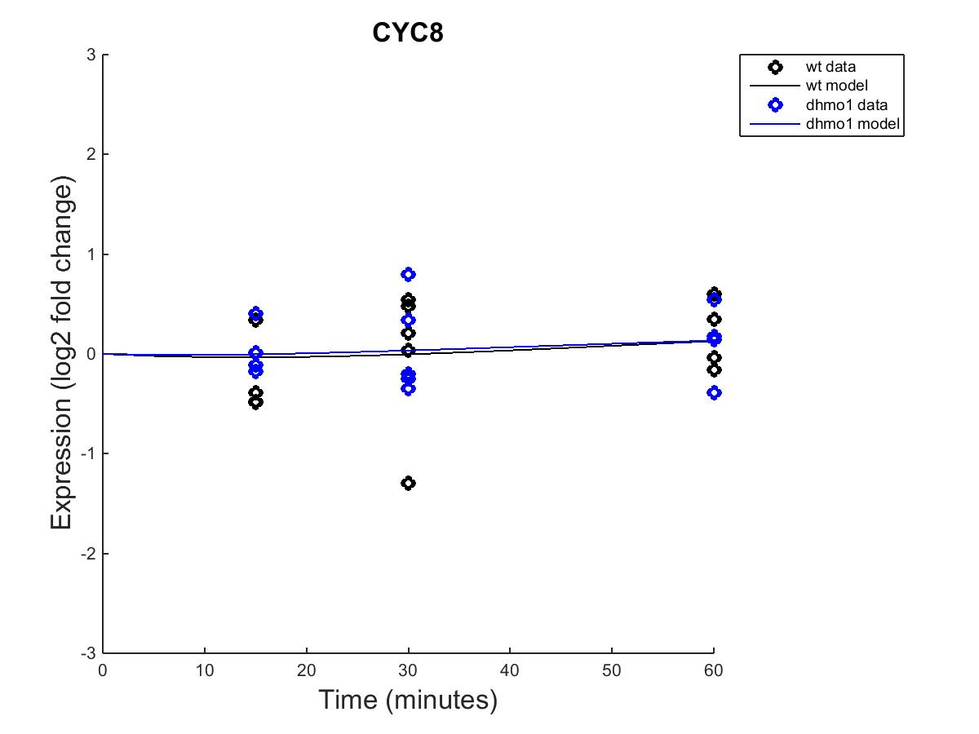
GRNmap model
Fixed b
Estimated b

Slide 33
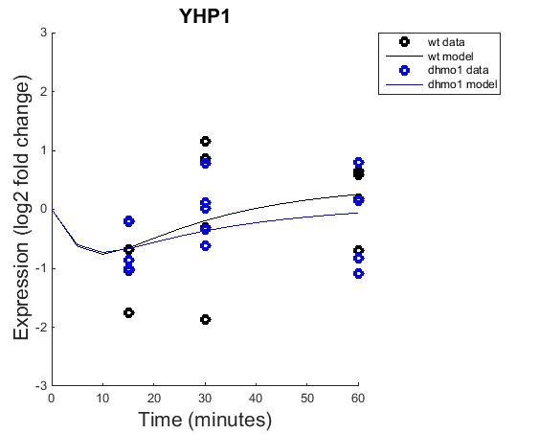
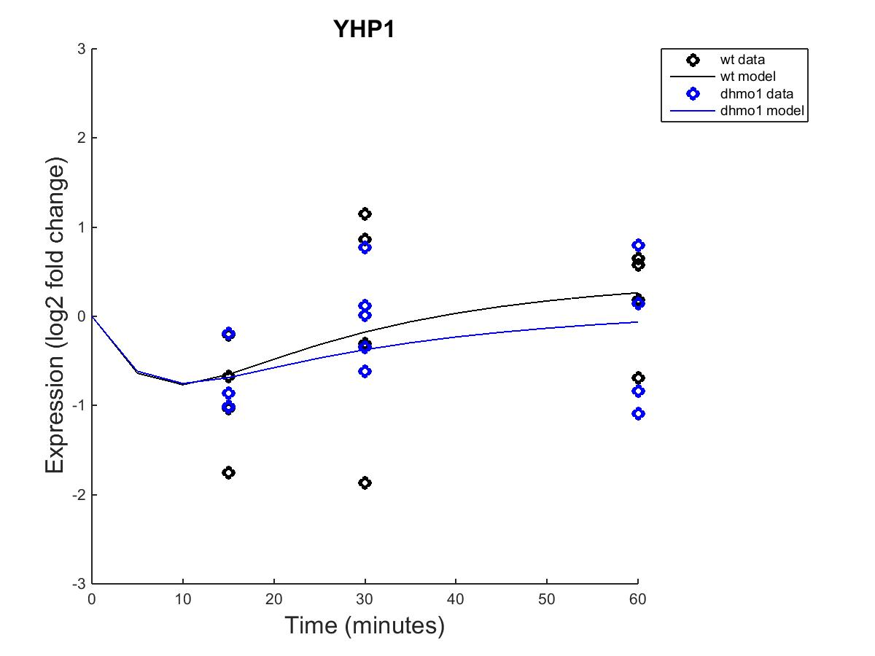
GRNmap model
Fixed b
Estimated b

Slide 34
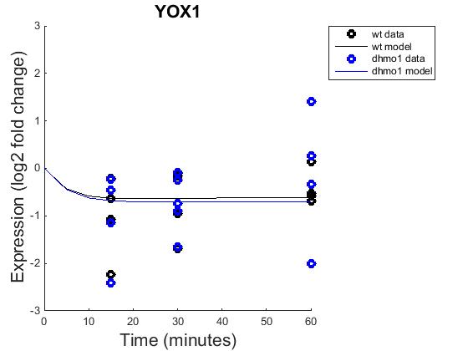
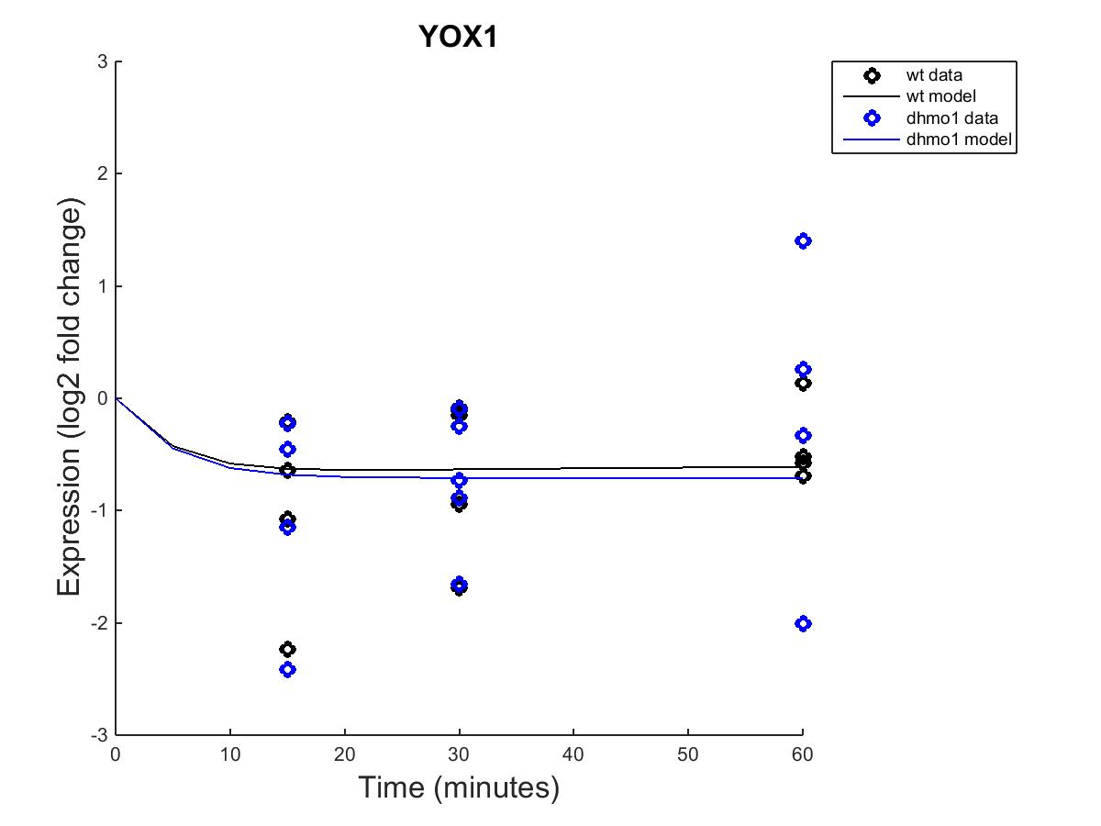
GRNmap model
Fixed b
Estimated b

Slide 35
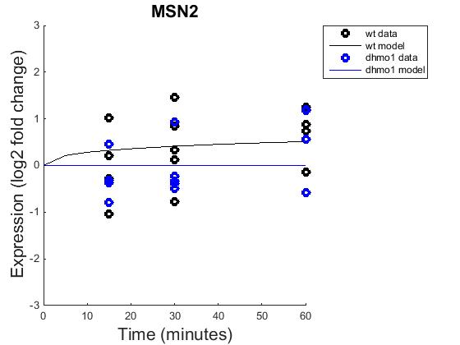
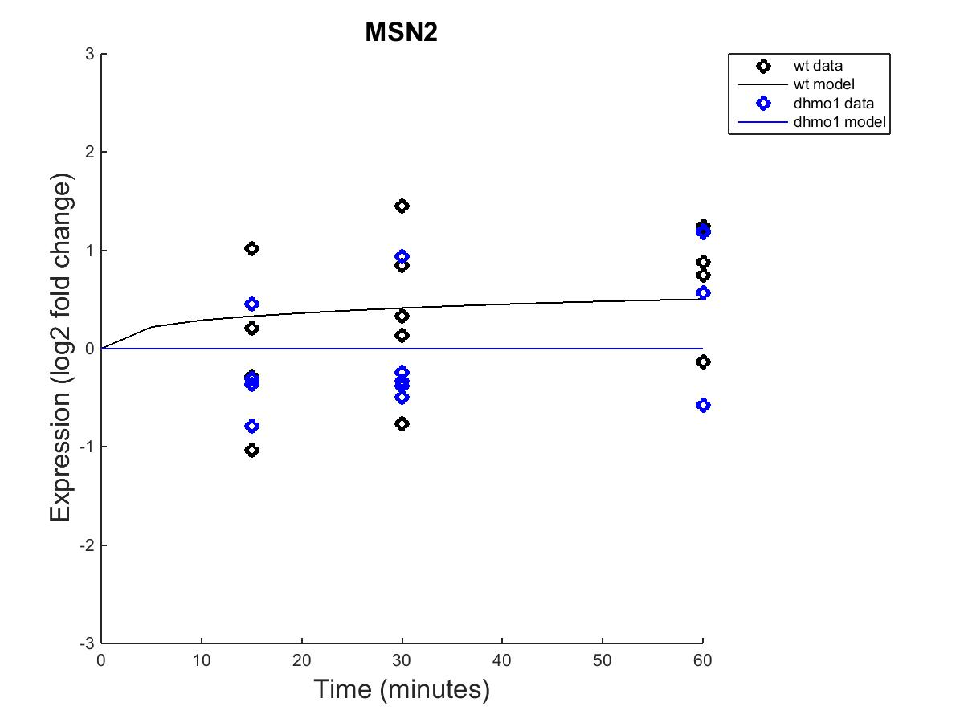
GRNmap model
Fixed b
Estimated b

Slide 36
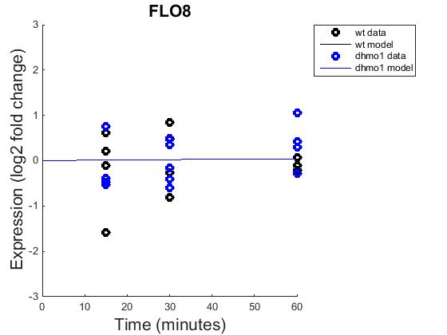
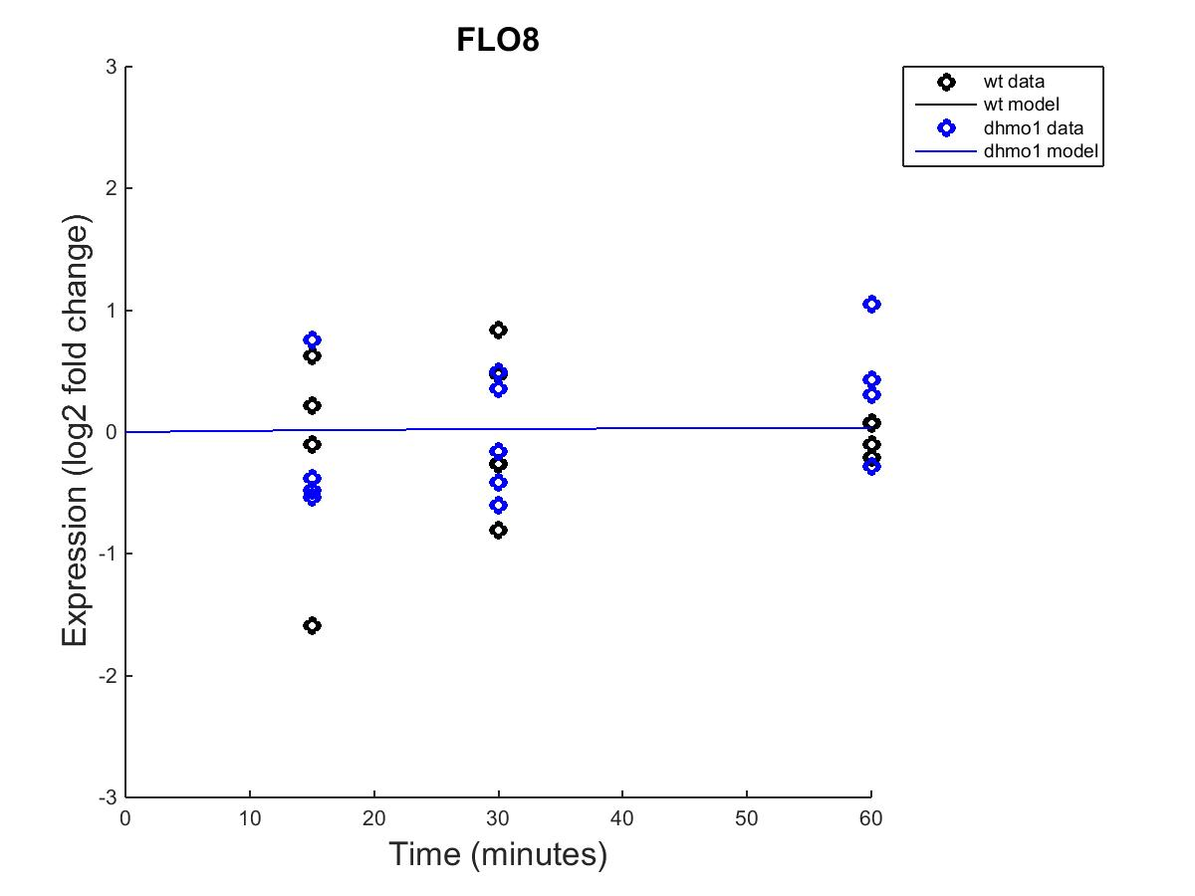
GRNmap model
Fixed b
Estimated b

Slide 37
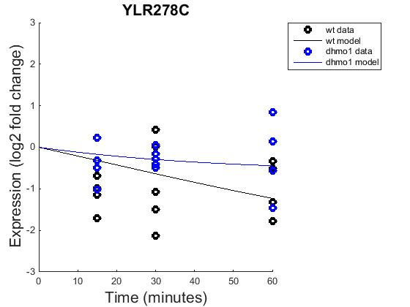
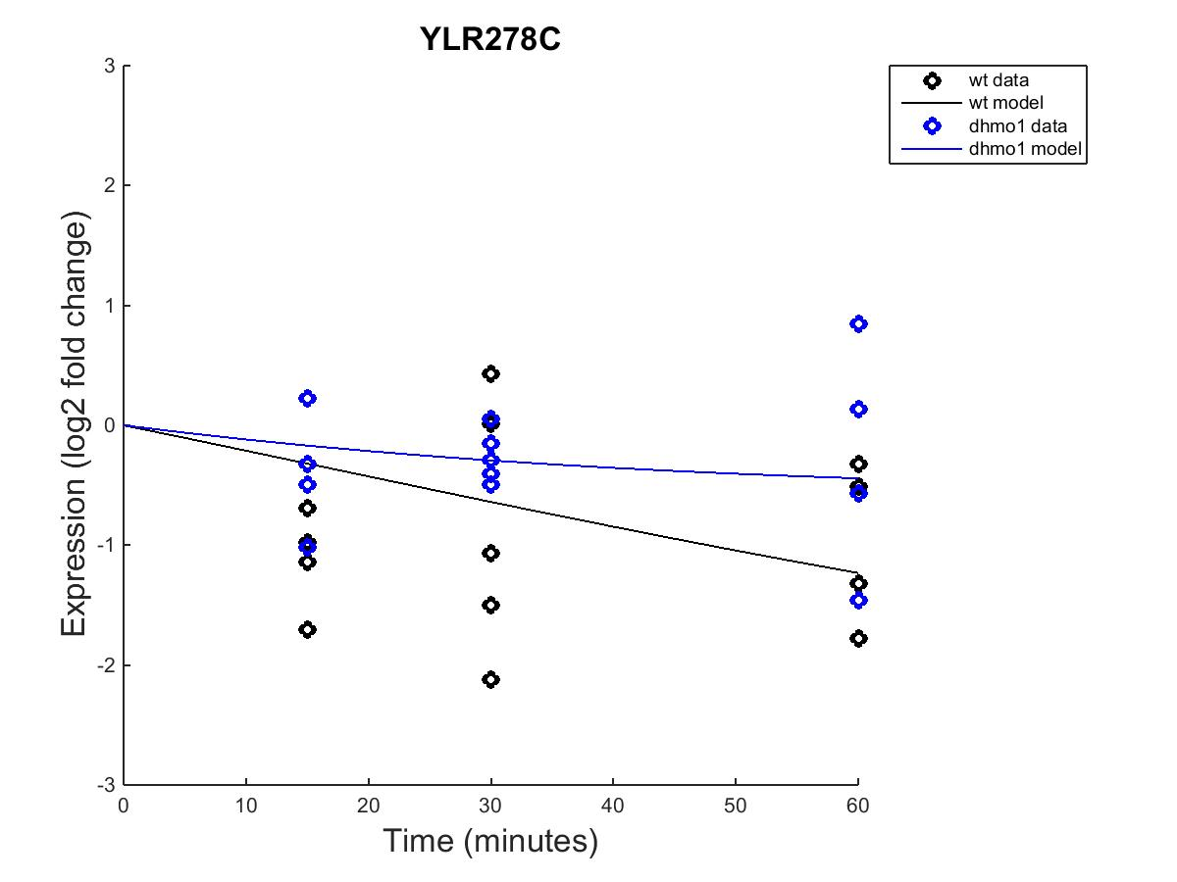
GRNmap model
Fixed b
Estimated b

Slide 38
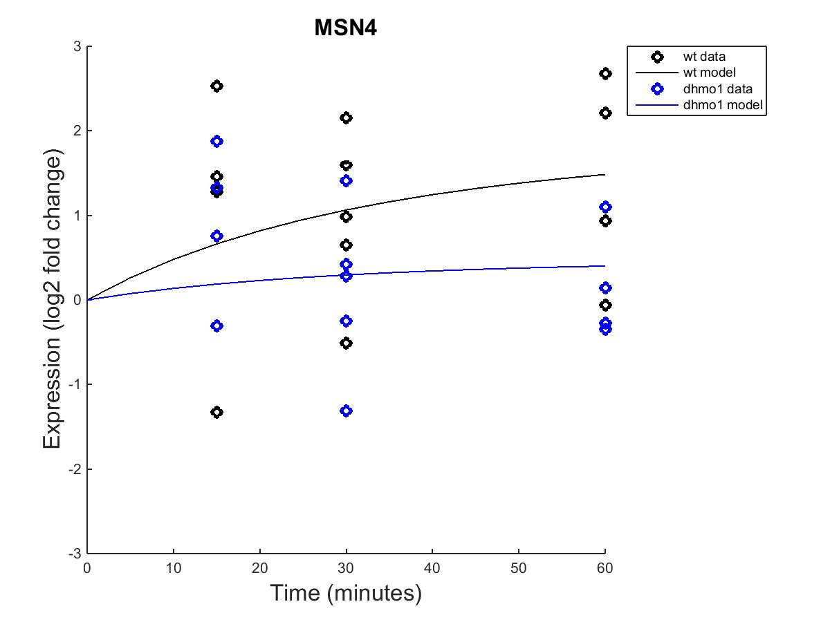
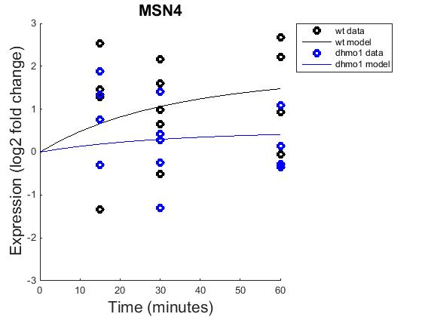
GRNmap model
Fixed b
Estimated b

Slide 39
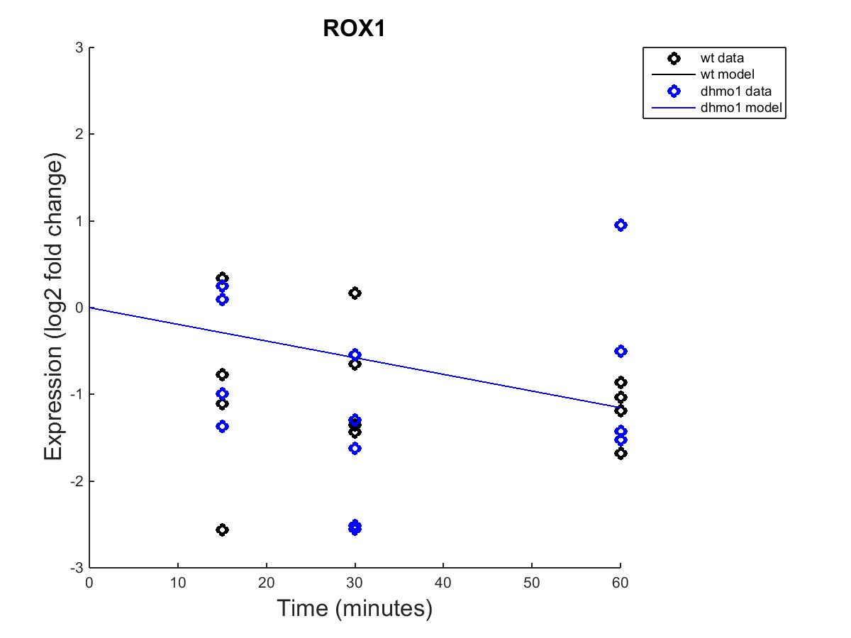
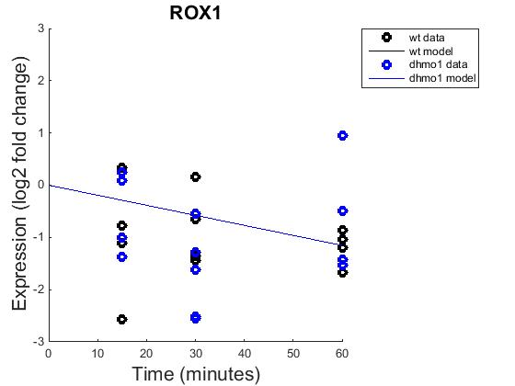
GRNmap model
Fixed b
Estimated b

Slide 40
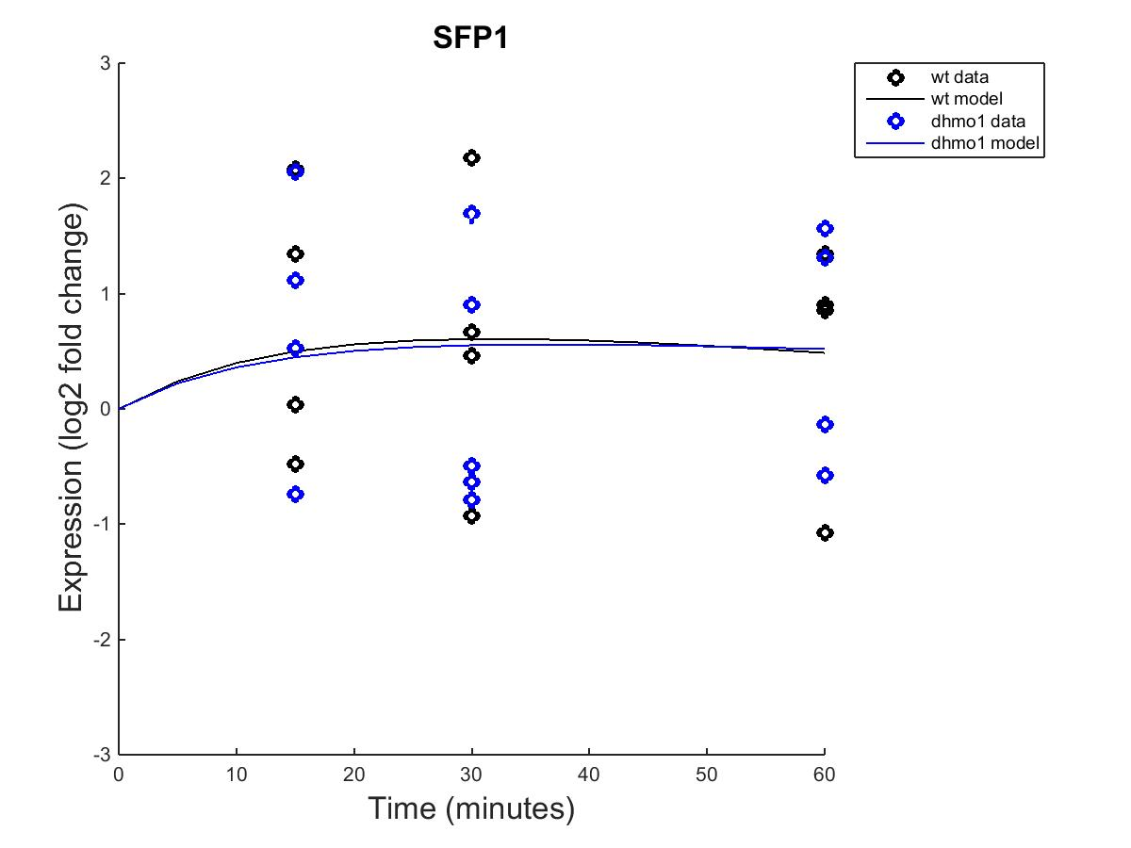
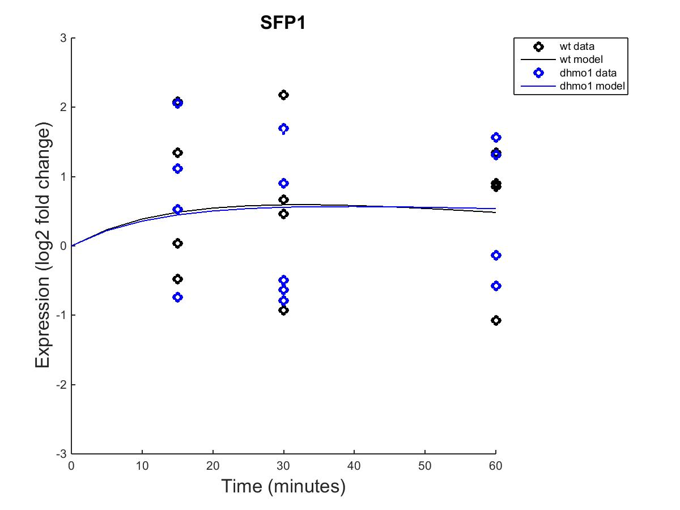
GRNmap model
Fixed b
Estimated b

Slide 41
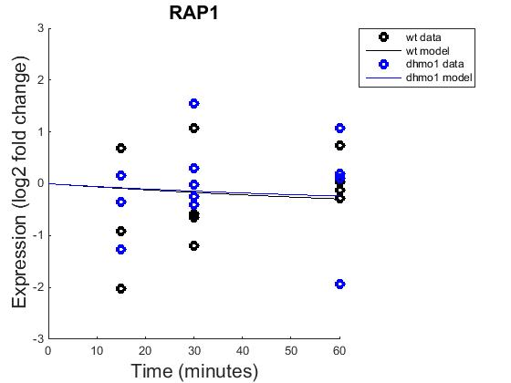
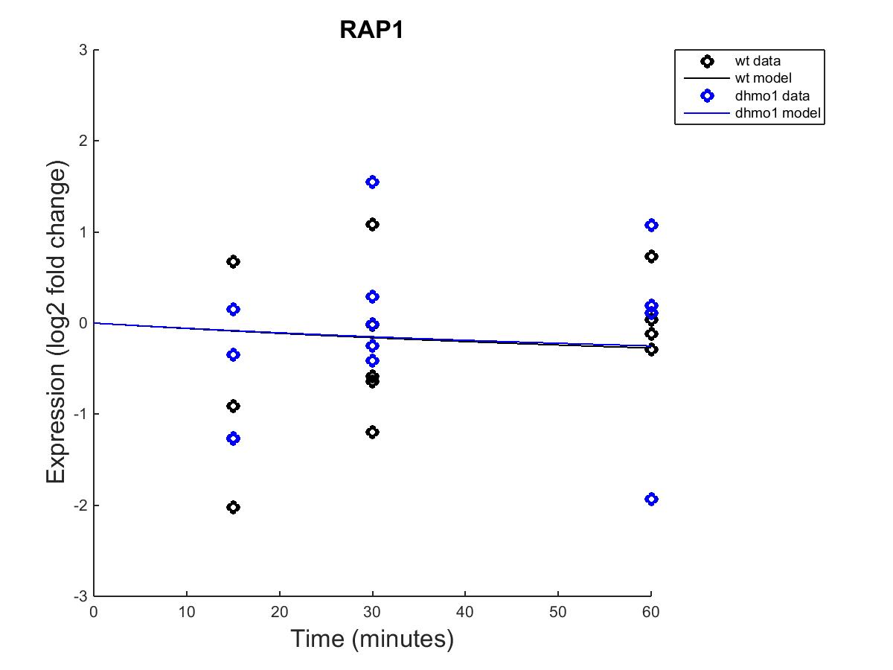
GRNmap model
Fixed b
Estimated b

Slide 42
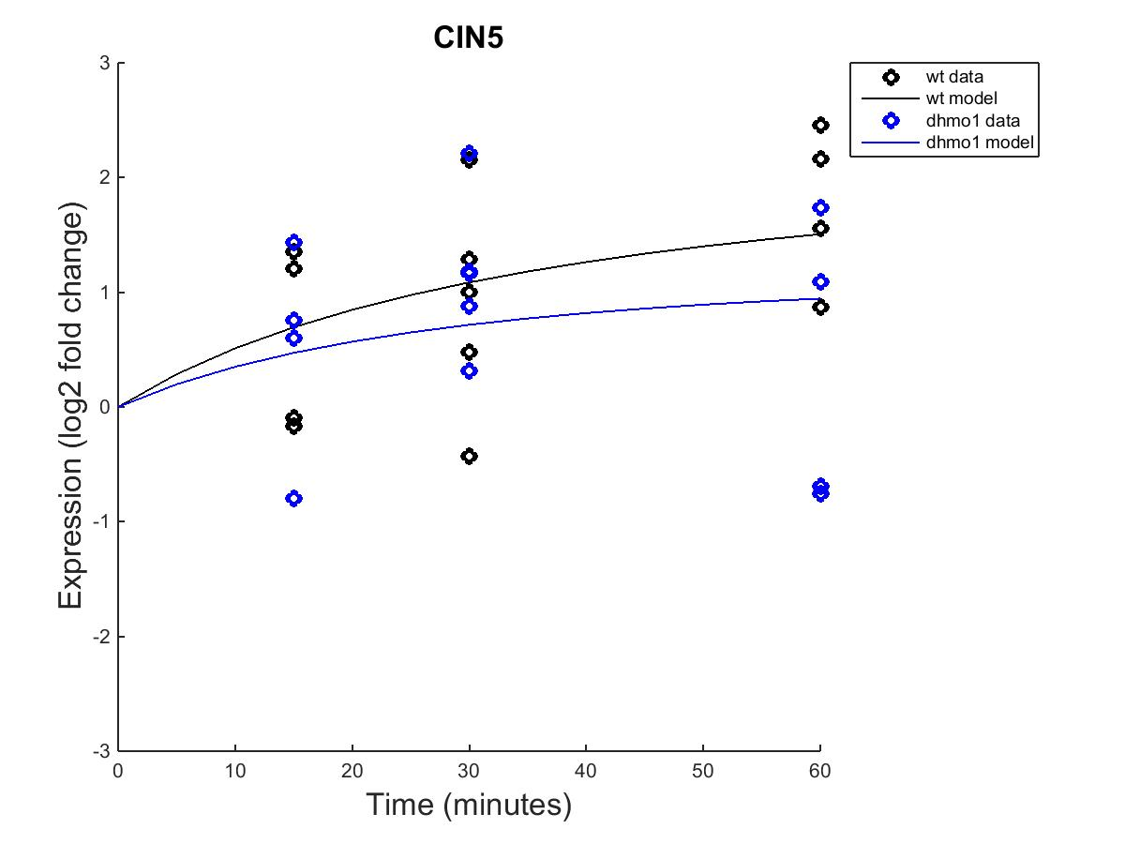
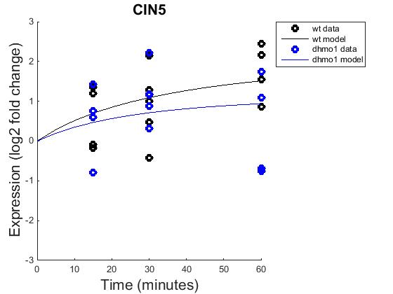
GRNmap model
Fixed b
Estimated b

Slide 43
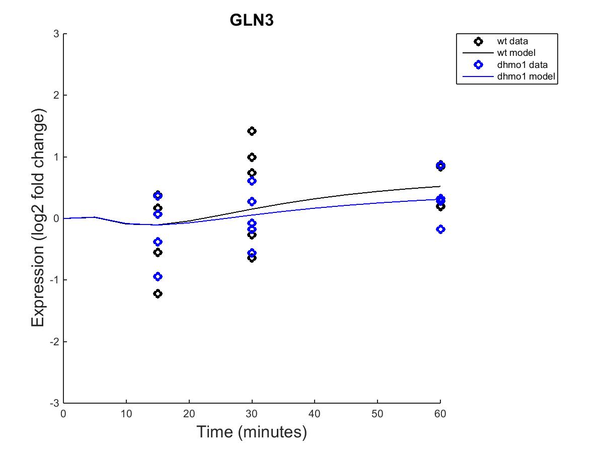
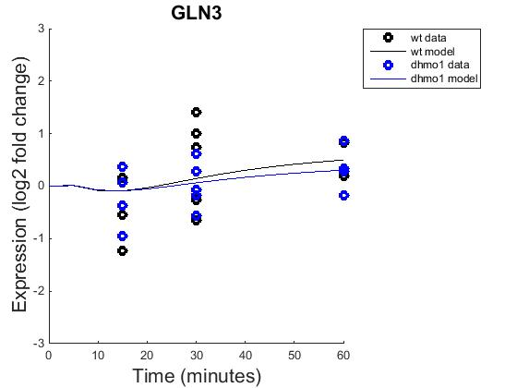
GRNmap model
Fixed b
Estimated b

Slide 44
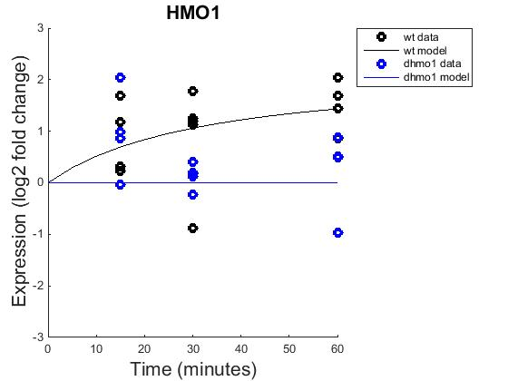

GRNmap model
Fixed b
Estimated b

Slide 45


Estimated vs. fixed b

