Slide 1
Synthetic approaches to transcription factor regulation and function
Tim Johnstone
BIOL1220
Spring 2010

Slide 2
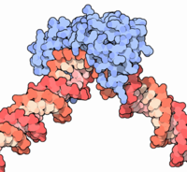
Transcription Factor
a protein that binds to specific DNA sequences to modulate the transcription of DNA to mRNA
Transcription factors bind to either enhancer or promoter regions of DNA adjacent to genes
Can as activators or repressors
Multiple TFs usually act on a single promoter/enhancer
Approximately 10% of genes in the human genome code for transcription factors
The transcription factor TATA binding protein (blue) bound to DNA (red). Image by David S. Goodsell

Slide 3

Structure
DNA-binding domain (DBD), which attach to specific sequences of DNA
Trans-activating domain (TAD), which contain binding sites for other proteins such as transcription coregulators.
Optional signal sensing domain (SSD) (e.g., a ligand binding domain), which senses external signals and in response transmit these signals to the rest of the transcription complex.
Typical layout of a TF

Slide 4
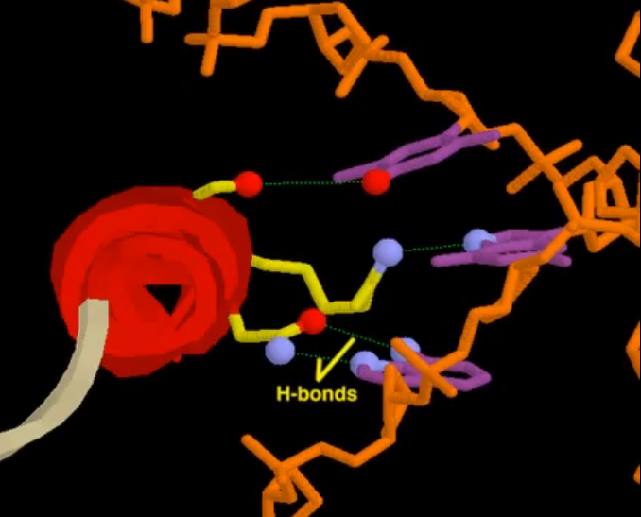
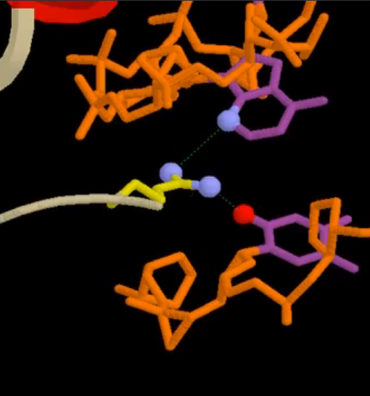
The Binding Domain
ex: Homeodomain
Amino acid R groups make sequence-specific contacts with DNA
Arginine residue in another loop of the protein contacts bases in the minor groove to anchor the protein

Slide 5
Mechanisms
Stabilize or block the binding of RNA polymerase to DNA
Catalyze the acetylation or deacetylation of histone proteins.
Recruit coactivator or corepressor proteins to the transcription factor DNA complex

Slide 6

Transcription Factor Mechanisms: p53

Slide 7

TF Mechanisms: MECP2

Slide 8
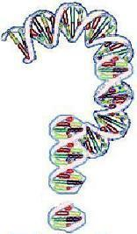
Why is this relevant to Synthetic biology??

Slide 9
Transcription Factors control almost every gene!
But how do we take advantage of this?

Slide 10
1) Change the transcription factor
2) Engineer a new transcription factor
3) Change the binding sites
4) Evolve a new promoter
5) Engineer a new promoter

Slide 11
1) Change the transcription factor
3) Change the binding sites

Slide 12
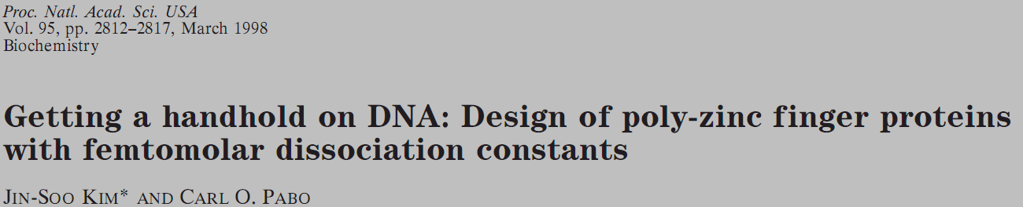
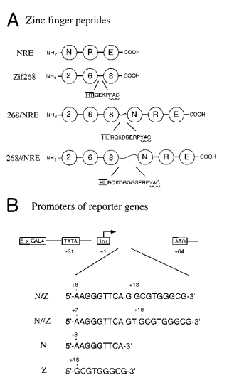
2 peptides: Zif268 and NRE
2 binding sites: N and Z
Zif 268 and NRE both contain Zinc Finger DBDs
Zif 268 and NRE are linked by a flexible linker sequence
Investigators created versions of the peptides and binding sites with longer linker sequences

Slide 13
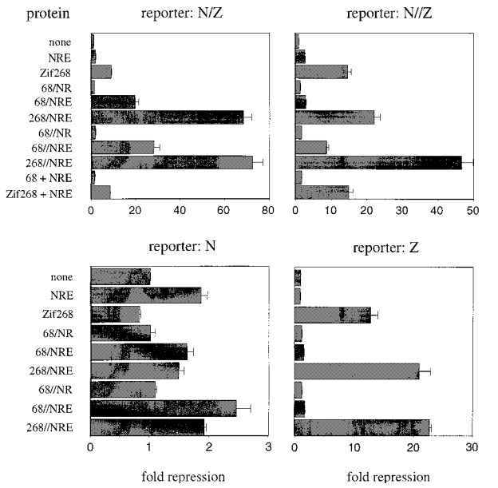
Results
“268//NRE peptide gives 72-fold repression of VP16-activated transcription at a promoter containing the N/Z site”
“Our peptides bind 6,000 to 90,000-fold more tightly than the original three-finger peptides”
“Longer linkers must relieve some strain that accumulates when a larger set of fingers all are connected with canonical linkers.”

Slide 14
2) Engineer a new transcription factor

Slide 15
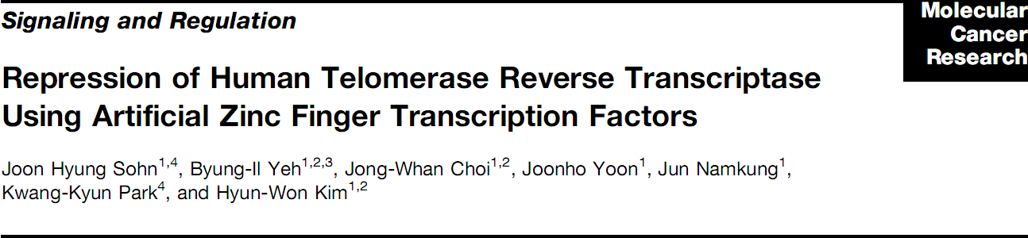

- Investigators created a synthetic transcription factor
HA – Epitope
NLS – Nuclear Localization Signal
ZFP – Zinc Finger Protein (4 zinc fingers)
KRAB – Repression domain
- TF was engineered to bind to a sequence in the hTERT promoter

Slide 16
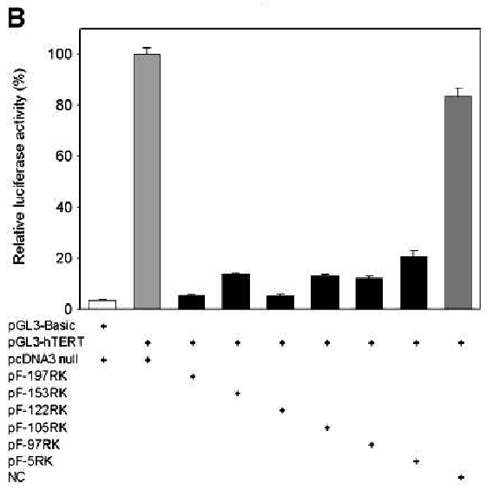
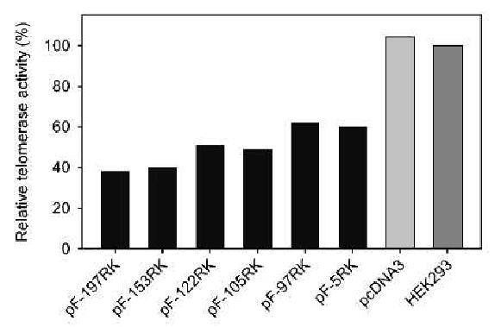
In trials with luciferase, the synthetic transcription factor repressed activity by ~80-95%
In HEK293 cells, telomerase activity was significantly reduced and cell growth was slowed

Slide 17
4) Evolve a new promoter

Slide 18
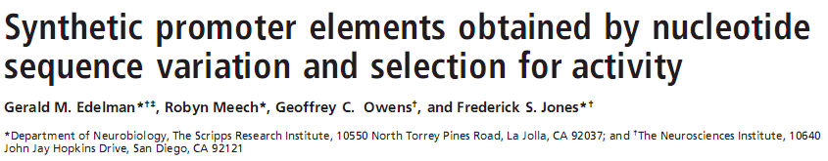
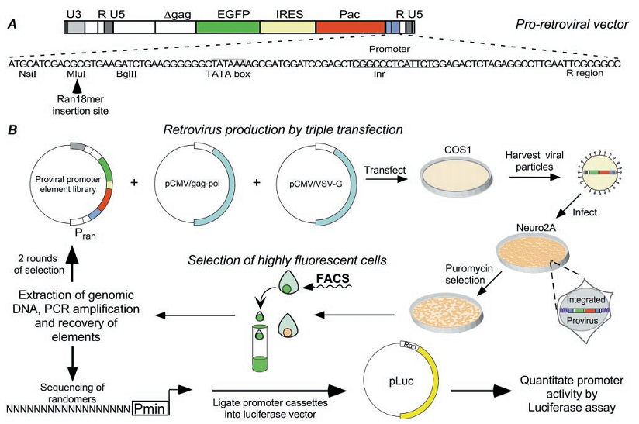

Slide 19
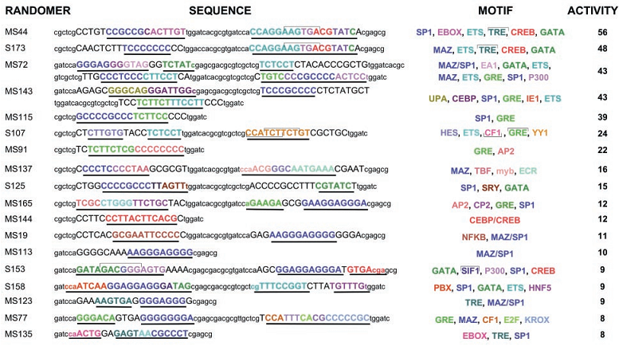
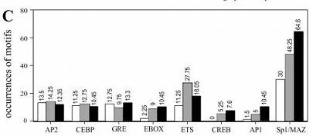
Results
120/480 selected 18-mers exceeded 4-fold activity
Discovered brand new binding motifs

Slide 20
5) Engineer a new promoter

Slide 21
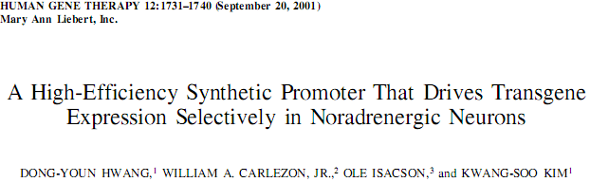
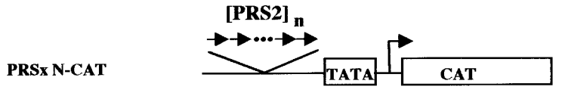
Investigators created a synthetic DBH (dopamine beta hydroxylase) promoter
Active specifically in NA neurons
Promoter contains:
TATA box
PRS2 (Phox2 response sites)
CAT reporter gene

Slide 22
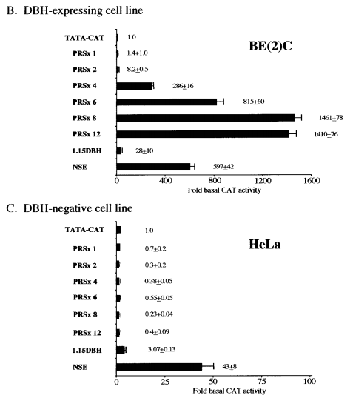
50-fold increase in reporter activity with synthetic promoter
Less nonspecific, “leaky” transcription

Slide 23
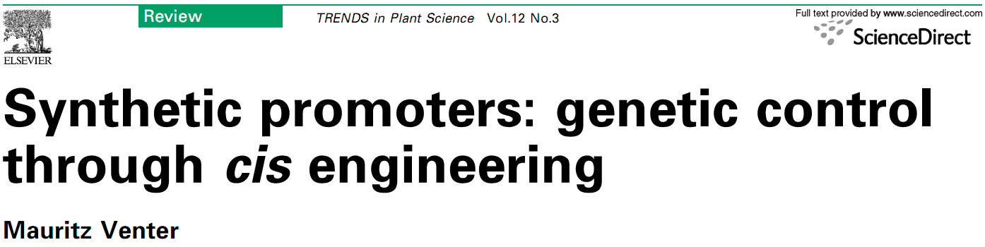
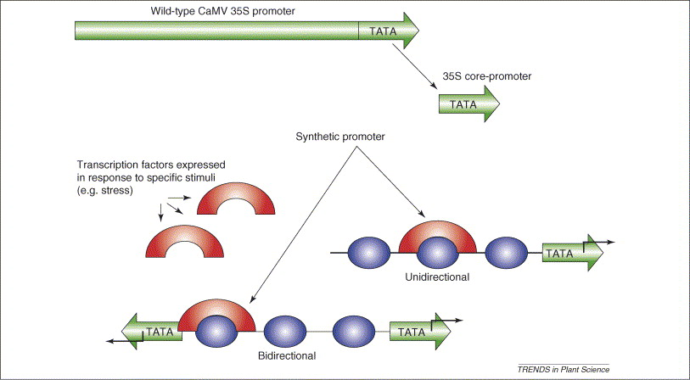
Simplified representation of a plant synthetic promoter

Slide 24
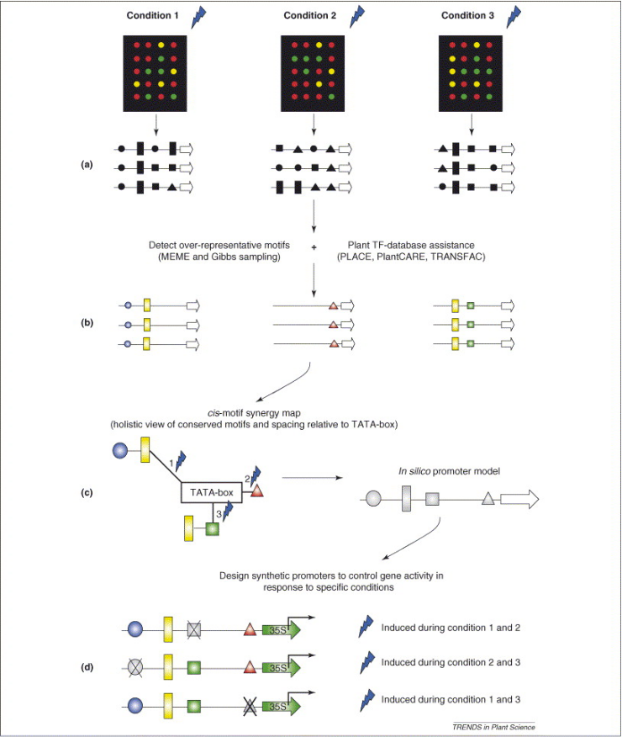
Combinatorial cis-motif engineering for the accurate design of synthetic promoters

