Slide 1
Percentages of specific p-value data
Table 1: Bonferroni-adjusted p-value proved most selective with 3.68% while, as expected, the other data became more specific as the p-value became more stringent
ANOVA | WT | dZAP1
p < 0.05 | 2378/6189 (31.42%) | 2264/6189 (36.58%)
p < 0.01 | 1527/6189 (24.67%) | 1445/6189 (23.35%)
p < 0.001 | 860/6189 (13.90%) | 792/6189 (12.80%)
p < 0.0001 | 460/6189 (7.43%) | 414/6189 (6.69%)
B-H p < 0.05 | 1656/6189 (26.76%) | 1538/6189 (24.85%)
Bonferroni p < 0.05 | 228/6189 (3.68%) | 192/6189 (3.10%)
Notes:
From Excel data/calculations

Slide 2
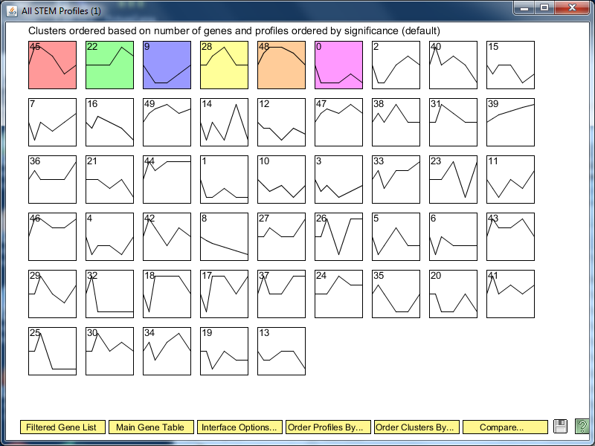
Overall STEM Profile Results for Wild Type

Slide 3
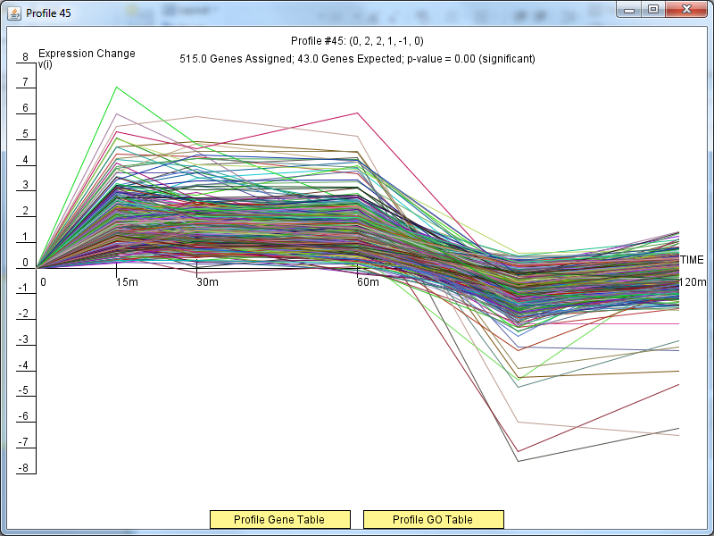
Profile 45 Results

Slide 4
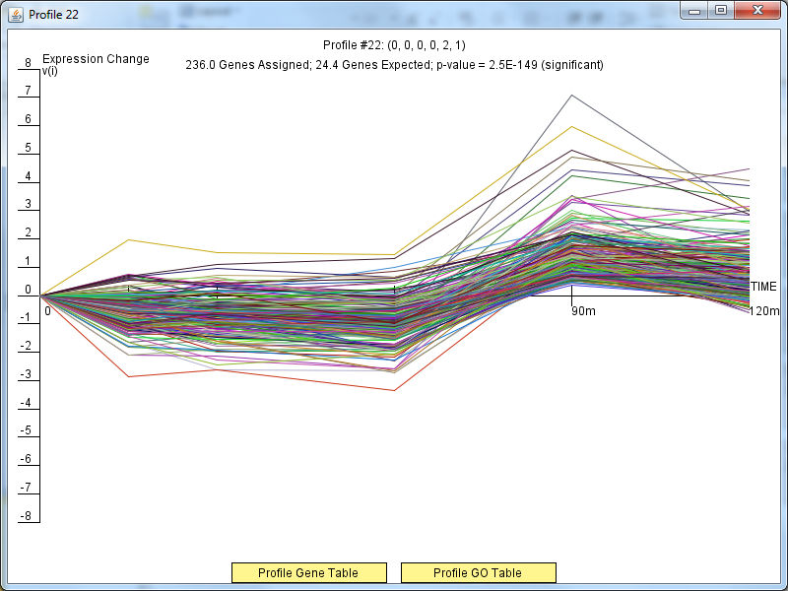
Profile 22 Results

Slide 5
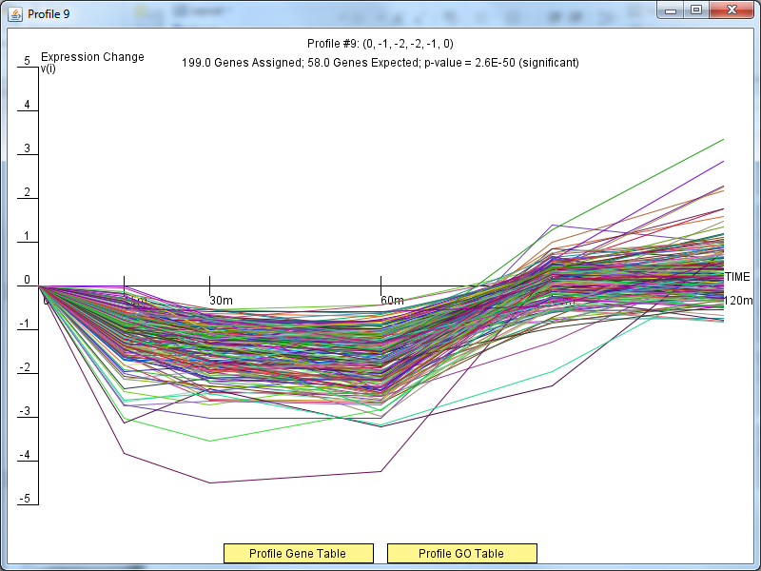
Profile 9 Results

Slide 6
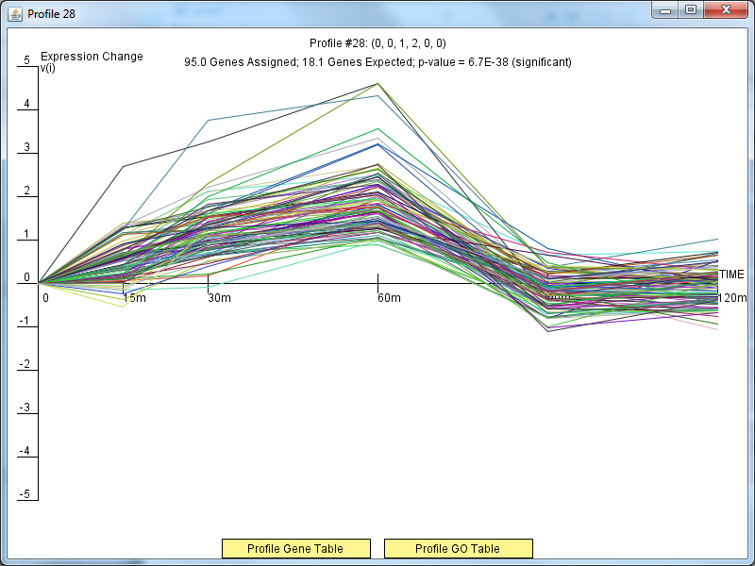
Profile 28 Results

Slide 7
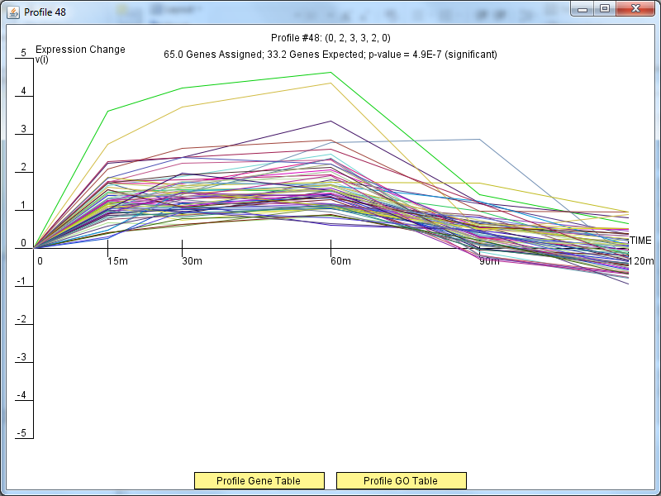
Profile 48 Results

Slide 8
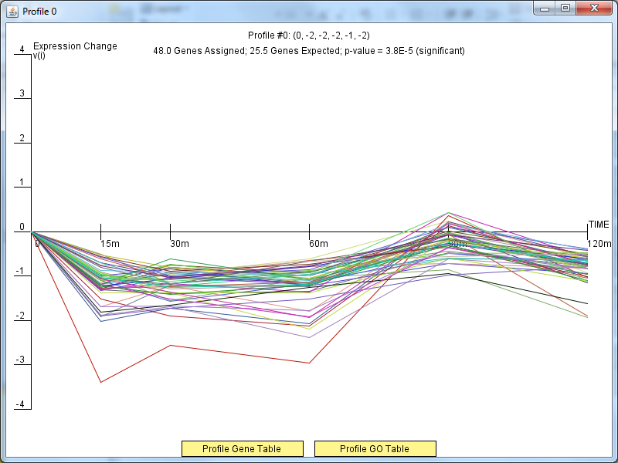
Profile 0 Results

Slide 9
DNA Binding And Expression Degree Distribution

Slide 10
DNA Binding Plus Expression Degree Distribution

Slide 11
Only DNA Binding Degree Distribution

Slide 12
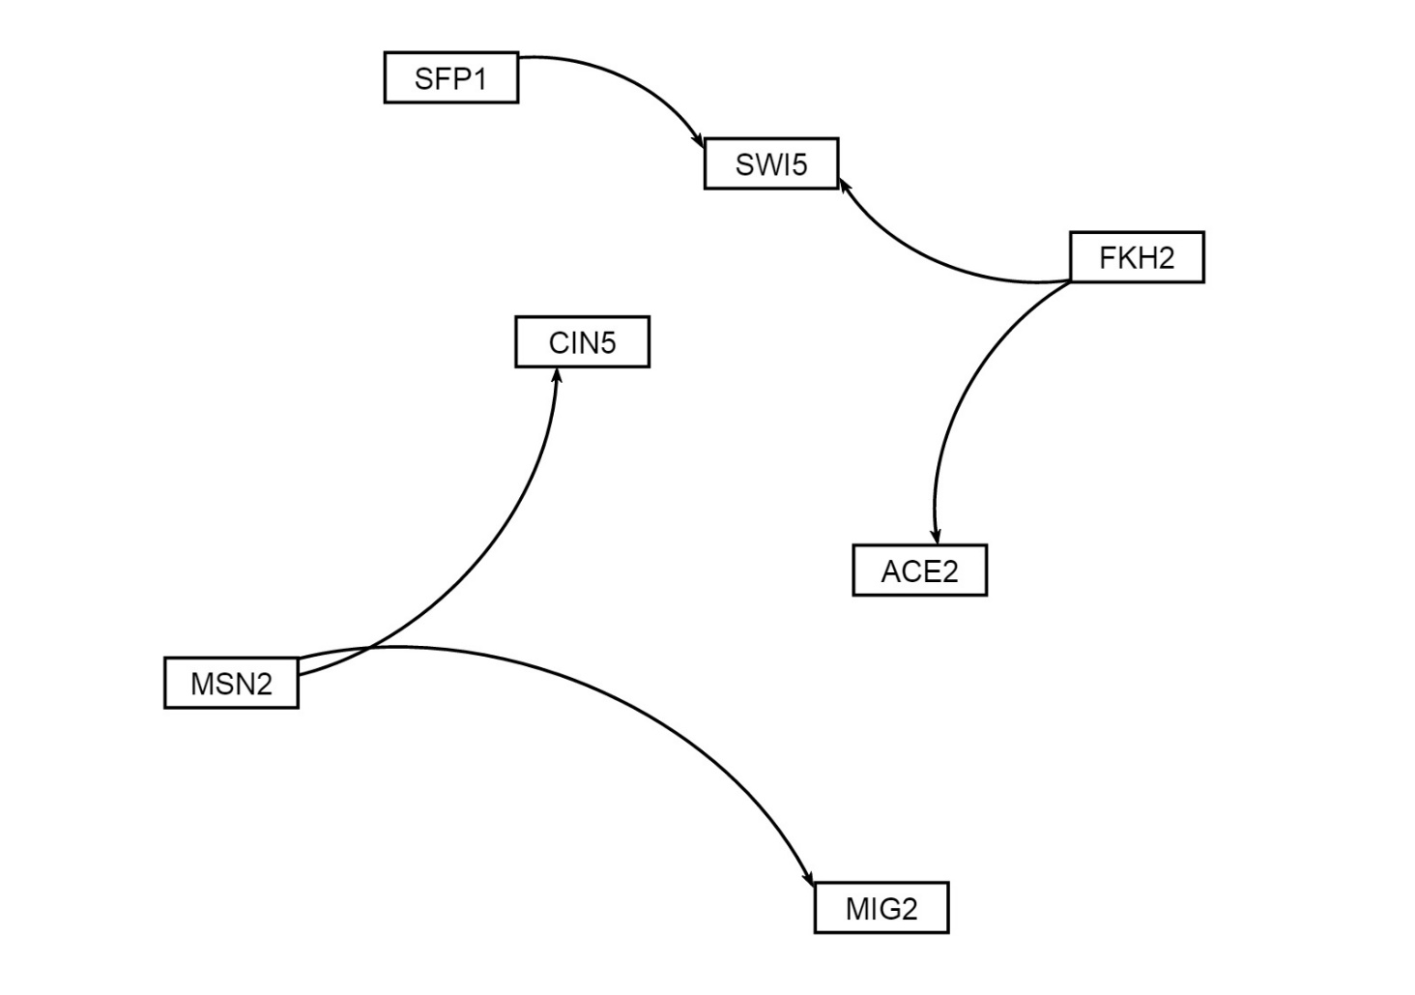
Gene regulatory network for matrix of binding AND expression (5 edges)

Slide 13
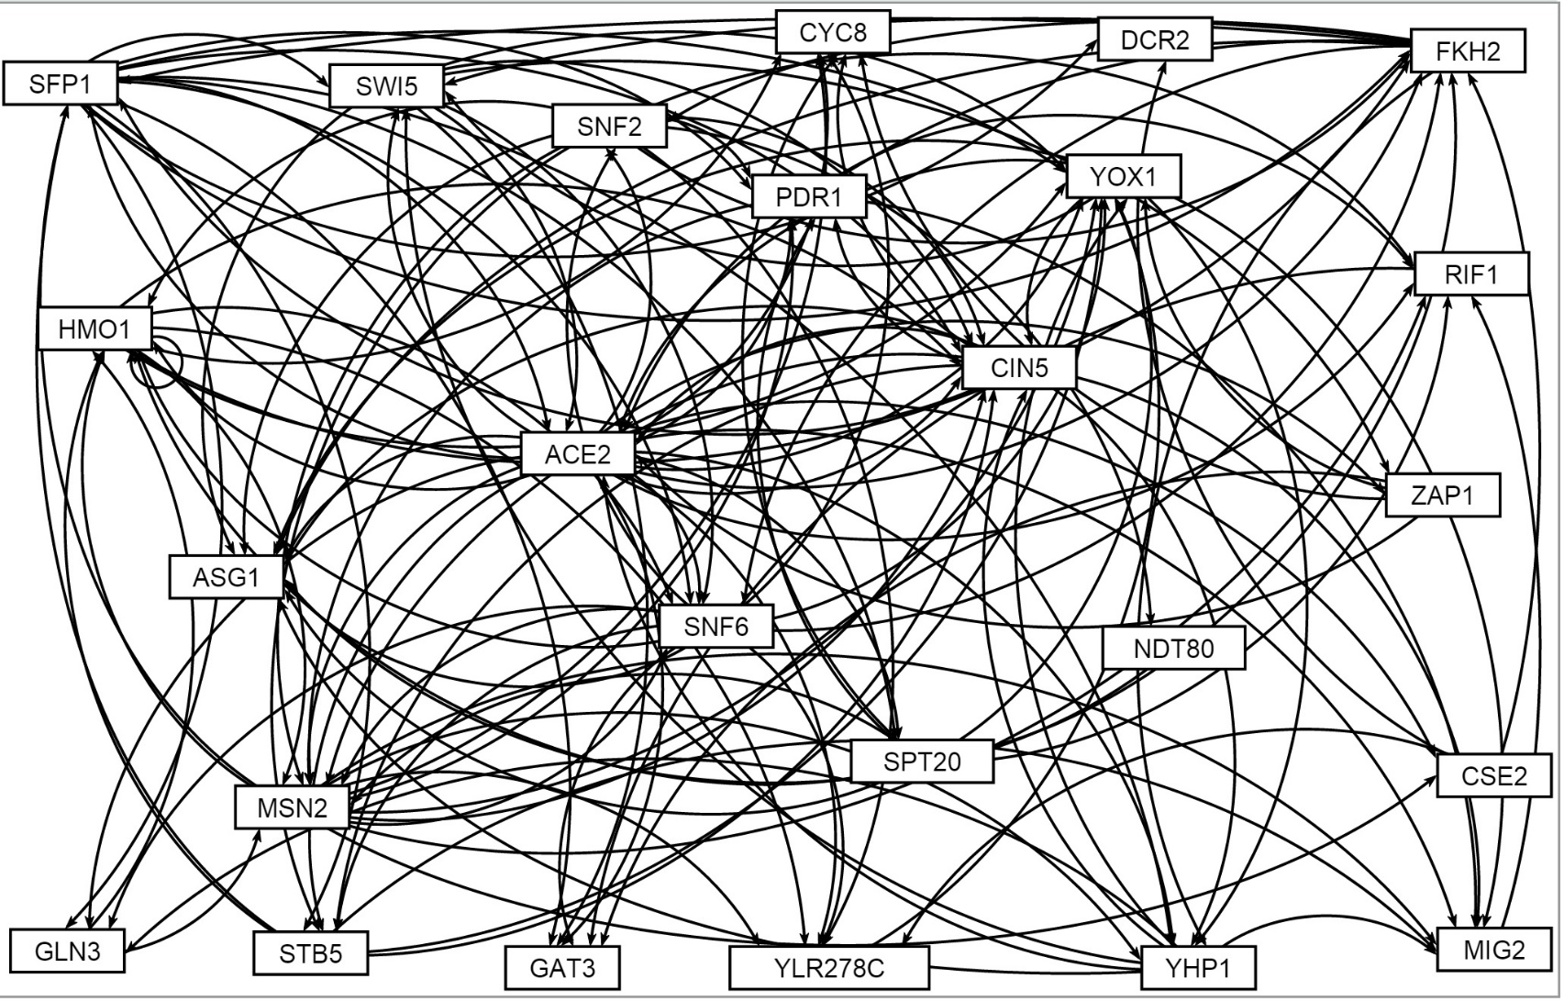
Gene regulatory network for documented binding PLUS expression (141 edges)

Slide 14
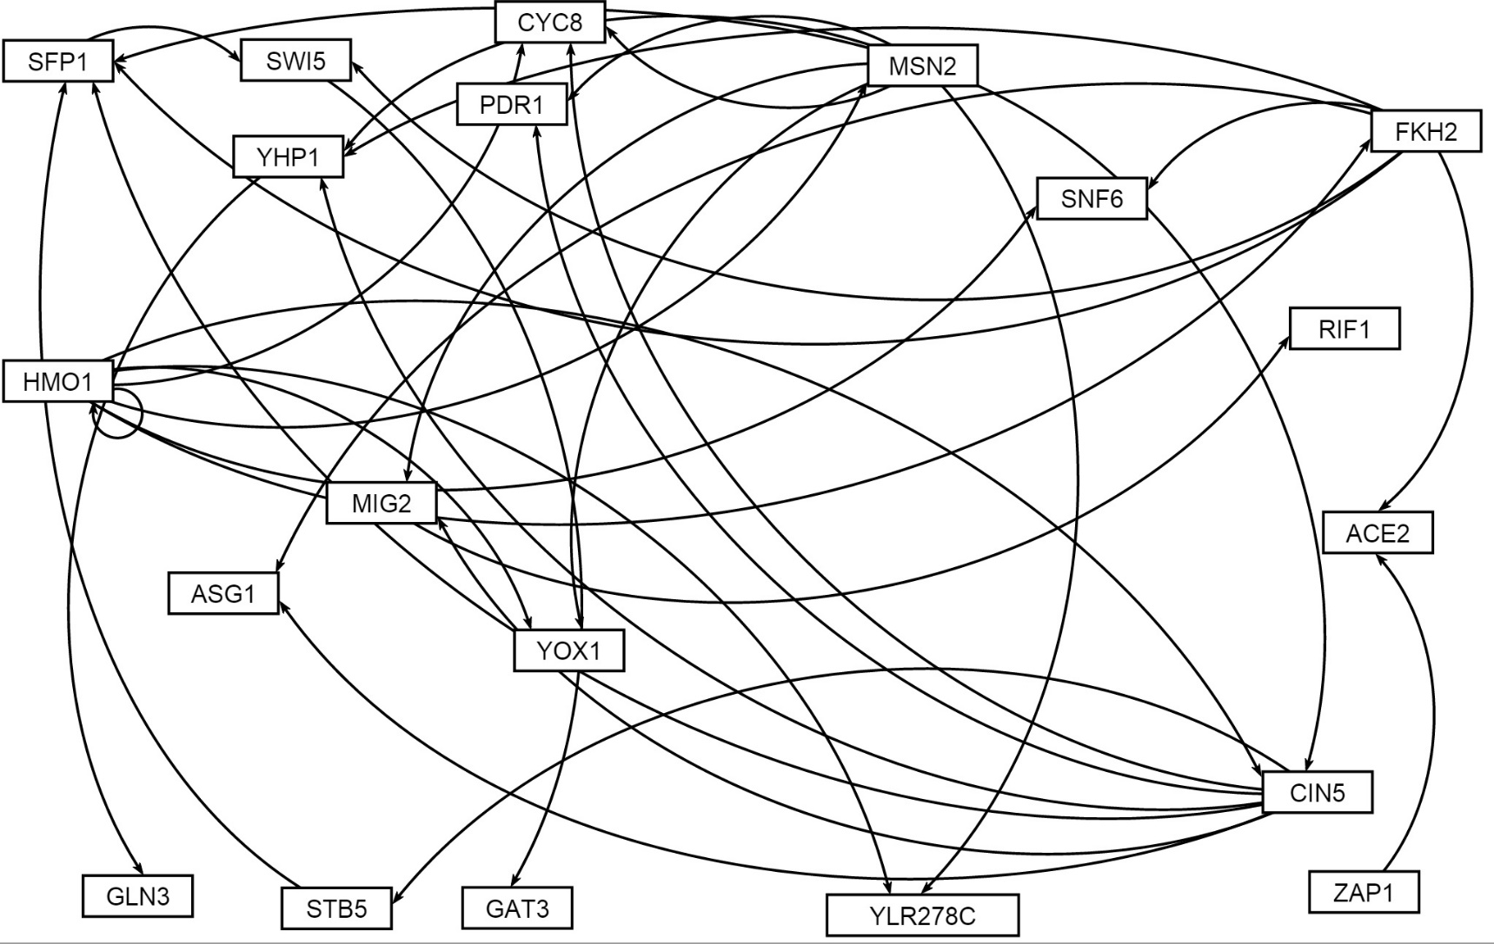
Gene regulatory network for DNA binding ONLY (35 edges)

