Slide 1
Week 14 Assignment
Kara Dismuke

Slide 2
MATLAB Counter (fixed b)

Slide 3
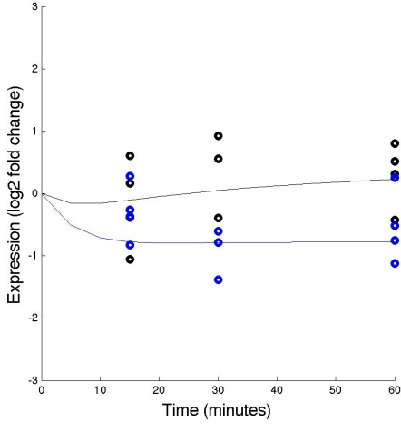
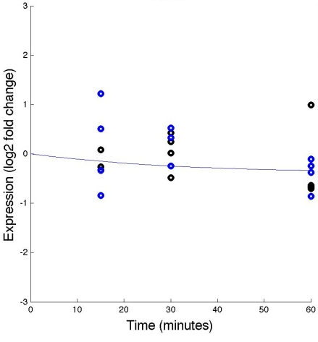
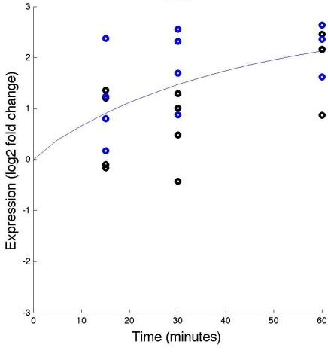
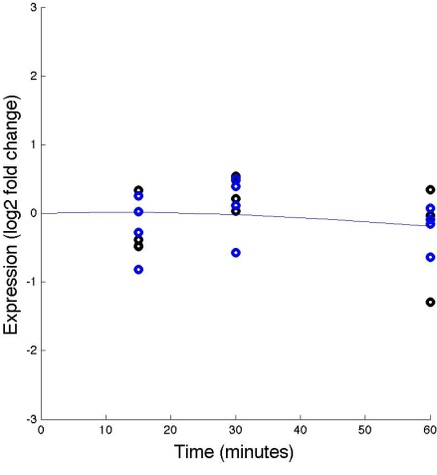
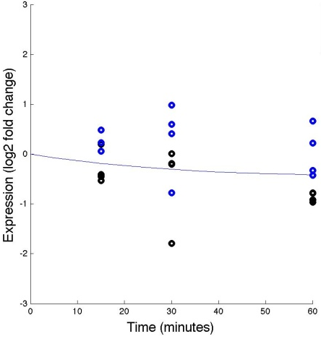
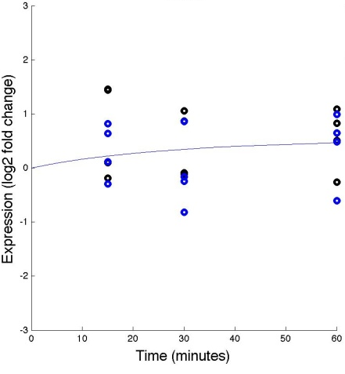
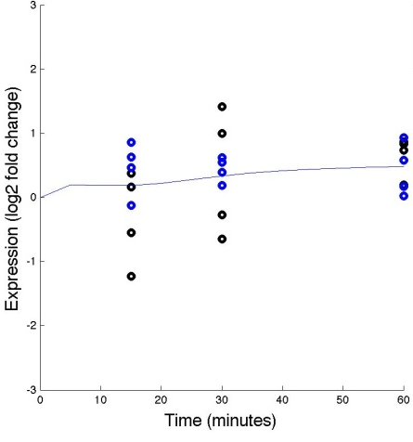
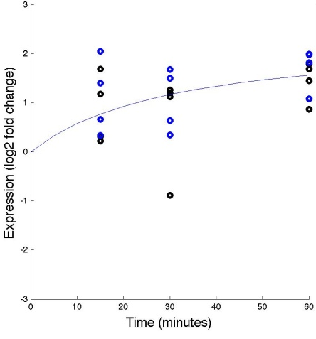
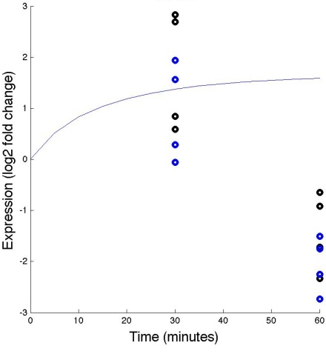
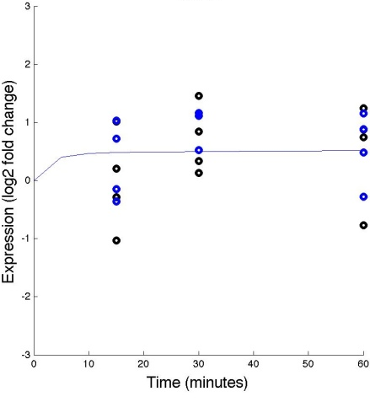

Effects of WT &dZAP1 on expressions of various genes (with fixed b)
ACE2
ASG1
CIN5
CYC8
FKH2
GAT3
GLN3
HMO1
MIG2
MSN2

Slide 4
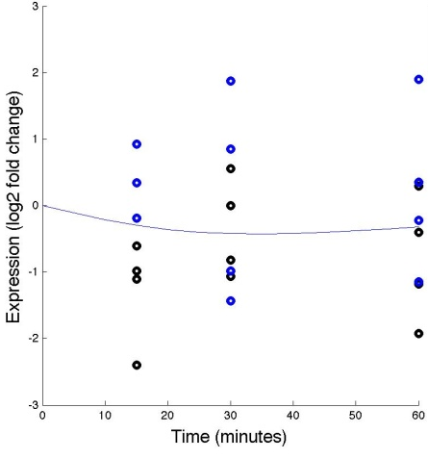
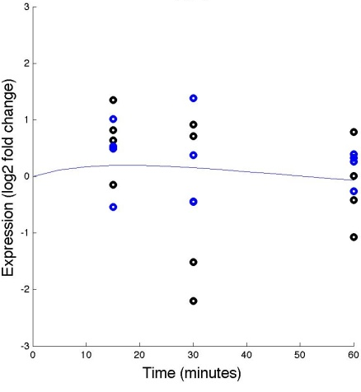
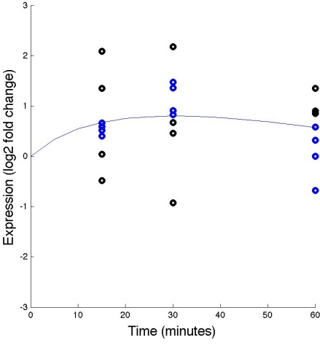
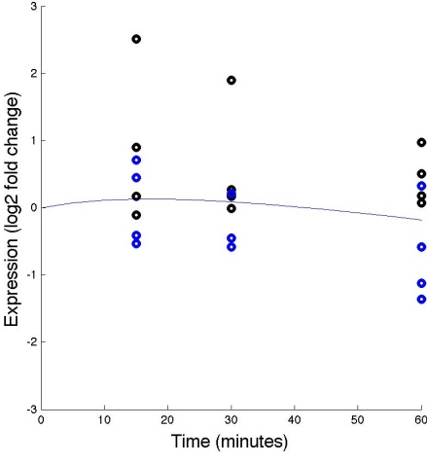
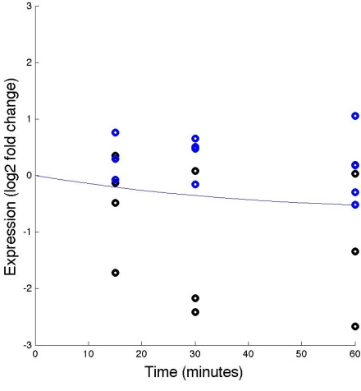
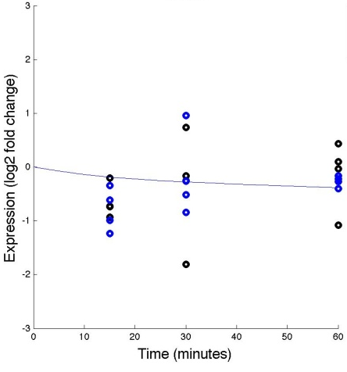
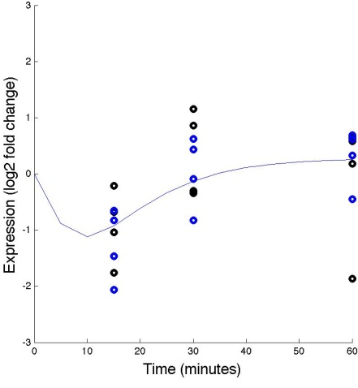
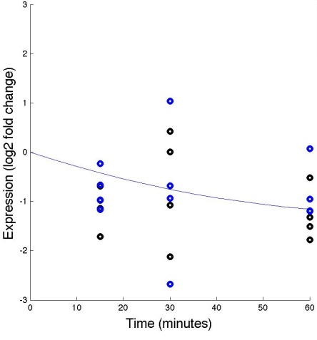
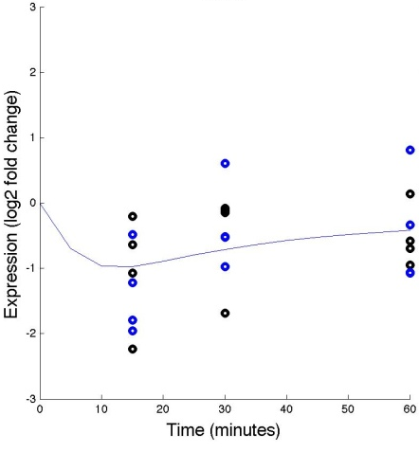
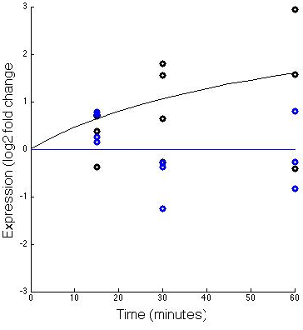
Effects of WT &dZAP1 on expressions of various genes (with fixed b)
PDR1
RIF1
SFP1
SNF6
STB5
SWI5
YHP1
YLR278C
YOX1
ZAP1

Slide 5
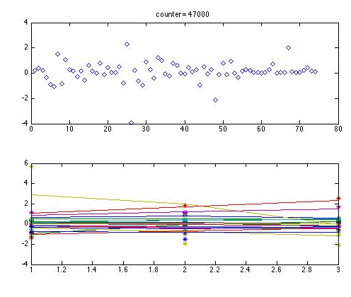
MATLAB Counter (estimated b)

Slide 6
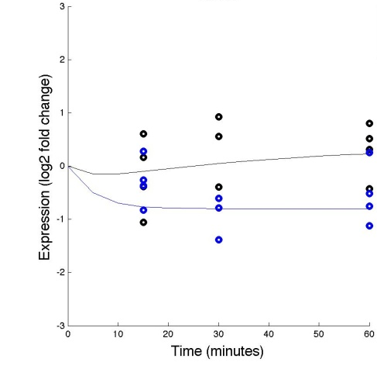


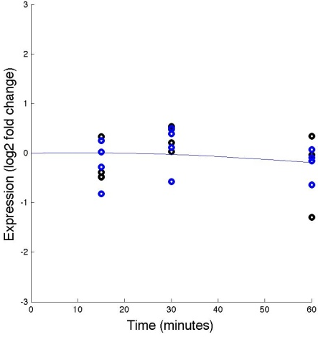
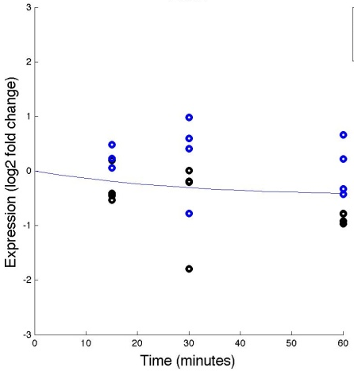



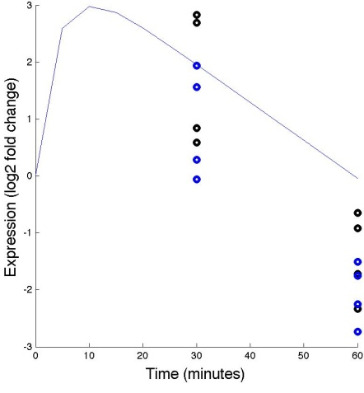
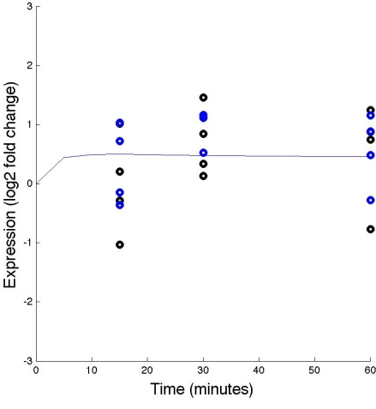
Effects of WT &dZAP1 on expressions of various genes (with estimated b)
ACE2
ASG1
CYC8
CIN5
FKH2
GAT3
GLN3
HMO1
MSN2
MIG2
Notes:
CHANGE

Slide 7
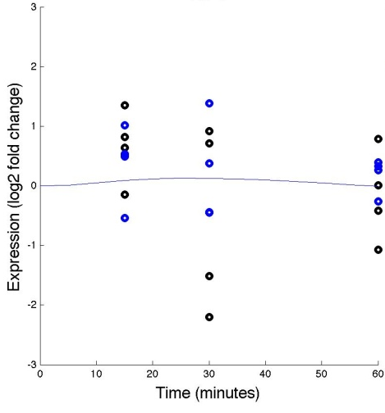

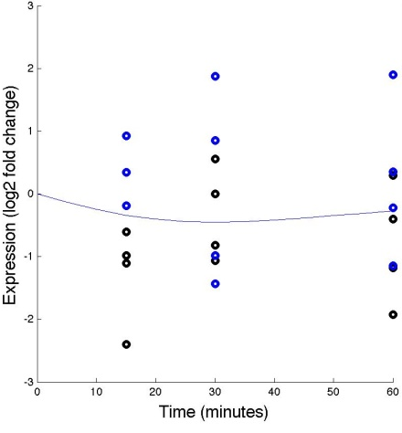
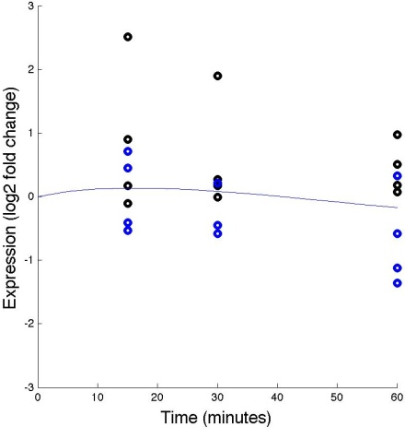
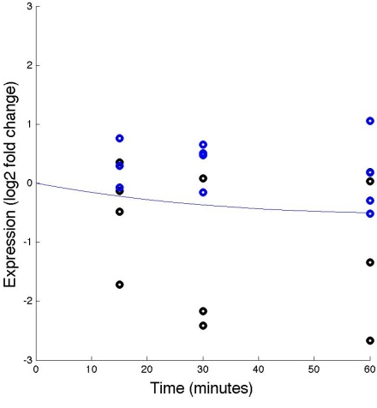


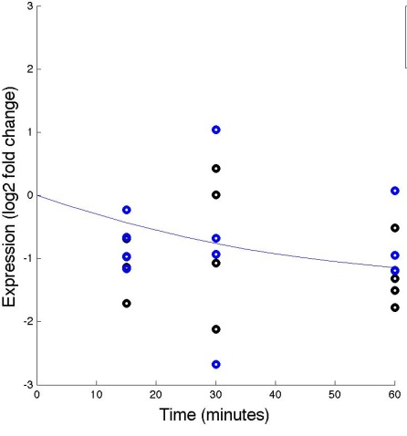


Effects of WT &dZAP1 on expressions of various genes (with estimated b)
PDR1
RIF1
SNF6
SFP1
STB5
SWI5
YHP1
YLR278C
YOX1
ZAP1
Notes:
CHANGE

Slide 8
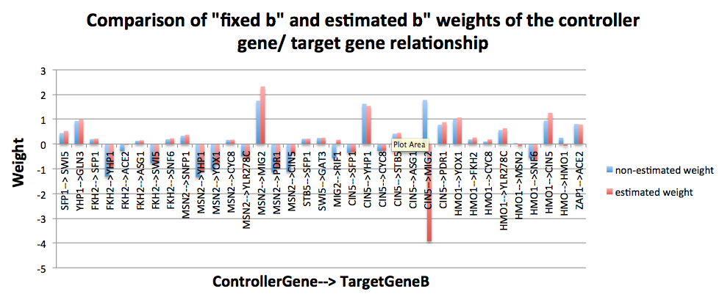

Slide 9
Notes:
Note there is a column for NDT80, but this is because after I corrected by input workbooks (ASG1 instead of NDT80), MALAB failed to generate the output workbooks properly. Thus, I couldn’t take these new production rates and create a new graph. Keep in mind the only thing that is wrong is the presence of bars of NDT80 data instead of ASG1 data. Thus, we will be sure to use Kristen’s graph for this.

Slide 10
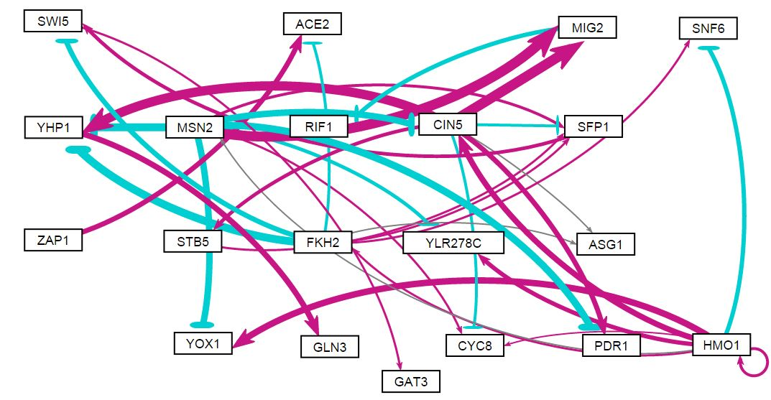
GRNsight Generated Network (fixed b)
More descriptive title?

Slide 11
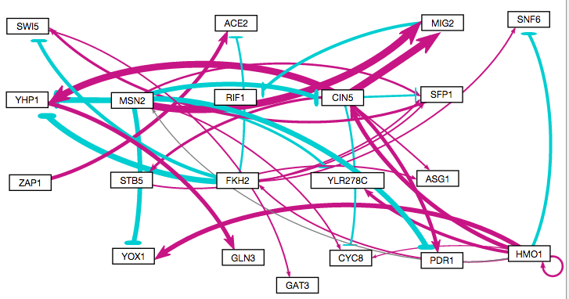
GRNsight Generated Network (estimated b)
More descriptive title?

