Slide 1
Tissue Culture
Mod1 Day6
Thursday Sept 25th

Slide 3
Today’s Lab: part 1
Restriction Map
While your gel runs you’ll discuss RAD51 paper

Slide 4
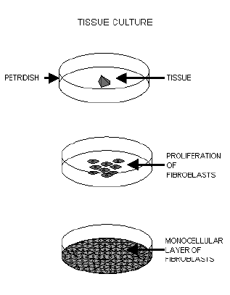
Today’s Lab: part 2
TC for fun

Slide 5
Grow mammalian vs bacterial cells
For both need:
For bacteria:
Tryptone, yeast extract, salt +/- antibiotic, agar
For MES cells: DMEM, calf serum, glutamine, penn/strep

Slide 6
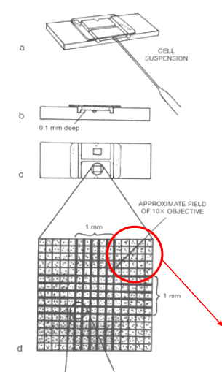
Figuring out how many cells you have

Slide 7
Things to do for next time
Submit lab report by email before the start of lecture
Read Mod1 Day7 + do calculations for experiment
Answer one hypothetical question about doubling times + cell #

