Slide 1
Amino Acid Sequences in V3 Loop Conformation
Alex Cardenas, Bobby Arnold and Zeb Russo
Loyola Marymount University Department of Biology
BIO 398 11/02/11

Slide 2
Outline
CD4 T cell count is a trait in developing AIDs ( >200 safe, <200 AIDs).
Differing CD4 T cell count is correlated with conservation in amino acid sequences.
Usage of Star Biochem to Answer our Question
BioWorkbench used to create multiple sequence alignments
Results obtained from multiple sequence were observed and analyzed.
Discussion and thoughts of our findings are shared.

Slide 3
Outline
CD4 T cell count is a trait in developing AIDs ( >200 safe, <200 AIDs).
Differing CD4 T cell count is correlated with conservation in amino acid sequences.
Usage of Star Biochem to Answer our Question
BioWorkbench used to create multiple sequence alignments
Results obtained from multiple sequence were observed and analyzed.
Discussion and thoughts of our findings are shared.

Slide 4
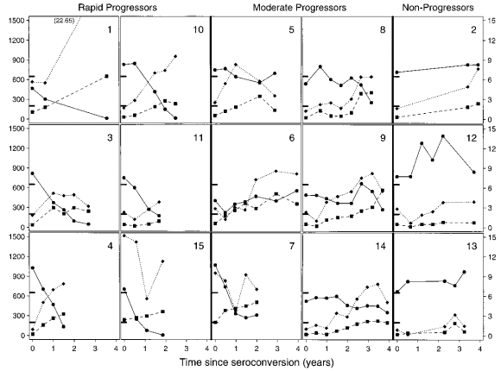
CD4 T cell count is an trait in developing AIDs ( >200 safe, <200 AIDs)
Observations led us to conclude that CD4 T cell counts were crucial in developing AIDs.
Rapid Progressors – 1, 3, 4, 10, 11, 15.
Controls
Moderate progressor – 6.
Non Progessor – 13.

Slide 5
Outline
CD4 T cell count is a trait in developing AIDs ( >200 safe, <200 AIDs).
Differing CD4 T cell count is correlated with conservation in amino acid sequences.
Usage of Star Biochem to Answer our Question
BioWorkbench used to create multiple sequence alignments
Results obtained from multiple sequence were observed and analyzed.
Discussion and thoughts of our findings are shared.

Slide 6
CD4 T cell count and relationship to V3 loop amino acid sequence
We were interested in the amino acid sequences of AIDs subjects.
Our question
Is there a conserved region in the V3 loop sequence that led the subject to develop AIDs?

Slide 7
Outline
CD4 T cell count is a trait in developing AIDs ( >200 safe, <200 AIDs).
Differing CD4 T cell count is correlated with conservation in amino acid sequences.
Usage of Star Biochem to Answer our Question
BioWorkbench used to create multiple sequence alignments
Results obtained from multiple sequence were observed and analyzed.
Discussion and thoughts of our findings are shared.

Slide 8
Usage of Star Biochem and to Answer our Question
Star Biochem was used to determine the location and structure of the V3 loop region
ProtParam was considered as a tool to use, however all the variable regions were determined to be coils so therefore was not necessary

Slide 9
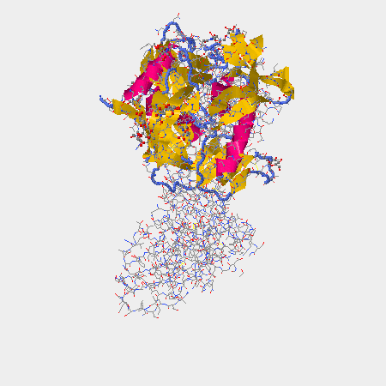
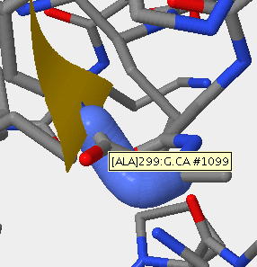
gp120 Secondary Structure Using Star Biochem Kwong et. al
V3 region

Slide 10
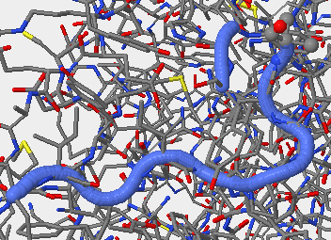
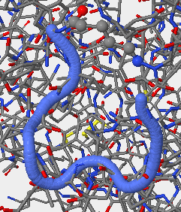
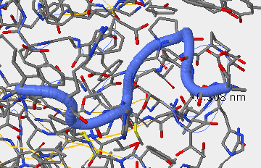
V3 region Secondary Structure Stanfield et. al
1F58 313-325
2F58 315-324
1NAK 312-323

Slide 11
Stanfield et. al 2ndary Structure not useful in our examination of Markham data
Stanfield data composed of 12-14 amino acid chains
Markham data composed of 94-95 amino acid chains

Slide 12
Outline
CD4 T cell count is a trait in developing AIDs ( >200 safe, <200 AIDs).
Differing CD4 T cell count is correlated with conservation in amino acid sequences.
Usage of Star Biochem to Answer our Question
BioWorkbench used to create multiple sequence alignments
Results obtained from multiple sequence were observed and analyzed.
Discussion and thoughts of our findings are shared.

Slide 13
BioWorkbench used to create multiple sequence alignments
Each rapid progressor subject had a clone randomly chosen from their first and last visit
Control subjects had one clone randomly selected from last visit.
Each rapid progressor had their two sequences aligned
Control subjects were aligned with each other
All rapid progressor last visits were aligned with and without a control sequence

Slide 14
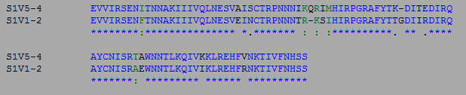
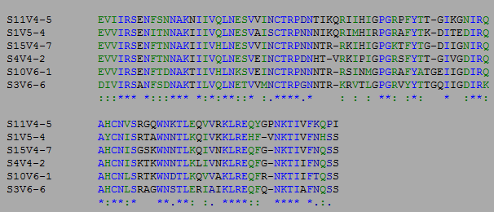
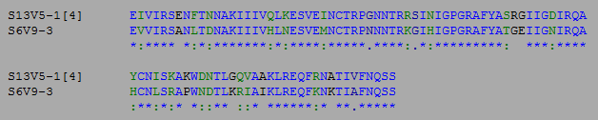
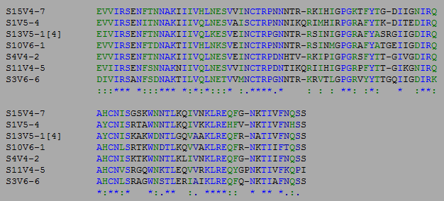
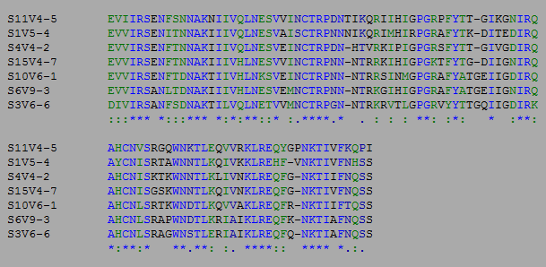
ClustalW Multiple Sequence Alignment Results
Single Subject Alignments
Multiple Subject Alignments

Slide 15
Outline
CD4 T cell count is a trait in developing AIDs ( >200 safe, <200 AIDs).
Differing CD4 T cell count is correlated with conservation in amino acid sequences.
Usage of Star Biochem to Answer our Question
BioWorkbench used to create multiple sequence alignments
Results obtained from multiple sequence were observed and analyzed.
Discussion and thoughts of our findings are shared.

Slide 16
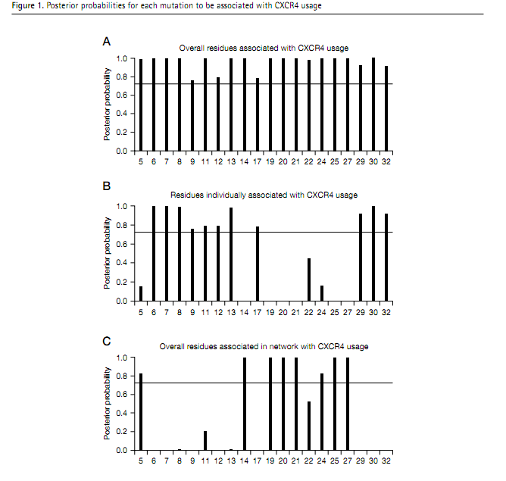

Slide 17
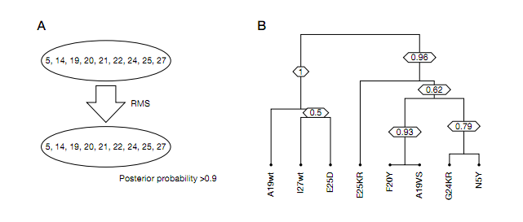

Slide 18
