Slide 1
Table 1: Number of genes with expression significantly different from zero for within-strain ANOVA tests of wt and dHAP4
Within Strain ANOVA | WT | dHAP4
p < 0.05 | 2377 (38.4%) | 2387 (38.6%)
p < 0.01 | 1531 (24.7%) | 1489 (24.1 %)
p < 0.001 | 850 (13.8%) | 679 (11.0%)
p < 0.0001 | 449 (7.25%) | 240 (3.88%)
B & H p < 0.05 | 1673 (27.0%) | 1615 (26.1%)
Bonferroni p < 0.05 | 226 (3.65%) | 61 (0.986%)

Slide 2
Table 2: Number of genes with significantly different expression for within-strain t-test
dHAP4 | Cold Shock |  | Recovery
t test | t₁₅ | t₃₀ | t₆₀ | t₉₀ | t₁₂₀
Average Log Fold Change > 0.25 and p < 0.05 | 690 (11.1%) | 947 (15.3%) | 1028 (16.6%) | 141 (2.28%) | 289 (4.67%)
Average Log Fold Change < -0.25 and p < 0.05 | 501 (8.10%) | 814 (13.2%) | 967 (15.6%) | 83 (1.34%) | 216 (3.49%)
Total p < 0.05 | 1197 (19.3%) | 1772 (28.6%) | 2006 (32.4%) | 234 (3.78%) | 515 (8.32%)
Total B & H p < 0.05 | 2 (0.03%) | 108 (1.75%) | 241 (3.89%) | 0 (0%) | 0 (0%)
Total Bonferroni p < 0.05 | 2 (0.03%) | 0 (0%) | 1 (0.02%) | 0 (0%) | 0 (0%)

Slide 3
Table 3: Number of genes with significantly different expression for between-strain ANOVA test
Between Strain ANOVA | p<0.05 | B-H p<0.05
wt vs. dCIN5 | 563 | 4
wt vs. dGLN3 | 720 | 36
wt vs. dHAP4 | 640 | 23
wt vs. dHMO1 | 556 | 5
wt vs. dZAP1 | 553 | 31
wt vs. spar | 1498 | 703

Slide 4
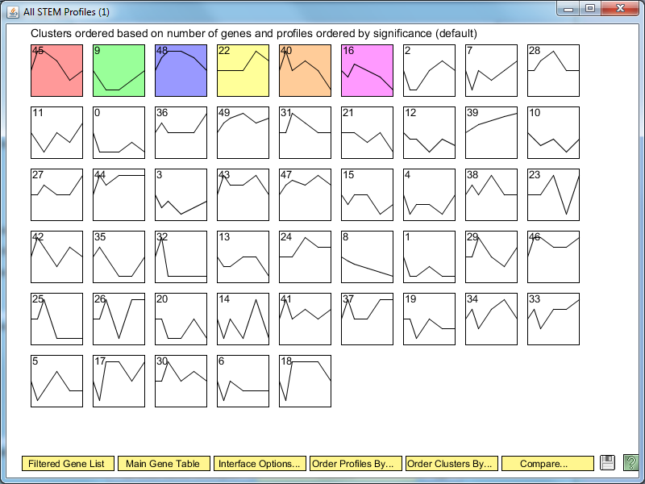
Figure 1: STEM profiles generated from dHAP4 LogFC expression

Slide 5
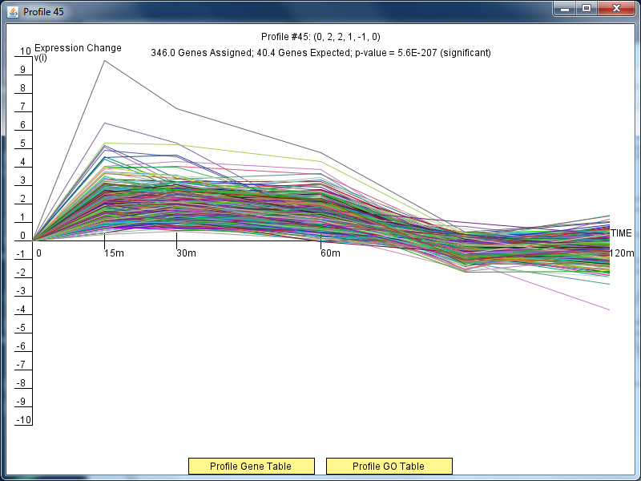

Slide 6
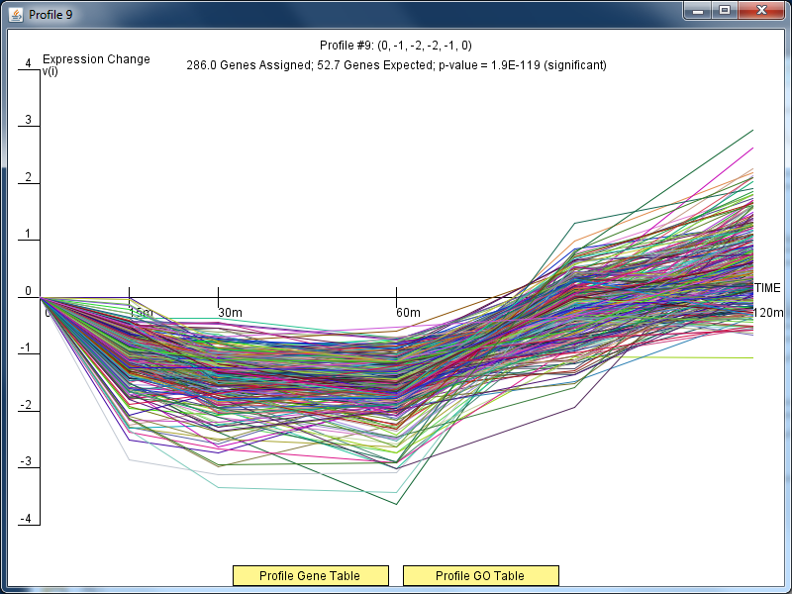

Slide 7
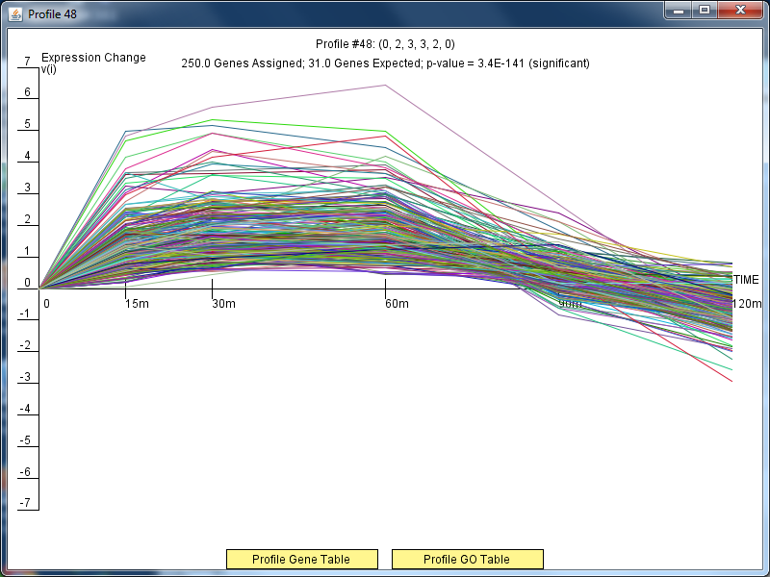

Slide 8
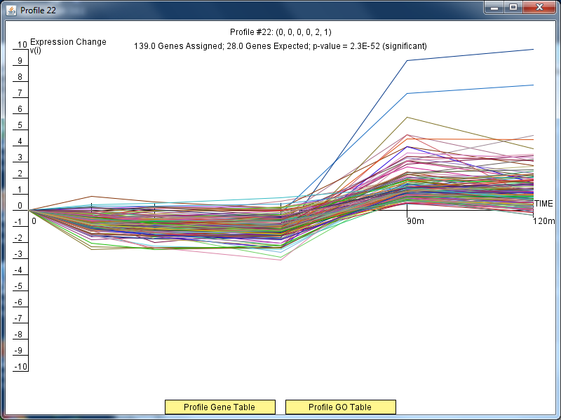

Slide 9
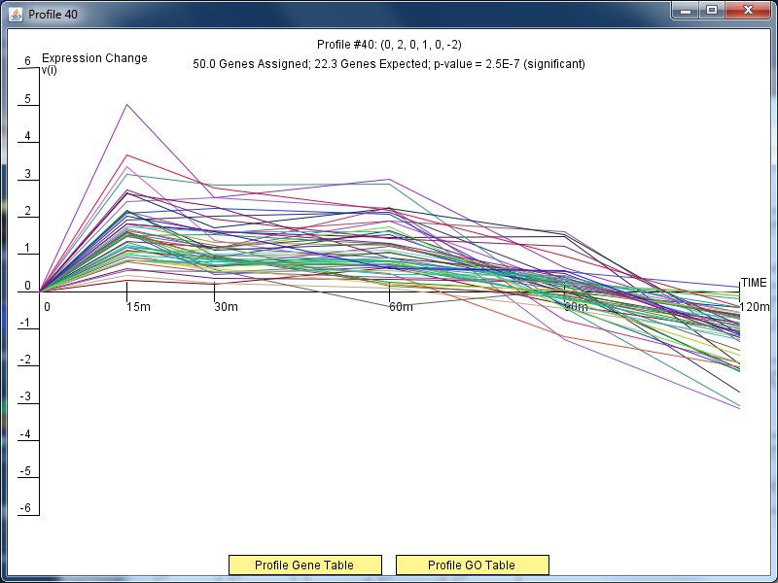

Slide 10
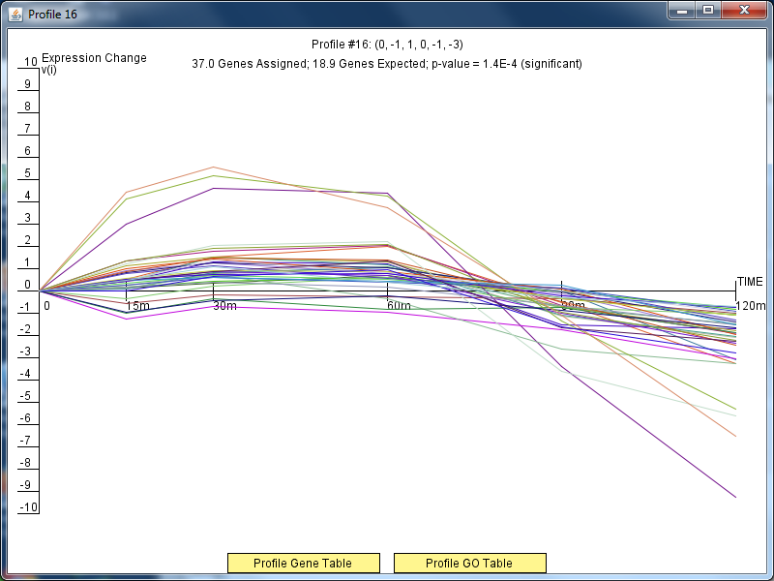

Slide 11
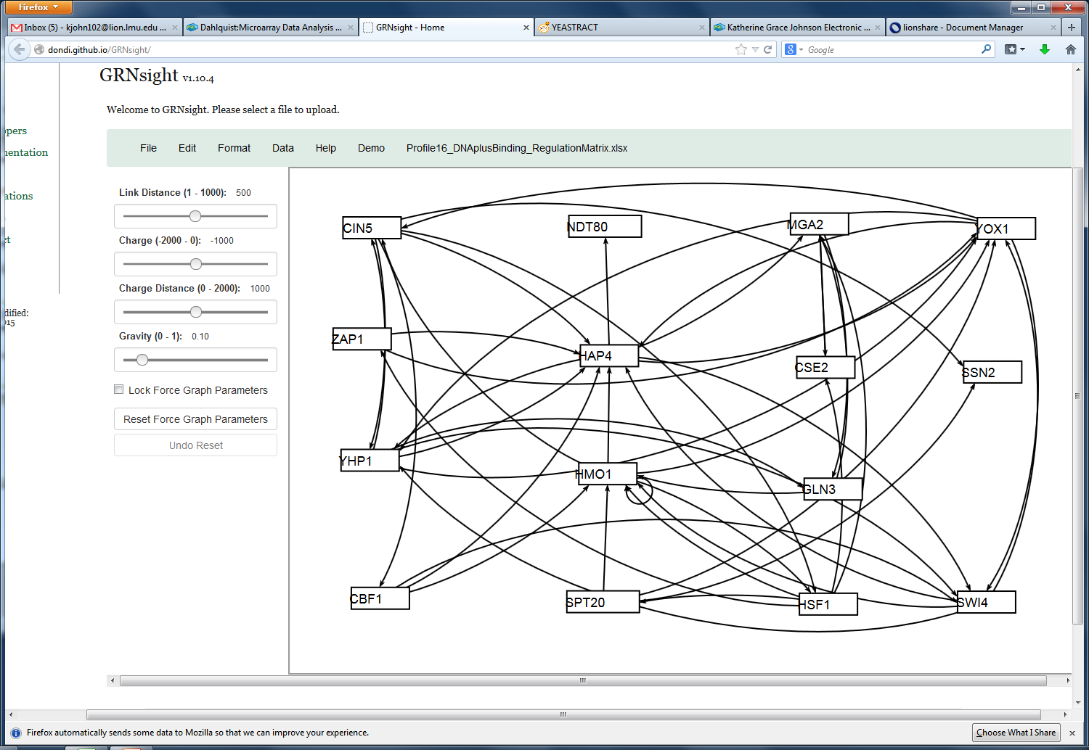
Profile 16 Regulation Network for DNA plus Binding (Most connected)

Slide 12
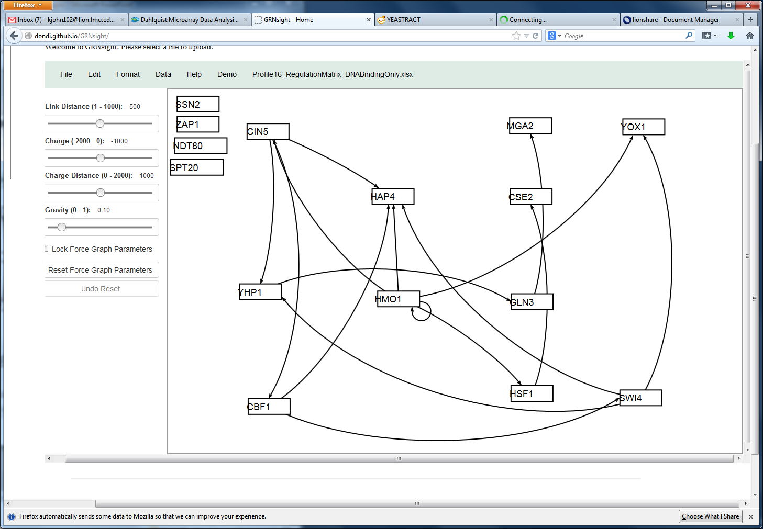
Profile 16 Regulation Network for DNA Binding Only (Middle connected)

Slide 13
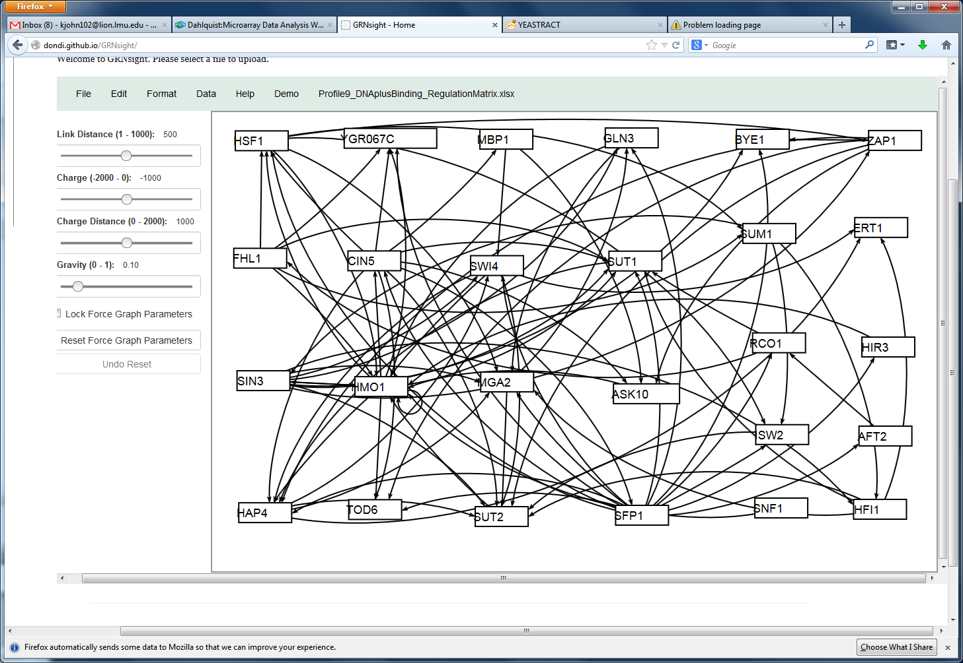
Profile 9 Regulation Network for DNA plus Binding (Most connected)

Slide 14
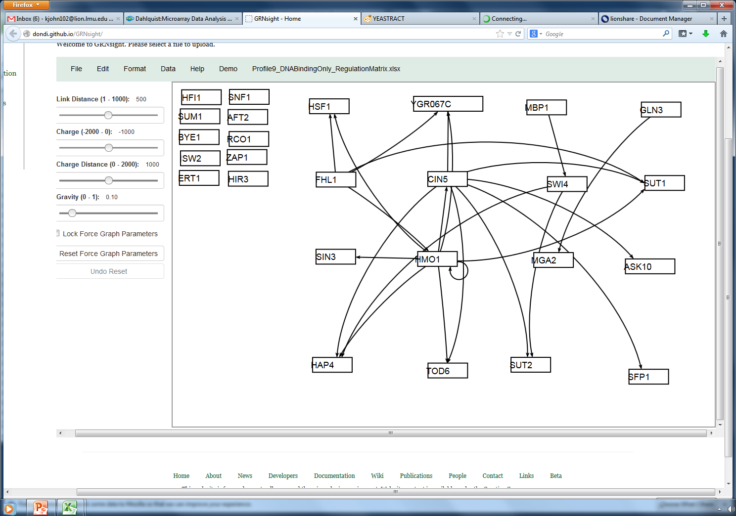
Profile 9 Regulation Network for DNA Binding Only (Middle connected)

Slide 15
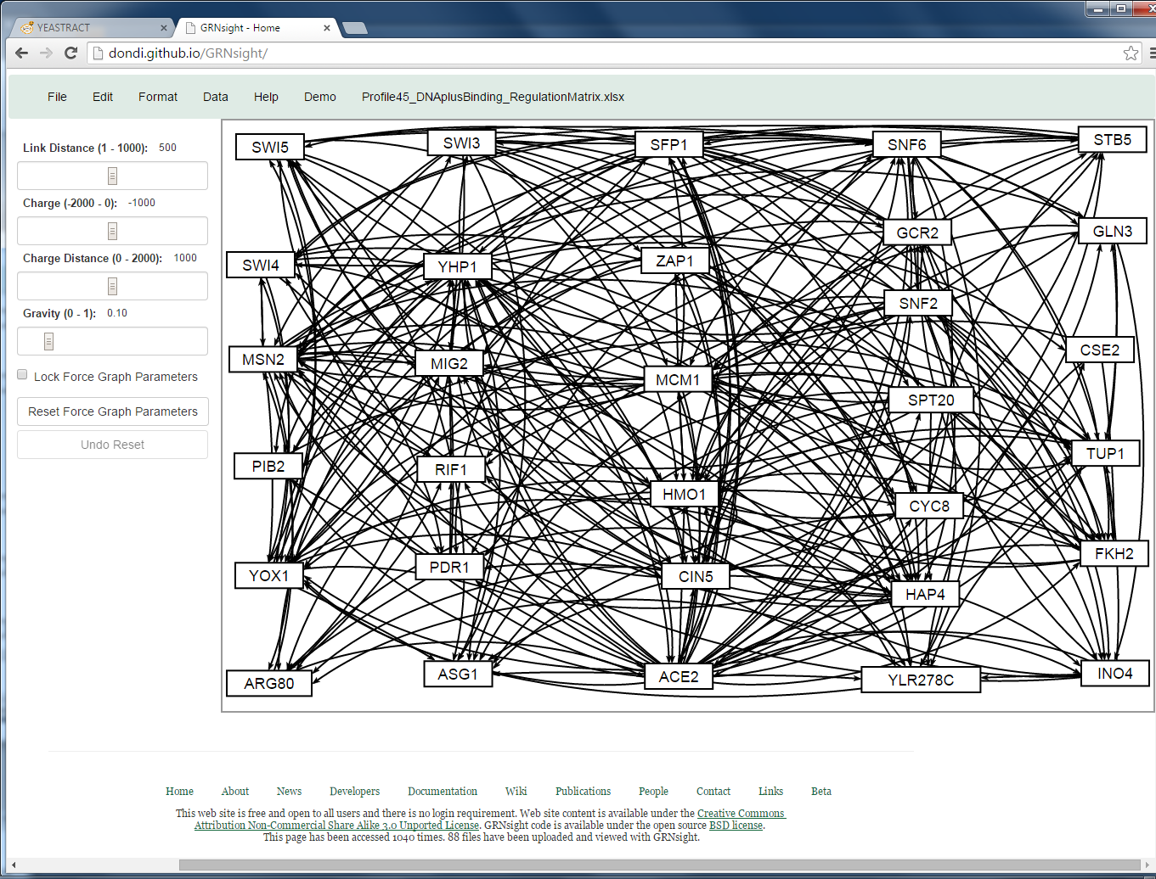
Profile 45 Regulation Network for DNA plus Binding (Most connected)

Slide 16
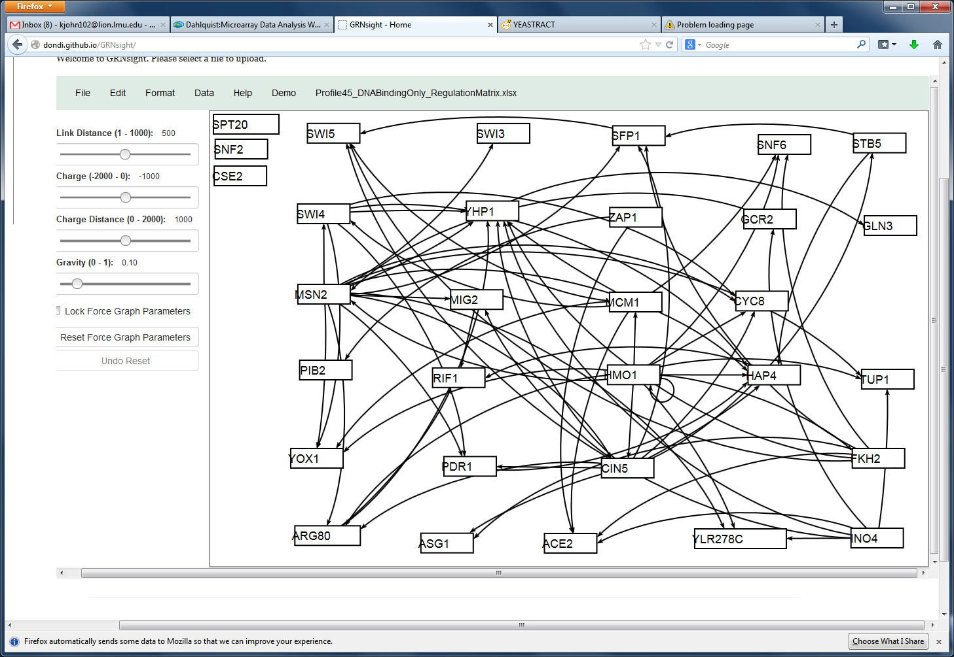
Profile 45 Regulation Network for DNA Binding Only (Middle connected)

Slide 17
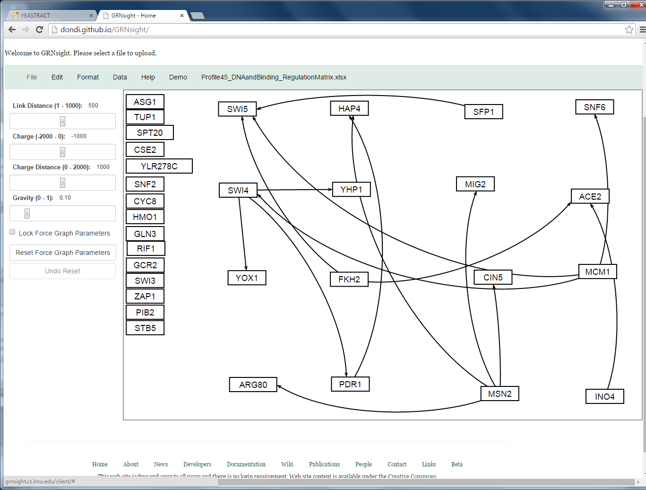
Profile 45 Regulation Network for DNA and Binding (Least connected)

Slide 18
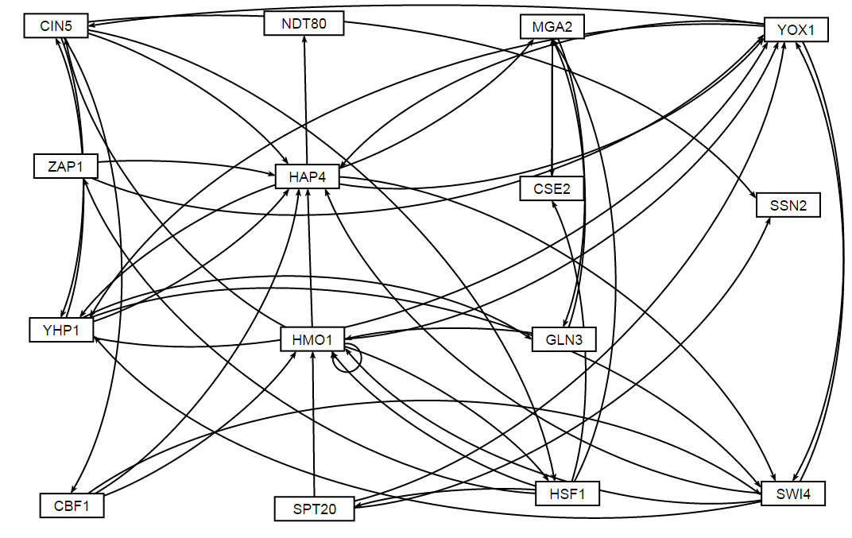
Profile 16 using DNA binding PLUS expression evidence was input into MATLAB

Slide 19
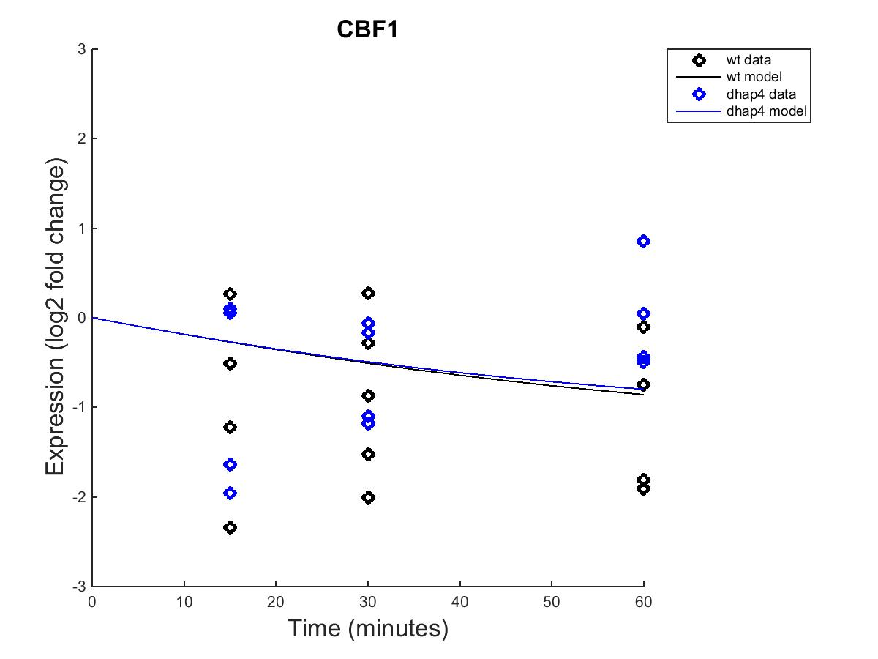
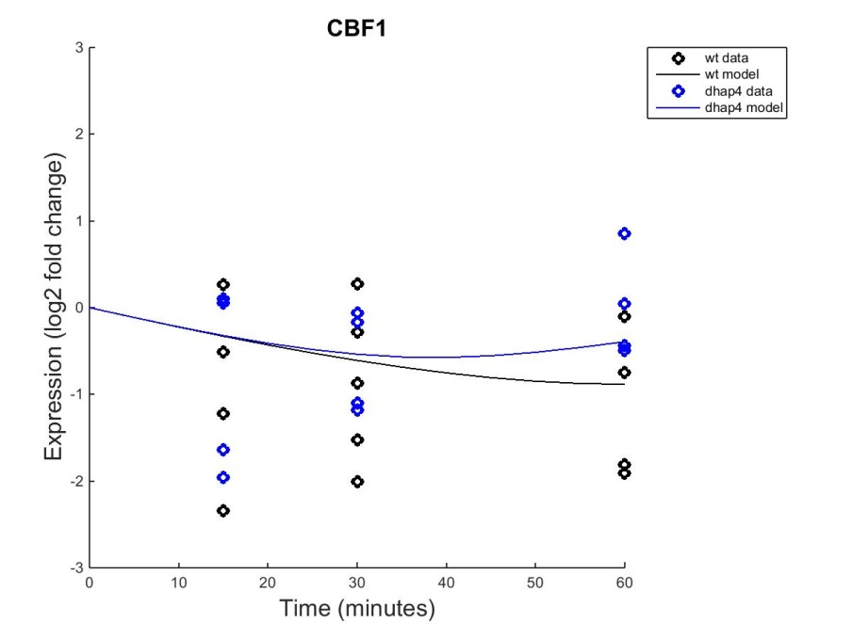
CBF1 Outputs, fixed b and estimated b

Slide 20
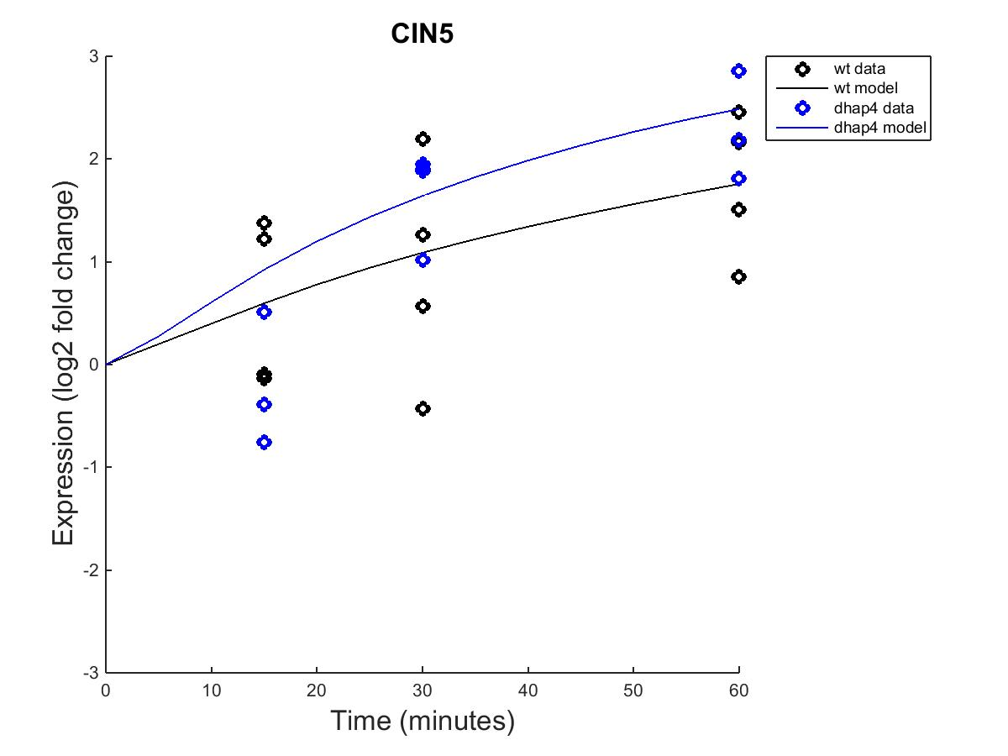
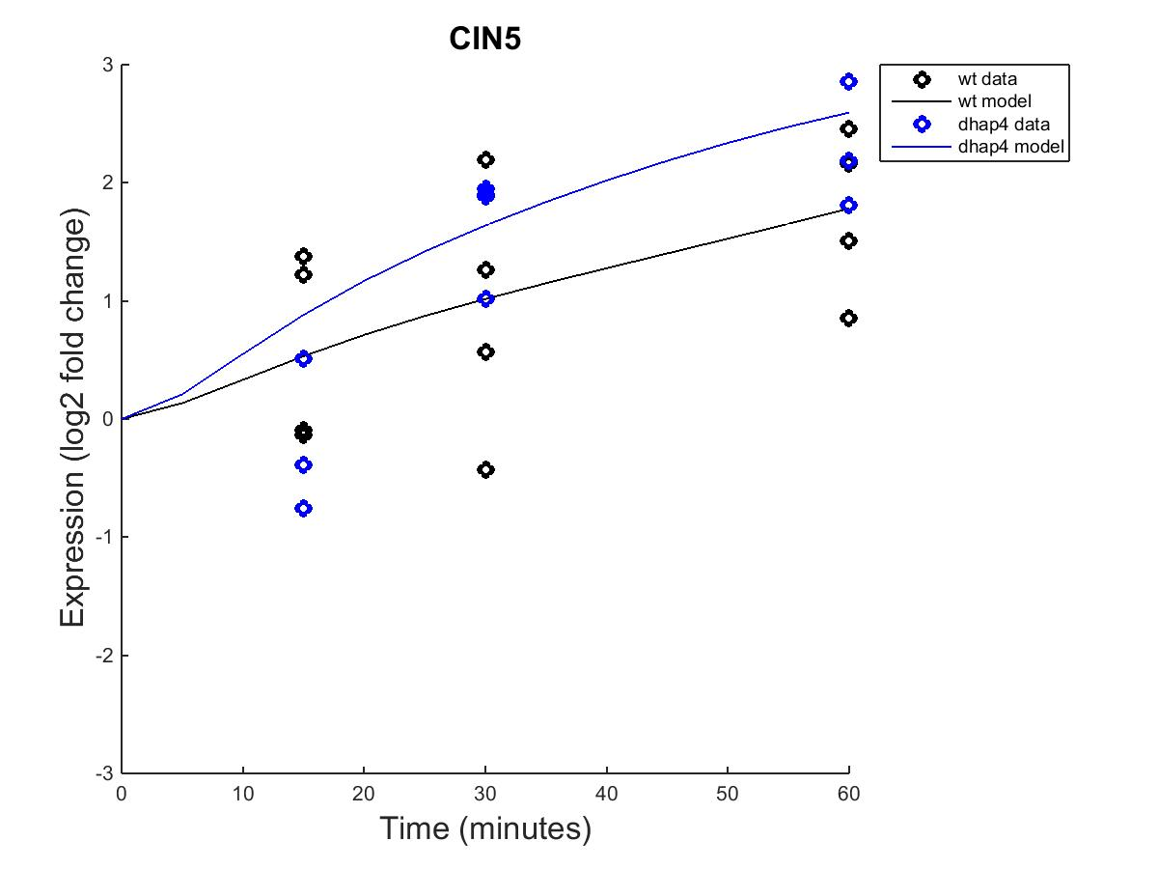
CIN5 Outputs, fixed b and estimated b

Slide 21
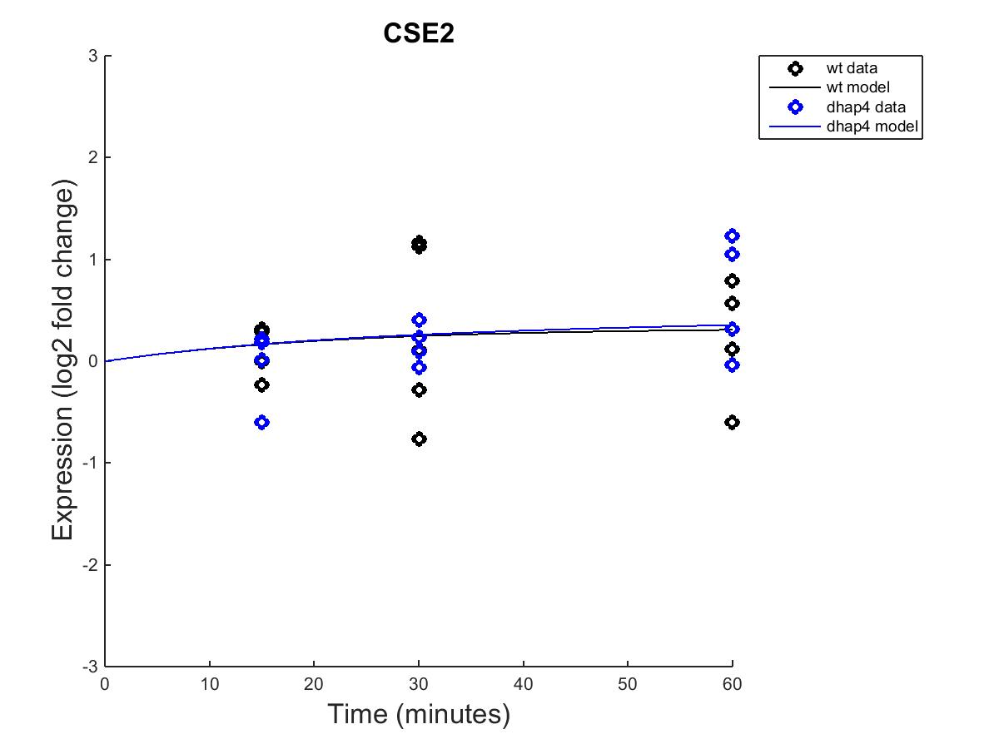

CSE2 Outputs, fixed b and estimated b

Slide 22

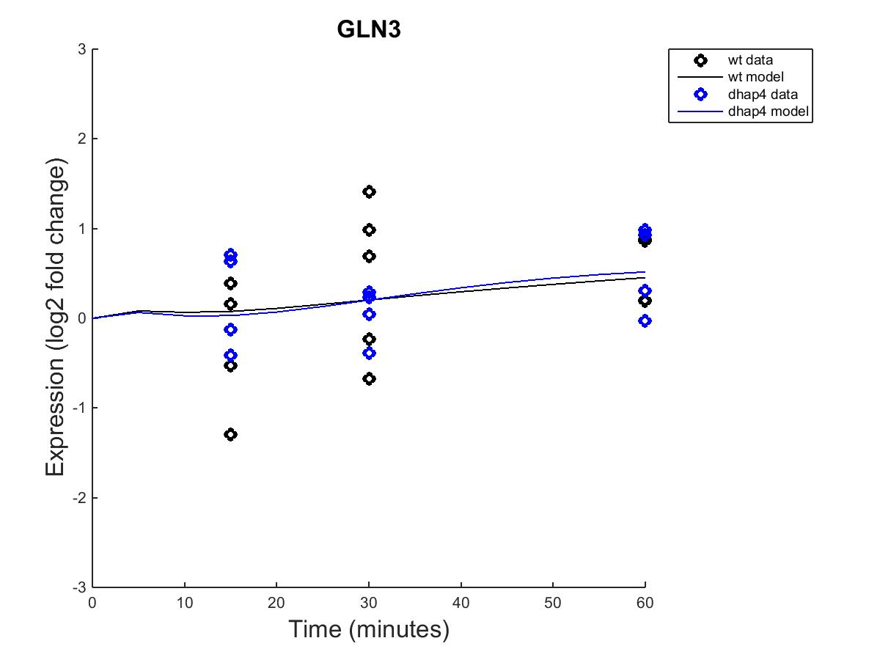
GLN3 Outputs, fixed b and estimated b

Slide 23
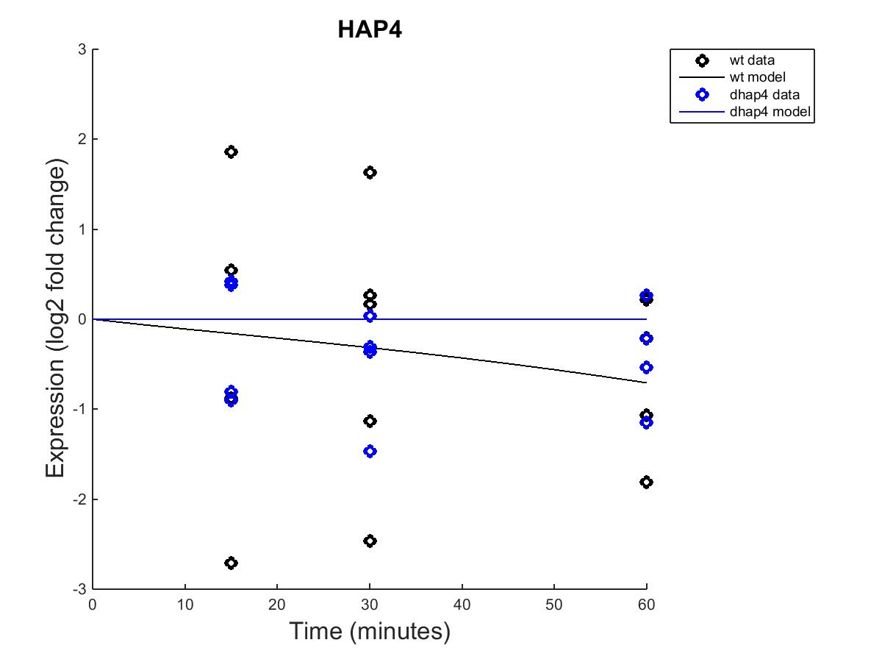

HAP4 Outputs, fixed b and estimated b

Slide 24
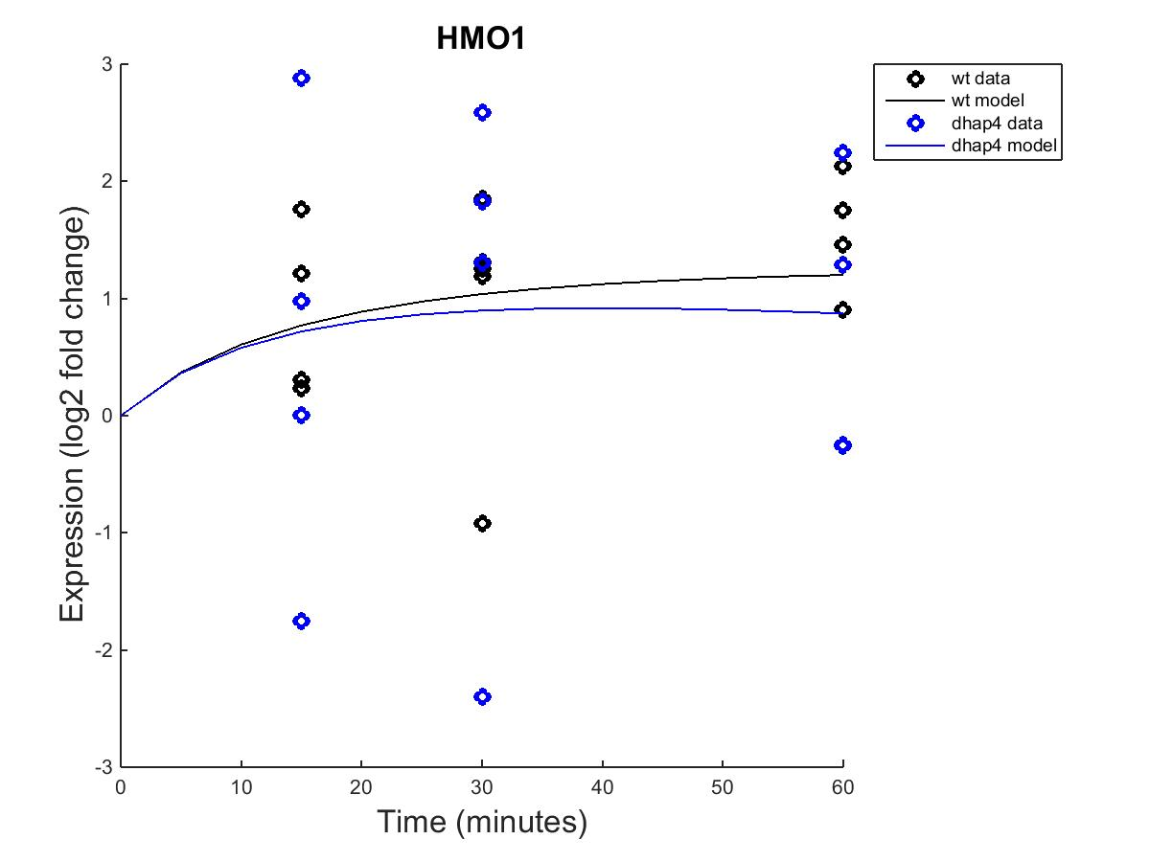
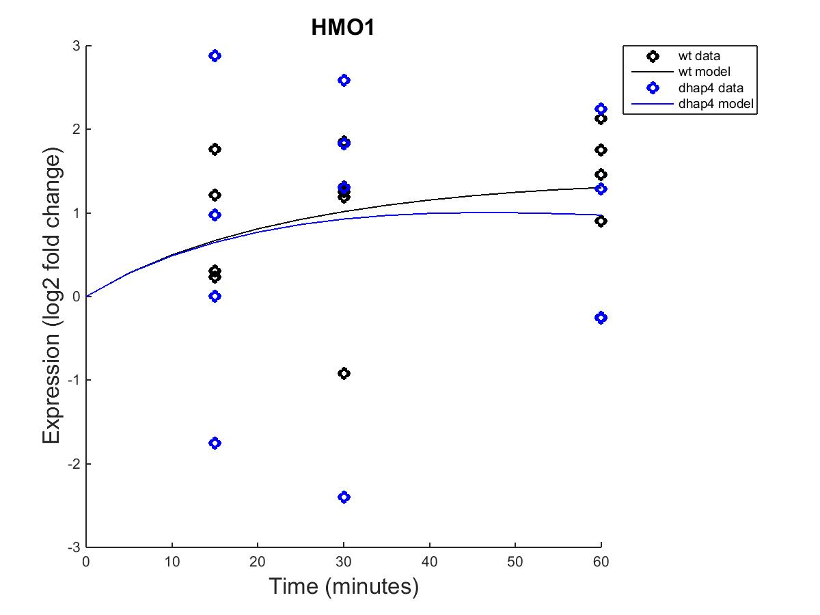
HMO1 Outputs, fixed b and estimated b

Slide 25
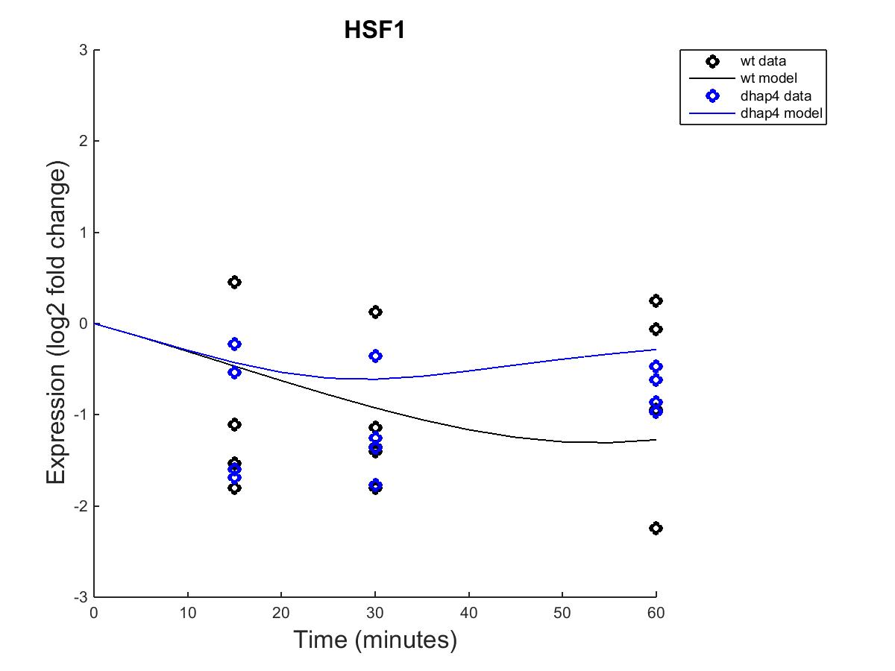

HSF1 Outputs, fixed b and estimated b

Slide 26
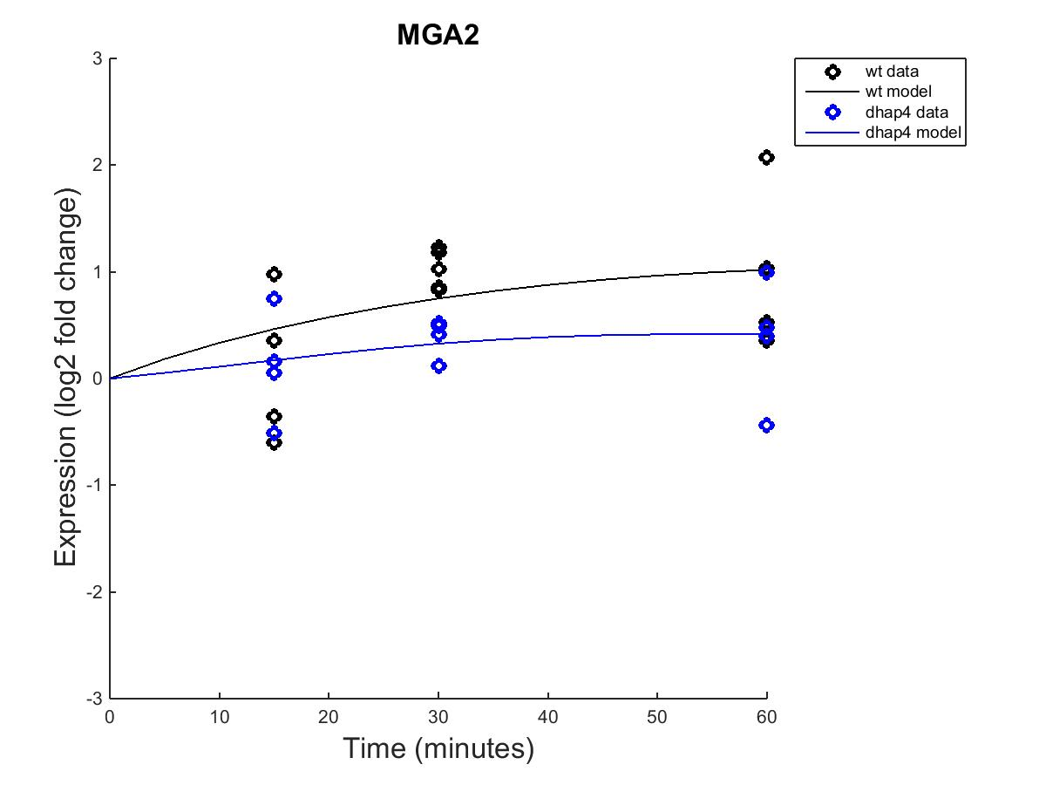
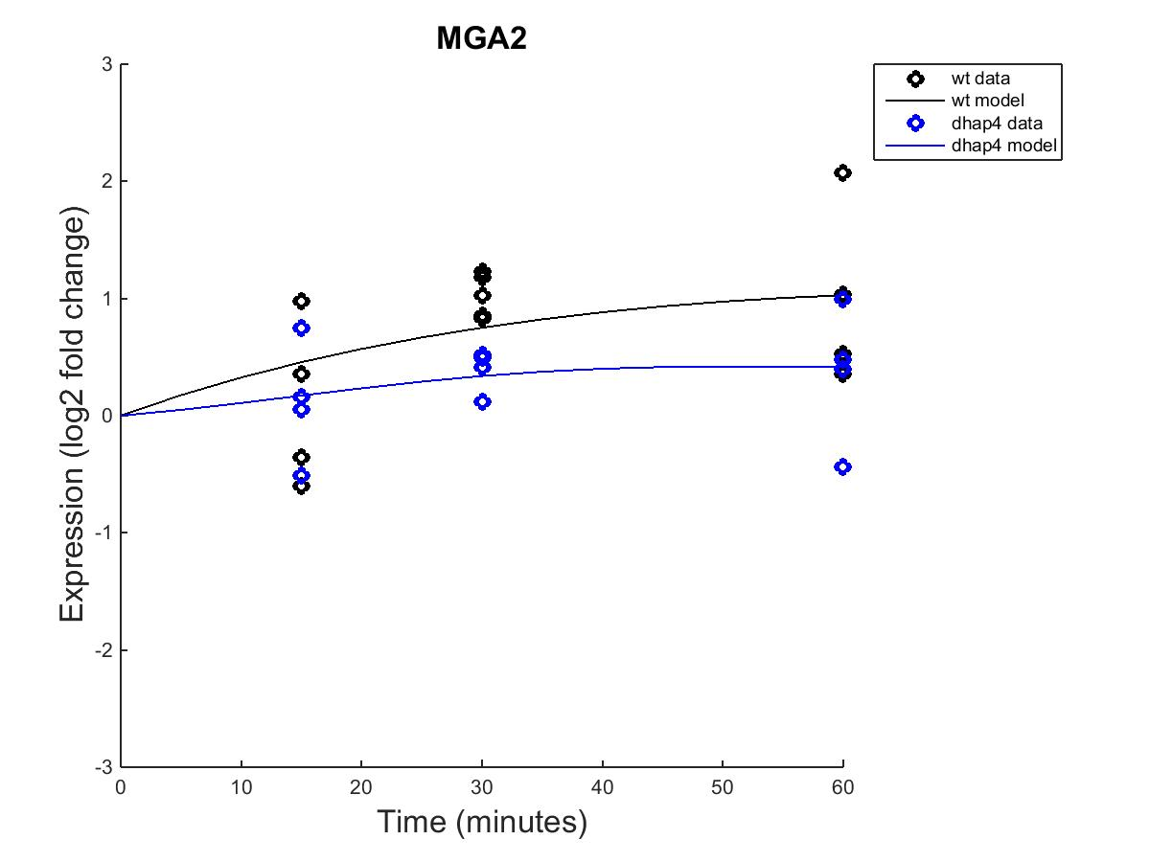
MGA2 Outputs, fixed b and estimated b

Slide 27
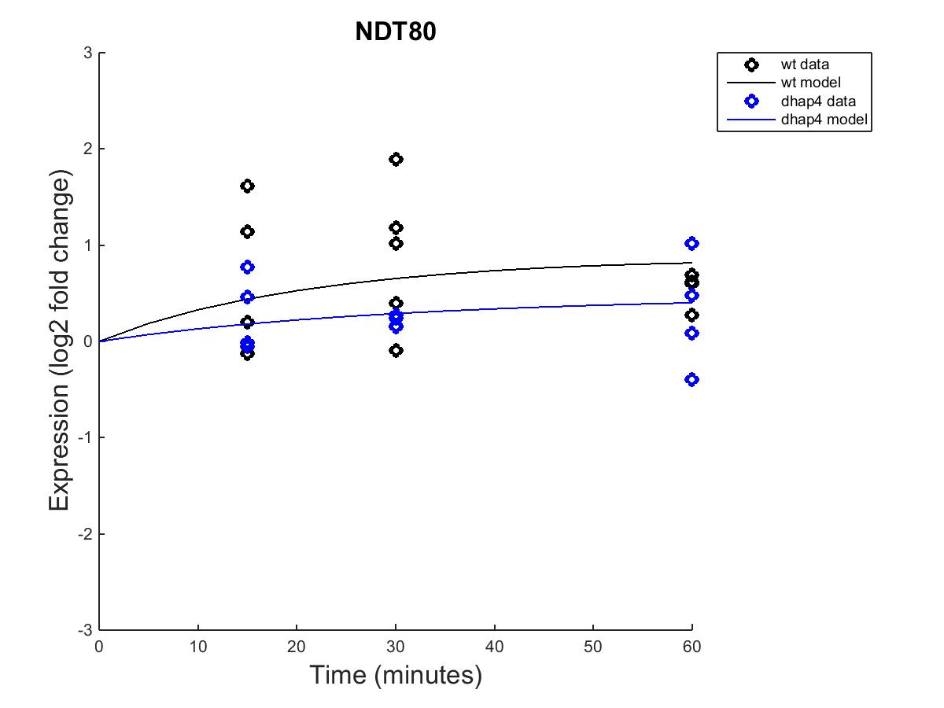

NDT80 Outputs, fixed b and estimated b

Slide 28
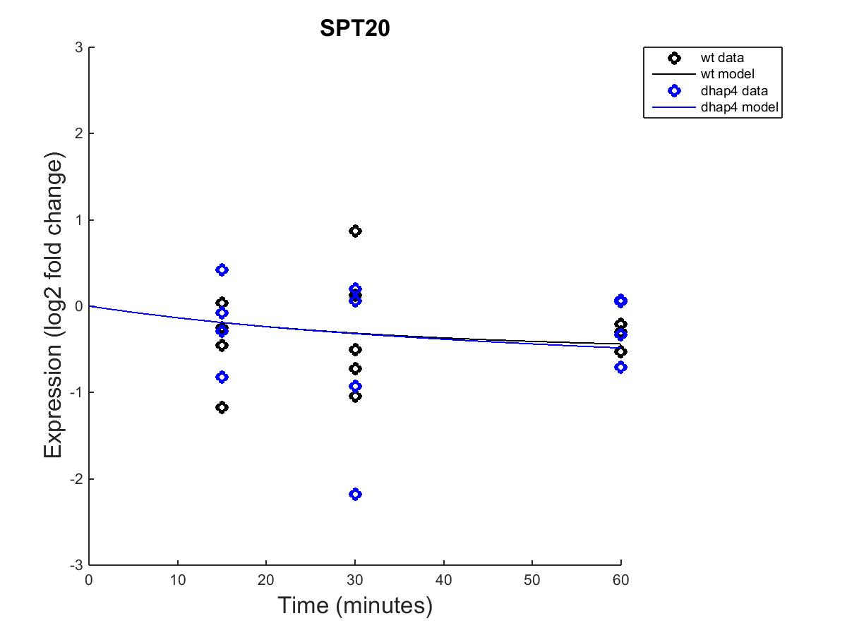

SPT20 Outputs, fixed b and estimated b

Slide 29
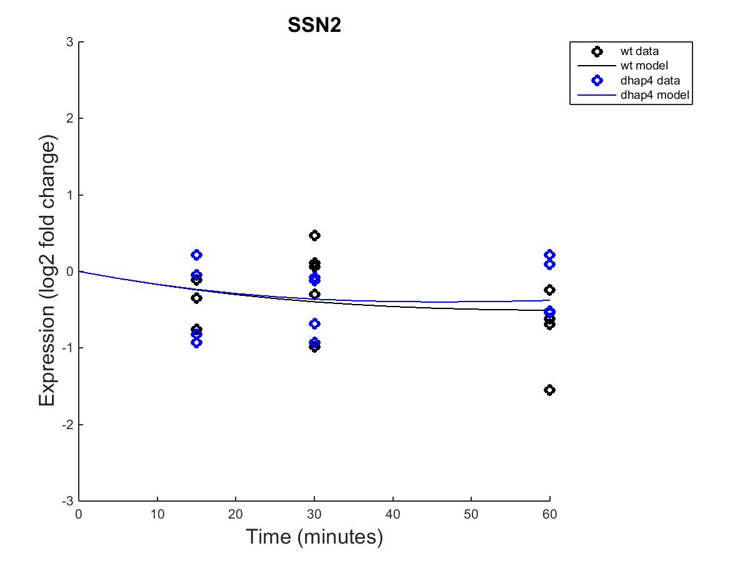

SSN2 Outputs, fixed b and estimated b

Slide 30
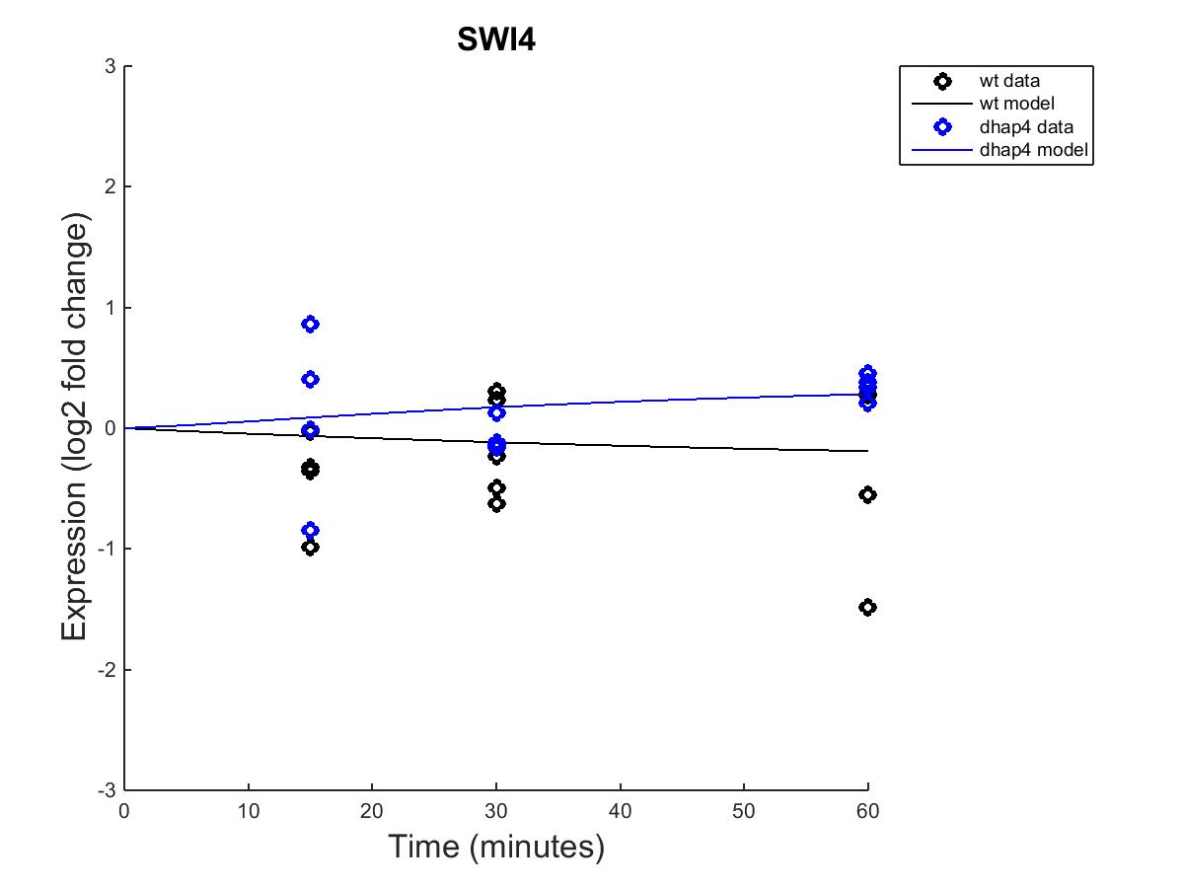
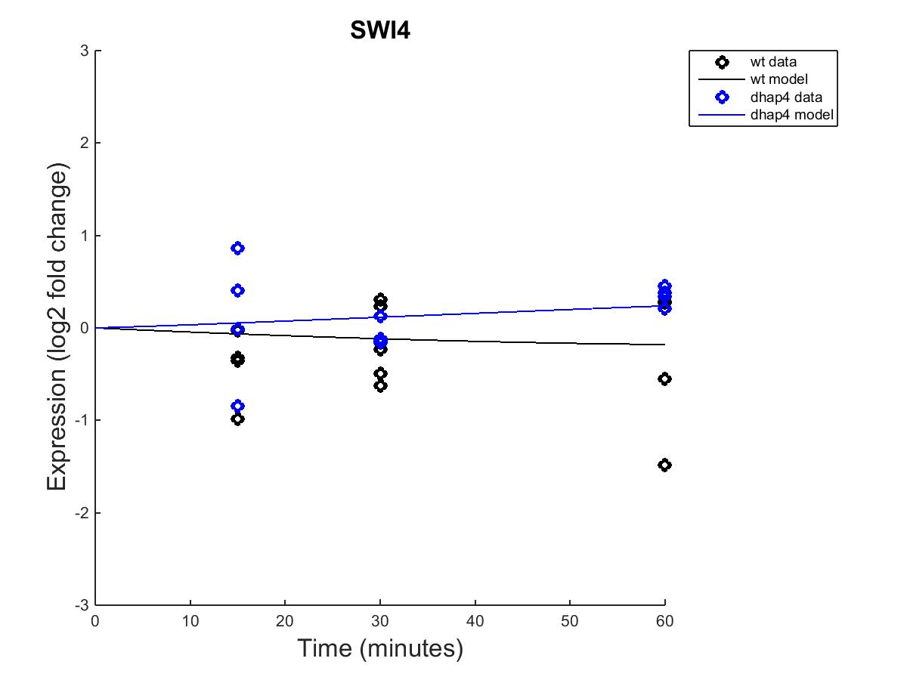
SWI4 Outputs, fixed b and estimated b

Slide 31
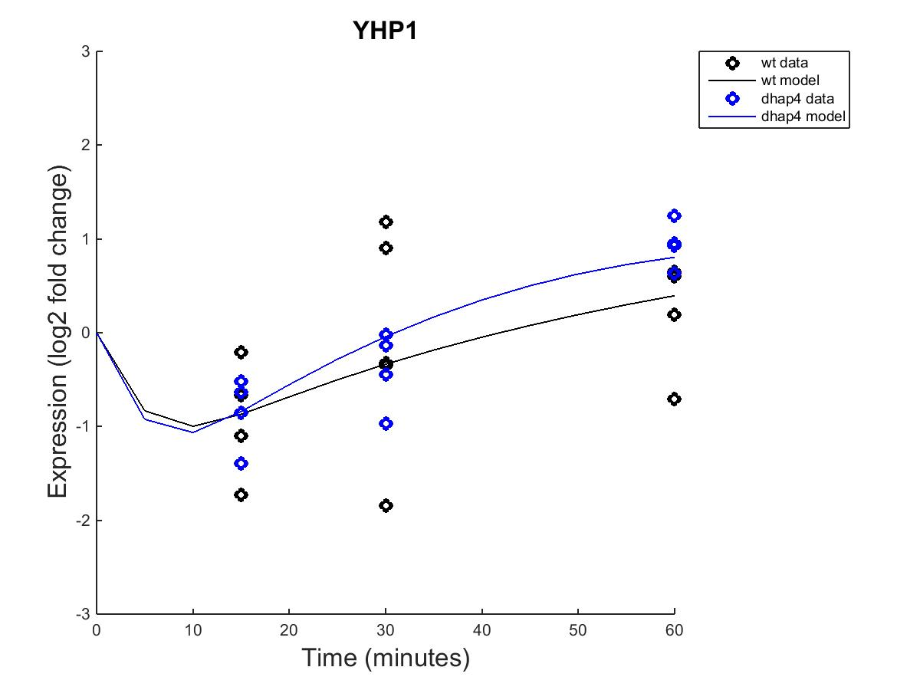
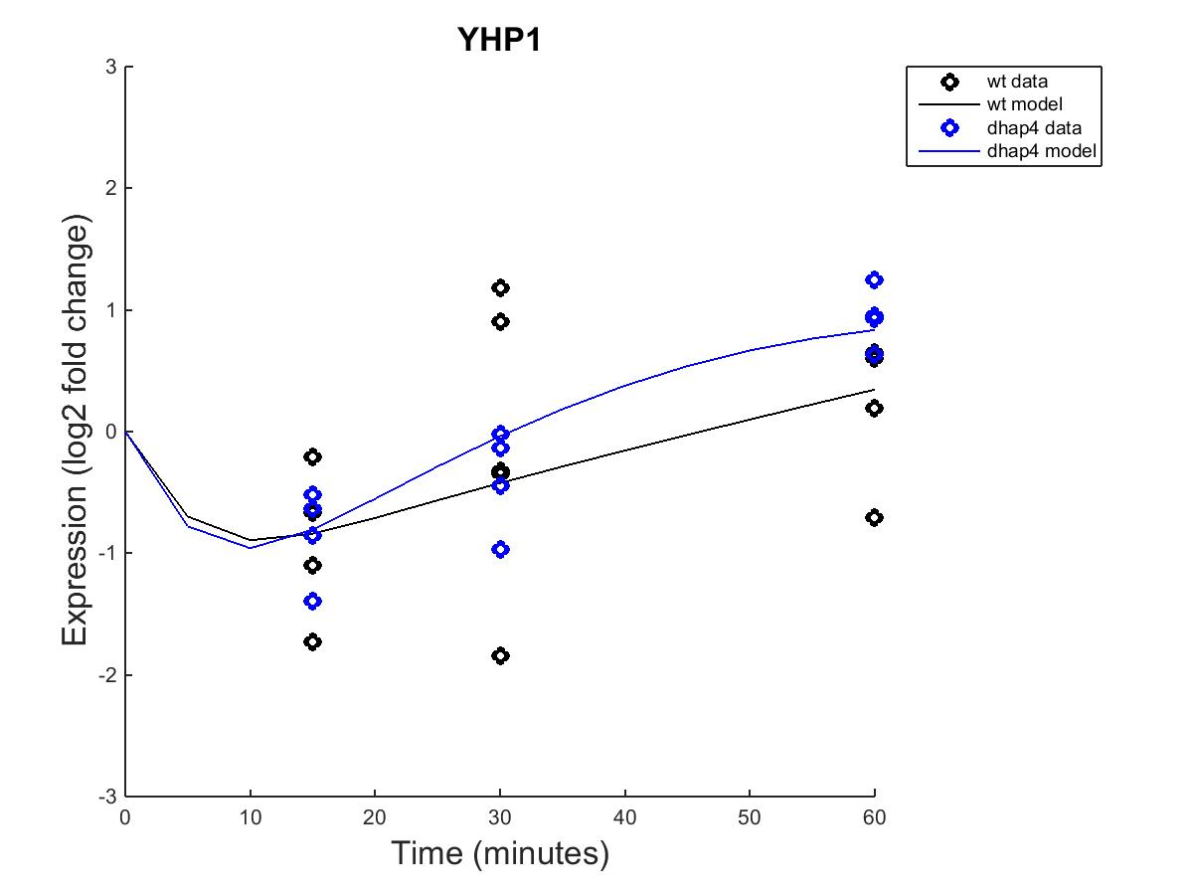
YHP1 Outputs, fixed b and estimated b

Slide 32
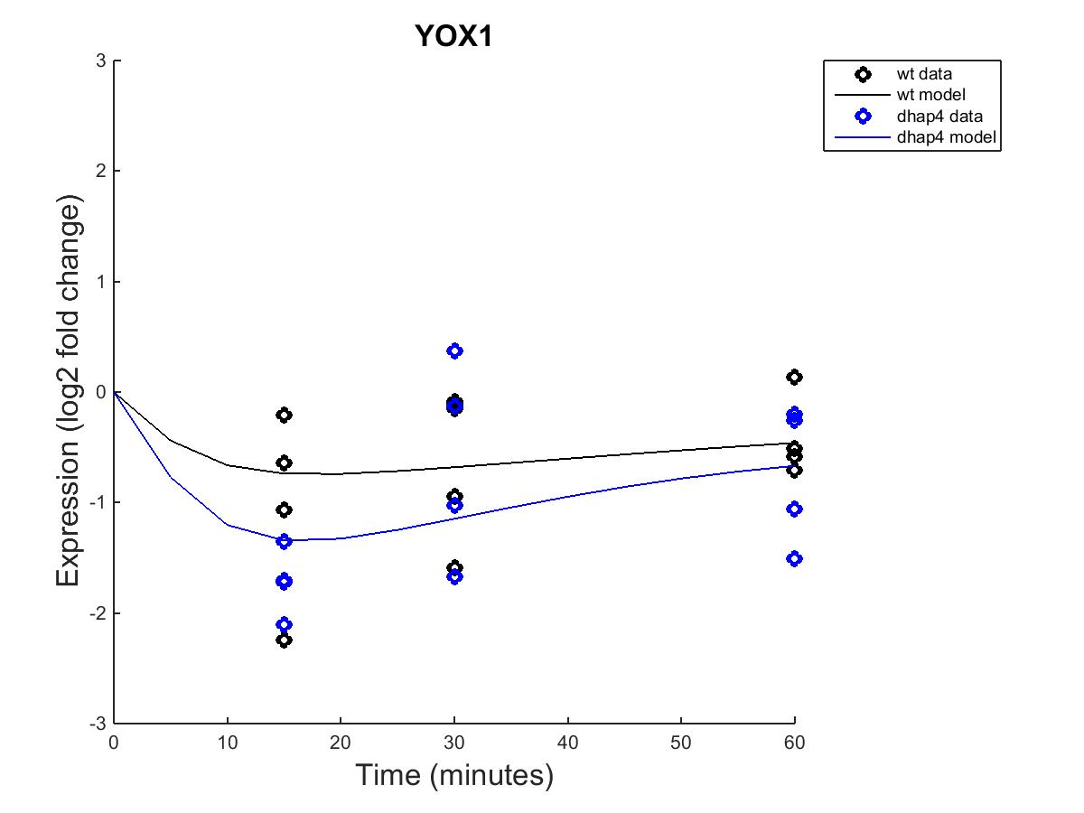
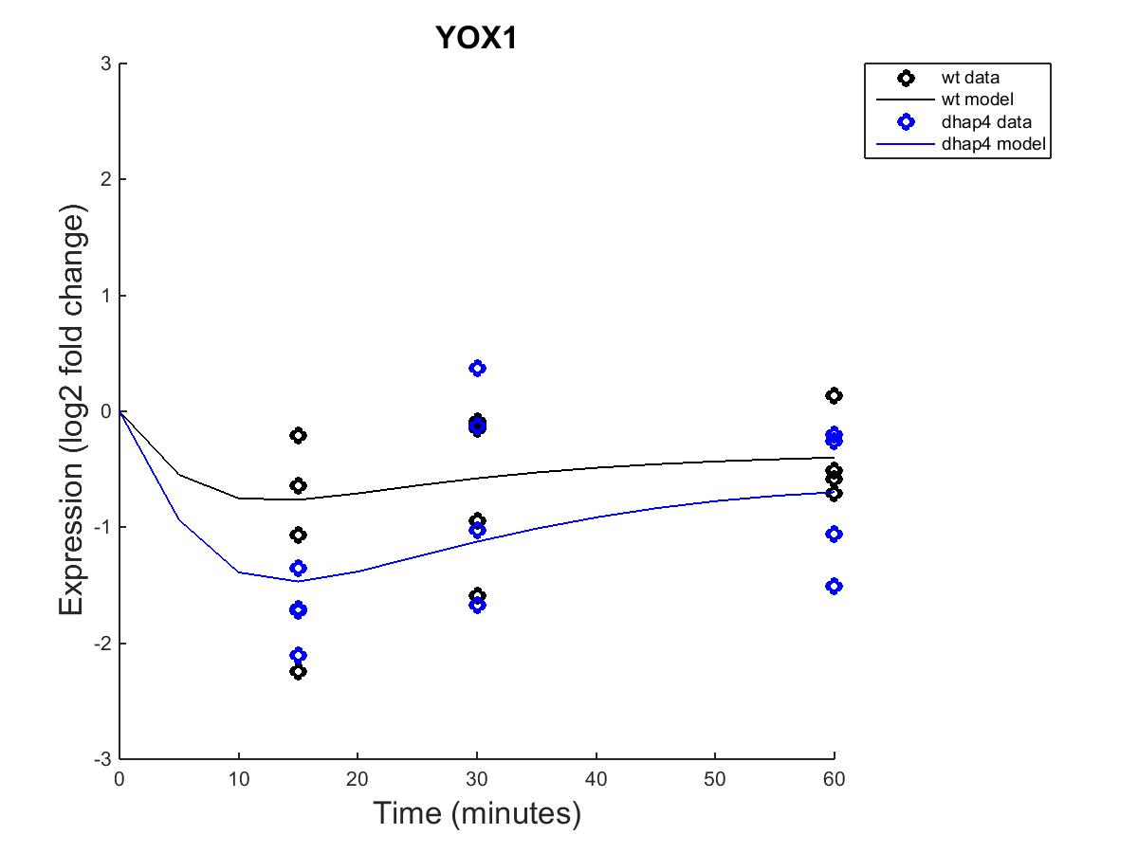
YOX1 Outputs, fixed b and estimated b

Slide 33
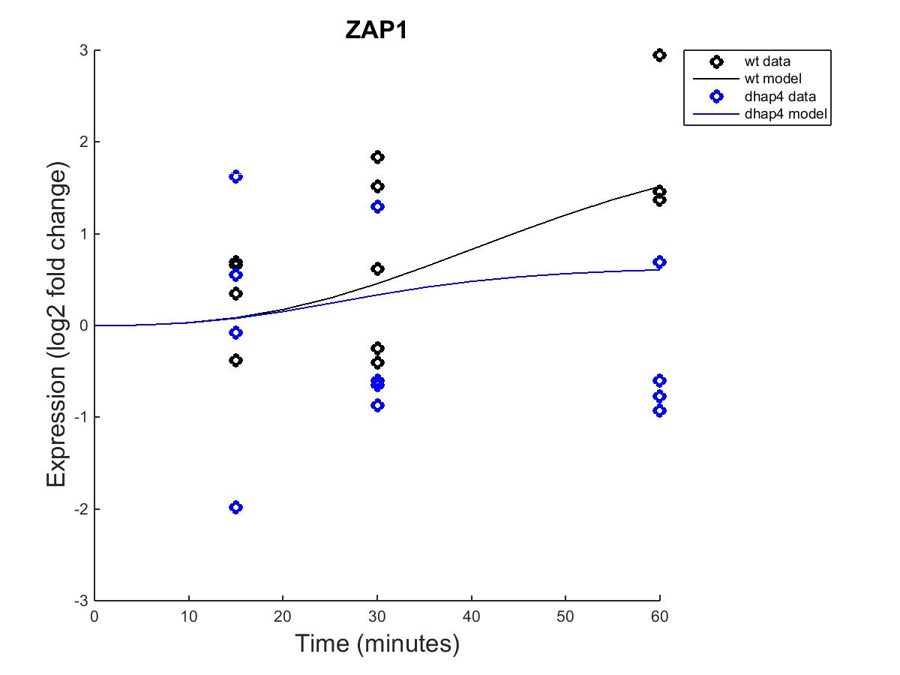
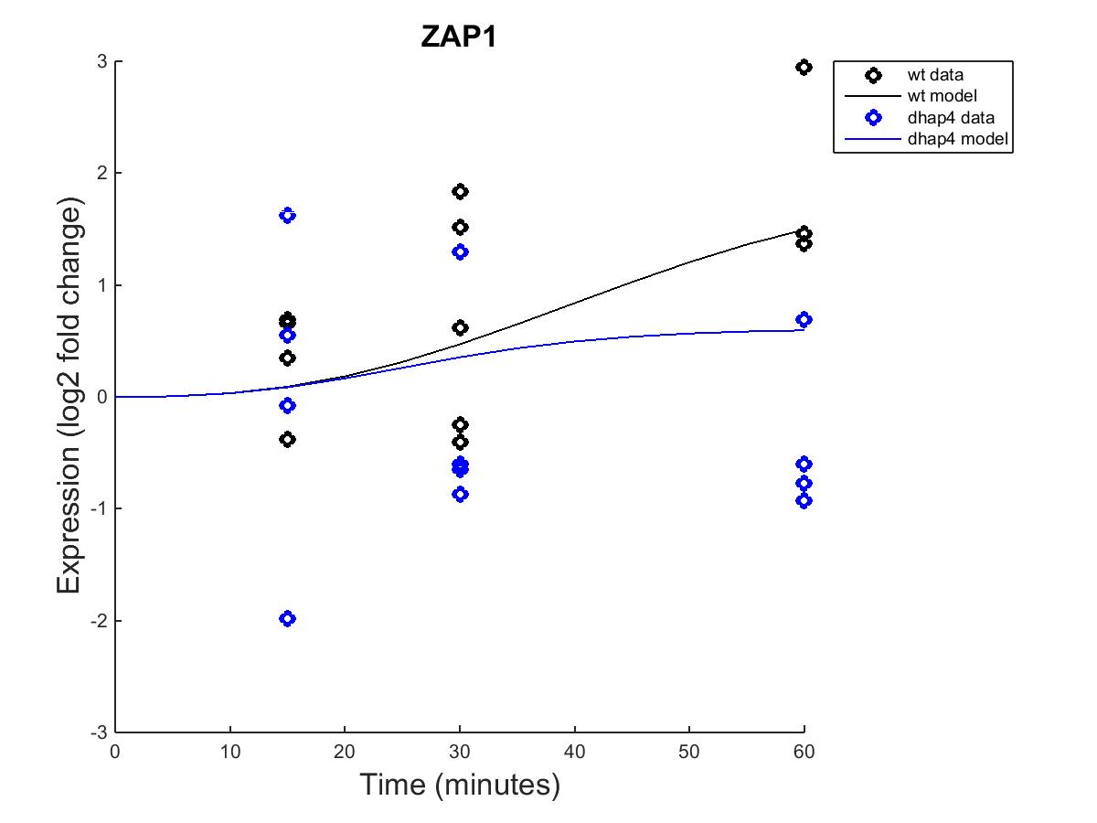
ZAP1 Outputs, fixed b and estimated b

Slide 34
Estimated weights, fixed and estimated b

Slide 35
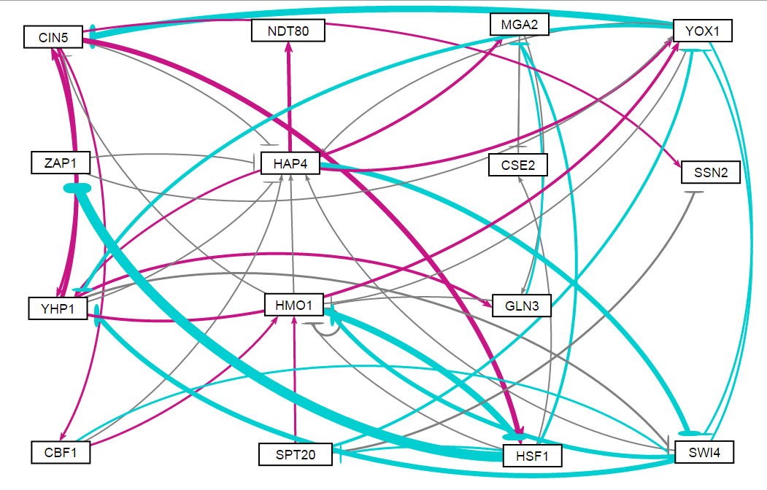
Profile 16 Plus, fixed b

Slide 36
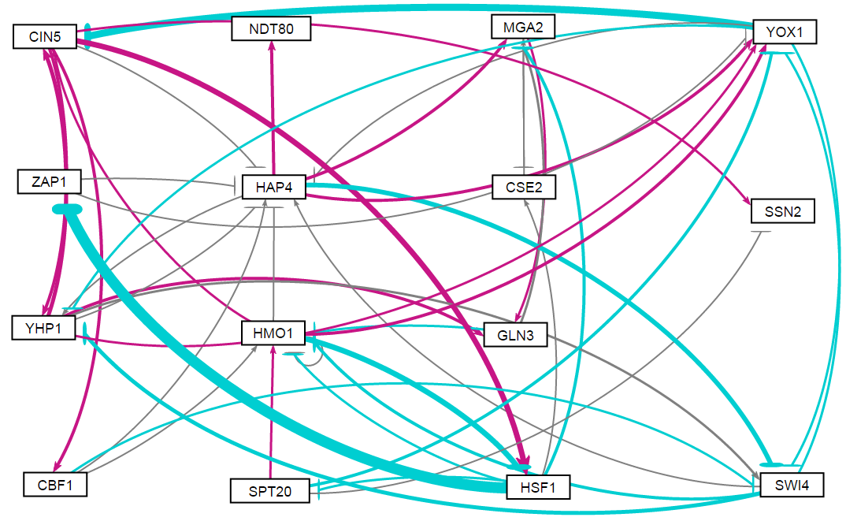
Profile 16 Plus, estimated b

