Slide 1

What’s in store for today
Review weeks 1 & 2: All questions answered environment….

Slide 2
What’s in store for today
Review weeks 1 & 2: All questions answered environment….
New Material: abstraction + bacterial photography system

Slide 3
What’s in store for today
Review weeks 1 & 2: All questions answered environment….
New Material: abstraction + bacterial photography system
Hands on: Tinkercell CAD tool

Slide 4
What’s in store for today
Review weeks 1 & 2: All questions answered environment….
New Material: abstraction + bacterial photography system
Hands on: Tinkercell CAD tool
Home stretch: Launch project groups

Slide 5
What’s in store for today
Review weeks 1 & 2: All questions answered environment….
New Material: abstraction + bacterial photography system
Hands on: Tinkercell CAD tool
Home stretch: Launch project groups
Epilogue:
20.385: journal article discussion
20.020: project discussions continue as needed/wanted

Slide 6


Tools for Engineering Biology
Synthetic Biology
Standardization
Abstraction
Synthesis
A+A+C+T+T…
Genetic Engineering
rDNA
Sequencing
PCR

Slide 7
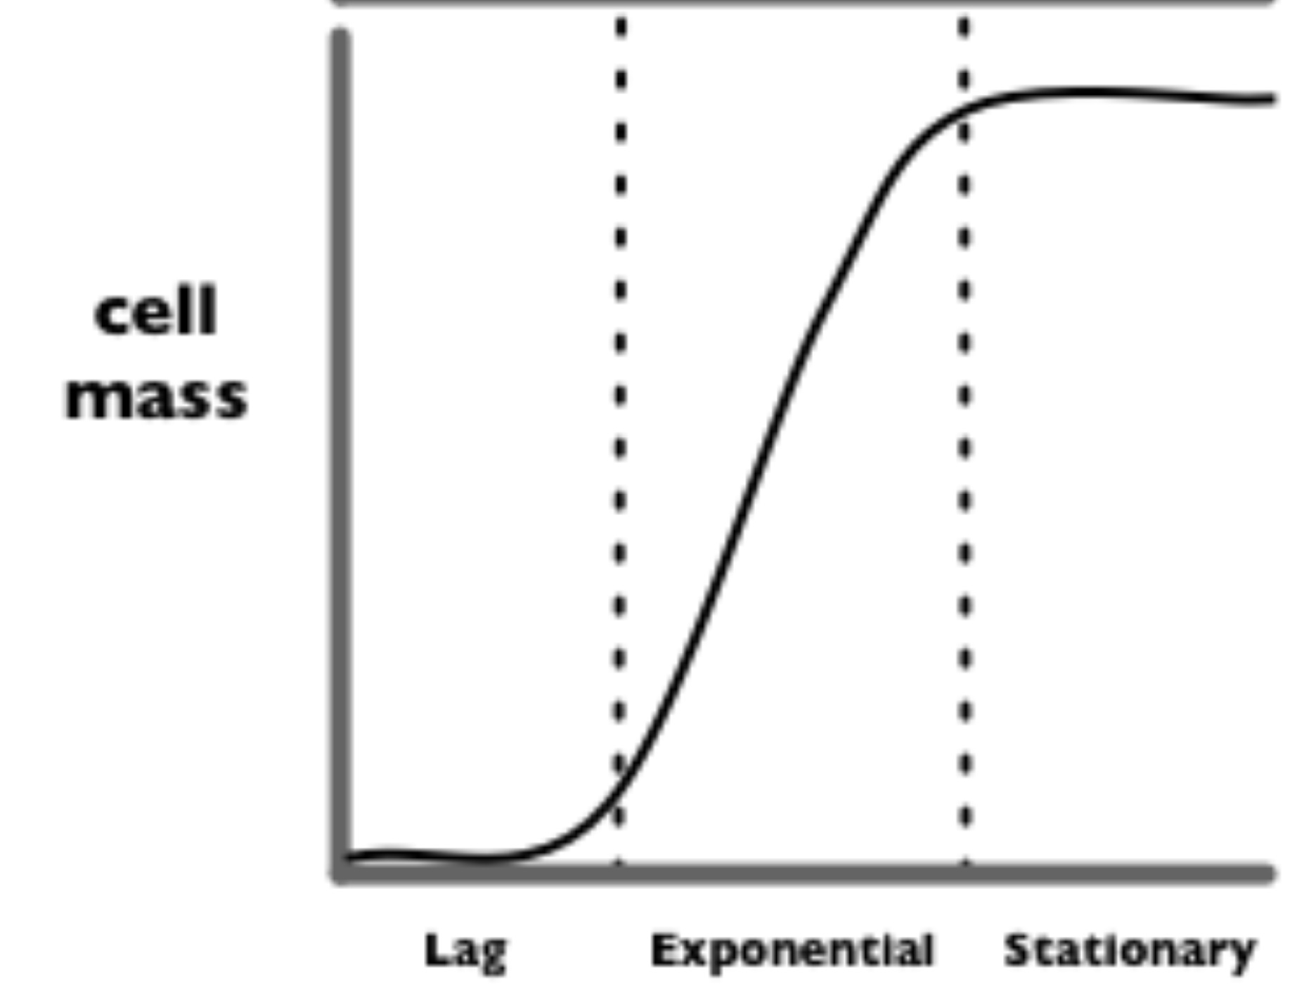
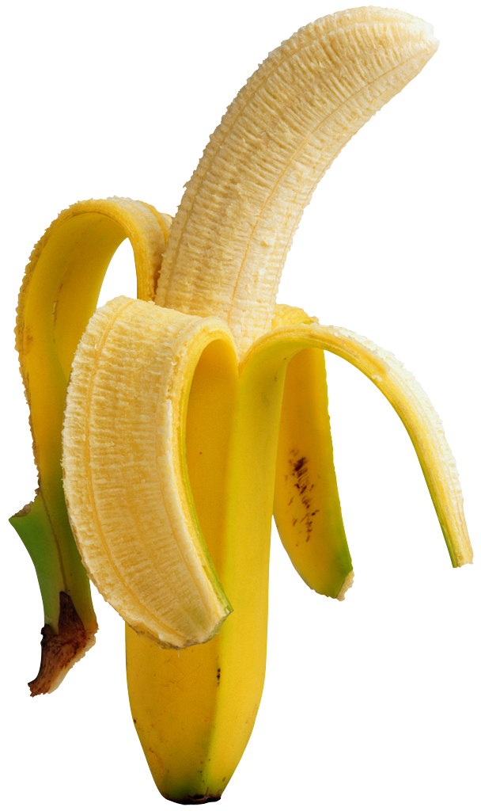

Parts specification for stationary phase banana smell
“stationary”
BGD
cell density
“log”
OsmY is a promoter that is only active during stationary phase
“lag”
time

Slide 8
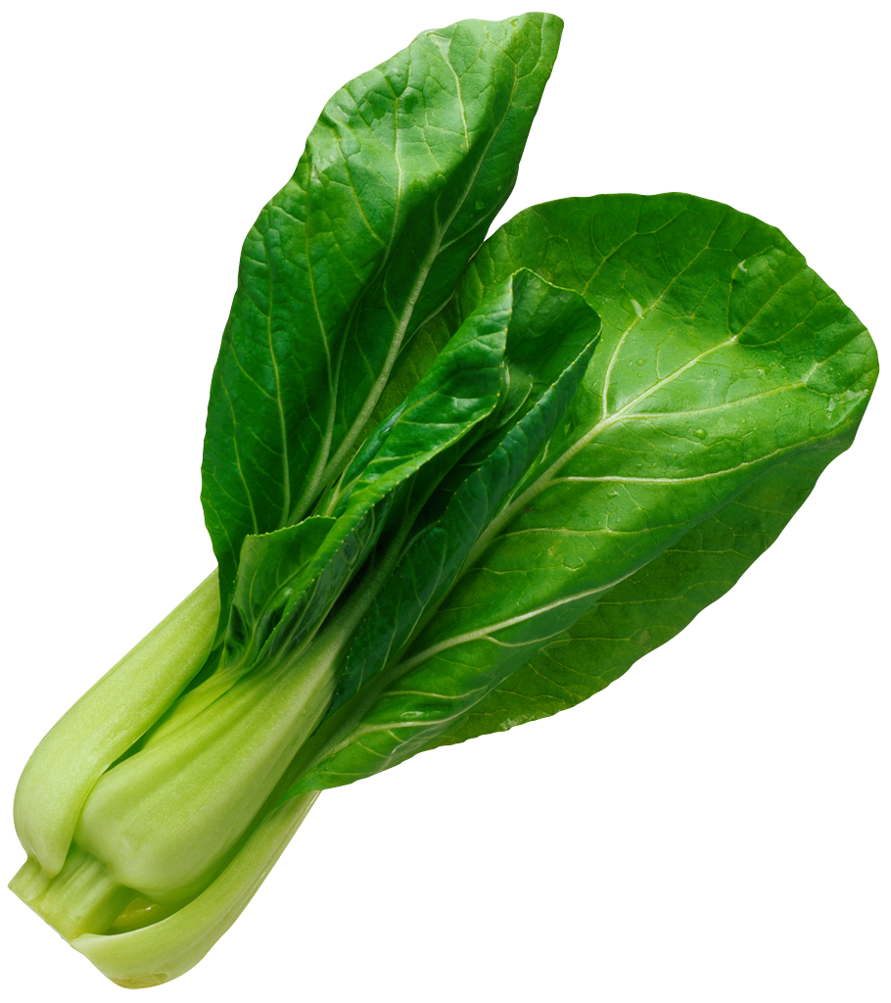

Parts specification for log phase wintergreen smell
“stationary”
cell density
“log”
WGD
“lag”
 | Stationary | Log
OsmY | 1 | 0
OsmY + inverter | 0 | 1
time

Slide 9
“Eau d’coli”
“stationary”
cell density
“log”
saGD
WGD
“lag”
iaGD
BGD
time

Slide 10
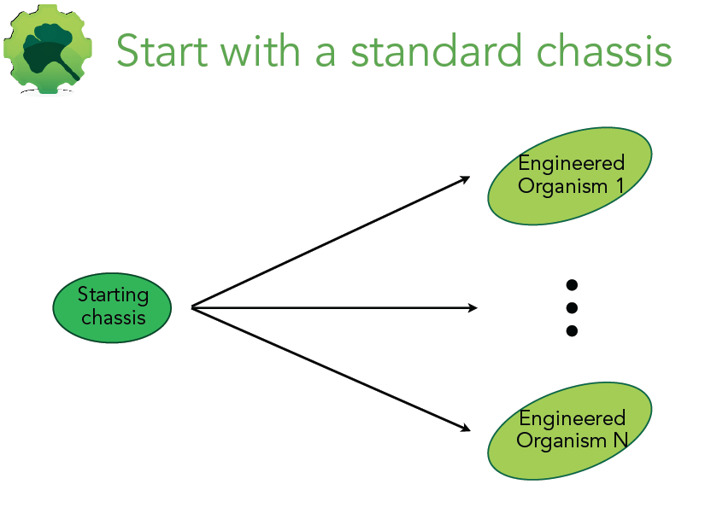

Slide 11
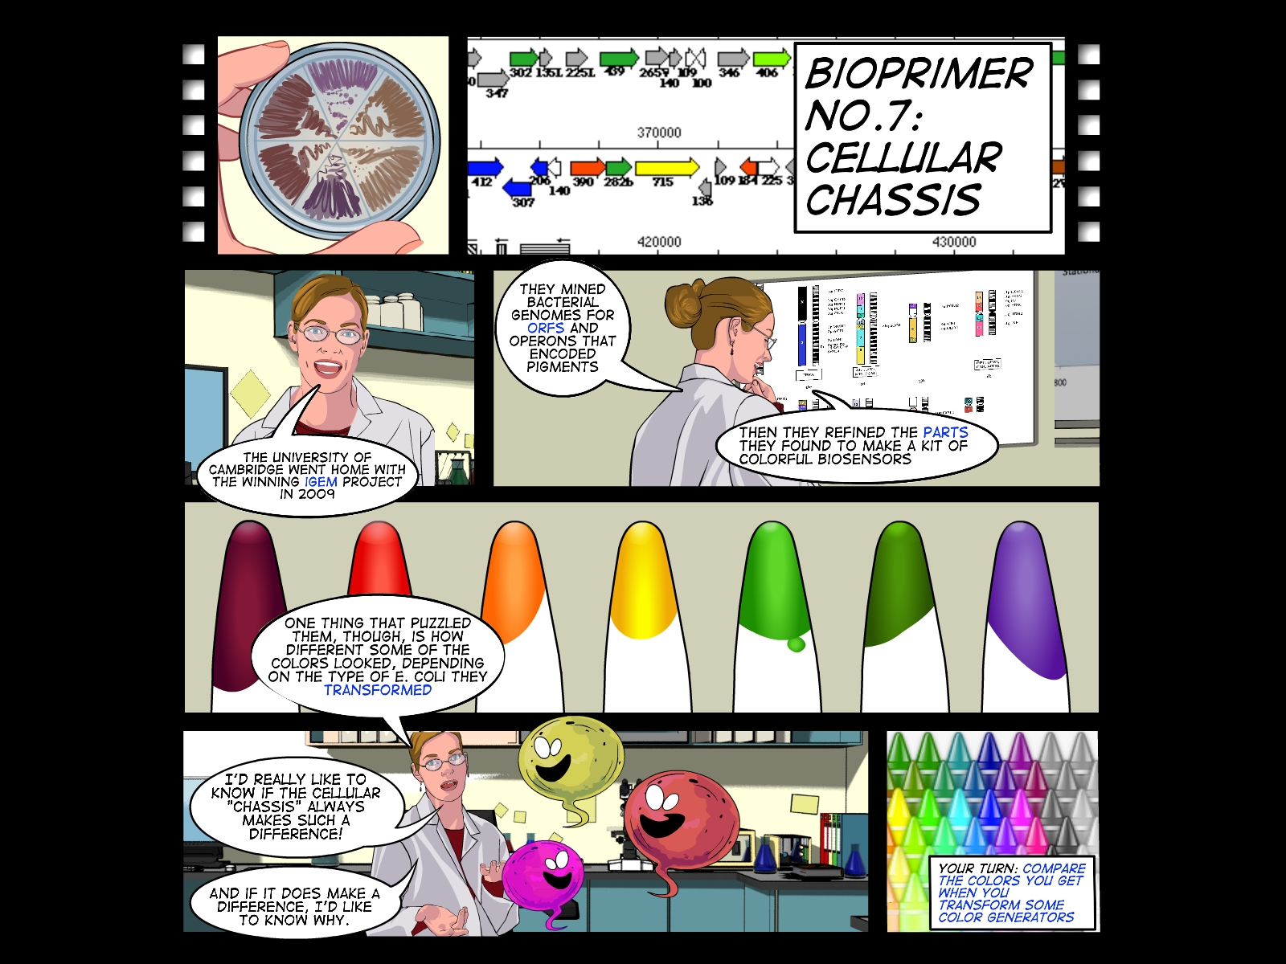

Slide 12
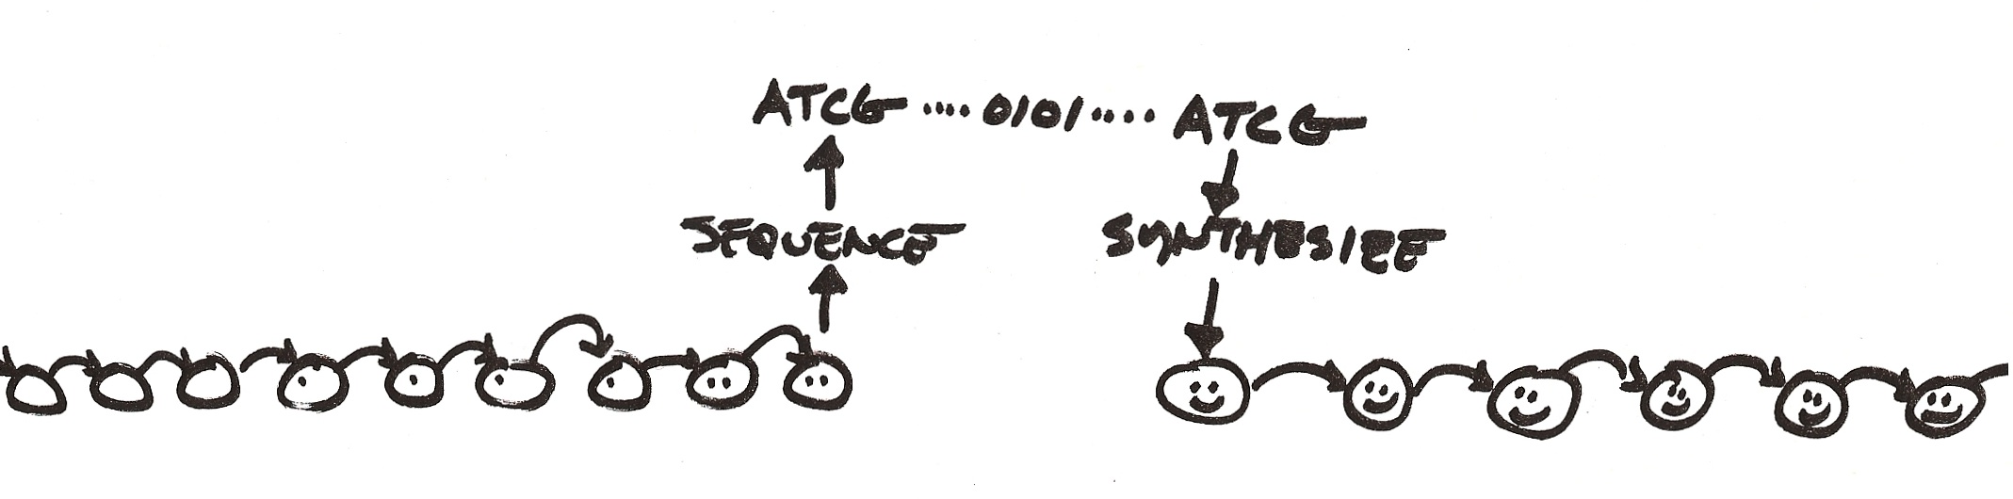
Goal: build a working cell that uses a synthetic genome
Design, synthesis and assembly of largest functional genome to date
aka “Darwin is dead”
art from Drew Endy

Slide 13
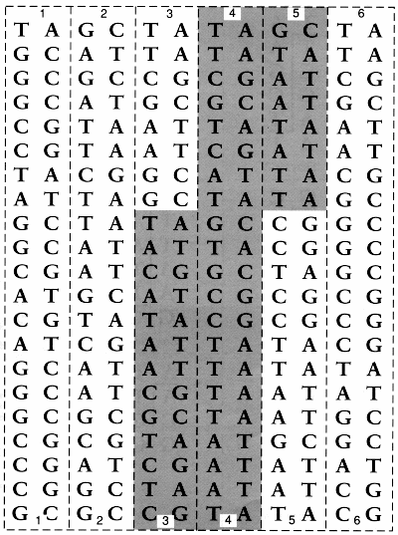
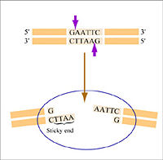
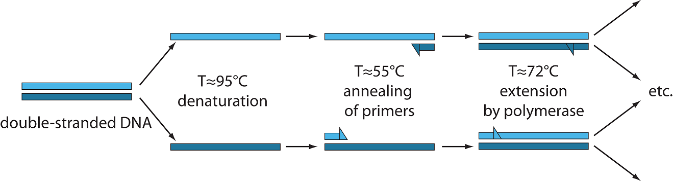
Cloning and PCR

Slide 14
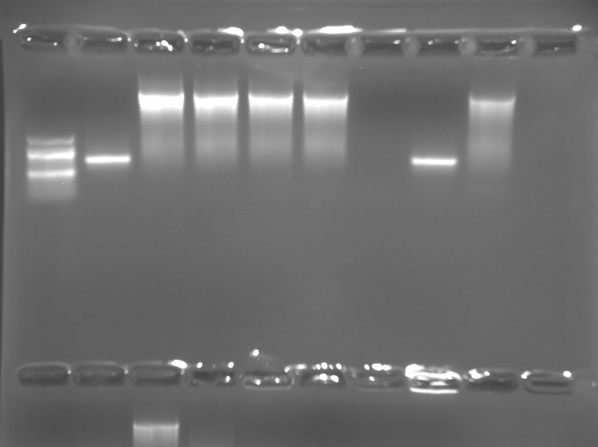
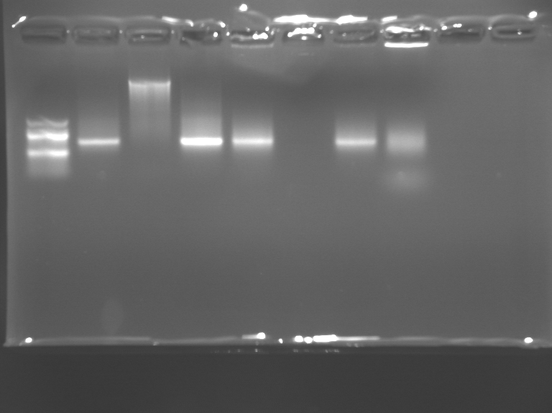
Cloning and PCR
http://openwetware.org/wiki/Talk:2020(S12)_Lecture:week_2

Slide 15
Tools for Engineering Biology
Synthetic Biology
Standardization
Abstraction
Synthesis
A+A+C+T+T…
Genetic Engineering
rDNA
Sequencing
PCR

Slide 16
Abstraction introduction
Natalie Kuldell
February 22nd, 2012

Slide 17
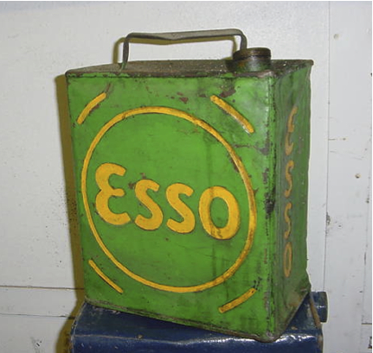
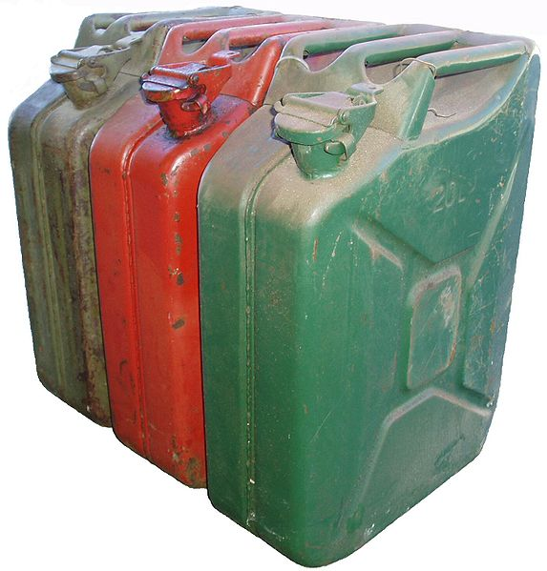
Reverse Engineering
Fuel Cans used by WW I British army
German Wehrmachtskanister, 1930s
Leaked
Need wrench and funnel to use
“Flimsies”
Snapcap
X-marks for strength, expansion
Plastic lined
Pressed seems
“WWII JerryCans”

Slide 18
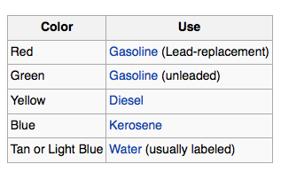
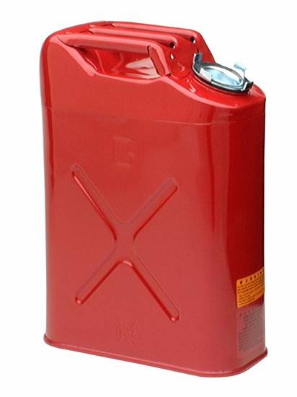

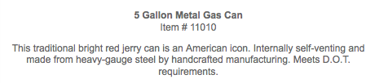
Reverse (historical) Engineering
"Study the past, if you would divine the future" -Confucius
"Learn from your mistakes" -my mom

Slide 19
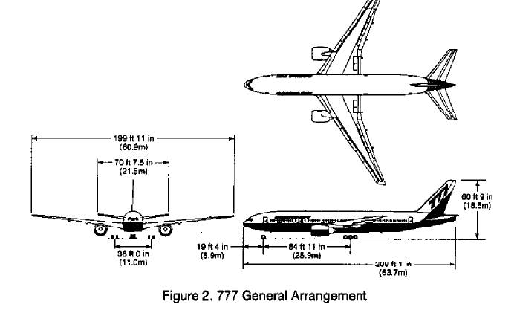
Forward Engineering
238 teams of engineers
8 mainframe computers
2200 workstations
Scientific understanding of materials, physics, atmosphere
~100 year history of manned flight
Commercial needs (#passengers, cost, distance)
Consumer data
Notes:
[PDF] The Boeing 777: A Look Back
ftp.rta.nato.int/public//PubFulltext/AGARD/CP/...CP...///08CHAP05.pdf

Slide 20

Forward Engineering
Scientific understanding of materials, physics, atmosphere
Notes:
[PDF] The Boeing 777: A Look Back
ftp.rta.nato.int/public//PubFulltext/AGARD/CP/...CP...///08CHAP05.pdf

Slide 21
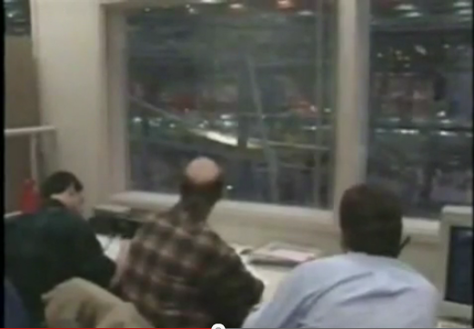
Forward Engineering: 154, 154, 154…
Wing stress test video

Slide 22
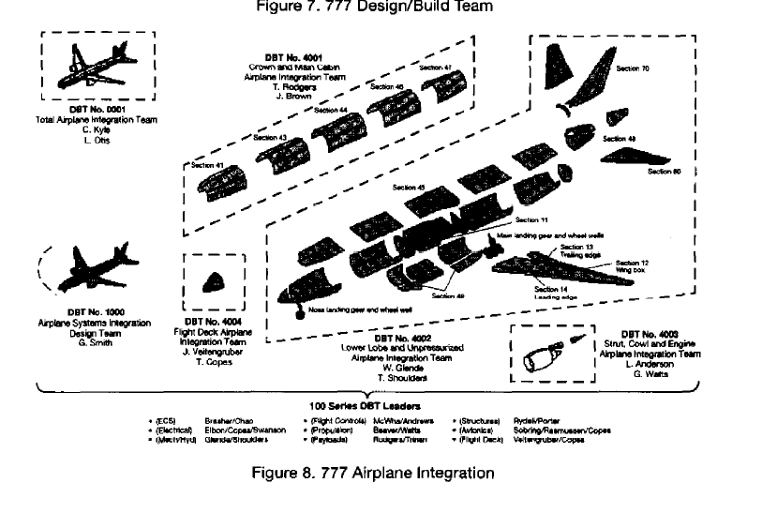
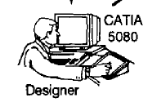
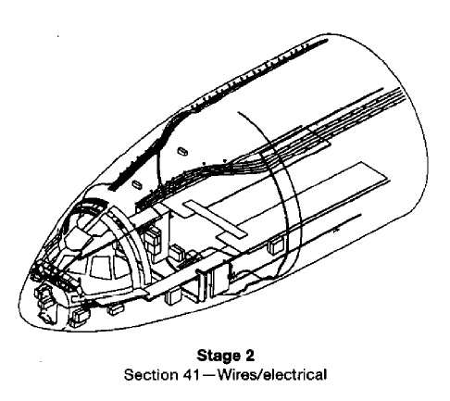
Abstraction Hierarchy
a human invention designed to assist people in engineering complex systems
Some system designers
Other experts who integrate of subcomponents
Some experts in electrical system wiring

Slide 23
Abstraction Hierarchy
a human invention designed to assist people in engineering complex systems
Everyone has to do their job right for the final product to work
No single person understands everything about the final product
Interfaces between layers are critically important

Slide 24
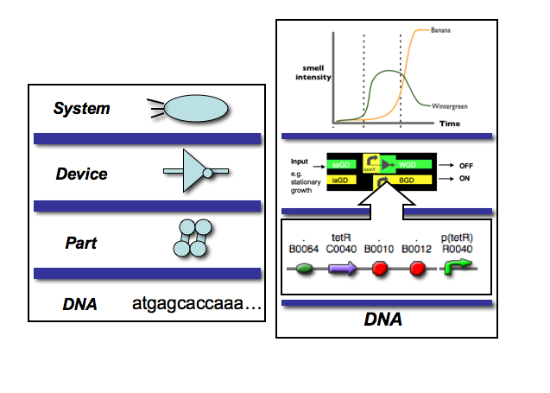
Abstraction Hierarchy
a human invention designed to assist people in engineering complex systems

Slide 25
Abstraction Hierarchy
a human invention designed to assist people in engineering complex systems

Slide 26

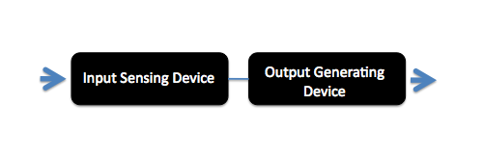
Abstraction Hierarchy
a human invention designed to assist people in engineering complex systems

