Slide 1

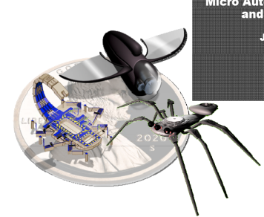
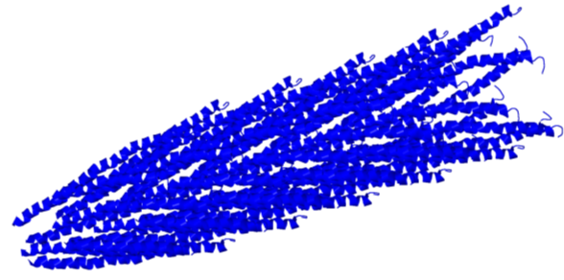
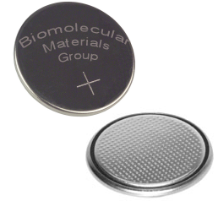
Electrochemistry &
Virus-Templated Electrodes
F. John Burpo
Biomolecular Materials Laboratory
Massachusetts Institute of Technology
November 30, 2010
Notes:
Correct references

Slide 2
Outline
Electrochemistry Review
Lithium Rechargeable Batteries
Battery Testing
Notes:
Main Themes:
USMA trains you to be a general problem solver, not a mechanical/chemical engineer/chemist/life scientist
Army career path is not fixed and has many opportunities . . . If you keep them open
Energy is a multidisciplinary field
Bioengineering is not necessarily an extension of pure biology
Biology presents a toolbox Mother Nature already engineered to solve human engineering problems
MechE themes: nanomechanical properties, electrical device applications, thermo/entropy, material properties, vibrations engineering for mass transport math
Ask questions! As a LT, as a scientist/engineer, etc. Never assume you know, and never assume you have the best method to do something

Slide 3

1970: Design Choice
Imagine
Blue Pill:
Increase CPU transistor
chip density x2,000,000
Red Pill:
Increase rechargeable
battery capacity x4

Slide 4


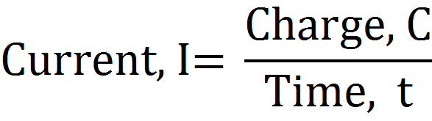
Electrochemistry Basics
I
V
e⁻
e⁻
I
(+)ions
(-)ions
+
–
Salt
Bridge
Cu
Zn
Capacity = I∙time
Cu²⁺(aq) +2e⁻ → Cu(s) +0.337 V
Zn(s) → Zn²⁺(aq) +2e⁻ +0.763 V
Zn(s) + Cu²⁺(aq) → Zn²⁺(aq) + Cu(s) 1.100 V

Slide 5
Standard reduction potentials
Half reaction Eº, V
F₂ (g) + 2H⁺ + e⁻ 2HF (aq) 3.053
Ce⁴⁺ + e⁻ Ce³⁺ (in 1M HCl) 1.280
O₂ (g) + 4H⁺ + 4e⁻ 2H₂O (l) 1.229
Ag⁺ + e⁻ Ag (s) 0.799
Cu²⁺ + 2e⁻ Cu(s) 0.340
2H⁺ + 2e⁻ H₂ (g) 0.000
Pb²⁺ + 2e⁻ Pb (s) -0.125
Fe²⁺ + 2e⁻ Fe (s) -0.440
Zn²⁺ + 2e⁻ Zn (s) -0.763
Al³⁺ + 3e⁻ Al (s) -1.676
Li⁺ + e- Li(s) -3.04

Slide 6
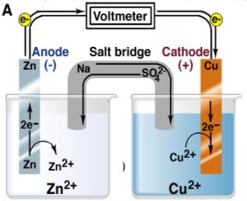
What is Eº for the Zn/Cu cell?
Products ̶̶ Reactants
Eº_{cell} = Eº_{cathode} ̶ Eº_{anode}
Product gets electron
Reactant gives electron
Cathode: Cu²⁺(aq) + 2e- → Cu(s) Eº = +0.34 V
Anode: Zn(s) → Zn²⁺(aq) + 2e- Eº = +0.76 V
Net: Cu²⁺(aq) + Zn(s) → Zn²⁺(aq) + Cu(s)
Eº_{cell} = Eº_{cathode} - Eº_{anode}= 0.34 – (-0.76) = +1.10 V

Slide 7
Eº and ΔGº
ΔGº = - n F Eº
For a product-favored reaction
Galvanic cell: Chemistry → electric current
Reactants → Products
ΔGº < 0 and so Eº > 0 (Eº is positive)
For a reactant-favored reaction
- Electrolytic cell: Electric current → chemistry
Reactants ← Products
ΔGº > 0 and so Eº < 0 (Eº is negative)

Slide 8
When not in the standard state (Nernst Equation)
ΔG = - nFE
ΔGº = - nFEº
ΔG = ΔG⁰ + 2.303 RT log Q
E = E⁰ - (RT/nF) ln Q aA + bB  cC + dD
At standard state temperature, Nernst equation
Q is the reaction quotient, or the ratio of the activities of products to reactants

Slide 9

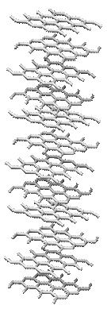
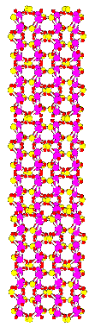
Lithium Rechargeable Batteries
How They Work
e⁻
e⁻
Discharged state
Discharging
Charged state
Anode
Cathode
Courtesy
Dr. Mark Allen
C (graphite anode)
Co₃O₄ (cobalt oxide anode)
LiC₆ (graphite anode)
Li₂O/Coº (cobalt oxide anode)
FePO₄ cathode
CoO₂ cathode
= Li⁺
LiFePO₄ cathode
LiCoO₂ cathode
= LiPF₆
Notes:
9
Ask cadets question about the performance of there digital system batteries?
Implications for electric cars.
Soldier load

Slide 10
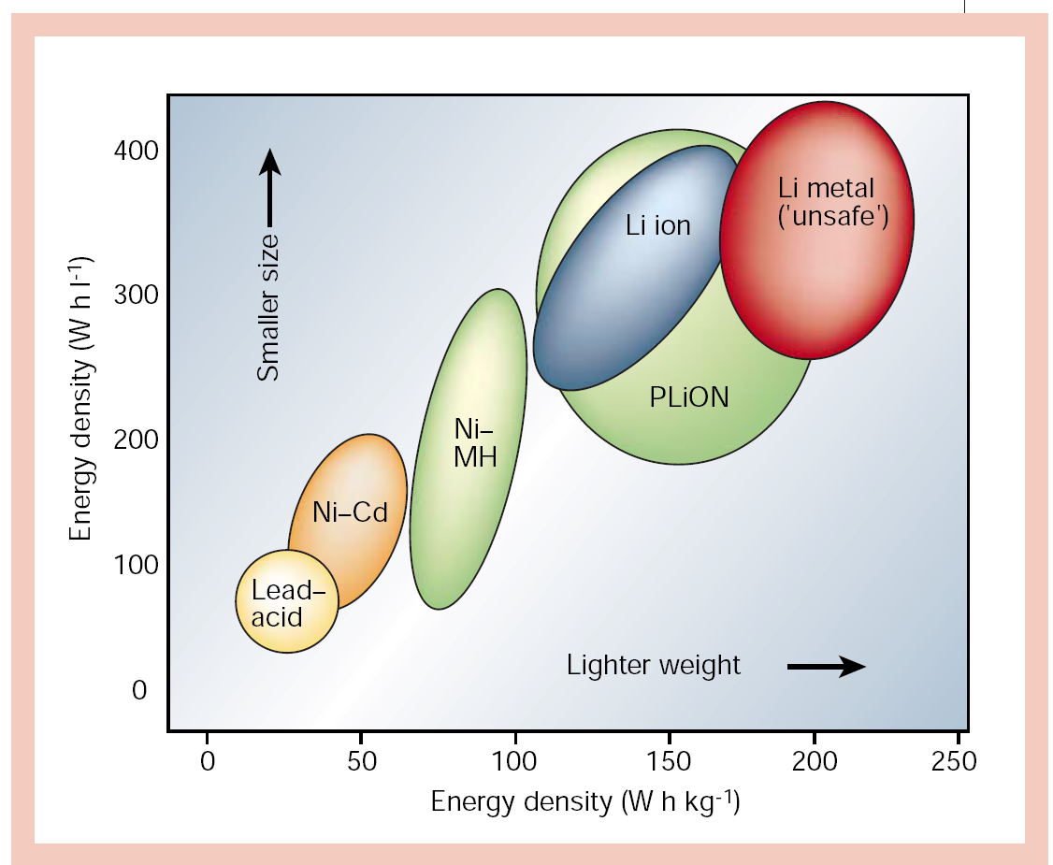
Energy Density & Capacity
Tarascon, Nature 414, 359-367 (2001)

Slide 11
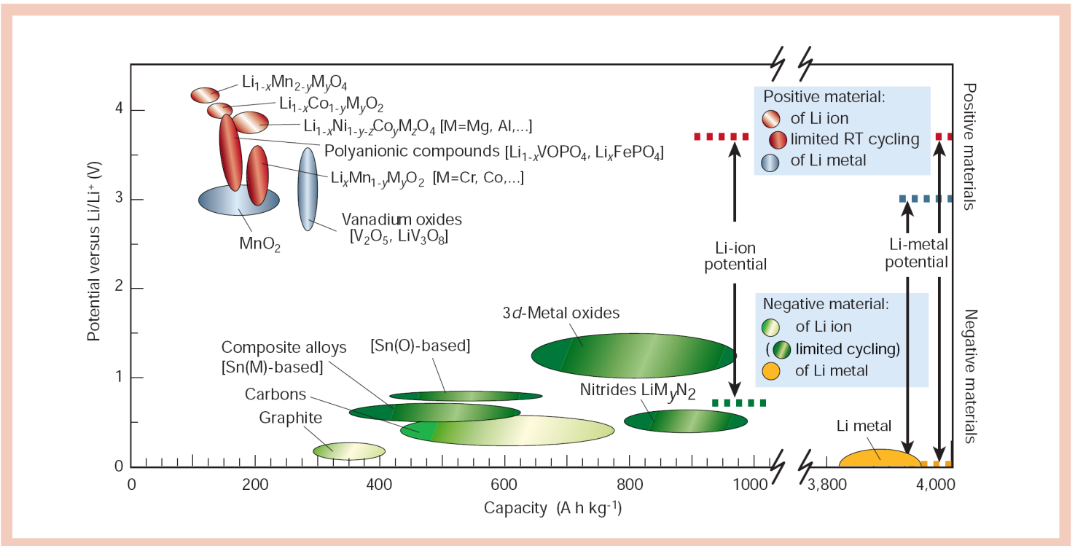
Energy Density & Capacity
Tarascon, Nature 414, 359-367 (2001)

Slide 12
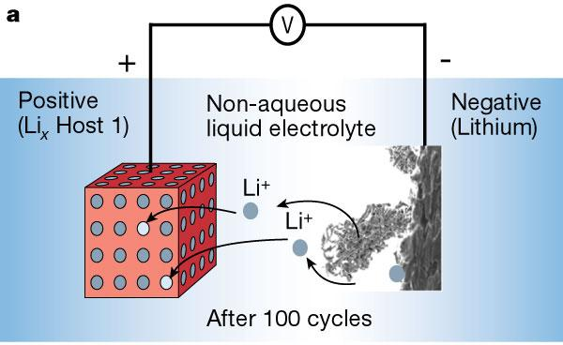
Lithium plating and dendrites
Tarascon, J.M. & Armand, M., Nature, 414, (2001)
Xu, K., Chemical Reviews, 2004 4303-4417
Notes:
Dendrite formation and lithium plating happen because of the low voltage of anodes

Slide 13
Chemistries of electrodes
Most common electrode system is that of LiCoO₂ and graphite
0.1 V vs. Li
3.8-3.9 V vs. Li
3.7 V total
Notes:
If the battery gets discharged too far, the LiCoO2 is converted to CoO, the oxygens move from hcp to ccp

Slide 14
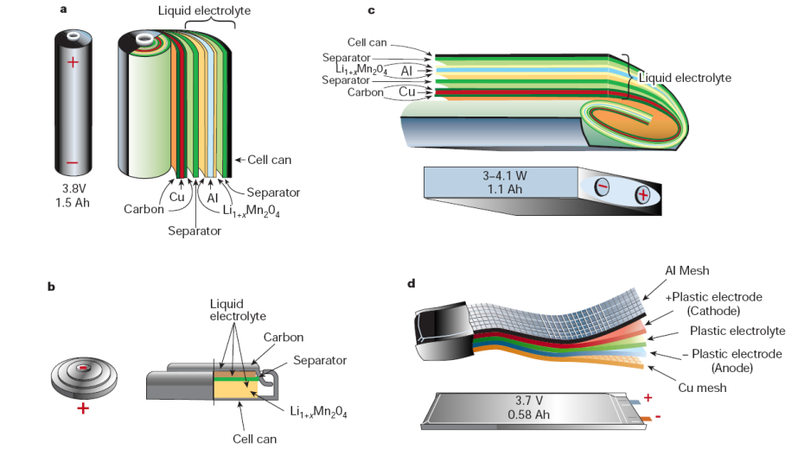
Battery Form Factors
Tarascon, Nature 414, 359-367 (2001)

Slide 15
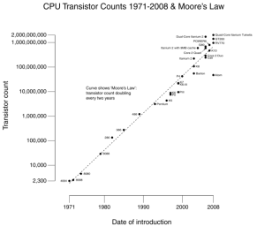
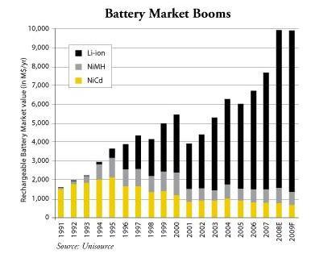
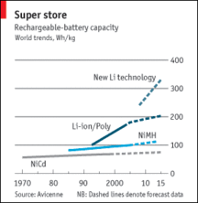
Demand & Capacity
Ubiquitous device demand for energy storage.
Need for flexible, conformable, and
microbatteries.
Micro Power Demand: MEMS devices, medical
implants, remote sensors, smart cards, and
energy harvesting devices.

Slide 16

Battery Design Parameters
“Design Landscape”
Charge/Discharge Rates
Pressure
Capacity
Volume Swelling
Electrolyte Stability
Separator permeability
Power Density
Overpotential
Energy Density
Solid Electrolyte Interface
Cycling Life
Electrode Potentials
Li Dendritic Growth
Background Objectives Research Design Results
Notes:
Formidable landscape of challenges that might account for the slow progress in the field
Proprietary withholding of information also impedes progress

Slide 17
Where to go next?
Background Objectives Research Design Results

Slide 18

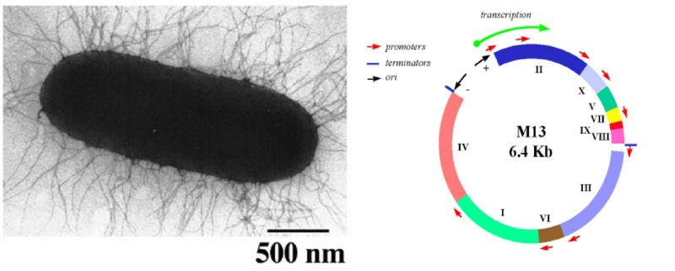
M13 Bacteriophage
Specthrie, J Mol Biol. 228(3):720-4 (1992)
M. Russel, B. Blaber.

Slide 19
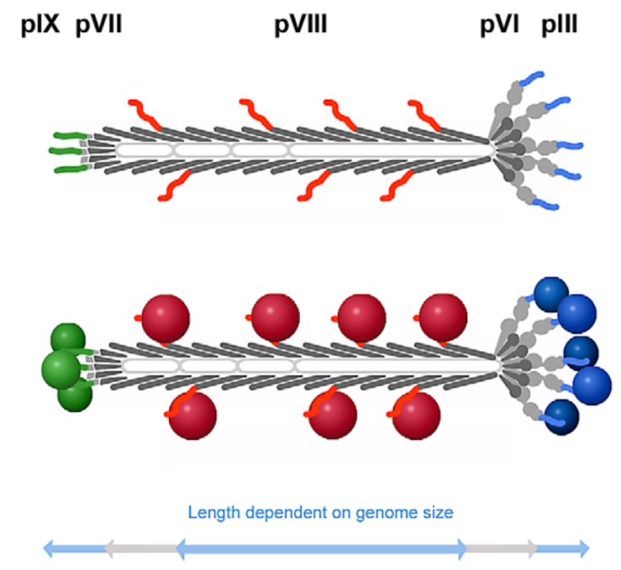
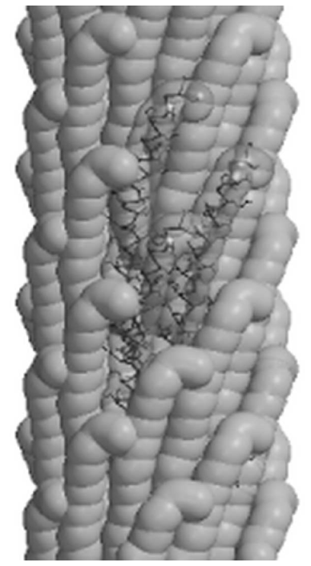
M13 Bacteriophage
Flynn, Acta Materialia 51, 5867-5880 (2003)
(Marvin, J. Mol. Biol. 355, 294–309 (2006)
Background Objectives Research Design Results
Notes:
Molecular weight of 1.64 3 107 g/M. (Dogic, 1997)
Virus Advantages
functional heterostructured templates for precisely
positioned nanomaterials (16, 17). Furthermore,
the intrinsically anisotropic virus structures
are well suited for the growth of monodisperse,
highly crystalline nanowires (14, 15). In addition,
the anisotropic virus structures are promising
as elements of well-ordered nanostructure,
as demonstrated in three-dimensional (3D)
liquid crystal film (18, 19).
(Nam, 2006)
Laundry list of uses demonstrated by the Belcher End

Slide 20
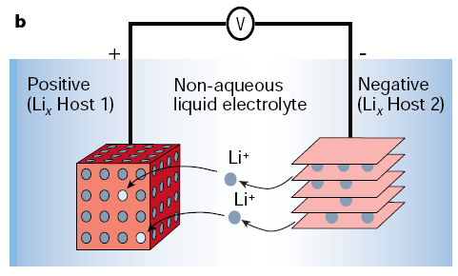
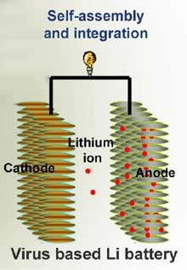
Evolving the Battery
Tarascon, Nature 414, 359-367 (2001)
Courtesy of Angela Belcher
Background Model Aims Experiments Future

Slide 21





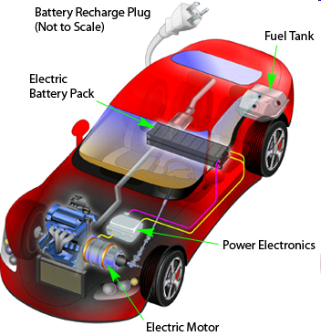
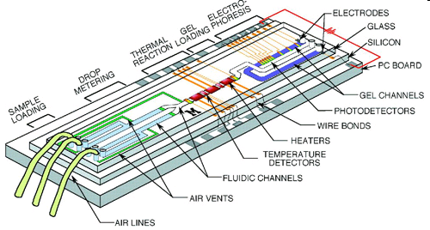
Bio-Battery Applications
UAS Systems
Soldier Load
Lab on a Chip
Plug-in Hybrid
Background Objectives Research Design Results

Slide 22
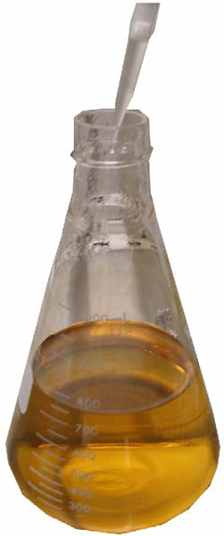
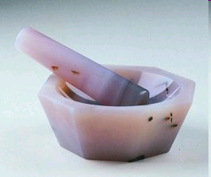
Synthesizing Electrodes
Mix Nanowires with carbon and organic binder

Slide 23
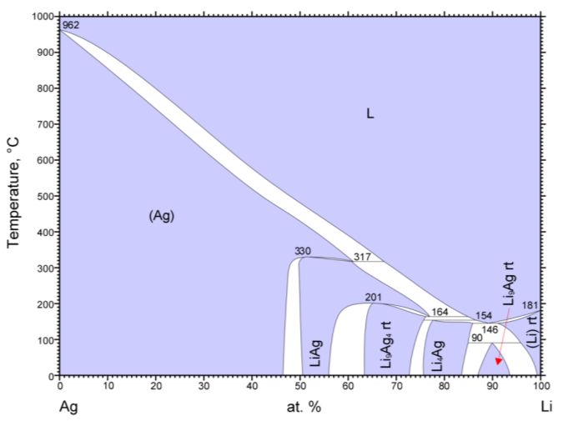
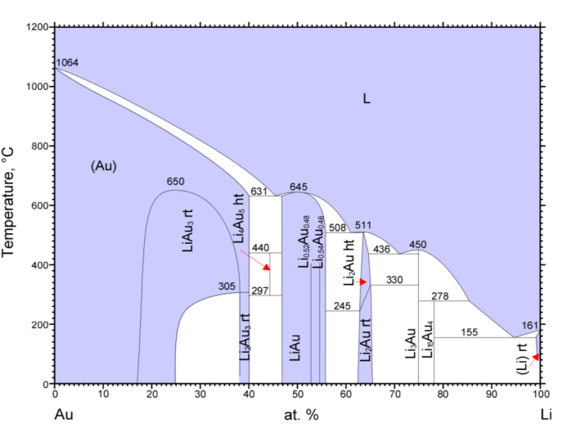
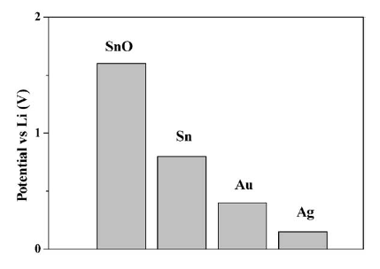
Alloy forming anodes for Lithium ion batteries
Au or Ag : capable of alloying with Li up to AgLi₉ and Au₄Li₁₅ at very negative potential
http://www.asminternational.org/
Taillades, 2002, Sold State Ionics
Notes:
23

Slide 24
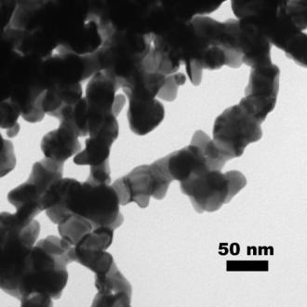
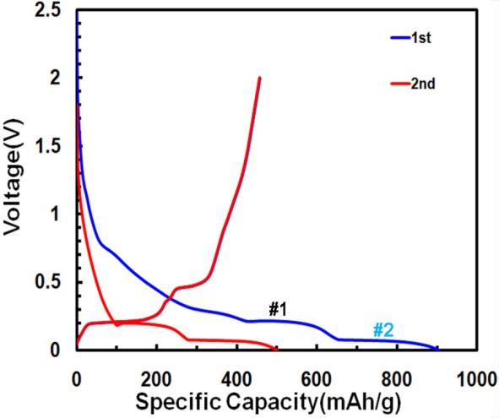
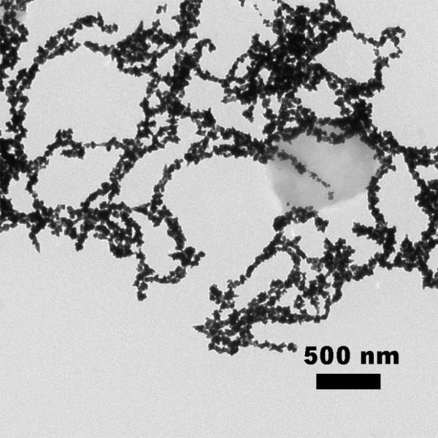
Pure Au viral nanowires
Plateaus:
0.2 and 0.1 V/discharge
0.2 and 0.45V/charge
Capacity from 2nd cycle
501 mAh/g [AuLi_{3.69}]
Diameter: ~40 nm, free surface

Slide 25
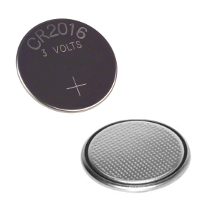

Coin Cell Assembly
Upper Assembly
Plastic
O-Ring
Lithium (s)
Electrolyte
2 x Polymer Separators
Electrolyte
Electrode
Copper Foil – Current Collector
Steel Spacer
Lower Assembly
Background Design Results Future

Slide 26
Capacity Calculation
= 881 mAh/g

Slide 27
Calculating capacity for Gold Anode
Determine the active mass, not everything in the electrode is redox active
Example: a 2 mg electrode with 20% inactive material (super P and PTFE binder)
In order to discharge this electrode over one hour, apply -0.499 mA

Slide 28
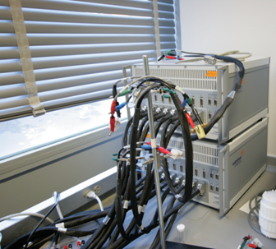
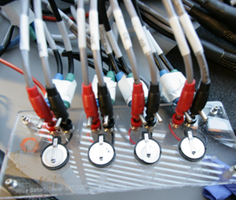
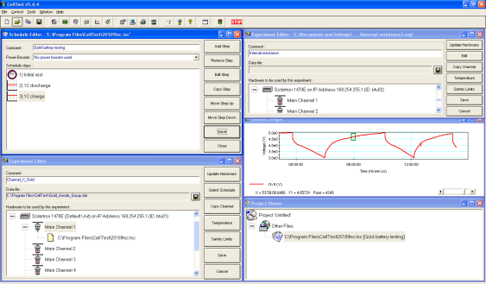
Battery Testing
16 channels for testing batteries
8 coin cell testers
Celltest program for measurement and analysis

Slide 29
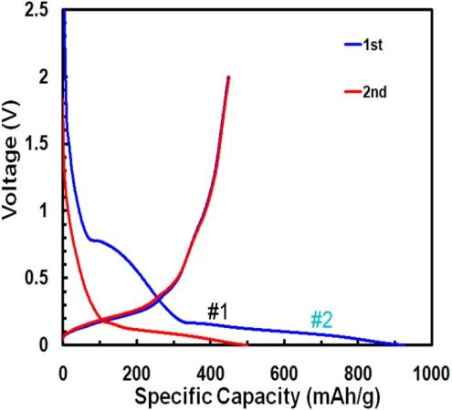
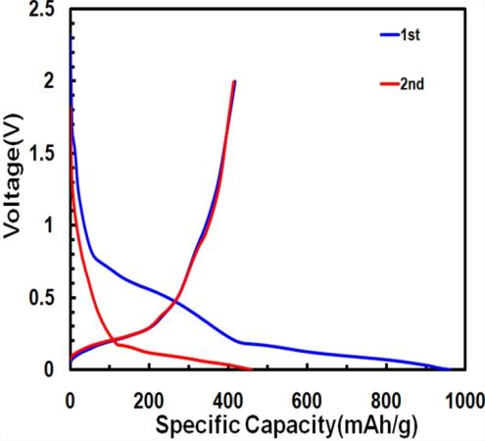
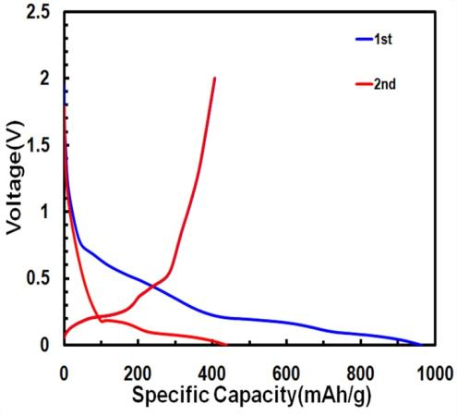
Discharge/charge curves from the first two cycles
Au_{0.9}Ag_{0.1}
Au_{0.5}Ag_{0.5} Au_{0.67}Ag_{0.33}
2nd cycle :
499mAh/g 459mAh/g
Au_{0.9}Ag_{0.1}
Curve shape similar with Au
Capacity at 2nd cycle : 439mAh/g

Slide 30
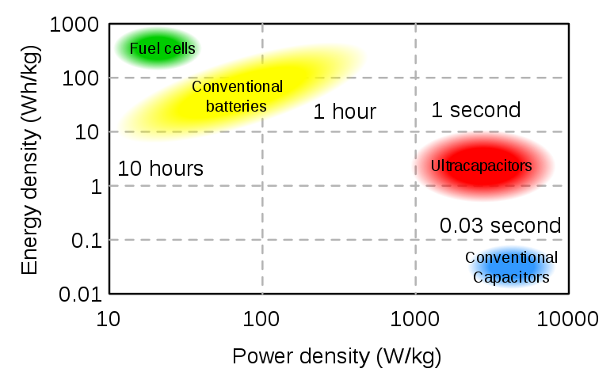
The Ragone Plot
Gasoline energy density ~12 kWh/kg and nuclear fission yields ~ 25 billion Wh/kg

Slide 31
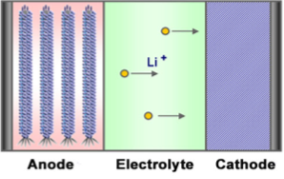
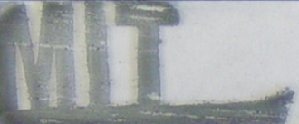
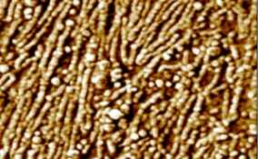
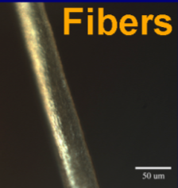
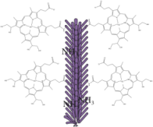
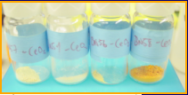
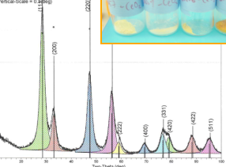
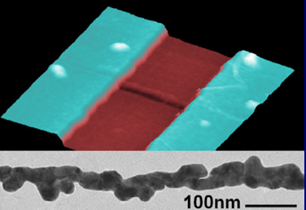
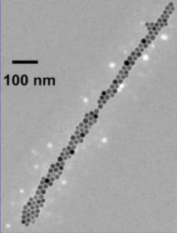
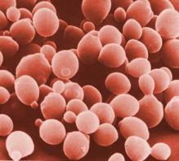
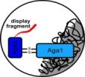
So What Else Can the Virus Do?
Batteries
Electrochromics
Solar Cells
H₂O Splitting
gVII, gIX
gVIII
gIII, gVI
Carbon
Capture
Fuel Cells
Electronics
Medicine

Slide 32

Questions ???

Slide 33
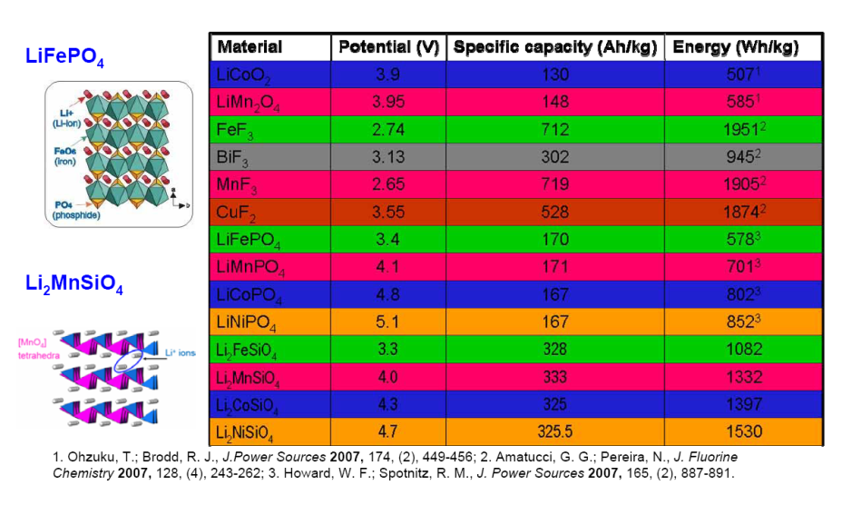
Cathode Materials

