Slide 1
GLN3 of Saccharomyces Cervesiae
Ashley Rhoades

Slide 2
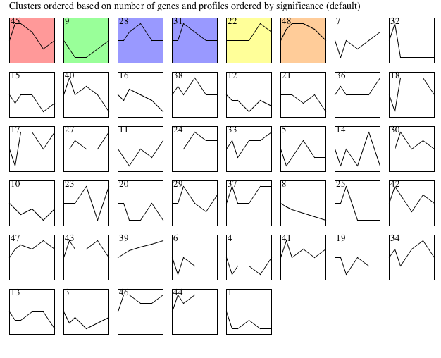
Overall

Slide 3
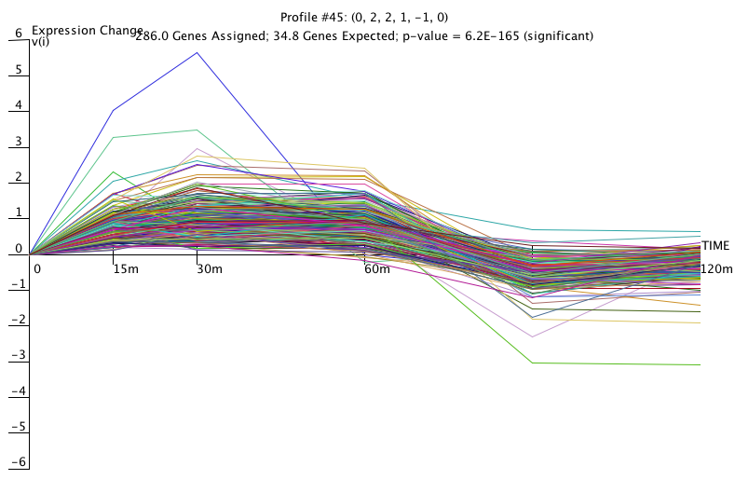
Profile 45

Slide 4
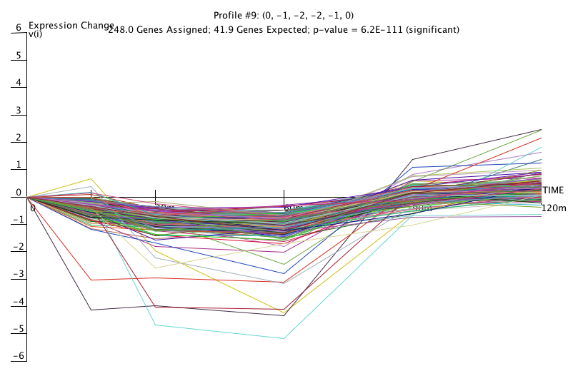
Profile 9

Slide 5
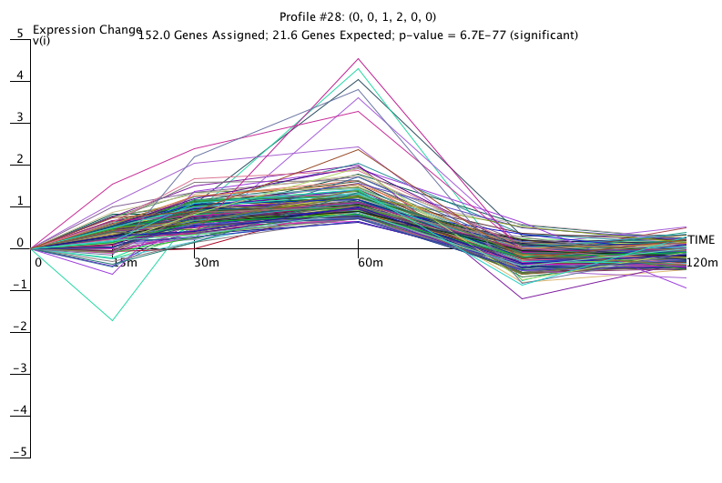
Profile 28

Slide 6
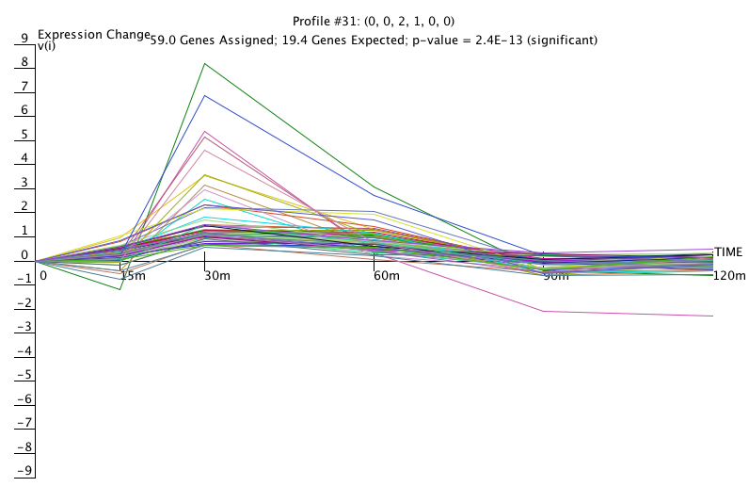
Profile 31

Slide 7
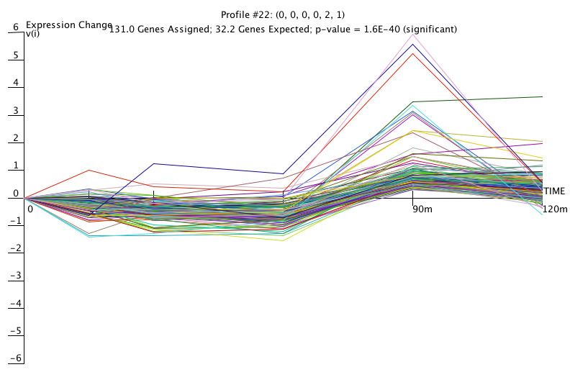
Profile 22

Slide 8
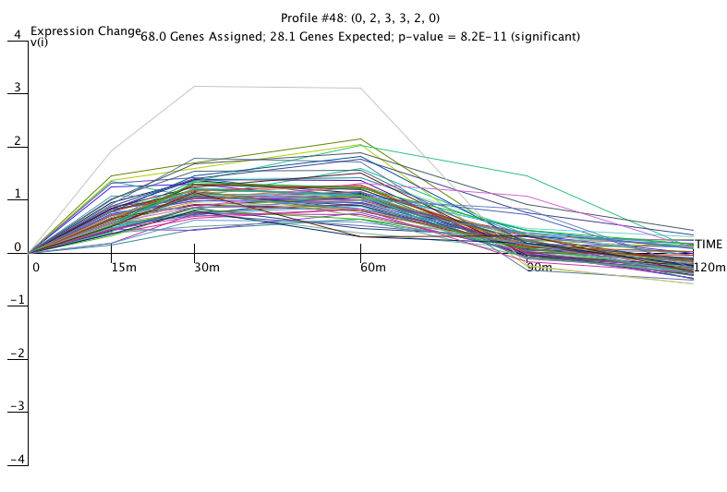
Profile 48

