Slide 1
Week 11 Data and Figures
Nika Vafadari
BIOL-398-05/S17
Department of Biology
Loyola Marymount University

Slide 2
One third
of genes significant
ANOVA | dGLN3
p < 0.05 | 2088 genes, 33.74%
p < 0.01 | 1232 genes, 19.91%
p < 0.001 | 594 genes, 9.60%
p < 0.0001 | 236 genes, 3.81%
B & H p < 0.05 | 1231 genes, 19.89%
Bonferroni p < 0.05 | 72 genes, 1.16%%

Slide 3
 | Cold Shock |  |  | Recovery
t test | t₁₅ | t₃₀ | t₆₀ | t₉₀ | t₁₂₀
Average Log Fold Change > 0.25 and p < 0.05 | 1017 genes (16.43%) | 1060 genes (17.13%) | 1019 genes (16.46%) | 681 genes (11.00%) | 780 genes (12.60%)
Average Log Fold Change < -0.25 and p < 0.05 | 834 genes (13.48%) | 862 genes (13.93%) | 809 genes (23.00%) | 903 genes (14.59%) | 817 genes (13.20%)
Total p < 0.05 | 2088 genes (33.74%) | 2088 genes (33.74%) | 2088 genes (33.74%) | 2088 genes (33.74%) | 2088 genes (33.74%)
Total B & H p < 0.05 | 1231 genes (19.89%) | 1231 genes (19.89%) | 1231 genes (19.89%) | 1231 genes (19.89%) | 1231 genes (19.89%)
Total Bonferroni p < 0.05 | 72 genes (1.16%) | 72 genes (1.16%) | 72 genes (1.16%) | 72 genes (1.16%) | 72 genes (1.16%)

Slide 4
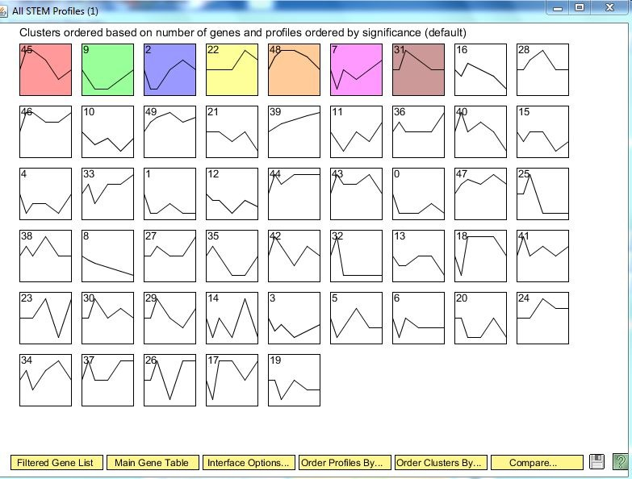
7 statistically significant profiles

Slide 5
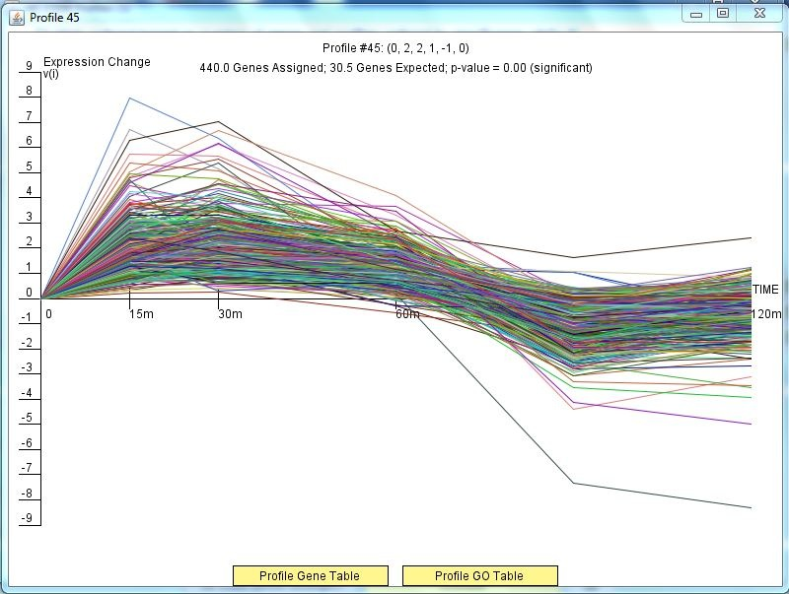
440 genes found in profile 45

Slide 6
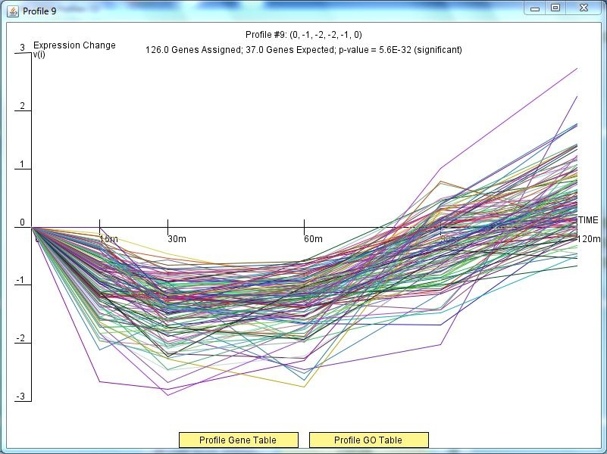
126 genes found in profile 9

Slide 7
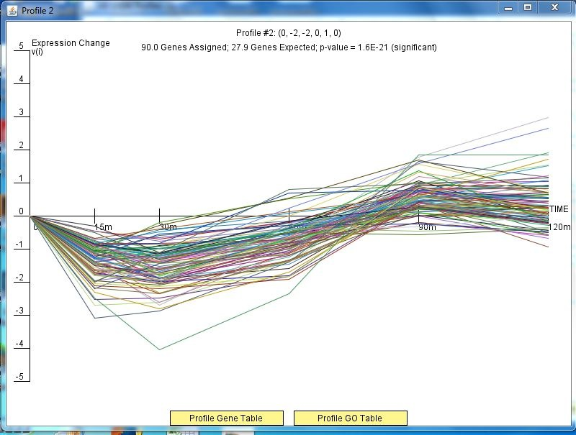
90 genes found in profile 2

Slide 8
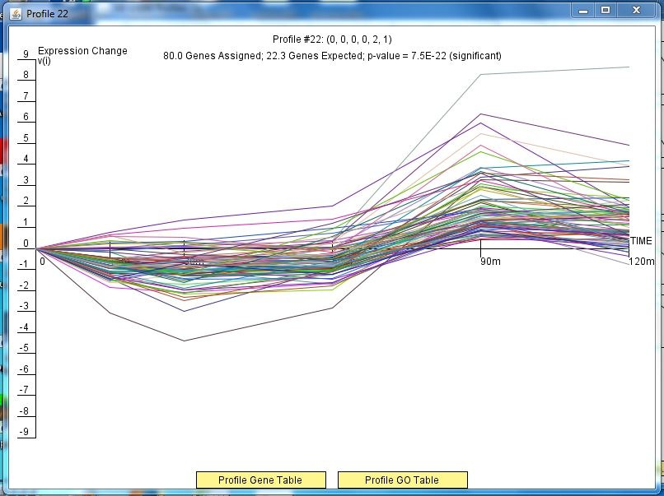
80 genes found in profile 22

Slide 9
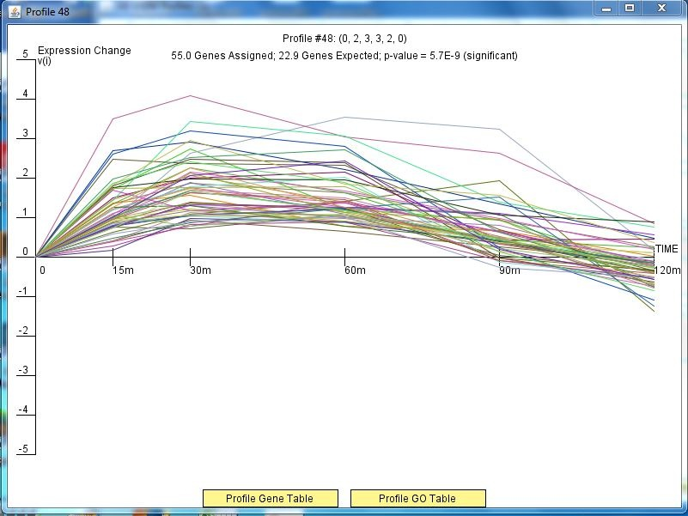
55 genes found in profile 48

Slide 10
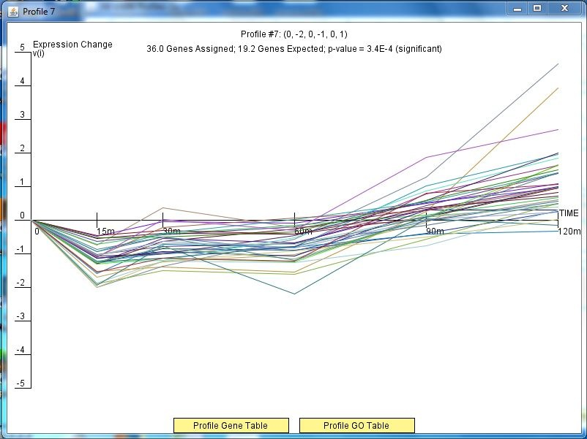
36 genes found in profile 7

Slide 11
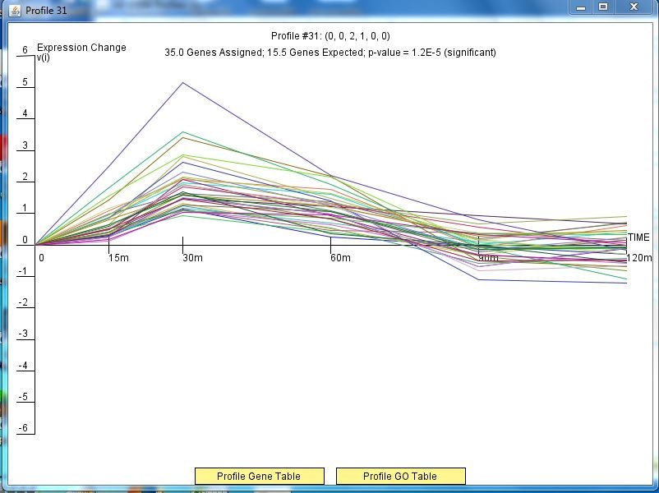
35 genes found in profile 31

