Slide 1
Robust multicellular computing using genetically encoded NOR gates and chemical ‘wires’
Avin Tamsir, Jeffrey J. Tabor & Christopher A. Voight
Presented by Colin Reisterer

Slide 2
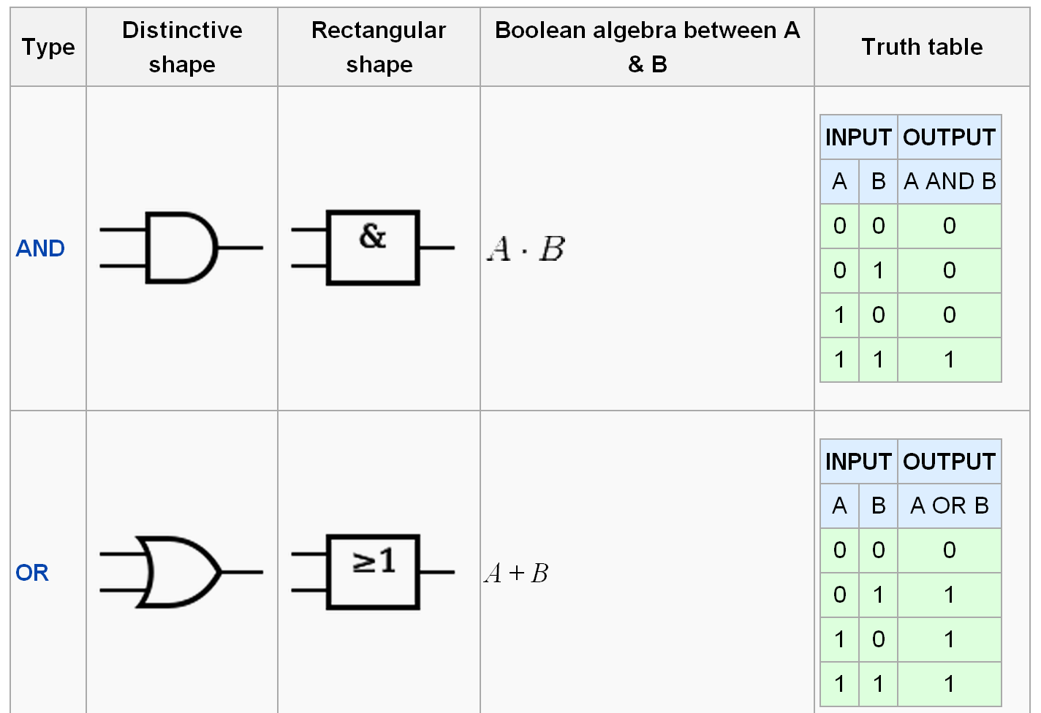
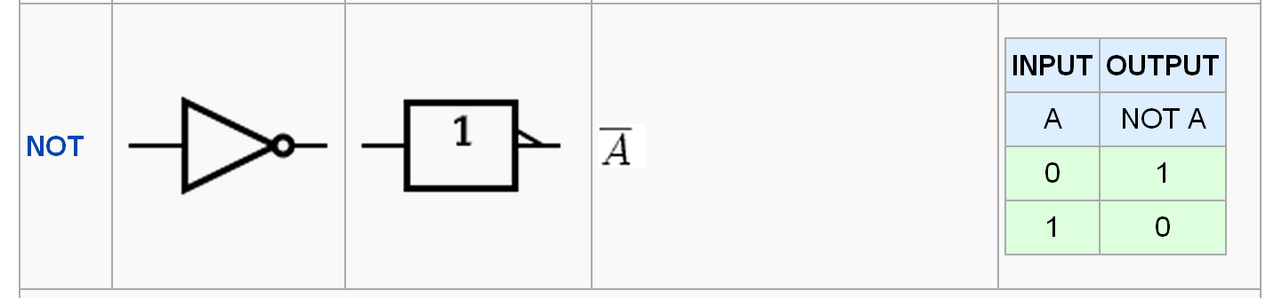
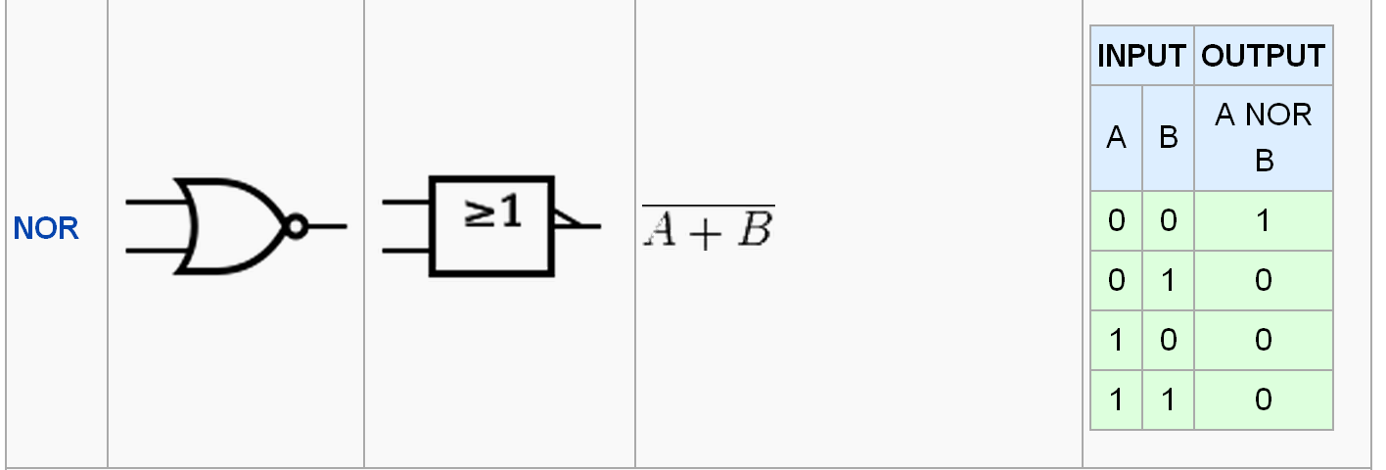
Logic Gates

Slide 3
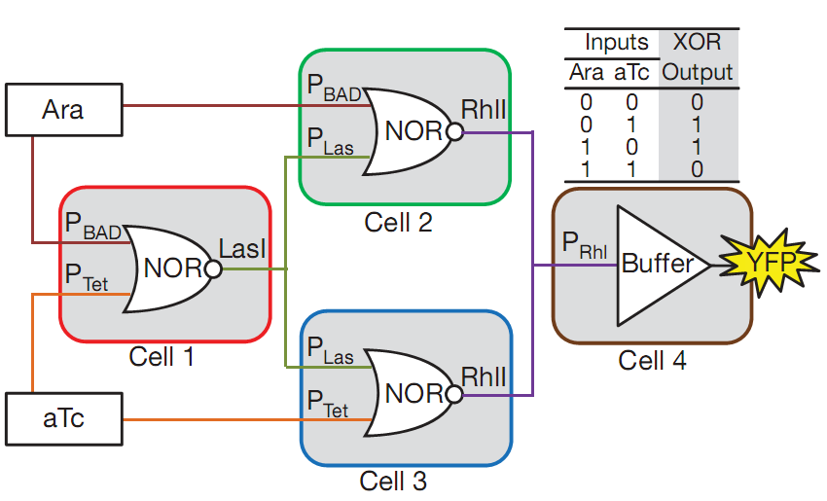
Multicellular computing
Cells as computational devices
Input-Output
Interpreting environmental cues
Logic decisions: rest or replicate?
Multicellular approach
Compartmentalize simple logic gates into different colonies
Colonies can be arranged on plate in defined pattern to achieve circuit.
diffusion time∝ distance²

Slide 4
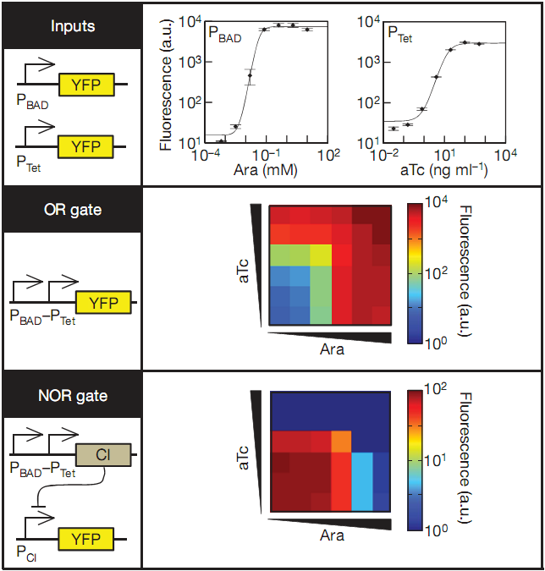
Simple single cell logic gates
P_{BAD}: Activated by Ara
P_{Tet}: Activated by aTc
NOR gate: CI-repressor gene in OR gate, YFP under control of CI-repressible promoter
Using promoters as input gives modularity

Slide 5
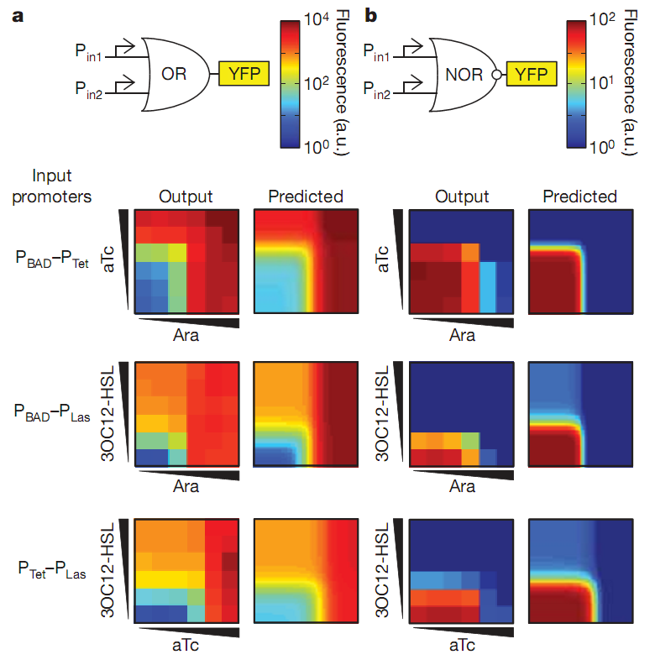
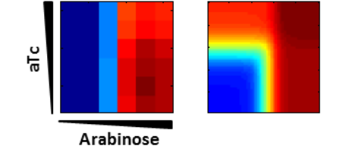
Demonstrated modularity of logic gates
Four other combinations of promoters were tested
Incorporated P_{Las} promoter
Responds to 3OC12-HSL input

Slide 6
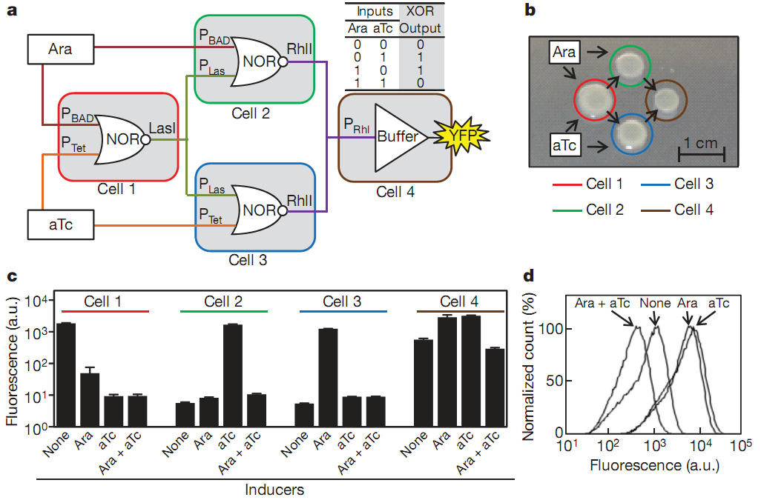
Multicellular XOR Gate
Implemented XOR gate from 3 NOR gates and buffer gate

Slide 7
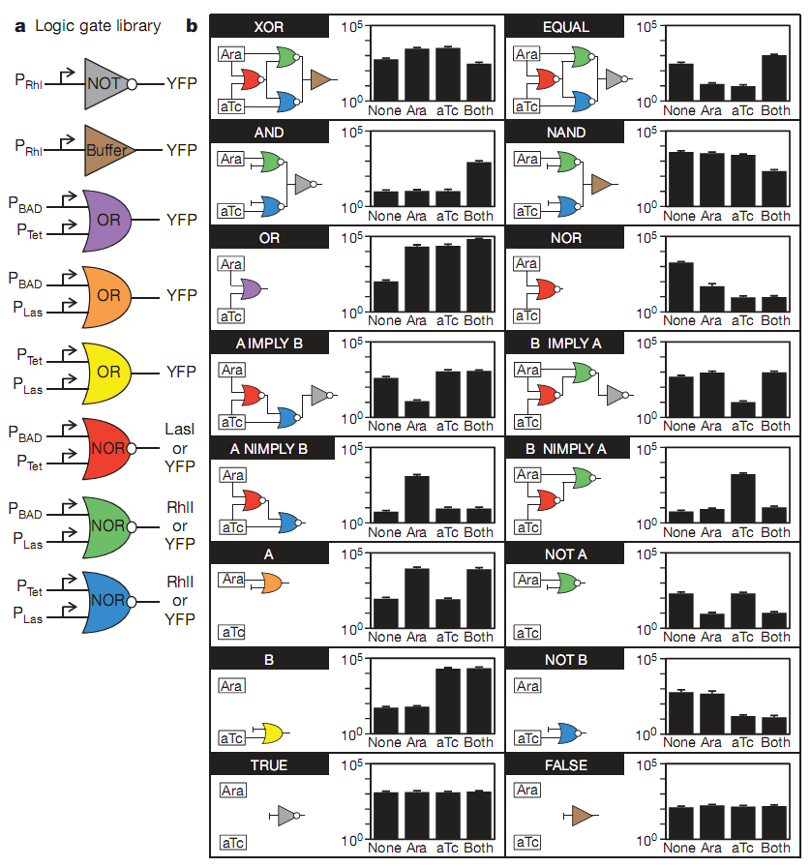
Construction of 16 2-input gates
No circuits required genetic manipulation
Results analyzed using flow cytometry

Slide 8
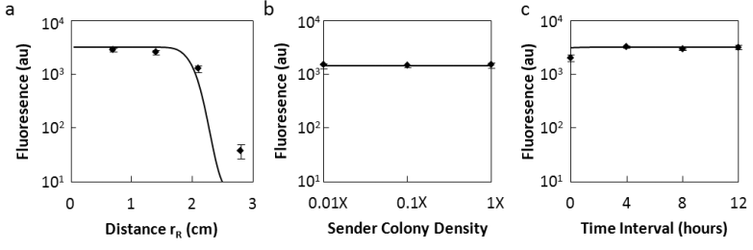
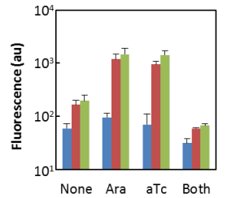
Discussion of Results
Advantages:
Wide dynamic range
Low variability between test
Disadvantages
Time interval necessary between colony spotting
Applicability?
“Reducing the interval from 12 to 6 hours produces an equivalent XOR behaviour. However, when all four XOR colonies were spotted at the same
time (0 hours), the quality of the logic function is reduced significantly.”

Slide 9
Thanks!

Slide 10
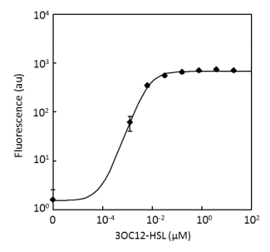
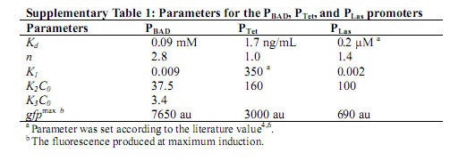
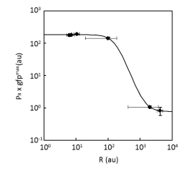
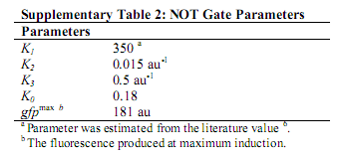
Supplementary Info

