Slide 1
Statistical Modeling and Analysis of Scientific Inquiry:
The Basics of Hypothesis Testing

Slide 2
Statistics: The Science of Data
Data comprises quantitative measurements of individuals
Individuals are representative sample from a population
Population is modeled by a probability density function representing the likelihood of measurement values
Statistics is a collection of tools and techniques for organizing, analyzing, illustrating, and interpreting data

Slide 3
Basic Data Analysis Tools
Data:
Mean and median: what’s the middle
  Sample mean, ,is the average
  Median is the middle data point (of the sorted list)
Standard deviation, IQR, median absolute deviation: how much variability
Histograms and box plots: what does the distribution look like?

Slide 4
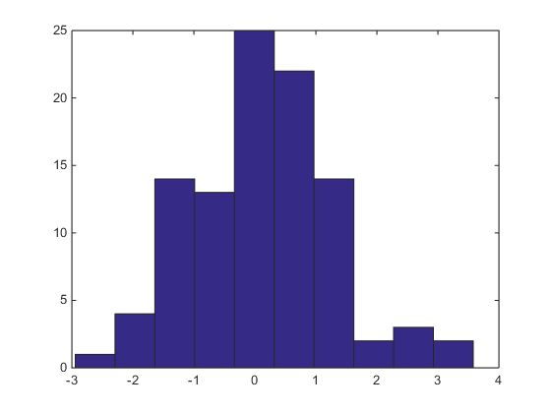
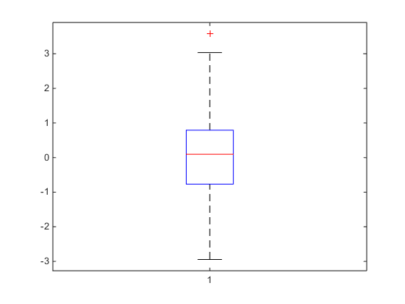
Histograms and Box Plots
Each bar is the number of data points between the ordinate values of the bar
Should look like a piecewise constant approximation (like Riemann sums in calc)
The box is bounded by the first and third quartiles, with the mid line being the median.
The whiskers go out to q1-1.5*IQR and q3+1.5*IQR
Outliers are plotted beyond the whiskers

Slide 5
Science and Statistics: An Abstract View
Theory: we have a population of individuals or “experimental units” (EUs)
  In bio applications, these are typically organisms
  In medical applications, these are typically patients
Inquiry: we propose hypotheses about the properties of these EUs.
  How an organism respond to stress
  How a patient responds to treatment
  Does one treatment work better than another

Slide 6
Principles of Statistical Modeling
Modeling Concept 1: We can characterize the EUs with a vector of attributes that can be observed
Modeling Concept 2: EUs selected randomly from the population produce attributes according to a probability distribution
Modeling Concept 3: The population’s probability distribution is known except for a parameter vector that must be estimated from observations
Modeling Concept 4: “Truth” is defined by this unknown parameter vector.

Slide 7
Elements of a Hypothesis Test
Sample of data
Two competing hypotheses: the null and its alternative
A statistic, which is a function of the data with a known sampling distribution
A rejection criterion against which we assess the statistic’s value to decide whether or not we can reject the null.

Slide 8
The Math of Statistics, 1
The parametrically modeled probability distribution
The parameter represents truth about the population
Question: what can we say about after we’ve seen some x’s?

Slide 9
The Math of Statistics, 2
The probability density models EUs by weighting the possible measurement values
Area under curve tells us probabilities

Slide 10
The Math of Statistics, 3
The sample is a collection
Ideally the histogram of these would look like the probability density (if we knew )

Slide 11
Population vs. Sample
Population is fixed
  Very large
  Impractical to investigate all members
Population has one distribution
Population has parameters
  Fixed, but usually not known
Samples are random
  Large enough to be representative
  Small enough to be studied
Each sample has a histogram
Sample has statistics
  Known, but repeated samples will have different values
Meta: we can think of a population of possible statistic values!!!!!

Slide 12
The biggest idea in statistics
In most circumstances, a larger sample produces an average that more accurately represents a population mean.
If has average
If the population has mean μ and std dev σ
Then the population of averages has mean μ and std dev
And the sample average tends to be normally distributed as n grows

Slide 13
Hypothesis Testing For the Mean
Population is characterized by a central value μ and a spread σ of values around that.
  Should be symmetric
  Tails should taper relatively quickly
  The actual values of μ and σ are not known
The question is the following: Is the unknown μ equal to a specified value μ₀?
  H₀: μ =μ₀
  H_{A}: μ ≠μ₀

Slide 14
Mistakes That Can Be Made, 1
Choosing H_{A} when H₀ is true
  Type I error
  The greek letter α is used denote the likelihood
  In applications, this is usually a false positive or false detection.
  Common approach is to select a value of α we’re willing to tolerate
    α =0.05 is the most common choice
  Concept: Over many many repetitions when H₀ is true, α percent of the time, we’d declare H₀ to be false

Slide 15
Mistakes That Can Be Made, 2
Choosing H₀ when H₀ is false
  Type II error
  The greek letter β is used denote the likelihood
  In applications, this is usually a false negative or missed detection.
  Common approach is to hope β is small
  1 - β is called the power of the test
    Represents the likelihood of detecting a real effect!!!
    This is the probability of selecting H_{A} when H_{A} is true
  Note that H_{A} being true is complicated: as long as μ ≠μ₀ the alternative H_{A} is true! Even if by 10⁻¹⁵ !!!!

Slide 16
Some Concepts and Lingo
Generally H₀ is something you expect not to be true.
  For example, you expect a non-zero mean
In science, models can only be demonstrated to be false.
We reject an actually true H₀ fairly infrequently (depends on the α we choose)
When H₀ is not rejected by the test, we say that we “fail to reject H₀,” not that we accept H₀.
  The Type II error probability is difficult to assess

Slide 17
How to Test
Collect a sample
Form the t-statistic
If H₀ is true, T has a known probability density
  Student’s T distribution with n-1 degrees of freedom
Choose critical value, t_{α}, of T distribution
  Such that would occur with probability α.
H₀: μ =μ₀
H_{A}: μ ≠μ₀

Slide 18
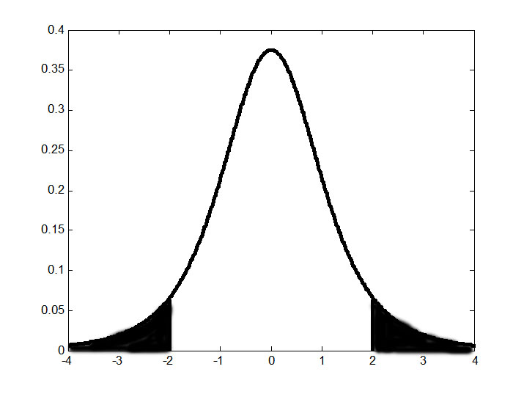
The P Value
Instead of the critical value and the T statistic, we often use α directly with the p value statistic
  Plug the T statistic into its (null) distribution and find the associated probability.
P-value is the shaded area added together
T value and its minus

Slide 19
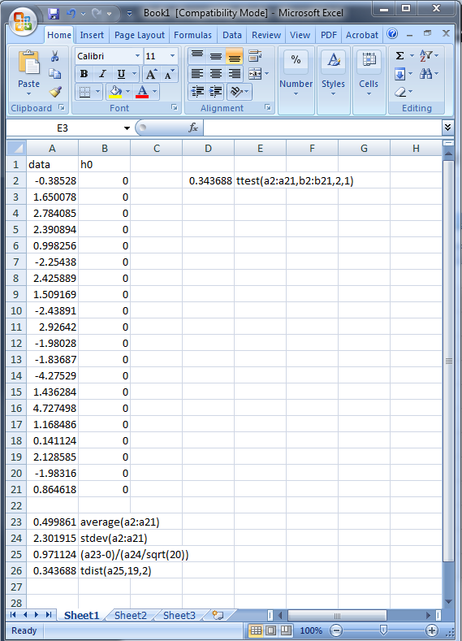
Doing this in Excel
Data in a column or row
Compute the sample mean with the average function
Compute the sample standard deviation with the stdev function
Compute the t statistic
Compute the p-value by plugging the t statistic into the integral with tdist(T,n-1,2)
  That last 2 is for two-tailed integral
Alternatively, use ttest to compute.
  Ttest is designed for two-sample comparison, so you have to trick it by creating a sample with all μ₀’s

Slide 20
More On Student’s T
Slightly false null:
Centered near 0
Null true:
Centered at 0
Extremely false null:
Centered far from 0

Slide 21
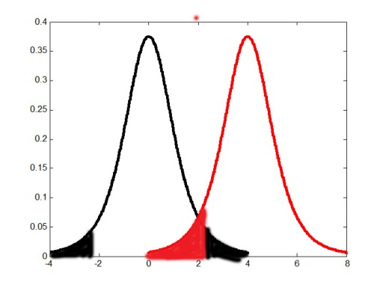
Type I and Type II
α is the black shaded:
Depends Only on Null
β is the red shaded:
Depends on how far the red curve is shifted
Some alternatives are easier to detect

Slide 22
The Alternative Hypothesis
If H₀ is true, T has Student’s T distribution with n-1 degrees of freedom
If H_{A} is true, then
has the T distribution!
H₀: μ =μ₀
H_{A}: μ ≠μ₀

Slide 23
The Alternative Hypothesis

Slide 24
The Alternative Hypothesis
We fail to reject the null when
What this tell us:
  If we have s and n fixed, an effect of size d leads to a power of 1 – β.
  If we have s and n fixed, a power of 1 – β requires an effect size no smaller than d.
  If we want a power of 1 – β and an effect size of d, then we need n samples to achieve our goal.

Slide 25
Effect Size, Sample Size, and Power
To detect an alternative of with power 1-β, we need
With n samples, an effect size of d can be detected with power from

Slide 26
Multi-Group Similarity Testing
Population comprises a fixed set of groups: 1,2, …, p
  Usually thought of as “statistically identical” individuals within the groups
  Each group receives a different “treatment”
  Process leads to groups that may have different means μ₁,... μ_{p,}
  Groups have the same variance σ²
  We sample from each group, size n₁,…n_{p}
The question is the following: Is at least one treatment different?
  H₀: μ₁ =μ₂=… μ_{p}
  H_{A}: At least one of the μ_{i}’s is different

Slide 27
A Digression
Given two numbers, how do we compare them?
  Subtract to compute the difference
  Divide to compute the ratio
Statistical use of subtraction relies on T-statistics
    Two numbers are equal if difference is 0
  Statistical use of division relies on F-statistics
    Two numbers are equal if ratio is 1

Slide 28
Probability Density Functions
The normal distribution(mu,sigma): bell shaped, with
  mu+/- sigma containing 68%
  mu+/- 2sigma containing 95.4%
  mu+/- 3sigma containing 99.7%
Chi squared (m)
  This distribution is what you get when you square m normal(0,1)’s and add them up
  The quantity below is chi squared (n-1)

Slide 29
Probability Density Functions
The T-distribution comes from dividing a normal(0,1) by the square root of a chi-squared
The F-distribution comes from a ratio of chi-squareds

Slide 30
</digression>: ANOVA
Collect a sample
Test the hypothesis:
Assumption: common variance σ²
  H₀: μ₁ =μ₂=… μ_{p}
  H_{A}: At least one of the μ_{i}’s is different

Slide 31
How To Test
All treatments have the same mean under H0

Slide 32
Pseudo-ANOVA
Collect a sample
Test the hypothesis:
Assumption: common variance σ²
  H₀: μ₁ =μ₂=… μ_{p}=0
  H_{A}: At least one of the μ_{i}’s is different from 0

Slide 33
How To Test
All treatments have the same mean under H0

