Slide 1
Alternative Splicing of Integrins
Alyssa Schwartz
Group Meeting
11-30-15

Slide 2
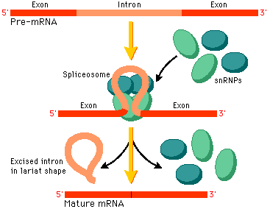
Splicing is an Essential Step in the Central Dogma
Pearson, Prentice Hall

Slide 3
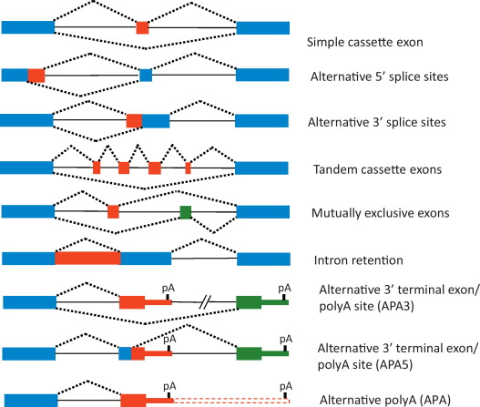
Types of Splice Variations
A D. melanogaster
gene called Dscam potentially has 38,016 splice variants
Claude C. Warzecha, Russ P. Carstens. Complex changes in alternative pre-mRNA splicing play a central role in the epithelial-to-mesenchymal transition (EMT). Seminars in Cancer Biology. Volume 22, Issues 5–6, October 2012, Pages 417–427
Notes:
Alternative Splicing Allows Cells to Generate Multiple Functional Transcript Variants from a Single DNA Region

Slide 4
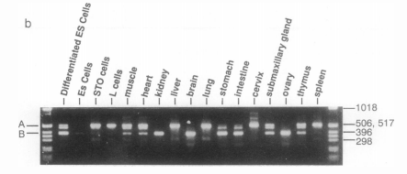
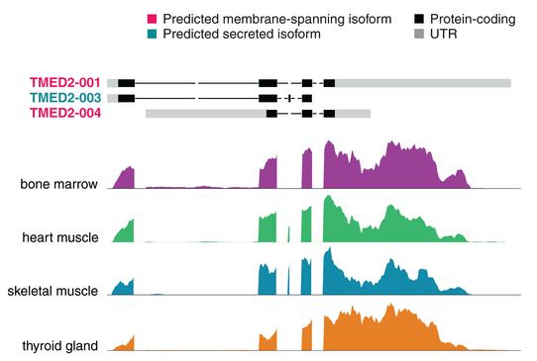
Detection of Splice Variants
PCR – mRNA length of variants is often different
RNA-Seq – local fragments indicate relative abundance of isoforms
R.N. Tamura et al. Cell type-specific integrin variants with alternative- a chain cytoplasmic domains. Proc. Nati. Acad. Sci. USA Vol. 88, pp. 10183-10187 1991
Uhlen et al. Tissue-based map of the human proteome. 2015: Vol. 347 no. 6220

Slide 5
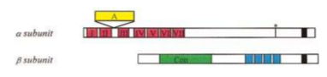
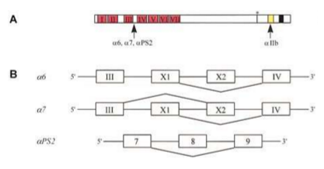
Integrin Protein Structure and Extracellular Modifications
Annemieke A. de Melker and Arnoud Sonnenberg. Integrins: alternative splicing. as a mechanism to regulate ligand binding and integrin signaling events. BioEssays 21:499–509, 1999 John Wiley & Sons, Inc.
Notes:
Extracellular domains contain 7 homologous repeats which fold into the b propeller

Slide 6
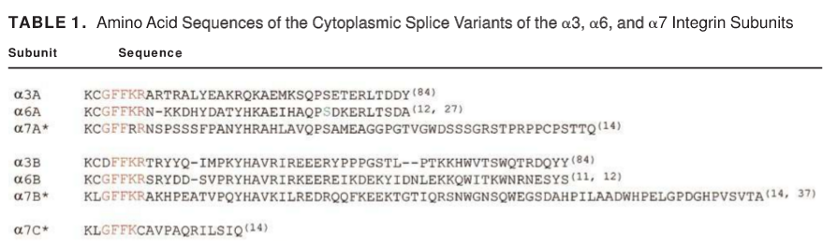
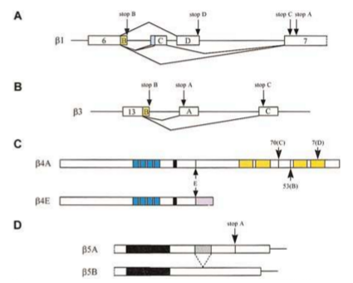
Intracellular Modifications
Mara Fornaro, Lucia R. Languino. Alternatively spliced variants: A new view of the integrin cytoplasmic domain. Matrix Biology. Volume 16, Issue 4, October 1997, Pages 185–193
Arjan van der Flier, Arnoud Sonnenberg. Function and interactions of integrins. Cell and Tissue Research. September 2001, Volume 305, Issue 3, pp 285-298.

Slide 7
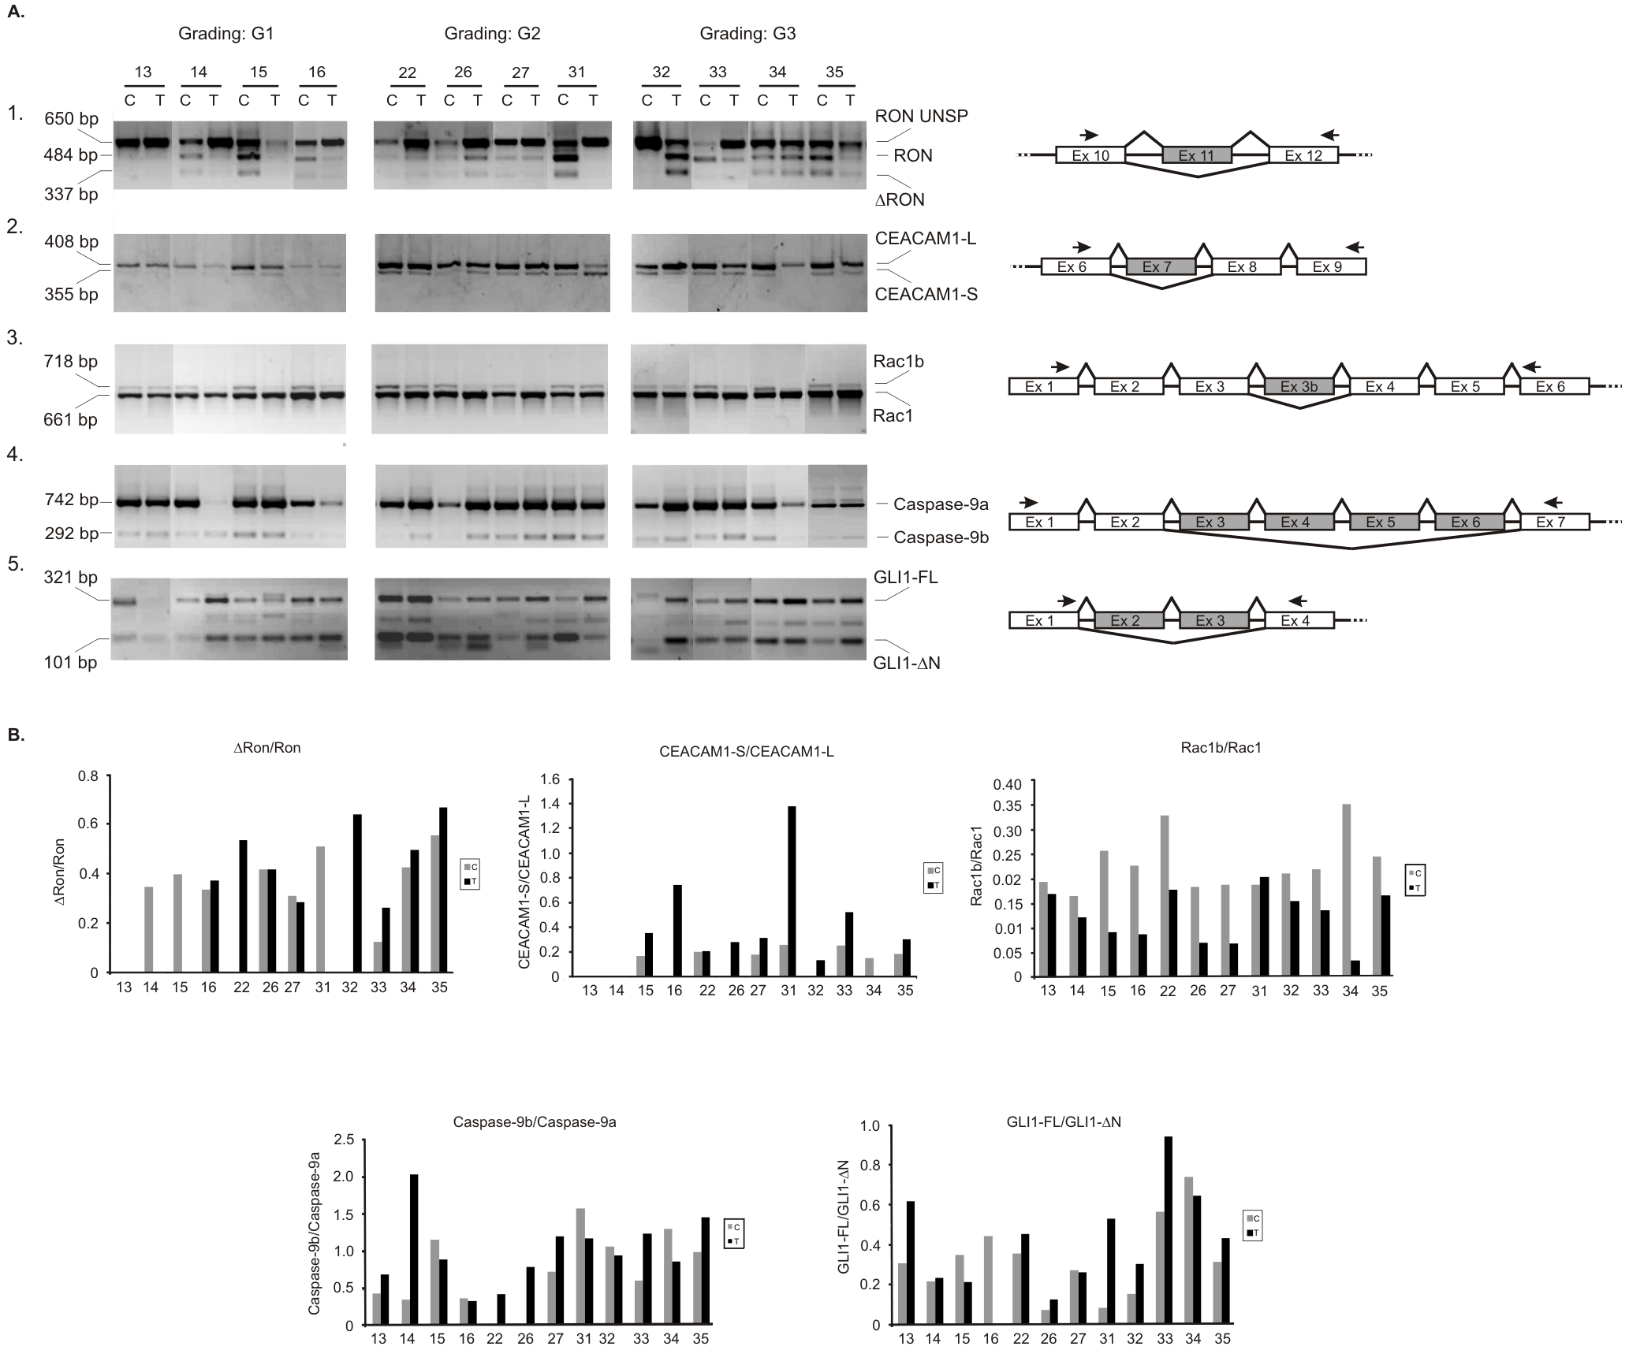
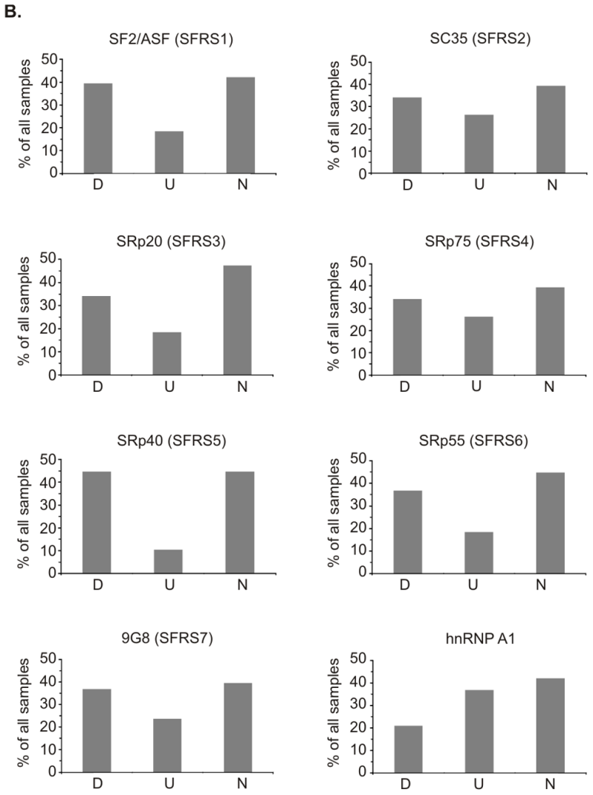
Alternative Splicing and Oncogenic Transformation
A. Piekielko-Witkowska et al. Disturbed Expression of Splicing Factors in Renal Cancer Affects Alternative Splicing of Apoptosis Regulators, Oncogenes, and Tumor Suppressors. PLoS ONE 5(10): e13690.
Notes:
Not specifically related to integrins, but…. In clear cell renal cell carcinoma
Left: 30% change was used to classify if splicing factors were up or down regulated in tumor samples, as compared to matched healthy tissue
Right: PCR shows that there is more alternative splicing in higher grade tumors, although that is somewhat patient specific

Slide 8
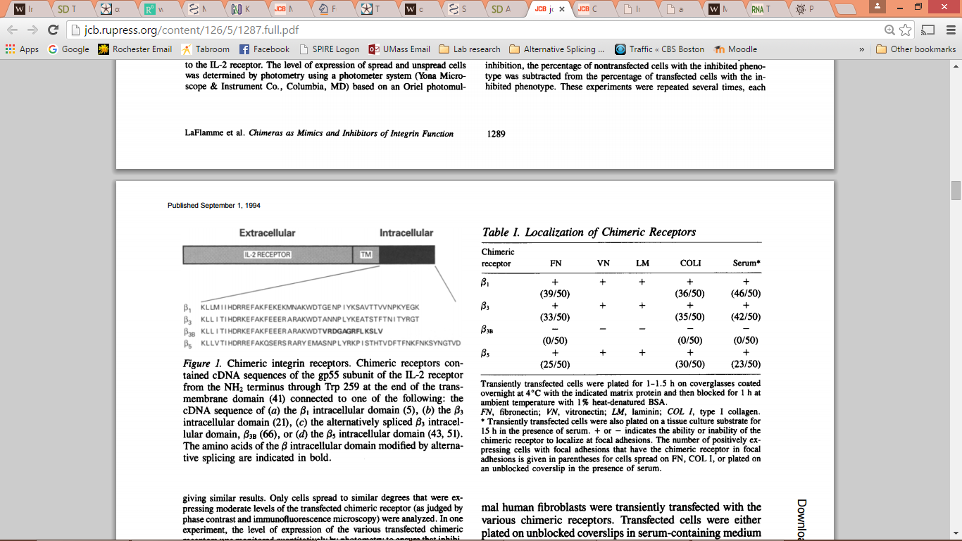
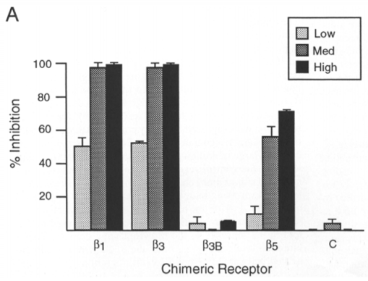
In Vitro “Model” system
S.E. LaFlamme, et al. Single Subunit Chimeric Integrins as Mimics and Inhibitors of Endogenous Integrin Functions in Receptor Localization, Cell Spreading and Migration, and Matrix Assembly. The Journal of Cell Biology, Volume 126, Number 5, 1994 1287-1298
Notes:
Yamada Lab. Fibroblasts + Chimeric Receptor

Slide 9
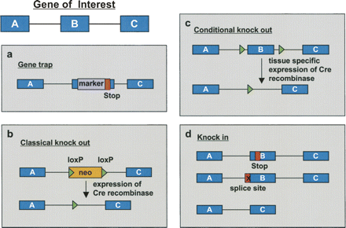
Mouse Models
Möröy and Heyd. The impact of alternative splicing in vivo: Mouse models show the way. RNA 2007. 13: 1155-1171
Notes:
Research mostly looks at alternative splicing in vitro, but about 15% of point mutations are thought to affect splicing, which would be organism wide.
Gene Trap: Large scale insertion of Markers into the genome & Sequence the insertion site. Can insert LoxP sites or stop codons, etc.
Classical KO: LoxP-Cre Recombinase
Conditional KO: Tissue specific expression of Cre
Knock In: Alter Isoform expression profile.

Slide 10
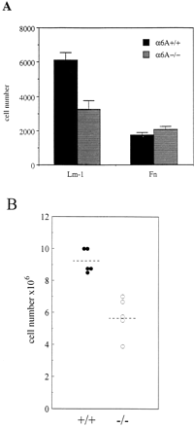
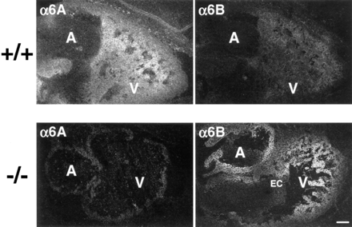
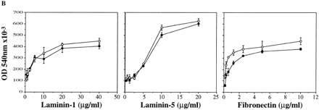
α6B can replace α6A in Mouse Cardiac Development
C. Gimond, et al. Cre-loxP–mediated Inactivation of the α6A Integrin Splice Variant In Vivo: Evidence for a Specific Functional Role of α6A in Lymphocyte Migration but Not in Heart Development. 1998 // JCB vol. 143 no. 1 253-266
Notes:
Sonnenberg lab – keratinocytes
Normal development and fertility of mutant mice indicated that the α6B isoform is able to fully replace the α6A protein during mouse development.
Sometimes when KO of one isoform happens, the other is upregulated to compensate. Sometimes it isn’t. we don’t know the mechanism.
BL: Adhesion
Right: Transwell Migration

Slide 11
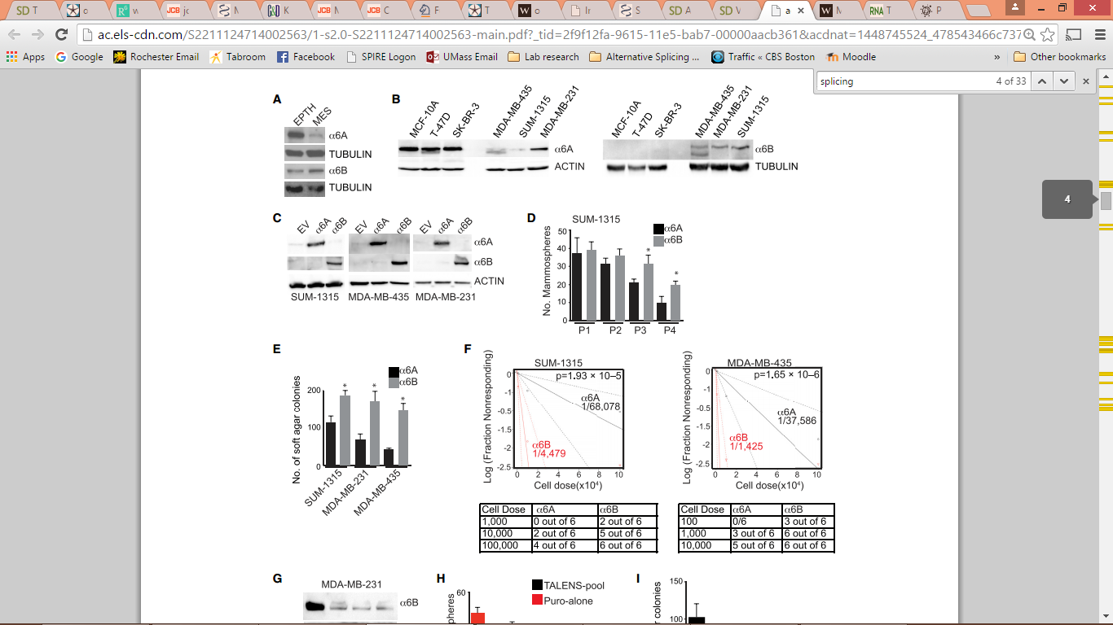
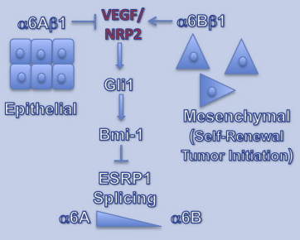
Integrin Alpha 6 Isoform B Dictates Stem-ness
SUM-1315
MDA-MB-435
Hira Lal Goel, Tatiana Gritsko, Bryan Pursell, Cheng Chang, Leonard D. Shultz, Dale L. Greiner, Jens Henrik Norum, Rune Toftgard, Leslie M. Shaw, and Arthur M. Mercurio. Regulated Splicing of the a6 Integrin Cytoplasmic Domain Determines the Fate of Breast Cancer Stem Cells. Cell Reports 7, 747–761, May 8, 2014
Notes:
Top left: Endogenous expression of isoforms
Bottom left: Injection into mammary fat pad of NSG mice
Top Right: Transfected cells for the a6 isoform – a6B helps growth on soft agar?

Slide 12
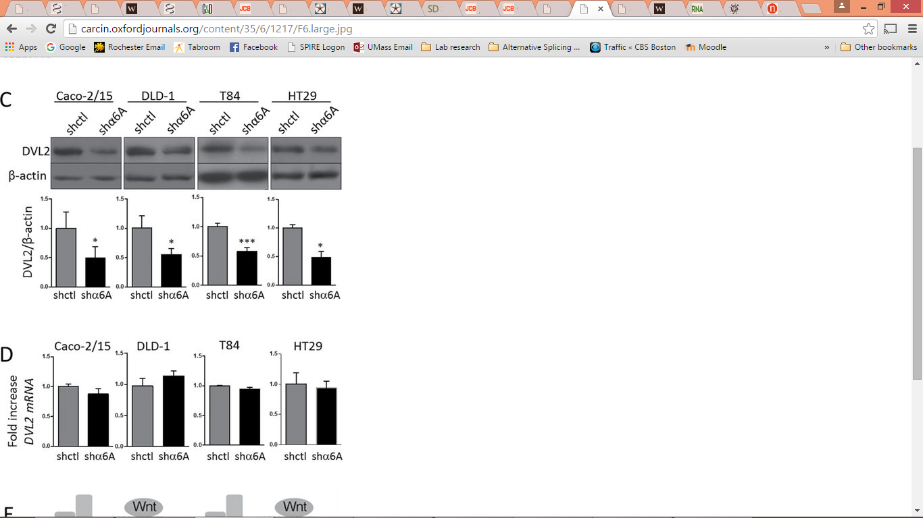
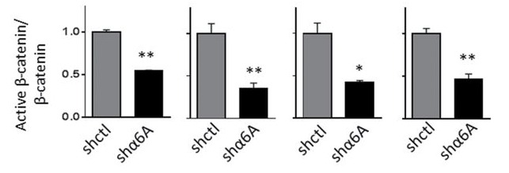
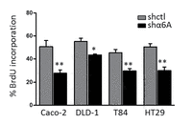
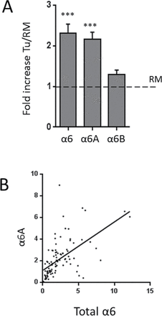
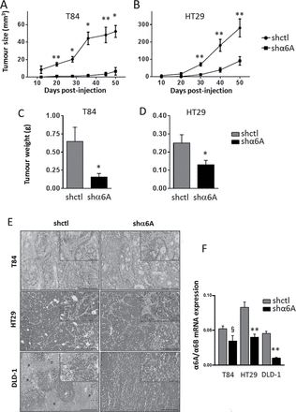
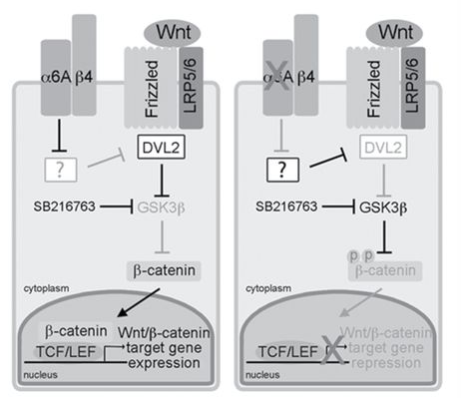
α6A Increases Proliferation and WNT signaling
Jean-François Groulx, Véronique Giroux, Marco Beauséjour, Salah Boudjadi, Nuria Basora, Julie C. Carrier and Jean-François Beaulieu. Integrin α6A splice variant regulates proliferation and the Wnt/β-catenin pathway in human colorectal cancer cells. Carcinogenesis (2014) 35 (6):1217-1227.doi: 10.1093/carcin/bgu006
Notes:
Colorectal cancer
Left: Tumor vs. matched normal
KO a6A, decreases proliferation and tumor size (subcutaneous injection into nude mice)
Downstream signaling via B-catenin and DVL2

Slide 13
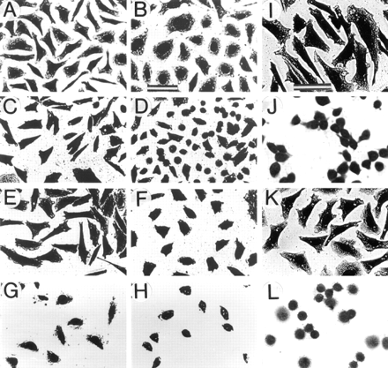
Integrin β1A vs Integrin β1D
β1A-CHO
β1D-CHO
}
Plated on Fn and cultured for 1 day
β1A-GD25
serum-free medium on Fn
Serum-free medium on Fn for 30 min
β1D-GD25
}
Serum-free medium on Fn for 1 hour
β1A-GD25
serum-free medium on Vitronectin
mAb against human β1 integrin for 2 h
β1D-GD25
Christian Baudoin, Marie-José Goumans, Christine Mummery, and
Arnoud Sonnenberg. Knockout and knockin of the β1 exon D define distinct roles for integrin splice variants in heart function and embryonic development. Genes & Dev. 1998. 12:1202-1216
Alexey M. Belkin, S. Francesco Retta, Olga Y. Pletjushkina, Fiorella Balzac, Lorenzo Silengo, Reinhard Fassler, Victor E. Koteliansky, Keith Burridge, and Guido Tarone. Muscle β1D Integrin Reinforces the Cytoskeleton–Matrix Link: Modulation of Integrin Adhesive Function by Alternative Splicing. J Cell Biol. 1997 Dec 15; 139(6): 1583–1595.
Notes:
Conclusions: B1A cells are more spread and spread faster on fn
GD25 cells lack B1 naturally – mouse fibroblasts

Slide 14
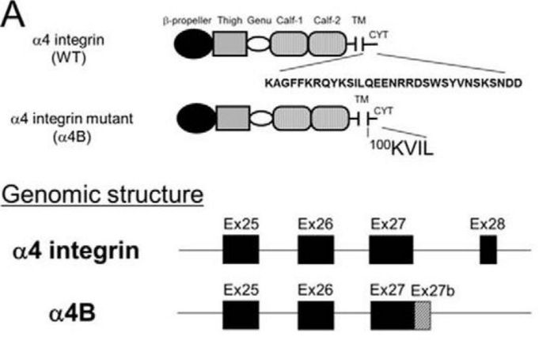
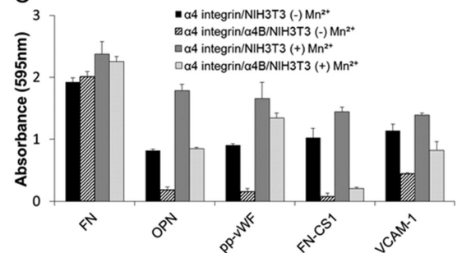
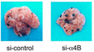
Integrin Alpha 4 Cytoplasmic Domain Splicing Inhibits Lung Colonization
Hitomi Kouro et al. The Novel α4B Murine α4 Integrin Protein Splicing Variant Inhibits α4 Protein-dependent Cell Adhesion. June 6, 2014 The Journal of Biological Chemistry, 289,16389-16398
Notes:
A4 adheres to VCAM – promotes both intravasation and extravasation
When activated, the combo of a4 full length and a4B decreases adhesion to OPN, FN-cs1 and VCAM-1
Mechanism of inhibition is due to a dominant negative effect of VCAM1
Fn = fibronectin
OPN = osteopontin
Pp-WF = pro=polypeptide of von wildebrand factor
FN-CS1 = CS1 domain of fibronectin
VCAM-1 = vascular cell adhesion molecule

Slide 15
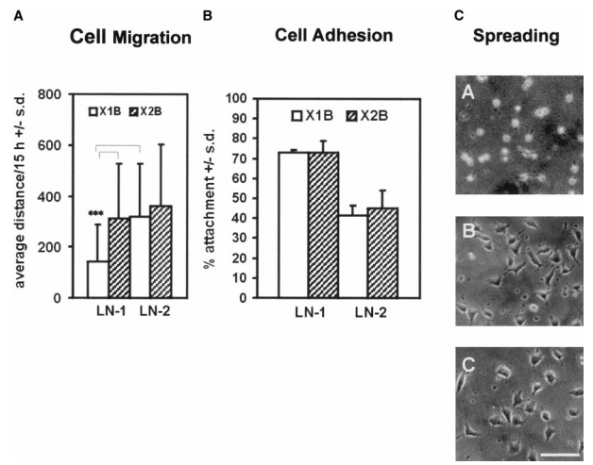
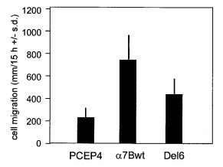
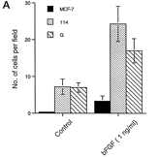
Integrin Alpha 7 Extracellular Variant Alters Phenotype
S Schöber et al. The Role of Extracellular and Cytoplasmic Splice Domains of α7-Integrin in Cell Adhesion and Migration on Laminins. Experimental Cell Research. Volume 255, Issue 2, 15 March 2000, Pages 303–313
Chung-Chen Yao, Barry L. Ziober, Rachel M. Squillace and Randall H. Kramer. α7 Integrin Mediates Cell Adhesion and Migration on Specific Laminin Isoforms. October 11, 1996 The Journal of Biological Chemistry, 271,25598-25603
Notes:
X1 vs X2 are extracellular varients.
Hek293 cells (human ebryonic kidney)
Under spreading:
A = mock transfected
B = a7X1B
C = a7X2B

Slide 16
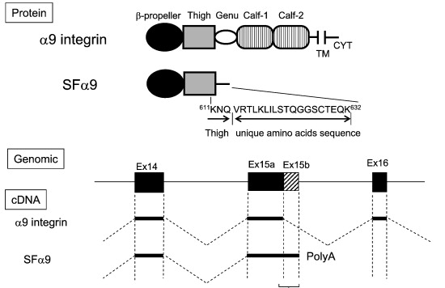
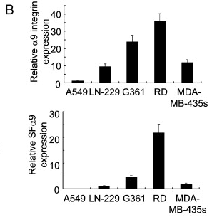
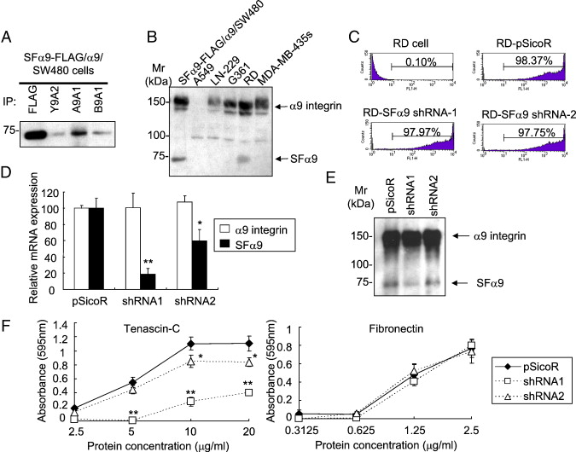
Integrin α9 Lacking Intracellular Domain Creates Full Length α9 Adhesion Dependence
Shigeyuki Kon, Amha Atakilit, Dean Sheppard. Short form of α9 promotes α9β1 integrin-dependent cell adhesion by modulating the function of the full-length α9 subunit. Experimental Cell Research. Volume 317, Issue 12, 15 July 2011, Pages 1774–1784
Notes:
The α9β1 integrin is a multifunctional receptor that interacts with a variety of ligands including vascular cell adhesion molecule 1, tenascin-C, and osteopontin
Sicor is the vector.
his cDNA encodes a truncated 632-aa protein, which has β-propeller domain, thigh domain, and a novel 19-aa sequence at its C-terminus. We named this isoform the short form of α9 (SFα9) and found that the predicted protein is endogenously made and expressed on the cell surface.

Slide 17
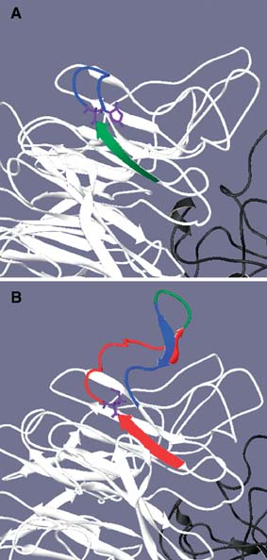
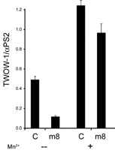
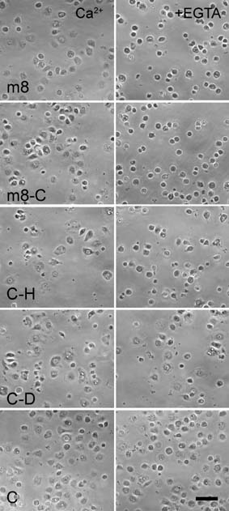
Splicing Structural Changes alter Ionic Activation
Thomas A. Bunch, Timmy L. Kendall, Kishore Shakalya, Daruka Mahadevan, Danny L. Brower. Modulation of Ligand binding by alternative splicing of the αPS2 integrin subunit. Journal of Cellular Biochemistry. Volume 102, Issue 1. 1 September 2007. Pages 211–223
Notes:
aPS2 is the primary insect RGD binding receptor.
Because integrins are largely conserved across species, they believe this is an early progenitor of many alpha integrins in vertebrates.
Ex. M8 is missing exon 8 in the B-propeller, in a similar location to some a6 and a7 splicing.

Slide 18
Conclusions
Alternative Splicing is a complex mechanism that increases the number of human functional isoforms up to 5 fold
Extracellular Integrin splicing modifies binding affinity
Intracellular integrin
splicing alters
downstream signaling
Notes:
We understand a lot actually about the proteins that make up the spliceosome, but we don’t understand how they are regulated
Or how expression levels of certain proteins determines which isoform dominates at specific points during development or in disease.

