Slide 1
Cell Migration, the Cytoskeleton, Chemotaxis, and Haptotaxis
3/1/16
Lecture 9, ChE 575

Slide 2
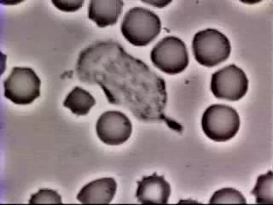
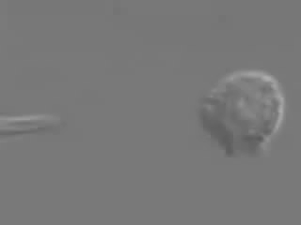
When, Where, Why do cells migrate? 1. Neutrophil Migration to Battle Infection

Slide 3
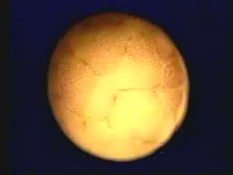
2. Development

Slide 4
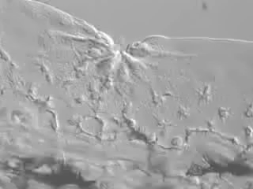
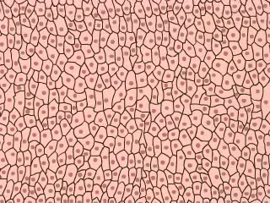
3. Wound Healing

Slide 5
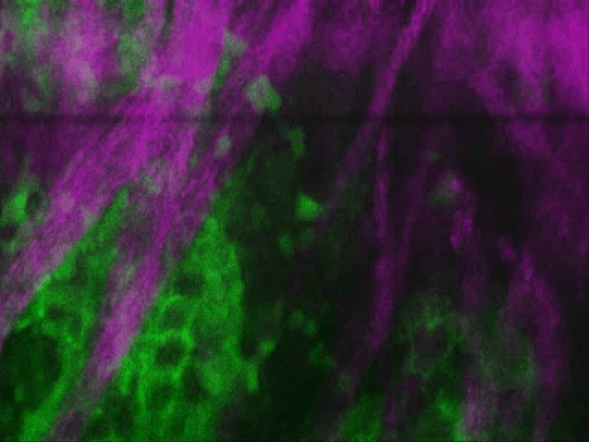
4. Disease
Tumor cell metastasis
Courtesy E. Roussos

Slide 6
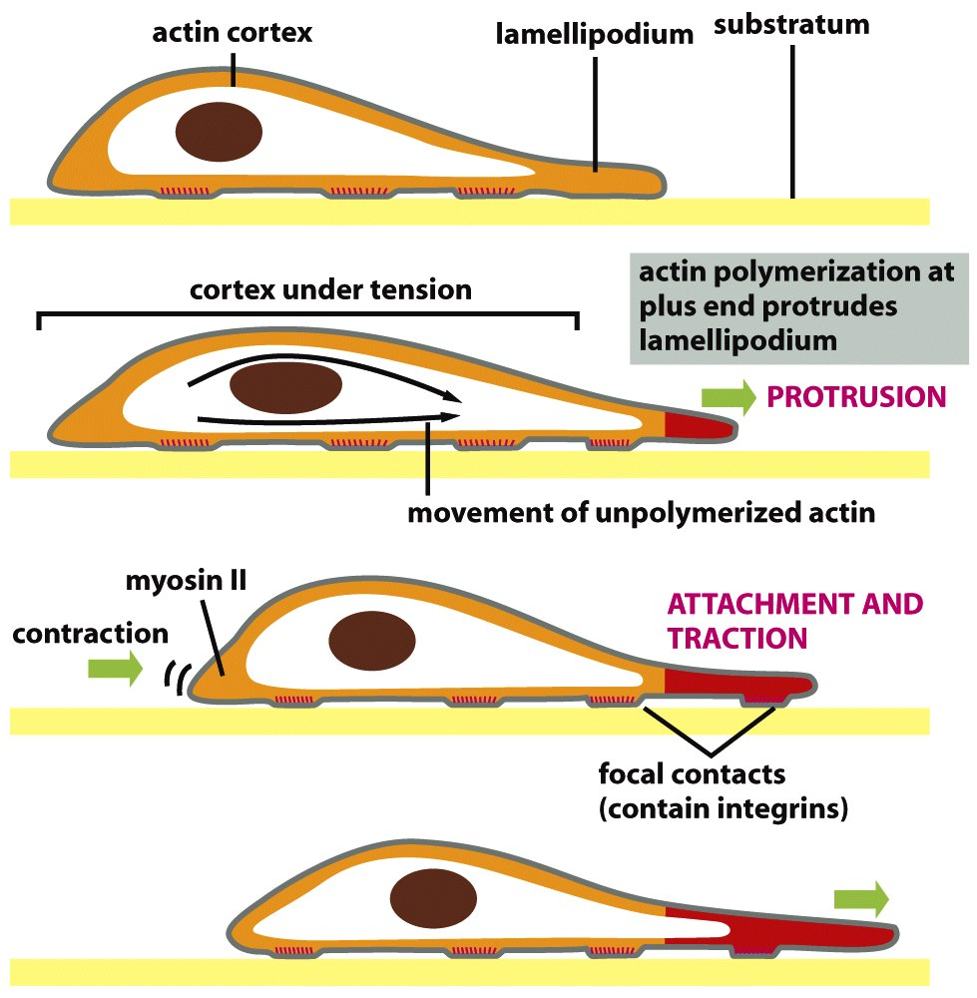
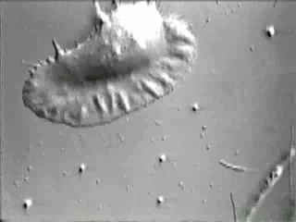
Basic Migratory Process Observed through Time-Lapse microscopy
Migrating Keratinocyte
Molecular Biology of the Cell

Slide 7
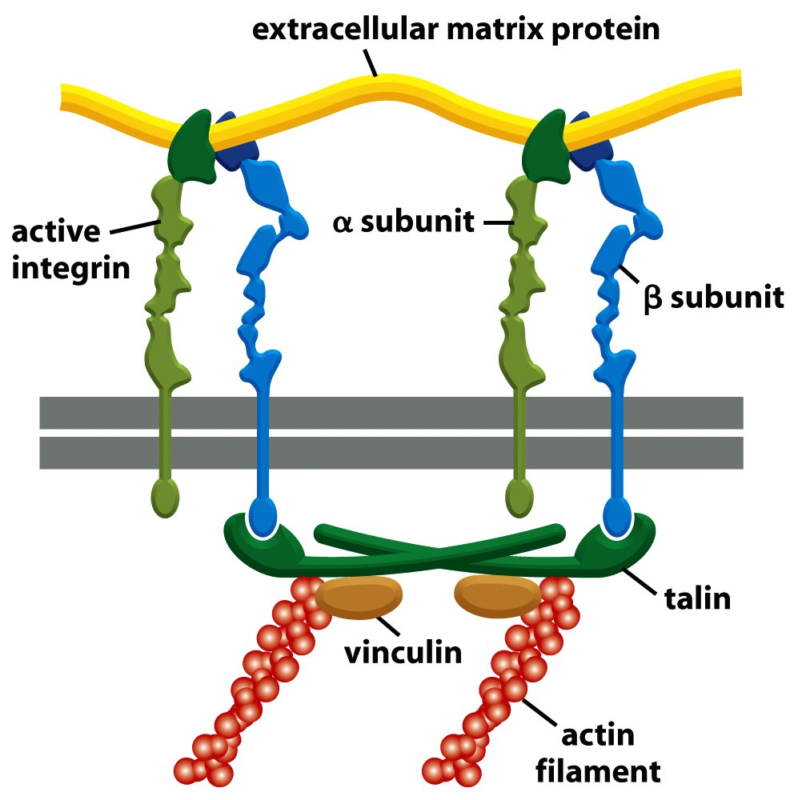
Cells connect to the ECM: ECM→Integrin→Focal Adhesion→Actin
Transmit force and movement in cell via cytoskeleton and focal adhesions

Slide 8
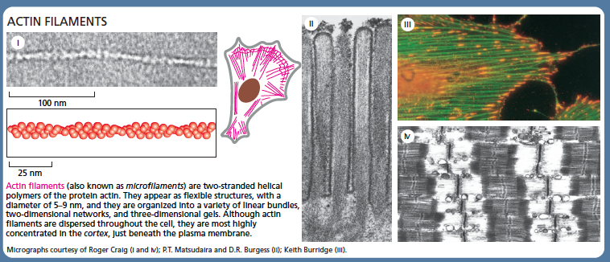
Actin filaments: double helix with 5-9nm diameter, connect to integrins (indirectly via focal adhesion proteins)

Slide 9
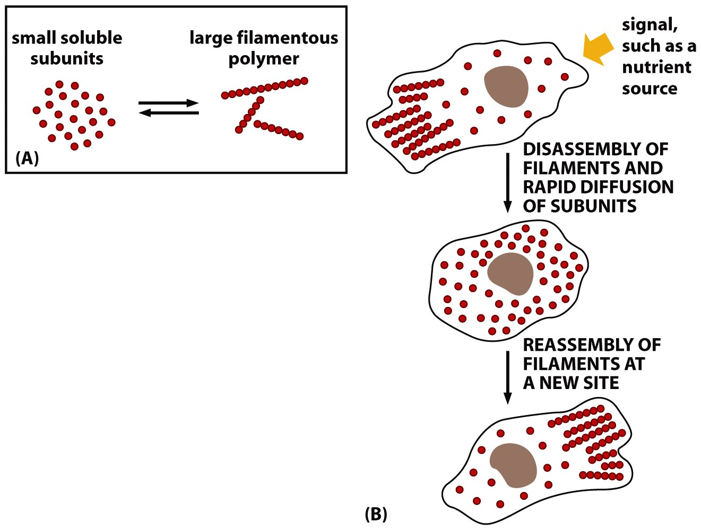
Each class of filaments is a polymer:
- made up of smaller, soluble subunits
Cells using ATP energy to polymerize and depolymerize monomers when needed

Slide 10
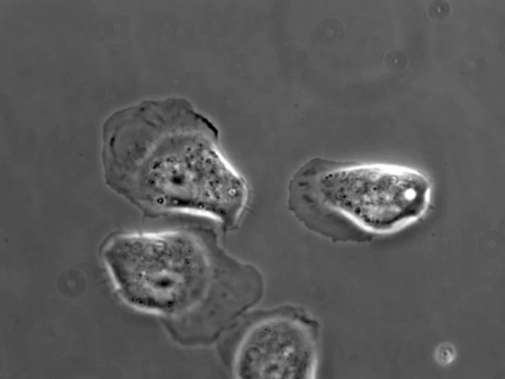
Lamellipodia
Rat mammary carcinoma cells
10 min, images every 20 seconds
Michele Balsamo, Gertler lab MIT

Slide 11
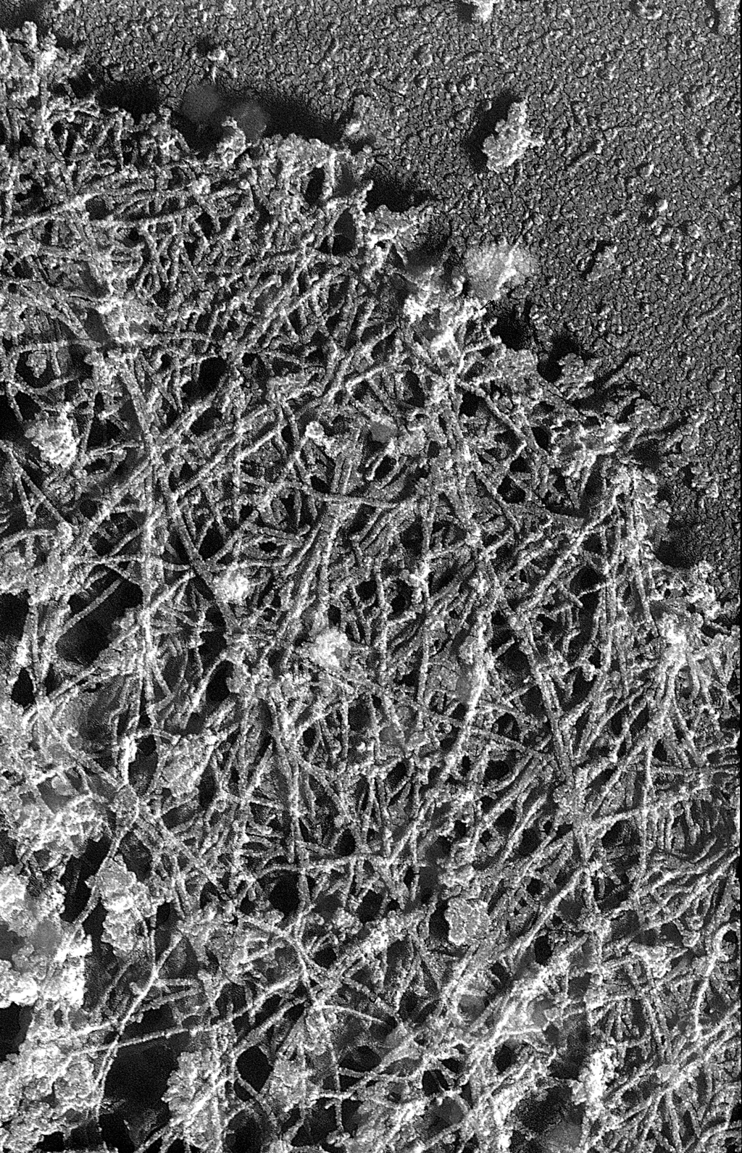
Electron Micrograph view of the Actin cytoskeleton in Lamelipodia
Mena11a
Michele Balsamo & Leslie Mebane, Gertler Lab, MIT

Slide 12
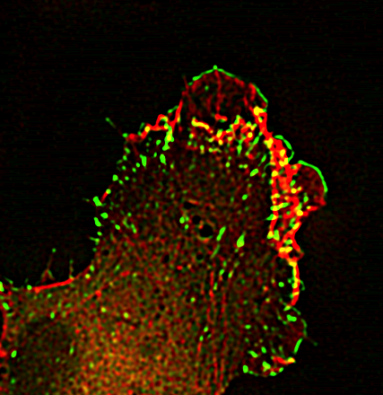
Filopodia (1D Protrusions)

Slide 13
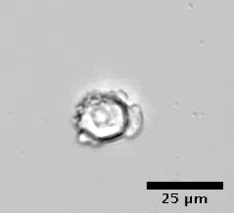
Blebs (3D protrusions)

Slide 14
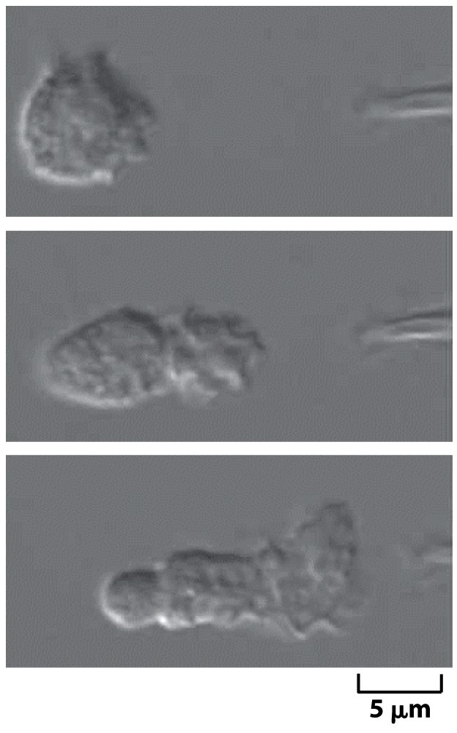
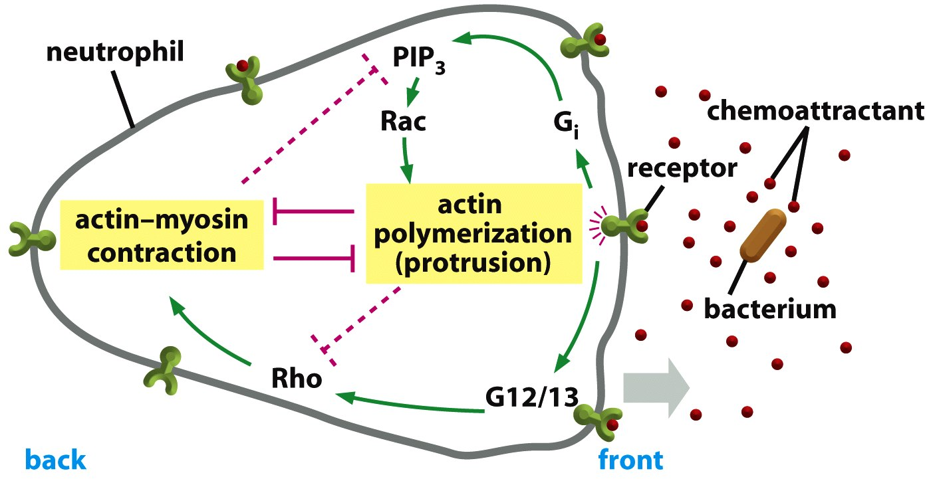
Chemotaxis: Controlling Direction of Motility via Soluble Chemical Cues

Slide 15
Chemotactic Index is a measure of how efficiently a cell follows a chemical gradient

Slide 16
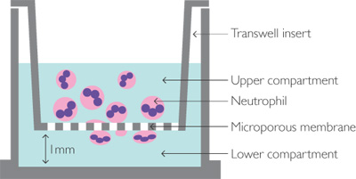
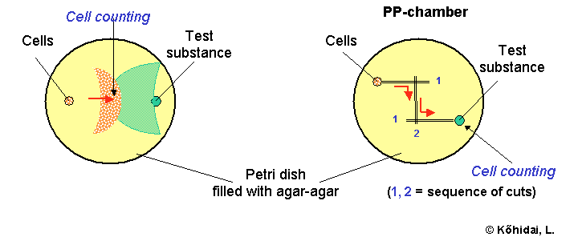
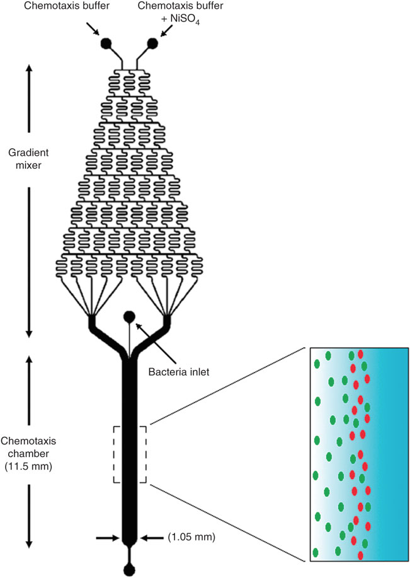
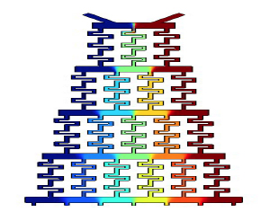
In vitro Chemotaxis
Boyden Chamber
Under-Agarose Assay
Microfluidics

Slide 17
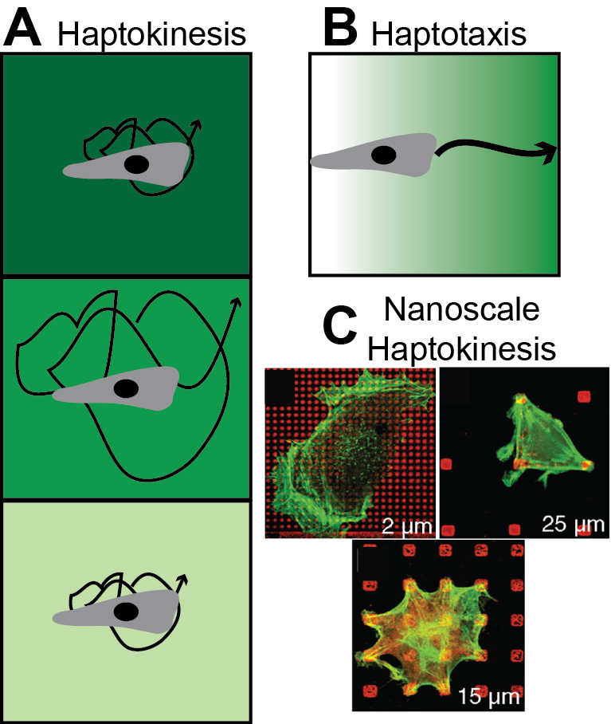
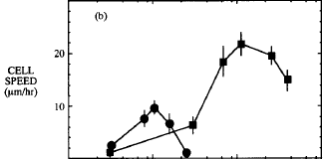
Haptokinesis vs Haptotaxis
Increasing Protein Concentration
(FN or Collagen IV)
DiMilla et al., JCB 1993

Slide 18
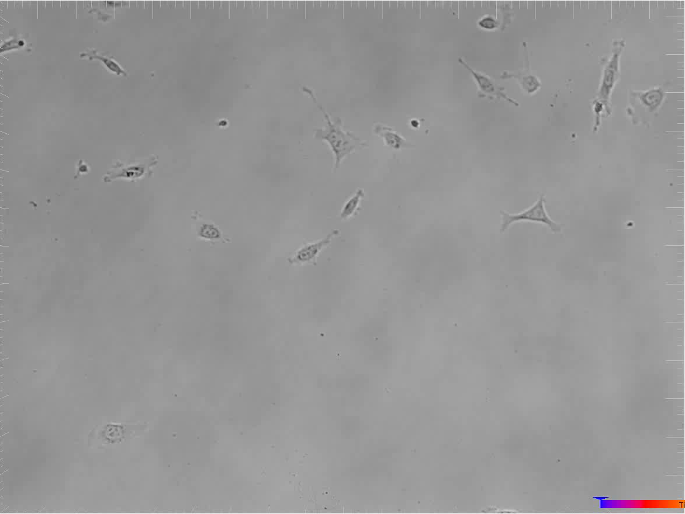
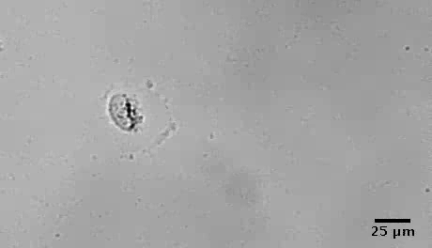
Let’s look at movement more closely – how do we measure/predict? Sample Movies from Peyton Lab
Breast Cancer Cells migrating on a biomaterial
Courtesy Peyton Lab

Slide 19
How does one quantify this movement?
Speed
Displacement
Path Length
finish
y
t=3
x
t=2
t=1
start

Slide 20
Mean Squared Displacement analysis
Free diffusion
Dimension (1, 2 or 3)
Diffusion coefficient
<r²> (µm)
Time (min)

Slide 21
Migration is Random at Long Time points, but persistent at short intervals
Longer timepoints (min-hr):
Cell locomotion observed
Breast Cancer Cells migrating on a biomaterial
Courtesy Peyton Lab

Slide 22
Accounting for this in MSD analysis
Persistent Random Walk

Slide 23
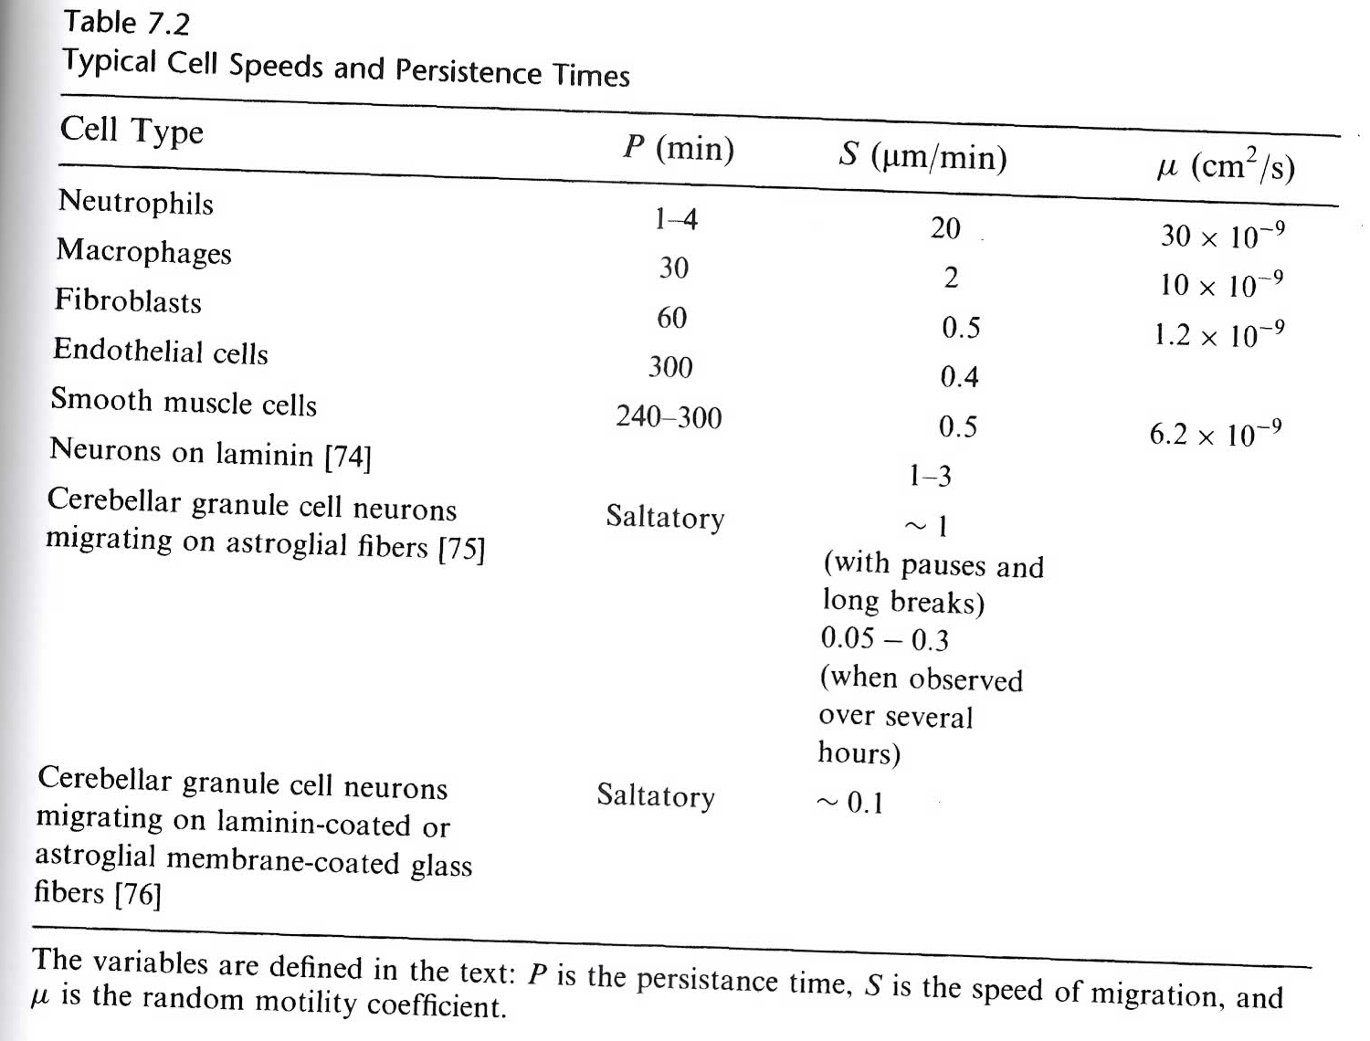

Slide 24
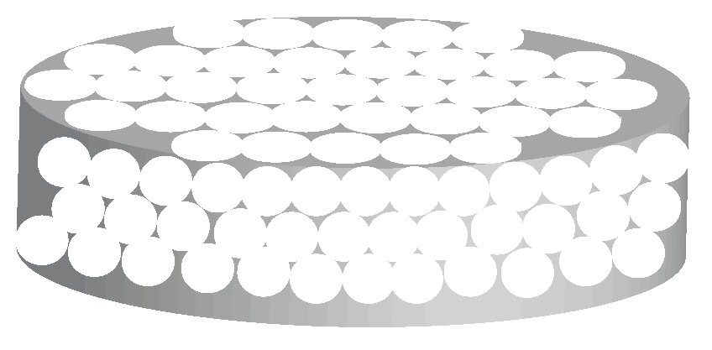
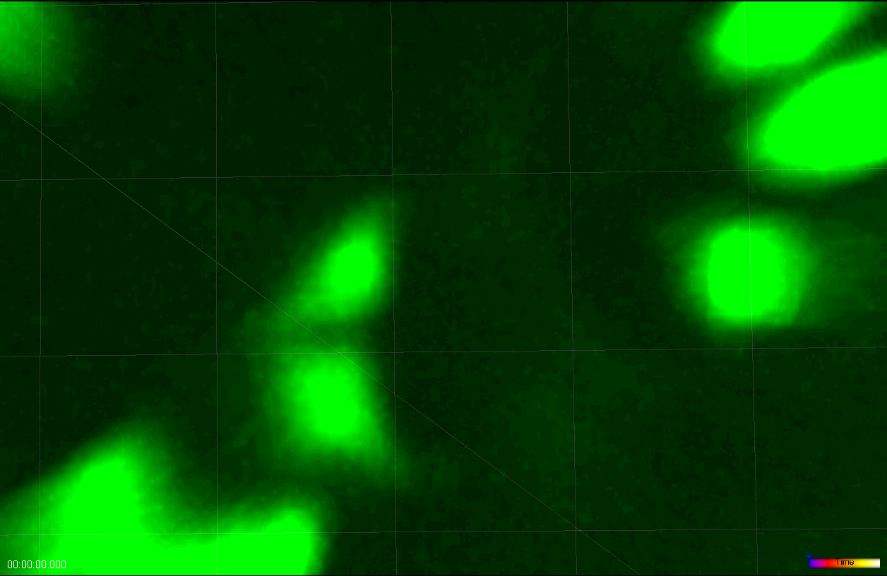
Anomalous diffusion:
Often confined
If there are obstacles or traps in the way, diffusion might be anomalous (depends on obstacle concentration).
Anomalous diffusion exponent
<r²> (µm)
Time (min)
Saxton 1994

Slide 25
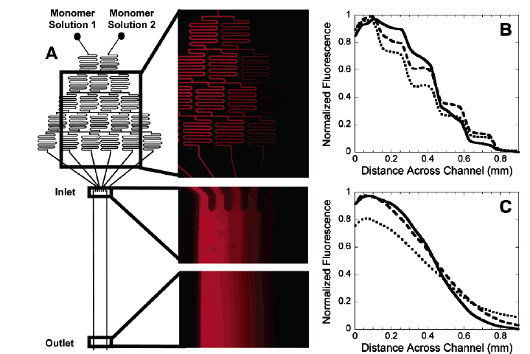
Adapting microfluidics to create haptotaxic gradients
Burdick et al., Langmuir 2004

