Slide 1
Melamine Sensor Project
2008/11/25
Gel project team

Slide 2
Popular Methods
LC (liquid chromatography)
LC/MS (liquid chromatography-tandem mass spectrometry)
HPLC (High-performance liquid chromatography)
ELISA (enzyme-linked immunosorbent Assay)

Slide 3
Conventional Methods
LC/MS:
      High preciseness
      Expensive equipment
      Difficult pre-sampling
      Operator training
HPLC:
      High preciseness
      Can’t allowing high-through put
      Expensive equipment

Slide 4
ELISA:
      Speed rate
      High-throughput
      Low preciseness
      Convenience
      Expensive kit

Slide 5
Synthetic Biology Method
Strategy
  Detect the byproducts of melamine after catabolism
    Ammonia (co-operated with pH sensor or others)
    Ammeline
    Cyanuric acid
  Capture melamine directly
    Melamine receptor?

Slide 6
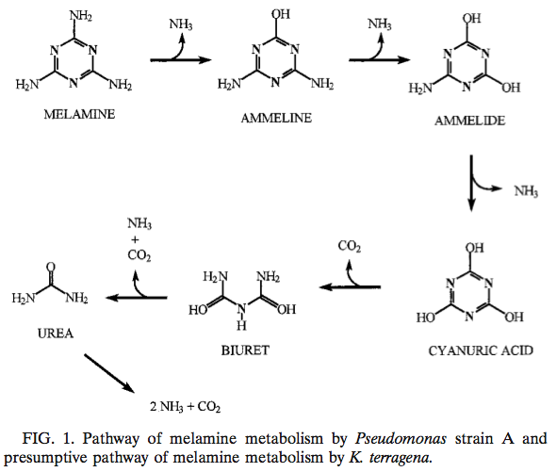
Catabolism of melamine

Slide 7
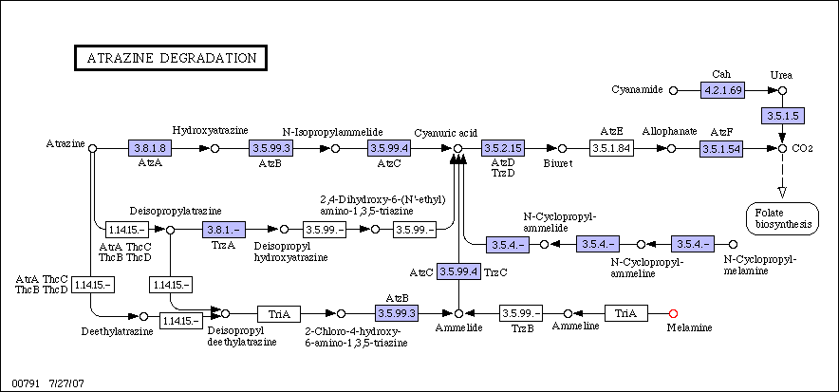
Melamine Metabolic Pathways

Slide 8
Synthetic Biology Method
Advantage:
        Much cheaper
        Amplification rate
        High-through put
        Convenience
Disadvantage:
        Detection range
        Low preciseness

Slide 9
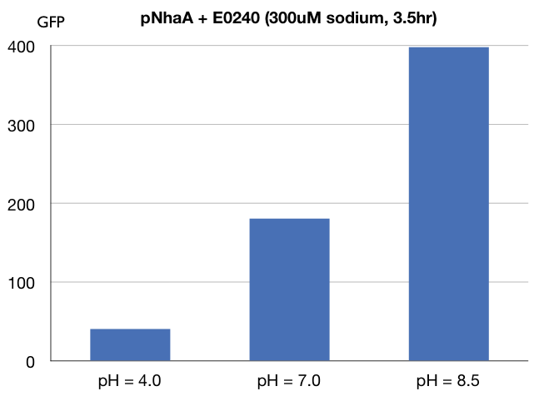
pH sensor

