Slide 1
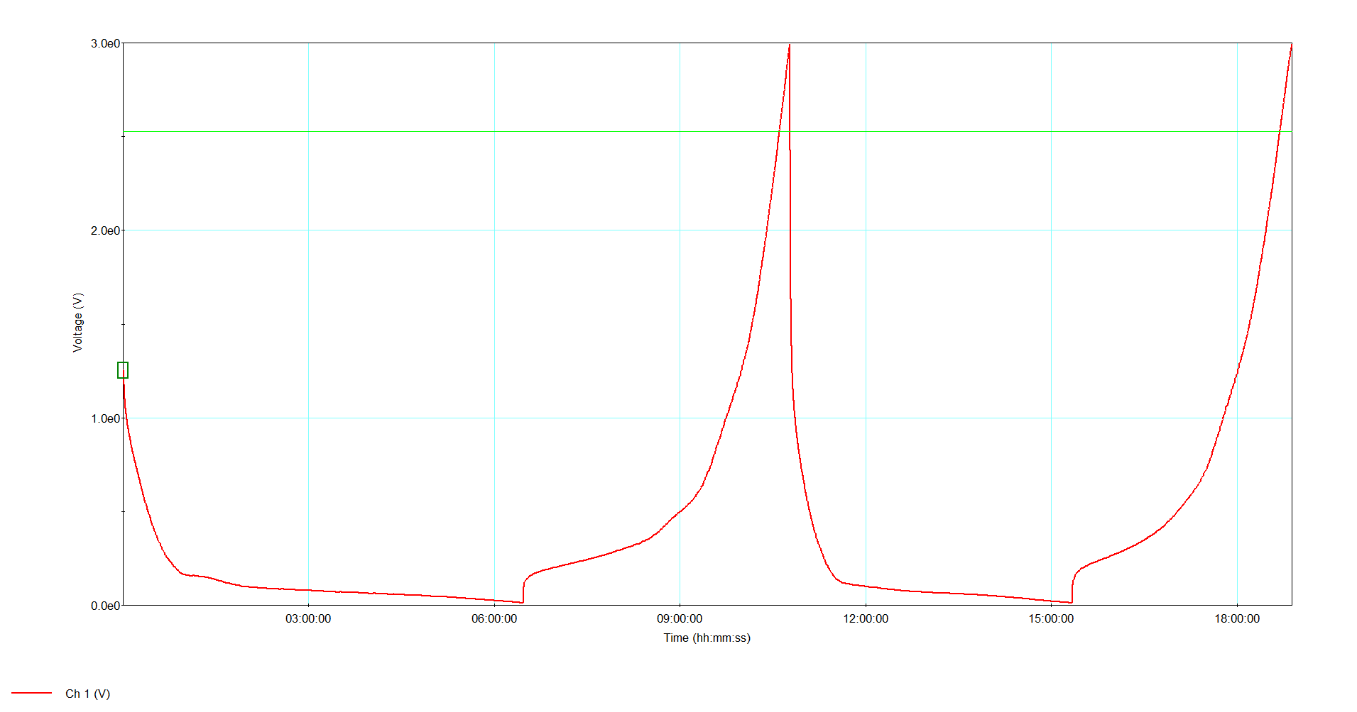
Group: Tu/Th Pink-Purple-Red
Alloy: Au_{0.67}Ag_{0.33}
2d Discharge Time (h:min): 4:34

Slide 2
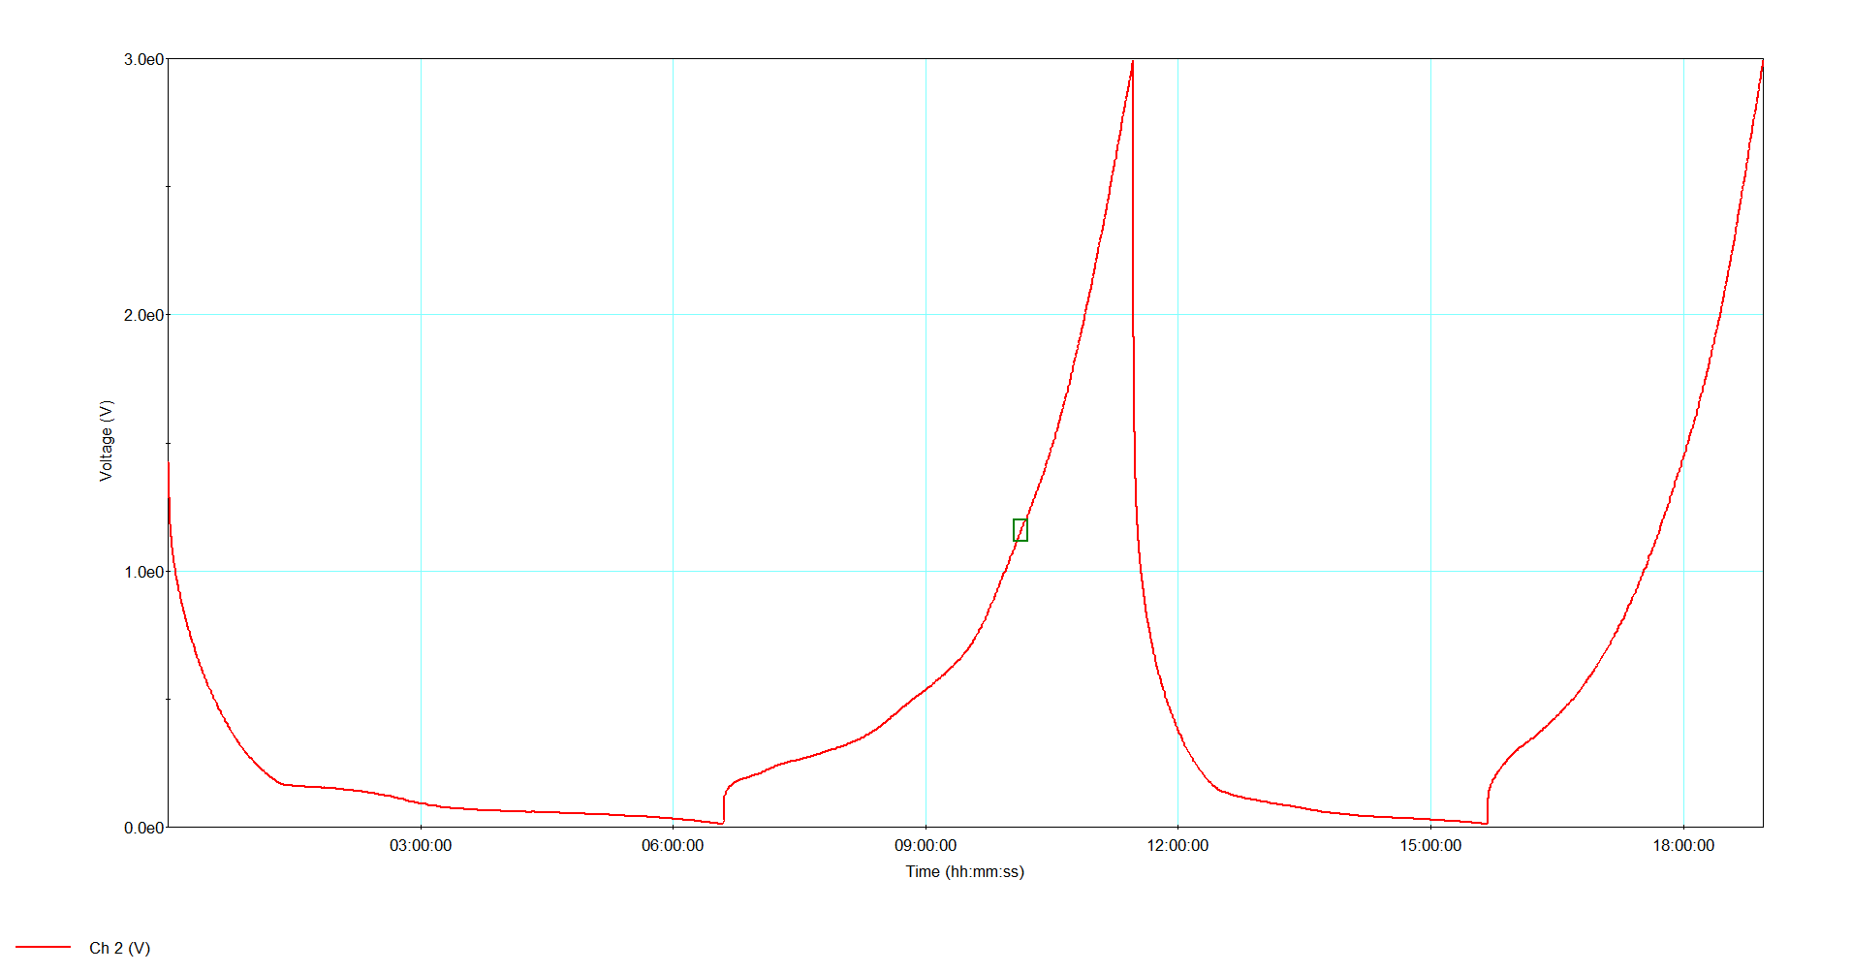
Group: Tu/Th Green-Yellow
Alloy: Au_{0.9}Ag_{0.1}
2d Discharge Time (h:min): 4:13

Slide 3
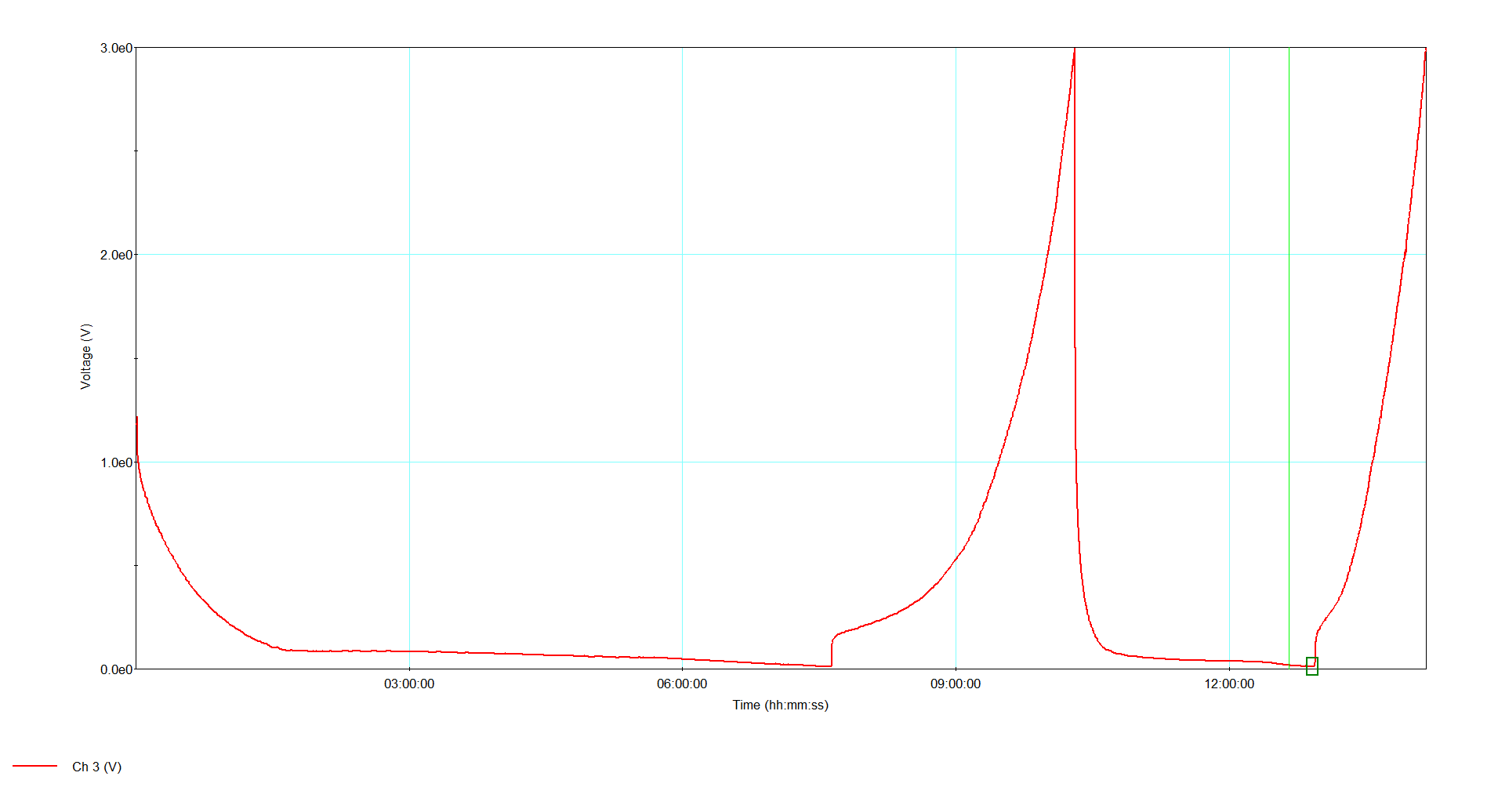
Group: Tu/Th Orange-Blue
Alloy: Au_{0.5}Ag_{0.5}
2d Discharge Time (h:min): 2:37

Slide 4
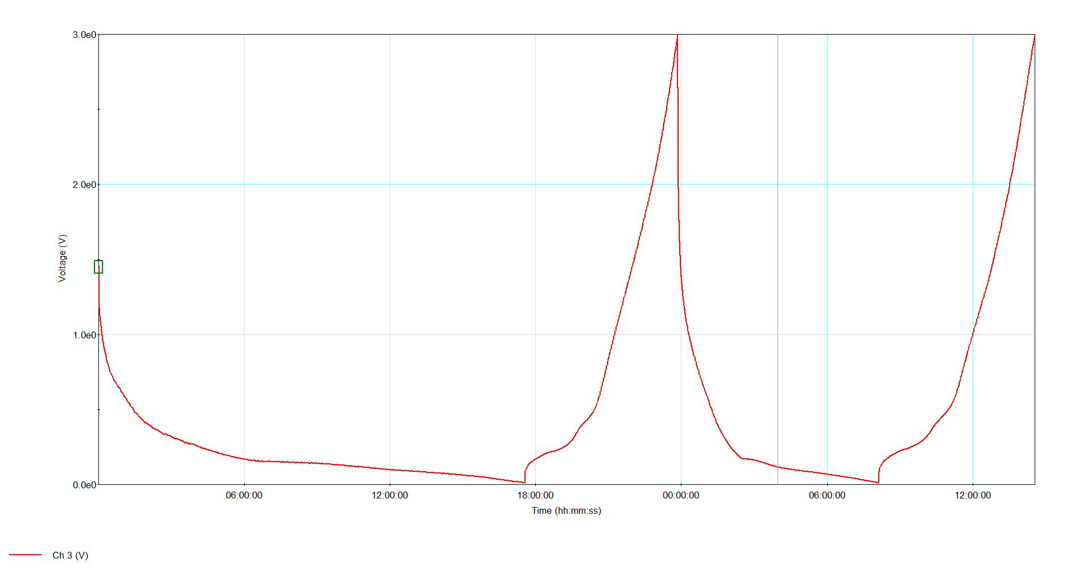
Group: W/F Red-Blue
Alloy: Au_{0.67}Ag_{0.33}
2d Discharge Time (h:min): 8:17

Slide 5
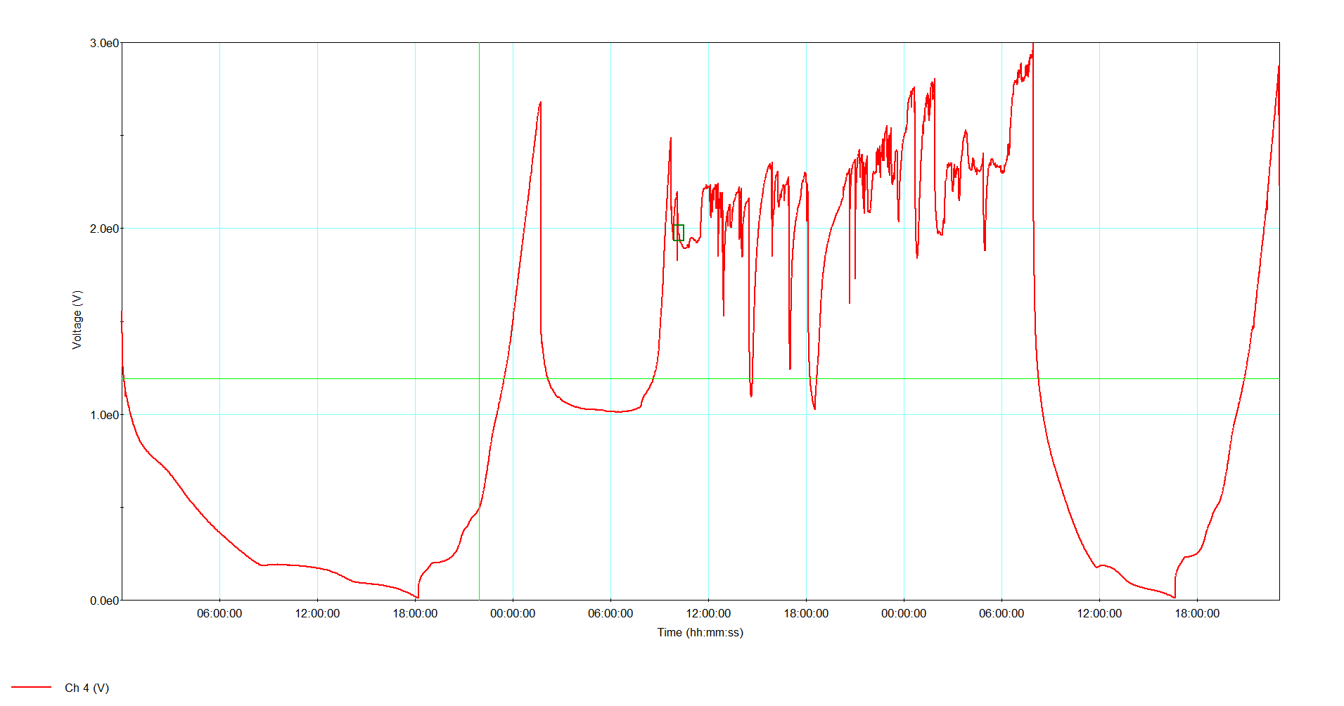
Group: W/F Pink-Purple
Alloy: Au_{0.9}Ag_{0.1}
2d Discharge Time (h:min): 8:43
Erratic charge likely due to problems with potentiostat given the smooth charge/discharges before and after

