Slide 1
Cloning the OmcF gene from geobacter sulferreducens to E. coli
Valerie Wisco & Casey Durnan

Slide 2
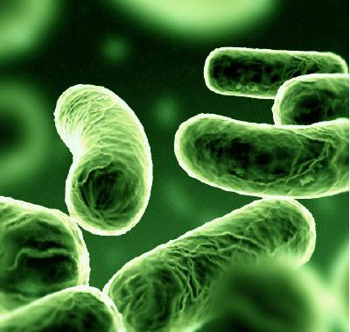
General Background
Organism: Geobacter sulferreducens
    have the ability to transfer electrons on
    to the surface of electrodes creating
    a pass of electricity
    Useful in potential bioreactors
Gene of Interest: OmcF
    Outer membrane f-type cytochrome
    Regulates the transcription
    of other Omc genes that play a role in
    current production
    Removing the omcF inhibits electron
    transfer, reducing electricity production

Slide 3
General Information
Accession #:AAR35805.1
315 base pairs, no introns
BioBrick Part: BBa_I0500
    In vector PSB2K3
    Kanamycin Resistant
Our cultures were sent from a research lab at the University of Massachusetts
They were sent in anaerobic NBAF liquid media

Slide 4
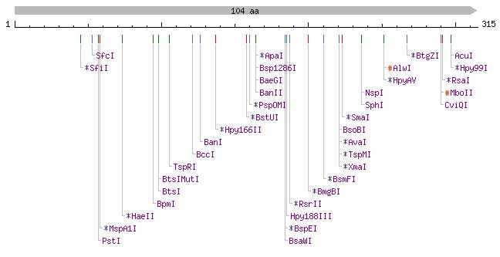
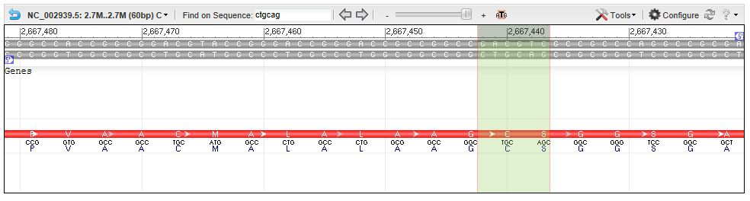
Internal Restriction

Slide 5
Procedure
DNA extraction from Geobacter
Plasmid and Insert Digestion
Ligation of Plasmid and Insert and Plating
Plasmid Isolation
Ligation of PCR fragments
Final Verification
Amplification of PCR fragments and gel electrophoresis
Site-directed Mutagenesis
Sequencing

Slide 6
E. Coli Transformation
Objective:
    To transform BBa_I0500 into E.coli and grow on Kanamycin plates
Results:
    E.coli cells on LB media→ Growth
    Transformed cells on Kan. Media→ No Growth
    Unsuccessful
Reasons for Failure:
    Bad part from Kit Plate

Slide 7
DNA Extraction from Geobacter sulferreducens
Digested DNA
Objective:
  To successfully extract viable DNA from our organism for gene extraction
Successful digest
    Enzyme EcoR1
    Missing Band
Ladder
Undigested DNA

Slide 8
Plasmid DNA Isolation
Objective:
    To isolate the DNA from our plasmid from E.coli
Results:
    Successful- band across the 4 lanes seen at approx. 3000-4000 bp as expected
100 bp Ladder
Plasmid DNA Samples
~3000bp
1000bp
500bp

Slide 9
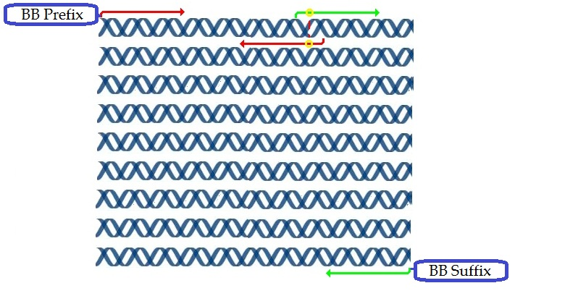
Site-directed Mutagenesis

Slide 10
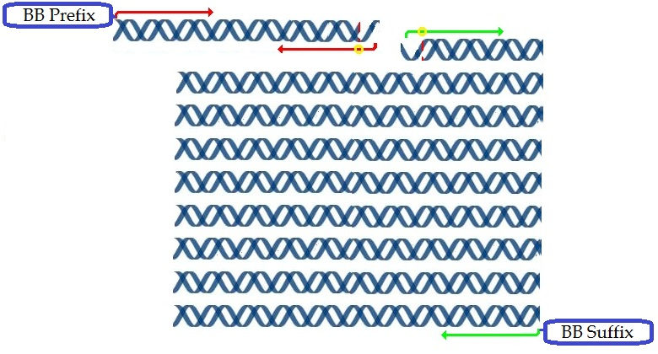
Site-directed Mutagenesis
~120 bp
~300bp

Slide 11
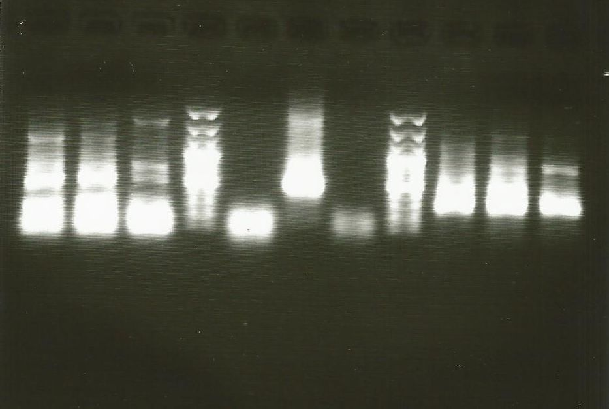
Site-directed Mutagenesis:
PCR amplification of fragments
Amplified upstream and downstream fragments separately
Amplified each fragment at varying annealing temperatures to find optimal setting
+ Control
500bp
1000bp
Upstream
Downstream
55 →65°
55 →65°
100bp
Primers ( - Control)

Slide 12
Site-directed Mutagenesis:
PCR amplification of fragments
The 65°C annealing temperature produced the cleanest results
Band sizes appear to be correct
Primers had substantial background noise– prone to 2’ folding
Many PCR artifacts

Slide 13
Site-directed Mutagenesis:
PCR ligation
Combined upstream and downstream fragments in PCR amplification, as an attempt to allow complimentary overhangs to act as primers
In another reaction, added outside primers in addition to fragments

Slide 14
Site-directed Mutagenesis:
PCR ligation and verification
Annealing temp of 65° C
Amplified d/s and u/s for comparison
1.8% agarose gel, 15v for 16 hrs for high resolution
+ Control L non-template L ds p-lig us L replicates
1000bp
500bp
100bp

Slide 15
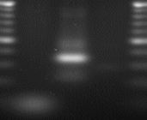
PCR ligation results
D/s ~100-120bp
U/s ~250-300bp
P-lig ~350 OR 450bp
Since sequencing was inconclusive, we continued work on both the 350- and 450bp inserts

Slide 16
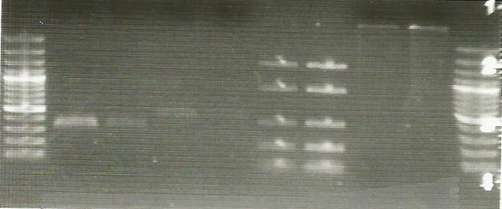
Digestion and Quantity Check
Objective:
  To digest plasmid
  with enzymes in
  order to insert and ligate our target gene
Procedure:
  Our inserts were
  digested with with
  XbaI and PstI
  Plasmid was digested
  with SpeI and PstL
4μL Low Range Ladder
450 bp sample
Plasmid DNA
100 bp Ladder
2μL Low Range Ladder
100 bp Ladder
350 bp sample
1000 bp
500bp

Slide 17
Transformation: Ligation & Plating
Objective:
    To seal our insert into the vector and then add to competent E.coli cell for uptake of plasmid.
    Plated all concentrations on Kanamycin plates, including a + control
Results:
  Contrast with control plates indicate resistance uptake
  Background may indicate digestion/ligation problems

Slide 18
A: 1:1 Ratio insert to vector
B: 0.5:7.5 Ratio insert to vector
C: 7.5: 0.5
D: 0 insert: 4uL vector
E: 4uL insert : 0 vector
+ control: max amount of growth possible on plates

Slide 19
Verification
350 bp + Promoter
100 bp Ladder
450 bp + Promoter
100 bp Ladder
Objective:
  To cut out our promoter part, BBa_Io5oo and insert- for gel verification and sequencing
Procedure:
  Extracted plasmid and then digested it with XbaI and PstI
Results:
  No band at 1500-1600 target range
  Band should be at 2 different sizes but is only at one
~3000bp
~1200bp

Slide 20
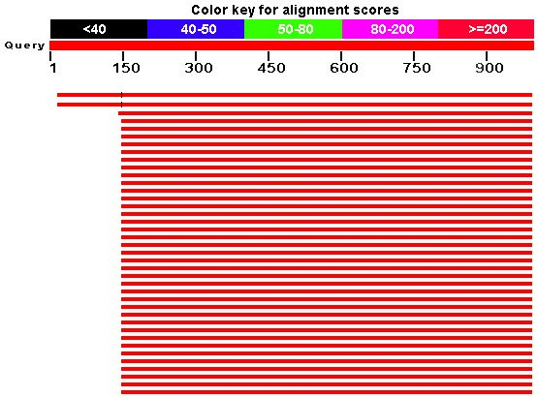
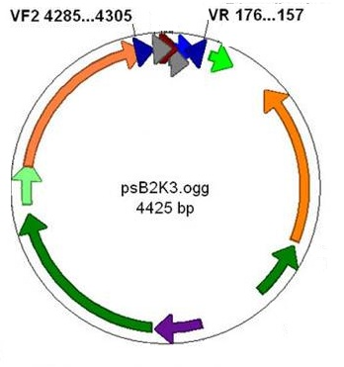
Sequencing and Blast Results
Submitted 3 samples, received good quality reads.
nBLAST for all n/t database confers high-match probability for a number of known BB vectors.
- Lack of internal unknowns confirm that our gene was not present. Our vector and promoter did match directly.

Slide 21
Project Summary
There was unpredicted PCR products, perhaps due to problematic and unmatched primers. Shorten the mutation primers for matched T_{m}. Check for 2’ folding probabilities.
We believe we succeeded in isolating the omcf gene.
Promoter was found in transformed E. coli, but our insert was not. Since digestion products appeared correctly, this may have been due to ligation process. Since there was substantial background colonies, there may have been unpredicted digestion problems as well.

Slide 22
References
Kim, B., Postier, B., DiDonato, R., Chaudhuri, S., Nevin, K., & Loveless, D. (2008). Insights into genes involved in electricity generation in geobacter sulfurreducens via whole genome microarray analysis of the omcf-de!cient mutant. Bioelectrochemistry, Retrieved from http://www.geobacter.org/publication-files/18538641.pdf
http://www.ncbi.nlm.nih.gov/nuccore/NC_002939.5?report=genbank&from=2667181&to=2667495&strand=true----
http://www.geobacter.org/about

