Slide 1
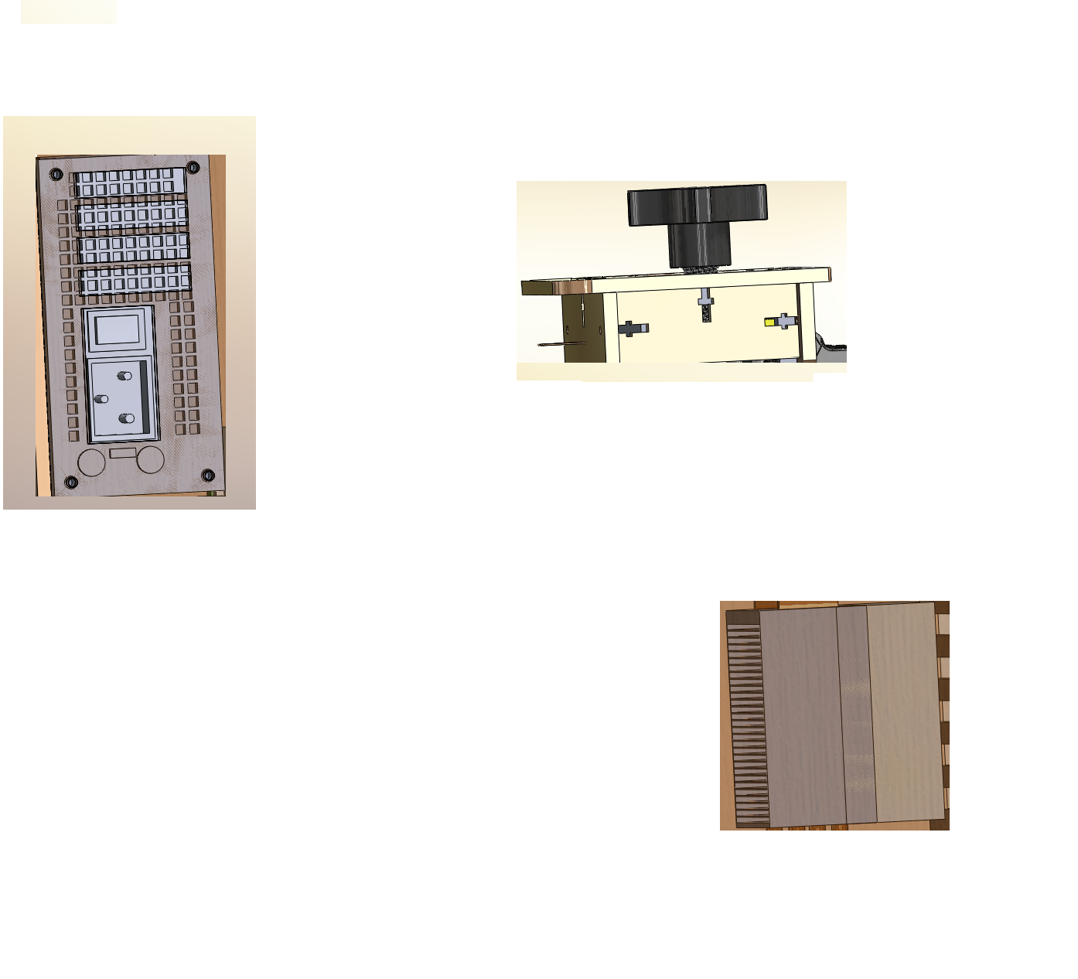
Well Plate
Rearrange framework of PCR to fit new well plate

