Slide 1
Cloning the omcF gene from geobacter sulferreducens to E. coli
Valerie Wisco & Casey Durnan

Slide 2
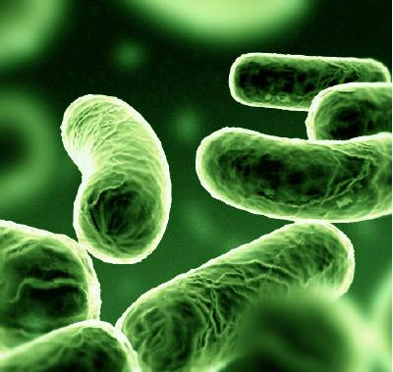
Geobacter sulferreducens
Anaerobic bacteria
Has the ability to transfer electrons
outside the cell and transport the
electrons over long distances by
conductive filaments known as
microbial ‘nanowires’
have the ability to transfer electrons
on to the surface of electrodes creating
a pass of electricity
Has the highest known current density
of any pure culture

Slide 3
We are receiving our cultures from a research lab from the University of Masachusetts – Lab Manager Joy Ward
Will be sent in and cultured anaerobically in NBAF (acetate fumarate) media

Slide 4
omcF
Accession #:AAR35805.1
315 base pairs, no introns
The omcF gene helps code for a subunit of a large lipoprotein cytochrome-c. It is the heme-binding site.
Shown to help regulate the transcription of other Omc genes that play a role in current production
Trials indicate down-regulation of omcF profoundly inhibits electron transfer, reducing electricity production in the organism.
Cloning this gene can eventually help produce efficient bioreactors.

Slide 5
Tentative Procedure
Grow source bacteria culture on NBAF media
DNA extraction
PCR amplification
Quality check/ purify DNA by electophoresis
Digestion of source DNA and promoter
Ligation
Digestion/Ligation of new part and plasmid
Transformation into E. Coli host
Antibiotic selection-Kanomycin
Possible verification testing

Slide 6
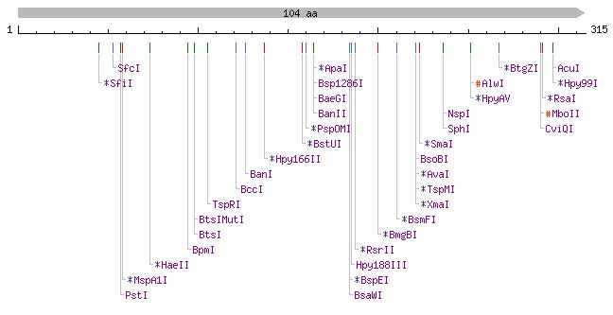
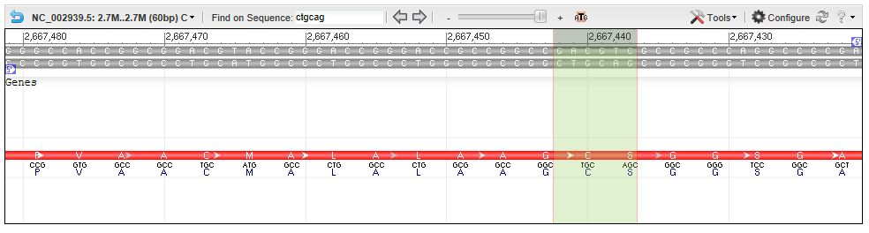
Internal Restriction

Slide 7
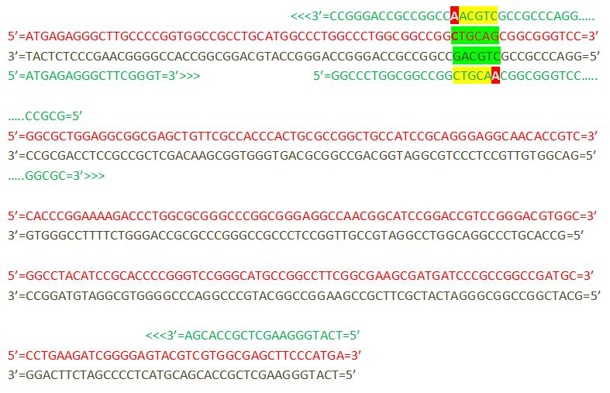
Primer Design

Slide 8
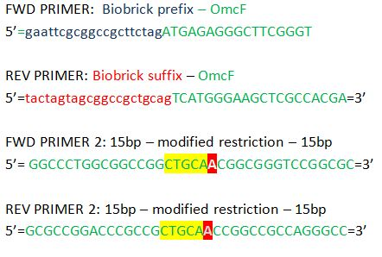
Primer Design

Slide 9
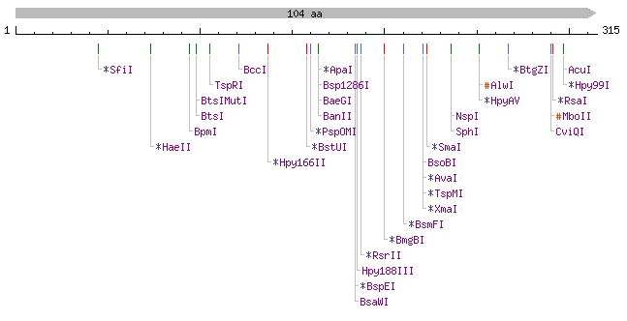
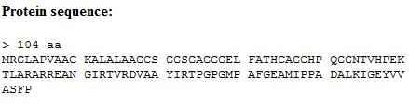
Primer Design
Verified removal of restriction site
Verified lack of new restriction sites
Verified protein sequence

Slide 10
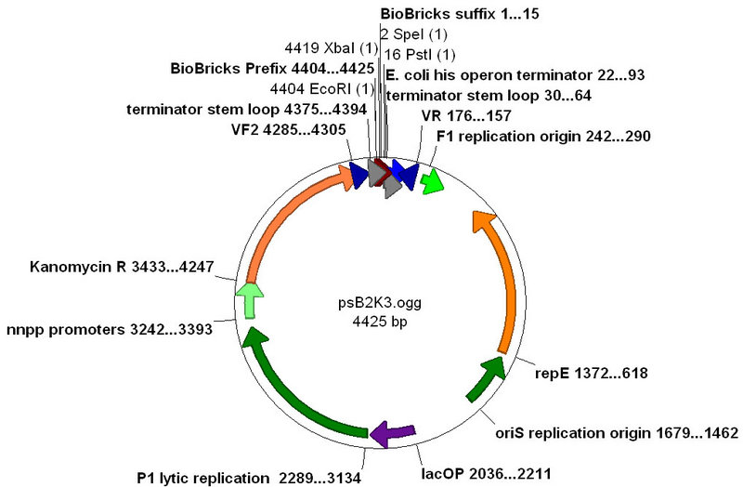
Vector and Promoter Selection
Promoter: pBad/araC
Strictly controlled by L-arabinose as an inducer and restricted by araC
Vector:
psB2K3
Kanomycin Resistent

Slide 11
Testing
SDS-PAGE
Eventual testing would be to see if electrons would be passed onto an electrode, creating a current- after cloning of all essential parts, all Omc genes and genes for creating the “nanowires”
Other genes that could be cloned would be OmcZ (essential for current production), OmcS (conducts the electrons away from the cell-on the pili) and OmcS (important in electron conduction to anodes)

Slide 12
References
Kim, B., Postier, B., DiDonato, R., Chaudhuri, S., Nevin, K., & Lovely D. (2008). Insights into genes involved in electricity generation in geobacter sulfurreducens via whole genome microarray analysis of the omcf-de!cient mutant. Bioelectrochemistry, Retrieved from http://www.geobacter.org/publication-files/18538641.pdf
http://www.ncbi.nlm.nih.gov/nuccore/NC_002939.5?report=genbank&from=2667181&to=2667495&strand=true----
http://www.geobacter.org/about

