Slide 1
Genetics for Biotechnology

Slide 2
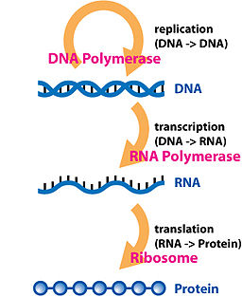
Central Dogma
The direction of the flow of genetic information is from DNA to RNA to polypeptide.

Slide 3
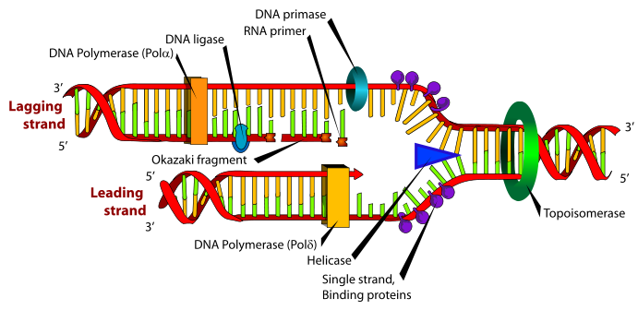
DNA Replication
Initiation and Unwinding of DNA
DNA gyrase (topoisomerase) unwinds the DNA coil.
DNA helicase splits the hydrogen bonds between complimentary bases.
This starts at the origin of replication site and two replication forks move in opposite directions to separate the two strands of DNA

Slide 4
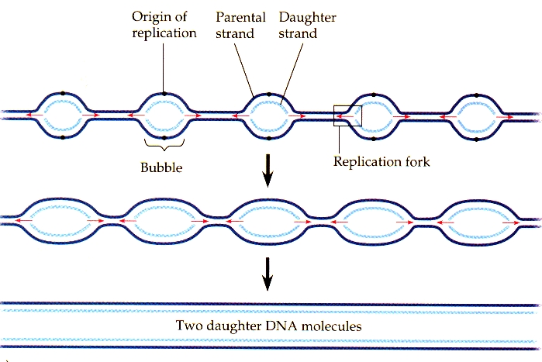
DNA Replication
There are multiple replication bubbles formed in the initiation of DNA replication.

Slide 5
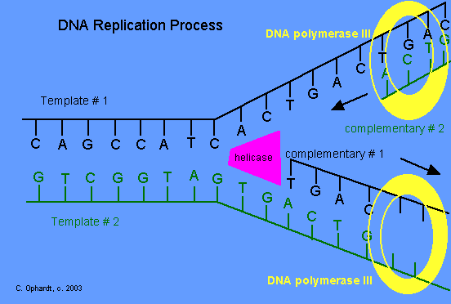
DNA Replication
Synthesis
The enzyme primase lays down a 10-15 nucleotide RNA primer sequence to start replication.
RNA primers serve as the binding sites for DNA polymerase.
DNA polymerase moves along the strand of DNA, using it as a template, to lay down nucleotides and creates a new complimentary strand of DNA for each of the original DNA strands.

Slide 6
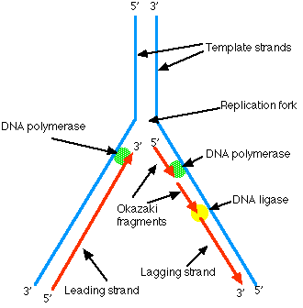
DNA replication
Synthesis
DNA polymerase is a uni-directional enzyme.
DNA polymerase reads the template DNA in a 3’ to 5’ direction, while synthesizing the new strand in a 5’ to 3’ direction.
DNA polymerase moves toward the replication fork on the leading strand and away from the replication fork on the lagging strand.

Slide 7
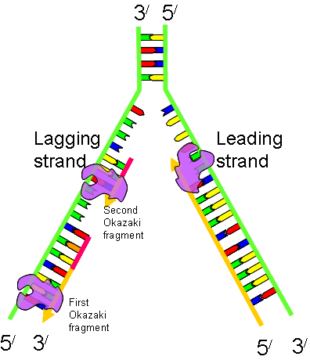
DNA Replication
Synthesis
On the lagging strand, DNA synthesis occurs in short, discrete stretches called Okazaki fragments.
The Okazaki fragments are connected into one long molecule by DNA ligase.
http://highered.mcgraw-hill.com/sites/0072943696/student_view0/chapter3/animation__dna_replication__quiz_1_.html

Slide 8
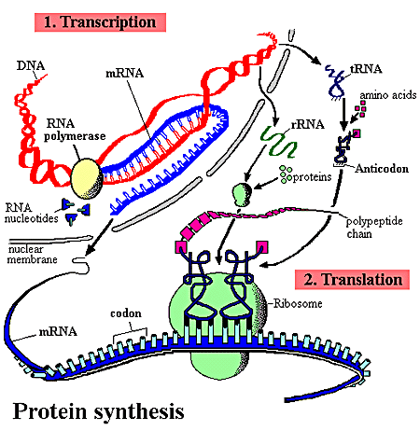
Protein Synthesis
There are 2 processes in photosynthesis.
Transcription – Genes on DNA are transcribed into an RNA code.
Translation – RNA code is used to make a polypeptide.

Slide 9
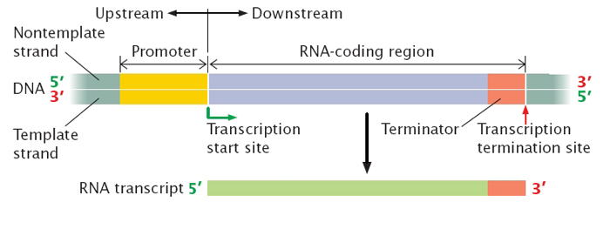
Protein Synthesis
Transcription
Transcription begins when RNA polymerase binds to a specific sequence called a promoter.
Promoters in prokaryotic cells are simple. One RNA polymerase binds to one promoter.
Eukaryotic promoters require the use of 3 types of RNA polymerase, the use of proteins called transcription factors to initiate transcription, and regulatory proteins to modulate transcription.

Slide 10
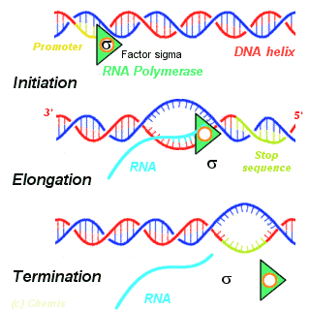
Protein Synthesis
Transcription
Initiation- DNA helicase unwinds the DNA molecule and RNA polymerase begins the synthesis of messenger RNA (mRNA).

Slide 11

Protein Synthesis
Transcription
Elongation – RNA polymerase moves along the DNA strand in the 3’ to 5’ directions adding RNA nucleotides.
The RNA elongates by the addition of ribonucleotides to the 3’ end of the newly synthesized mRNA.

Slide 12
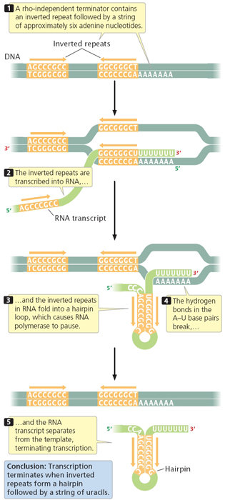
Protein Synthesis
Transcription
Termination – occurs when the end of the gene is reached. RNA polymerase disengages the DNA, and the new mRNA molecule is released.

Slide 13
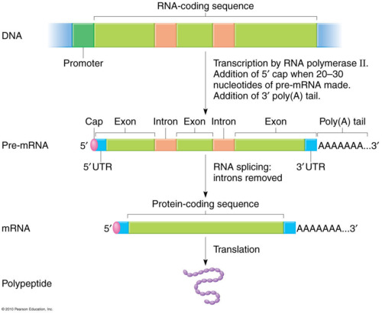
Protein Synthesis
RNA Processing
Prokaryotic cells do not undergo RNA processing.
In eukaryotic cells, a newly synthesized mRNA primary transcript must be modified before it is fully functional.
3 modifications are necessary:
Addition of a 5’ cap structure- nine methylated guanines are added to the 5’ end of the mRNA.
Addition of 3’ poly-A-tail. A string of adenine nucleotides called a poly- A-tail is added to the 3’end of mRNA.

Slide 14
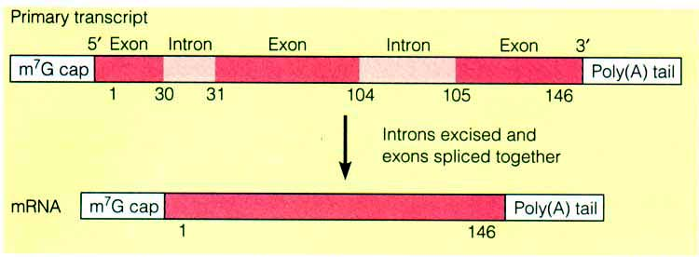
Protein Synthesis
RNA processing
Non coding sequences called introns intervene between the coding sequences called exons. Introns are spliced out so that exons are adjacent to each other.
The 5’ and 3’ modifications:
Facilitate transport of mRNA out of the nucleus.
Prevent degradation of mRNA in the cytoplasm.
Maintain stability for translations

Slide 15
Transcription
http://highered.mcgraw-hill.com/sites/0072507470/student_view0/chapter3/animation__mrna_synthesis__transcription___quiz_1_.html
Transcription

Slide 16
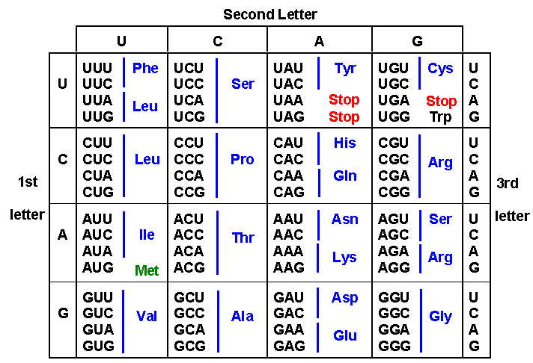
Protein Synthesis
Genetic Code
mRNA nucleotides are read in 3 base sequences called codons. Each codon represents a particular amino acid.

Slide 17
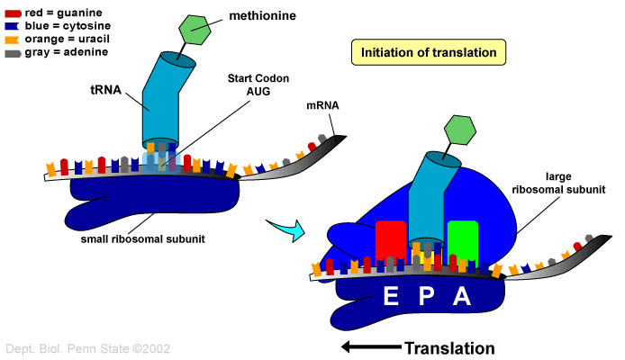
Protein Synthesis
Translation
Initiation
Small ribosomal unit binds to initiator tRNA with its methionine.
The small ribosomal unit and tRNA bind to the 5’ end of the mRNA.
Small subunit moves along mRNA until AUG start codon is found. Anticodon of tRNA and codon of mRNA pair.
Large ribosomal unit is added.

Slide 18
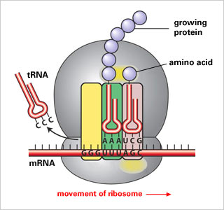
Protein synthesis
Translation
Translocation
The initiator tRNA is located at the Psite on the ribosome.
A second tRNA with its amino acid is transferred to the A site on the ribosome.
The methionine on the initiator tRNA is removed and bonded to the second amino acid on the A site tRNA via peptide bond.
The ribosome moves and the A site tRNA is moved to the P site.
The initiator tRNA moves to the E site and is released into the cytoplasm.
A new tRNA with an amino acid is brought to the A site.
The process continues as the mRNA is read in the 5’ to 3’ direction and a polypeptide is formed.

Slide 19
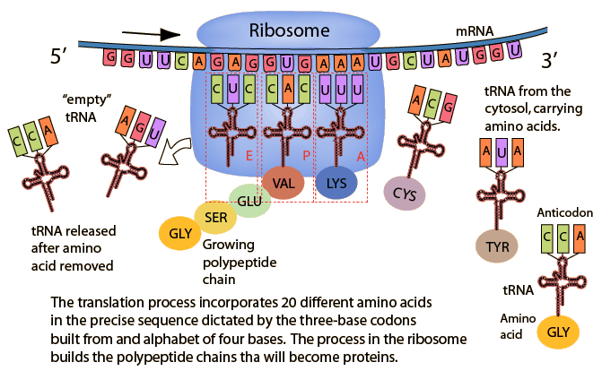
Protein Synthesis

Slide 20
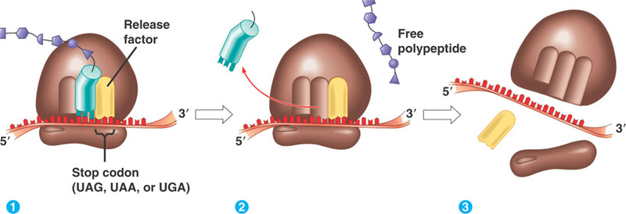
Protein Sythesis
Translation
Termination
Elongation of the polypeptide chain continues until a stop codon (UAA,UAG,UGA) is reached.
A protein release factor interacts with the stop codon to terminate translation.
The ribosome dissociates and the mRNA is released and can be used again.

Slide 21
Translation
http://highered.mcgraw-hill.com/sites/0072507470/student_view0/chapter3/animation__how_translation_works.html
Translation

Slide 22
Gene Mutations
Mutations can occur spontaneously during DNA replication or be caused environmental mutagens that mimic nucleotides and alter DNA structure.
Mutations can have no effect, a positive effect, or a negative effect.
There are two types of mutations
Point (gene) mutations
Chromosome mutations

Slide 23
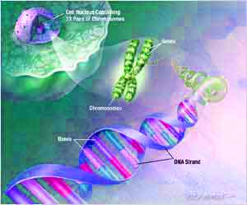
Gene Mutations
Point mutations are called single nucleotide polymorphisms (SNPs) and represent one major genetic variation in the human genome.
Point mutations are caused by:
Substitution of a base
Deletion of a base
Insertion of a base

Slide 24
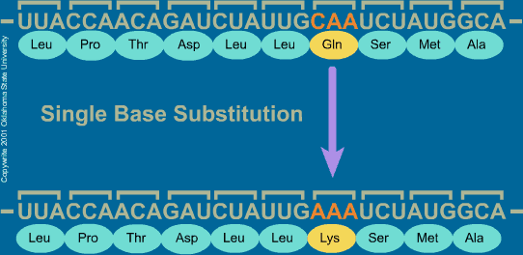
Gene Mutations
Substitution
One base is substituted for another.
Silent mutation – occurs when the base substitution does not change the amino acid.
Missense mutation - occurs when the base substitution results in a new amino acid to be inserted in a protein.
Nonsense mutation - occurs when the base substitution results in an early stop codon and a shortened protein.
http://highered.mcgraw-hill.com/sites/0072556781/student_view0/chapter11/animation_quiz_3.html

Slide 25
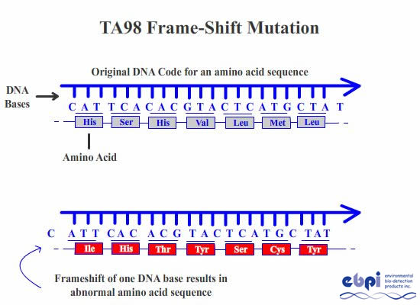
Gene mutations
Insertion and Deletion
Insertion is the adding of a single base to the nucleic acid sequence and deletion is the omitting of a single base.
Both insertion and deletion lead to frameshift mutations.
Frameshift mutations cause the reading frame for codons to be shifted changing the protein encoded by the mRNA.
http://highered.mcgraw-hill.com/sites/0072552980/student_view0/chapter9/animation_quiz_5.html

Slide 26
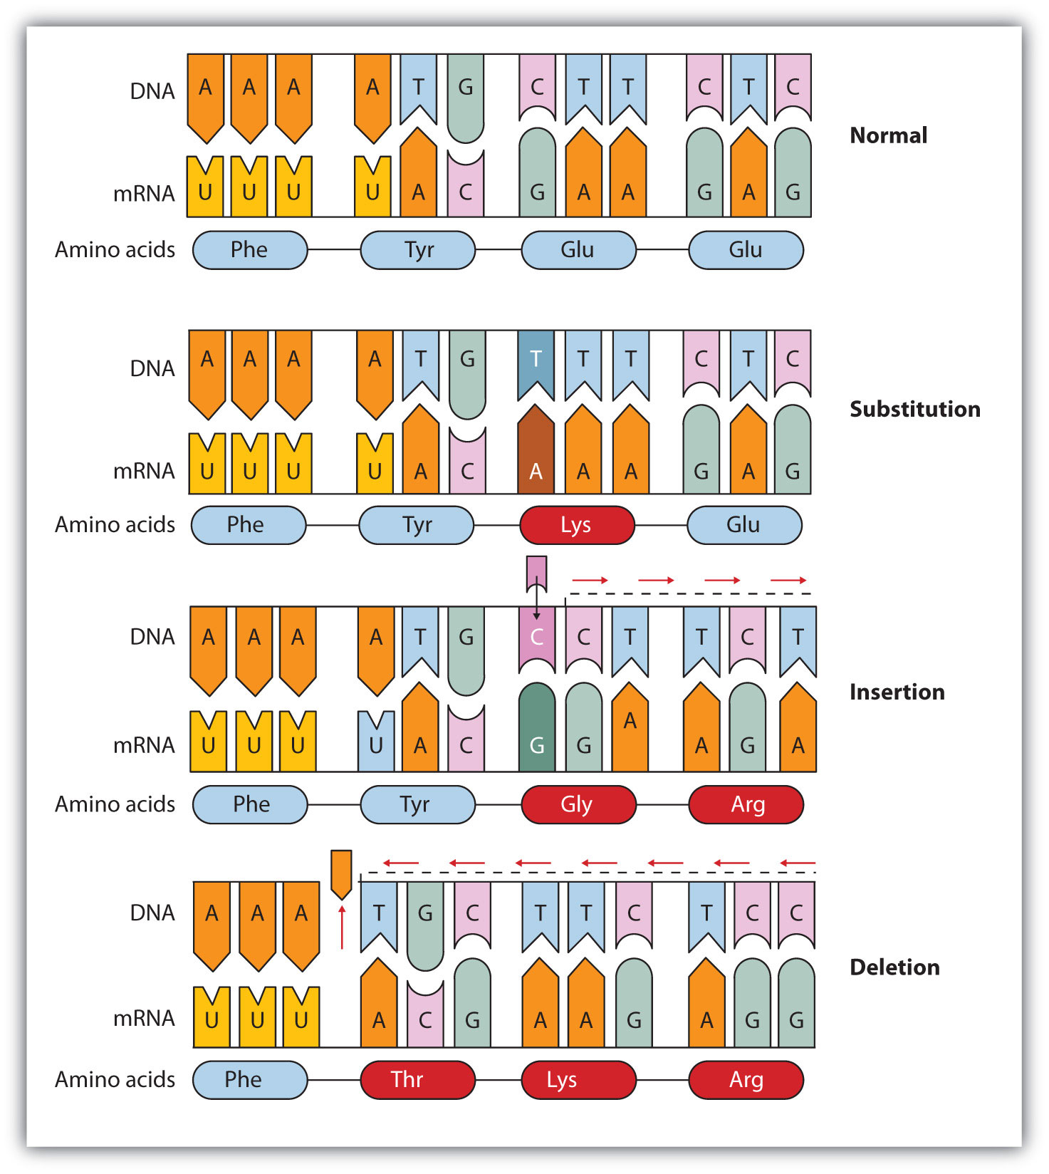

Slide 27
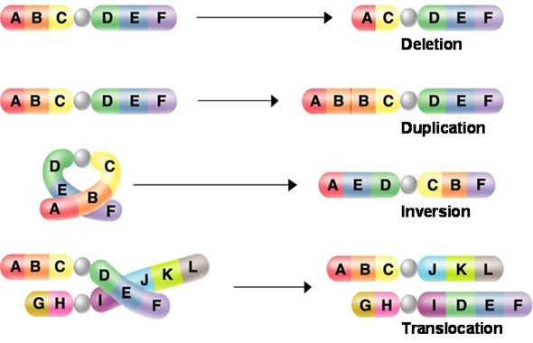
Chromosome Mutations
Chromosome Mutations affect large sections of a chromosome (many genes).
Deletion – Remove a large section of chromosome.
Duplication- Double sections of chromosome
Inversion - Invert sections of chromosome
Translocation – Remove sections of chromosome to transfer section to another location; either on the same or different chromosome.
http://highered.mcgraw-hill.com/sites/0070960526/student_view0/chapter18/animation_quiz_1.html

Slide 28
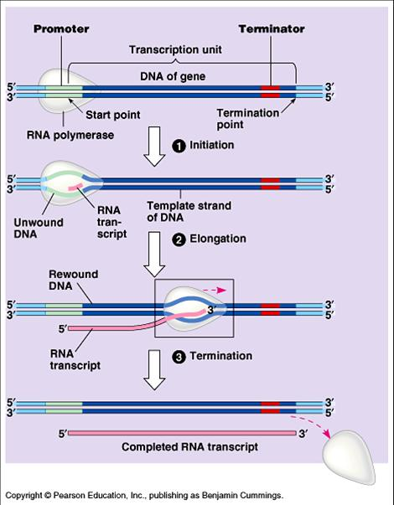

Slide 29
Mutations –Basis for variation
Humans have 99.9% of DNA sequence in common.
.1% variation due to SNPs. This .1% equals about 3 million bases..
Most genetic variation between humans are due to SNPs.
Most SNPs have no effect because they occur in introns or other non-coding sections of DNA.
Those that occur in coding sections of DNA can influence cell function, genetic disease, and behavior.

Slide 30
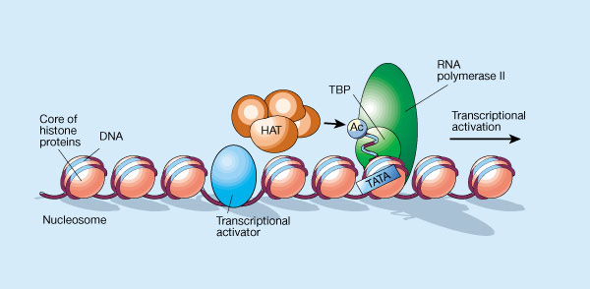
Regulation of Gene Expression
Cells usually synthesize only proteins that are required.
Turning genes “off” and “on” is highly controlled in cells.
In prokaryotes, control occurs at the level of transcription initiation.
Eukaryotes are more complex. There are many regulatory proteins and controls occur at many levels in the cell.

Slide 31
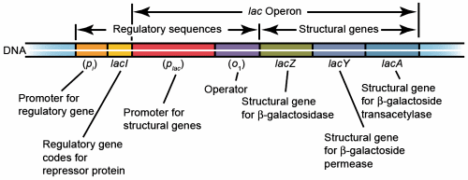
Regulation of Gene Expression
Prokaryotic Gene Expression
Microorganisms must respond rapidly to the environment and proteins or enzymes my be required for a brief time.
A single promoter often controls several structural genes or coding regions called cistrons.
The arrangement is called an operon.
Genes in the same operon have related functions.
An operon specifically consists of a promoter, structural (coding) genes and a repressor binding site called an operator.
Repressor proteins are synthesized and bind to the operator to block transcription

Slide 32
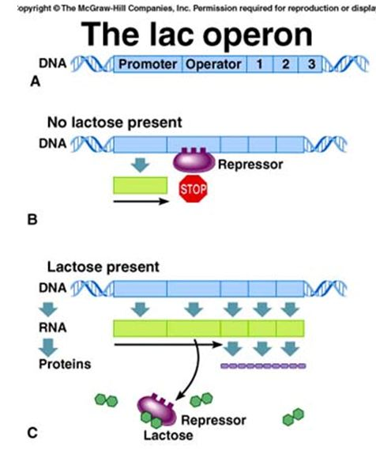
Regulation of Gene Expression
Prokaryotic Gene Expression
Lac Operon – has a promoter region, an operator, 3 structural genes, and a repressor binding site.
If no lactose is present, the lac repressor protein bind to the operator and prevents transcription by not allowing RNA polymerase to bind to the promoter.
If lactose is present, lactose binds to the repressor protein and the protein cannot bind to the operator. RNA polymerase is free to bind to the promoter and transcription is initiated.
http://www.sumanasinc.com/webcontent/animations/content/lacoperon.html

Slide 33
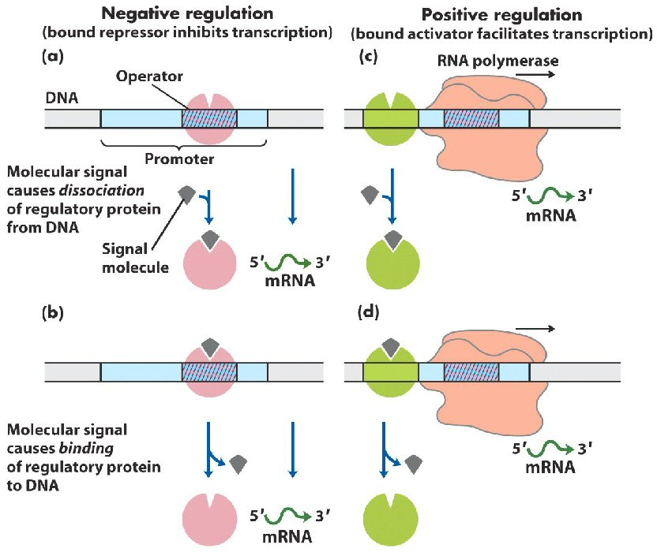

Slide 34
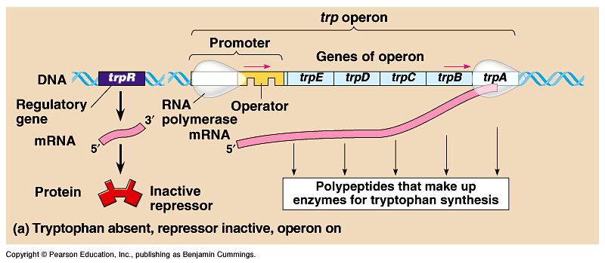
Figure 18.20a The trp operon: regulated synthesis of repressible enzymes

Slide 35
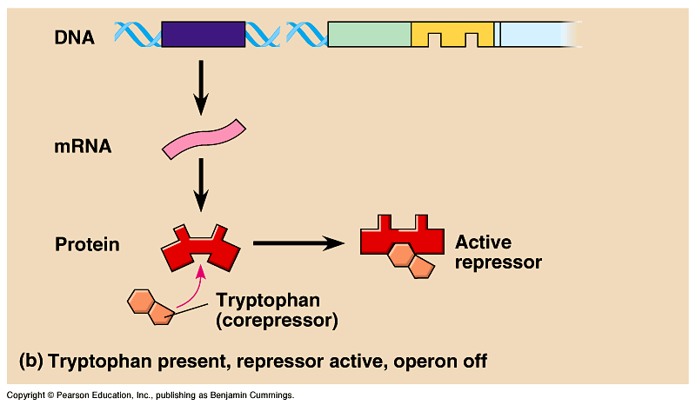
Figure 18.20b The trp operon: regulated synthesis of repressible enzymes (Layer 1)

Slide 36
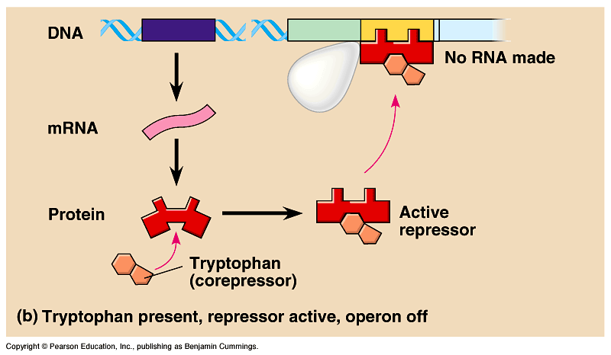
Figure 18.20b The trp operon: regulated synthesis of repressible enzymes (Layer 2)

Slide 37
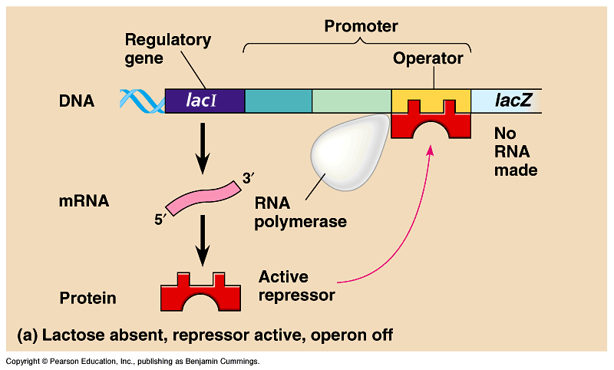
Figure 18.21a The lac operon: regulated synthesis of inducible enzymes

Slide 38
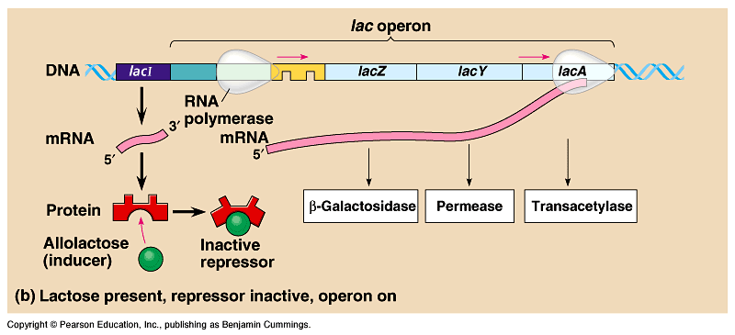
Figure 18.21b The lac operon: regulated synthesis of inducible enzymes

Slide 39
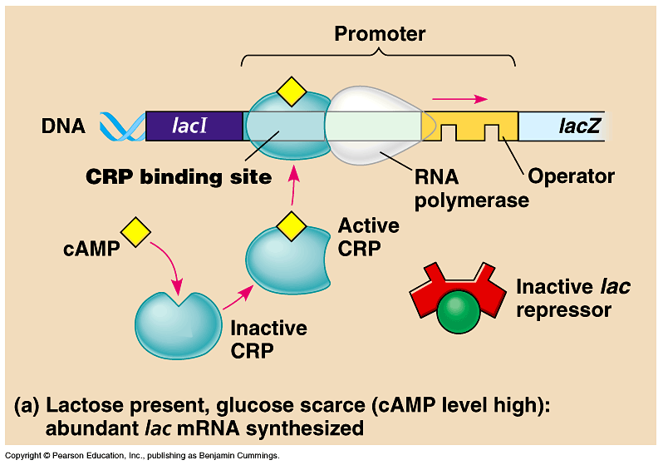
Figure 18.22a Positive control: cAMP receptor protein

Slide 40
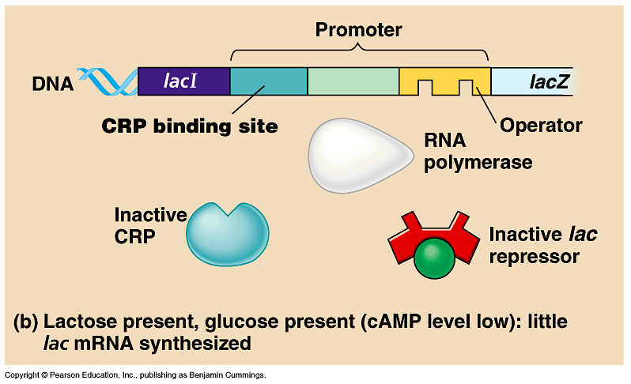
Figure 18.22b Positive control: cAMP receptor protein

Slide 41
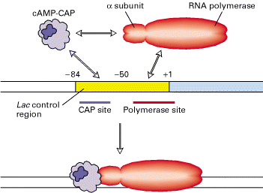
Cooperative binding of Crp and RNAP
Binds more stably than either protein alone

Slide 42
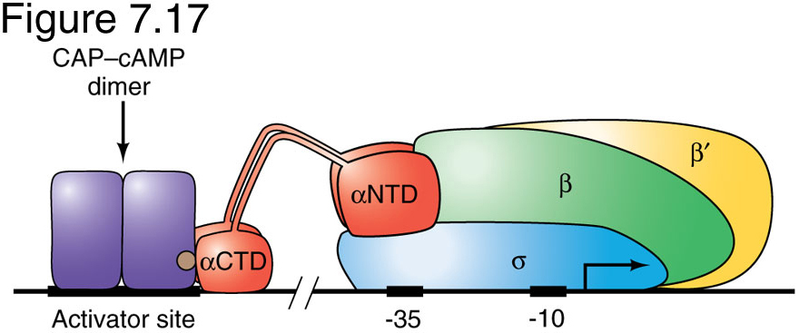
Interaction of CAP-cAMP, RNA Pol and
DNA of lac control region

Slide 43
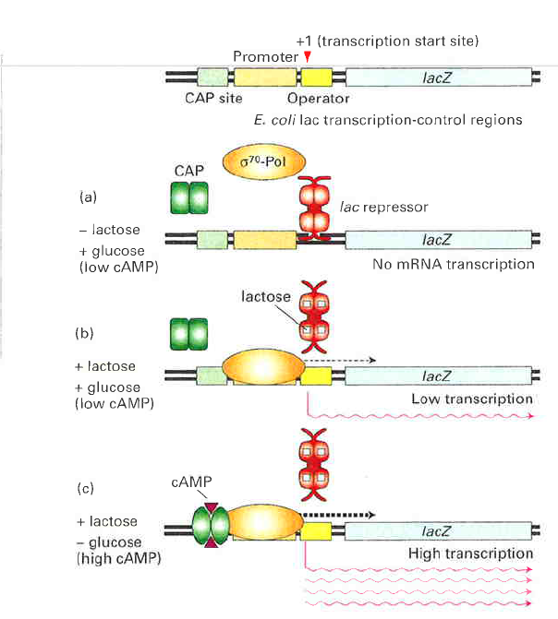
lac operon – activator and repressor
CAP = catabolite
activator protein
CRP = cAMP receptor
protein

Slide 45
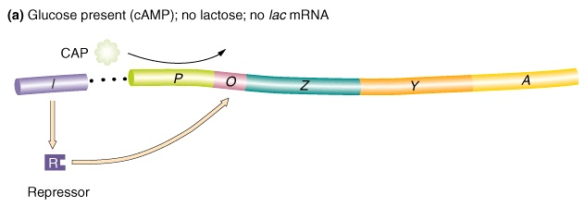
lac operon off
low

Slide 46
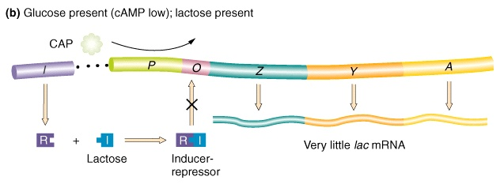
lac operon very weakly on

Slide 47
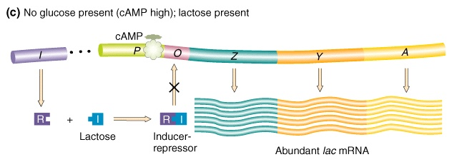
lac operon fully induced

Slide 48
Regulation of Gene Expression
Eukaryotic Gene Expression
Eukaryotic gene expression is much more intricate and variable than prokaryotes.
Eukaryotes control
Transcription
mRNA processing
Transport of mRNA to the cytoplasm.
Rate of translation
Protein processing

Slide 49
Regulation of Gene Expression
Eukaryotic Gene Expression
There are many reasons for the complexity of eukaryotic gene expression.
Larger genome size with many non-coding regions. Prokaryotes do not have non-coding regions.
Compartmentalization within the cell. Nuclear encoded gene products must be transported to organelles.
More extensive transcript processing; introns removed, 5’ cap and 3’ poly-A-tail.
Genes that perform similar functions are scattered around the genome and must be coordinated.
Transcription regulator sequences can be great distances from the genes they regulate.
Cell specialization means that specific sets of genes are activated or inactivated depending on cell type.

Slide 50
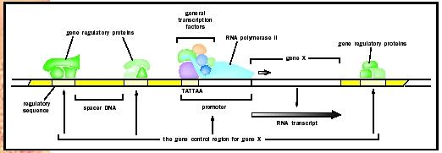
Regulation of Gene Expression
Transcription
Eukaryotic gene complexes have 3 basic parts:
Upstream regulatory enhancers
Upstream promoters
Coding gene sequence.

Slide 51
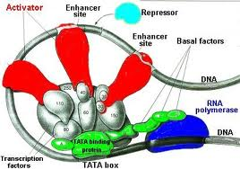
Regulation Gene Expression
Eukaryotic Gene Expression - Transcription
RNA polymerase does not act alone in eukaryotic transcription.
RNA polymerase needs to bind with proteins called transcription factors.
The RNA polymerase/transcription factor complex can bind to the promoter to initiate transcription.
In addition, upstream gene regulatory sequences called enhancers also bind to the RNA/protein/promoter complex.
Enhancers regulate the speed of transcription.
Then transcription of the coding gene can begin.

Slide 52
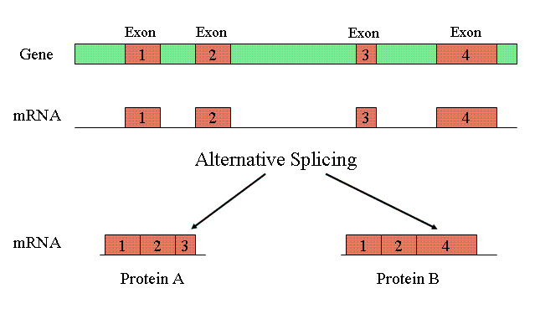
Regulation of Gene Expression
Eukaryotic Gene Expression
Regulation of RNA processing/transport out of the cytoplasm.
Two different cell types can process a primary mRNA transcript differently. This is called alternative splicing.
As a result, different proteins can be produced from the same type of primary transcript.

Slide 53
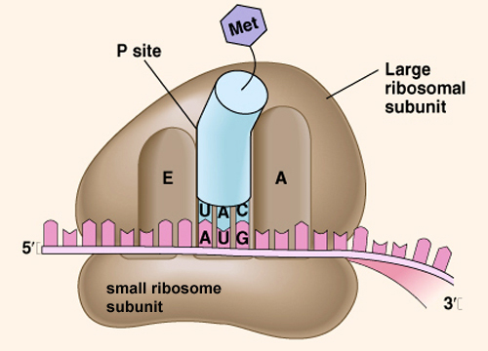
Regulation of Gene Expression
Eukaryotic Gene Expression
Translation Control
Initiation factors control the start of translation and repressor proteins can inhibit translation.
Different mRNAs have different degradation times. The stability of the mRNA controls how long the message is available.

Slide 54
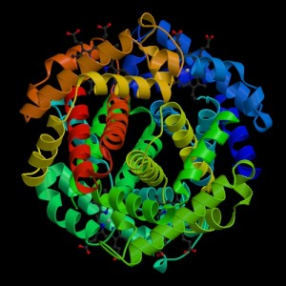
Regulation of Gene Expression
Eukaryotic Gene Expression
Posttranslational control
Protein products are altered after they are synthesized.
Alteration include
Protein folding
Modification with addition of sugars, lipids, phosphates.
Assembly with other proteins.
http://glencoe.mcgraw-hill.com/sites/9834092339/student_view0/chapter16/control_of_gene_expression_in_eukaryotes.html
Eukaryotic Gene Expression

Slide 55

Initiation
RNA polymerase
Transcription factors
Promoter DNA
RNAP binding sites
Operator – repressor binding
Other TF binding sites
Start site of txn is +1
α α β β’σ

Slide 56
Initiation
RNA polymerase
4 core subunits
Sigma factor (σ)–
determines promoter
specificity
Core + σ = holoenzyme
Binds promoter sequence
Catalyzes “open complex” and transcription of DNA to RNA

Slide 57
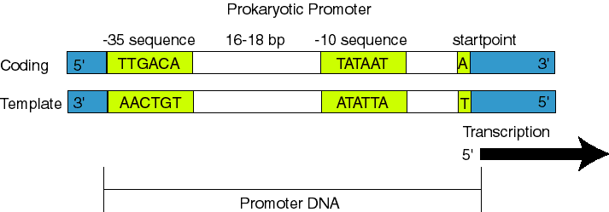

Slide 58
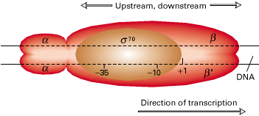
RNAP binds specific promoter sequences
Sigma factors recognize consensus
-10 and -35 sequences

Slide 59
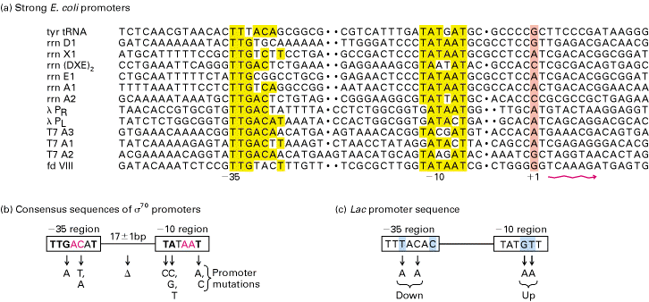
RNA polymerase promoters
TTGACA
TATAAT
Deviation from consensus -10 , -35 sequence leads to
weaker gene expression

Slide 60
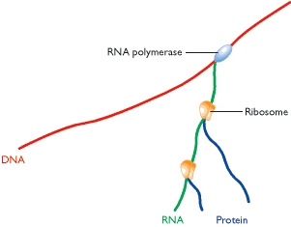

Slide 61

Control can also happen at the Ribosome binding site

Slide 62
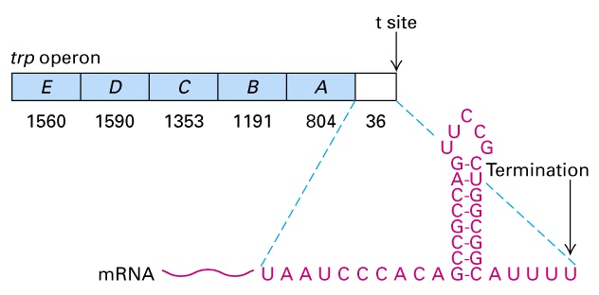
What about the terminator?
Termination sequence has 2 features:
Series of U residues
GC-rich self-complimenting region
GC-rich sequences bind forming stem-loop
Stem-loop causes RNAP to pause
U residues unstable, permit release of RNA chain

Slide 63


Slide 64
Bacterial Logic Gates

Slide 65


Slide 66


Slide 67


Slide 68


Slide 69


Slide 70

Repressilator

Slide 71


Slide 72

Toggle Switch

Slide 73


Slide 74


