Slide 1
Exploring the Relationship of Fermentation and Respiration on Glucose and Ammonia Consumption in S. Cereviseae
Margaret J. ONeil
Department of Biology
Loyola Marymount University
BIOL-398-05/S17
March 2, 2017

Slide 2
Outline
Fermentation and aerobic respiration control conversion of glucose into yeast biomass
Fermentation and aerobic respiration simplified to the production and consumption of key metabolic by-products
Model shows success for population and glucose concentration, needs improvement in all other variables
Moving forward improvement can be made on assumptions for fermentation and aerobic respiration equations

Slide 3
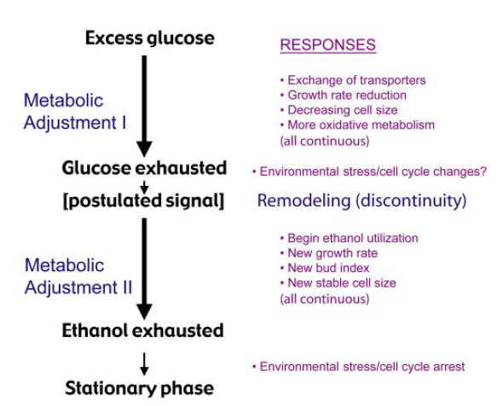
As Glucose Concentration Becomes Limiting, Yeast Switch from Fermentation to Aerobic Respiration
Albertin et al. (2011) shows positive relationship in population size and fermentative ability
Brauer et al. (2005) shows glucose concentration as driver in determining metabolic function
Indicate population and glucose concentration important in factors in metabolic systems
Courtesy of Brauer et al. (2005)

Slide 4
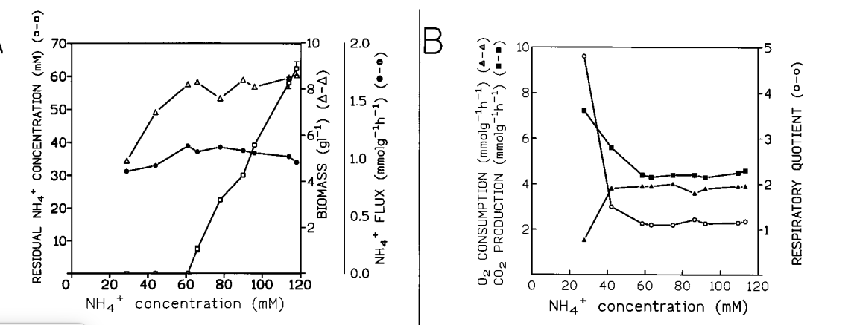
ter Schure et al. (1995) Seems to Confirm that Change in Metabolic Function Depends on Glucose
Courtesy of ter Schure et al. (1995) J. Bacteriology 177(22)

Slide 5
Adding State Variables to take Aerobic Respiration and Fermentation into Account will Improve Week 5 Model
Results from Week 5 showed improvement could be made in considering metabolism and glucose
Hypothesized fermentation and aerobic respiration were impacting conversion of glucose into yeast biomass
Need to find system of equations that connects these processes to ammonia consumption

Slide 6
Outline
Fermentation and aerobic respiration control conversion of glucose into yeast biomass
Fermentation and aerobic respiration simplified to the production and consumption of key metabolic by-products
Model shows success for population and glucose concentration, needs improvement in all other variables
Moving forward improvement can be made on assumptions for fermentation and aerobic respiration equations

Slide 7
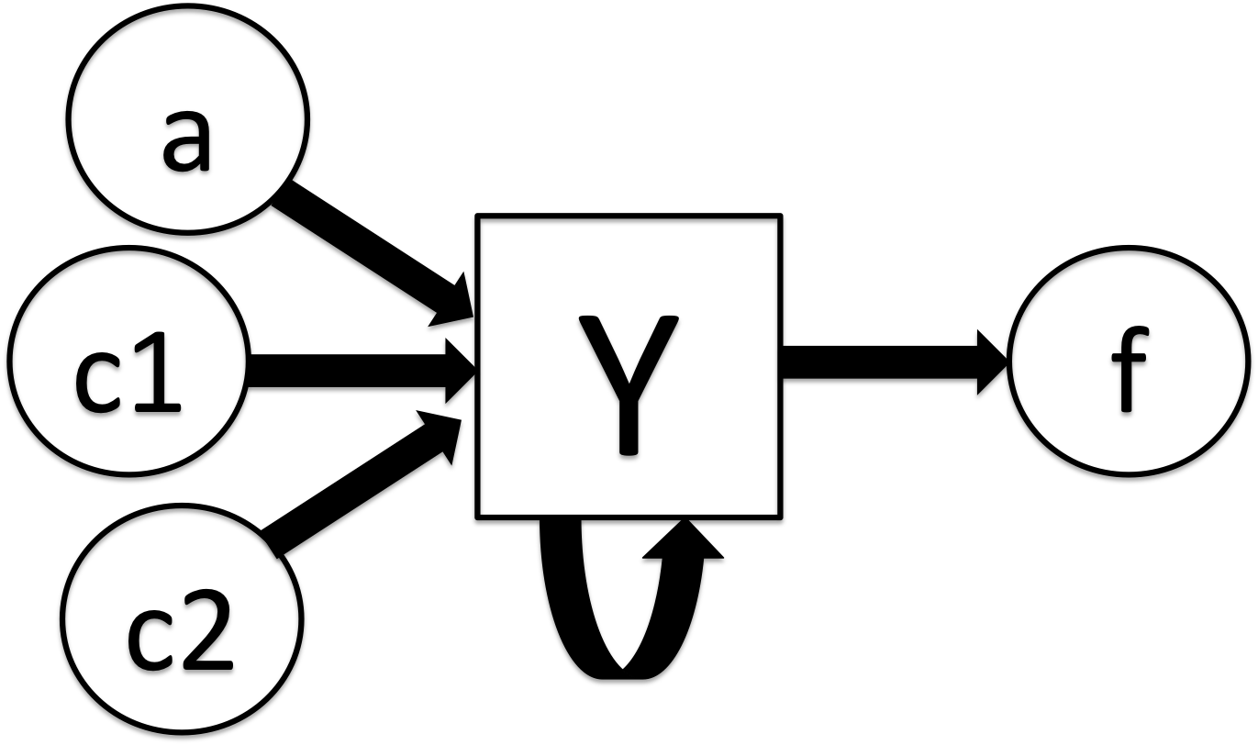
Fermentation and Aerobic Respiration Terms Simplified to Keep Variable Count Minimal
Looking at population, ammonia, glucose and aerobic respiration and fermentation
Fermentation rewritten as ethanol production
Aerobic respiration becomes O2 consumption

Slide 8
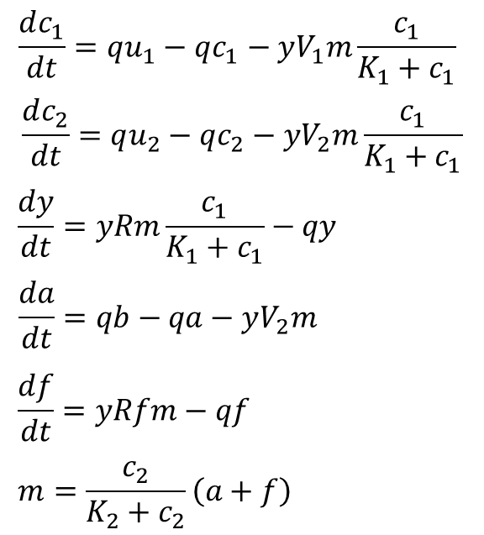
System of Differential Equations Models Ethanol Production like Population and O2 Consumption as Nutrient Consumption
Parameters:
q=dilution rate
u1=Ammonia concentration in
V1=Volume
K=metabolic constant
u2=Concentration of glucose in
b= Amount of oxygen at start
State Variables:
y= Yeast biomass
c1= Residual Ammonia
c2= Residual Glucose
a= Glucose Consumption
f= Ethanol Production

Slide 9
Outline
Fermentation and aerobic respiration control conversion of glucose into yeast biomass
Fermentation and aerobic respiration simplified to the production and consumption of key metabolic by-products
Model shows success for population and glucose concentration, needs improvement in all other variables
Moving forward improvement can be made on assumptions for fermentation and aerobic respiration equations

Slide 10
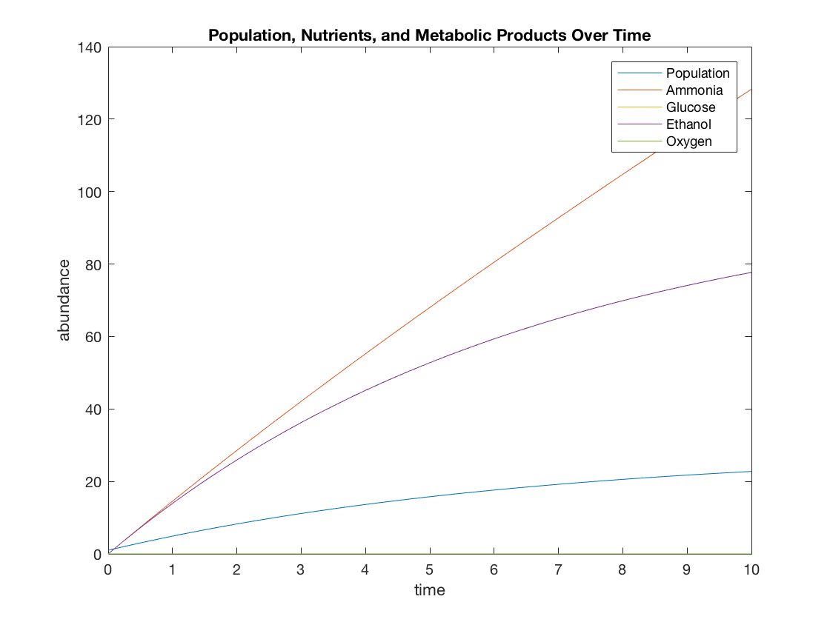
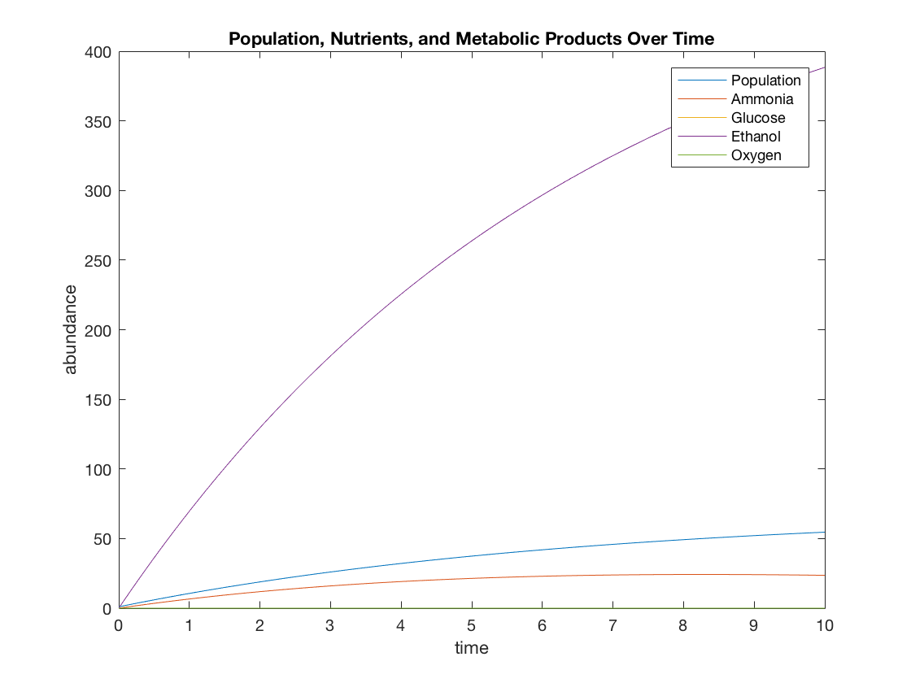
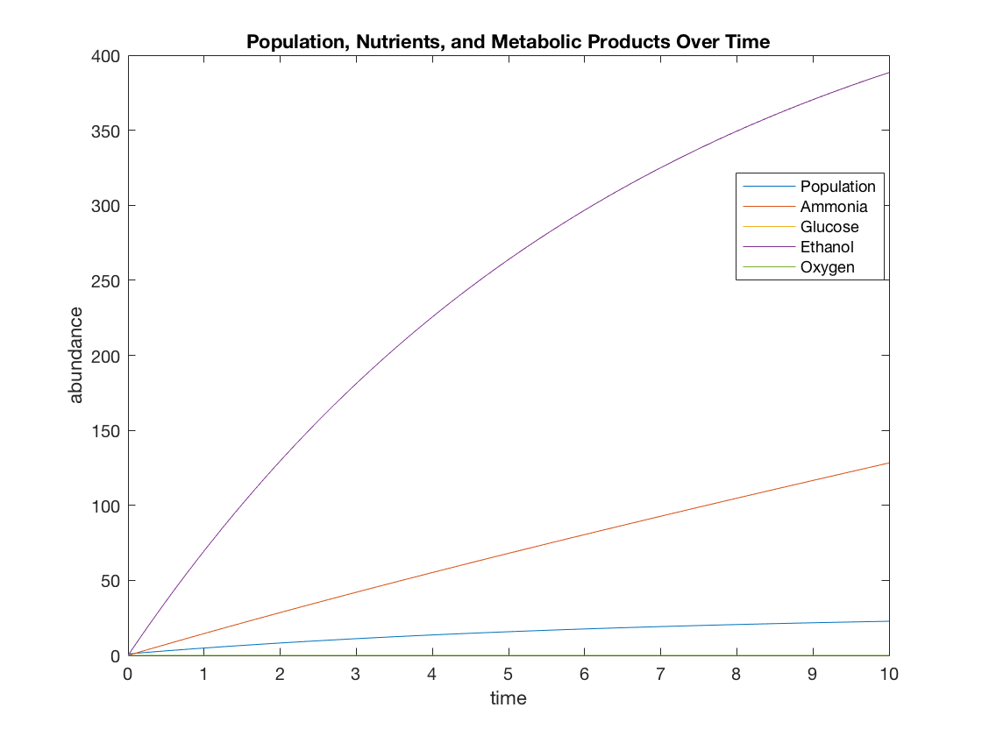
Parameters must be Drastically Increased or Decreased to have an Impact on Model
Starting plot
Glucose Decreased
O2 Increased

Slide 11
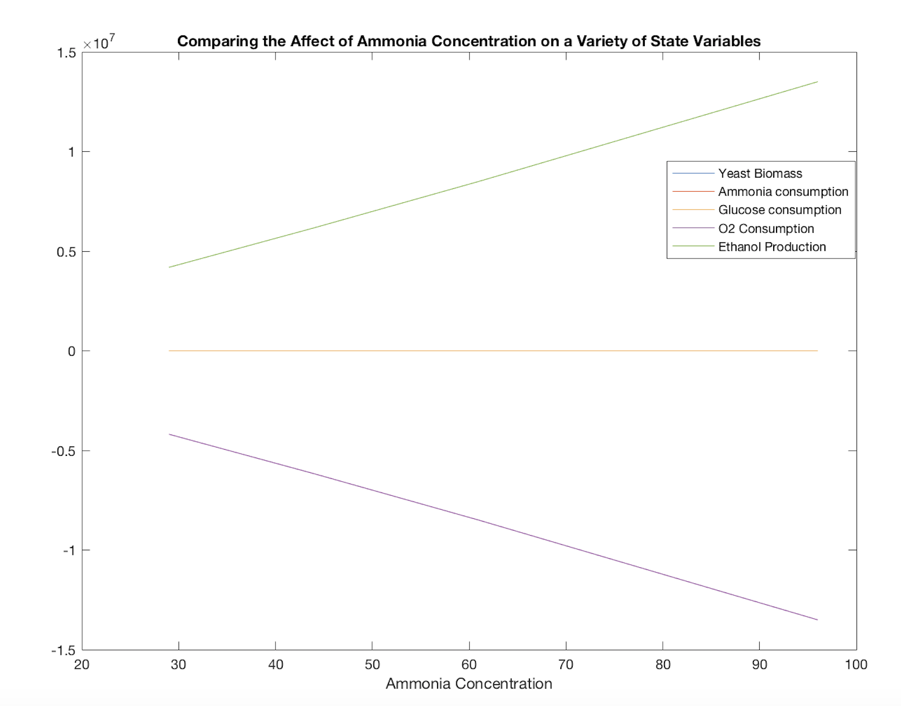
Steady-State Showed Strong Relationship Between a and f, but in Unexpected Way
U1 values of 29, 44, 61, 96 selected from ter Schure et al. (1995)
All parameters kept same as Week 5 Assignment
B taken from ter Schure et al. (1995), (4mmolg⁻¹l⁻¹ is the highest level of O2 consumption)
Somehow a=-f; numbers way higher than they should be

Slide 12
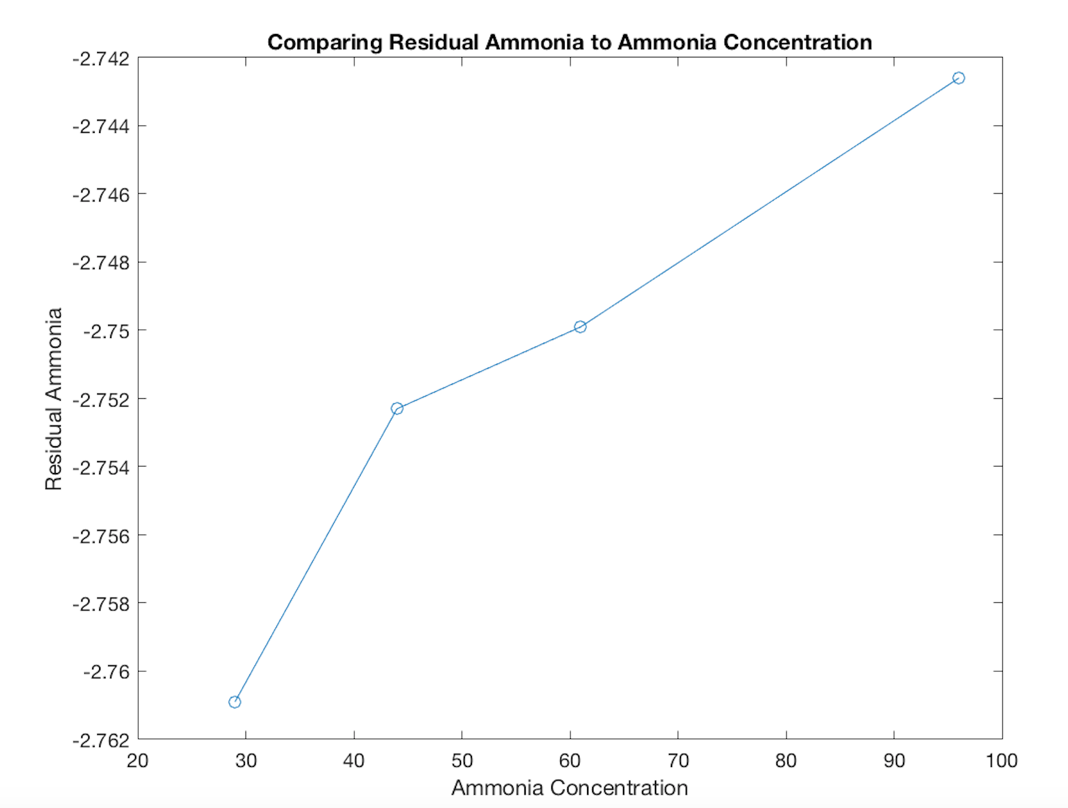
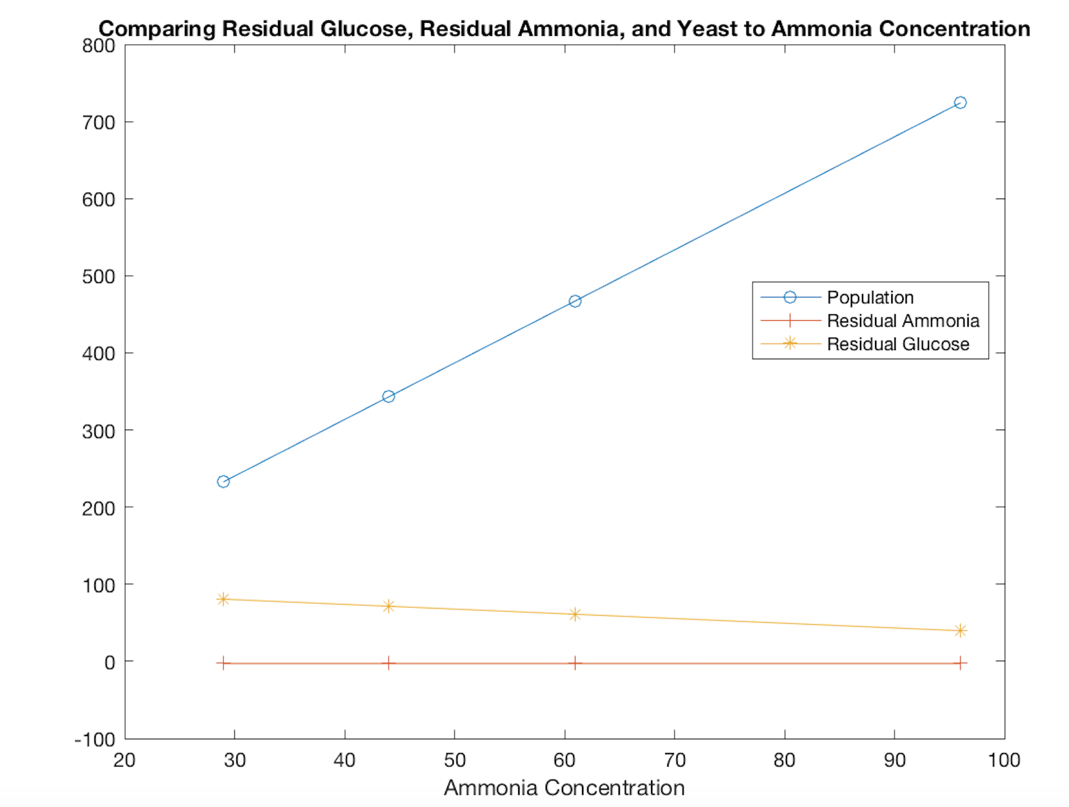
Steady-State Succeeded in Modeling General Relationships but Failed in Modeling Limiting Factors
Model meets expectations for relationships between ammonia concentration and other variables
Fails in that residual ammonia stays negative and gets only slightly less negative
Does not show switch in limiting factors

Slide 13
Outline
Fermentation and aerobic respiration control conversion of glucose into yeast biomass
Fermentation and aerobic respiration simplified to the production and consumption of key metabolic by-products
Model shows success for population and glucose concentration, needs improvement in all other variables
Moving forward improvement can be made on assumptions for fermentation and aerobic respiration equations

Slide 14
Moving Forward, Model Could be Improved Through Making it More Complicated
Issue lies in how a and f are being modeled; overly simplistic corresponds to poor modeling of a and f
Look into other papers where oxygen consumption is modeled and where ethanol production is modeled
Is there a better relationship than (a+f) by which to adjust conversion of glucose to biomass?

Slide 15
While Overall Modeling Poor, Hypothesized Relationships Between State Variables Shown in Steady-State
Despite output range being unexpected, model does show aerobic respiration and fermentation impacting conversion of glucose into biomass
Indicates with some tweaks to parameters and relationship between a and f, model could easily be improved
Next task would be to find models of aerobic respiration on biomass conversion, and fermentation on biomass conversion

Slide 16
Outline
Fermentation and aerobic respiration control conversion of glucose into yeast biomass
Fermentation and aerobic respiration simplified to the production and consumption of key metabolic by-products
Model shows success for population and glucose concentration, needs improvement in all other variables
Moving forward improvement can be made on assumptions for fermentation and aerobic respiration equations

Slide 17

Acknowledgments
Thank you to Dr. Fitzpatrick and Dr. Dahlquist for their guidance and help on this project
Thank you BIOL-398-05/S17 Classmates for listening and collaborating when issues arose with MatLab errors

Slide 18
References
Albertin, W., Marullo, P., Aigle, M., Dillmann, C., de Vienne, D., Bely, M., & Sicard, D. (2011).
Population Size Drives Industrial Saccharomyces cerevisiae Alcoholic Fermentation and Is under Genetic Control .Applied and Environmental Microbiology, 77(8), 2772–2784. http://doi.org/10.1128/AEM.02547-10
Dahlquist, Kam D. (2017)
BIOL398-05/S17:Week 5. Retrieved from http://www.openwetware.org/wiki/BIOL398-05/S17:Week_5 on 1 March 2017
Brauer, M. J., Saldanha, A. J., Dolinski, K., & Botstein, D. (2005).
Homeostatic adjustment and metabolic remodeling in glucose-limited yeast cultures. Molecular biology of the cell, 16(5), 2503-2517. doi: 10.1091/mbc.E04-11-0968
ter Schure, E. G., Sillje, H. H., Verkleij, A. J., Boonstra, J., & Verrips, C. T. (1995).
The concentration of ammonia regulates nitrogen metabolism in Saccharomyces cerevisiae. Journal of bacteriology, 177(22), 6672-6675.

