Slide 1
In Silico Feedback for In Vivo Regulation of a Gene Expression Circuit.
Andreas Milias-Argeitis, Sean Summers, Jacob Stewart-Ornstein, Ignacio Zuleta, David Pincus, Hana El-Samad, Mustafa Khammash, and John Lygeros
Nature Biotechnology
November 6th, 2011
Jamal Elkhader
20.385 Journal Club II

Slide 2
Feedback Control
Regulation of Cell Behavior
Feedback Control Important for Regulation
  Processing measurements in real time
  Determining inputs
Robust regulation can be achieved!
Notes:
Currently, regulating cell behavior has some difficulties. By using feedback control, cell behavior can be regulated. With good feedback control, measurements of the output are processed in real time, which helps to determine the appropriate inputs so that the desired behavior can emerge. By using this, cells may be able to produce new desired functions. Currently, the process to do this is very repetitive and tedious, and there has not been much success. With the in silico feedback, regulation may be able to be achieved

Slide 3
In Silico Feedback Control
In silico – Performed on Computer or via Computer Simulation
In silico feedback
  Computer
  Real time data
  Inputs
  Regulation
Notes:
However, these can be overcome by using in silico feedback control. In silico means that the processes are performed on a computer, or via computer simulation. The research deals with feedback control. For this paper, they decided to use in silico feedback control as a complement to feedback circuitry that was already built from biological components. This way, there are able to combine both computer parts and biological parts to work together. For in silico feedback, computational control algorithms are run on a computer and constantly updated with real-time measurement data. Then, the proper external inputs achieve and maintain the desired behavior, while compensating for circuit variability.

Slide 4
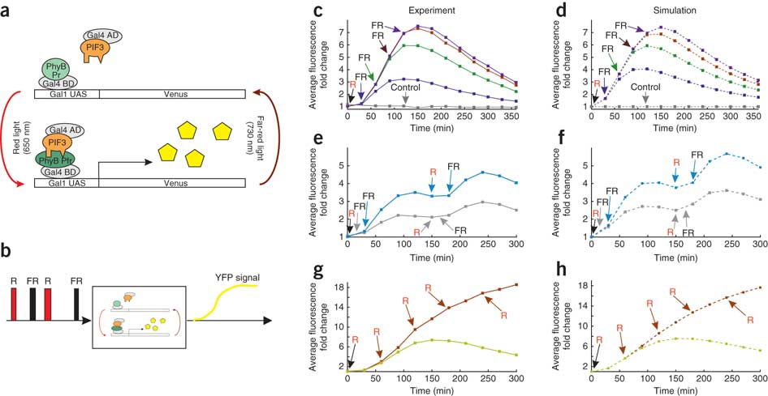
Implementation
S. cerevisiae
Light-switchable system (PhyB-PIF3)
Transformed cells
  Grown in Dark
  PCB
Notes:
To implement the in silico feedback, they needed an external input. They decided to use a light switchable system found in S. cerevisiae, a type of yeast. To do this, they took cells grown in darkness and incubated with chromophore phycocyanobilin (PCB), and synthesized them with PhyB-GBD and PIF3-GAD fusion proteins. PhyB is a plant photoreceptor chromoprotein which is fused to the Gal4 binding domain, and PIF, a phytochrome interacting factor, is fused to the Gal4 activation domain. The Gal4 binding sites are contained in the Gal1 promoter, which drives a YFP promoter, which is the signal they used to measure.

Slide 5
Exposure to Light
Red (650 nm) and Far Red (730 nm) Pulses
Input – Light Pulses
YFP expression
Output - YFP
Notes:
With exposure to red light (650 nm), PhyB is converted into its active form and binds to the PIF3, which induces transcription of the target gene. Exposure to Far Red Light (730 nm) switches off gene expression because PhyB is converted into an inactive form and dissociates from PIF3. The different light pulses serve as the controlled input, and the YFP signal serves as the output, as this can be turned on and off due to the light inputs

Slide 6
Results
Notes:
Each pulse had a 1 minute duration. These graphs show experimental response to a red pulse followed by a far red pulse. On the left side are the actual experimental graphs, while on the right side are the simulated graphs. Transition of PhyB to its inactive form takes place in the dark, which explains why cell fluorescence reaches a peak and then decays. Graph E shows the reversibility of the PhyB-PIF3 interaction, which shows the system doesn’t lose responsiveness to light over many cycles. Graph G shows the response to multiple red pulses. As can be seen, multiple red light pulses lead to higher fluorescent expression.

Slide 7
Results
Notes:
Each pulse had a 1 minute duration. These graphs show experimental response to a red pulse followed by a far red pulse. On the left side are the actual experimental graphs, while on the right side are the simulated graphs. Transition of PhyB to its inactive form takes place in the dark, which explains why cell fluorescence reaches a peak and then decays. Graph E shows the reversibility of the PhyB-PIF3 interaction, which shows the system doesn’t lose responsiveness to light over many cycles. Graph G shows the response to multiple red pulses. As can be seen, multiple red light pulses lead to higher fluorescent expression.

Slide 8
Results
Notes:
Each pulse had a 1 minute duration. These graphs show experimental response to a red pulse followed by a far red pulse. On the left side are the actual experimental graphs, while on the right side are the simulated graphs. Transition of PhyB to its inactive form takes place in the dark, which explains why cell fluorescence reaches a peak and then decays. Graph E shows the reversibility of the PhyB-PIF3 interaction, which shows the system doesn’t lose responsiveness to light over many cycles. Graph G shows the response to multiple red pulses. As can be seen, multiple red light pulses lead to higher fluorescent expression.

Slide 9
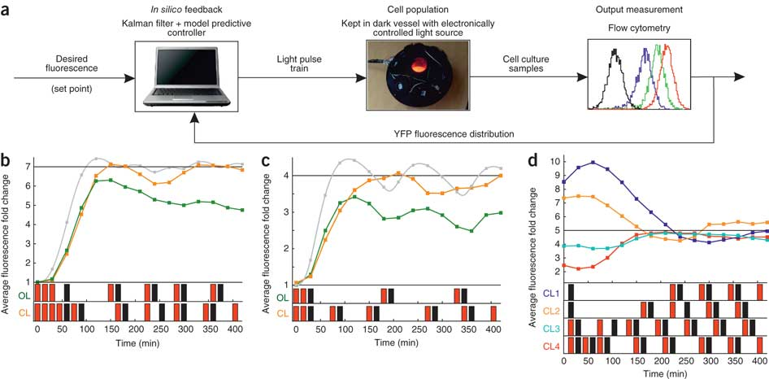
Using a Kalman Filter
Real Time Regulation
Notes:
A Kalman filter uses information from the most recent YFP measurements, to help create a feedback algorithm which calculates (in real time) the light pulses which will help make the output similar to the desired output. For the leftmost graph, it shows regulation of YFP fluorescence to sevenfold over seven hours. The green line shows precomputed regulation, which did not achieve seven fold, while the closed loop feedback did show seven fold. The same goes for the other two graphs.

Slide 10
Summary
Notes:
This is a summary of the in silico feedback control scheme for the light activated gene system.

Slide 11
Significance
Enhancement of expression
Electronic control over living cells
Therapeutics
  Regulation of expression
  Regulation of toxic by-products

Slide 12
Questions?

Slide 13
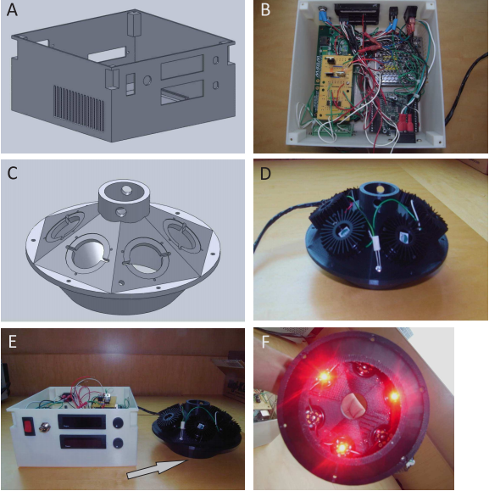
Light Pulse Delivery System
Notes:
This shows the pulse delivery system. B and D were the prototypes. The final product is compact, portable, and inexpensive.

