Slide 2
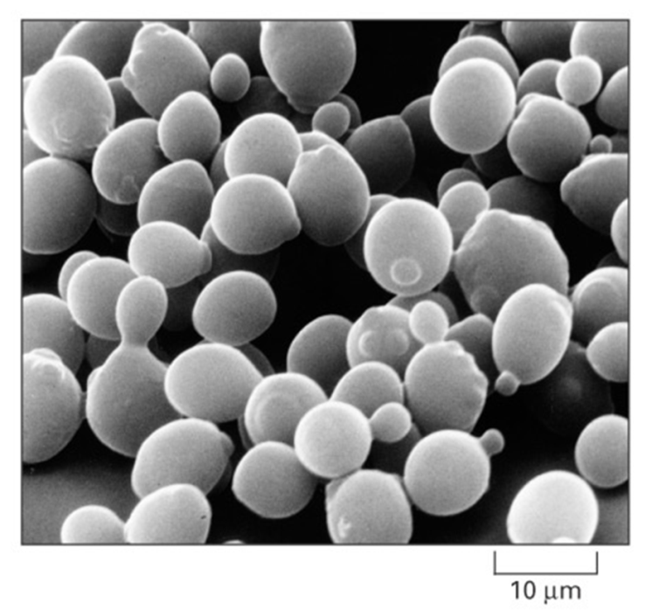
Budding Yeast, Saccharomyces cerevisiae is an Ideal Model Organism for Systems Biology
Budding yeast has a small genome of approximately 6000 genes.
These 6000 genes are regulated by roughly 250 transcription factors.
Deletion strain collections and other molecular genetic tools are readily available.
Alberts et al. (2004)

Slide 3
Cold Shock Is an Environmental Stress that Is Not Well-Studied
Heat shock
Cold shock
response less well-characterized
decrease fluidity of membranes
stabilize DNA and RNA secondary structures
impair ribosome function and protein synthesis
decrease enzymatic activities
no equivalent set of cold shock proteins that are conserved in
all organisms
response very well-characterized
proteins denature due to heat
induction of heat shock proteins (chaperonins), that assist in protein folding
conserved in all organisms (prokaryotes, eukaryotes)

Slide 4
Yeast Respond to Cold Shock by Changing Gene Expression
Cold shock temperature range for yeast is 10-18°C
Previous studies indicate that the cold shock response can be divided into:
Late response genes – 12 to 60 hours
General environmental stress response genes (ESR) are induced
Regulated by the Msn2/Msn4 transcription factors
Early response genes – 15 minutes to 2 hours
Genes unique to cold shock are induced, such as genes involved in ribosome biogenesis and membrane fluidity
Which transcription factors regulate this response is unknown

Slide 5
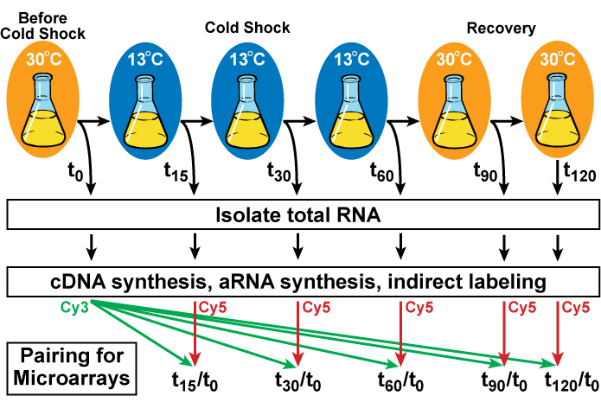
Yeast Cells Deleted for a Particular Transcription Factor are Harvested Before, During and After Cold Shock and Recovery

Slide 6
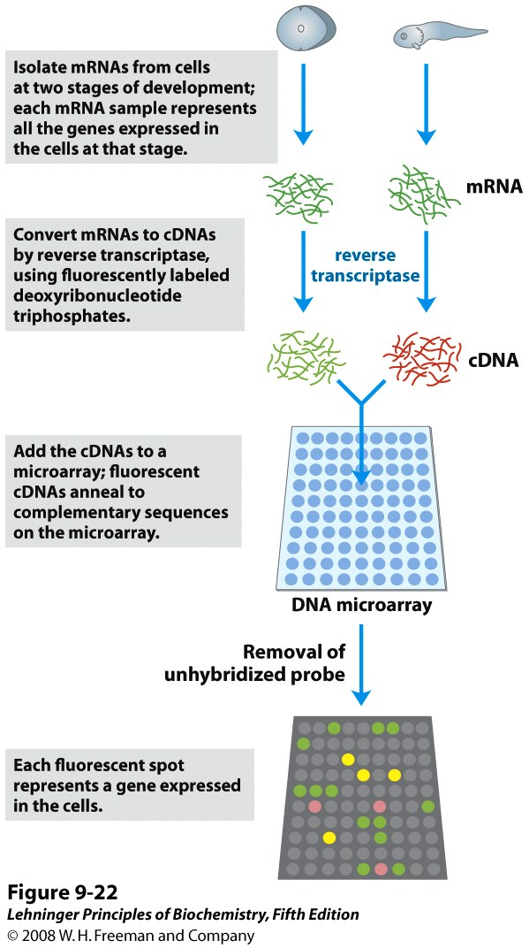
Yeast Cells are Subjected to Controlled Intervals of Cold Shock and Recovery

Slide 7
Yeast Cells are Subjected to Controlled Intervals of Cold Shock and Recovery
aRNA
aRNA

Slide 8
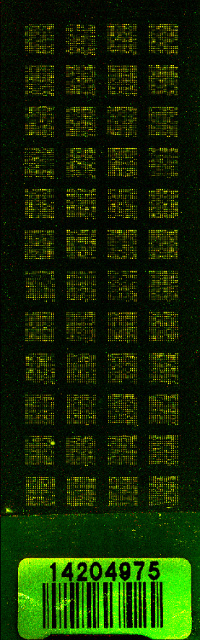
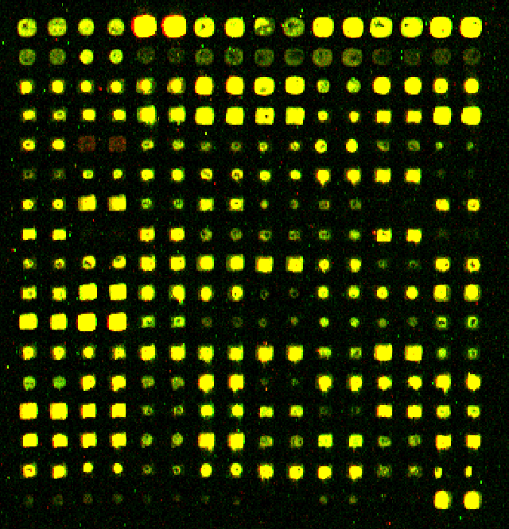
DNA Microarray Results Show Changes in Expression of Individual Genes
Each spot contains DNA from one gene, which hybridizes to the fluorescently-labelled aRNA.
Red spots indicate an increase in gene expression relative to the control (t₀).
Green spots indicate a decrease in gene expression relative to the control (t₀).
Yellow spots indicate no change in expression.
Δyap1, replicate 1, 06/23/15

Slide 9
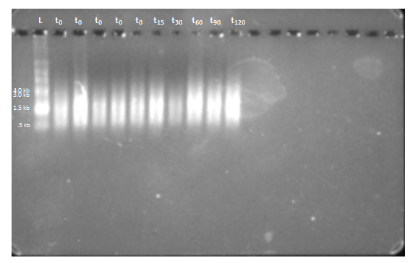
Gel Electrophoresis Can be Used to Show the High Quality of Purified aRNA Samples
aRNA shows up as a smear because it is derived from genes of different lengths.

Slide 10
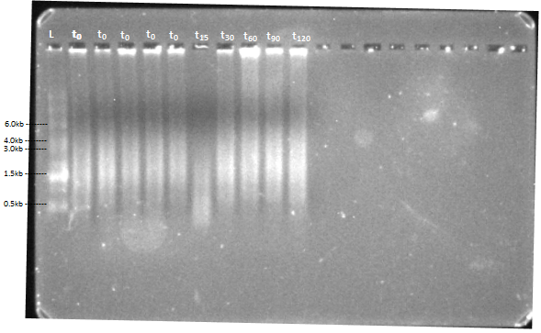
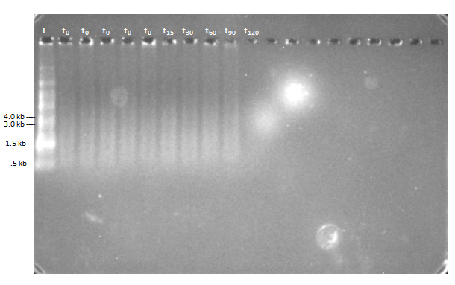
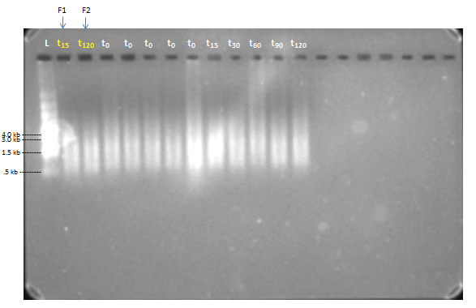
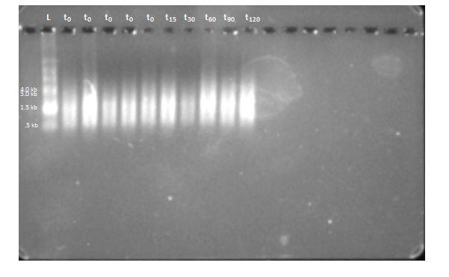
Gel Electrophoresis Can be Used to Show the High Quality of Purified aRNA Samples
Δyap1, Flask 1
Δyap1, Flask 2
Δyap1, Flask 3
Δyap1, Flask 4

Slide 11
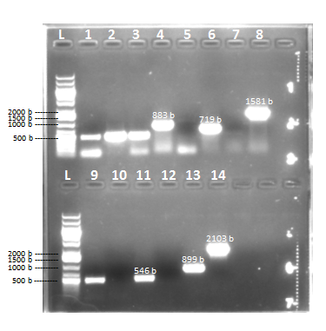
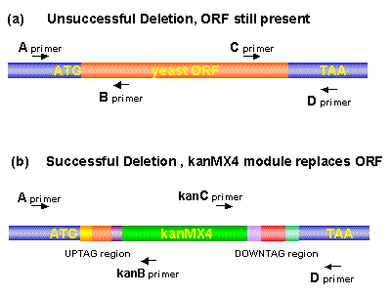
Genotype of Strains Confirmed by PCR and DNA Sequencing
The mutant strains genotyped include: Δnrg1, Δphd1, Δrsf2, Δrtg3, Δyhp1, Δyox1
Genotyping of ∆yhp1 by Colony PCR

Slide 12
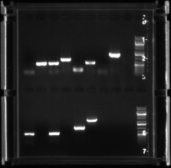
Gel Electrophoresis confirms the success of PCR
From Left to right:
Row 1
Negative control
Positive control, master mix
Positive control, wild type lysate
Wt lysate, Primers A & B
Wt lysate, Primers A & kanB
Wt lysate, Primers C & D
Wt lysate, Primers kanC & D
Wt lysate, Primers A & D
Blank
DNA Ladder
Row 2
Positive control, dNRG1 lysate
dNRG1 lysate, Primers A & B
dNRG1 lysate, Primers A & kanB
dNRG1 lysate, Primers C & D
dNRG1 lysate, Primers kanC & D
dNRG1 lysate, Primers A & D
Blank
Blank
Blank
DNA Ladder
dNRG1 Gel Electrophoresis
1
2
3
4
5
6
7
8
9
10
1
2
3
4
5
6
7
8
9
10

Slide 13
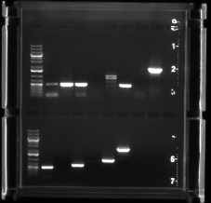
Gel Electrophoresis confirms the success of PCR
From Left to right:
Row 1
DNA Ladder
Negative control
Positive control, master mix
Positive control, wild type lysate
Wt lysate, Primers A & B
Wt lysate, Primers A & kanB
Wt lysate, Primers C & D
Wt lysate, Primers kanC & D
Wt lysate, Primers A & D
Blank
Row 2
DNA Ladder
Positive control, dPHD1 lysate
dPHD1 lysate, Primers A & B
dPHD1 lysate, Primers A & kanB
dPHD1 lysate, Primers C & D
dPHD1 lysate, Primers kanC & D
dPHD1 lysate, Primers A & D
Blank
Blank
Blank
dPHD1 Gel Electrophoresis
1
2
3
4
5
6
7
8
9
10
1
2
3
4
5
6
7
8
9
10

Slide 14
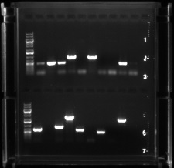
Gel Electrophoresis confirms the success of PCR
From Left to right:
Row 1
DNA Ladder
Negative control
Positive control, master mix
Positive control, wild type lysate
Wt lysate, Primers A & B
Wt lysate, Primers A & kanB
Wt lysate, Primers C & D
Wt lysate, Primers kanC & D
Wt lysate, Primers A & D
Positive control, dRSF2 Lysate
dRSF2 lysate, Primers A & B
Blank
Row 2
DNA Ladder
dRSF2 lysate, Primers A & kanB
dRSF2 lysate, Primers C & D
dRSF2 lysate, Primers kanC & D
dRSF2 lysate, Primers A & D
Wt lysate, Primers A & B
Wt lysate, Primers A & kanB
Wt lysate, Primers C & D
Wt lysate, Primers kanC & D
Wt lysate, Primers A & D
Blank
Blank
dRSF2 Gel Electrophoresis
1
12
1
2
2
3
4
5
6
7
8
9
10
11
1
2
3
4
5
6
7
8
9
10
11
12

Slide 15
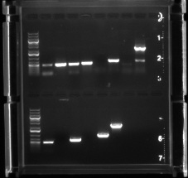
Gel Electrophoresis confirms the success of PCR
dRTG3 Gel Electrophoresis
From Left to right:
Row 1
DNA Ladder
Negative control
Positive control, master mix
Positive control, wild type lysate
Wt lysate, Primers A & B
Wt lysate, Primers A & kanB
Wt lysate, Primers C & D
Wt lysate, Primers kanC & D
Wt lysate, Primers A & D
Blank
Row 2
DNA Ladder
Positive control, dRTG3 lysate
dRTG3 lysate, Primers A & B
dRTG3 lysate, Primers A & kanB
dRTG3 lysate, Primers C & D
dRTG3 lysate, Primers kanC & D
dRTG3 lysate, Primers A & D
Blank
Blank
Blank
1
2
3
4
5
6
7
8
9
10
1
2
3
4
5
6
7
8
9
10

Slide 16
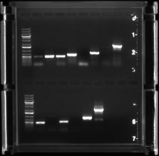
Gel Electrophoresis confirms the success of PCR
Row 1
DNA ladder
Negative control
Master Mix Positive control
Wt Template Positive control
Wt, Primers A-B
Wt, Primers A-kanB
Wt, Primers C-D
Wt, Primers kanC-D
Wt, Primers A-D
Blank
Row 2
DNA ladder
Yox1 template positive control
Yox1, Primers A-B
Yox1, Primers A-kanB
Yox1, Primers C-D
Yox1, Primers kanC-D
Yox1, Primers A-D
Blank
Blank
Blank
dYOX1 Gel Electrophoresis Results
1
2
3
4
5
6
7
8
9
10
1
2
3
4
5
6
7
8
9
10

Slide 17
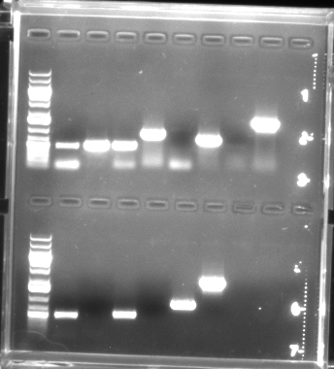
Gel Electrophoresis confirms the success of PCR
From Left to right:
Row 1
DNA Ladder
Negative control
Positive control, master mix
Positive control, wild type lysate
Wt lysate, Primers A & B
Wt lysate, Primers A & kanB
Wt lysate, Primers C & D
Wt lysate, Primers kanC & D
Wt lysate, Primers A & D
Blank
Row 2
DNA Ladder
Positive control, dYHP1 lysate
dYHP1 lysate, Primers A & B
dYHP1 lysate, Primers A & kanB
dYHP1 lysate, Primers C & D
dYHP1 lysate, Primers kanC & D
dYHP1 lysate, Primers A & D
Blank
Blank
Blank
dYHP1 Gel Electrophoresis Results
1
2
3
4
5
6
7
8
9
10
1
2
3
4
5
6
7
8
9
10

Slide 18
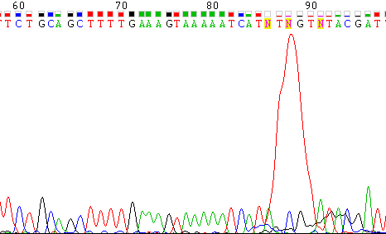
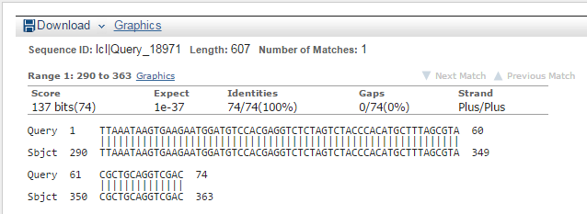
Genotype of Strains Confirmed by PCR and DNA Sequencing
Sequencing data for Δnrg1 A-kanB Primer A
BLAST Alignment for Δrtg3 A-kanB Primer A
100% Accuracy to Uptag Sequence

Slide 19
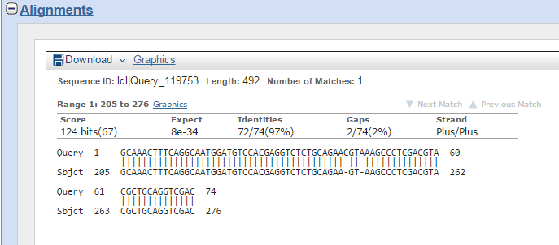
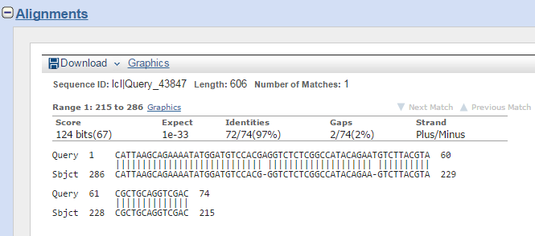
BLAST Alignment for Δnrg1 A-kanB Primer A
97% Accuracy to Uptag Sequence
BLAST Alignment for Δphd1 A-kanB Primer A
97% Accuracy to Uptag Sequence

Slide 20
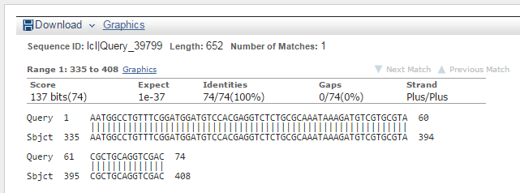
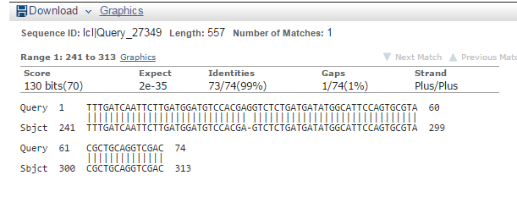
BLAST Alignment for Δrsf2 A-kanB Primer A
100% Accuracy to Uptag Sequence
BLAST Alignment for Δyox1 A-kanB Primer A
99% Accuracy to Uptag Sequence

Slide 21
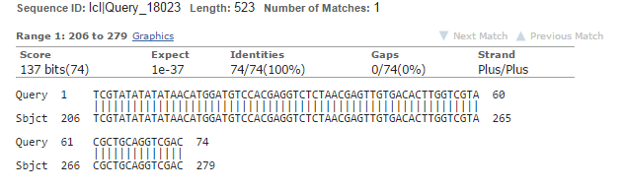
BLAST Alignment for Δyhp1 A-kanB Primer A
100% Accuracy to Uptag Sequence

Slide 22
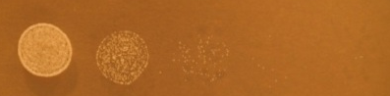
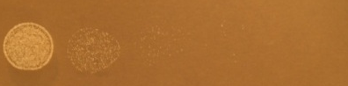
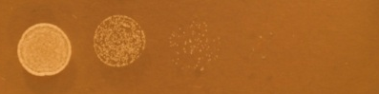
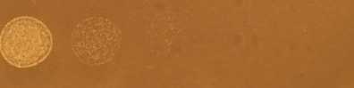
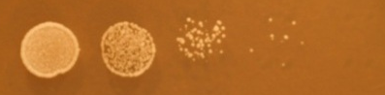
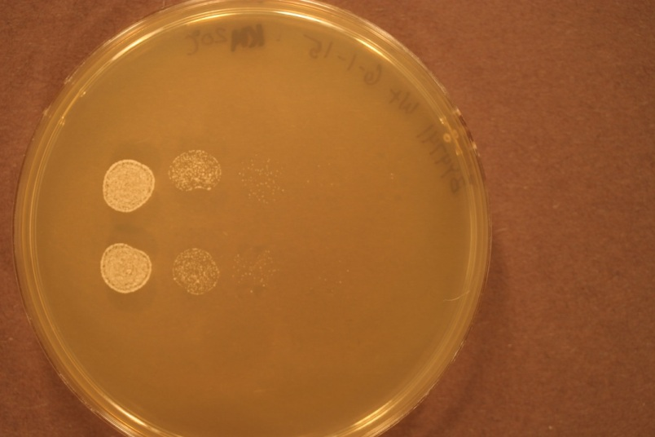
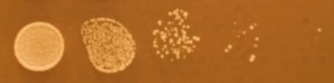
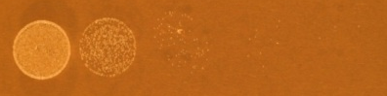
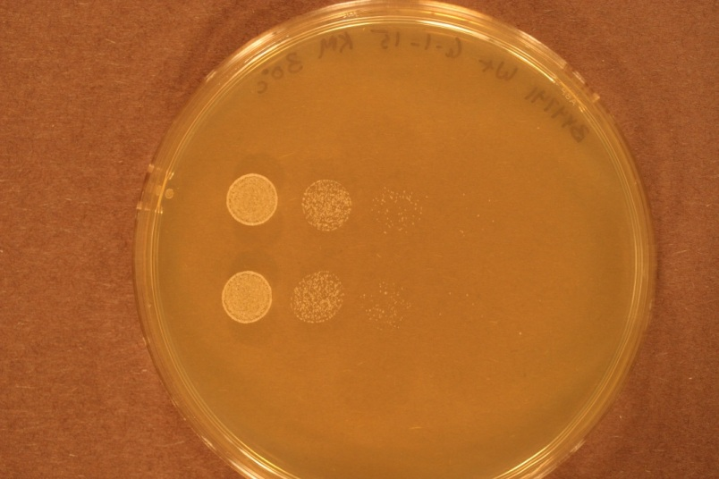

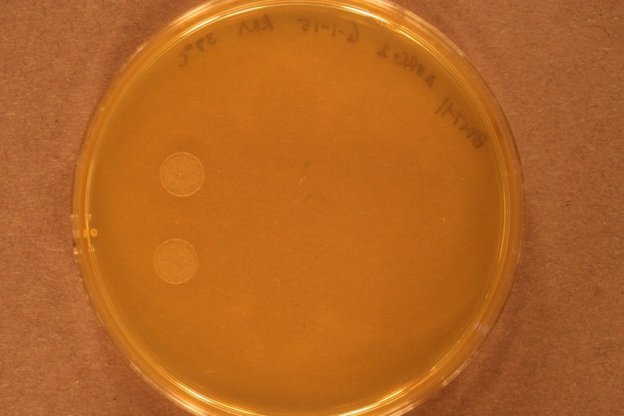
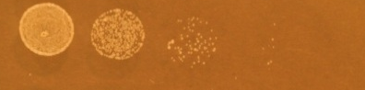

Δnrg1 is Impaired for Growth at 37ºC, but Grows Better than the Wild-Type at 15ºC
Δnrg1
wild-type
15ºC
day 5
20ºC
day 4
30ºC
day 1
37ºC
day 1

Slide 23
dPHD1 and dNRG1
Growth Experiment
June 2nd through June 8th , 2015
Monica Hong, Kevin McGee and Kevin Wyllie

Slide 24
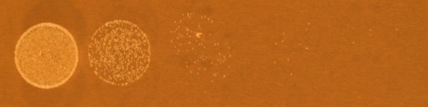
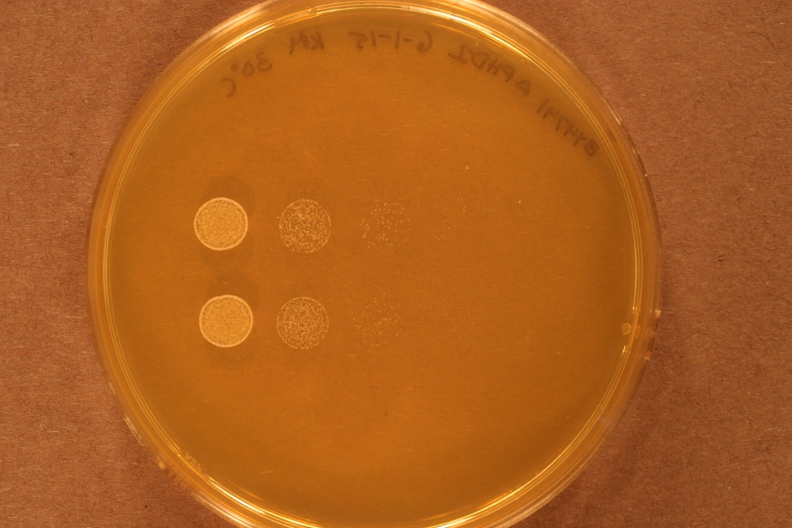
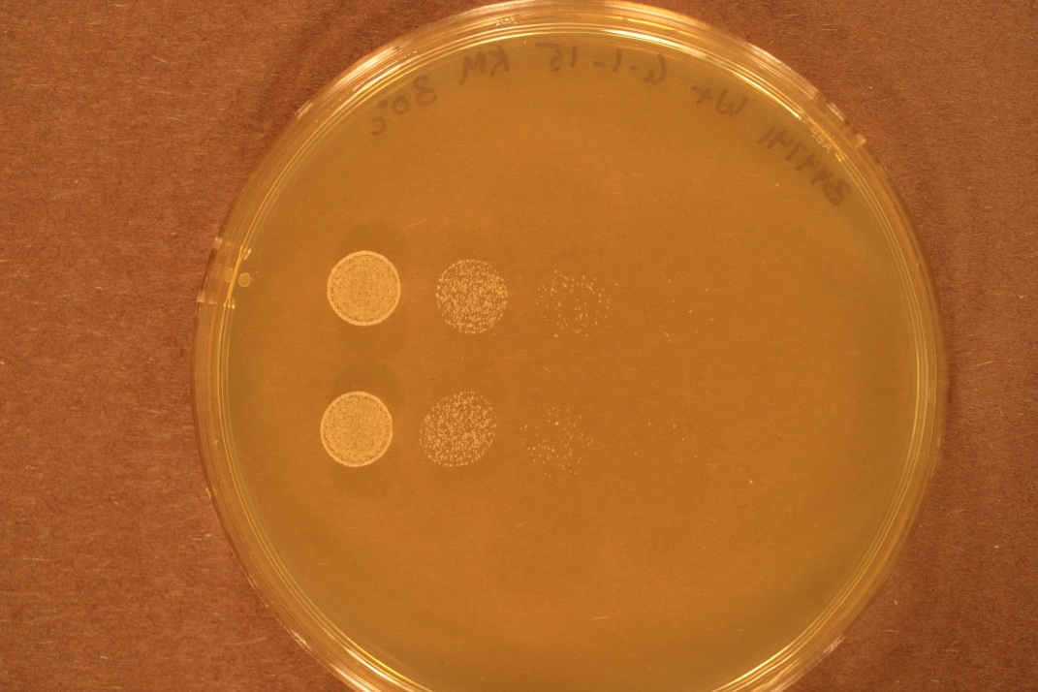


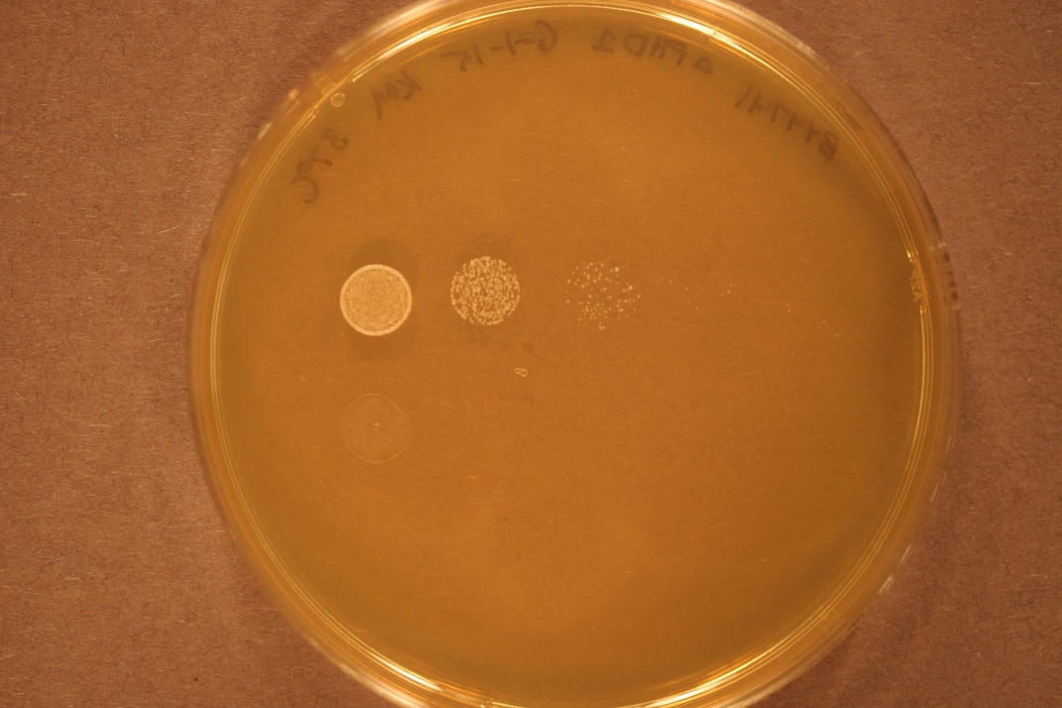

Day 1 – 06/02/2015
dNRG1 30°C
dPHD1 30°C
WT 30°C
dNRG1 37°C
dPHD1 37°C
WT 37°C

Slide 25
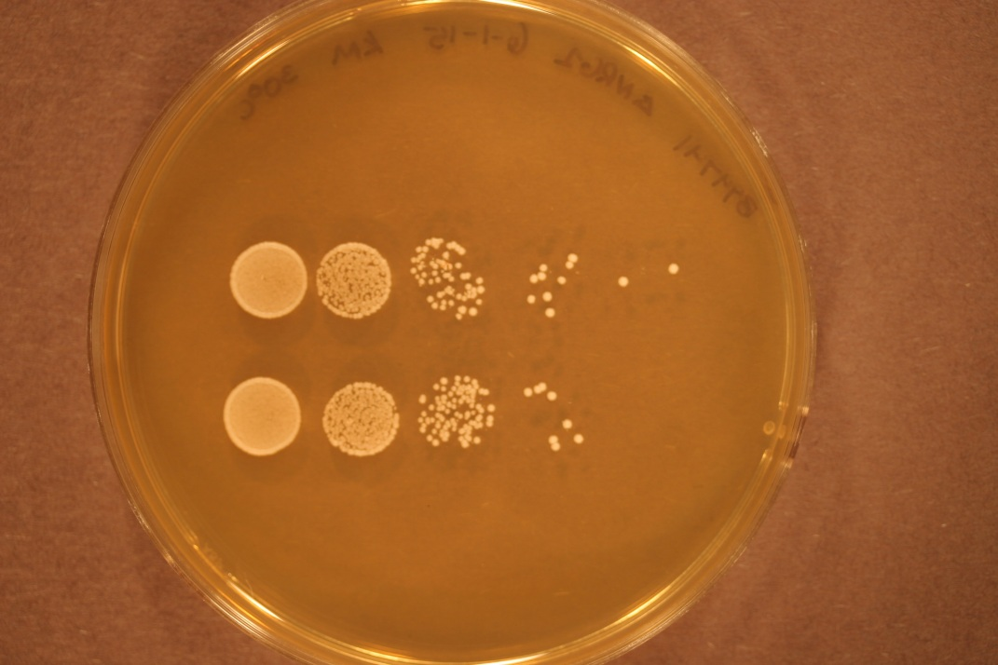
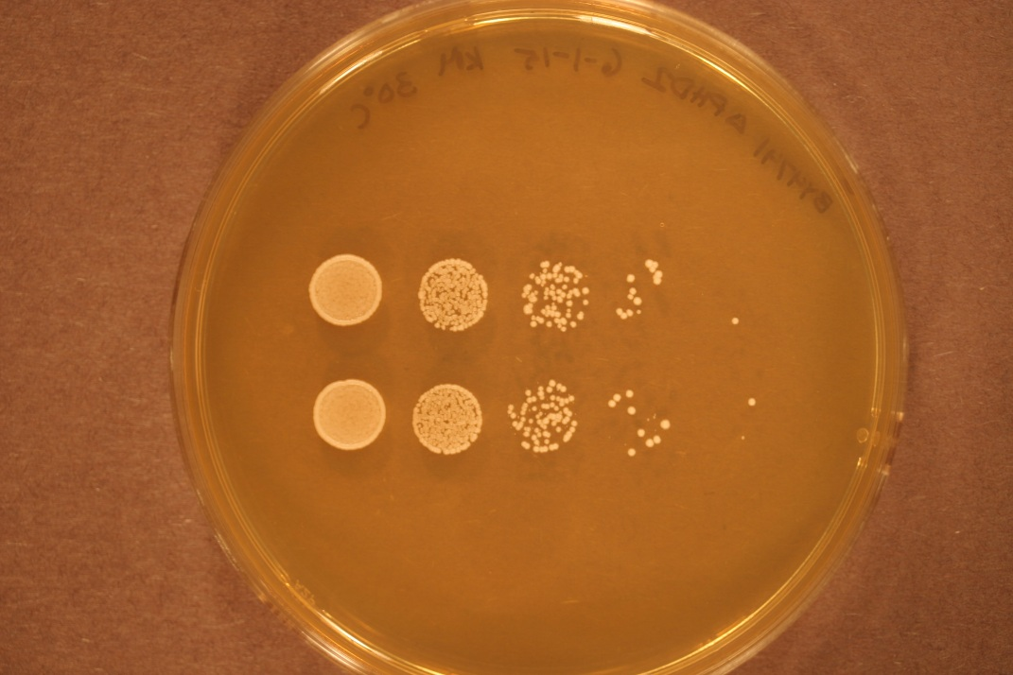
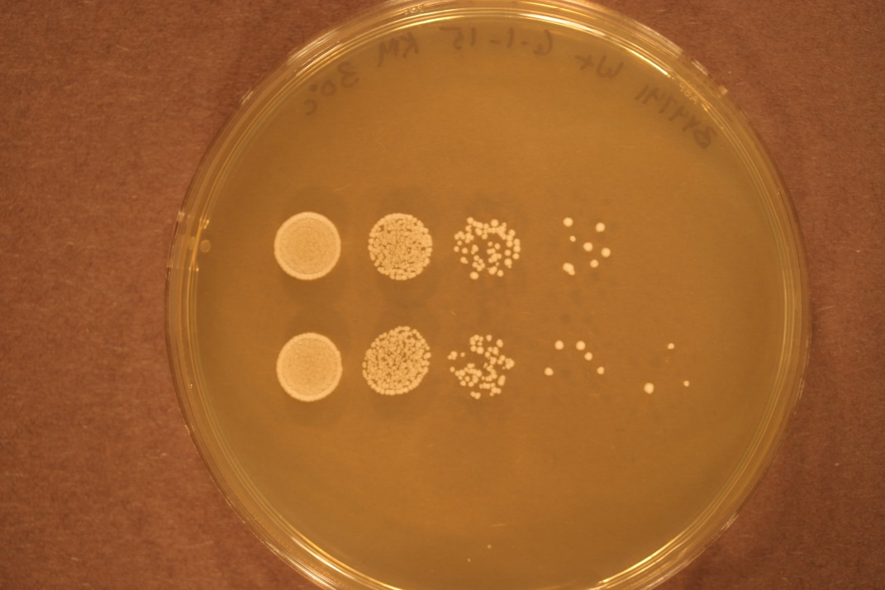
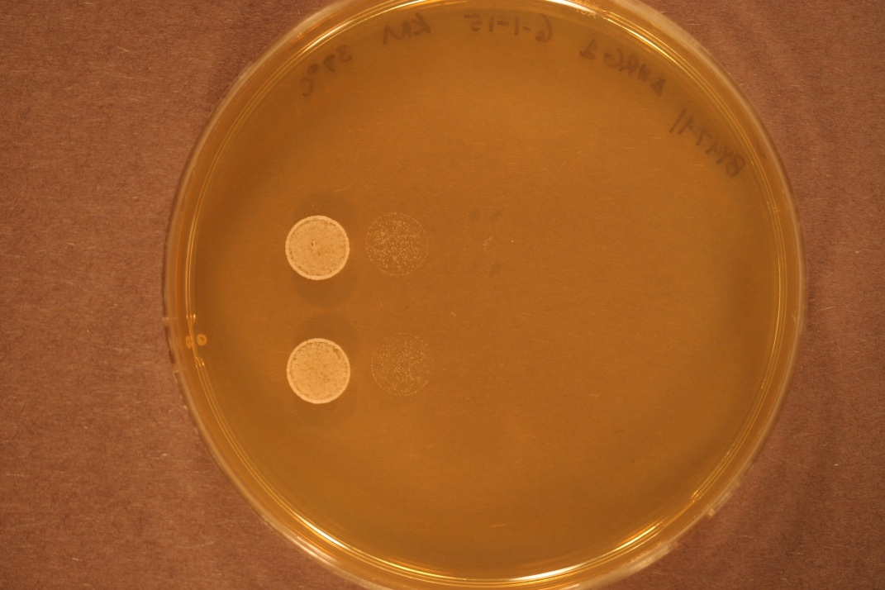
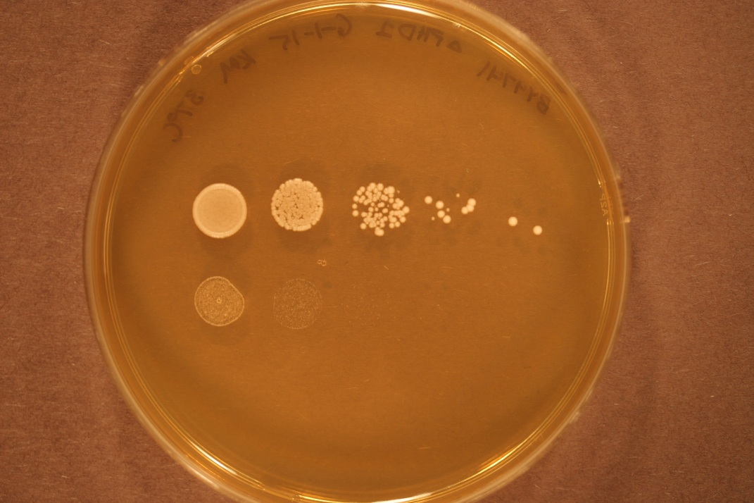
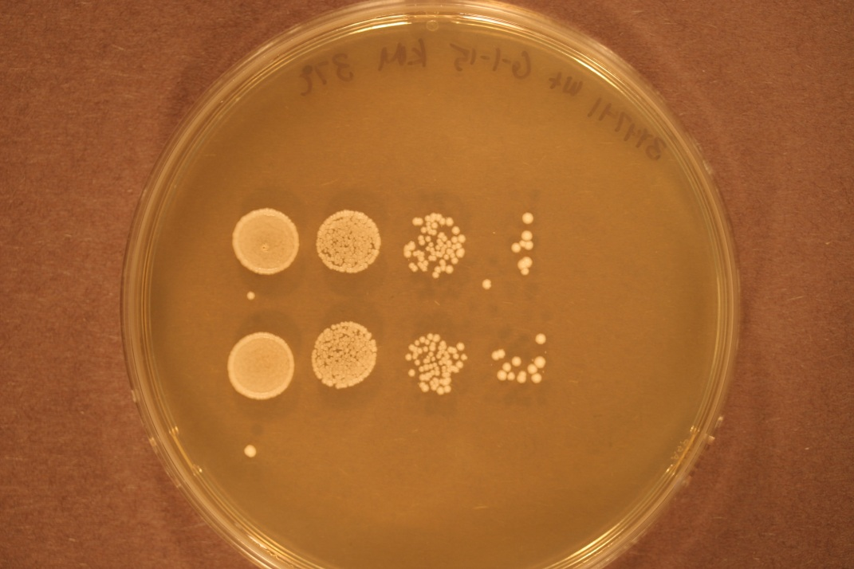
Day 2 – 06/03/2015
dNRG1 30°C
dPHD1 30°C
WT 30°C
dNRG1 37°C
dPHD1 37°C
WT 37°C

Slide 26
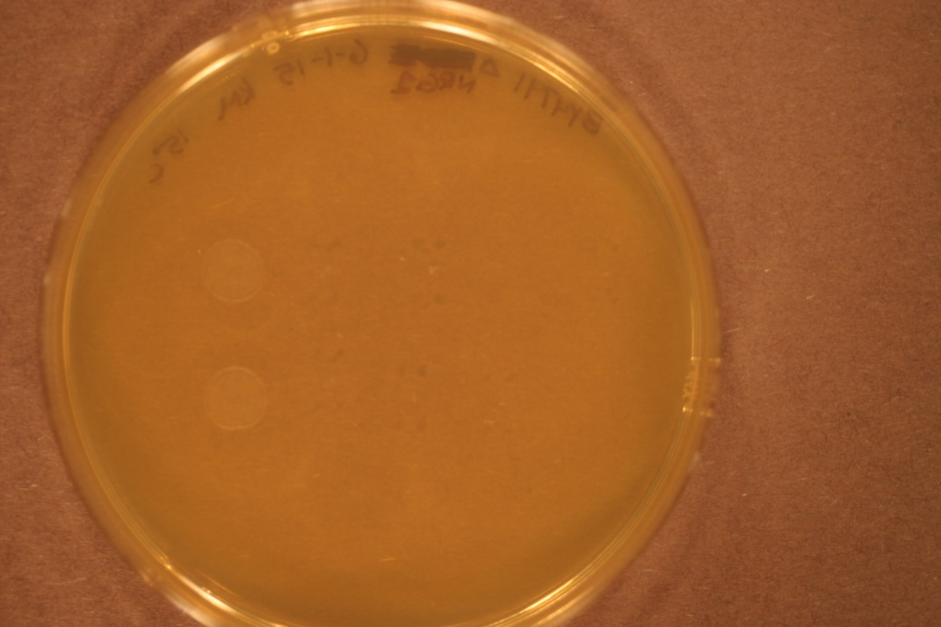
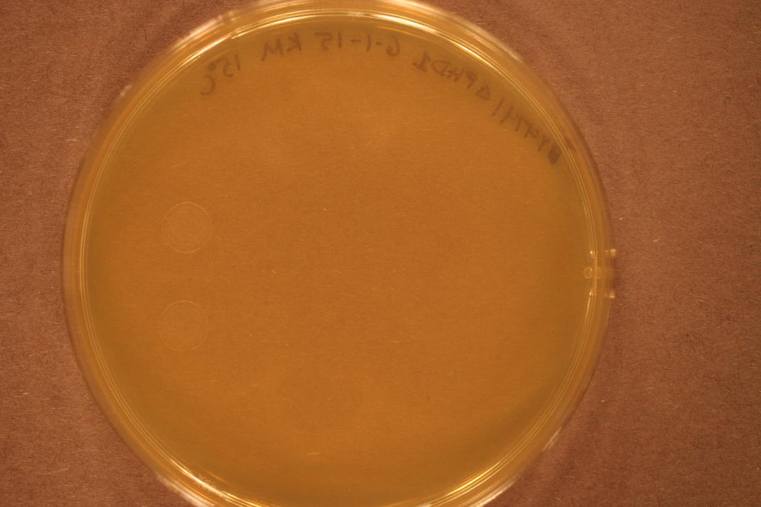
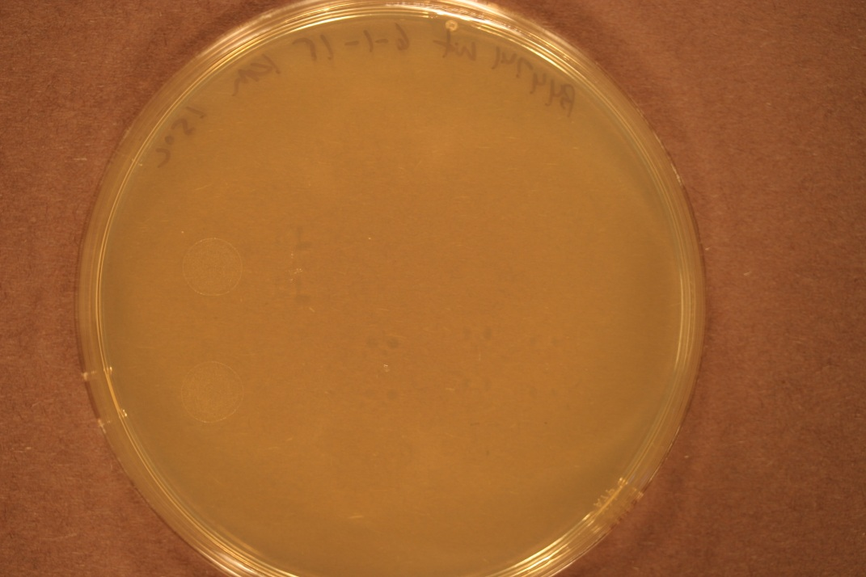
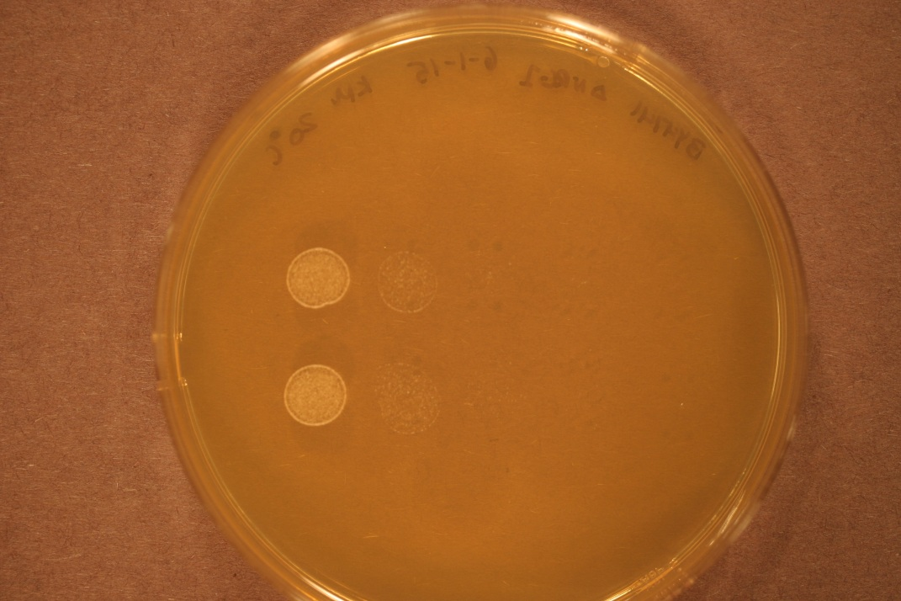



Day 2 – 06/03/2015
dNRG1 15°C
dPHD1 15°C
WT 15°C
dNRG1 20°C
dPHD1 20°C
WT 20°C

Slide 27







Day 3 – 06/04/2015
dNRG1 15°C
dPHD1 15°C
WT 15°C
dNRG1 20°C
dPHD1 20°C
WT 20°C

Slide 28






Day 4 – 06/05/2015
dNRG1 15°C
dPHD1 15°C
WT 15°C
dNRG1 20°C
dPHD1 20°C
WT 20°C

Slide 29






Day 5 – 06/06/2015
dNRG1 15°C
dPHD1 15°C
WT 15°C
dNRG1 20°C
dPHD1 20°C
WT 20°C

Slide 30







Day 6 – 06/07/2015
dNRG1 15°C
dPHD1 15°C
WT 15°C
dNRG1 20°C
dPHD1 20°C
WT 20°C

Slide 31



Day 7 – 06/08/2015
dNRG1 15°C
dPHD1 15°C
WT 15°C

Slide 32



Day 8 – 06/09/2015
dNRG1 15°C
dPHD1 15°C
WT 15°C

Slide 33
dRTG3 and dYHP1
Growth Experiment
June 11th through June 17th , 2015
Monica Hong, Kevin McGee and Kevin Wyllie

Slide 34






Day 1 – 06/11/2015
dRTG3 30°C
dYHP1 30°C
WT 30°C
dRTG3 37°C
dYHP1 37°C
WT 37°C

Slide 35






Day 2 – 06/12/2015
dRTG3 30°C
dYHP1 30°C
WT 30°C
dRTG3 37°C
dYHP1 37°C
WT 37°C

Slide 36



Day 3 – 06/13/2015
dRTG3 20°C
dYHP1 20°C
WT 20°C

Slide 37






Day 4 – 06/14/2015
dRTG3 15°C
dYHP1 15°C
WT 15°C
dRTG3 20°C
dYHP1 20°C
WT 20°C

Slide 38






Day 5 – 06/15/2015
dRTG3 15°C
dYHP1 15°C
WT 15°C
dRTG3 20°C
dYHP1 20°C
WT 20°C

Slide 39



Day 6 – 06/16/2015
dRTG3 15°C
dYHP1 15°C
WT 15°C

Slide 40



Day 7 – 06/17/2015
dRTG3 15°C
dYHP1 15°C
WT 15°C

Slide 41
dRSF2 and dPHD1
Growth Experiment
June 10th through June 16th , 2015
Monica Hong, Kevin McGee and Kevin Wyllie

Slide 42






Day 1 – 06/10/2015
dRSF2 30°C
dPHD1 30°C
WT 30°C
dRSF2 37°C
dPHD1 37°C
WT 37°C

Slide 43






Day 2 – 06/11/2015
dRSF2 30°C
dPHD1 30°C
WT 30°C
dRSF2 37°C
dPHD1 37°C
WT 37°C

Slide 44



Day 3 – 06/12/2015
dRSF2 20°C
dPHD1 20°C
WT 20°C

Slide 45







Day 4 – 06/13/2015
dRSF2 15°C
dPHD1 15°C
WT 15°C
dRSF2 20°C
dPHD1 20°C
WT 20°C

Slide 46




Day 7 – 06/16/2015
dRSF2 15°C
dPHD1 15°C
WT 15°C

Slide 47
dNRG1 and dYOX1
Growth Experiment
June 16th through June 23th , 2015
Monica Hong, Kevin McGee and Kevin Wyllie

Slide 48






Day 1 – 06/13/2015
dNRG1 30°C
dYOX1 30°C
WT 30°C
dNRG1 37°C
dYOX1 37°C
WT 37°C

Slide 49






Day 2 – 06/14/2015
dNRG1 30°C
dYOX1 30°C
WT 30°C
dNRG1 37°C
dYOX1 37°C
WT 37°C

Slide 50



Day 3 – 06/15/2015
dNRG1 20°C
dYOX1 20°C
WT 20°C

Slide 51








Day 4 – 06/16/2015
dNRG1 15°C
dYOX1 15°C
WT 15°C
dNRG1 20°C
dYOX1 20°C
WT 20°C

Slide 52








Day 5 – 06/17/2015
dNRG1 15°C
dYOX1 15°C
WT 15°C
dNRG1 20°C
dYOX1 20°C
WT 20°C

Slide 53




Day 6 – 06/18/2015
dNRG1 15°C
dYOX1 15°C
WT 15°C

Slide 54



Day 7 – 06/19/2015
dNRG1 15°C
dYOX1 15°C
WT 15°C

Slide 55
HAP4 30ºC Liquid Growth Curves
Average Doubling Times: 102.385 minutes

Slide 56
NRG1 30ºC Liquid Growth Curve
Average Doubling Time:102.385 minutes

Slide 57
HAP4 13ºC Liquid Growth Curves
Average Doubling Time: 335. 57

Slide 58
NRG1 13ºC Liquid Growth Curves
Average Doubling Time: 330.07 minutes

