Slide 1
Modeling Nitrogen Metabolism in Yeast
Natalie Williams & Karina Alvarez
Departments of Biology and Mathematics
Loyola Marymount University
3 March 2015

Slide 2
Outline
Nitrogen metabolism in yeast
Modeling concentrations of three molecules involved in nitrogen metabolism
How does our model relate to studies done in this area?

Slide 3
Outline
Nitrogen metabolism in yeast
Modeling concentrations of three molecules involved in nitrogen metabolism
How does our model relate to studies done in this area?

Slide 4
Background
Nitrogen is a limiting factor for yeast cells
Nitrogen is taken up as ammonia, NH₃
Yeast metabolize nitrogen using the amino acids α-ketoglutarate, glutamate, and glutamine
Notes:
because nitrogen is a limiting factor, nitrogen metabolism determines growth of cell
do we need flux rates?

Slide 5
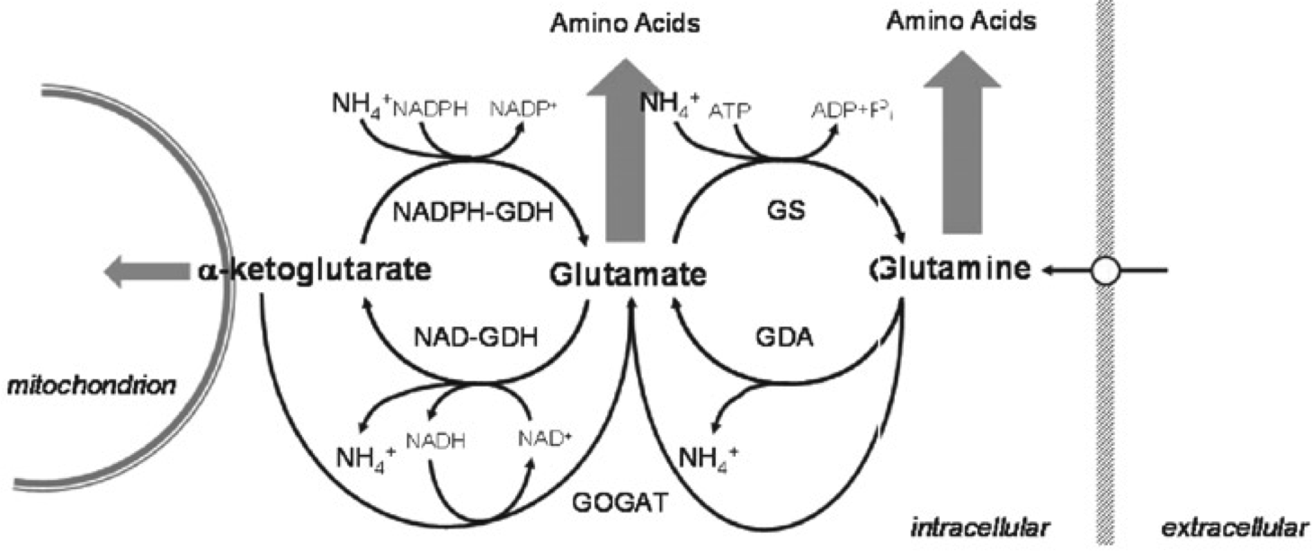
Central Nitrogen Metabolism Pathway

Slide 6
Outline
Nitrogen metabolism in yeast
Modeling concentrations of three molecules involved in nitrogen metabolism
How does our model relate to studies done in this area?

Slide 7
Purpose of Modeling
Represent the rate at which the amino acids are produced
Amino acid production indicates the level of nitrogen metabolism

Slide 8

Significance of Model
Provide a basis to understand how yeast cells metabolize nitrogen in relation to yeast cell growth
r₁
r₂
r₃
r₋₁
r₋₂
Notes:
environments that promote yeast cell growth

Slide 9
State Variables
a = concentration of α-ketoglutarate in the cell
b = concentration of glutamate in the cell
c = concentration of glutamine in the cell
Notes:
state variables are what are changing in relation to time

Slide 10
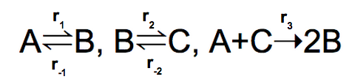
Parameters
r₁: rate of α-ketoglutarate conversion to glutamate
r₋₁: rate of glutamate conversion to α-ketoglutarate
r₂: rate of glutamate conversion to glutamine
r₋₂: rate of glutamine conversion to glutamate
r₃: rate of α-ketoglutarate and glutamate combining
to form glutamine
Notes:
parameters are for the forward and reverse reactions and stay constant throughout time (coefficients)

Slide 11
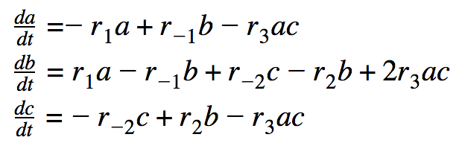
Modeling the Dynamics

Slide 12

Analysis of the Steady State
Steady state is obtained by setting
= 0
Occurs when the initial values of a, b, c = 0 or under specific parameters so that there is no fluctuation
Notes:
first steady state occurs at initial values when there is no concentration of any of the amino acids present in the cell because they create each other
the other steady state is when specific parameters lead to no change
see website for work

Slide 13
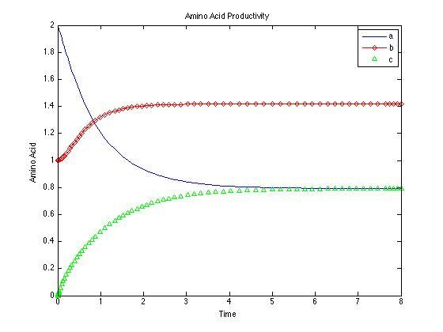
Simulation 1: Parameters All Equal
Figure 1 shows conditions where the parameters (rates) are all set equal to 1. The steady state seems to appear around 6 time units.
Initial conditions:
a0 = 2
b0 = 1
c0 = 0
Figure 1

Slide 14
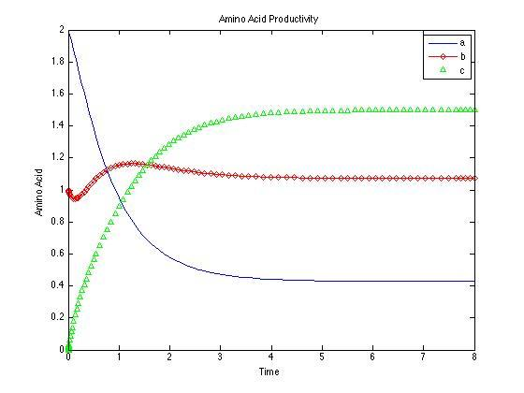
Simulation 2: Alteration of Parameter
Figure 2 shows conditions where one parameter, r₂, was altered to equal 2. The steady state seems to appear at approximately 6 time units.
Figure 2
Notes:
only talk about this graph; just mention the time units as well as alteration of r2 = 2

Slide 15
Comparison of Simulations 1 & 2
a = α-ketoglutarate
b = glutamate
c = glutamine
Figure 1
Figure 2
Notes:
increasing the rate of r2 leads to an increase in dc/dt = increase in c
graph shows that a and b remain relatively similar to the original levels in figure 1, but C has an obvious increase
bigger dip for levels of b because initially, the rate of c production from b is larger than the rate of c production from b and bigger than the rate of c production in graph 1

Slide 16
Results and Discussion
Both models reach steady state at approximately the same time
Changing one rate of production affects the concentrations of other amino acids

Slide 17
Outline
Nitrogen metabolism in yeast
Modeling concentrations of three molecules involved in nitrogen metabolism
How does our model relate to studies done in this area?

Slide 18
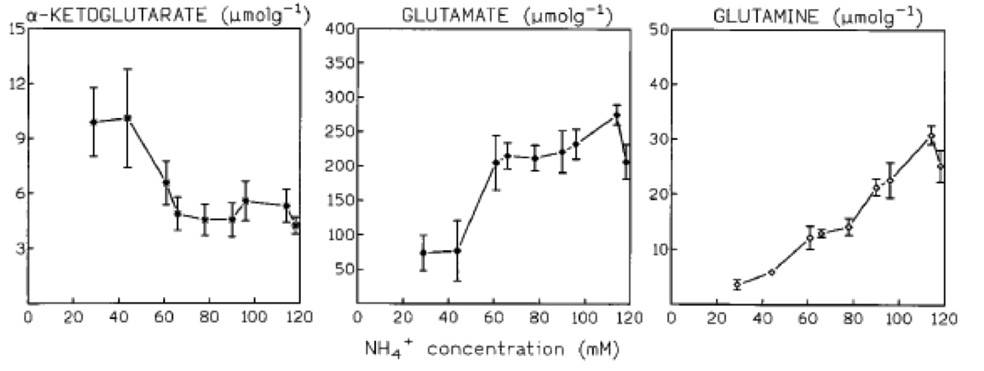
Comparison to Journal of Bacteriology
Same general trends
Modeled only amino acid concentrations
Figure 3
Figure 1
Notes:
alpha ketoglutarate decrease as glutamate and glutamine increase
flux rates not measured, only amino acid levels

Slide 19
Comparison to Microbiology Journal
Carbon and nitrogen fluxes both analyzed
Internal conditions do not influence transcription of nitrogen-regulated genes
Extracellular nitrogen regulates transcription
Amino acids within the cell respond to internal levels of nitrogen
Notes:
alpha ketoglutarate decrease as glutamate and glutamine increase
cell responds to extracellular nitrogen for transcription of nitrogen metabolizing enzymes

Slide 20
Comparison to Both Studies
Model vs. Experimental Data
Amino acids measured in model
Models do not account for source of nitrogen
Notes:
our numbers were arbitrary for levels of enzymes
numbers in Bacteriology are from actual experiment, numbers in microbiology derived from literature
not necessarily what would actually be seen in chemostat

Slide 21
Potential Cellular Nitrogen Sensors
Cell have various mechanisms in place that sense varying nitrogen concentrations
Components could be allosteric binding sites for enzymes and proteins
Notes:
"If the ammonia concentration is the regulator, this may imply that S. cerevisiae has an ammonia sensor which could be a two-component sensing system for nitrogen…" What do you make of this sentence? What could these two components be?
Allosteric binding sites intercept/detect the presence of nitrogen from various sources
account for the two-component system at play in nitrogen metabolism

Slide 22
Conclusions
Central pathway for nitrogen metabolism in yeast cells includes α-ketoglutarate, glutamate, and glutamine
The central pathway can be modeled using differential equations
The model here consistent with other studies in the same field
Notes:
conversion amongst the amino acids >> specify which ones
differential equations relates the rate at which concentrations of the amino acids change with respect to time
and depends on the amounts of fellow amino acids and their rates of conversion in the cell
Same general trends are seen in our model with regards to Schure’s experimental data

Slide 23
Acknowledgments
Dr. Fitzpatrick, Department of Mathematics
Dr. Dahlquist, Department of Biology

Slide 24
References
ter Schure, E.G., Sillje, H.H.W., Verkleij, A.J., Boonstra, J., and Verrips,
C.T. (1995). The concentration of ammonia regulates nitrogen metabolism in Saccharomyces cerevisiae. Journal of Bacteriology 177: 6672-6675.
ter Schure, E.G., Sillje, H.H.W., Raeven, L.J.R.M., Boonstra, J., Verkleij,
A.J., and Verrips, C.T. (1995). Nitrogen-regulated transcription and enzyme activities in continuous cultures of Saccharomyces cerevisiae. Microbiology. 141.5: 1101-1108

