Slide 1
Week 14 – Network Modeling
Jeffrey Crosson

Slide 2
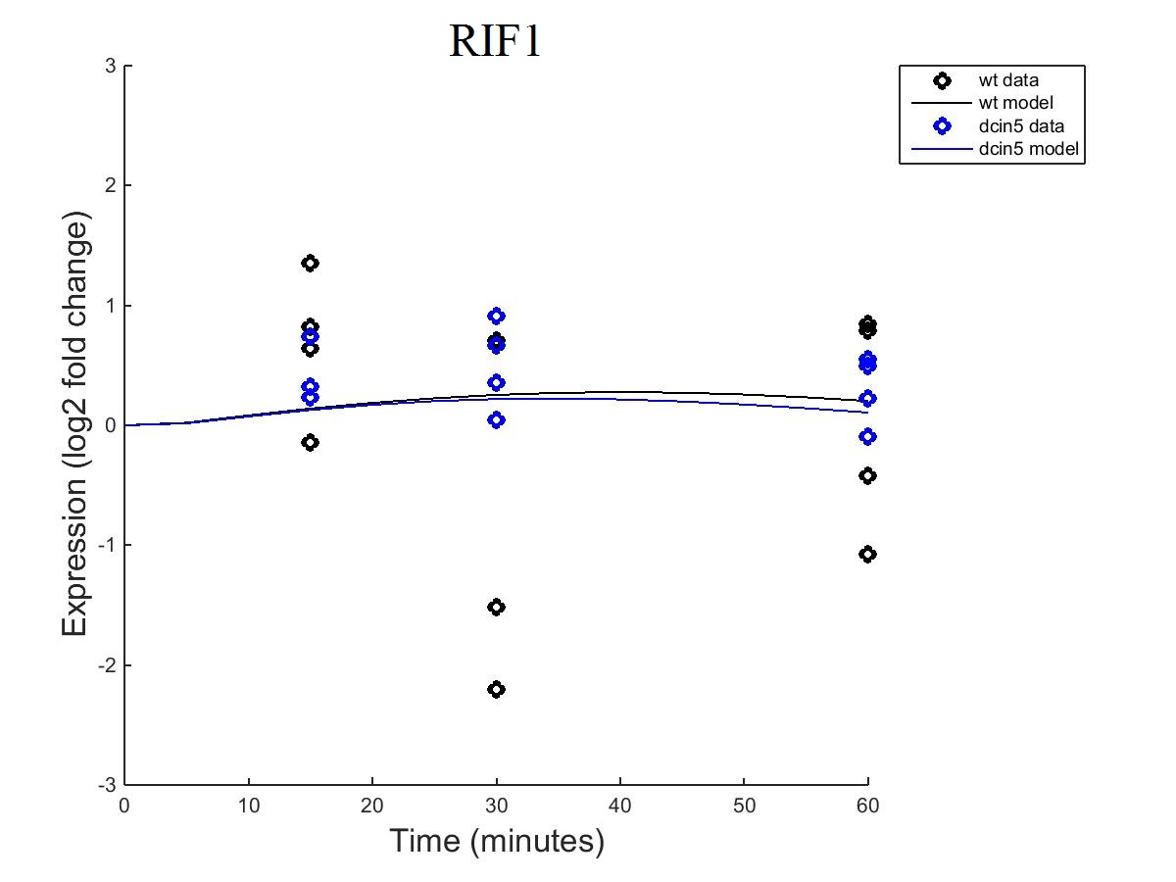
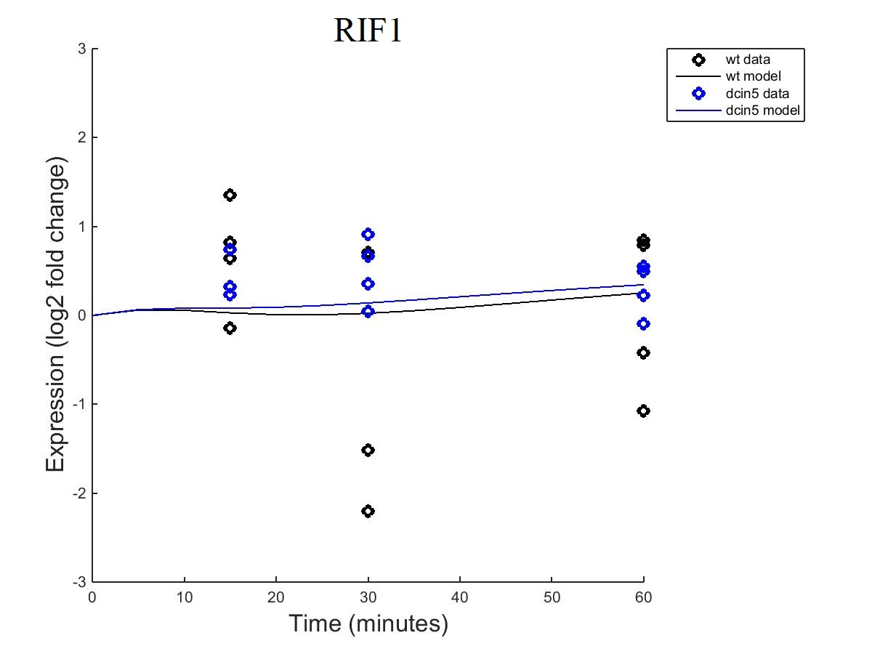
RIF1
Fixed B
Estimated B

Slide 3
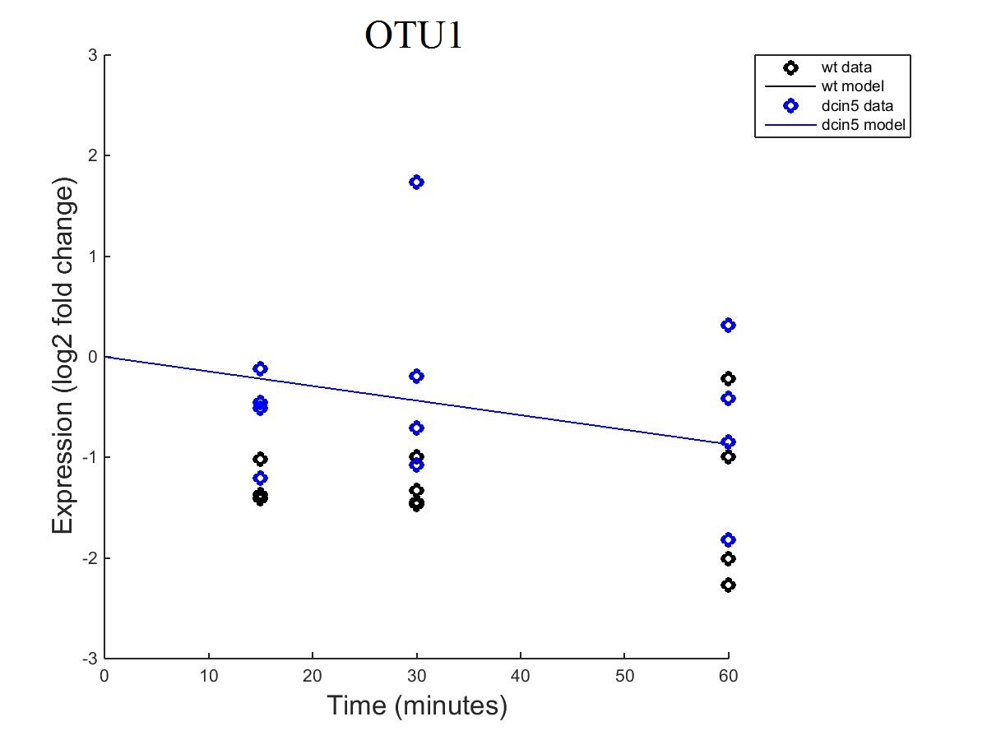

OTU1
Fixed B
Estimated B

Slide 4
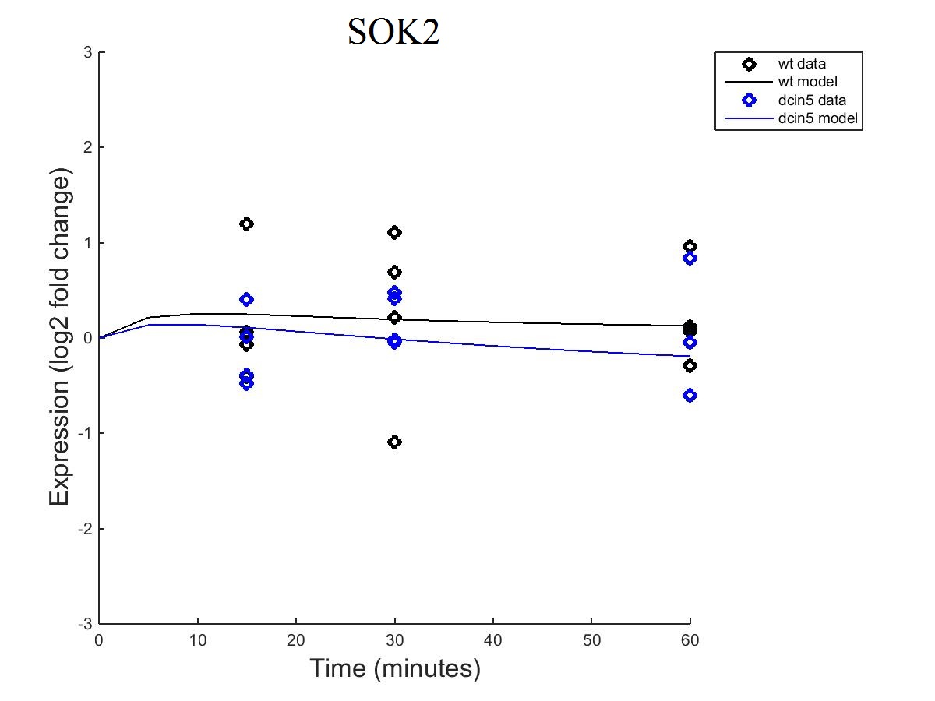
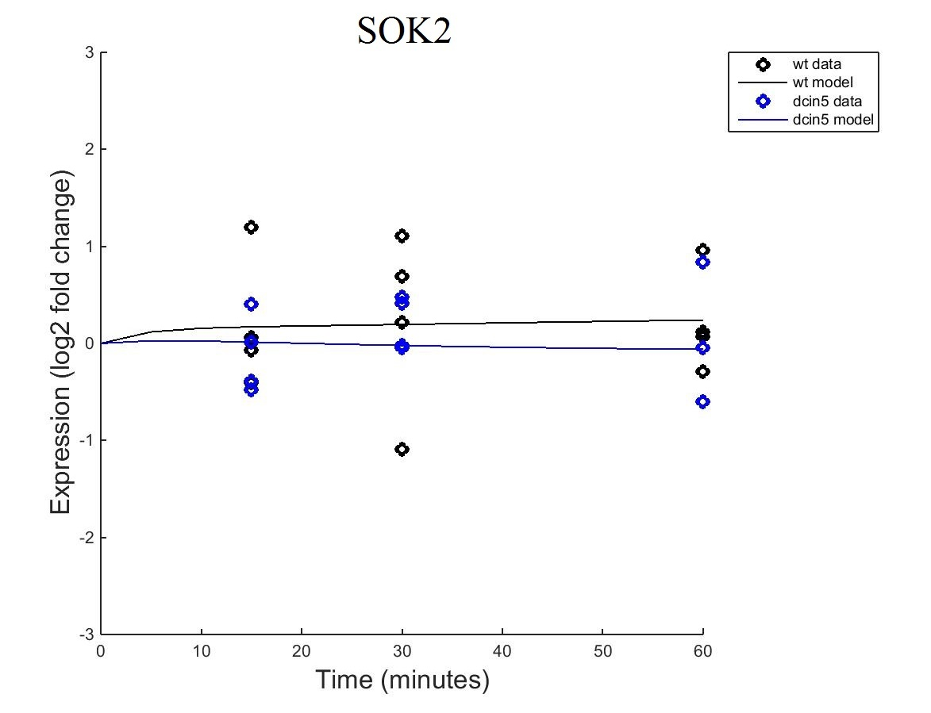
SOK2
Fixed B
Estimated B

Slide 5
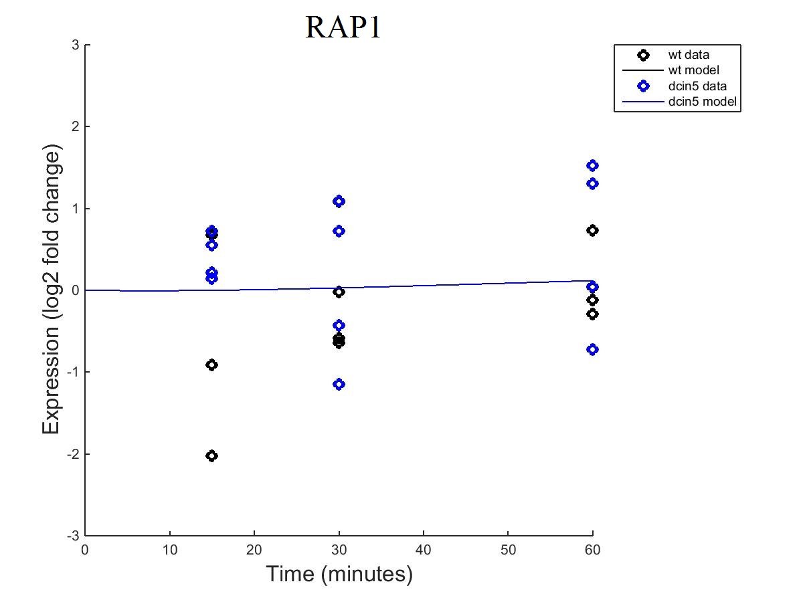

RAP1
Fixed B
Estimated B

Slide 6
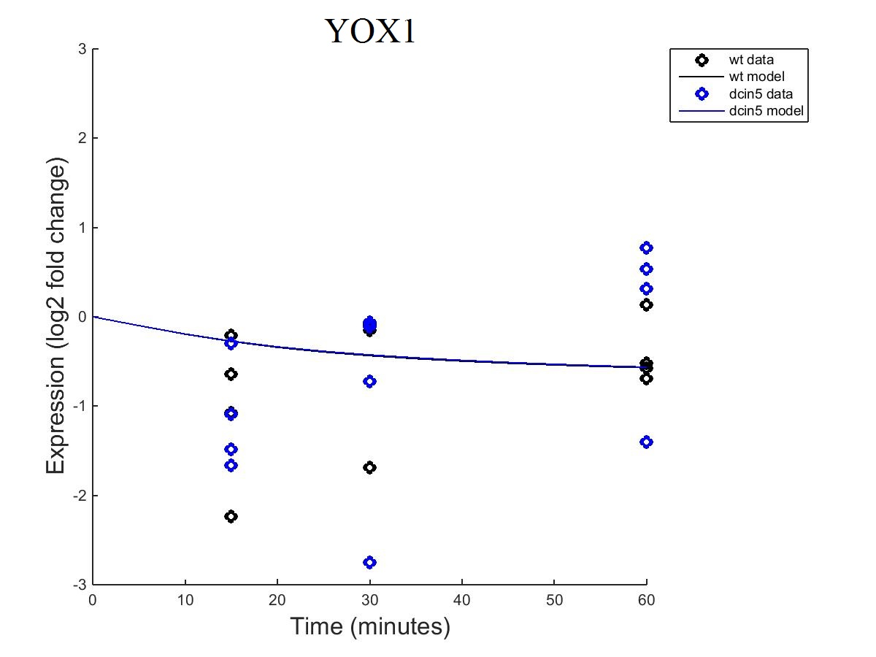
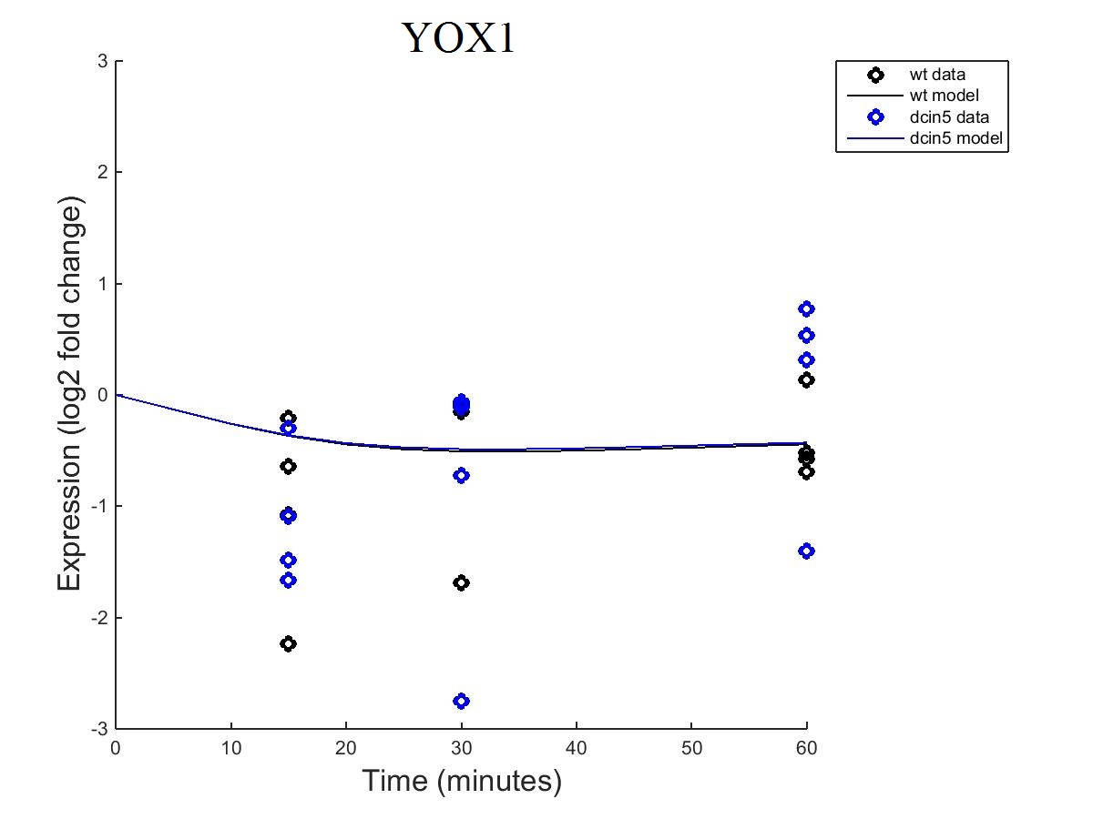
YOX1
Fixed B
Estimated B

Slide 7
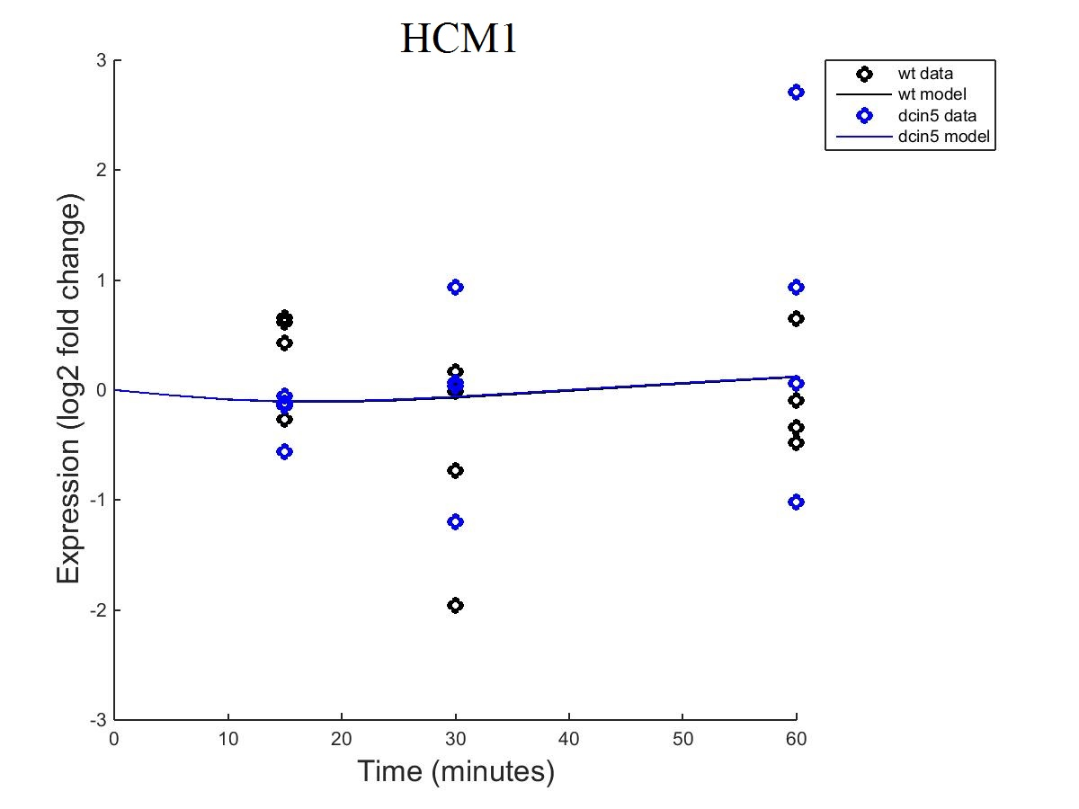
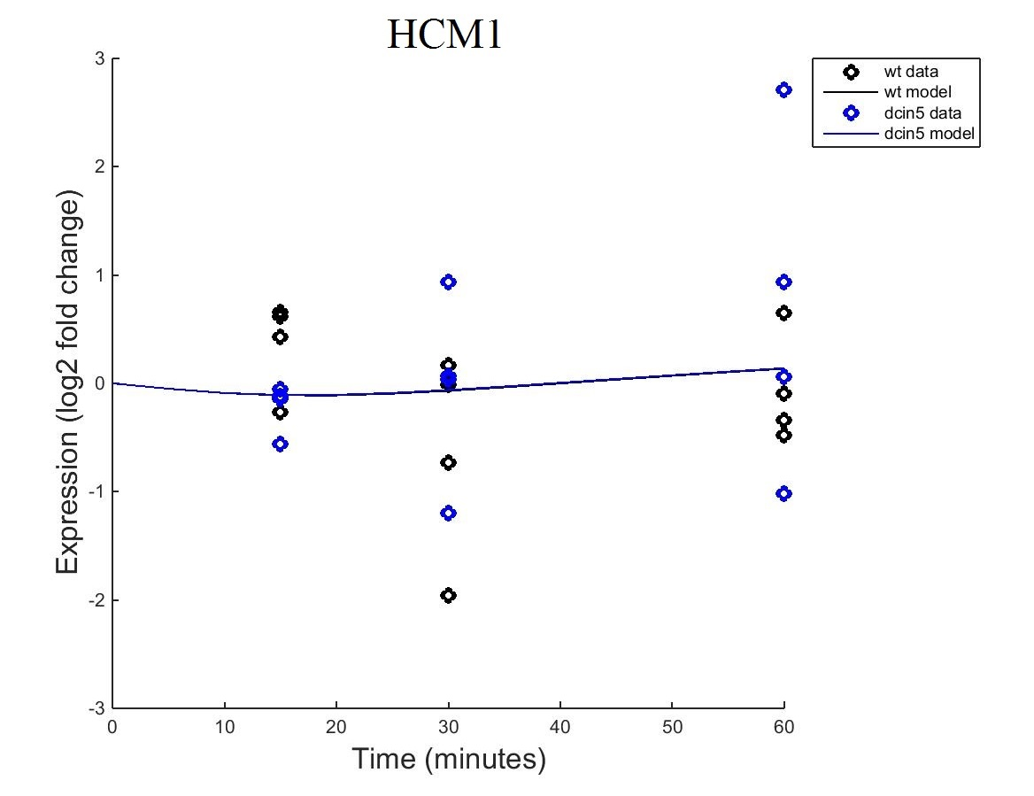
HCM1
Fixed B
Estimated B

Slide 8
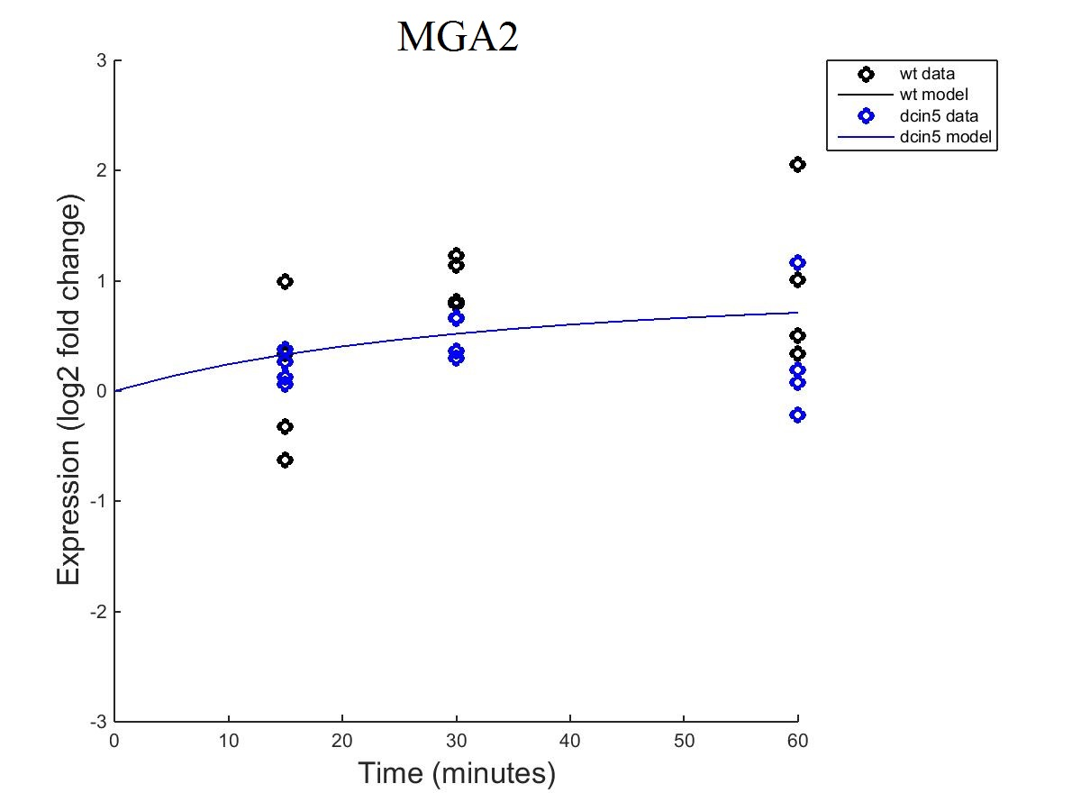

MGA2
Fixed B
Estimated B

Slide 9
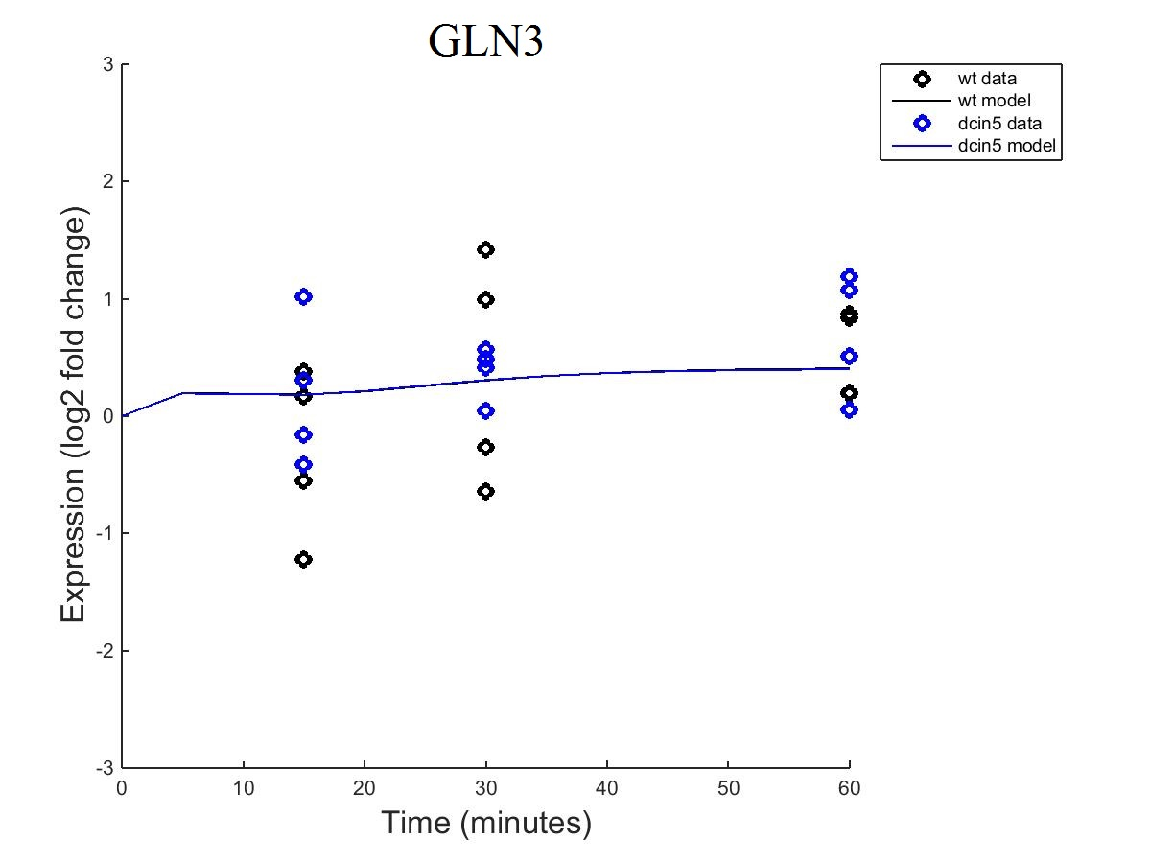

GLN3
Fixed B
Estimated B

Slide 10
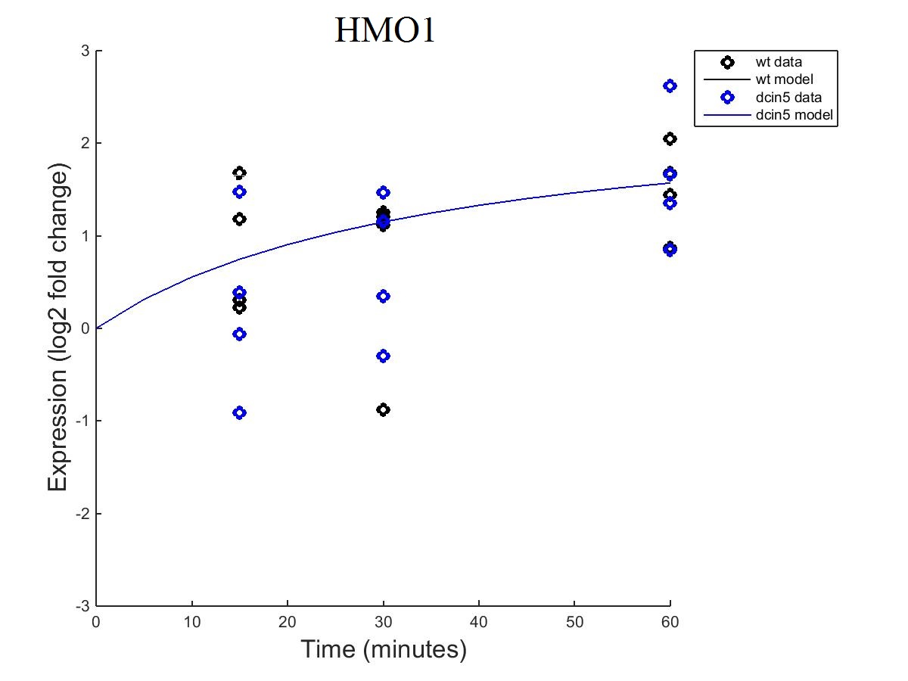
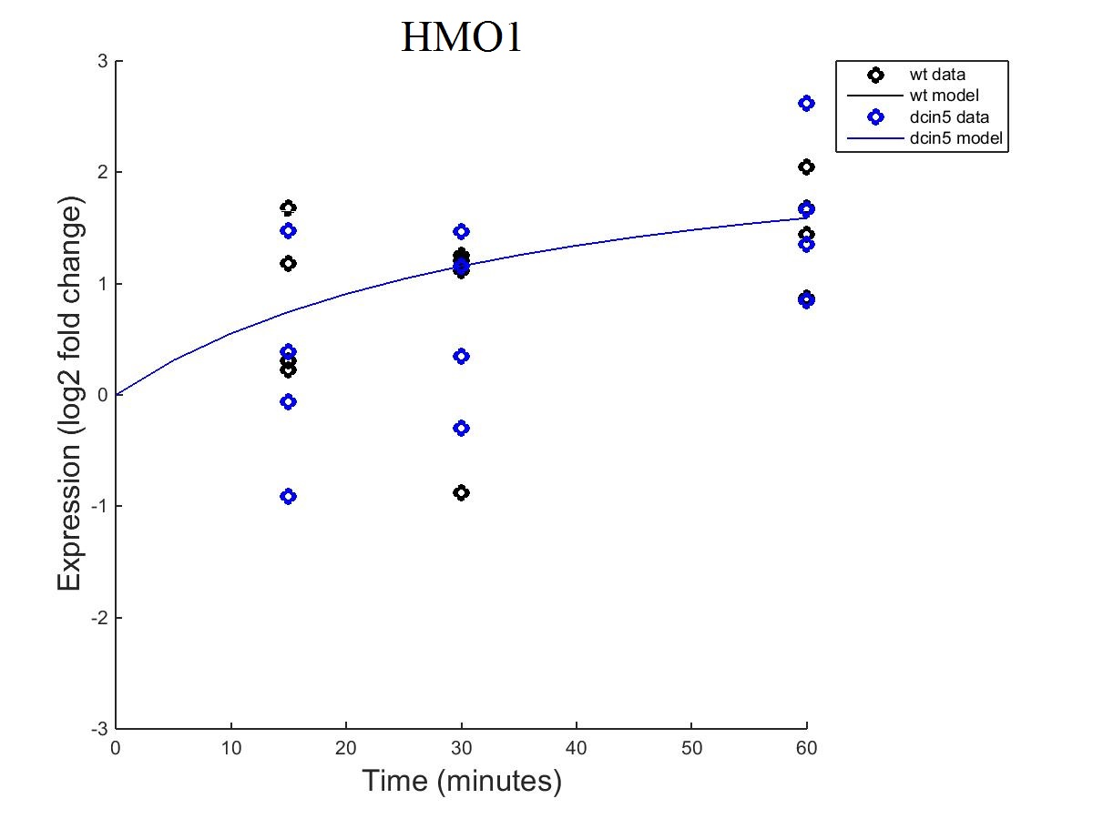
HMO1
Fixed B
Estimated B

Slide 11
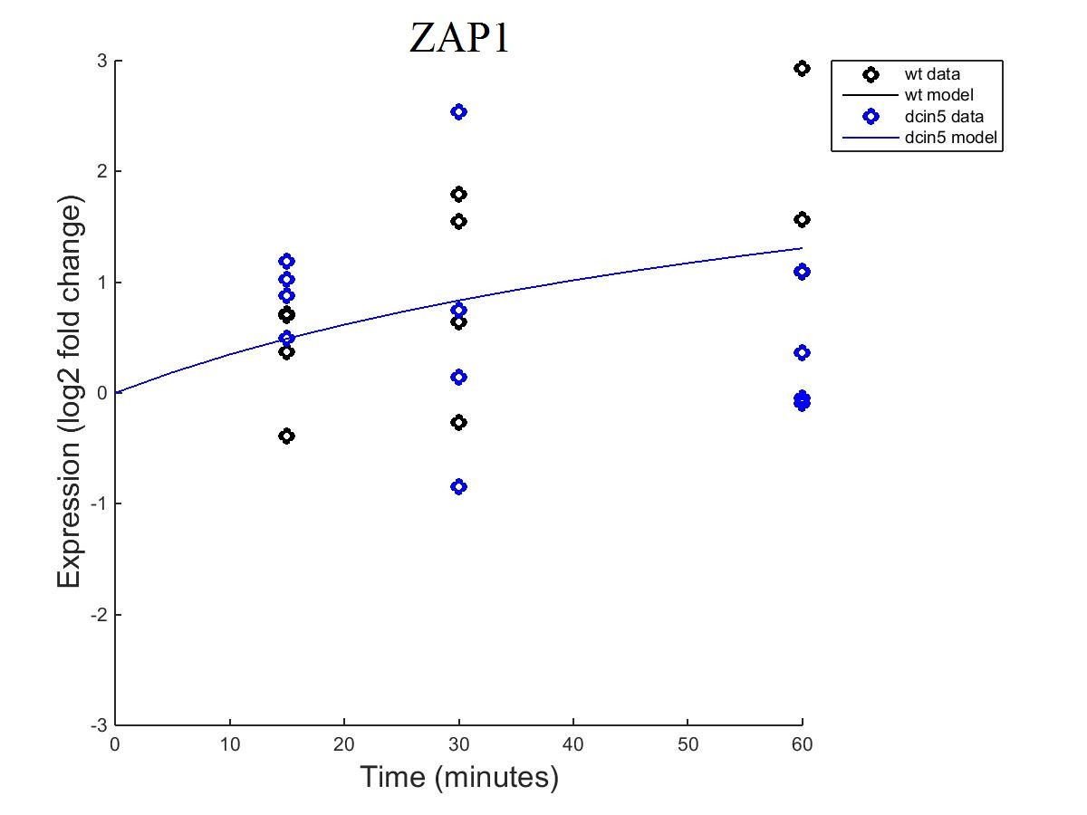

ZAP1
Fixed B
Estimated B

Slide 12
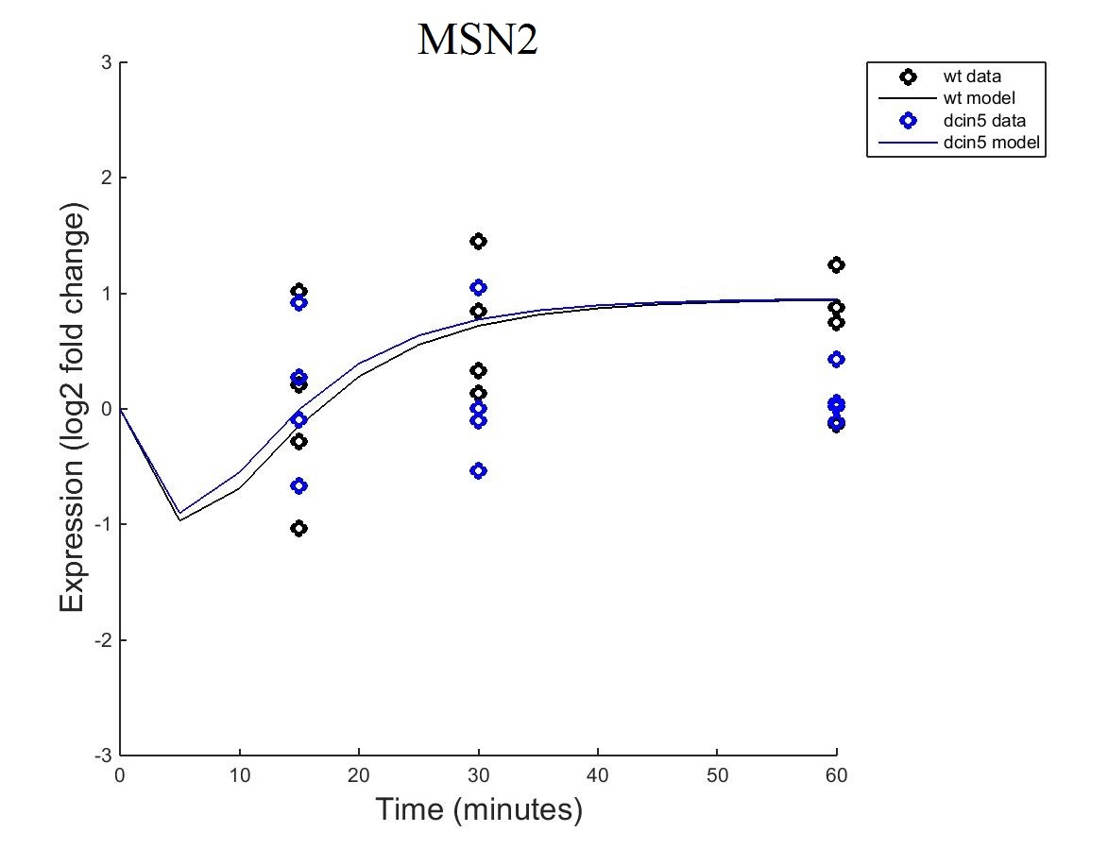
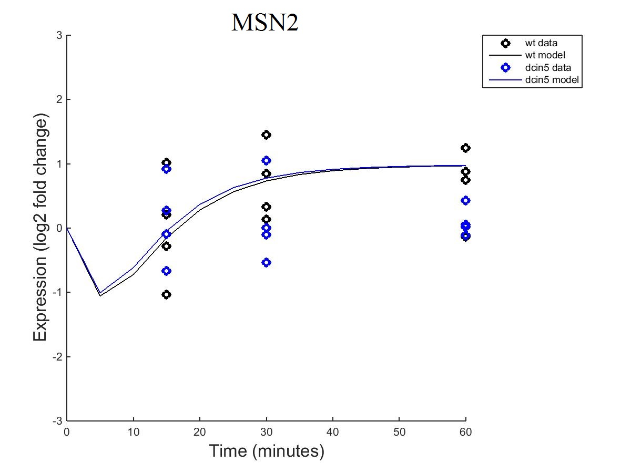
MSN2
Fixed B
Estimated B

Slide 13
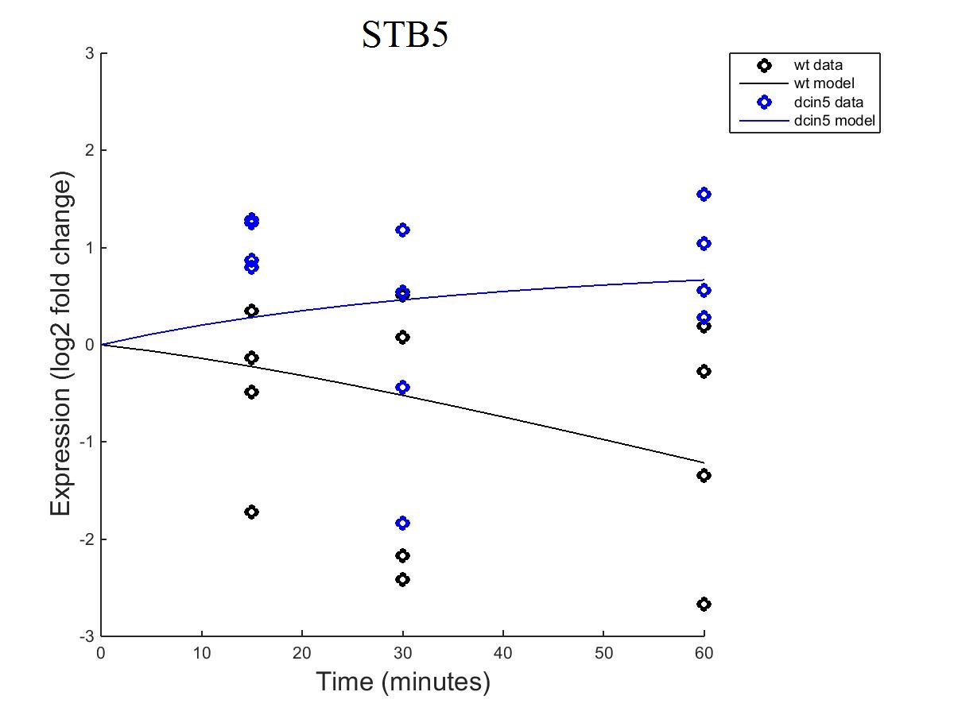
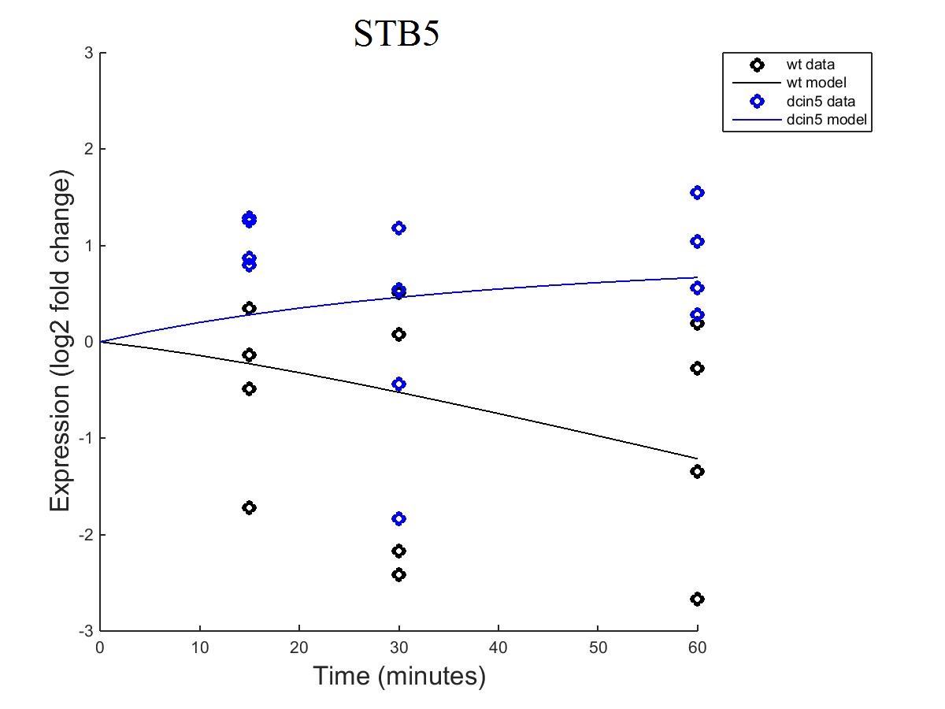
STB5
Fixed B
Estimated B

Slide 14
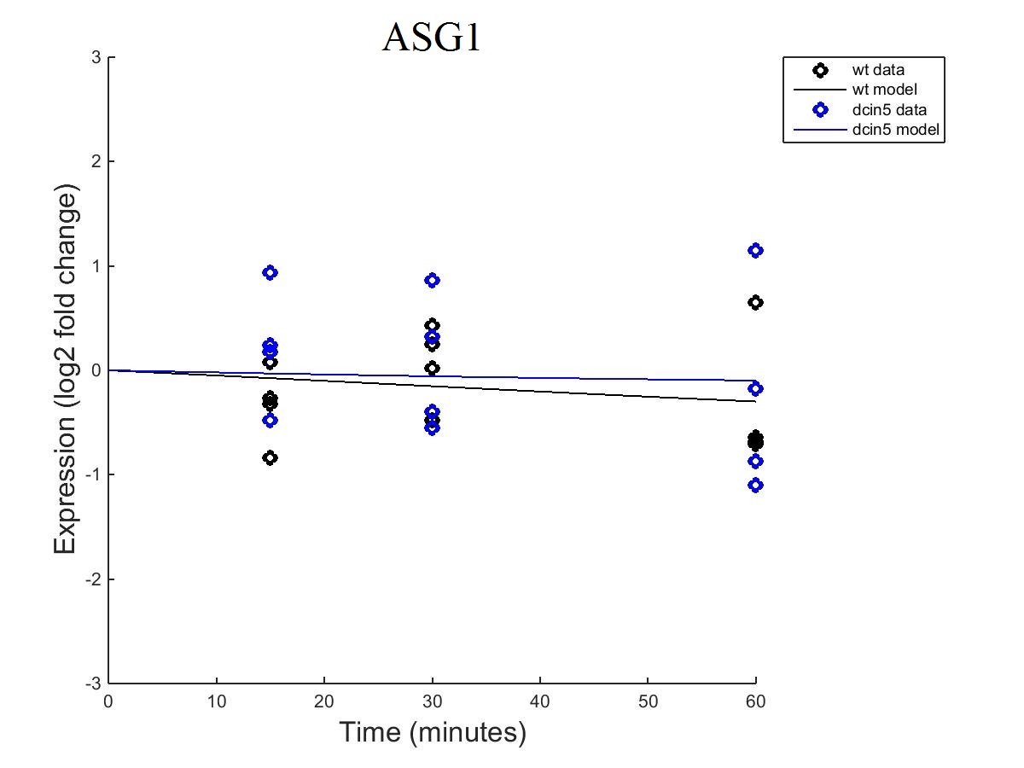
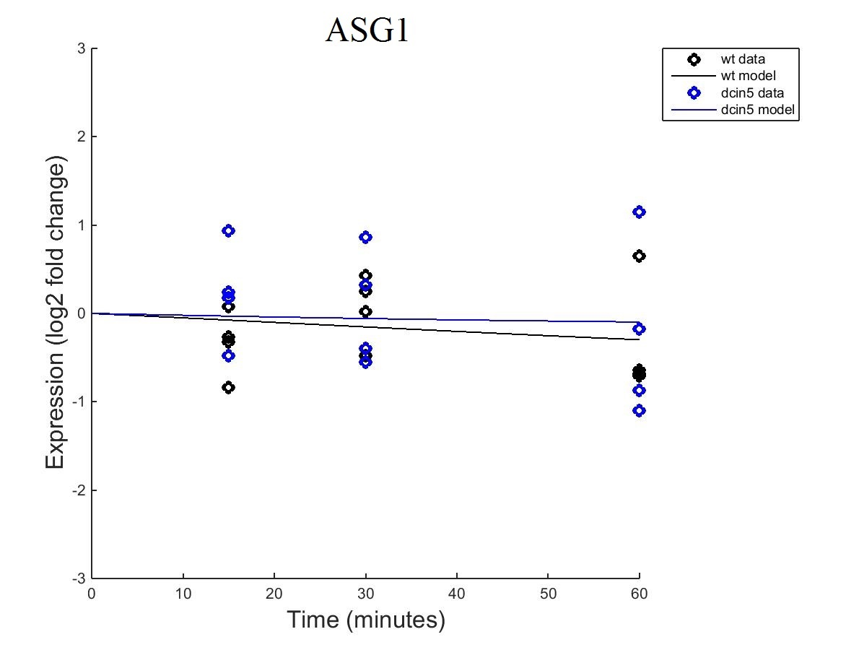
ASG1
Fixed B
Estimated B

Slide 15
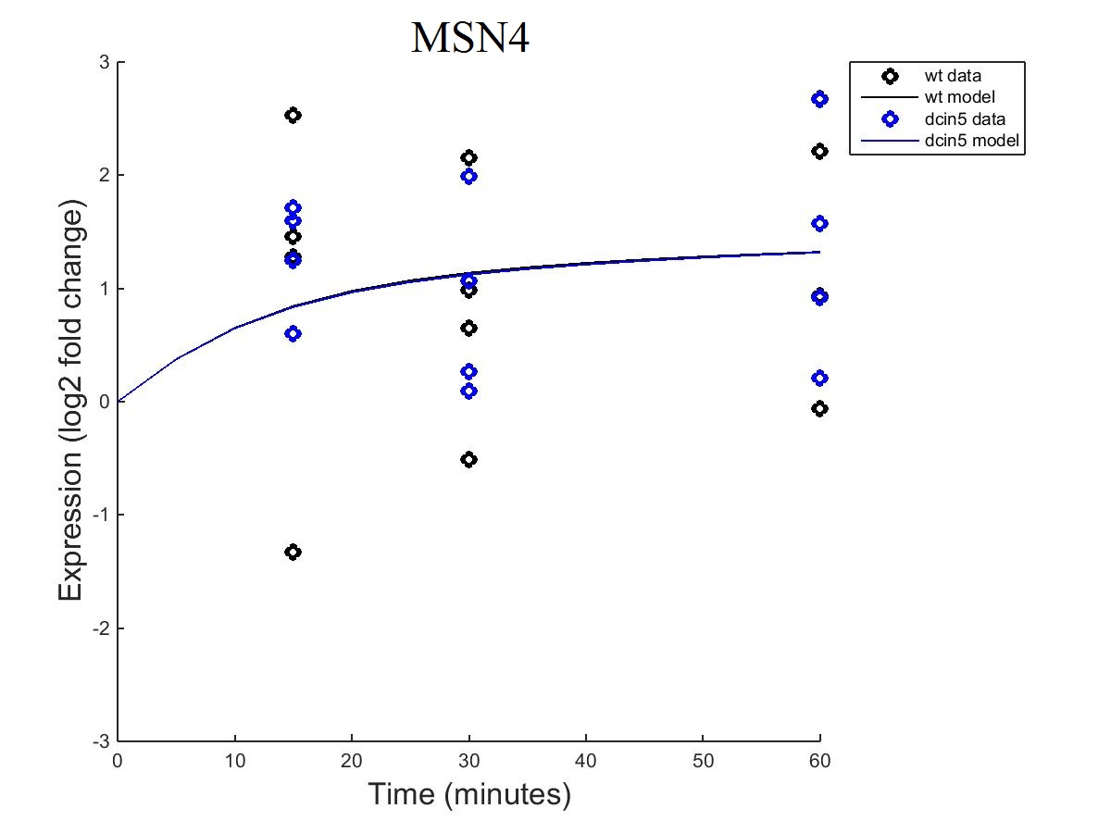
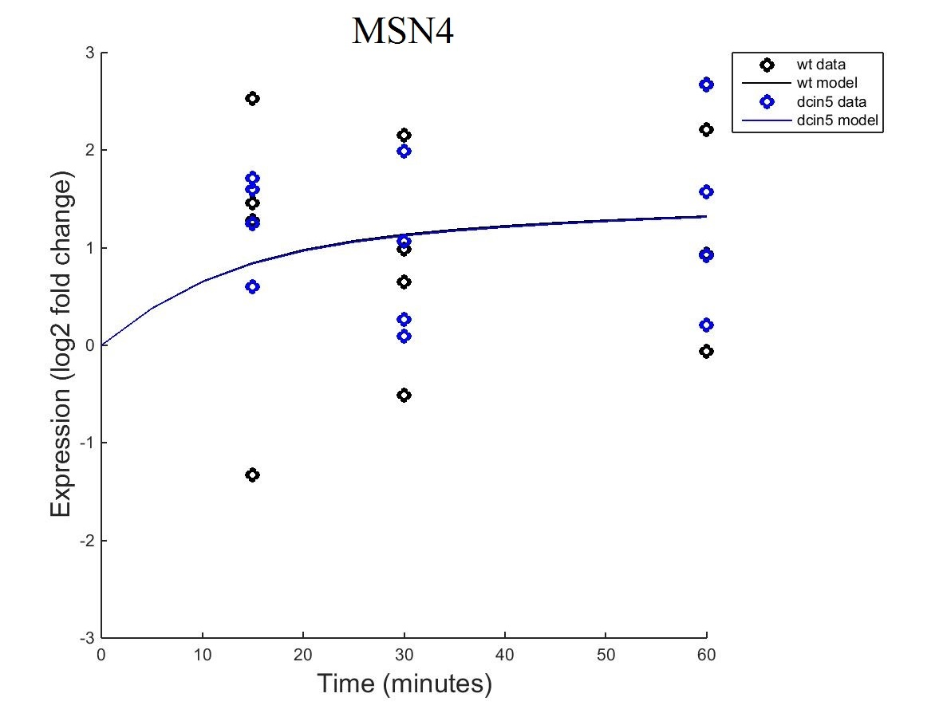
MSN4
Fixed B
Estimated B

Slide 16
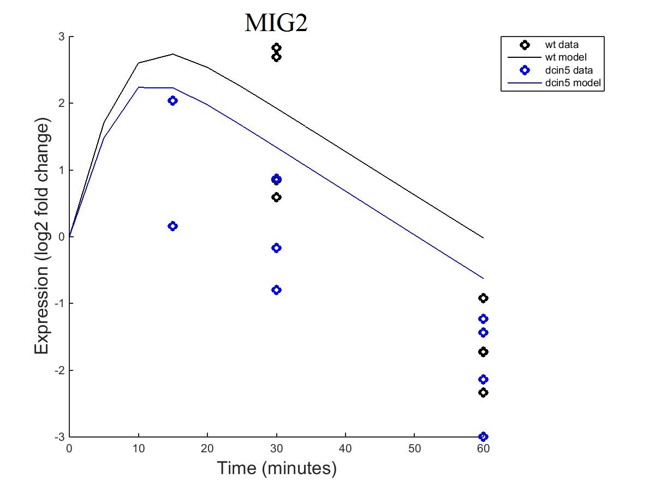
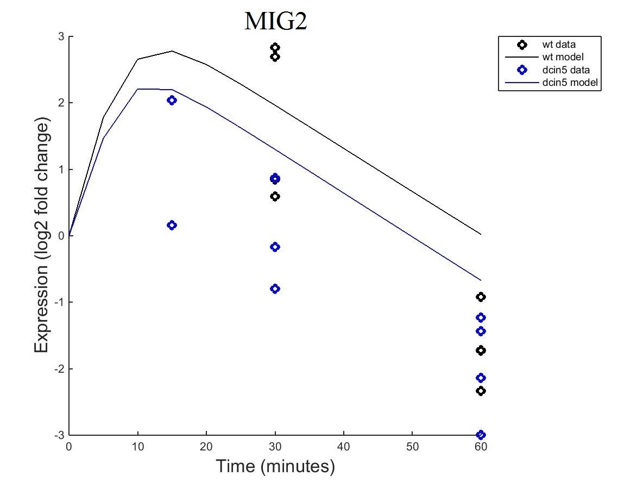
MIG2
Fixed B
Estimated B

Slide 17
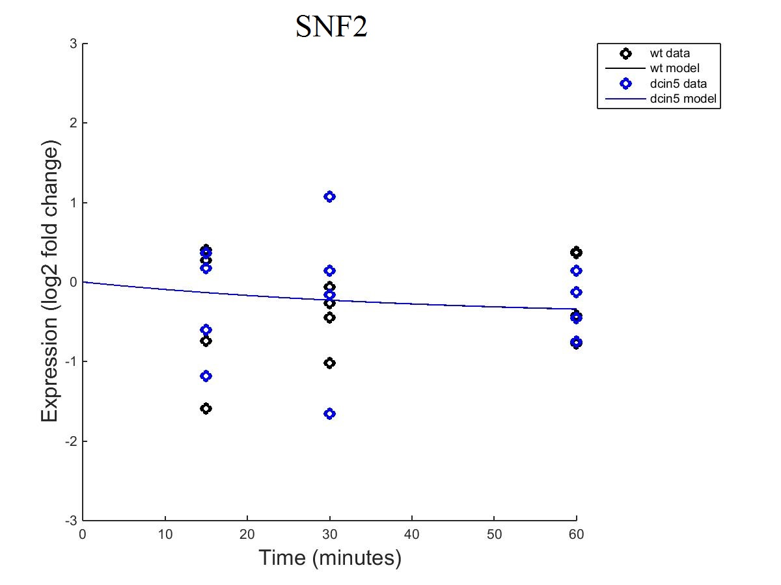

SNF2
Fixed B
Estimated B

Slide 18
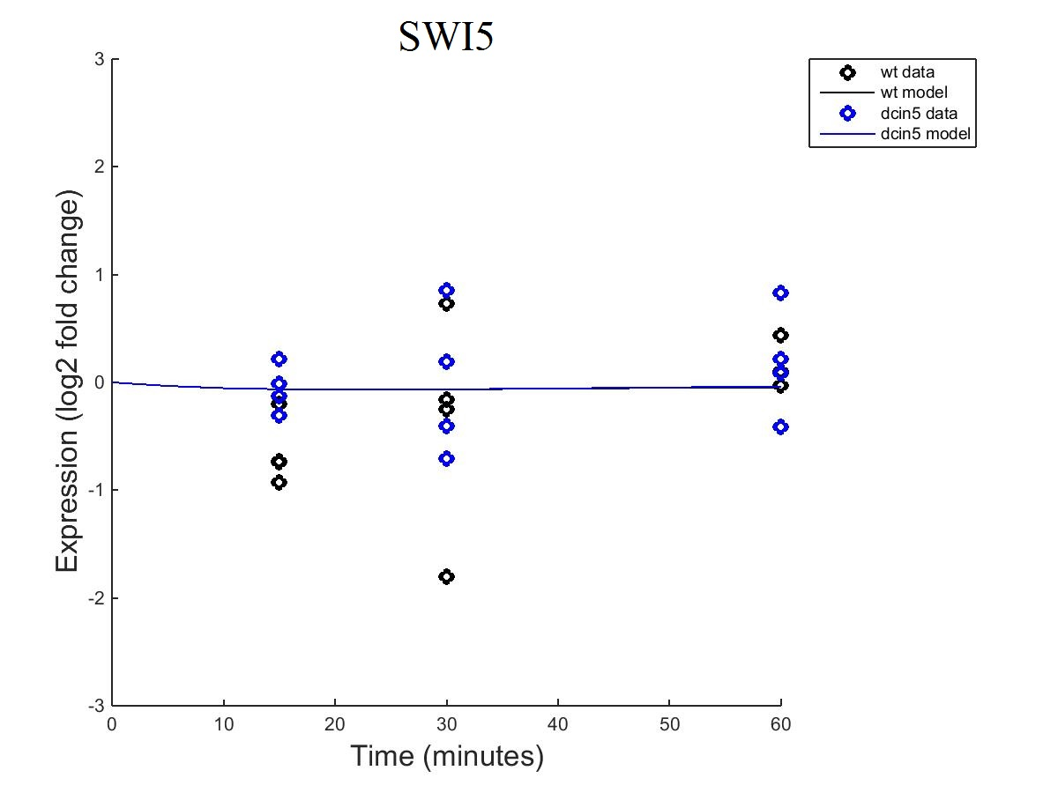
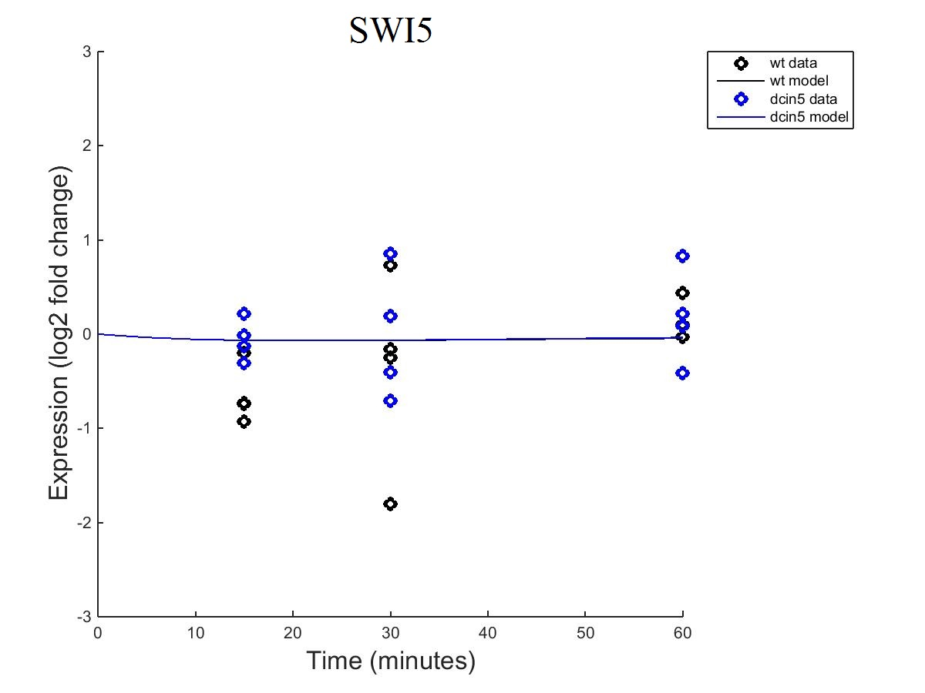
SWI5
Fixed B
Estimated B

Slide 19
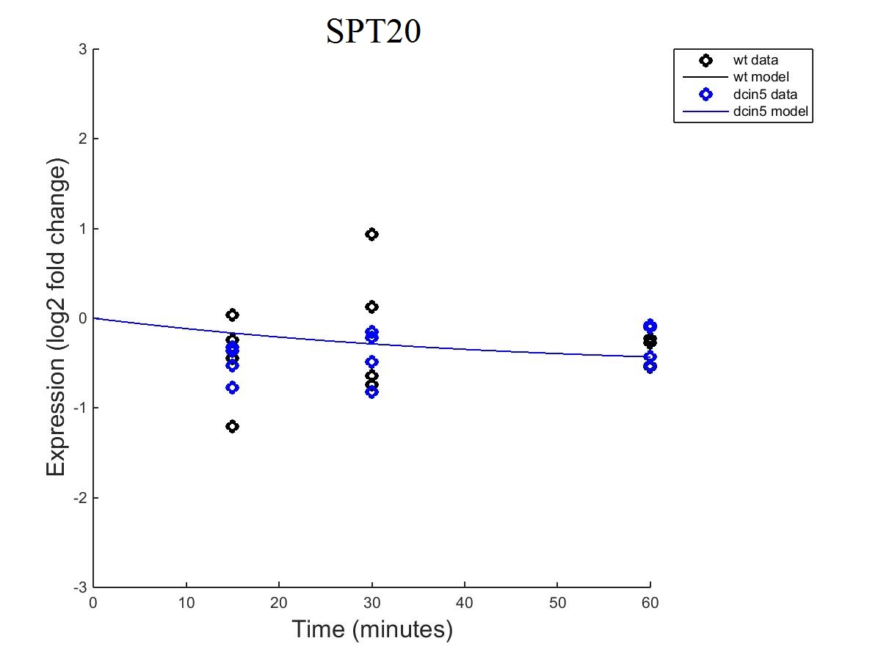
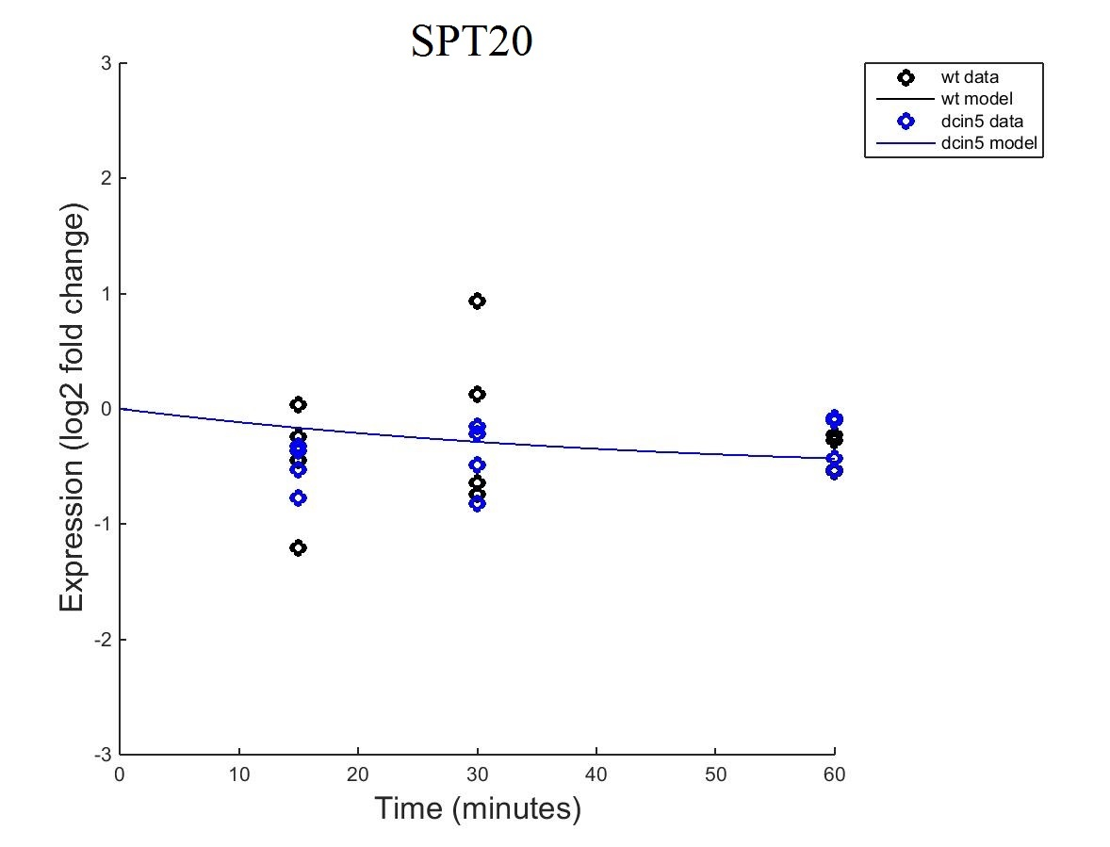
SPT20
Fixed B
Estimated B

Slide 20
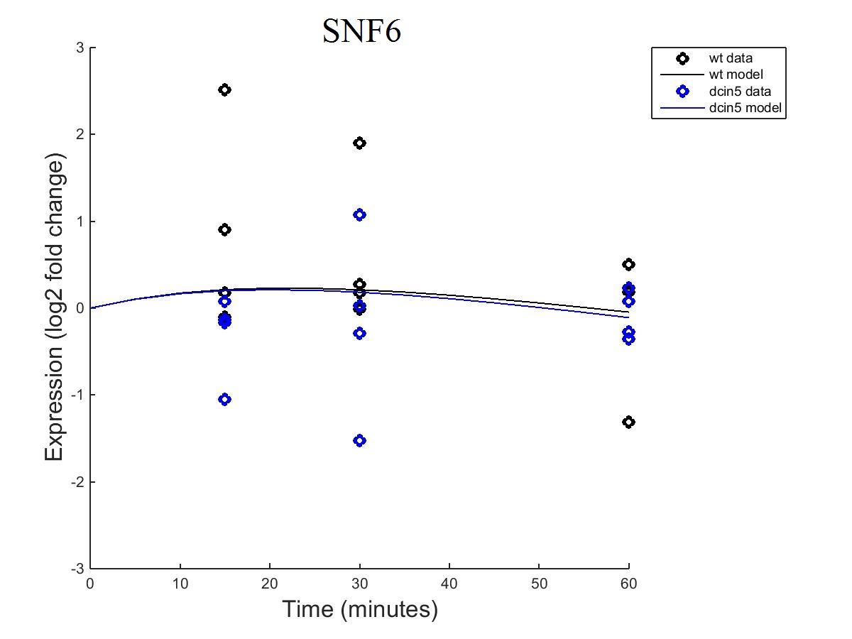

SNF6
Fixed B
Estimated B

Slide 21
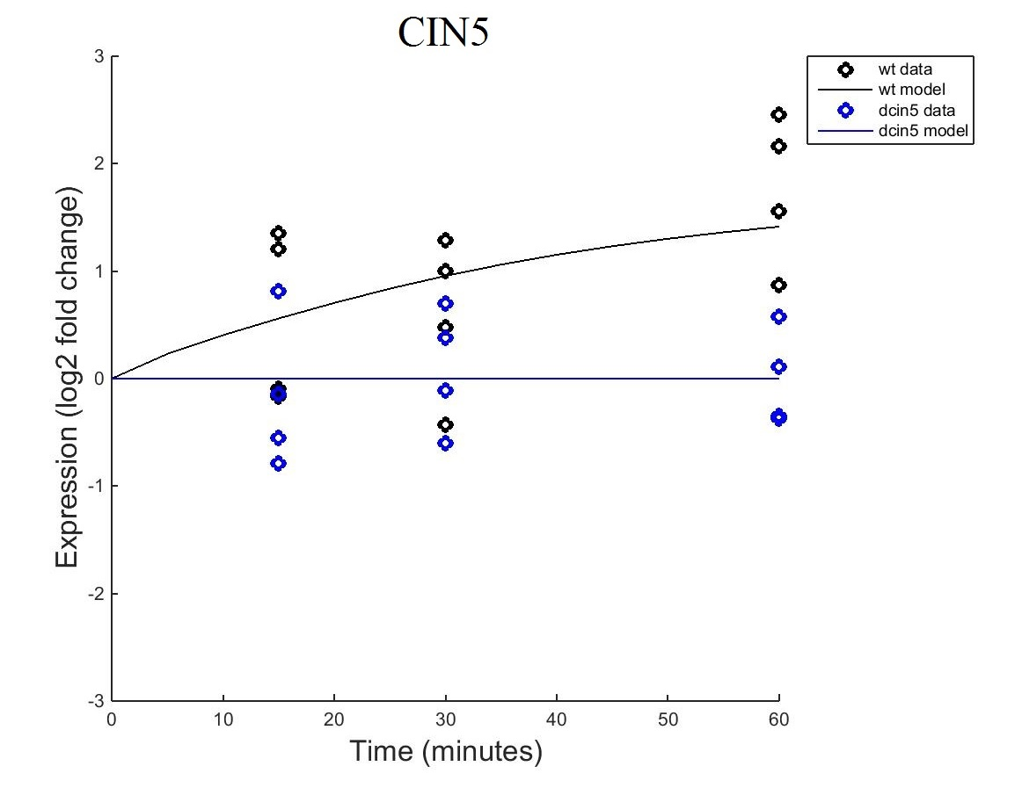
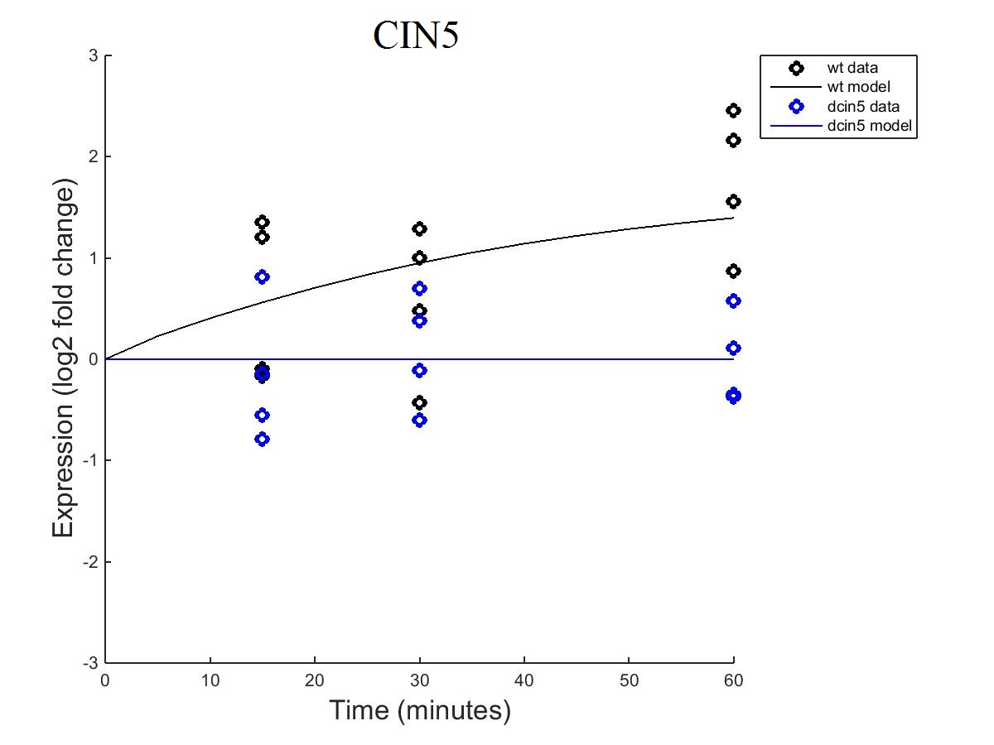
CIN5
Fixed B
Estimated B

Slide 22
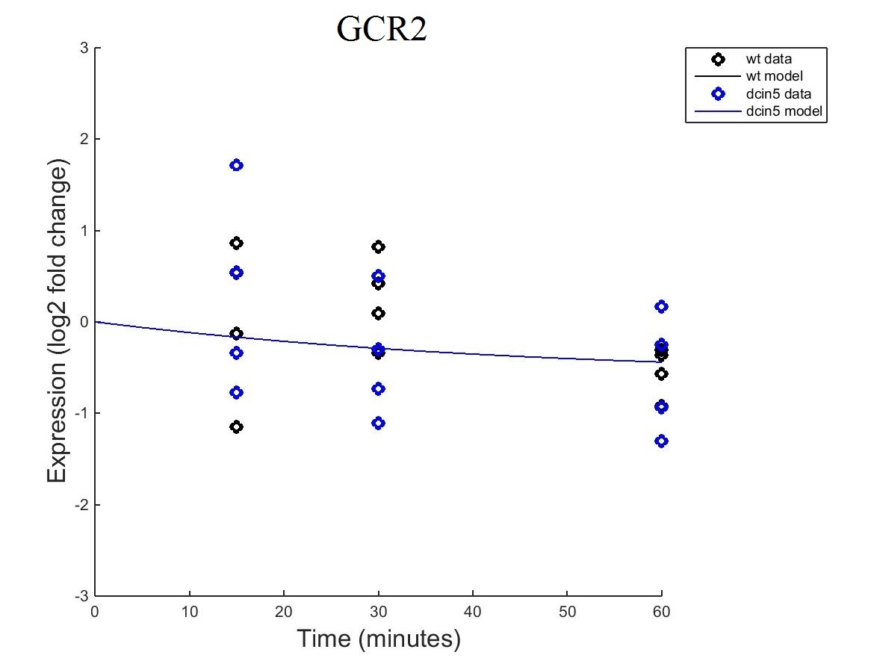
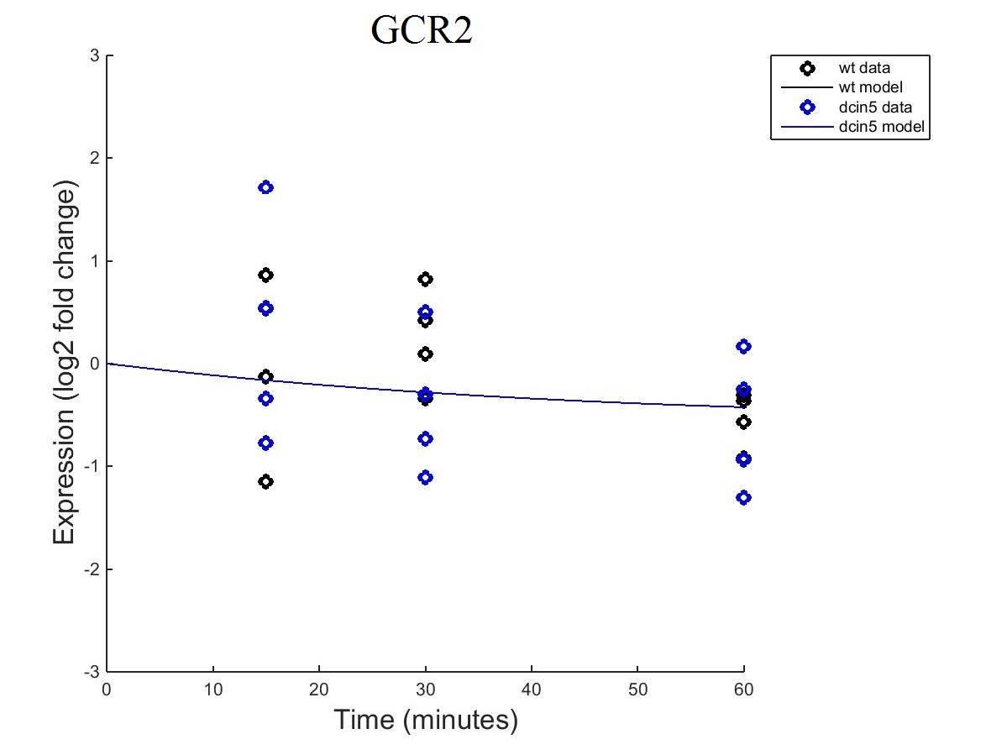
GCR2
Fixed B
Estimated B

Slide 23
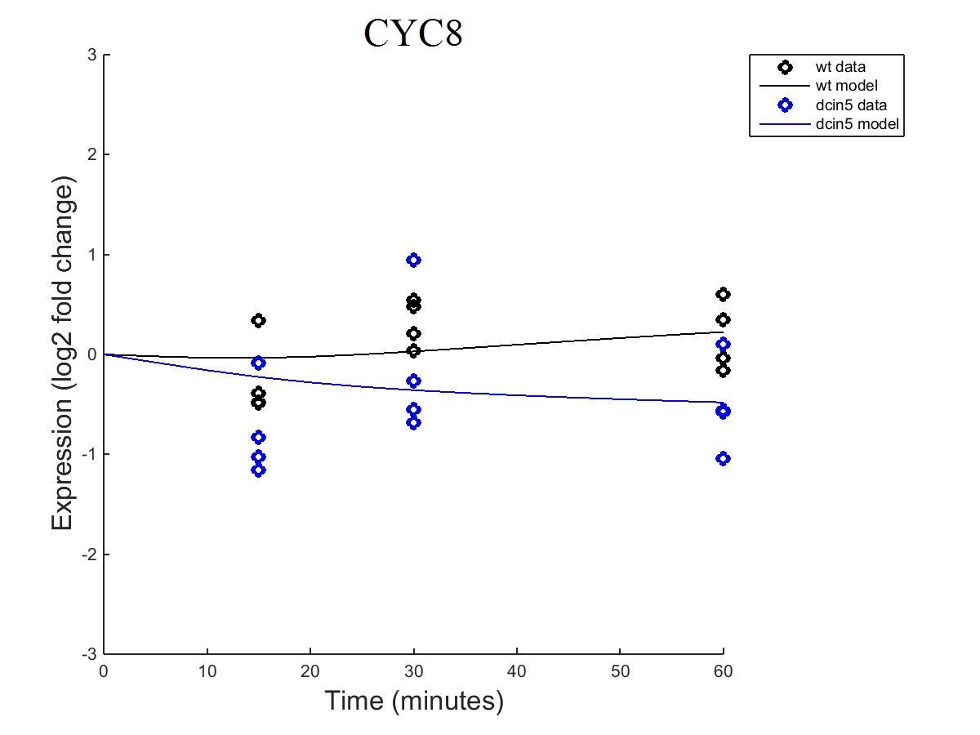

CYC8
Fixed B
Estimated B

Slide 24
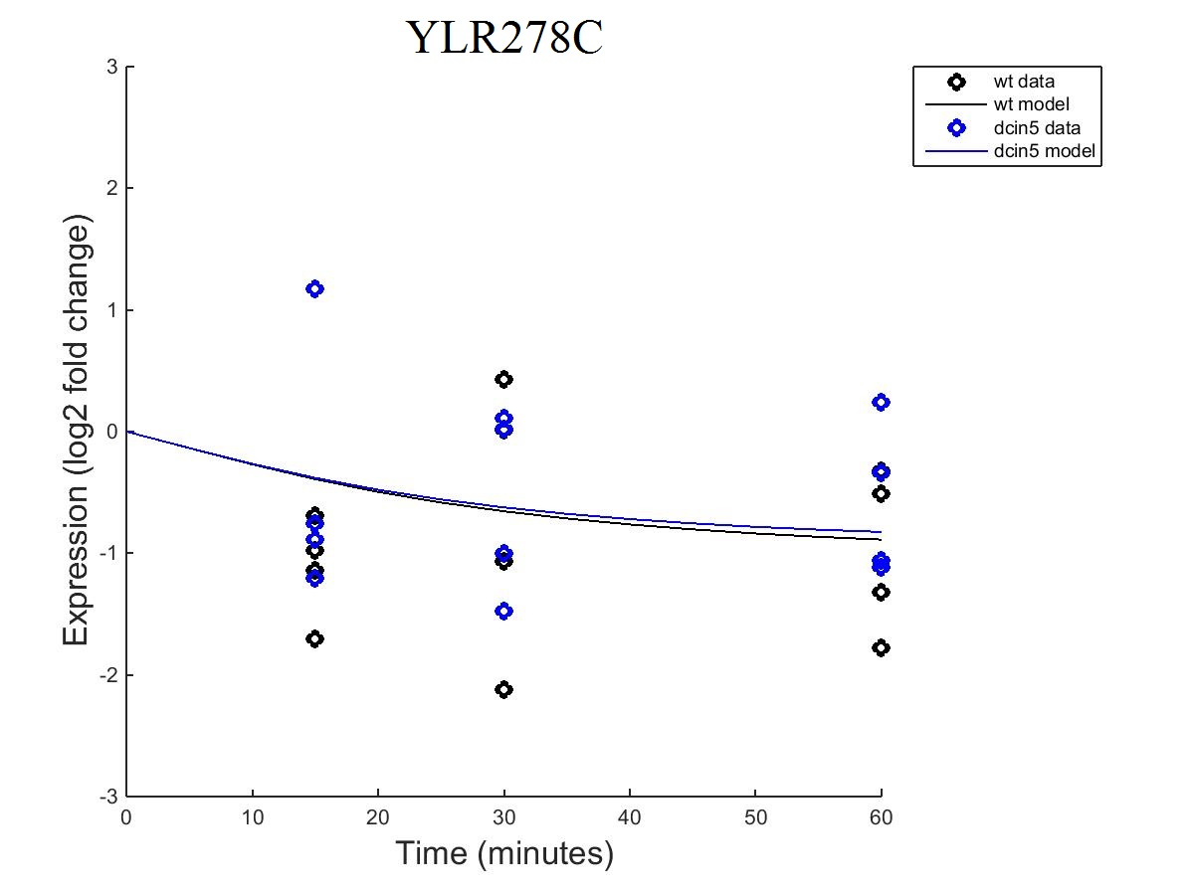
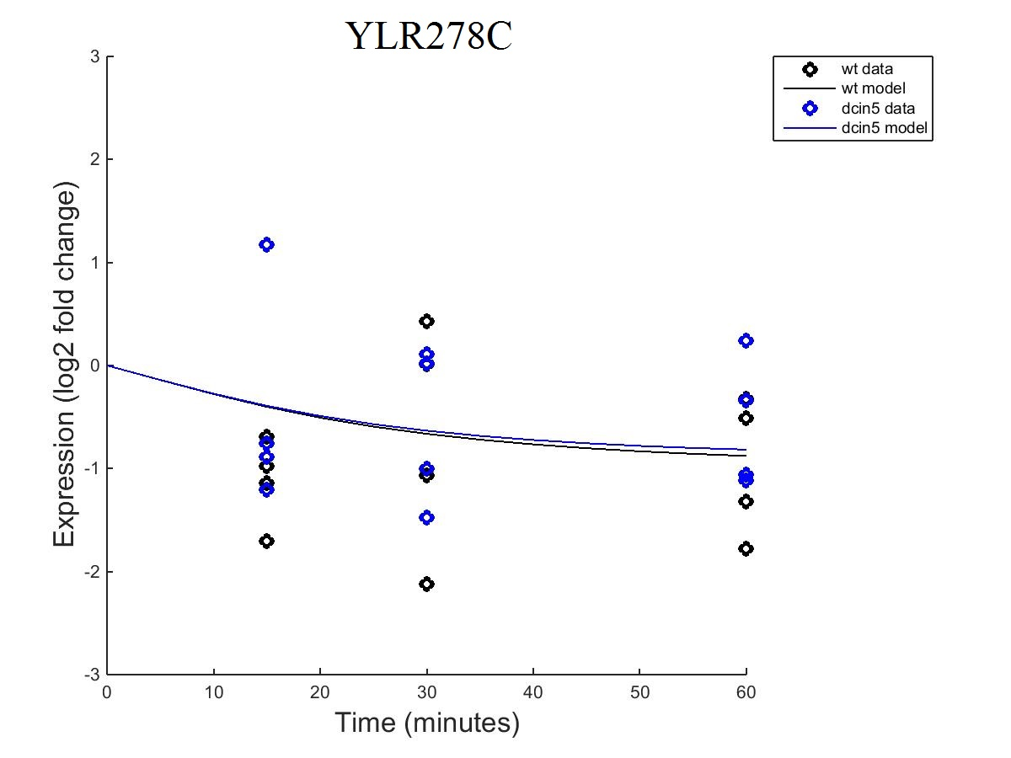
YLR278C
Fixed B
Estimated B

Slide 25

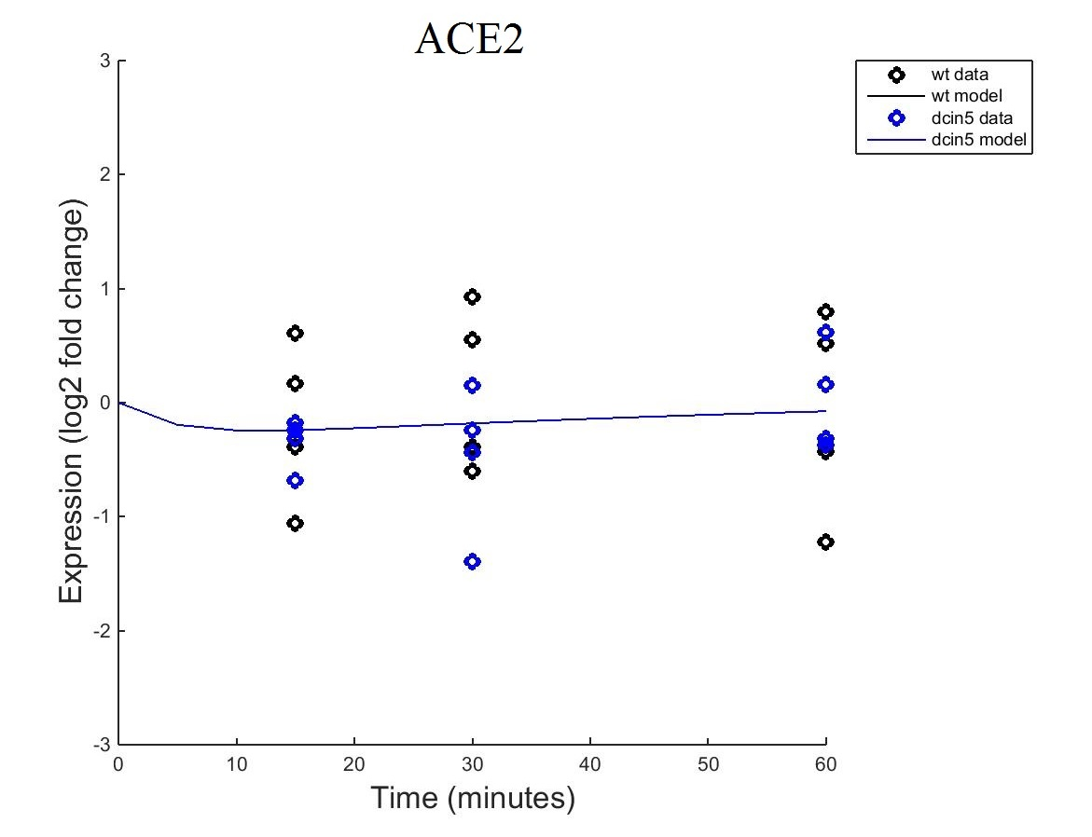
ACE2
Fixed B
Estimated B

Slide 26
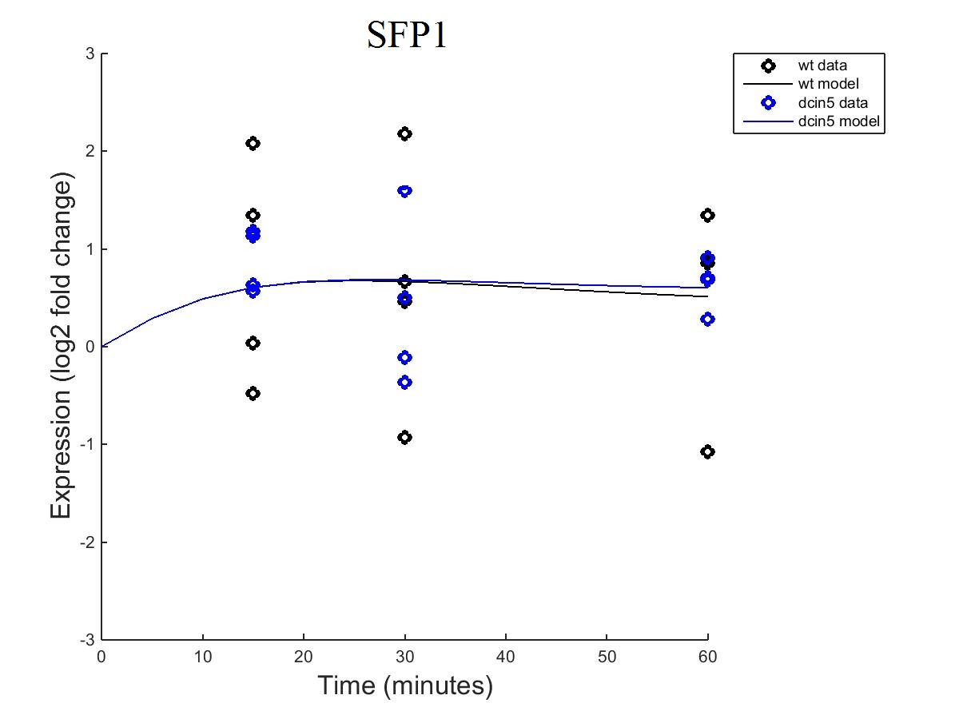

SFP1
Fixed B
Estimated B

Slide 27
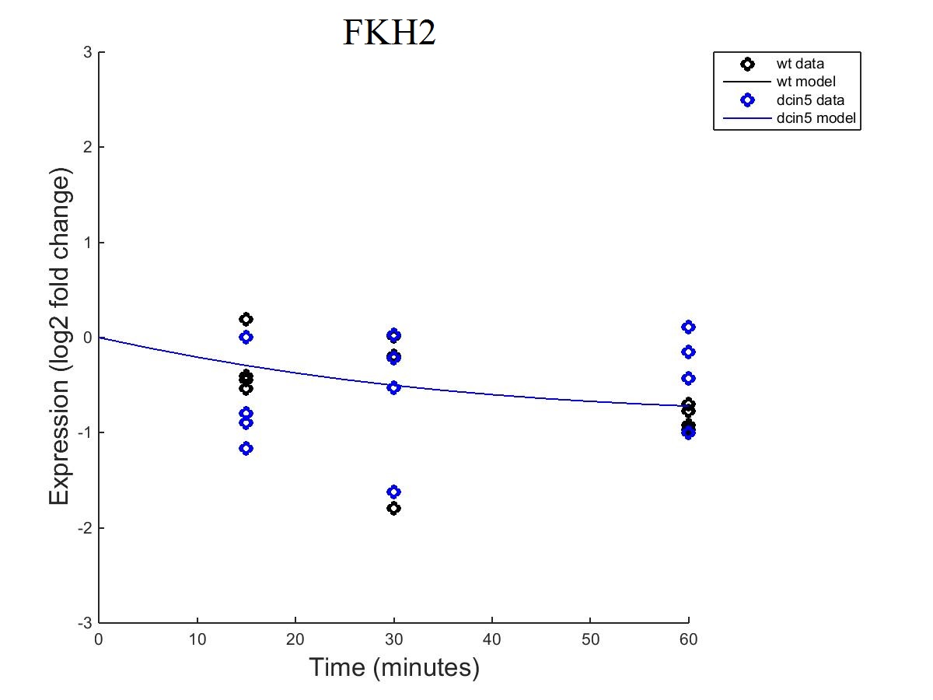

FKH2
Fixed B
Estimated B

Slide 28
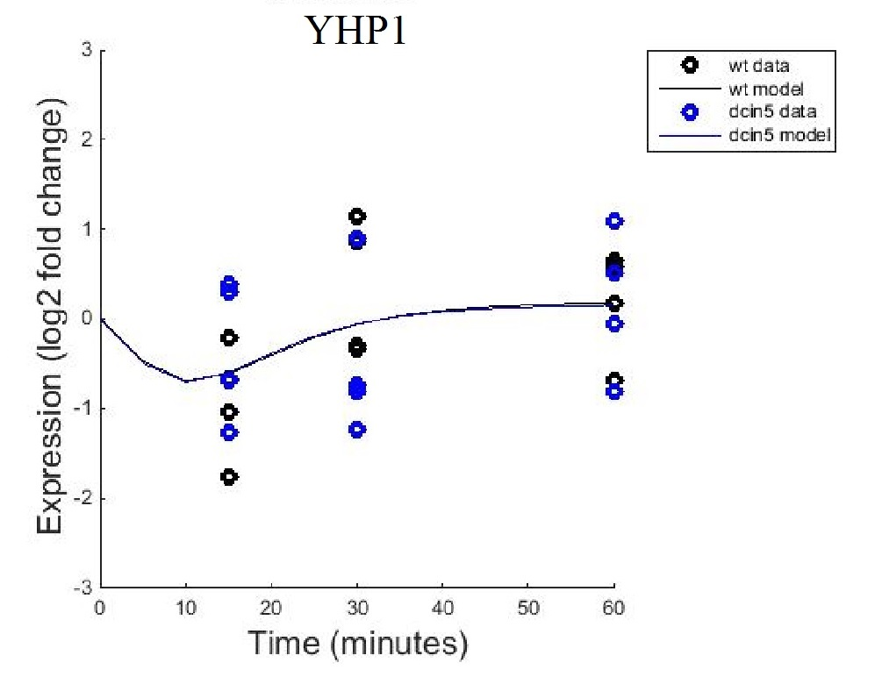
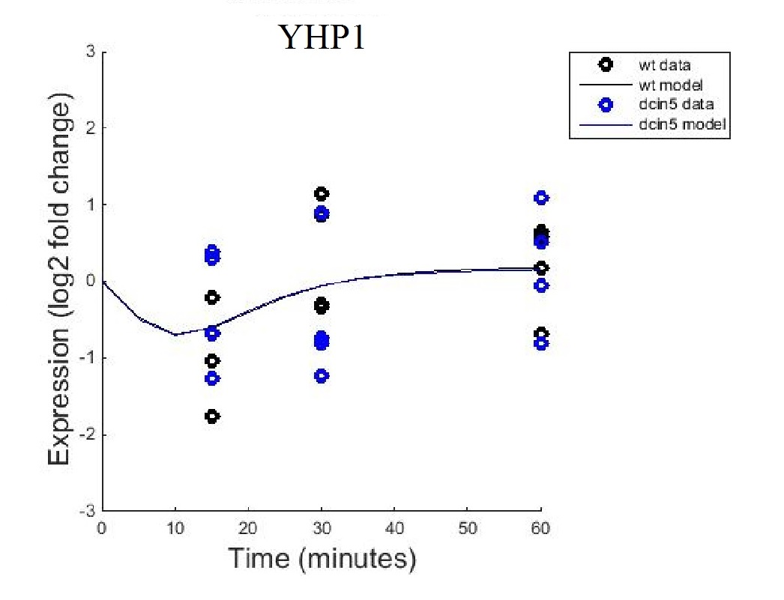
YHP1
Fixed B
Estimated B

Slide 29
Weight Comparison

Slide 30
Production Weight Comparison

Slide 31
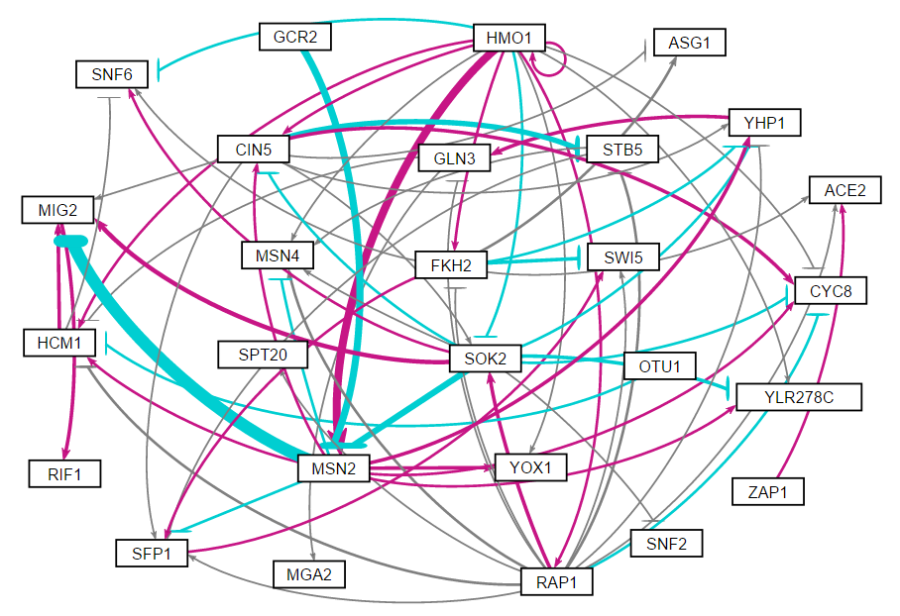
Fixed B Network Map

Slide 32
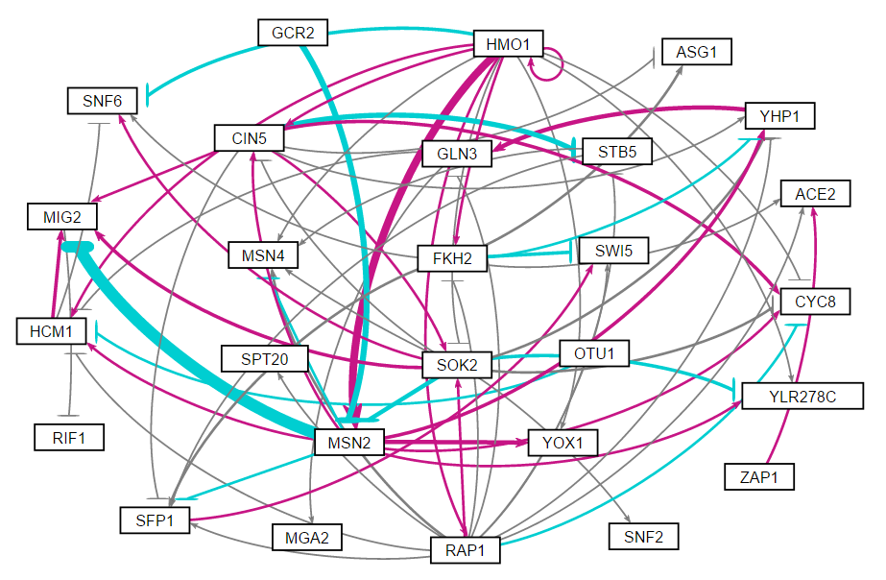
Estimated B Network Map

