Slide 1
Within-strain ANOVA for dCIN5
ANOVA | WT | dCIN5
p < 0.05 | 2377 (38.41%) | 1995 (32.23%)
p < 0.01 | 1531 (24.74%) | 1157 (18.69%)
p < 0.001 | 850 (13.73%) | 566 (9.15%)
p < 0.0001 | 449 (7.25%) | 280 (4.52%)
B & H p < 0.05 | 1673 (27.03%) | 1117 (18.05%)
Bonferroni p < 0.05 | 226 (3.65%) | 109 (1.76%)

Slide 2
Within-strain ANOVA for All Strains
ANOVA | WT | dCIN5 | dGLN3 | dHAP4 | dSWI4
p < 0.05 | 2377 (38.41%) | 1995 (32.23%) | 1856 (29.99%) | 2387 (38.57%) | 2583 (41.74%)
p < 0.01 | 1531 (24.74%) | 1157 (18.69%) | 1007 (16.27%) | 1489 (24.06%) | 1679 (27.13%)
p < 0.001 | 850 (13.73%) | 566 (9.15%) | 398 (6.43%) | 679 (10.97%) | 869 (14.04%)
p < 0.0001 | 449 (7.25%) | 280 (4.52%) | 121 (1.96%) | 240 (3.88%) | 446 (7.21%)
B & H p < 0.05 | 1673 (27.03%) | 1117 (18.05%) | 889 (14.36%) | 1615 (26.09%) | 1855 (29.97%)
Bonferroni p < 0.05 | 226 (3.65%) | 109 (1.76%) | 20 (0.32%) | 61 (0.99%) | 179 (2.89%)

Slide 3
Modified t test for Each Time Point for dCIN5
 | Cold Shock |  |  | Recovery
t test | t₁₅ | t₃₀ | t₆₀ | t₉₀ | t₁₂₀
Average Log Fold Change > 0.25 and p < 0.05 | 705 (11.39%) | 391 (6.32%) | 662 (10.70%) | 295 (4.77%) | 189 (3.05%)
Average Log Fold Change < -0.25 and p < 0.05 | 683 (11.04%) | 358 (5.78%) | 584 (9.44%) | 335 (5.41%) | 160 (2.59%)
Total p < 0.05 | 1393 (22.51%) | 756 (12.22%) | 1250 (20.20%) | 634 (10.24%) | 351 (5.67%)
Total B & H p < 0.05 | 0 (0%) | 0 (0%) | 1 (0.02%) | 0 (0%) | 0 (0%)
Total Bonferroni p < 0.05 | 0 (0%) | 0 (0%) | 1 (0.02%) | 0 (0%) | 0 (0%)

Slide 4
Two Strain ANOVA
 | p < 0.05 | B-H p < 0.05
wt vs. dCIN5 | 563 | 4
wt vs. dGLN3 | 720 | 36
wt vs. dHAP4 | 640 | 23
wt vs. dHMO1 | 556 | 5
wt vs. dZAP1 | 553 | 31
wt vs. S. par | 1498 | 703

Slide 5
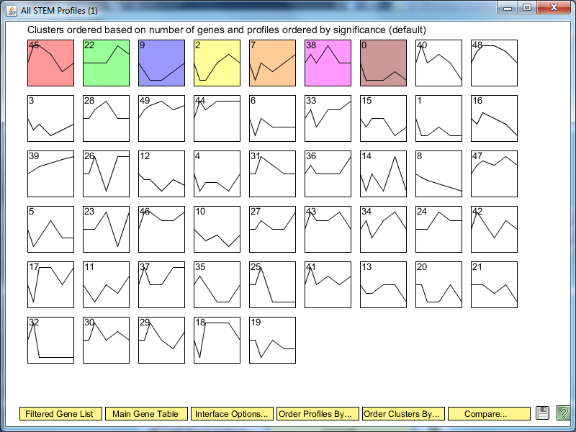
All STEM Profiles for dCIN5

Slide 6
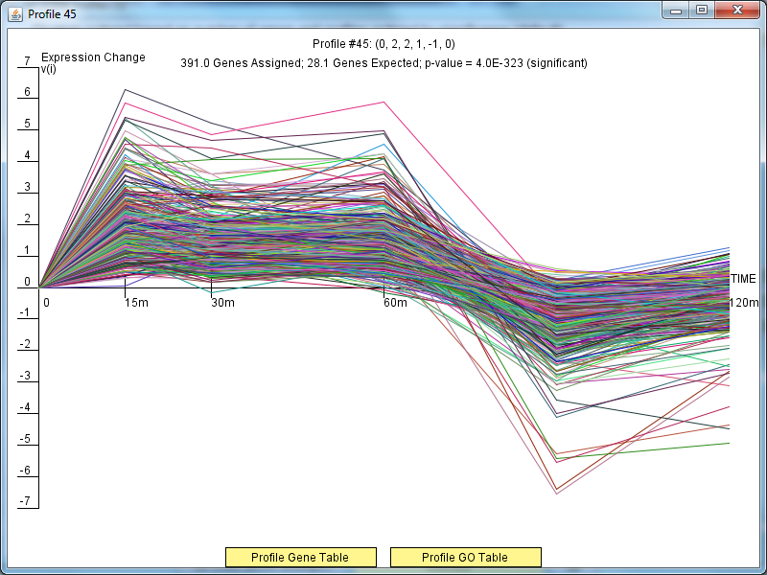
Profile #45 for dCIN5

Slide 7
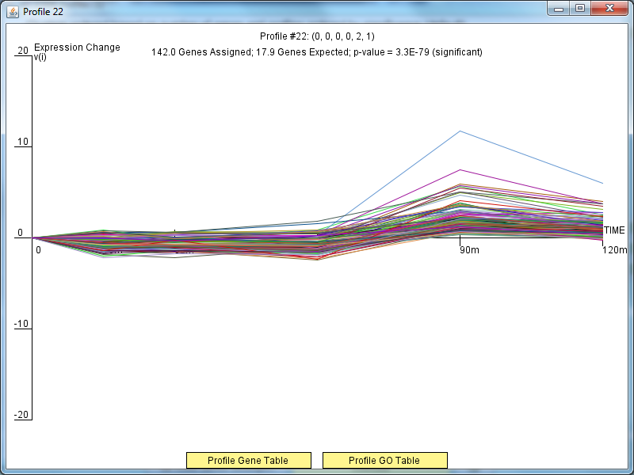
Profile #22 for dCIN5

Slide 8
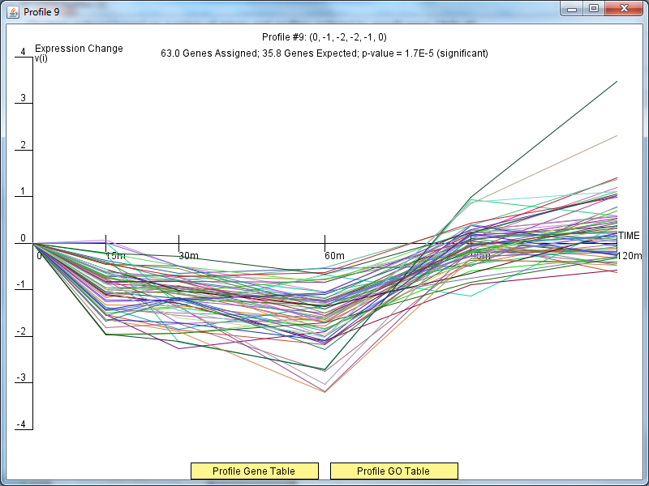
Profile #9 for dCIN5

Slide 9
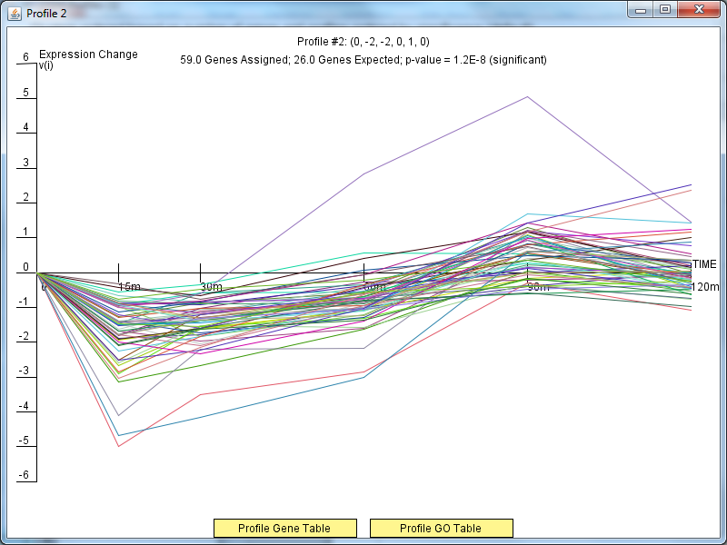
Profile #2 for dCIN5

Slide 10
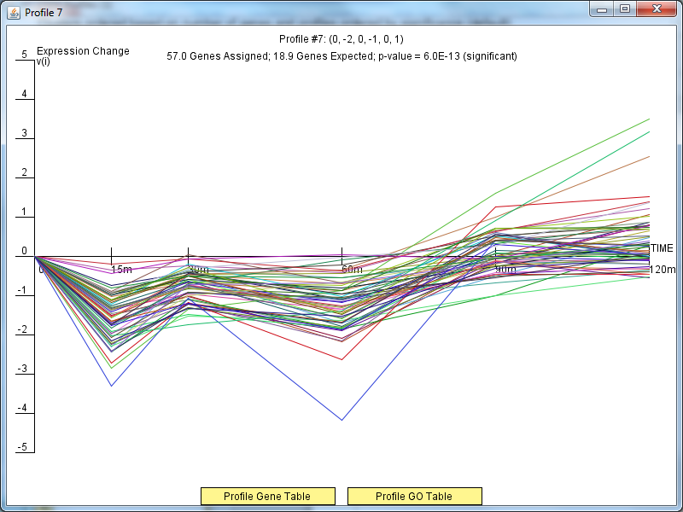
Profile #7 for dCIN5

Slide 11
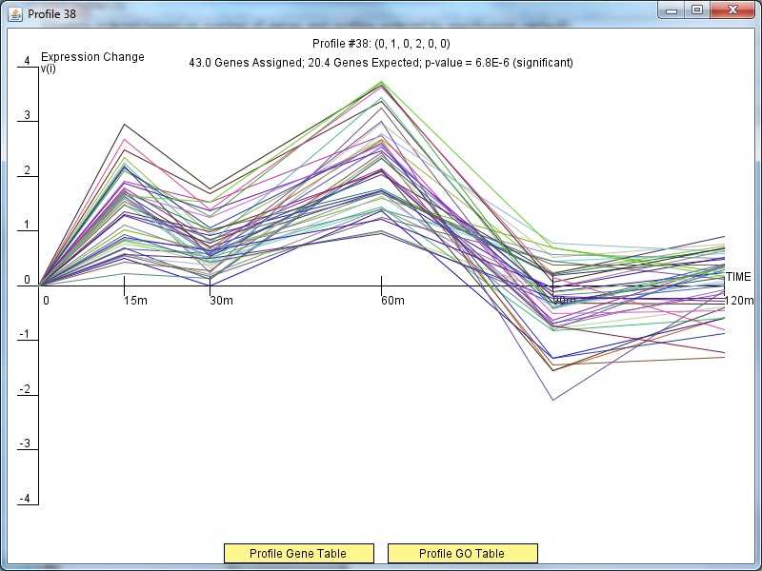
Profile #38 for dCIN5

Slide 12
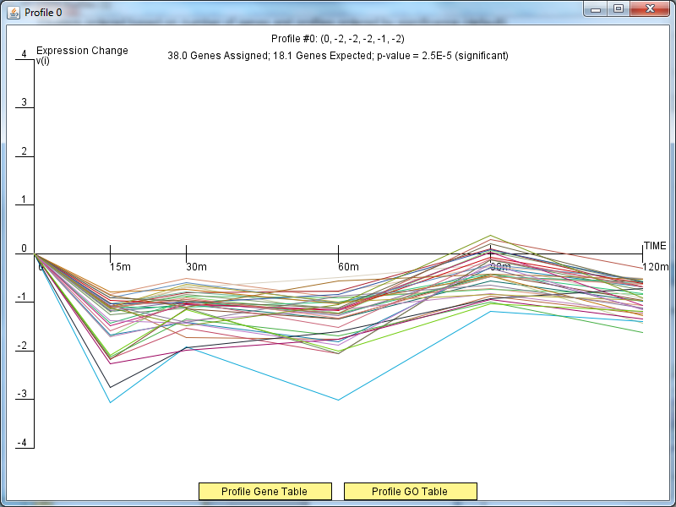
Profile #0 for dCIN5

