Slide 1
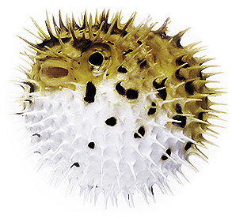
Tetrodotoxin Production in E.coli Using FLP Genes from Pufferfish
By:
Brett Fuller
Chase Meusel
Holly Tjaden

Slide 2
Goals
To Isolate tetrodotoxin genes (FLP) from the pufferfish.
Isolate an orange fluorescence gene from biobrick BBa_K152005.
Combine the FLP gene with the biobrick gene using the biobrick restriction sites.
Insert the combine FLP gene into a plasmid and replicate the gene-containing plasmid in E. coli.
Test whether the genes were successfully replicated by exposing the bacteria to UV radiation.

Slide 3
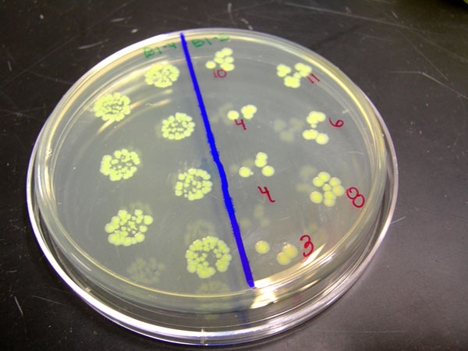
Back-up Plans
FLP is a conglomerate of three different FLP genes.
  If the larger of the three genes does not work, we can isolate the other two and test them as well.

Slide 4
Procedure
1. Obtain live puffer fish specimen and extract the total genomic DNA from fin tissue using a kit from Dr. Berendzen.
2. Design primers to amplify the three FLP genes identified as well as a gene for orange fluorescence to confirm that the FLP genes should be getting expressed. These primers should also contain the restriction site ends that are required for biobrick usage.
3. Amplify all three FLP genes using PCR from the total genomic DNA isolated from the puffer fish tissue.
4. Amplify the orange fluorescence gene (BBa_K152005) from the biobrick plasmid using the provided procedure.
5. Ligate the orange fluorescence gene and one or more of the FLP genes.
6. Ligate the combined genes into a plasmid and transfer the plasmid into the bacteria, E. coli.
7. Allow the bacteria to grow up and plate them on selective LB media with ampicillin.
8. Test bacterial colonies for fluorescence using UV radiation.
Notes:
2. FLP does not have accession numbers

Slide 5
Part and Sequence Details
Primer details:
  FLP1-F =
  E-X-ATTCGACACCCAGCAGGGAAG
  FLP1-R =
  CACGAGTATTTATTAGATCA-S-P
  FLP2,3-F =
  E-X-GGAAGATGGAGCGAGTGACT
  FLP2-R =
  ACGGTGCCATATCTGATAGG-S-P
  FLP3-R =
  GGGAGTCTTTAGTGTTTATT-S-P

Slide 6
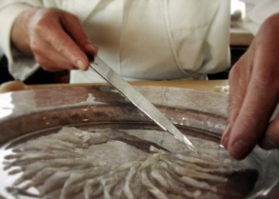
How will we test it?
In order to ensure that our plasmid is in the bacteria, we will plate it on media with ampicillin (or whatever the plasmid carries a resistance to).
If the bacteria grows, we will expose the bacteria to UV radiation. If it glows, we know that the plasmid is in the bacteria.
Or eat it?!
Puffer Fish Dining Video from National Geographic

