Slide 1
Cancer Metastasis: Building a framework
Gaorav P. Gupta and Joan Massague
Gabriella F. de Paz and Susana S. Hak
Fall 2011, 20.309

Slide 2
An Evolutionary Metaphor
Evolution = environmental stresses select for organisms with advantageous survival traits
Metastasis = cellular and micro-environmental stresses select for tumor cells with advantageous survival traits
Both situations require genetic heterogeneity:
evolution → meiosis
metastasis → genomic instability

Slide 3
Take-home:
Successful metastasis requires TCs to face and overcome a wide array of biological defenses put forth by the body.

Slide 4
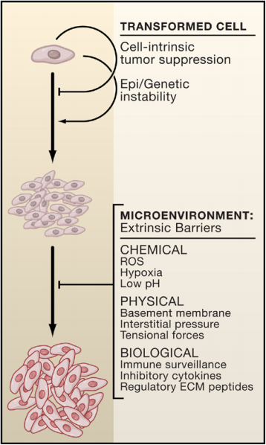
Notes:
genetic instability allows TCs to circumvent intrinsic anti-tumor signals
extrinsic signals are encounters at the BM an onward

Slide 5
Intrinsically Advantageous Molecular Mechanisms
altered cellular adhesions
loss of E-cadherin-mediated adhesions
deregulated cell motility
gain-of-function mutations in Rho family GTPases
resistance to extracellular death signals
ectopic overexpression of anti-apoptotic effectors (i.e. BCL2)
tumor-initiating capacity
overexpression of transcriptional repressor Bmi-1
Notes:
altered cellular adhesions - lack of responsiveness to surrounding cells allows for circumvention of apoptotic signals due to overcrowding (loss of E-cadherin-mediated adhesions via inactivating mutations or EMT)
deregulated cell motility - allows for cells to have increased mobility (caused by mutations in regulatory GTPases like Rho, cdc42, and Rac)
resistance to extracellular death signals - metastatic cells have to face additional death threats from microenvironment (i.e. hypoxia, changes in cell shape during invasion, exposure to novel stromal micro-environments can all trigger cell death) and survive - can do this via ectopic over expression of potent anti-apoptotic effectors (BCL2, XIAP, etc) or loss of expression of apoptotic initiators (caspase 8)
Tumor-initiating capacity: self-renewal (ability to differentiate into any type of cell present in tumor and thus re-initiate tumor in a different location)

Slide 6
Beyond the Basement Membrane
disruption of the basement membrane and ECM
deregulation of ECM proteases
co-option of stromal cells
gene expression signature of fibroblast activation in vitro indicates which cancers are more likely to metastasize
recruitment of immune response cells
tumor-associated macrophages secrete vasoactive factors and GFs
Notes:
disruption of the basement membrane and ECM - BM normally acts as a barrier to the invasion of transformed cells to underlying stroma, so cells that can disrupt this barrier can break through into circulation (achieved through deregulation of ECM proteases)
co-option of stromal cells by tumor cells have been implicated in increasing a cell's metastatic ability (basically getting a cell originally designed to maintain homeostasis to switch over to the dark side… muahaha) - lots of reviews focused on this, but here are main findings:
→ disrupting TFGß signaling between fibroblasts can induce carcinomas in certain organs in mice --> shows that interfering with tumor-suppressing crosstalk in stromal cells can potentially lead to metastatic advantages in non-stromal tumor cells
looking at gene expression signature of fibroblast activation in vitro gave indication of which cancers were more likely to metastasize
breast cancer associated fibroblasts make chemokine CXCL12, which augments the proliferation and migratory activity of tumor cells + facilitates angiogenesis
recruitment of immune response cells can also increase metastatic progression:
inflammatory cells from the immune system synthesize prostaglandins (pro-metastasis)
tumor-associated macrophages secrete copious amounts of vasoactive factors (VEGF, IL-8, etc) that potently induce angiogenesis and proteases that enhance their biological activity
macrophages also release GFs that facilitate survival, proliferation, and invasion during cancer progression (evidence: mice with defects in macrophage production seldom produce metastasizing carcinomas from aggressive mammary tumors)

Slide 7
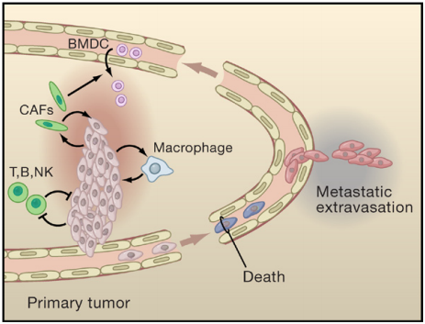
Notes:
CAFS = carcinoma associated fibroblasts – promote angiogenesis
T, B, NK = tumor-suppressive factors that are suppressed by cytokines released from tumor cells
Once in blood stream, many die due to stresses in next slide but those that survive implant in target tissue

Slide 8
Intravasation
Metastatic tumor cells → cancer-associated vasculature → lymph nodes → hematogenous circulation
Advantageous molecular mechanisms:
Twist: TF that promotes EMT + rate of hematogenous intravasation
Motility: motile tumor cells can freely move down natural chemoattractive gradient

Slide 9
Stresses Encountered in Transit
physical damage from hemodynamic shear forces
immune-mediated killing
anoikis (debatably)
Circumvention Mechanisms:
co-opt blood platelets
overexpression of BDNF-receptor trkB

Slide 10
Extravasation
Timing and method of escape into vasculature and target tissue varies:
tumor cells grow in intravascular space until lesion bursts through surrounding vasculature
tumor cells release ezrin as an anchoring mechanism (osteosarcoma)
tumor cells release signals that permeabilize vasculature (ex. VEGF)

Slide 11
Colonization
Two theories on target tissue selection:
path-based theory:
target tissue of CTC is determined by the TCs circulatory pattern and immediate need to adhere
surface interaction (honing) theory:
target tissue of CTC is determined by molecular interaction of ectopically expressed ligand-receptor pairings
research indicates latter theory holds more merit
Dormancy period:
some TCs lose proliferative ability upon entering target tissue
limiting factors vary among tumors
known as minimal residual disease (MRD)

Slide 12
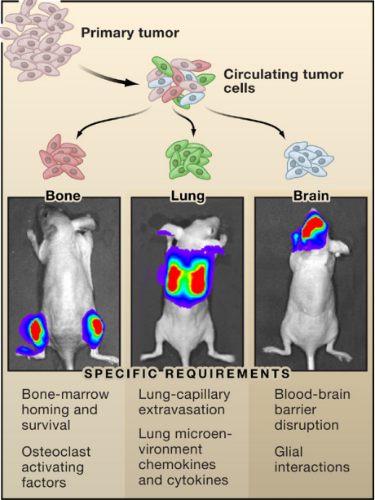

Slide 13
Site-Specific Colonization: Bone
Preservation of bone homeostasis
Osteoclasts Osteoblasts
Two types of cancer cells metastasize to bone
Breast cancer: hyperactivation of osteoclasts
Prostate cancer: stimulation of osteoblasts
Positive feedback loop
“The vicious cycle of osteolytic bone metastasis”
Bone-metastatic signature manifested in breast cancer

Slide 14
Site-Specific Colonization: Lungs
Common with metastatic diseases
Cardiac output circulates through lung-capillary network
Initiated through small pulmonary arterioles
Burst through or breach endothelial junctions and basement membrane
Growth factors in breast cancers implicated in lung metastasis
Same breast-cancer cell line associated to bone metastasis
Gene-expression signature enriched with mediators

Slide 15
Site-Specific Colonization: Brain
Less frequent and poor prognosis
Colonize brain parenchyma or thrive along the leptomeninges
Blood brain barrier (BBB) protects the central nervous system
Compromised in metastasis
Lack of reliable experimental models
Notes:
Leptomeninges = refers to 2 of the membranes surround the brain and spinal core
BBB = composed of tightly adjoined endothelial cells that are lined by basal lamina and astrocyte foot processes → barrier is so restrictive that even serum proteins are excluded unless actively shuttled

Slide 16
Site-Specific Colonization: Liver
Densely vascularized tissue
Vessels highly porous for circulating cells and nutrients
Rate-limited step for metastasis
Invasion in hepatic parenchyma
Avoidance of cell death from immune cells
Hepsin proteases promote liver metastasis of prostate cancer

Slide 17
Seeding and Reseeding
Genes promoting metastasis coexpressed within subset of primary tumors
Selectable growth advantage
Metastatic cells may travel back to point of origin
Intrinsic colonizing function → constantly reseeding primary tumor
Linked with large tumor size, rapid growth rate, and metastatic behavior

Slide 18
Impact of the Cell of Origin
Certain cell lineages express small molecules that bias metastatic efficiency to different target organs
Development history of cell can cause activation of specific metastasis-promoting mechanisms
Impact of developmental predisposition → transformation occurs at different stages within same lineage
Organism level predisposition → cell is mutated but is phenotypically silent

Slide 19
Overview
Metastasis, a somatic evolution from cancerous cells
Heterogeneity allows selection for advantageous traits → overcome environmental defenses
Understanding metastasis as a series of mechanistic actions with associated markers and potentials can lead to new avenues for clinical metastasis therapies

Slide 20
Supplemental Slides

Slide 21
Co-option of Stromal Cells
co-option of stromal cells by tumor cells have been implicated in increasing a cell's metastatic ability:
disrupting TFGß signaling between fibroblasts can induce carcinomas in certain organs in mice: shows that interfering with tumor-suppressing crosstalk in stromal cells can potentially lead to metastatic advantages in non-stromal tumor cells
looking at gene expression signature of fibroblast activation in vitro gave indication of which cancers were more likely to metastasize
breast cancer associated fibroblasts make chemokine CXCL12, which augments the proliferation and migratory activity of tumor cells + facilitates angiogenesis

Slide 22
Recruitment of Immune Response Cells
inflammatory cells from the immune system synthesize prostaglandins (pro-metastasis)
tumor-associated macrophages secrete copious amounts of vasoactive factors (VEGF, IL-8, etc) that potently induce angiogenesis and proteases that enhance their biological activity
macrophages also release GFs that facilitate survival, proliferation, and invasion during cancer progression (evidence: mice with defects in macrophage production seldom produce metastasizing carcinomas from aggressive mammary tumors)

Slide 23
Homing Examples
Homing of disseminated tumor cells to a secondary organ may be a result of rapid lodging into capillaries (i.e. cell not wanting to be un-adhered for too long) but recent studies propose that it's more specific than that:
could be an adhesive interaction between cell-surface receptors expressed on malignant cells (integrins) and their cognate ligands expressed on various target sites (adhesive proteins) in target site for metastasis (ex: a3ß1----> laminin-5 on exposed basement membrane in lung metastasis)
could also be interaction between ectopically expressed chemokines and their receptors (ex: in breast cancer cells, CXCR4 directed metastasis to CXCL12-rich tissues like lungs).

Slide 24
Confirmations of Extravasation Examples
cytoskeletal anchoring protein ezrin aids extravasation in osteosarcoma cells (inhibiting ezrin's expressions in these cells incited higher rates of cancer cell death prior to successful escape into lung parenchyma)
certain signals emanating from metastatic cells induce vascular permeability + make it easier for tumor cells to invade (VEGF has been shown to do this - activates Src family kinases in endothelial cell junctions and causes disruptions - proven by experiment that saw Src knockout mice protected from VEGF-secreting cancer cell metastasis)

Slide 25
Generating a Viable Niche
mobilization of hematopoietic progenitors from the bone marrow via circulation and into target sites for metastatic colonization
regulated/released in response to hormonal factors emitted by the primary TCs
hematopoietic cells found to express VEGFR1, CD133, CD34, and c-kit in target tissue
“Targeted inhibition of VEGFR1-expressing progenitors using neutralizing antibodies suggested that this preconditioning was necessary for metastatic progression.”
“A subcutaneously inoculated lung carcinoma that induced these bone marrow-derived progenitors to congregate only in the lungs also metastasized only to that site, whereas a melanoma that recruited these progenitors to multiple organ sites exhibited a widespread metastatic tropism.”

