Slide 1
GenMAPP 2
Margie Doyle and Andrew Forney
Loyola Marymount University
10/19/10

Slide 2
Goal and Outline
Goal: To familiarize the audience with the uses and nuances of GenMAPP 2
Background and main application of GenMAPP 2
Application structure and composition
Improvements of GenMAPP 2 over predecessor
Future directions of GenMAPP 2

Slide 3
GenMAPP Responds to Biologists’ Needs
Developing need of biologists to visualize and analyze complex genomics
Bridge gap between data and respective biological processes
Pathway-oriented data examination
GenMAPP 2’s Main Result: Visually rich, easy to use application for genomic analysis and data sharing

Slide 4
GenMAPP’s File Structure is Specialized
Programmed in Visual Basic 6.0
Three primary file categories
Experimental data (.gex)
Gene databases (.gdb)
Pathways (.mapp)
Data sharing enabled by “Data Acquisition Tool” within GenMAPP

Slide 5
Improvements Focus on Analysis and Sharing
New database organization better connects user data to existing archives
New visualization tools to enable simultaneous viewing of multiple datasets
New export capabilities for ease of sharing information and data

Slide 6
Homology MAPPs Provide a Basis for Analysis
Various species can be mapped using preexisting human pathway data (Figure 1)
There are limitations to the conversion process for certain species (Figure 2, Table 1)

Slide 7
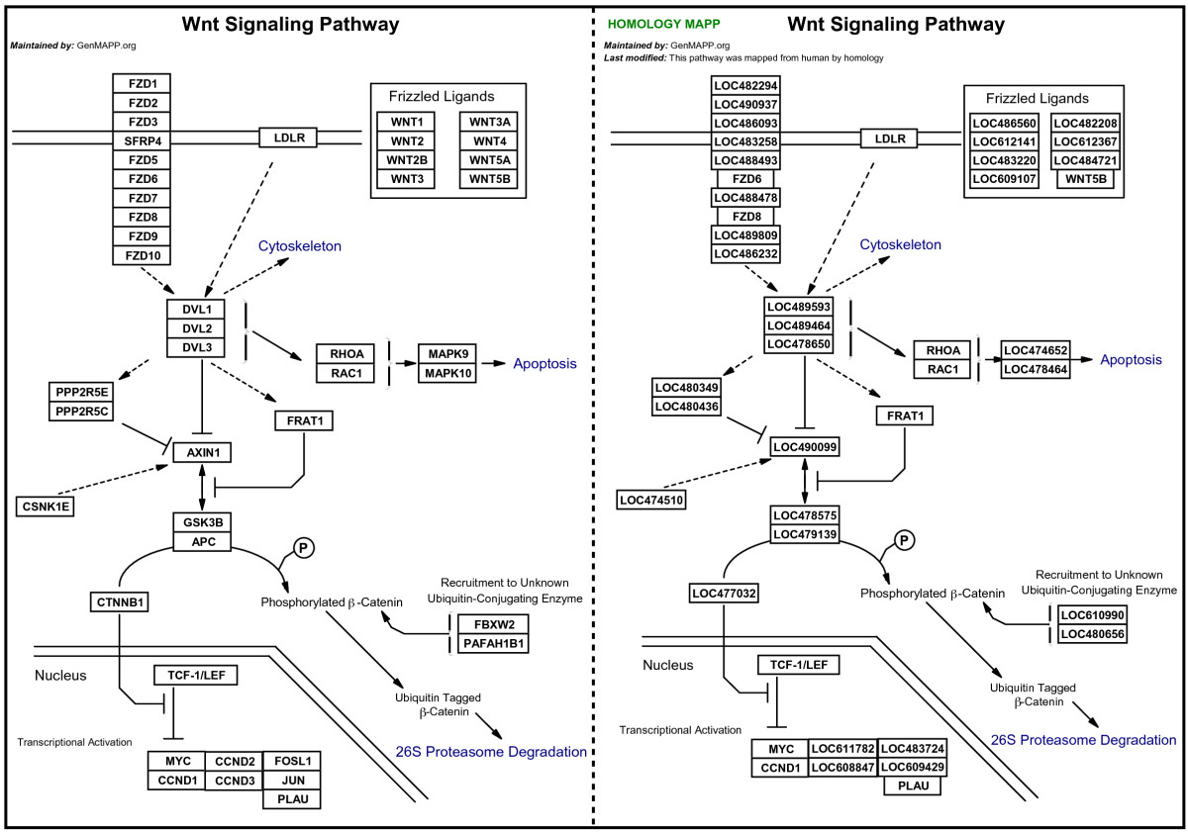
Figure 1

Slide 8
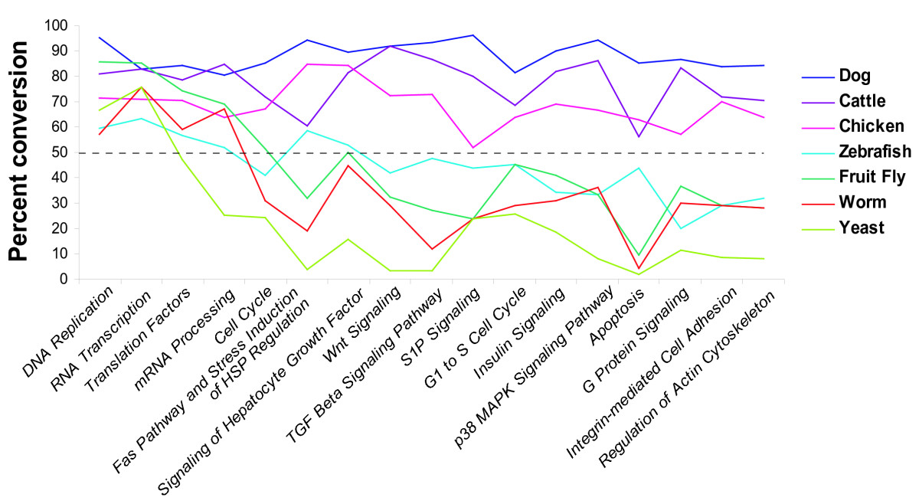
Figure 2

Slide 9
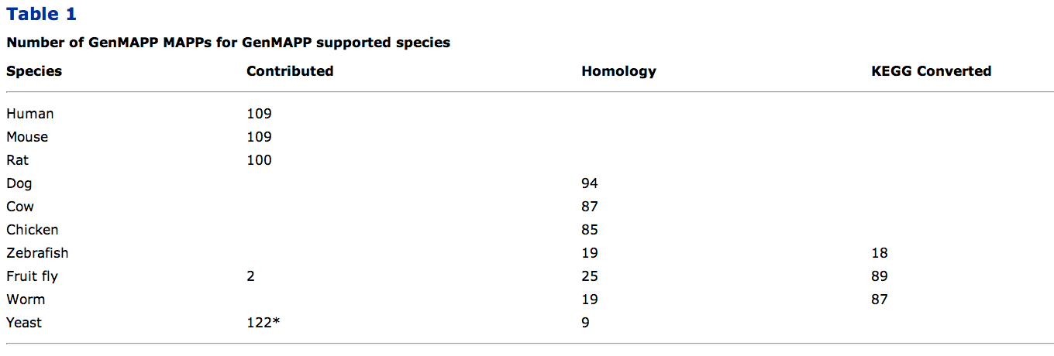

Slide 10
Inter-Database Pathway Extension Improves Content
Because of overlap with many databases (like Gene Ontology), extraction can expand GenMAPP records (Figure 3)
Possible extraction can be for coexpression or transcriptional regulation as well (Figure 4)

Slide 11
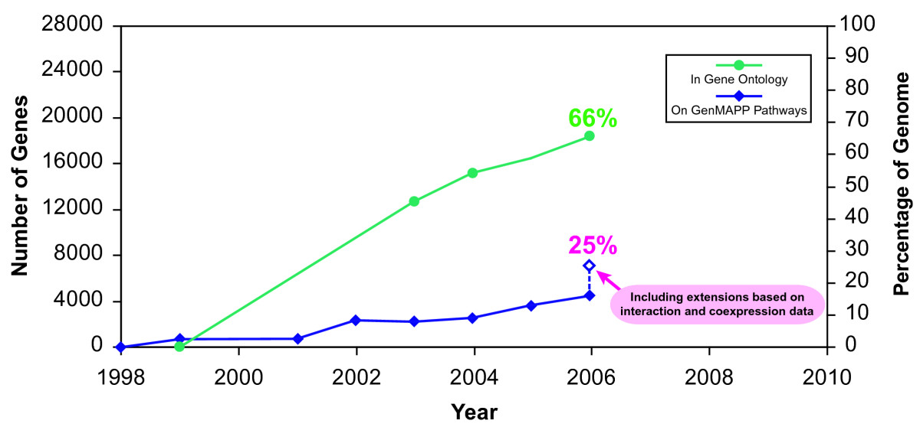
Figure 3

Slide 12
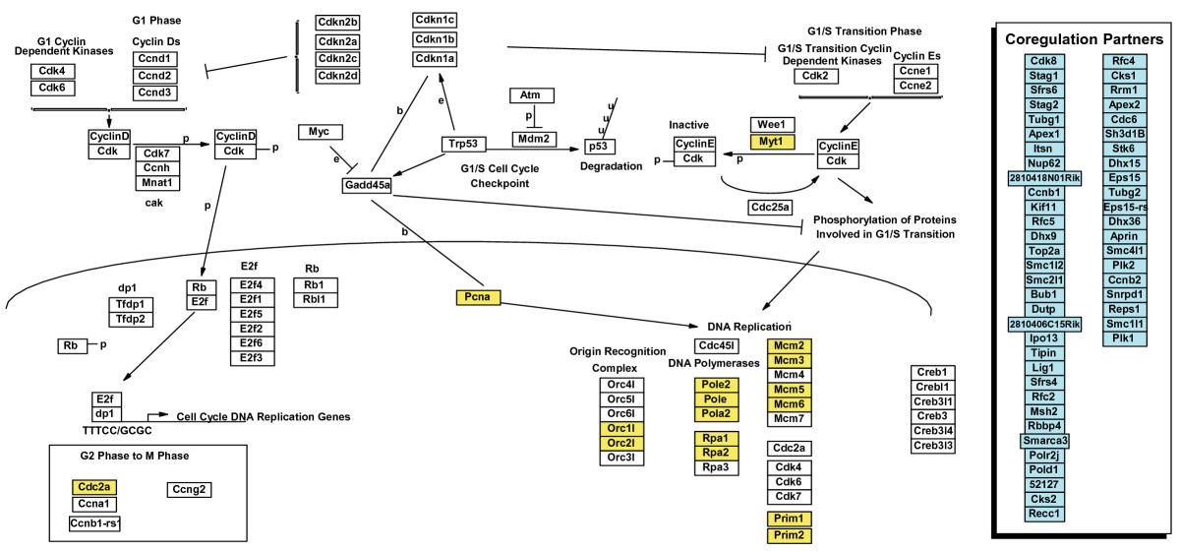
Figure 4

Slide 13
Improved Visualization of Data Allows for Clearer Analysis
GenMAPP 2 allows for clear analysis of multiple time-point comparisons, even simultaneously (Figure 5)
New feature to view multiple data types as a cohesive view all in one window (Figure 6)

Slide 14
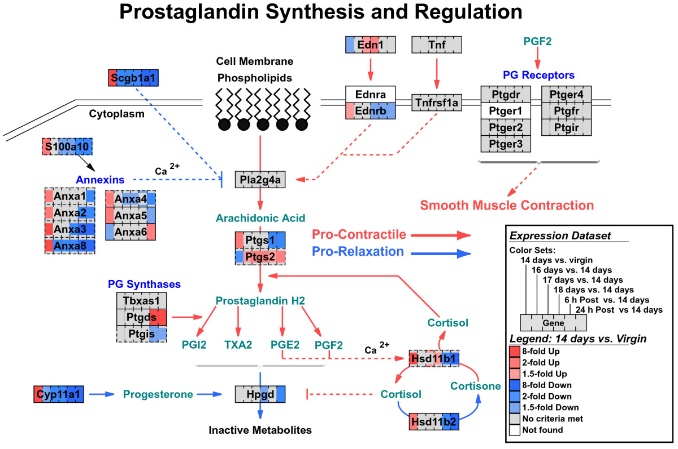
Figure 5

Slide 15
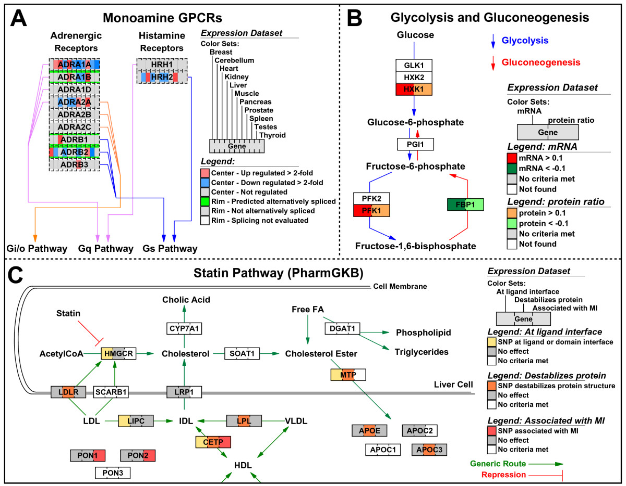
Figure 6

Slide 16
Future Directions of GenMAPP Reach for Efficiency / Expansion
Obstacle: Windows only
Solution: Java-based implementation
Obstacle: Genetic feature representation
Solution: Dynamic organization of records
Obstacle: More efficient pathway vocabularies
Solution: Better analysis methods / tools

Slide 17
GenMAPP 2 connects and serves the community of biologists with powerful tools to visually interpret and juxtapose complex genetic information

Slide 18
References
Salomonis N, Hanspers K, Zambon AC, Vranizan K, Lawlor SC, Dahlquist KD, Doniger SW, Stuart J, Conklin BR, and Pico AR. GenMAPP 2: new features and resources for pathway analysis. BMC Bioinformatics 2007 Jun 24; 8 217. doi:10.1186/1471-2105-8-217 pmid:17588266.

