Slide 1
Visualizing the Mechanical Activation of Src
Yingxiao Wang, Elliot L. Botvinick, Yihua Zhao, Michael W. Berns, Shunichi Usami, Roger Y. Tsien & Shu Chien
Presented by Tina Stutzman
Dec. 13, 2011

Slide 2
Background: Effect of Mechanical Stimuli
Cytoskeleton
Mechanical
Stimuli
Integrins
SH3
Src
Mechanical stimuli activate integrins
Integrins activate Src kinase activity
Src regulates integrin/cytoskeleton interactions
Notes:
Overall: Src is very active in cell growth and motility. Mechanical stimuli activate integrins, which associate with the SH3 domain on Src and activate its kinase activity. Then, Src mediates the integrin/cytoskeleton interactions and causes cell motility by triggering the dissolution of actin stress fibers.

Slide 3
Experimental Overview
Motivation
Mechanical stimuli influence critical cell functions yet little is known about the mechanism of mechanotransduction
This method allows imagining and quantification of spacio-temporal Src activation
Develop a FRET reporter specific for Src activation
Use optical tweezers to create mechanical stimuli on beads coated with fibronectin
Measure Src activation through entire cell through fluorescence microscopy
Notes:
Why would we want to study Src activation? Well little is known about the specifics of mechanotransduction, and mechanical stimuli are very critical on cell functions like growth and division. We would like to learn more about mechanotransduction because when it goes wrong and cell stop responding to mechanical signals from the environment as expected, this is a marker of cancer. So the method to study mechanotransduction using Src activation is useful because it gives us a visual and quantifiable way to measure src activation on a spacio-temporal level.
The overview of how this experiment was accomplished began with developing a FRET based reporter specific for Src activation. Next, optical tweezers were used to create mechanical stimuli on beads coated with fibronectin. Finally, the Src activation was measured through fluorescence microscopy over the whole cell at many time points to get a good idea of how src activation spreads in space and in time.
So the first step was to develop a reporter.

Slide 4
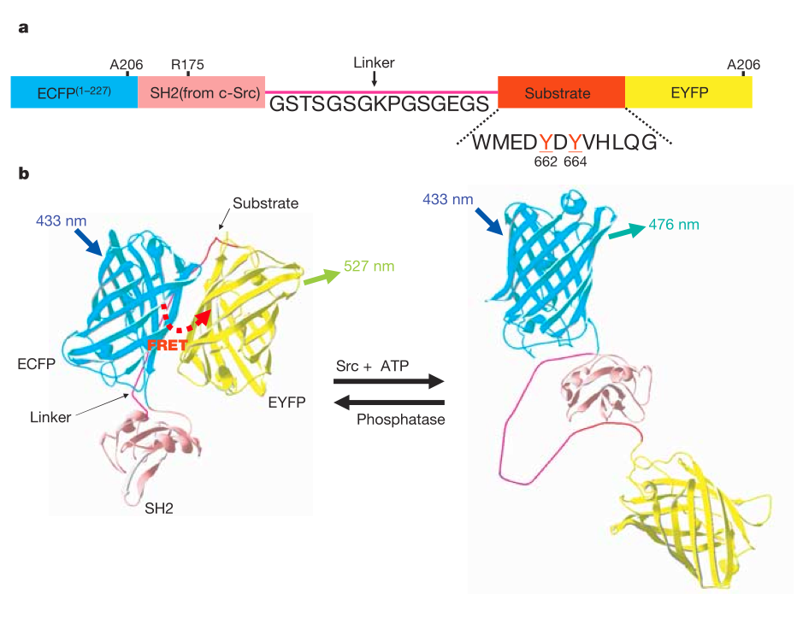
Src Activation Reporter Design
Src-induced phosphorylation of the substrate allows it to bind to the SH2 phosphopeptide binding pocket
Src activation causes a loss of FRET
A206K mutation to create monomeric reporter
Mutation of Y662/664F prevented phosphorylation and FRET loss
Notes:
The reporter is made from a cyan fluorescence protein domain, SH2 domain with a phosphopeptide binding pocket, a linker region, a substrate to be phosphorylated by src, and finally a yellow fluorescence protein. While the substrate remains unphosphorylated, the two fluorescent domains are close together and FRET occurs as seen in the left hand picture. However, when the substrate is phosphorylated by src, it binds to the SH2 domain shown by the arrow and this disrupts the FRET as you can see in the right side of the protein depiction. To make the reporter better, they made an analine 206 lysine mutation in the CFP to stop reporter dimerization. And to check to make sure there mechanism was correct, they made tyrosine 662/664 phenoalanine mutations and saw that these mutations prevented phosphorylation and loss of FRET. The next step was to test their reporter to make sure src activation is measurable and specific.
A = alanine
K = lysine
Y = tyrosine
F = phenoalanine

Slide 5
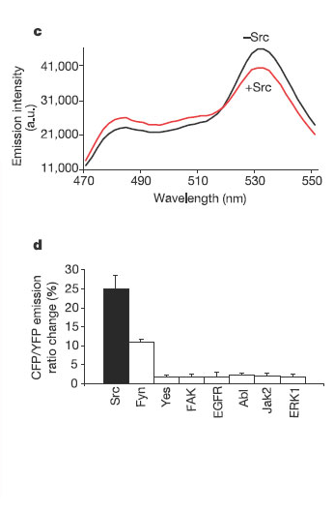
Reporter shows change in emission intensity and Src specificity
Emission spectra changes after Src activation
CFP/YFP ratio change after kinase activation shows high Src specificity
Notes:
The top graph shows the emission spectra change after src activation. There is a change is FRET that is measurable by the CFP/YFP ratio that can be analyzed in MATLAB on a pixel by pixel basis.
The bottom graph tests for specificity and shows that the reporter has the largest CFP/YFP ratio response with Src activation, but also changes slightly from Fyn kinase activation. The authors reasoned that since src still induced the largest response, the reporter would work for analysis given we were trying to measure an event with mainly src activation.

Slide 6
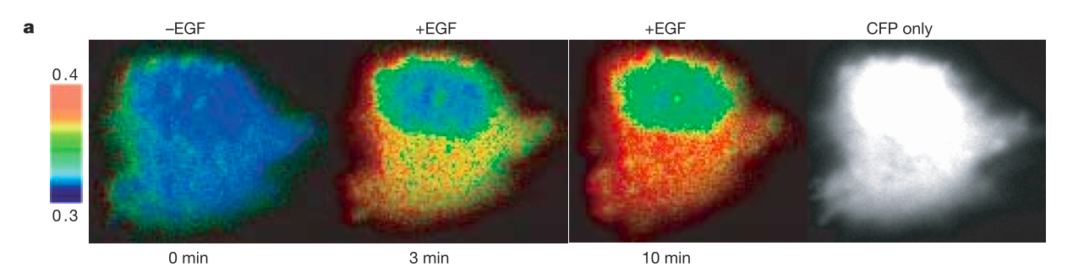
Src activated by EGF in HeLa cells
The CFP/YFP emission ratio changes in response to epidermal growth factor (EGF) treatment – a known activator of Src
Notes:
They tested to see if the reporter worked by treated cells with a known src activator called epidermal growth factor.. This activated src as shown in the pictures by reducing FRET as measured by the change in the CFP/YFP ratios. Without EGF on the left the cell was a dark blue color, but after EGF treatment, the ratios shifted and continued to shift after 3 and 10 minutes.
Now that the reporter was up and working, it was time to test the effects of mechanical stimuli on src activation. The first experiment was to introduce a bead to the cell.

Slide 7
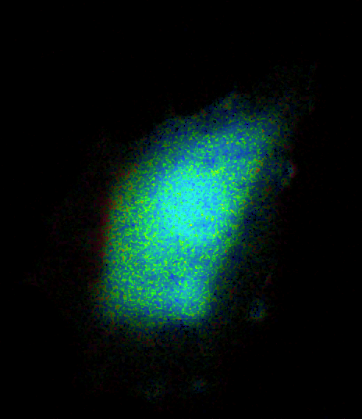
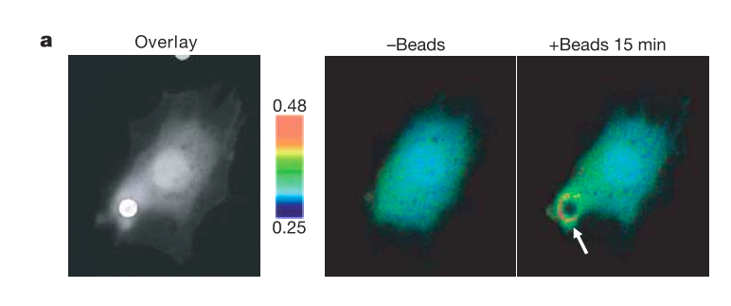
Fibronectin coated beads activate Src shown by local FRET response in HUVEC cells
Src is activated by integrin clustering
Small concentration of reporter near membrane so reporter is localized to lamellipodia with a fusion of the 16 N-terminal residues from Lyn kinase
Notes:
Fibronectin coated beads were applied to Human Umbillical Vein Endothelial cells and src activation was observed in the immediate where the bead was applied even without force on the bead. This is consistent with the theory that src can be activated locally by integrin clustering.
One thing the researchers noticed was that there needed to be a large concentration of reporter near the thin lamellipodia protrusion membranes in order to show activation on the edges. They modified the reporter by fusing the 16 N terminal residues from Lyn kinase and used the localized reporter in the remainder of the study.
The next area to study was the activation of src after mechanical stimuli was applied to the bead.

Slide 8
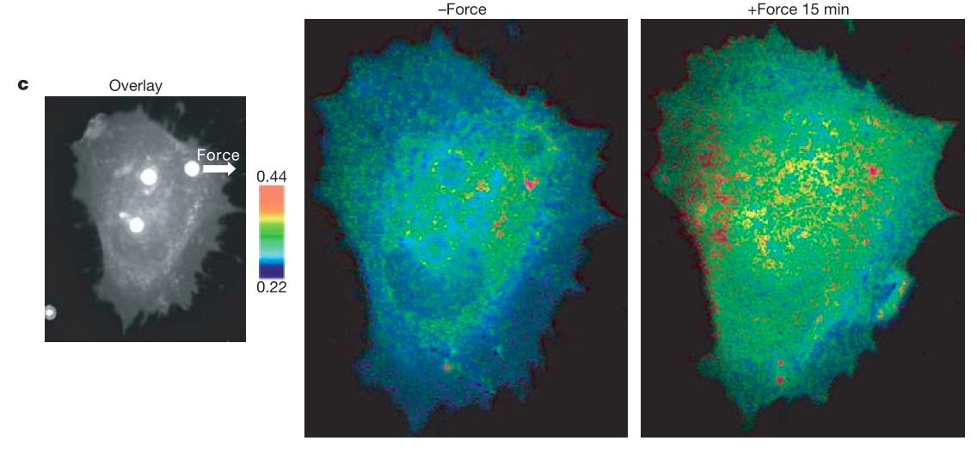
Laser-tweezer traction on upper right bead causes distal Src activation
Notes:
Laser tweezers were used to apply a force to the beads, in this case putting 300 pN on the upper right bead shown in the bright field overlay image. This caused distal Src activation as clearly seen by the red and yellow areas on the side of the cell opposite the direction the force was applied. We would also like to know how this activation occurred in time.

Slide 9
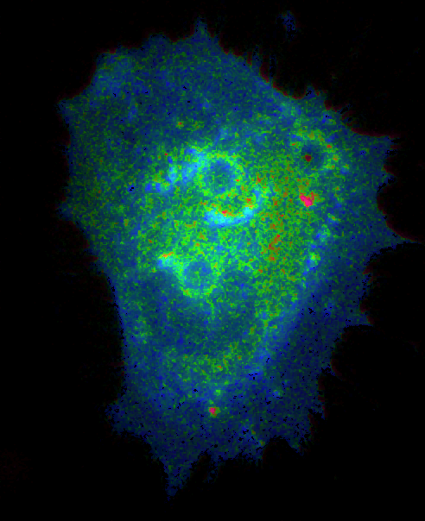
Notes:
This movie shows:
Immediate src activation at the distal cell membrane
Wave-like propagation of src
We can also see lamellipodia protrusions

Slide 10
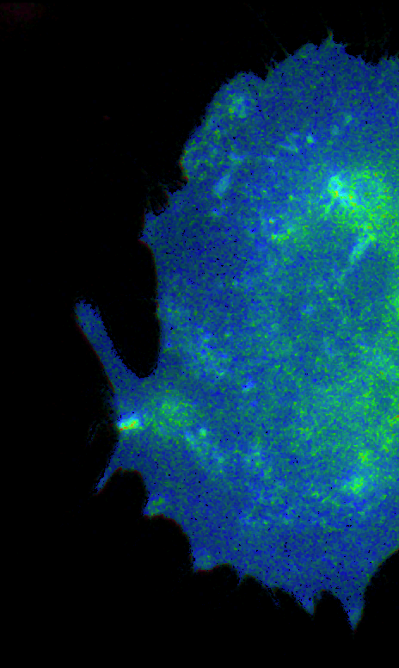
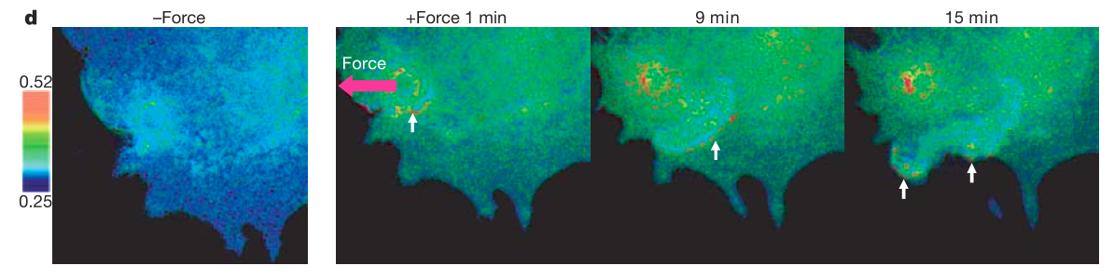
Wave propagation of Src activation by laser-tweezer force
Notes:
The same experiment was performed and these images and videos clearly show the wave propagation of src activation that start at the activation site and spread out until they reach the membrane and cause protrusions.
Next the researchers asked how important the cytoskeleton is in src activation.

Slide 11
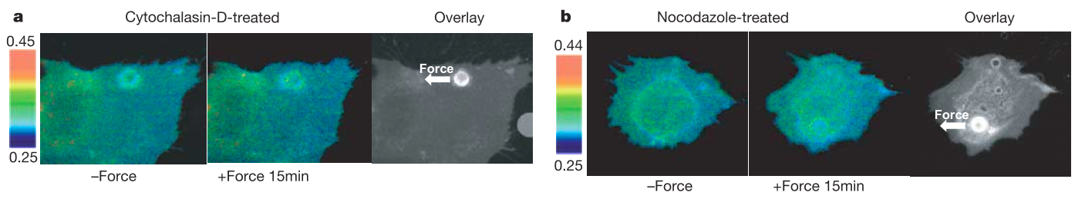
Inhibition of Microfilaments and Microtubules
Actin filaments and microtubules are necessary for long-range activation but not short range
Notes:
To test how important the cytoskeleton is, they blocked microfilament polymerization with cytochalasin D and blocked microtubules with nocodazole and then performed the same laser tweeer experiment. What they saw was that there was still local src activation, perhaps from integrin clustering, but there was not distal src activation or wave propagation. They concluded that actin filaments and micotubules are necessary for long-range activation but not for short range.

Slide 12
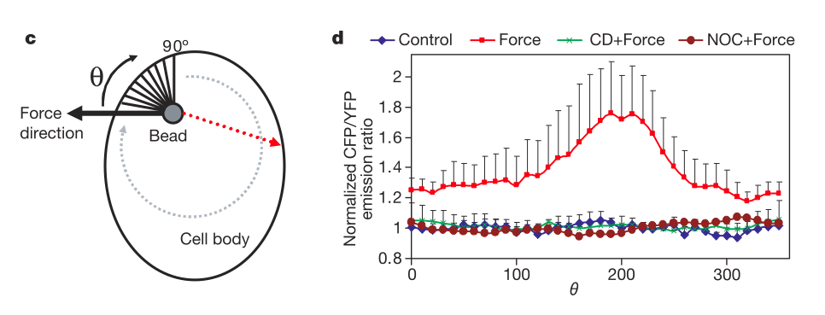
Src Direction of Activation
Inhibit Microtubule polymerization:
nocodazole
Inhibit Actin Polymerization:cytochalasin D
Notes:
The way they analyzed this was through looking at the CFP/YPF ratios in each pixel after the force was applied. They found a large change in the ratio about 200 degrees from the direction the initial force was applied. Also, this was not shown when either micofilament or microtubule polymerization were blocked indicating their implication in src activation.

Slide 13
Possible mechanism of wave propagation
Proposed meachanism:
Local src activation stimulates actin polymerization and ruffle extension
The tip of the extending actin recruits and activates src again
Src stimulates actin-ruffle extension
Directionality
Initial tension in directions opposite initial force
Quickly transmitted through cytoskeletal network to distal locations

Slide 14
Summary – Key Results
FRET reporter of Src activation from mechanical stimuli shows:
Immediate distal Src activation
Slower, wave-propagation of activation with speed 18.1 +/- 1.7 nm s⁻¹
Lamellipodia protrusions appear at cell periphery
Cytoskeleton necessary for long range activation

