Slide 1
Examining the Genetic Similarity and Difference of the Three Progressor Groups at the First and Middle Visits
Nicole Anguiano
BIOL398: Bioinformatics Laboratory
Loyola Marymount University
10/01/14

Slide 2
Talk Outline
Background information on HIV and how it led to the development of the question and hypothesis.
Examination of each progressor group with itself at the first visit and middle (~2 year) visit.
Examination of the comparison between progressor groups at the first visit and the middle (~2 year) visit.
An analysis of the results and the conclusions that can be drawn from them.

Slide 3
Talk Outline
Background information on HIV and how it led to the development of the question and hypothesis.
Examination of each progressor group with itself at the first visit and middle (~2 year) visit.
Examination of the comparison between progressor groups at the first visit and the middle (~2 year) visit.
An analysis of the results and the conclusions that can be drawn from them.

Slide 4
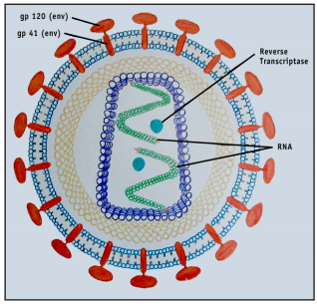
What is HIV?
HIV is a retrovirus spread through sexual contact or intravenous drug use.
It infects the immune system, targeting T cells that express the surface protein CD4.
Its high mutation and replication rate allow it to quickly adapt to the host immune system.
The env protein is a particularly active area for mutations.
An HIV infected person whose CD4 T cell count falls below 200 is diagnosed with AIDS.

Slide 5
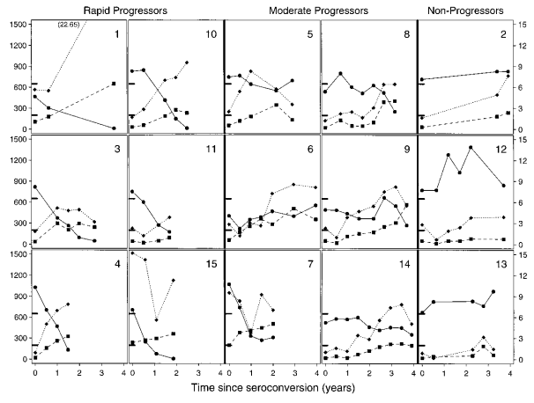
Describing the Three Progressor Groups
In Markham et al’s paper, those infected with HIV were placed into three broad categories:
Rapid progressors
Moderate progressors
Nonprogressors
There seemed to be no initial indication of whether one person would end up in one progressor group or another.

Slide 6
Motivation Behind the Question and Hypothesis
Why study progressor groups?
Figuring out what makes one person more likely to be relatively unaffected by the infection (a nonprogressor) could be the breakthrough needed to finding a functional cure for all patients.
Secondly, knowing what makes one person more predisposed to AIDS than another could lead to more effective treatments at an individual level.
Markham et all did not compare across groups to see what was similar or different between them.

Slide 7
Statement of the Question and Hypothesis
The question:
Are clones from subjects in the same group the most similar, or are they as dissimilar as clones from other groups?
Does the amount of variation and similarity, if any, change from the time of the first visit to a visit after about 2 years of infection with the virus?
The hypothesis:
The clones will be most similar to clones within its own group, and the groups will differentiate at a rate dependent on their group’s progressor level.

Slide 8
Talk Outline
Background information on HIV and how it led to the development of the question and hypothesis
Examination of each progressor group with itself at the first visit and middle (~2 year) visit
Examination of the comparison between progressor groups at the first visit and the middle (~2 year) visit
An analysis of the results and the conclusions that can be drawn from them

Slide 9
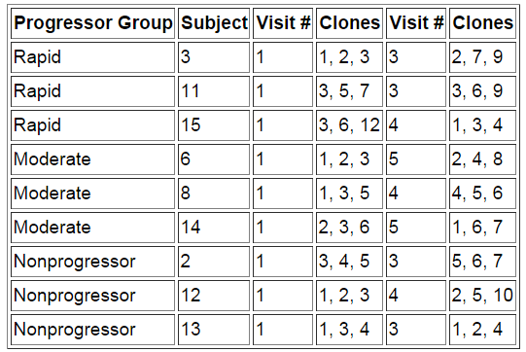
How the Subjects, Visits, and Clones were Chosen
Subjects were chosen due to progressor group (3 per group) and closeness of a visit to the 2 year mark. The first and middle visits were chosen. Clones were selected at random.

Slide 10
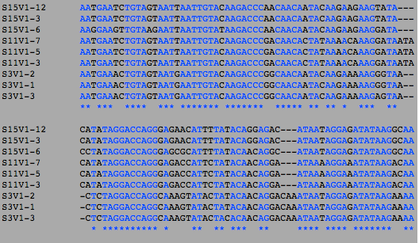
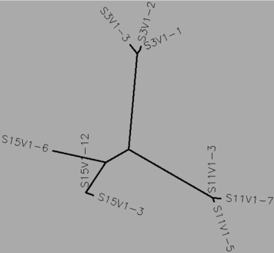

Comparing Each Progressor Group with Itself
ClustalW and ClustalDist were run on each group, first on the first visit and then on the middle (~2 year) visit.
Sequence analysis were used to find the S value on individual groups.
Trees were examined for similarity.
The clustal distance matrix was used to find the minimum and maximum differences.

Slide 11
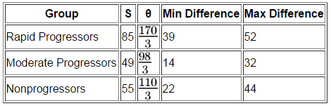
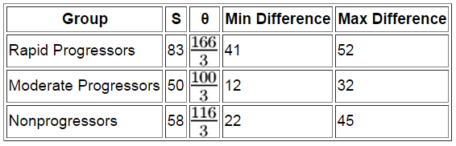
Quantifying the Differences within Progressor Groups
First Visit
Middle Visit
The minimum and maximum values in the clustal distance matrix were multiplied by 291 in the rapid progressors, by 288 in the moderate progressors, and by 285 in the nonprogressors to obtain the minimum and maximum difference.
The nonprogressors had a greater number of differences on average than the moderate progressors on both the first visit and the 2 year visit. The rapid progressors were consistently highest.

Slide 12
Talk Outline
Background information on HIV and how it led to the development of the question and hypothesis
Examination of each progressor group with itself at the first visit and middle (~2 year) visit
Examination of the comparison between progressor groups at the first visit and the middle (~2 year) visit
An analysis of the results and the conclusions that can be drawn from them

Slide 13
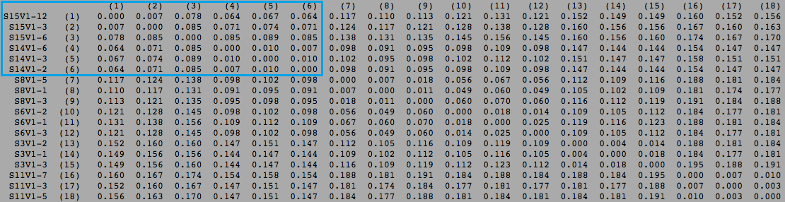
Comparing Between Progressor Groups
ClustalW and ClustalDist were run on a pairwise comparison between groups.
The clustal distance matrix was used to calculate the minimum and maximum differences.
The prediction was that it would be higher than in the individual groups on both maximum and minimum differences.

Slide 14
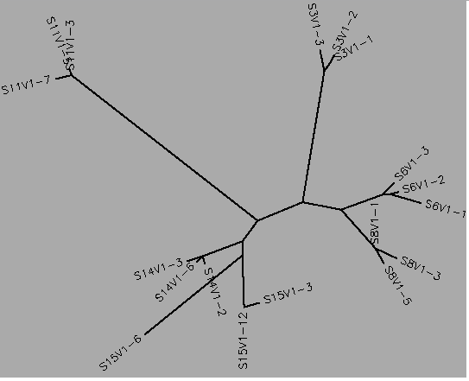
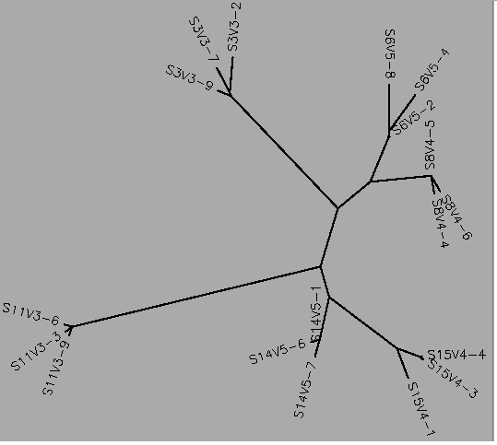
The Case of Subjects 14 and 15
Subject 15 (Rapid progressor) was consistently more similar to subject 14 than any other rapid progressor.

Slide 15
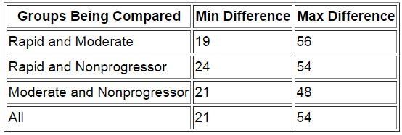
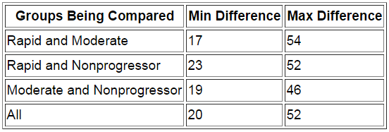
Quantifying the Differences within Progressor Groups
First Visit
Middle Visit
Both the rapid and nonprogressor groups, and rapid and moderate progressor groups were multiplied by 291 to obtain the min/max difference. The moderate and nonprogressor group was multiplied by 288.
The minimum difference when comparing the rapid progressors to any other group was significantly lower than just within the progressor group.
The minimum difference was consistently higher when comparing the moderate progressors with any other group.

Slide 16
Talk Outline
Background information on HIV and how it led to the development of the question and hypothesis
Examination of each progressor group with itself at the first visit and middle (~2 year) visit
Examination of the comparison between progressor groups at the first visit and the middle (~2 year) visit
An analysis of the results and the conclusions that can be drawn from them

Slide 17
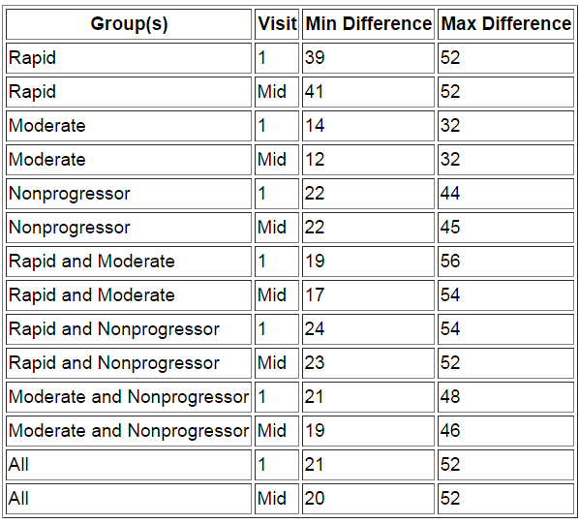
Comparing all the Data Reveals the Similarity and Difference Between Groups
Each group was relatively similar between each visit, and the comparisons remained relatively consistent.

Slide 18
How the Data Reflects the Hypothesis and Question
The question:
Are clones from subjects in the same group the most similar, or are they as dissimilar as clones from other groups?
Rapid progressors were always more similar to other groups than their own group.
Each group was more different from the other groups than its own.
Does the amount of variation and similarity, if any, change from the time of the first visit to a visit after about 2 years of infection with the virus?
The amount of similarity and difference between and within each group tends to remain about the same.
The hypothesis:
The clones will be most similar to clones within its own group, and the groups will differentiate at a rate dependent on their group’s progressor level.
In the case of the moderate and nonprogressors, the clones were more similar to their own group, but otherwise the hypothesis was disproven.

Slide 19
Did outside research yield any new insight?
Generally, no.
Most research focuses specifically on the evolution of the env gene, not on the various progressor groups.
Research on the progressor groups tends to only compare within groups, not across them.
Markham, et al: Diversity and divergence increase in rapid and moderate progressors.
Yet from the data calculated here, it seems that they tend to diversify and diverge in ways that prevented them from being too different or similar to each other as the years passed.

Slide 20
What further study could be done?
From here, the conducting of a larger study to obtain more subjects of different groups and comparing them would be the most effective way to prove or disprove the hypothesis.
Obtaining reliable data with such a small sample size is very difficult.
Repeating this same experiment with more clones from each subject would be ideal.
Comparing all clones from all subjects would be difficult due to the difference between number of rapid/moderate progressors and nonprogressors.

Slide 21
Talk Summary
Comparing between progressor groups could provide insight into the treatment of HIV.
The moderate and nonprogressors were similar to themselves, but the rapid progressors had a higher minimum and maximum difference than the other two.
With the exception of the rapid progressors, each group was more similar with its own clones than with the clones of another group, and the groups slightly increased in similarity with each other between visits.
Further study would be needed to see if there is a trend in similarity or difference between progressor groups.

Slide 22
References
Markham, R.B., Wang, W.C., Weisstein, A.E., Wang, Z., Munoz, A., Templeton, A., Margolick, J., Vlahov, D., Quinn, T., Farzadegan, H., & Yu, X.F. (1998). Patterns of HIV-1 evolution in individuals with differing rates of CD4 T cell decline.Proc Natl Acad Sci U S A. 95, 12568-12573. doi: 10.1073/pnas.95.21.12568
Exploring HIV Evolution Handout
The Bedrock HIV Problem Space (http://bioquest.org/bedrock/problem_spaces/hiv/)

Slide 23
Acknowledgments
Dr. Kam Dahlquist
Markham, R. B.

