Slide 1
System Engineering
M2D3
11.03.09

Slide 2
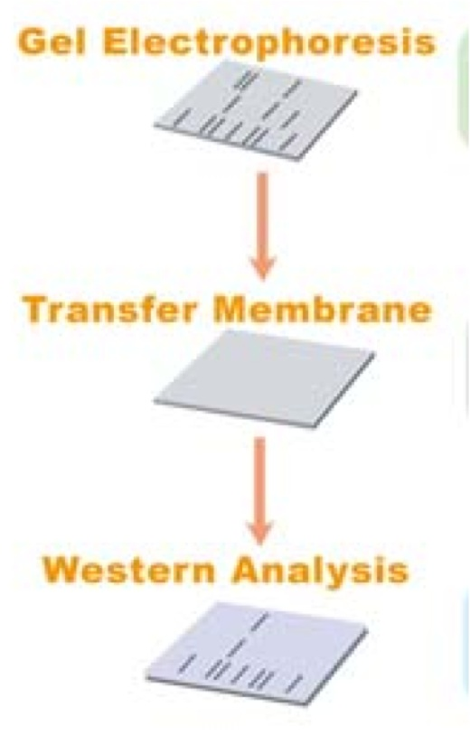
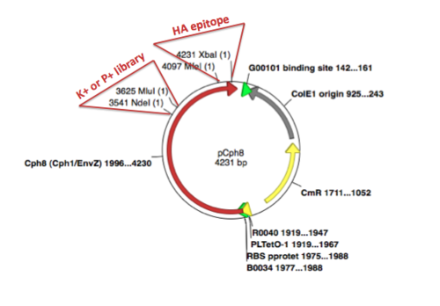
Three part lab today
Part 1: finish Western
Part 2: β-gal assay for your mutants
Part 3: sequence analysis

Slide 3
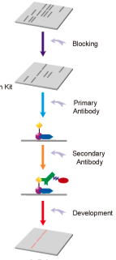
Part 1: finish Western
Why are we performing a Western blot?
Notes:
http://www.genscript.com/product_001/western_application/grp_id/60065/op/detail/Uvrag_Antibody_Analysis.html

Slide 4
Part 2: β-gal assay
Miller units
Why are we testing both light and dark grown cells?
Should we test + and – HA tag?
How many replicates should we test?

Slide 5
Part 3: Sequence analysis
Retrieve the sequences
find the reverse complement
BLAST your sequence (= query) vs pCph8 (= subject)
Will pCph8 have HA tag?
What will you do with your amino acid changes (if you have any)?

Slide 6
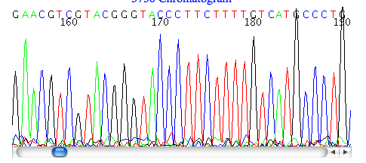
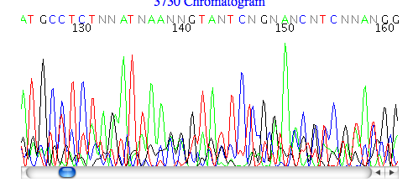
Part 3: Sequence analysis

