Slide 1
Detection of Mutations in EGFR in Circulating Lung-Cancer Cells
Shyamala Maherswaran, Ph.D. et al.
Sarah Gomez and Rachael Holmes

Slide 2
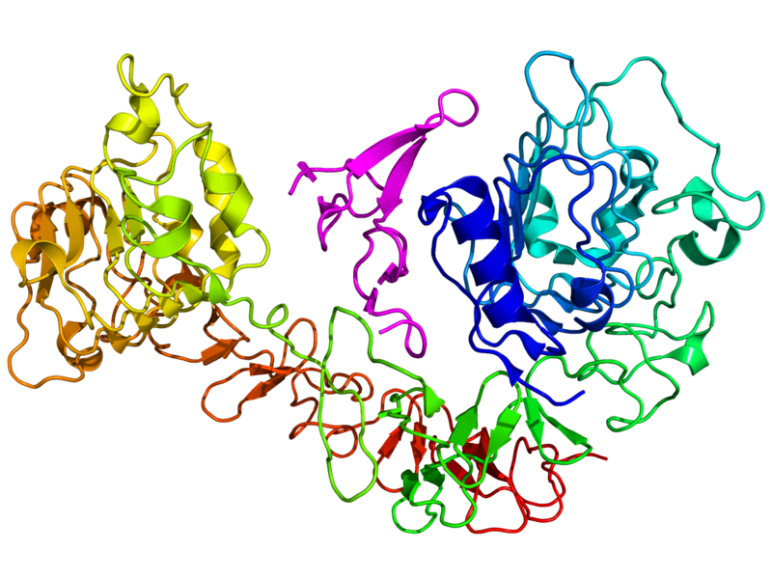
Non-Small-Cell Lung Cancer
Most common form of lung cancer
Primarily a result of mutations in the Epidermal Growth Factor Receptor (EGFR)
Treatments
Tyrosine kinase inhibitors (TKIs) such as gefitinib and erlotinib can be an effective treatment
Secondary EGFR mutations, such as T790M, confer drug resistance
Drug resistant tumors susceptible to “irreversible” tyrosine kinase inhibitors

Slide 3
Purpose
Characterize the evolution of mutations in the circulating tumor cells using the CTC-chip and the SARMS assay
Effectiveness of the CTC-chip and SARMS assays for non-invasive analysis of tumors
Investigate role of T790M mutation in TKI response and progression-free survival

Slide 4
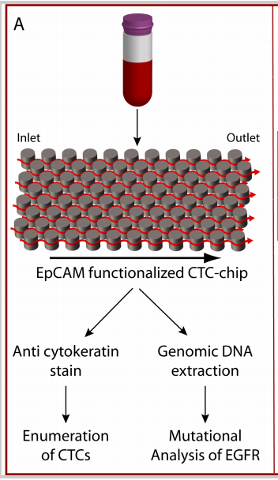
Methods
Circulating tumor cells were isolated using the CTC-chip
CTCs were quantified using and anti-cytokeratin stain
CTCs and tumor tissue were then analyzed using Scorpion Amplification Refractory Mutation System (SARMS) technology to identify rare mutations.

Slide 5
SARMS
SARMS is a fluorescence based assay, that is highly sensitive, but allele specific
Detects rare mutations using mutation specific probes
In the SARMS assay designed for this experiment 7 types EGFR mutations were probed
Notes:
Detects multiple in-frame exon 19 mutations (Del) and the L858R missense mutation which comprise 90% of EGFR mutations

Slide 6
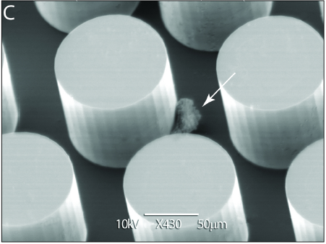
CTC-Chip Reliability
Chip successfully captured a median of 74 CTCs/mL in all samples
This number is similar to patients with other cancers
Tumor burden showed quantity of CTC at a single time point was not well-correlated to tumor volume

Slide 7
SARMS Assay Reliability
Analyzed 26 tumors whose alleles were identified by sequencing
Identified the same mutations in all but one of the samples
That rare deletion mutation was not within the detection capacity of SARMS
SARMS identifies mutant alleles below the detection limit of standard sequencing
SARMS identified EGFR mutations in the CTCs of 19 of 20 patients

Slide 8
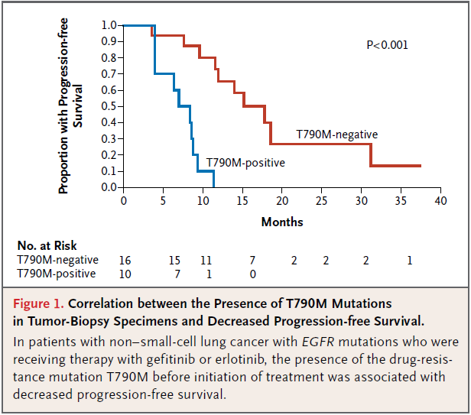
T790M Mutation
Low levels detected in 38% of pretreatment tumor cells
While T790M was found in 2 of 6 patients who had a response to TKIs, 9 of 14 patients who had clinical progression also had the mutation
T790M associated with lower progression-free survival
Seems likely TKI therapy results in selection of pre-existing T790M resistance allele
Notes:
T790M mutation found in 1 in 500 EGFR alleles

Slide 9
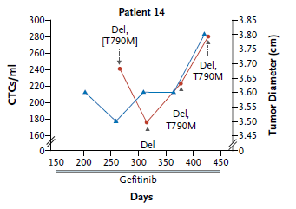
Serial Analysis
Performed in four patients after initiation of gefitinib therapy
Gefitinib treatment was associated with initial CTC decline
There is a close concordance observed with tumor volume and number of CTC
Also supports that TKIs select for T790M drug-resistant alleles over time

Slide 10
Conclusion
The CTC-chip and SARMS assay are effective non-invasive monitors of genetic changes in certain types of tumors with known mutations
The administration of TKIs in patients with T790M mutations can result in an initial decrease in tumor burden, but is linked to progression of the cancer due to selection of the drug-resistant allele T790M
Detection of the T790M mutation can identify candidates for irreversible TKIs or combination targeted therapy

Slide 11
Questions?

Slide 12
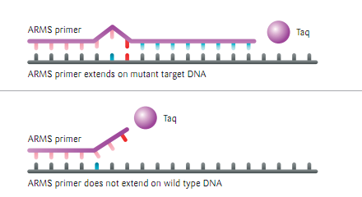
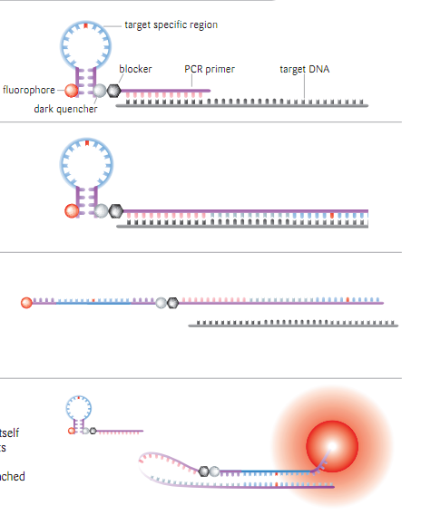
Scorpion Amplification Refractory Mutation System (SARMS) cont.
Selective Amplification
Fluorescence Detection of Mutation
Only the mutant sequence is amplified
The Scorpion primer contains a fluorophore that is quenched when self-annealed and fluoresces when bound to the mutant sequence.

