Slide 1
Global network analysis of drug tolerance, mode of action and virulence in methicillin-resistant S. aureus
Bobby Arnold
Alex Cardenas
Zeb Russo
Loyola Marymount University
Biology Department
16 November 2011

Slide 2
Outline
Staphylococcus aureus – human pathogen.
Treatments are important and antimicrobial peptides seem promising.
Responses modules when exposed to ranalexin showed varying regulation in genes.
Virulence factors inferred from experiments are collected.
Where scientists go from here.

Slide 3
Staphylococcus aureus is a human pathogen
Also referred to as MRSA (Methicillin Resistant Staphylococcus aureus) causes morbidity and mortality.
Strains are becoming resistant to treatments and is becoming a global problem.

Slide 4
Antimicrobial peptides fight against MRSA
AMPs seem to be a source of treatment to fight resistant bacteria (MRSA).
Produced by all living creatures for defense.
  Ranalexin – 20 a.a. peptide that has potent activity against Staphylococcus aureus.
Understanding transcriptome and proteome profiling is crucial to understanding mechanisms for antimicrobials.
  As these alter cell function by differing mRNA and protein profiles.
MRSA-252 genes studied by taking wide approach.

Slide 5
Outline
Staphylococcus aureus – human pathogen.
Treatments are important and antimicrobial peptides seem promising.
Responses modules when exposed to ranalexin showed varying regulation in genes.
Virulence factors inferred from experiments are collected.
Where scientists go from here.

Slide 6
Responses of MRSA when exposed to ranalexin
Upon ranalaxin exposure, genes downregulated secretion system components, which are vital to pathogenesis for MRSA.
  MRSA-252 ESAT-6 systems.
Genes associated with cell wall secretion and anchorage were also RanaDown.
Exposure results in repression of virulence factor expression

Slide 7
Microarray Data
Three replicates of control culture and ranalexin were used in the microarray experiment with two technical replicates of each type. Six total arrays were used in analysis.
2 microarray chips were used.
Ranalexin (A1) was paired with MRSA-252(A2), and MRSA-252(A1) was paired with Ranalexin(A2).
Ranalexin (A1) and MRSA-252(A2) were labeled red (Cy5). Ranalexin (A2) and MRSA-252(A1) were labeled green (Cy3).

Slide 8
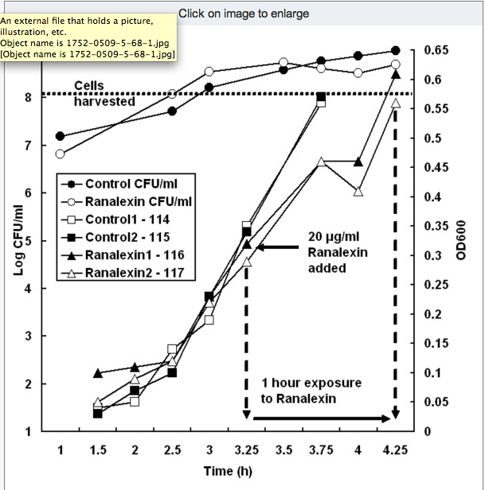
Impaired growth of MRSA when exposed to ranalexin

Slide 9
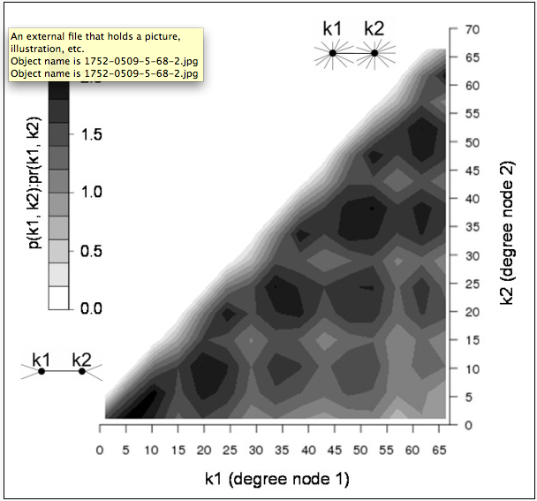
Gene functional association network
Probability of observing interacting pair of nodes in MRSA network.
Varying degrees are seen – k1, k2 and pr(k1,k2)
Bottom left shows low degree values.
Top right shows high degree values.

Slide 10
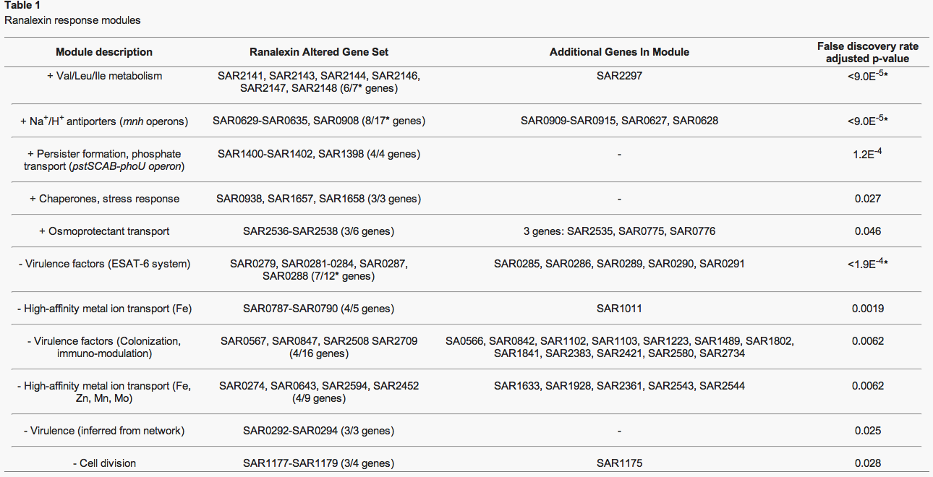

Slide 11
Outline
Staphylococcus aureus – human pathogen.
Treatments are important and antimicrobial peptides seem promising.
Responses modules when exposed to ranalexin showed varying regulation in genes.
Virulence factors inferred from experiments are collected.
Where scientists go from here.

Slide 12
Ranalaxin shows impact on virulence and novel determinants
Significant module included 5 ESAT-6 components → the 6th gene not being assigned to a module.
SAR0288 predicted 6 transmembrane regions; SAR0287→ secreted or cell wall anchored. These two genes matched virulence-associated families.
Correspondence with operon structure that was predicted showed that genes may be co-regulated with ESAT-6 system.

Slide 13
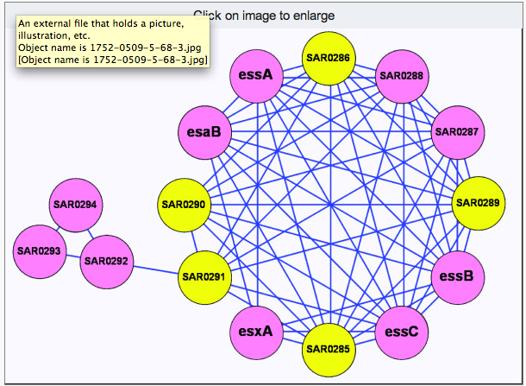
ESAT-6 downregulated virulence factors
Significantly downregulated genes are shown in pink, others genes are shown in yellow.

Slide 14
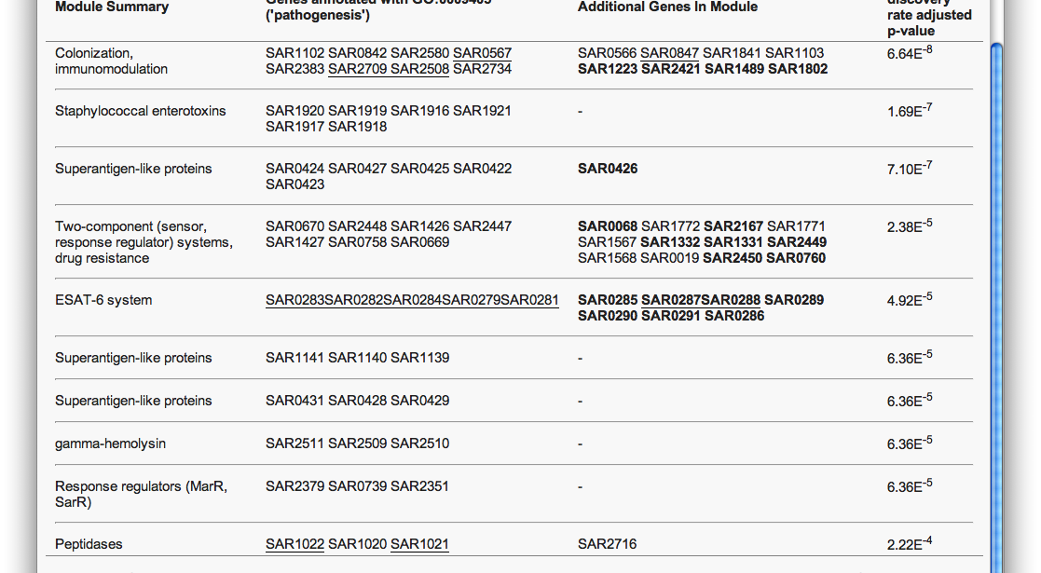
Table 2 – Significant virulence modules

Slide 15
Virulence functions
Two RanaDown modules showed high-affinity metal ion transport which is crucial for establishment of infection
12 genes in 16 node module show virulence functions
  12 showed colonization and immuno-modulation
  All 16 genes encode transmembrane/secreted proteins anchored to cell wall

Slide 16
Pathogenesis – mechanism of how disease is caused
Ranalexin treatment showed repression of MRSA-252, including ESAT-6 system and 22 virulence factors
Decrease in the ability of MRSA to infect
Ranalexin induces cell wall stress by affecting proteins involved in cell wall synthesis

Slide 17
Ranalexin induces cell wall stress
Affects VraSR, which controls gene expression is cell wall synthesis
  Genes regulated this were RanaUp
    SAR1461, SAR1964, SAR1030, SAR2442
Affects FtsH – key role in cell wall behavior and MRSA response to AMPs, in this case ranalexin
  Potential drug target

Slide 18
Ranalexin effects on cell wall continued
Transcriptional regulatory proteins that are RanaUp were induced when cell wall antibiotics present
  SAR1689 and SAR0625
Cell wall stress response induced by exposure to ranalexin

Slide 19
Ranalexin exposure inducing cell wall changes
Enhanced production of craR and tcaA observed in ranalexin exposure
Induction of expression seen after 15 minutes, peaked after 30, declined after 60
Genes from MRSA-252 identified in RN 4220 as being disrupted
Dose responses showed loss from vraR mutant and increasing concentrations and duration of exposure compared to parent strains

Slide 20
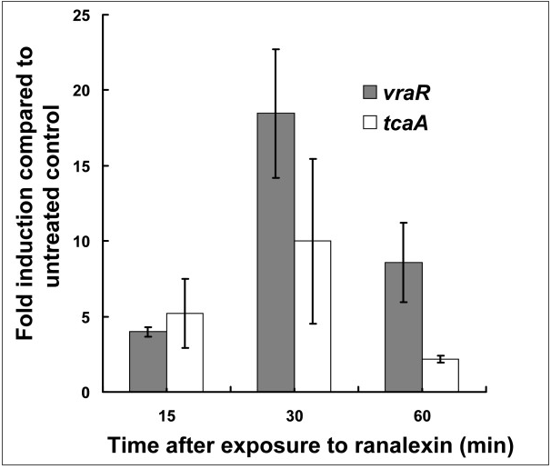
Figure 4 – Ranalexin to cell wall

Slide 21
Osmotic fragility and membrane disruption
MRSA cells treated with ranalexin were tested for osmotic fragility to gauge AMP effects
Cells treated with sublethal doses of vancomycin and ranalexin induced sensitivity to hypo-osmotic stress, when treated with both, similar degree of osmotic fragility
Ranalexin inhibits at the staphylococcal cell wall

Slide 22
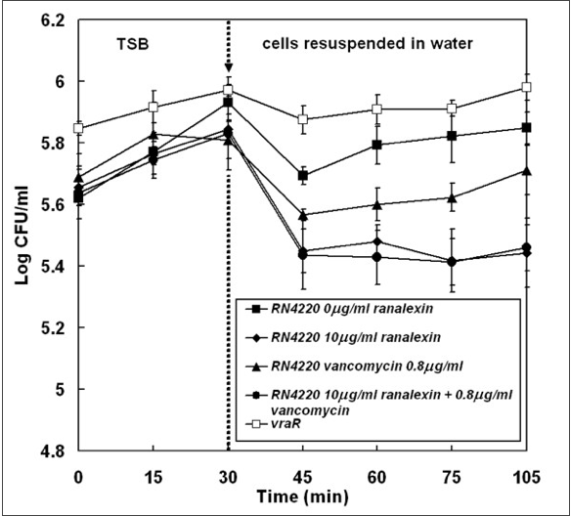
Figure 5 – ranalexin exposure inducing sensitivity to hypo-osmotic stress

Slide 23
MRSA drug tolerance
When exposed to ranalexin, strong upregulation of proteins encoded by pstSCAB-phoU operon seen
  PstS, PstC, PstA, PhoU, PstB
MRSA adopts a PhoU-mediated persister phenotype to gain antimicrobial tolerance
Persister bacteria exhibit thickening of cell wall and loss of virulence factors

Slide 24
Multiple actions in MRSA killing due to inhibatory actions of ranalexin
Major effects of ranalexin exposure
  Membrane permeabillisation leading to cation influx and dissipation of transmembrane electrochemical gradient
  Increase positive cell wall charge at surface, decresed peptide binding
  Cation antiport upregulated, increased influx of cations

Slide 25
Where Scientists Go from Here
Evidence showed effects of ranalexin on bacterial cell wall and action at cell membrane.
Evidence for PhoU-mediated persister switching as mechanism of drug tolerance
Further investigation is needed to find more mechanisms of drug tolerance for different antimicrobial peptide.

Slide 26
Acknowledgements
Dr. Dahlquist
Ian M Overton, Shirley Graham, Katherine A Gould et. al.

