Slide 1
λ
λ
λ
λ<d
λ>d
λ=d
d
d
d
Rayleigh regime
Intermediate regime
Mie regime

Slide 2
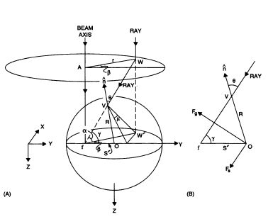
FOV’ is the incidence plane
AWW’ is the vertical plane contains the ray

Slide 3
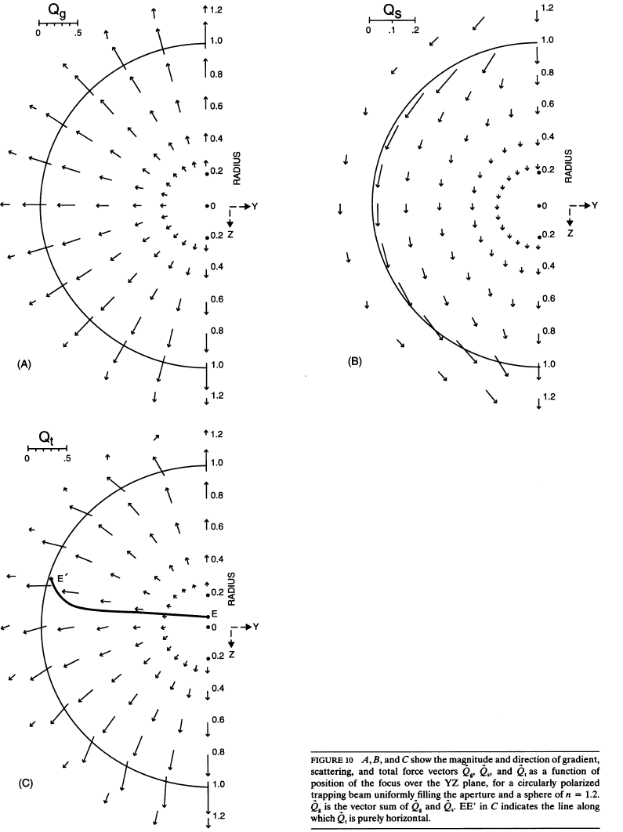

Slide 4
Z
d
X
O
f
Y
S
f: trap center
O: bead center
S: offset due to scattering force

Slide 5
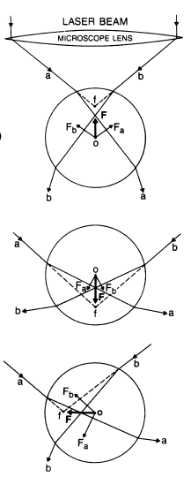

Slide 6
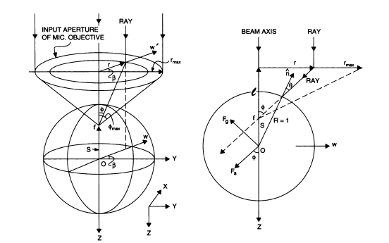
f: beam focus
θ: incident angle
φ: convergence angle
S: distance between bead center and
focus
r: exit pupil radius (output aperture)
F_{s}: scattering force
F_{g}: gradient force
n: surface normal

