Slide 1
Estrogen Detection by Luminance
By Kyle Albert & Josh Mixdorf

Slide 2
Why
Uncontrolled levels of estrogen in waste water treatment plants is a growing problem.
The high levels of estrogen have been found to cause feminization of fish that are exposed to it.
More studies are showing that it is having an effect on humans as well causing an increase in XXY genotypes in prenatal babies.

Slide 3
Goals
To detect the presence of estrogen.
To iluminate E. coli as a detection method.

Slide 4

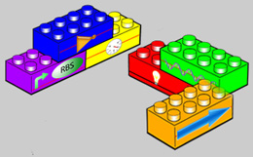
Parts

Slide 5
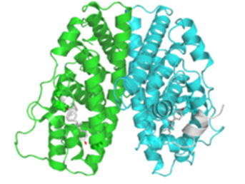
BBa_K123003
When estrogen or an estrogen like compound is present the receptor binds to it and forms a homodimer.
This homodimer is then able to bind to an Estrogen Responsive Element (ERE BBA_K123002).

Slide 6
BBa_K123002
LacIQ ERE TetR
We believe that in conjunction with another part (Bba_K123003 ER) ERE will detect estrogen.
We will use BBa_K123003, to bind to the ERE to act as our promoter.

Slide 7
BBa_J61139
Ribosome binding site
We will use the same coding sequence as this part but will buy it as just a stand of DNA instead of using a biobrick.

Slide 8
BBa_I712019
Firefly luciferase
Part is cloned into pSBAK3 vector with terminator.
Includes start and stop codon.

Slide 9
BBa_B1006
Terminator
Bidirectional, with the reverse estimated to be more effective than the forward.
We will include this terminator as a back up incase a problem occurs with stop codon from BBa_I712019.
We will also buy the same DNA code sequence for this part instead of using a biobrick.

Slide 10
BBa_K123003
(ER)
BBa_K123002 (ERE)
RBS
BBa_I712019 (GFP)
Terminator
Order of Parts Assembly

Slide 11
How We Will Accomplish This
Step 1: Join the BioBricks in accordance with the manual
Join BBa_K123003 with BBa_K123002
Then add the RBS DNA with the EX prefix and S suffix to the BBa_I712019 with the X prefix and the SP suffix
Then add the newly formed part with an EX prefix and the S suffix to the Terminator DNA that has X prefix and SP suffix
Now combine all parts specified above together: step one’s part with a EX prefix and a S suffix to step three’s part with a X prefix and a SP suffix

Slide 12
Step 2: Introduce the new strand of DNA into a vector
Step 3: Using vector insert DNA into E. coli
Step 4: Grow the E. coli on an ager dish infused with estrogen and ampicillin
Step 5: If the bacteria grow and light up on the estrogen plate and not the ampicillin only plate we have succeeded

Slide 13
Step 6: Once the strand has been tested and found to work we will then test variable concentrations of estrogen to find what needed to initiate and maintain the ER

