Slide 1
Chassis
Minimum cell versus cell-free system
Modern cells
Reduce
Complexity
Self-replicating entity
Build-up
function
Pure molecules
Jewett M. SynBio 4.0 Conference. March 9, 2009
Notes:
Endogenous pathways cause cross talk with engineered systems, we are dependent of cell viability and constrained to endogenous structures.
A key question for synthetic biologist how to develop a chassis into which genetic parts can be implanted. That is, what is the most ideal cellular environment to create genetic circuits.
There are two opposing dichotomies: Minimum cell and cell-free system.
Understanding Biology by building.
Both have the same goal to create a simplified self-replicating entity.
The paper I will be presented today, takes the bottom-up approach.

Slide 2
Study of messenger RNA inactivation and protein degradation in an Escherichia coli cell-free expression system
Jonghyeon Shin and Vincent Norieaux
Presented by Jessica Perez
MIT Department of Biological Engineering
Advanced Topics in Synthetic Biology (20.385)
April 20, 2011

Slide 3
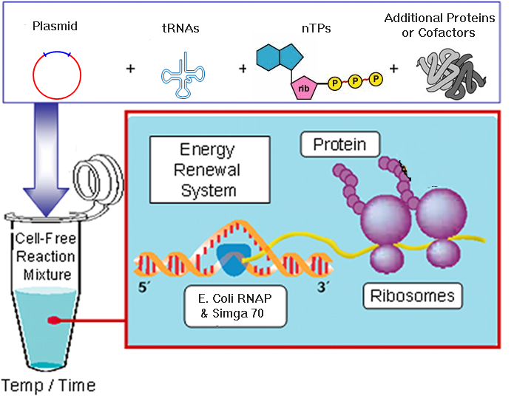
Cell-free expression systems
Modified from Cappuccio et al 2008
Notes:
A mixture of cytoplasmic and/or nuclear components from cells and used for in vitro protein synthesis or transcription or DNA replication or other purposes.

Slide 4
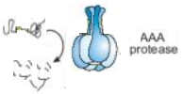
Goal
Balance of production and inactivation for
in vitro synthetic biology
mRNA Inactivation | Protein Degradation
Small ribonuclease, MazF, inactivates mRNA by cleavage | Endogenous AAA proteases , directed by degron degradation tags, degrade proteins
mRNA
ACA
MazF
Modified from Langer et al 1995
Notes:
Improve cell-free systems by providing mRNA inactivation and protein degradation mechanisms.
Degrons are degradation tags
Balance of production and inactivation for in vitro synthetic biology
The goal of this paper is to create mechanisms to allow there to be a balance between the production and inactivation to further improve in vitro synthetic biology.
For an inactivation meachanism, the authors used MazF, which is a ribonuclease that inactivates mrNA by cleavaging at a specific ss sequence ACA.
Protein degradation was directed utilizing endogenous AAA proteases that degrade proteins that are tagged with degradation tags called degrons. Several degrons were tested in this paper.

Slide 5
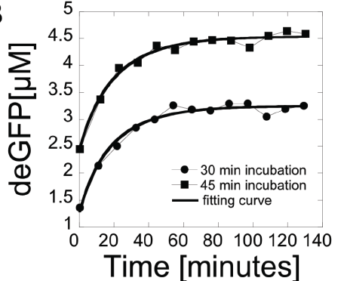
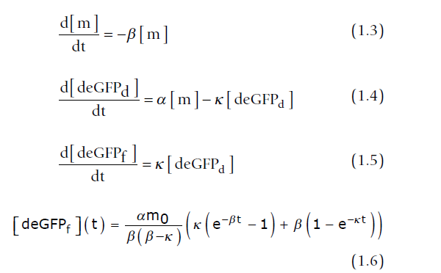
Endogenous mRNA inactivation rate
Experimental data: Accumulation of the reporter protein after transcription blocked by Tagetin
deGFP inactivation rate= 0.077 /min or
13 min average half life
Notes:
The mRNA inactivation rate was determined from the accumulation of the reporter protein in the solution after transcription was stopped. The RNA polymerase inhibitor Tagetin was used to stop transcription.
The necessary amount of Tagetin was found by adding increase concentration until transcription completely stopped.
T=0 is addition of Tagetion concentration need to completely stop transcription.
They created a model of how deGFP changes with time. After solving this equation they fit the data to this equation to solve to beta, the mRNA inactivation rate. Here endogeneous deGFP inaction rate was .077/min or an average life time of 13 minute
deGFP is

Slide 6
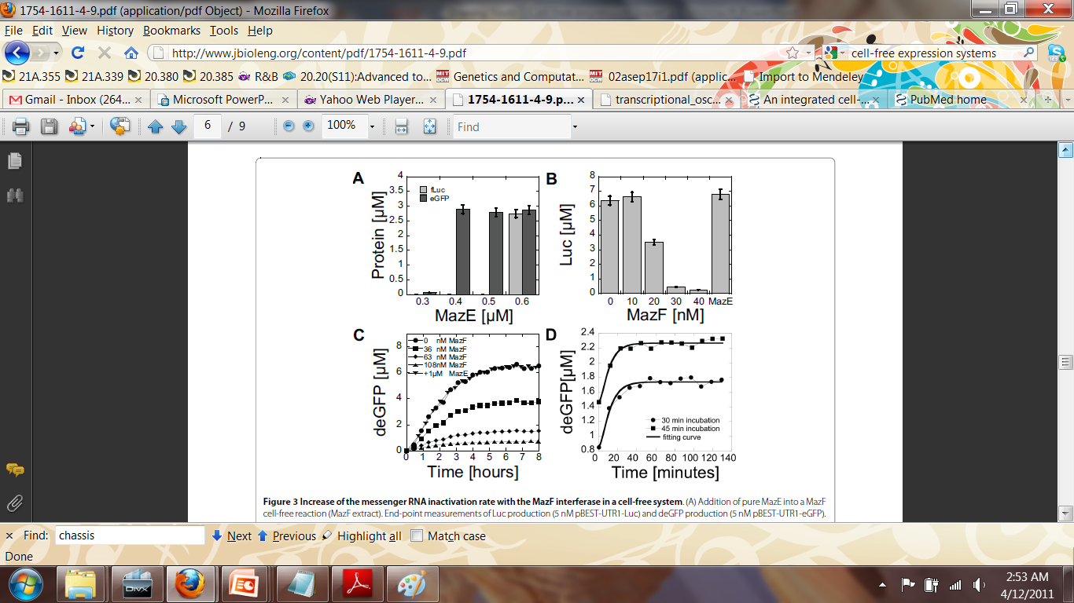
mRNA inactivation with MazF
deGFP t1/2=5min at 36 nM MazF
mRNA inactivation is tunable with MazF
Notes:
After creating a method for meauring mRNA inactivation rate. They wanted to find out the effect of MazF, the ribonuclease, on mRNA inactivation aka cleavage.
They used eGFP and Luc as their reporter proteins
Panel B shows that mRNA inactivation is tunable by varying MazF concentration. This is Ecoli Extract with MazF purified proteins added to the reaction. Last bar is a control showing that mRNA inactivation is solely from MazF activity. MazE is an anti-toxic that binds to two MazF molecules to block its activity.
Panel C shows the kinetic expression of deGFP with various MazF concentaions over time. Showing the tunablity of another deGFP mRNA.
Panel D shows another Tagetin assay to determine the mRNA decay rate for deGFP which was found to be 5 minutes. At a 36 nM MazF concentration. This shows that the mRNA lifetime can be precisely set from the endogenous lifetime of 13minutes to complete activation (0 min).

Slide 7
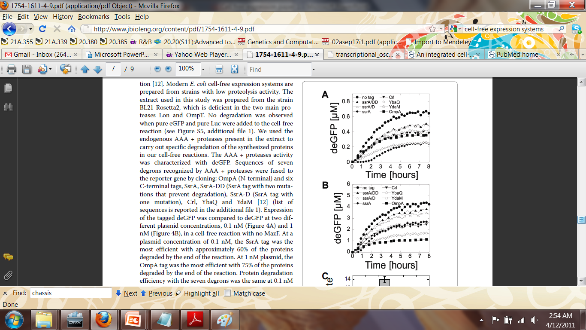
Protein degradation with degrons
0.1 nM plasmid
1.0 nM plasmid
Panel A= SsrA 60% protein degradation
Panel B=OmpA 75% protein degradation
Notes:
.1nM deGFP= SsrA 60%; 1nM deGFP= OmpA 75%.
Constant rate of degradation up to 1uM
Six C-terminal degrons were added to the mRNA sequence for deGFP. Seven degrons sequence were tested.
Panel C= determined by slopes of degradation curves

Slide 8
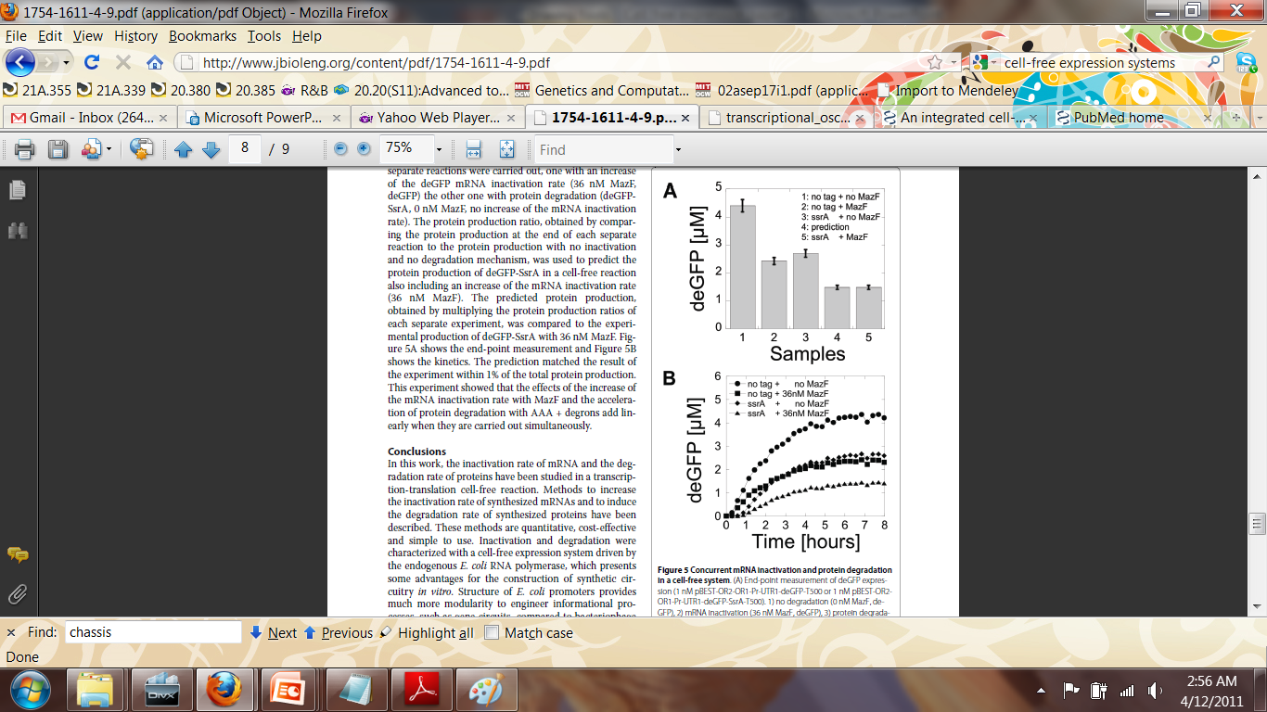
Concurrent mRNA inactivation protein degradation
Prediction matched within 1% of total protein production
mRNA inactivation and protein degradation effects add linearly

Slide 9
Summary
Pitfall
  Lack of mRNA inactivation specificity
  Additional factors need to be added
  Analyzing effect of multiple protein expression
  mRNA inactivation model vs Northern blot
Significance
  Opens up in vitro synthetic biology applications
  Step towards inactivation and degradation tools

Slide 10
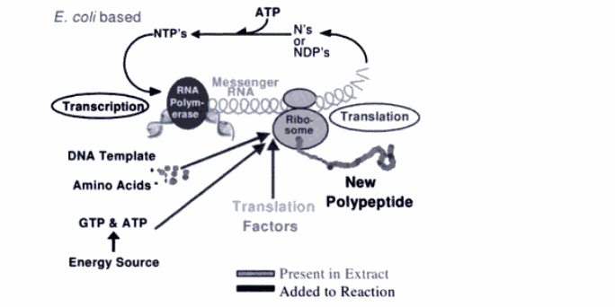
Large-scale Batch Reactions for Cell-free Protein Synthesis

Slide 11
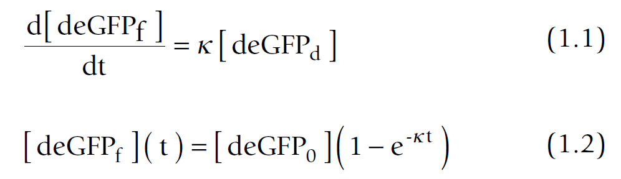
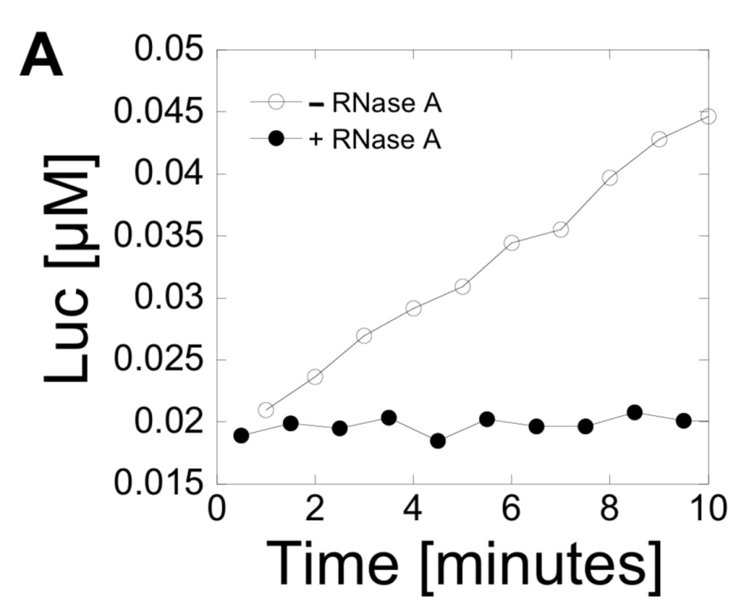

Luc and eGFP maturation time

