Slide 1
Integrated barcode chips for rapid, multiplexed analysis of proteins in microliter quantities of blood
Fan, Vermesh, et al. Nature Biotechnology (2008).
Jenny Zhou and Anne Ye
12-9-11
Notes:
Hi, I’m Jenny, and this is Anne, and today we’ll be presenting about the development of integrated barcode chips that can be used to rapidly analyze many proteins in microliter volumes of blood.

Slide 2
Motivation and Design Considerations
Blood is the most important fluid for clinical diagnostics
Current clinical assays only analyze a handful of plasma proteins
Rapid degradation of proteins in stored blood samples
Cost, efficiency, invasiveness
Notes:
Blood contains the most diverse representation of the human proteome, and changes in the plasma protein profile can reflect physiological changes indicative of many disease states. Thus, blood is the most important fluid for clinical diagnostics. Currently, the assays that are being used in the clinic only analyze a small fraction of all plasma proteins, limiting their diagnostic value, because they can’t take advantage of the full complexity of blood proteins. Also, because many currently-used assays only analyze blood samples that have been processed or stored, instead of fresh whole-blood samples, error can be introduced because proteins experience rapid degradation. Thus, there is a lot of motivation to develop an assay that can rapidly measure the levels of many proteins, which is also relatively inexpensive and minimally invasive.

Slide 3
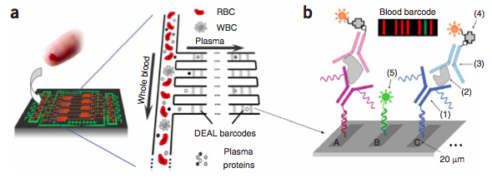
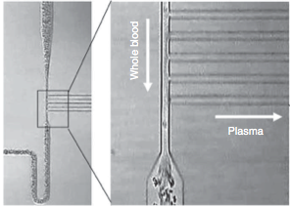
Integrated Blood Barcode Chip (IBBC) Design
A polydimethylsiloxane (PDMS)-on-glass chip
8–12 separate multiprotein assays sequentially or in parallel
Employing the Zweifach-Fung effect, which describes the blood cell flow at branch points of small blood vessels
DNA-Antibody barcodes to measure proteins in blood/plasma
Visualization using biotin-labeled antibodies and streptavidin-Cy5 fluorescence probe, complementary DNA-Cy3 reference probe
Notes:
The integrated blood barcode chip, or IBBC, is a PDMS-on-glass microchip with 8-12 chambers allowing for the sequential or parallel assaying of multiple blood samples per chip. Each chamber contains a main channel with multiple smaller side channels. Each of these side channels is pre-printed with a series of DNA barcodes. These DNA barcodes are then converted into antibody barcodes by flowing through antibodies that are tagged with the complementary DNA oligomers.
As the blood goes through the main channel of the chip, the proteins are separated from the cells via what we call the Z-F effect. This phenomenon describes what happens to particles when they reach a branch point in the channel. Larger particles, such as blood cells, remain in the low-resistance main channel, while plasma and the smaller blood proteins are diverted into the high-resistance side channels.
Once the proteins have been diverted into the side channels, they are captured by the antibody barcode. To visualize the protein levels, biotin-labeled antibodies and streptavidin-tagged red fluorescent probes are flowed through. Because each bar contains a distinct DNA oligomer, a reference can be made by printing a bar that does not have a complementary antibody, but rather, a complementary oligomer bound to a green fluorescent probe. The reference allows separation of individual barcodes.

Slide 4
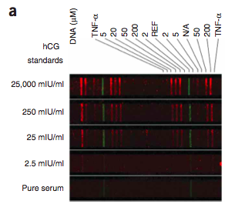
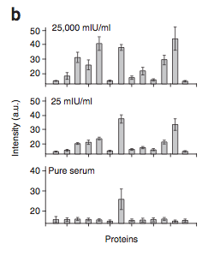
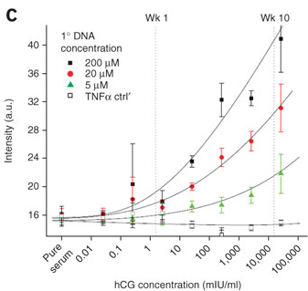
Chip Validation
Detecting human chorionic gonadotropin (hCG)
Standard hCG serum samples and 2 hCG samples of unknown concentration
Biotinylated anti-hCG and TNF-α were then applied
Fluorescent Cy5-labeled streptavidin (red) for all protein channels and Cy3-labeled M’ oligomers (green) for the reference channel
High sensitivity (~1 mIU/mL) and effectiveness range (~10⁵)
Notes:
In order to validate the design of the chip, it was used to detect human chorionic gonadotropin, or hCG, a common protein marker of pregnancy. Barcodes containing different concentrations of anti-hCG and negative controls of no antibody and anti-TNF-alpha were printed. Standard hCG serum samples were run through the chip, and the protein levels were visualized using the detection antibodies and fluorescent probes. As you can see, different hCG concentration samples can be visually differentiated based on absolute fluorescent intensity, although the relative intensities of the bars are maintained. As you can see, it appears that the same antibody barcode is mirrored within each channel. The mirror barcodes appear to be identical, which shows that there is negligible loss of protein along the channel.
In Figure B, they actually quantified the barcode fluorescences for 3 of the different hCG standard concentrations. From Figures B and C, you can see that higher DNA-loadings allow for greater sensitivity in protein detection. However, because higher DNA concentrations have the potential to oversaturate the fluorescence reader, high protein concentrations may be better resolved using lower DNA loadings.
The sensitivity of the chip was about 1 mIU/mL, which is comparable to that of standard ELISAs, and it was effective in measuring protein concentrations over 5 orders of magnitude.

Slide 5
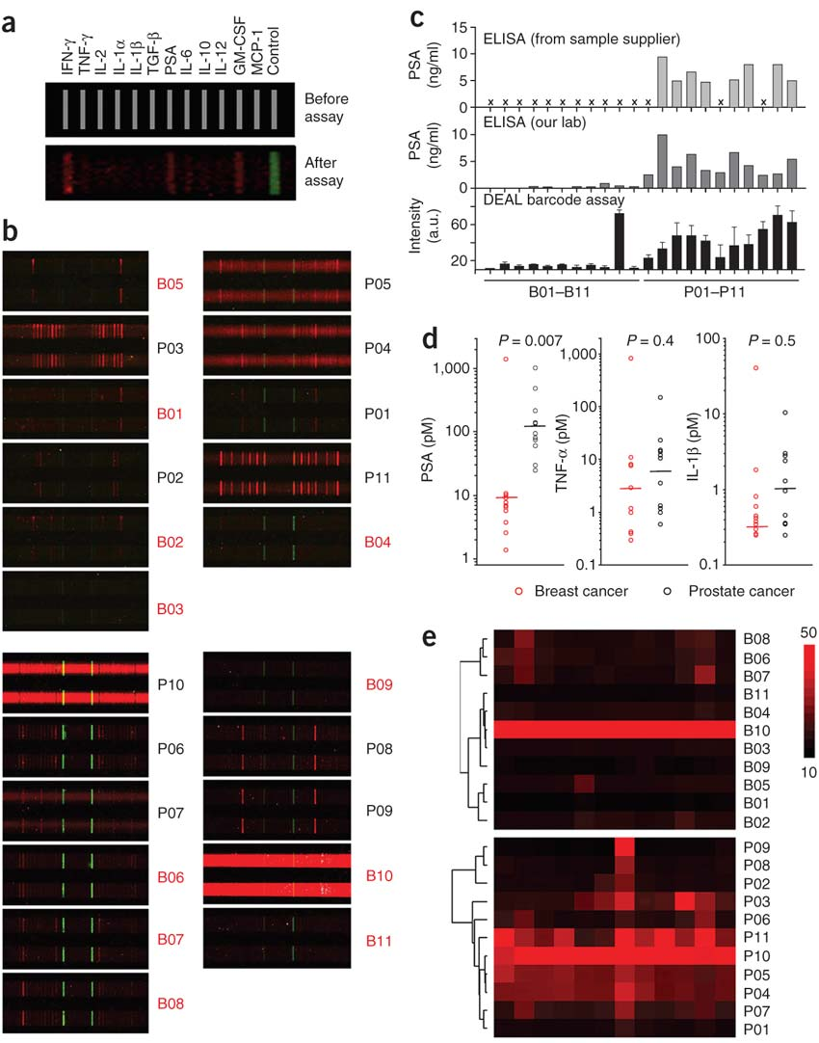
Clinical Application:
Analyzing Cancer Patient Blood Samples
Measured 12 tumor marker proteins in stored, thawed serum samples from 22 cancer patients
Patient-specific barcode signatures, high signal-to-noise
Heavy smokers had high background – carboxyhemoglobin?
Notes:
In order to test the clinical application of the IBBC, the chip was used to measure the levels of 12 tumor marker proteins in stored serum samples from 22 patients with breast cancer or prostate cancer. Figure A shows the layout of each barcode. Each assay chamber contained 20 DNA barcodes for statistical sampling.
Figure B shows 4 random barcodes for 11 of the patients. As you can see, the barcode signatures are distinct from patient to patient, and for the most part, had high signal-to-noise ratios. You can see 2 exceptions, P10 and B10, who were heavy smokers, and had high background. The authors hypothesized that this background may result from buildup of fluorescent carboxyhemoglobin due to smoking.

Slide 6
Clinical Applications (cont’d)
Quantified bound protein fluorescence intensities
PSA levels distinguish breast/prostate cancer (P < 0.0007)
IBBC can assess clinically relevant protein concentrations
Modest linear correlation between DEAL and ELISA measurements
Possible reasons for discrepancy:
  Manual chip fabrication
  Sample degradation during storage
Notes:
The fluorescence intensities were quantified, and in Figure C, the levels of prostate-specific antigen, or PSA, are plotted for each patient. Measurements obtained from the chip were compared to those obtained using standard ELISAs. Although the absolute protein levels were comparable between the chip and the ELISAs, the chip, as well as the in-lab ELISA, measured lower levels than the clinical ELISA did. This could be due to protein degradation due to blood storage. The high sample variability of the IBBC measurements could also be due to manual chip fabrication.
However, as you can see from Figure D, the chip was still able to detect a significant difference between the PSA levels in patients with breast cancer and patients with prostate cancer. Thus, they confirmed that the IBBC is capable of detecting clinically relevant protein concentrations.

Slide 7
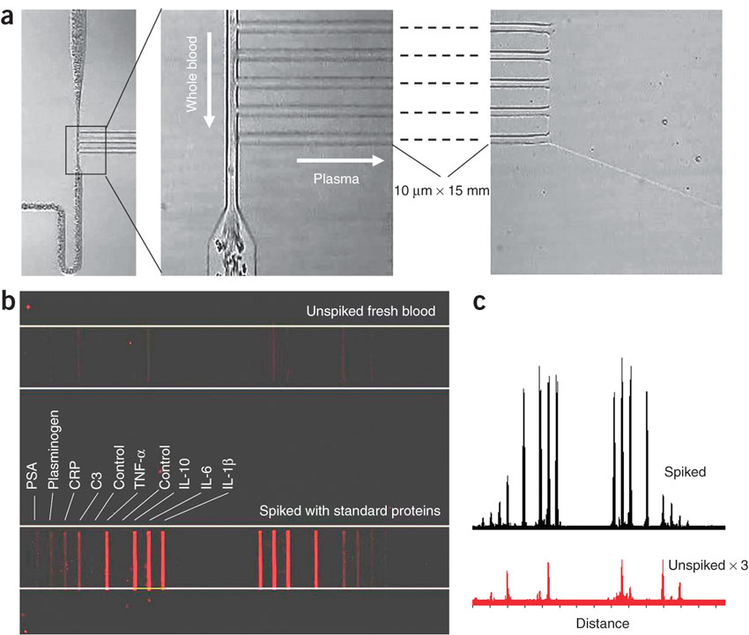
Validation of Rapid Blood Analysis
~9 min from finger prick to assay completion
Compared whole blood and protein-spiked blood from healthy volunteers
No biofouling, low background in freshly collected blood
All proteins detected in spiked blood
Confirmed that IBBC’s can rapidly separate and analyze whole blood
Notes:
Tying things back to some of the major motivations, the IBBC was tested for ability to measure a large number of proteins in small-volume whole blood samples within minutes of blood sampling. Whole blood was sampled from patients and flowed through the IBBC. Some of the blood sample was also spiked with a cocktail of proteins and tested. Blood samples were loaded within one minute of finger-prick and flowed through to completion in 8 minutes before detection antibodies and probes were added. The unspiked sample established baseline protein values in healthy patients. The spiked sample served as a positive control showing that all proteins could be detected using the IBBC. This study established the potential of the IBBC to rapidly separate and analyze whole blood.

Slide 8
Impact and Similar Applications
Noninvasive, rapid, sensitive diagnostic assay
Generalizable to many diseases
Promising for inexpensive, point-of-care diagnostics
2010 paper discusses LF-IBBC, which allows lateral separation of cells from plasma
Notes:
So in this paper, the authors described the development of a noninvasive, rapid, and sensitive diagnostic assay based on blood protein levels. Because the chip design allows for simultaneous measurement of many possible combinations of proteins, this method can be generalized to diagnosis of many diseases. This has a lot of promise for future application as an inexpensive, point-of-care diagnostic tool. A more recent development was the publication of a paper by the same lab in 2010, discussing the design of an LF-IBBC, which allows blood samples to be laterally separated into cells and plasma within the same channel. They have also been able to automate the fabrication of these LF-IBBC’s, which could reduce sample variability.

