Slide 1
Western Blotting: Tips, Tricks, and Best Practices
Methodology Club
11/18/2014
Notes:
Western blotting an empirical technique
Everything is dependent on the particular protein/system you’re working on, thus things will work differently for different people

Slide 2
Western Blotting
Run Gel
Transfer to Membrane
Probe with antibody(s)
Develop to obtain signal
Quantify signal

Slide 3
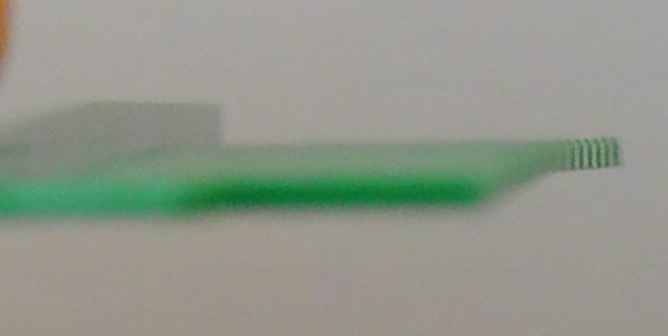
PAGE Gels
Sealing bottom of glass plates to prevent leaks
  0.5% Agarose + 0.5% SDS
  High APS/TEMED Acrylamide solution
Ice + High voltage (300V+) for faster runs
Gunk in wells
  Lower APS/TEMED amount
  Make sure combs are not bent/curved

Slide 4
PAGE Gels
Tris-glycine – classic system
Tris-Acetate [1] – pH 7, better separation range
Tris-Tricine [2,6] –
  pH 7
  More efficient stacking/destacking, higher resolution at some MWs
  Also, longer shelf-life, because no pH-dependant degradation of acrylamide
Agarose [3,4] – Large MW proteins
Riboflavin-phospate + UV light can be used instead of APS/TEMED [5,6]
  Allows for lengthy setup, such as with multi-casting or gradient gels
  Better for N-terminal sequencing
Notes:
Acrylamide undergoes pH dependent degradation and basic pH
Electrotransfer from Tris-Tricine gels prefers high capacity, low pore size membranes
Use acrylamide to seal bottom of vertical agarose gels
Electrotransfer to membranes from agarose gels goes ~15% faster

Slide 5
Choice of Membrane
 | Nitrocellulose | PVDF
Available Pore Sizes | 0.1, 0.2, 0.45 | 0.2, 0.45
Binding Capacity | 80-250 ug/cm² | 150-350 ug/cm²
Durability | Fragile when dry | Sturdy
Background | Generally low | Generally high
Chemical properties | Binds irreversibly to coomassie Can be dissolved | Can be destained from coomassie Tighter protein binding
Compatibility w/ N-terminal sequencing (Edmond) | Incompatible | Compatible
Interaction with SDS | SDS inhibits binding of proteins | Less protein binding inhibition by SDS
Notes:
Supported nitrocellulose is more durable than run-of-the-mill nitrocellulose, but loses a small bit of binding capacity
Small pore size is important, it increases binding capacity, especially with lower MW proteins, which can ‘blow through’ the membrane

Slide 6
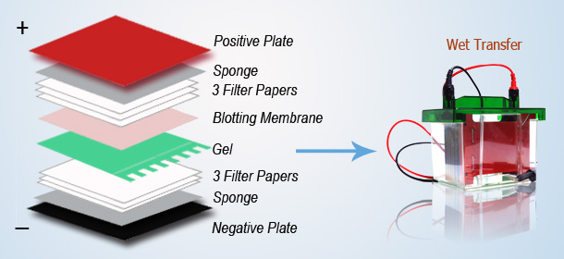
Electro-transfer to Membranes
Semi-dry
  Fast
  Lower materials cost
  Not-quantitative
Tank
  Slow
  Uses a lot of buffer
  More quantitative transfer
  More versatile
http://www.western-blot.us/uploads/images/Western-Blot-Transfer.jpg

Slide 7
Tank Transfer
High intensity
  100-200V for 0.5-2 Hrs.
Low intensity
  30V for 16 Hrs.
Biphasic [7]
  Low voltage, followed by high voltage
Square wave [7]
  2 steps forward, one step back

Slide 8
Tank Transfer - Buffers
Towbins [8]
  Tris/Glycine based with Methanol
Bjerrum Schafer-Nielsen [9]
  Tris/Gly w/low glycine + MeOH
  For semi-dry or Tank transfer of >80kDa proteins
CAPS or Dunn Carbonate
  High pH (9-11) buffers, no tris/gly
Acetic Acid (0.7%)
  Transfer of positively charged proteins in the reverse direction

Slide 9
Tank Transfer
Methanol vs. SDS
  Methanol aids in protein binding to membranes, especially nitrocellulose
  SDS inhibits protein binding, especially with nitrocellulose
  Methanol strips SDS from proteins making it harder for them to exit the gel
  SDS aids in getting proteins out of the gel
  Test between 0-20% MeOH and 0-0.1% SDS

Slide 10
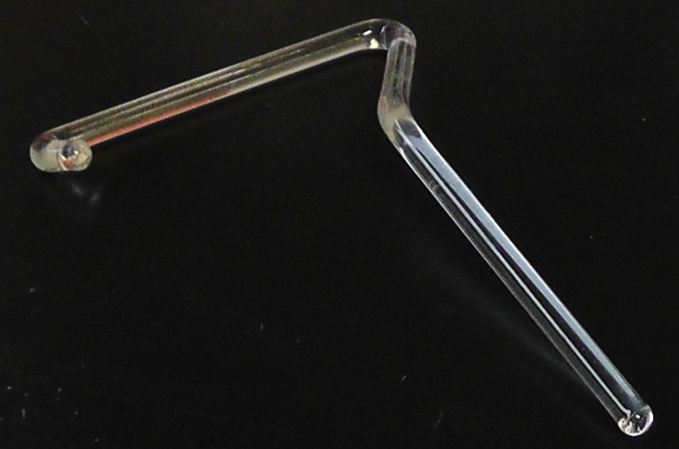
Tank Transfer
Native Transfer
  pH extremely important
    No SDS to impart negative charge
    High pH buffer, such as CAPS, to ensure protein has negative charge
    Alternatively, you can stay below the pI and transfer in reverse (towards the cathode, as the protein will be positively charged)
Gel/Membrane contact
  Air/buffer will cause artifacts
  Test tube as roller
  Glass-rod
Filter paper stuck to gel/membrane
  Add water
Dry membranes after transfer
  ‘helps fix proteins to membrane’ [10]

Slide 11
Blocking
Non-fat dry milk
  Super cheap
  ~5%
  Has endogenous biotinylated proteins
  IgGs that can cross-react with anti-goat antibodies
  Goes sour
BSA
  1-5%
Fish Gelatin
  Expensive
Tween-20 [11,12]
  0.25-2%
  May wash off a small amount of protein from blot
  May cause background with some forms of imaging
No blocking [13]
  Dried PVDF only
Notes:
0.5-1 Hr at room temp
or
Overnight at 4°C
Shortest time that gives good results

Slide 12
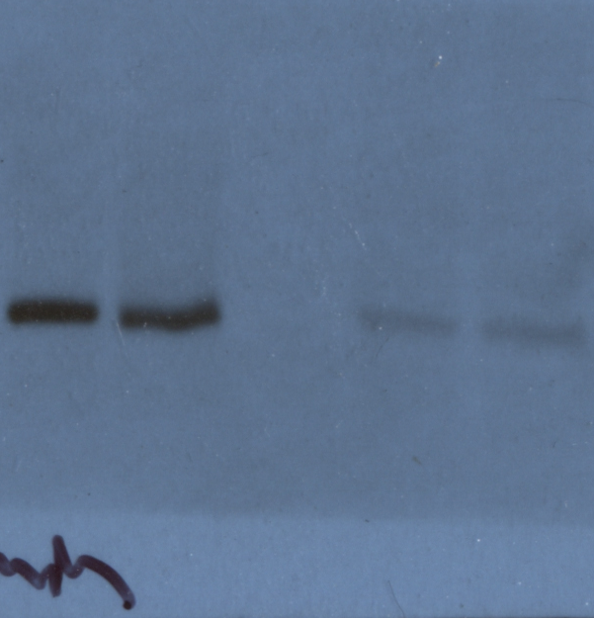
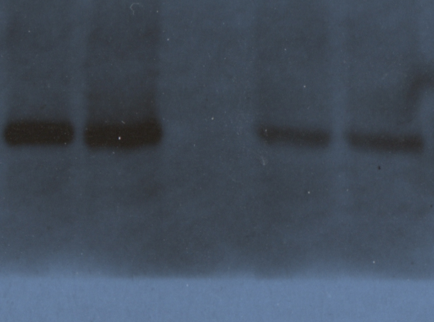
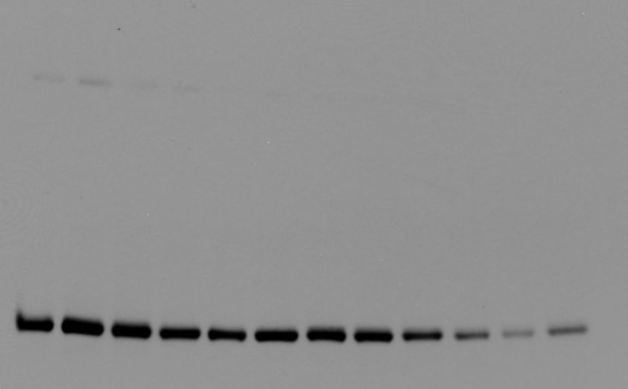
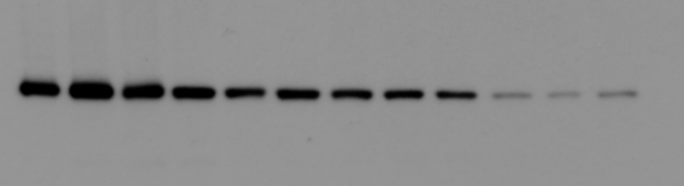
Tween-20 for Blocking
BSA
ΔTime
ΔTime
Tween
5-10 min exposure

Slide 13
Probing with Antibodies
Lowest dilution that gives good signal
  Can probe for as little as 30 min
Microwave assisted incubations for quicker probe times [14]
Membranes can be stripped and re-probed multiple times [15, 16]
  PVDF better for this
  Can lose some of protein bound to blot
  Heat + SDS, Low-pH, or High-pH
SDS in antibody stocks (0.01-0.05%)
  Can decrease background
  Can actually increase signal by revealing epitopes
    Especially when using protein based blocker

Slide 14
Secondary Antibody Conjugates
Alkaline Phosphatase
  Colorimetric (NBT/BCIP)
  Fluorescent (ECF)
Horseradish Peroxidase
  Colorimetric (CN/DAB)
  Flourescent (ECL Plus)
  Light based via Film or CCD camera (ECL, ECL Plus, etc)
Fluorescent Dyes
  Alexa flour dyes for imaging on Typhoon scanner
  More dynamic range than Film, but sacrifices some sensitivity
  Multiplex possible [17]
Gold [7]
  Usually silver-enhanced detection
Notes:
NBT/BCIP (100pg)
DAB/4CN (500pg)
HRP Film (1pg or even fg)

Slide 15
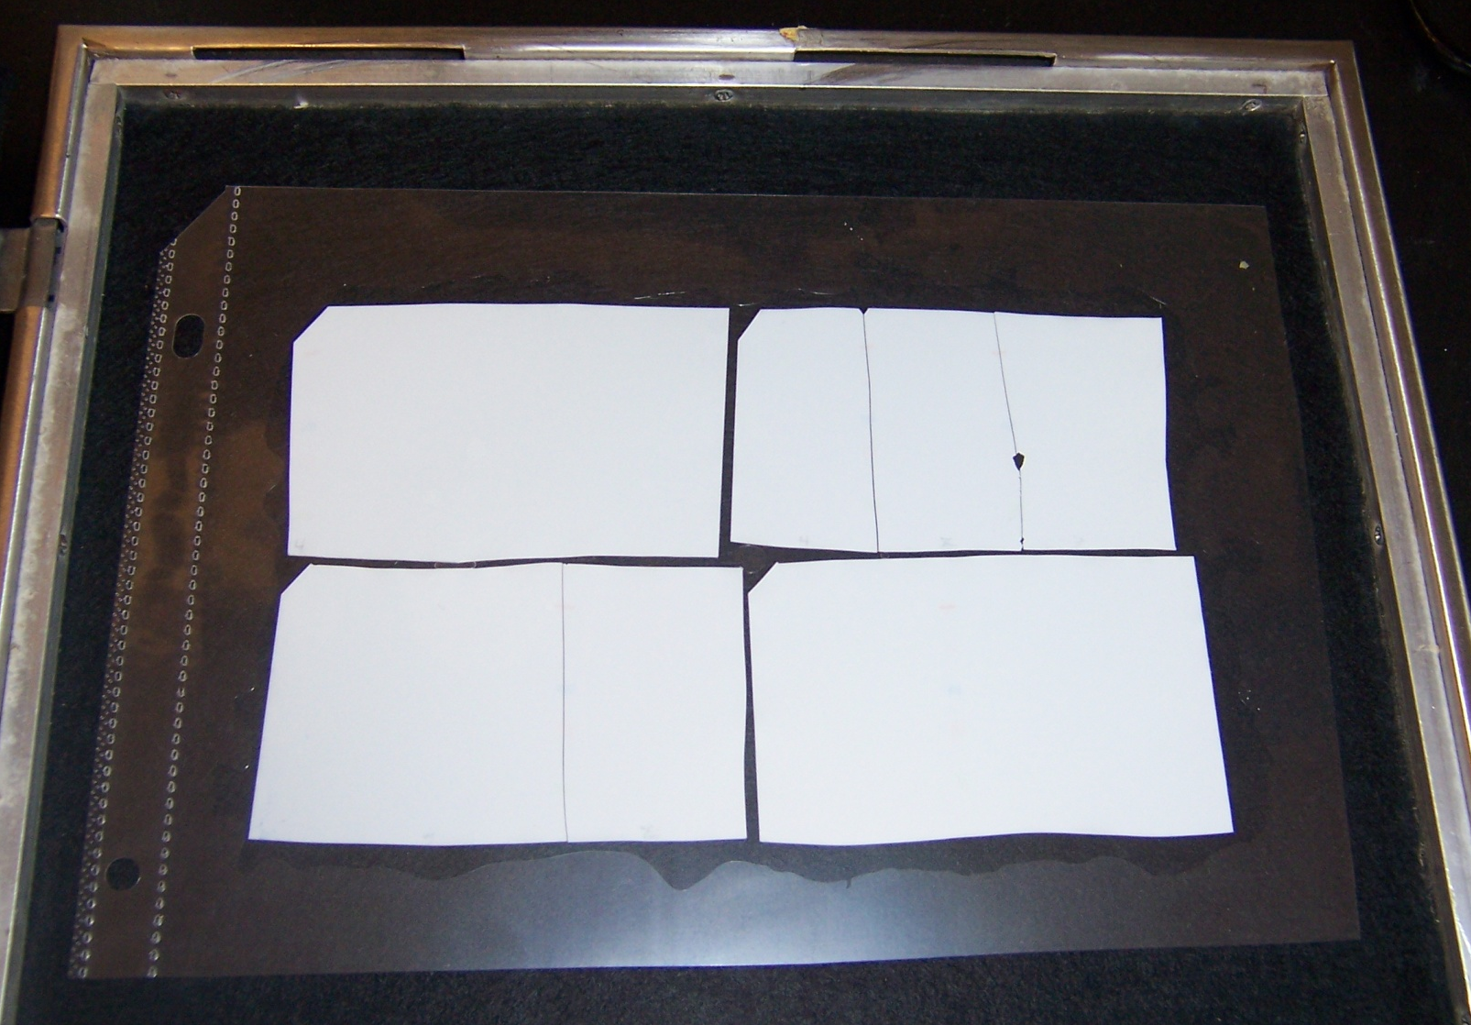
Exposing Blots to Film (HRP)
Page Protectors
  Works better than saran wrap for storing blots, don’t have to worry about wrinkles
Make sure no air bubbles, but also don’t too forceful such that there is little developing solution on blot
Fuzzy bands
  Possible that film was not flat on blot
  The greater the distance between film and blot, the more time for light to diffract and thus broaden the band
White in the middle of a band
  If you have too much signal, the substrate can be used up, paradoxically reducing your signal
  Signal is usually highest in center of a band, thus this is the area where substrate will be depleted first

Slide 16
Quantification
ImageJ [18]
  Free from NIH
ImageQuant
  Available on Typhoon computers ($oftware)
Other free programs
  LiCor Image Studio [19]
    Like a hybrid of ImageJ and ImageQuant
  Others?

Slide 17
Quantification - Pitfalls
Non-linearity
  Film only has a dynamic range of ~1.8 orders of magnitude (65x)
  Saturated signal does not give accurate quantification
  Binding capacity of membrane
Inter-blot comparisons
  All quantification needs to be intra-blot unless an identical sample is loaded between blots to normalized

Slide 18
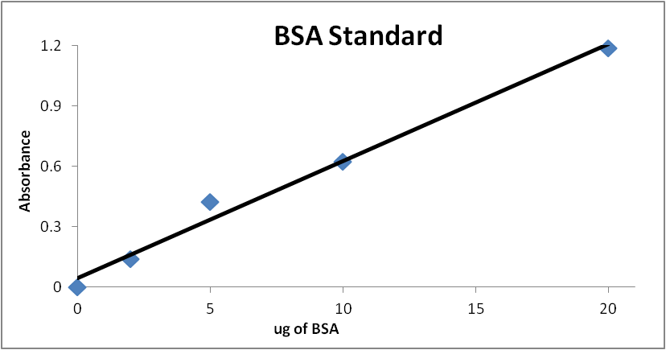
Quantification - Pitfalls
All values are relative
without a standard
quantified by some other
means
  Compare to how you do
  a protein assay (bradford/
  lowry)
  Protein levels can vary with respect to each other, but claims such as “twice as much protein A as protein B” cannot be made without a standard
Substrate can be limiting for enzyme coupled 2° antibodies
  White in the middle of HRB band = depleted substrate

Slide 19
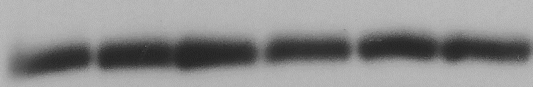
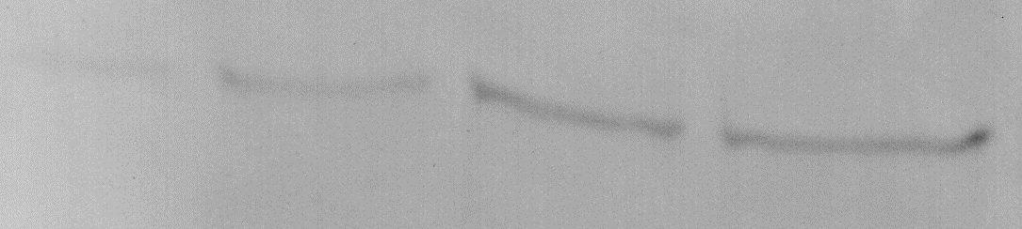
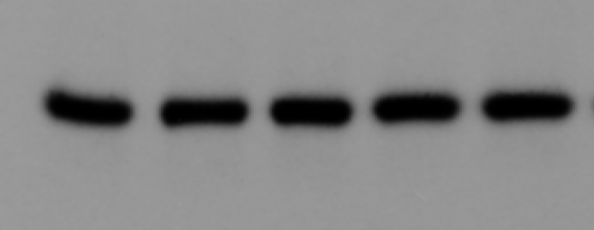
Quantification
Bands need to be of appropriate intensity (not saturated) and separated
  Stacking can cause bands to spread in the horizontally
    Likely caused by salts
  pH 8.8 + glycerol stacking gel
  Addition of salt to equalize between samples

Slide 20
Staining of Membranes
Ponceau [20]
  Quick, reversible stain (red)
  Limited detection
Coomassie [20]
  Works poorly for Nitrocellulose (almost irreversible binding
India ink [20]
  Irreversible, easy stain, black bands
  May or may not effect antigenicity
Can’t stain post-western if protein-based blockers used
  Another pro for Tween-20 blocking

Slide 21
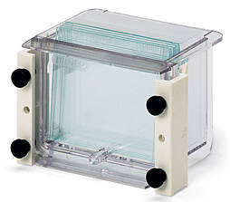
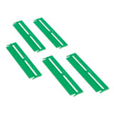
Tools
Tien Lab
  Gradient gel casting equipment
  Multi-gel caster (12x) [Biorad #165-4110]
  Combs for 2nd dimension SDS-PAGE
Dark room
  4th Floor S. Frear
  2x in Althouse
Typhoon Scanners
  4th Floor S. Frear
  206 Althouse (better one; more lasers)

Slide 22
Primary Antibody Development
Peptide
  Design unique 20-30-mer peptide
  Affinity purification by coupling to gel in column format
  Highly flexible, but $$$$
Protein
  Heterologous express all or part of target protein
    Or purify from source…
  Purification
    By coupling to gel in column format
    Transfer protein to membrane, bind antibodies, elute from membrane [21]
Background removal
  Cross-purify with similar proteins
  Incubate antibody with strip of membrane containing protein from knockout line

Slide 23
Crazy Other Stuff
Alternative membranes [7]
  Teflon
  GORE-TEX
  Compatible with other chemistries (C-terminal sequencing)
Odd “membranes” [7]
  Coomassie gel → overhead transparency
  Activated glass for microsequencing
Soaking gels in PEG enhances transfer efficiency [7]

Slide 24
Crazy Other Stuff
MALDI-TOF mass spec directly from a membrane [7]
  in silico western blot
Antibodies to carbohydrates [22,23]
Making membranes translucent for densitrometry [7]
  Nitrocellulose
    3in1 oil
    Tween-80
  PVDF
    Ethylene glycol/glycerol

Slide 25
My Protocol
Transfer 2 Hr @ 100V for
Dry Membrane
Block 20-30 min in Tween-20
1° Antibody for 30 Min
A single 10 min wash
2° Antibody for 30 min
3x 5min washes
Develop w/HRP + Film
Digitize and then quantify with ImageJ

Slide 26
References
[1] Cubillos-Rojas, M., Amair-Pinedo, F., Tato, I., Bartrons, R., Ventura, F., & Rosa, J. L. (2010). Simultaneous electrophoretic analysis of proteins of very high and low molecular mass using Tris-acetate polyacrylamide gels. Electrophoresis, 31(8), 1318–21.
[2] Schägger, H. (2006). Tricine-SDS-PAGE. Nature Protocols, 1(1), 16–22. doi:10.1038/nprot.2006.4
[3] Wu, M., & Kusukawa, N. (1998). SDS agarose gels for analysis of proteins. BioTechniques, 24(4), 676–8.
[4] Greaser, M. L., & Warren, C. M. (2009). Efficient electroblotting of very large proteins using a vertical agarose electrophoresis system. In B. T. Kurien & R. H. Scofield (Eds.), Protein Blotting and Detection (Vol. 536, pp. 221–227). Totowa, NJ: Humana Press. doi:10.1007/978-1-59745-542-8
[5] Rabilloud, T., Vincon, M., & Garin, J. (1995). Micropreparative one- and two-dimensional electrophoresis: improvement with new photopolymerization systems. Electrophoresis, 16(8), 1414–22.
[6] Rabilloud, T. (2010). Variations on a theme: changes to electrophoretic separations that can make a difference. Journal of Proteomics, 73(8), 1562–72. doi:10.1016/j.jprot.2010.04.001
[7] Kurien, B. T., & Scofield, R. H. (2009). A brief review of other notable protein blotting methods. Methods in Molecular Biology (Clifton, N.J.), 536(1), 367–84.

Slide 27
References
[8] Towbin, H., Staehelin, T., & Gordon, J. (1979). Electrophoretic transfer of proteins from polyacrylamide gels to nitrocellulose sheets: procedure and some applications. Proceedings of the National Academy of Sciences of the United States of America, 76(9), 4350–4.
[9] Bjerrum, O. J., & Schafer-Nielsen, C. (1986). Buffer systems and transfer parameters for semi-dry electroblotting with horizontal apparatus. Dunn Electrophoresis, 315–327.
[10] http://www.lifetechnologies.com/us/en/home/references/protocols/proteins-expression-isolation-and-analysis/western-blot-protocol/western-blotting-using-nitrocellulose-membranes.html
[11] Batteiger, B., Newhall, W. J., & Jones, R. B. (1982). The use of Tween 20 as a blocking agent in the immunological detection of proteins transferred to nitrocellulose membranes. Journal of Immunological Methods, 55(3), 297–307
[12] http://www.agrisera.com/en/info/western-blot.html
[13] Mansfield, M. A. (1995). Rapid immunodetection on polyvinylidene fluoride membrane blots without blocking. Analytical Biochemistry, 229(1), 140–3.
[14] Li, W., Murai, Y., Okada, E., Matsui, K., Hayashi, S., Horie, M., & Takano, Y. (2002). Modified and simplified western blotting protocol: use of intermittent microwave irradiation (IMWI) and 5% skim milk to improve binding specificity. Pathology International, 52(3), 234–8.

Slide 28
References
[15] http://www.abcam.com/index.html?pageconfig=resource&rid=11353
[16] Yeung, Y., & Stanley, E. R. (2009). A solution for stripping antibodies from polyvinylidene fluoride immunoblots for multiple reprobing. Analytical Biochemistry, 389(1), 89–91. doi:10.1016/j.ab.2009.03.017
[17] Gingrich, J. C., Davis, D. R., & Nguyen, Q. (2000). Multiplex detection and quantitation of proteins on western blots using fluorescent probes. BioTechniques, 29(3), 636–42.
[18] http://imagej.nih.gov/ij/
[19] http://www.licor.com/bio/products/software/image_studio_lite
[20] Dunn, M. J. (1998). Detection of Total Proteins on Western Blots of 2-D Polyacrylamide Gels. In 2-D Proteome Analysis Protocols (Vol. 112, pp. 319–329). New Jersey: Humana Press. doi:10.1385/1592595847
[21] Kurien, B. T. (2009). Affinity Purification of Autoantibodies from an Antigen Strip Excised from a Nitrocellulose Protein Blot. In B. T. Kurien & R. H. Scofield (Eds.), Protein Blotting and Detection (Vol. 536, pp. 201–211). Totowa, NJ: Humana Press. doi:10.1007/978-1-59745-542-8
[22] Heimburg-Molinaro, J., & Rittenhouse-Olson, K. (2009). Development and characterization of antibodies to carbohydrate antigens. Methods in Molecular Biology, 534, 341–57. doi:10.1007/978-1-59745-022-5_24
[23] http://www.ccrc.uga.edu/~mao/wallmab/Antibodies/antib.htm

Slide 29
Western Transfer Buffer Recipes (Tank)
Towbin’s
  25 mM Tris-HCl pH 8.3, 192 mM glycine, 20% (v:v) methanol
  Should not need to pH yourself
Bjerrum Schafer-Nielsen
  48 mM Tris, 39 mM glycine, 20% methanol
  Should not need to pH yourself
CAPS
  10 mM CAPS pH 10.5, 10% (v:v) methanol
  Should not need to pH yourself
Dunn Carbonate
  10 mM NaHCO₃, 3mM Na₂CO₃, pH 9.9, 20% methanol
Acetic Acid
  0.7% Acetic Acid

Slide 30
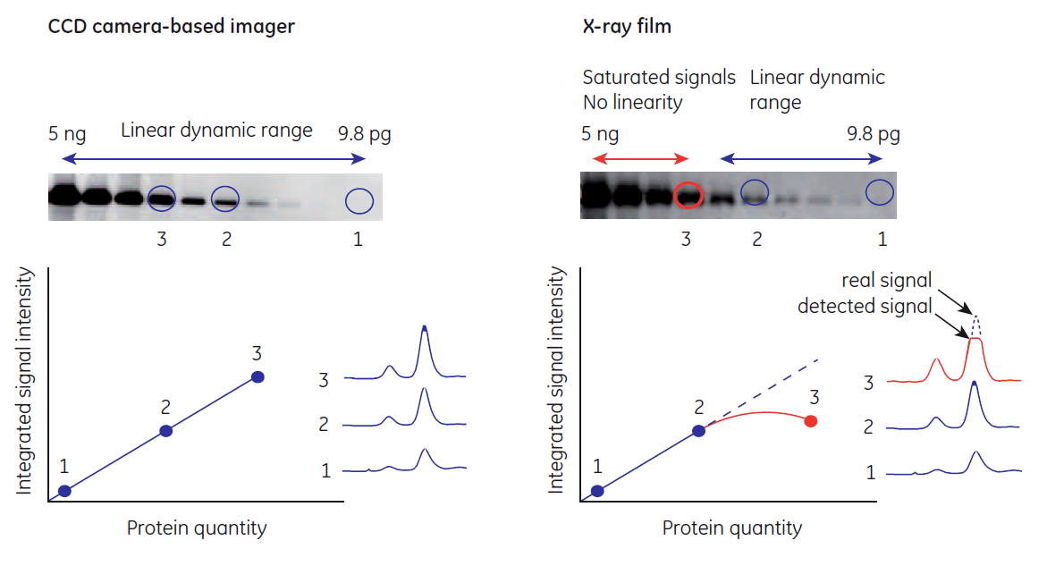
Film vs. Fluorescence – Dynamic Range
Westen blotting principles and methods

