Slide 1
Role of Integrin Glycosylation in Binding and Function
Lauren Barney
Peyton Group Meeting
November 23, 2015

Slide 2
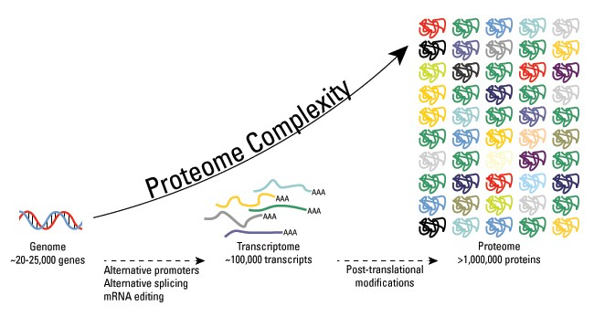
Post-Translational Modifications Increase Proteomic Diversity
Post-translational modifications:
Phosphorylation
Glycosylation
Ubiquitination
S-Nitrosylation
Methylation
N-Acetylation
Lipidation
Proteolysis
Notes:
https://www.thermofisher.com/us/en/home/life-science/protein-biology/protein-biology-learning-center/protein-biology-resource-library/pierce-protein-methodsoverview-post-translational-modification.html

Slide 3
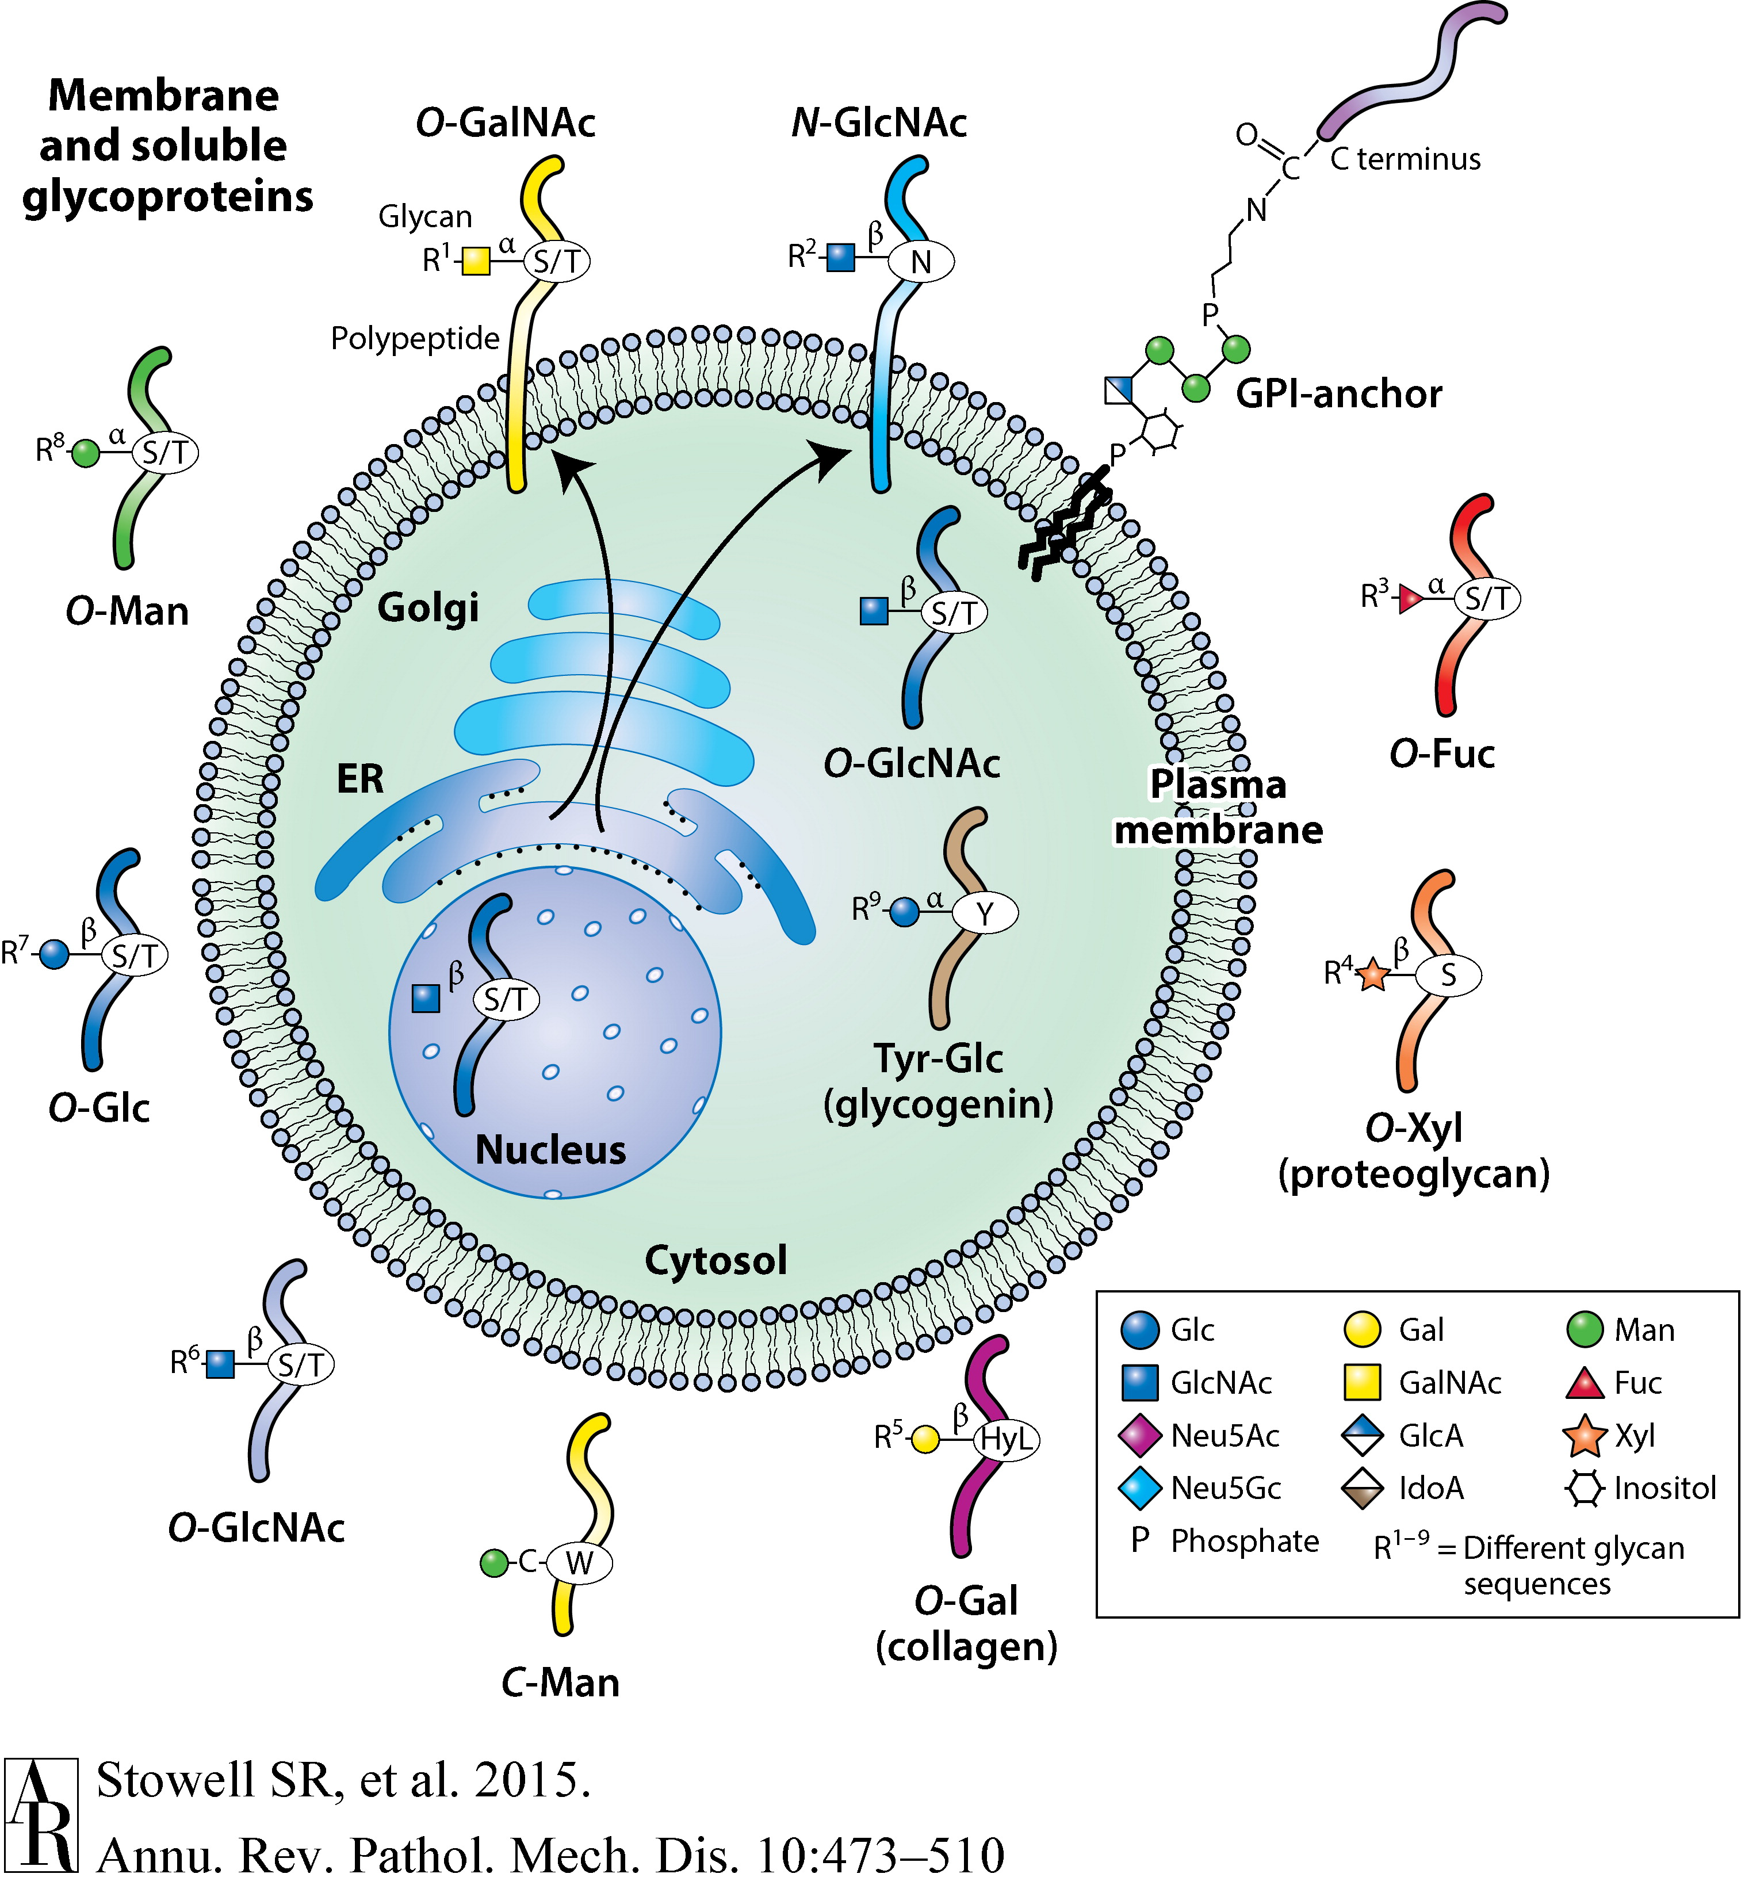
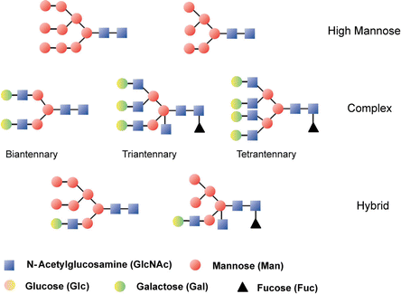
What is glycosylation?
Enzymatic addition of a carbohydrate to a protein, lipid, or other organic molecule (most often in ER or Golgi)
Biological purpose: proper protein folding, chemical stability, diversity in proteome, function & signaling
Many aspects of glycosylation can be varied on a single type or protein:
Glycosidic bond – the site of glycan linkage
Glycan composition — the types of sugars that are linked to a given protein
Glycan structure — can be unbranched or branched chains of sugars
Glycan length — can be short- or long-chain oligosaccharides
Notes:
Glyc initiated in ER, built upon in golgi
A common misconception is that protein glycosylation is relatively random and characterized by high degrees of heterogeneity. In reality, glycosylation is typically site specific, and specific classes of glycans are found on restricted subsets of glycoproteins
http://pubs.rsc.org/en/content/articlehtml/2008/an/b713816d
Figure:
Animal cells synthesize a wide assortment of glycoproteins in which different amino acids may be modified to contain specific glycan structures. Biosynthesis of such glycoproteins is initiated in the secretory pathway comprising the endoplasmic reticulum and Golgi apparatus of cells and can lead to membrane localization and secretion of glycoproteins. In addition, O-GlcNAc may be added to glycoproteins in the cytoplasm, nucleus, and mitochondria. This single GlcNAc residue is not extended but can be reversibly added and removed. The multiple other types of glycan linkages to proteins can be extended (R groups indicated) with many additional sugar molecules to form oligosaccharides or polysaccharides, all termed glycans. The 10 common monosaccharides that make up animal glycans are indicated: N-acetylglucosamine (GlcNAc), N-acetylgalactosamine (GalNAc), 5-N-acetylneuraminic acid (Neu5Ac, or sialic acid), fucose (Fuc), galactose (Gal), glucose (Glc), glucuronic acid (GlcA); iduronic acid (IdoA); mannose (Man), and xylose (Xyl). 5-N-Glycolylneuraminic acid (Neu5Gc), a non-natural sugar, is also shown. Other abbreviations: ER, endoplasmic reticulum; GPI, glycosylphosphatidylinositol; HyL, hydroxylated lysine.
http://www.nature.com.silk.library.umass.edu/nrm/journal/v13/n7/box/nrm3383_BX1.html
In mammals the major glycans com- prise 10 monosaccharide building blocks—glucose (Glc), galactose (Gal), N-acetylglucosamine (GlcNAc), N-acetylgalactosamine (GalNAc), fucose (Fuc), mannose (Man), xylose (Xyl), glu- curonic acid (GlcA), iduronic acid (IdoA), and 5-N-acetylneuraminic acid (Neu5Ac, or sialic acid)—all derivable from glucose in every cell (Figure 1) (4); thus, glycosylation is comparable to phosphorylation in terms of the range of modified sites
From Annual reviews paper in folder
Post-translational modification that happens in the rough ER
The majority of all proteins are glycosylated
N- and C-glycosylation take place in the endoplasmic reticulum and/or the Golgi apparatus and only extracellular or secreted proteins are concerned. In contrast, both intracellular and extracellular proteins can be O-glycosylated.

Slide 4
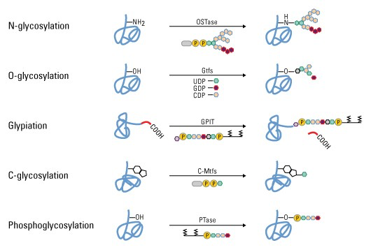
Many types of glycosylation, reactions mediated by glycosyltransferases
Attached to nitrogen on asparagine or arginine
Most common type, often an on/off switch, only extracellular proteins
Attached to hydroxyl oxygen of serine, threonine, tyrosine, hydroxylysine, hydroxyproline
Both intra and extracellular proteins
GPI anchor links lipid to protein through glycan linkage
Attached to tryptophan
Linked through phosphate of phospho-serine (phosphodiester bond)
Notes:
N-linked: most common type, often important for folding, and for cell-cell and cell-ECM attachment
-occurs in the lumen of the ER
-often important for protein function (on/off switch)
--only extracellular proteins are N-linked glycosylated
All N-linked carbohydrates are linked through N-Acetylglucosamine and the amino acid asparagine
-N because linked to amide nitrogen of asparagine
O-linked glycans:
Most O-linked carbohydrate covalent attachments to proteins involve a linkage between the monosaccharide N- Acetylgalactosamine and the amino acids serine or threonine.
Both cytoplasmic and extracellular proteins
-O-linked because linked to hydroxyls
C-linked glycans, a rare form of glycosylation where a sugar is added to a carbon on a tryptophan side-chain, specific sequence required
Glypiation: addition of a GPI anchor that links proteins to lipids through glycan linkages, common in proteins localized to cell membrane.
Phosphoglycosylation
oligosaccharides linked to serine or threonine in a peptide backbone via phosphodiesters.
The glycosylation of secreted and membrane glycoproteins requires the specific actions of an assortment of glycosyltransferases; over 200 gene-encoded enzymes are known (4). The molecular mechanisms of protein substrate recognition and modi- fication are very poorly understood,
Because it is enzyme mediated, glycosylation is NON RANDOM, although there are MANY possibilities that can happen
http://www.uniprot.org/help/carbohyd
https://www.thermofisher.com/us/en/home/life-science/protein-biology/protein-biology-learning-center/protein-biology-resource-library/pierce-protein-methods/protein-glycosylation.html
Oligosaccharide transferase (OSTase)
glycosyltransferases (Gtfs)

Slide 5
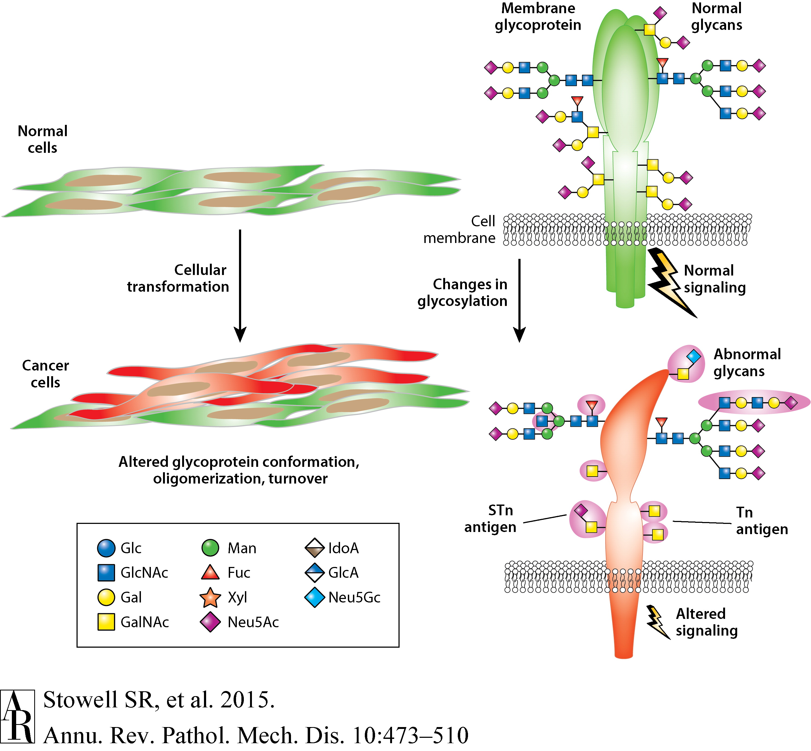
Glycosylation, like many things, is altered in cancer
Regulation is complex, depends in part upon:
Levels of enzymes throughout pathway, localization
Availability of protein substrates, sugars
Many transporters
pH in ER and Golgi
Notes:
Regulation of glycoslation depends on:
▪ Levels of expression of specific glycosyltransferases
▪ Localization of glycosyltransferases in the secretory compartments and other cellular compartments, such as the nucleus and mitochondria
▪ Expression of specific molecular chaperones that regulate protein folding and quality control of glycoproteins and glycosyltransferases
▪ Site- and protein-specific nature of glycosyltransferases
▪ Levels of expression of specific glycosidases in the processing pathway
▪ Levels of expression of lysosomal hydrolases in lysosomes and cellular secretions
▪ Availability of protein substrates
▪ Availability and levels of nucleotide sugars and 3′-phosphoadenosine-5′-phosphosulfate (PAPS)
▪ Activity of nucleotide sugar and monosaccharide transporters
▪ Glycoprotein turnover kinetics
▪ pH of the ER and Golgi
▪ Competition reactions between glycosyltransferases for similar glycan acceptors

Slide 6
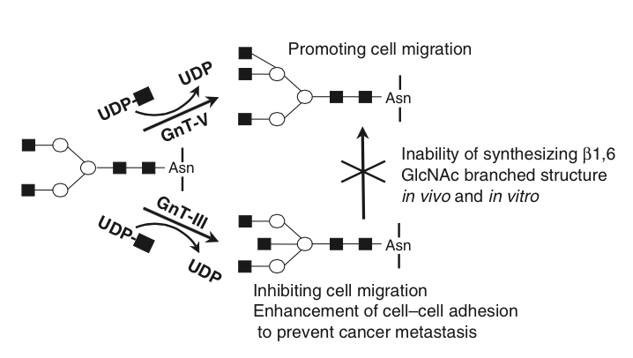
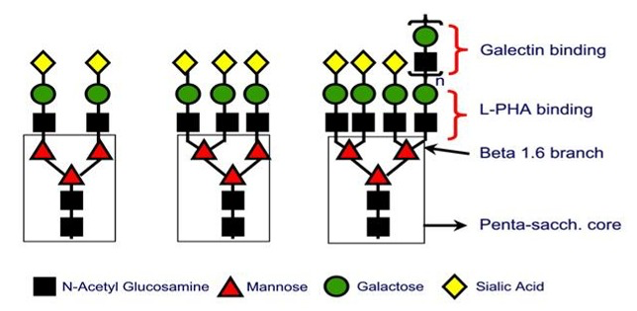
Integrin Glycosylation Overview
Integrins can have many glycosylation sites (26 in a5b1)
β1,6 branching of N-linked oligosaccharides is very often highly expressed in cancer cells
  Caused by increased transcription (GnT-V).
  GnT-V transcription is stimulated by several oncogenes including src, her-2/neu, H-ras, and v-sis
14 sites
12 sites
Koyama and Hughes, JBC, 1992; Bellis, Biochem Biphys Acta, 2004; Zhao 2008
Notes:
The fibronectin receptor a􏰀5b􏰁1 contains a total of 26 putative N-linked glycosylation sites (14 on 􏰀a5 and 12 on 􏰁b1), although it is not known which of these sites are used.
One of the most common forms of glycosylation in transformed cells and human tumors is the highly elevated β1,6 branching of N-linked oligosaccharides caused by increased transcription of N-acetylglucosaminyltransferase V (GnT-V).
Image: http://www.actrec.gov.in/pi-webpages/RajivKalraiya/rajiv-projects.htm

Slide 7
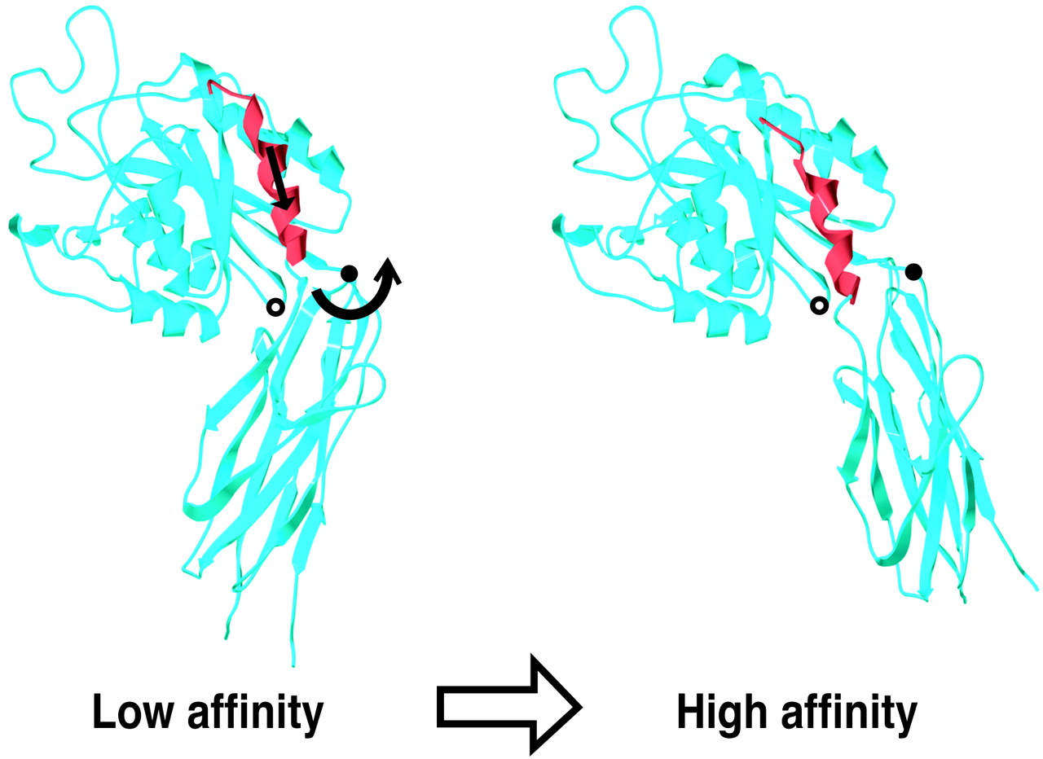
How does glycosylation affect integrin function?
N-Glycosylation may affect b1 integrin conformation
Glycan chains can interact with polypeptide backbone
Glycosylation restricts dynamic conformation fluctuation
Glycosylation induced conformation change can activate integrins
Glycosylation masks critical function domains
Via their size, charge
Complex relationship, dependent upon each integrin and ligand
Glycsylation can affect interactions between integrins and other proteins
EGFR, tetraspanins, etc
β3 head (I-like and hybrid domains)
Luo et al., PNAS, 2003
Notes:
This site is far from the ligand-binding site on the upper face of the I-like domain containing the metal ion-dependent adhesion site and thus should only enhance ligand binding allosterically.
Protein structure:
Linkage between swing-out of the hybrid domain and pull-down of the I-like domain C-terminal helix. Model of β3 head (I-like and hybrid domains) shows that outward swing of the hybrid domain about the pivot point (residue 106, filled circle) results in downward shift of the C-terminal helix of I-like domain (red). Position of Asn-303 used for glycan wedge mutation is denoted by an white circle.
From review paper
The mechanisms that link altered glycosylation to altered function have not been defined, although many mechanisms can be speculated. One of the obvious possibilities is that N- glycosylation influences protein conformation.
Spatial con- formation studies indicate that h1-6-linked poly-N-acetyl- lactosamine chains bend back toward the protein rather than extending into the extracellular milieu, implying that this structure could interact with the polypeptide backbone [109,110]. Other studies, based on NMR analyses, suggest that glycosylation restricts dynamic fluctuations in protein conformation [111 – 113]. This is due, at least in some cases, to stabilizing interactions between the glycan and selected amino acid residues [111,112]. Finally, exciting new work from Luo et al. [114] provides very convincing evidence for conformational regulation by N-glycans.
In this study, an asparagine residue was substituted for a proline in the h1 integrin subunit at amino acid #333. Upon expression in CHO-K1 cells, this asparagine was N-glycosylated, and it was elegantly shown that a5h1 integrins with these aber- rantly glycosylated h1 subunits assumed an active ligand- binding conformation. Although the introduction of an asparagine residue at site 333 does not mimic any known naturally occurring mutation, clearly these studies provide proof of principal that altered glycosylation can affect integrin conformation.
Another possibility is that the large size (or charge) of N-glycans masks critical functional domains within the integrin heterodimer. In fact, masking of peptide, or particularly carbohydrate (e.g., galactose), epitopes is thought to be one of the important functions of sialic acid [96,115]. However, our research suggests that any rela- tionship between sialic acid masking and integrin function may be complex. We find that the enzymatic de-sialylation of purified a1h1 integrins inhibits a1h1 binding to collagen (the preferred ligand for this receptor), whereas de-sialylation of a5h1 stimulates fibronectin binding [7,8]. Like a5h1, de-sialylated a3h1 integrins exhibit enhanced ligand binding [30].
It is tempting to speculate that the fundamental difference in the effects of sialylation on the function of a1h1, versus a5h1 or a3h1, has something to do with the fact that a1, but not a5 or a3, subunits have an ‘‘I’’ domain, a domain thought to bind directly to integrin ligands [116,117]. The h1 subunit has an ‘‘I-like’’ domain, and it is hypothesized that, in heterodimers lacking I domain-containing a subunits, ligand binds directly to the h1 I-like domain [116]. Conversely, in heterodimers that have an a I domain, the conformation of the h1 subunit is thought to allosterically regulate a I domain/ligand interactions. Hence, the mechanisms regu- lating ligand binding appear to be fundamentally different for integrin heterodimers with and without I-domain-con- taining a subunits. Surprisingly, the h1 integrin asparagine residues that carry N-linked carbohydrates have not yet been identified, so it is currently difficult to speculate how altered sialylation (with the corresponding change in negative charge) could affect integrin conformation and/ or ligand recognition. However, two of the 12 asparagine residues that have consensus for N-glycosylation [118] lie within the h1 integrin ‘‘I-like’’ domain, and therefore, carbohydrate modifications at these sites would likely affect ligand binding.

Slide 8
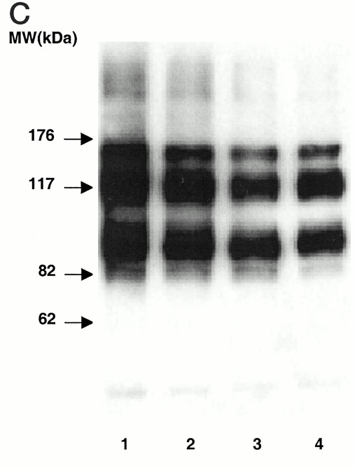
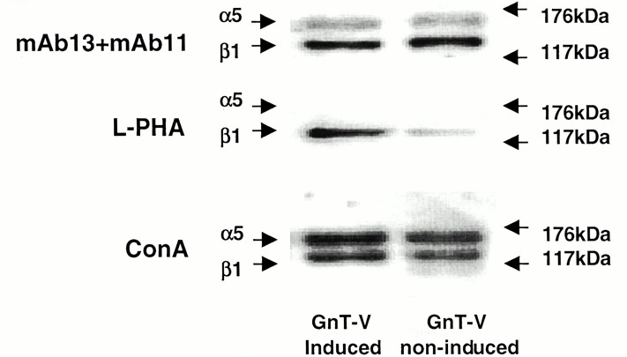
Aberrant N-Glycosylation of 􏰁b1 Integrin Causes Reduced 􏰀a5b􏰁1 Integrin Clustering and Stimulates Cell Migration (fibrosarcoma)
Overexpress N-acetylglucosaminyltransferase V (GnT-V) → increase b-1,6 branching of N-linked oligosaccharides
Induced GnT-V: decreased adhesion, decreased a5b1 clustering, increased migration (wound healing, boyden chamber)
Tetracycline-off inducible expression of GnT-V
No tet 1 ng/ml 1ug/ml Mock
No change in expression of a5 or b1, but change in localization
Only b1-6 branching on b1
Both bind ConA
L-PHA: binds to b-1-6 branches
Guo et al., Cancer Research, 2002
Notes:
one of the most common forms of glycosylation in transformed cells and human tumors is the highly elevated 􏰁1,6 branching of N-linked oligosac- charides caused by increased transcription of N-acetylglucosaminyltransferase V (GnT-V)
human fibrosarcoma HT1080 cells were transfected with retroviral systems encoding GnT-V that used both noninducible and tetracycline-inducible promoters. Increased GnT-V expression resulted in a >25% inhibition of cell attachment to and a >50% inhibition of cell spreading on fibronectin.
Lectin blot - Cells were harvested, rinsed with PBS, and lysed with 1% Triton X-100 in PBS. Cell lysates containing 30 􏰂g of protein were boiled in SDS sample buffer with or without 􏰁-mercaptoethanol, loaded on 4–20% SDS-PAGE gels, and then transferred onto a PVDF membrane. After being blocked with 1% BSA, the membrane was incubated with 1 􏰂g/ml biotinylated L-PHA in blocking solution for 1 h followed by the incubation with a 1:5000 dilution of streptavidin-HRP for another 30 min at room temperature. The blots were washed and developed with the ECL detection system using X-ray film. Quantification was obtained using a Fluor-S scanner (Bio-Rad).
IP:
The results of these experiments (Fig. 7C) ⇓ showed that the subunits could be distinguished and that each bound the lectin ConA. Surprisingly, however, only the β₁ subunit and not the α₅ subunit was bound by L-PHA, demonstrating that β1,6 branching could be detected only on the β₁ subunit. When GnT-V activity was induced, significant increases in L-PHA staining (>3-fold) were observed on the β₁ subunit. Even after induction, however, no L-PHA binding to the α₅ subunit was observed, suggesting a selective glycosylation of the β₁ subunit by GnT-V. These results demonstrate that induction of GnT-V activity caused increased β1,6 branching on the β₁ subunit and that the effects of increased GnT-V expression on fibronectin-mediated adhesive phenotypes likely result from this altered glycosylation.

Slide 9
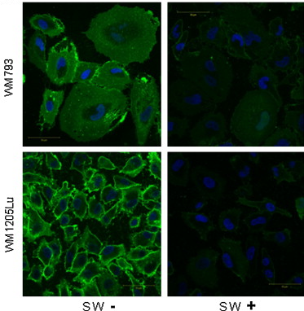
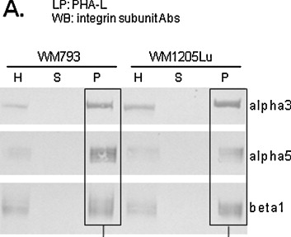
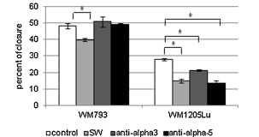
GlcNAc 􏰁1,6 branching influences metastatic melanoma cell migration
WM793: primary tumor
WM1205Lu: metastatic
SW: inhibits Golgi 􏰀-mannosidase II and consequently obstructs the carbohydrate processing pathway prior to the initiation of GlcNAc 􏰁1,6 branching
H: Homogenate
S: Supernatant
P: precipitate
PHA-L staining
Alpha3: Laminin, Thrombospondin
Alpha5: Fibronectin, Osteopontin
Migration on FN
Affected by glycosylation
Only affected by integrins in the more metastatic cell line
Pochec et al., European Journal of Cell Biology, 2013
Notes:
Melanoma cell lines: vertical growth phase (VGP) (WM793 cell line) to the metastatic stage (WM1205Lu line)
IF images:
(B) Some cells growing on FN-covered slides were treated with SW (10 μg/ml RPMI medium supplemented with 10% FBS). After 24 h, SW-treated and control cells were fixed with 2% PFA and incubated with Alexa Fluor 488-labeled PHA-L (1:100).
Wound healing assay:
Primary tumor cells migrated more, potentially because they are larger and occupy a larger area?
IP:
Integrin subunits α3 and α5 differ in β1,6 glycan branching. Whole-cell lysate proteins (250 μg) were precipitated with 25 μl agarose-bound PHA-L. The captured glycoproteins were recovered by boiling in Laemmli sample buffer. PHA-L precipitates (P), cell homogenates (H) and supernatants (S) collected after precipitation were resolved by 10% SDS-PAGE followed by Western blotting and probed with specific anti-integrin chain antibodies: rabbit polyclonal anti-α3 (Chemicon, AB1920), rabbit polyclonal anti-α5 (Chemicon AB1928) and mouse monoclonal anti-β1 (Chemicon, MAB2251, clone B3B11). PHA-L-positive integrin subunits were visualized by AP colorimetric reaction (A) and the glycoprotein band intensities were measured densitometrically (B). LP – lectin precipitation.
Densitometric analysis of WB revealed differences between the two cell lines in the amount of GlcNAc 􏰁1,6 glycans on integrin subunits 􏰀3 and 􏰀5. Subunit 􏰀3 possessed more structures recognized by PHA-L in WM1205Lu cells than in non-metastatic cells (Fig. 5), a result confirmed by immunodetection of this subunit in SW-treated and untreated cells

Slide 10
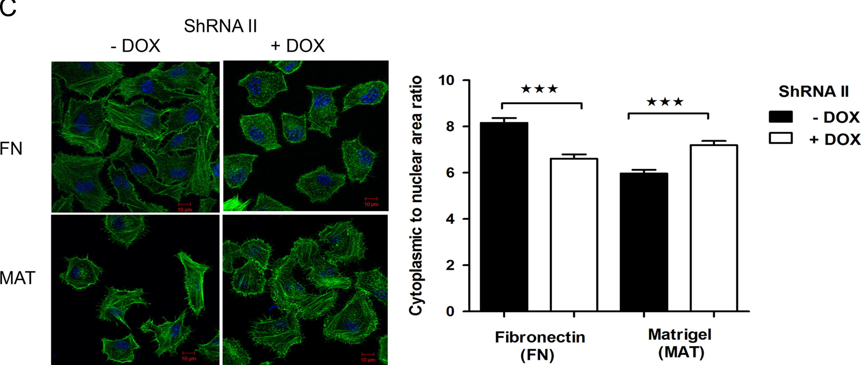
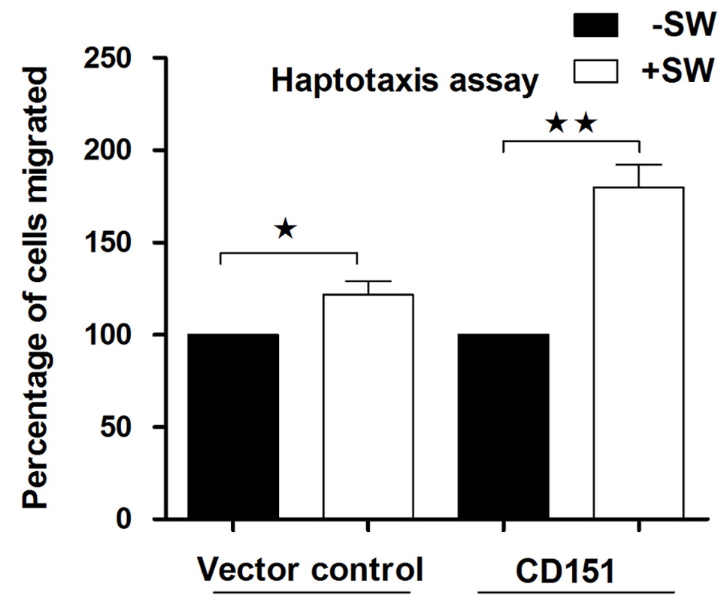
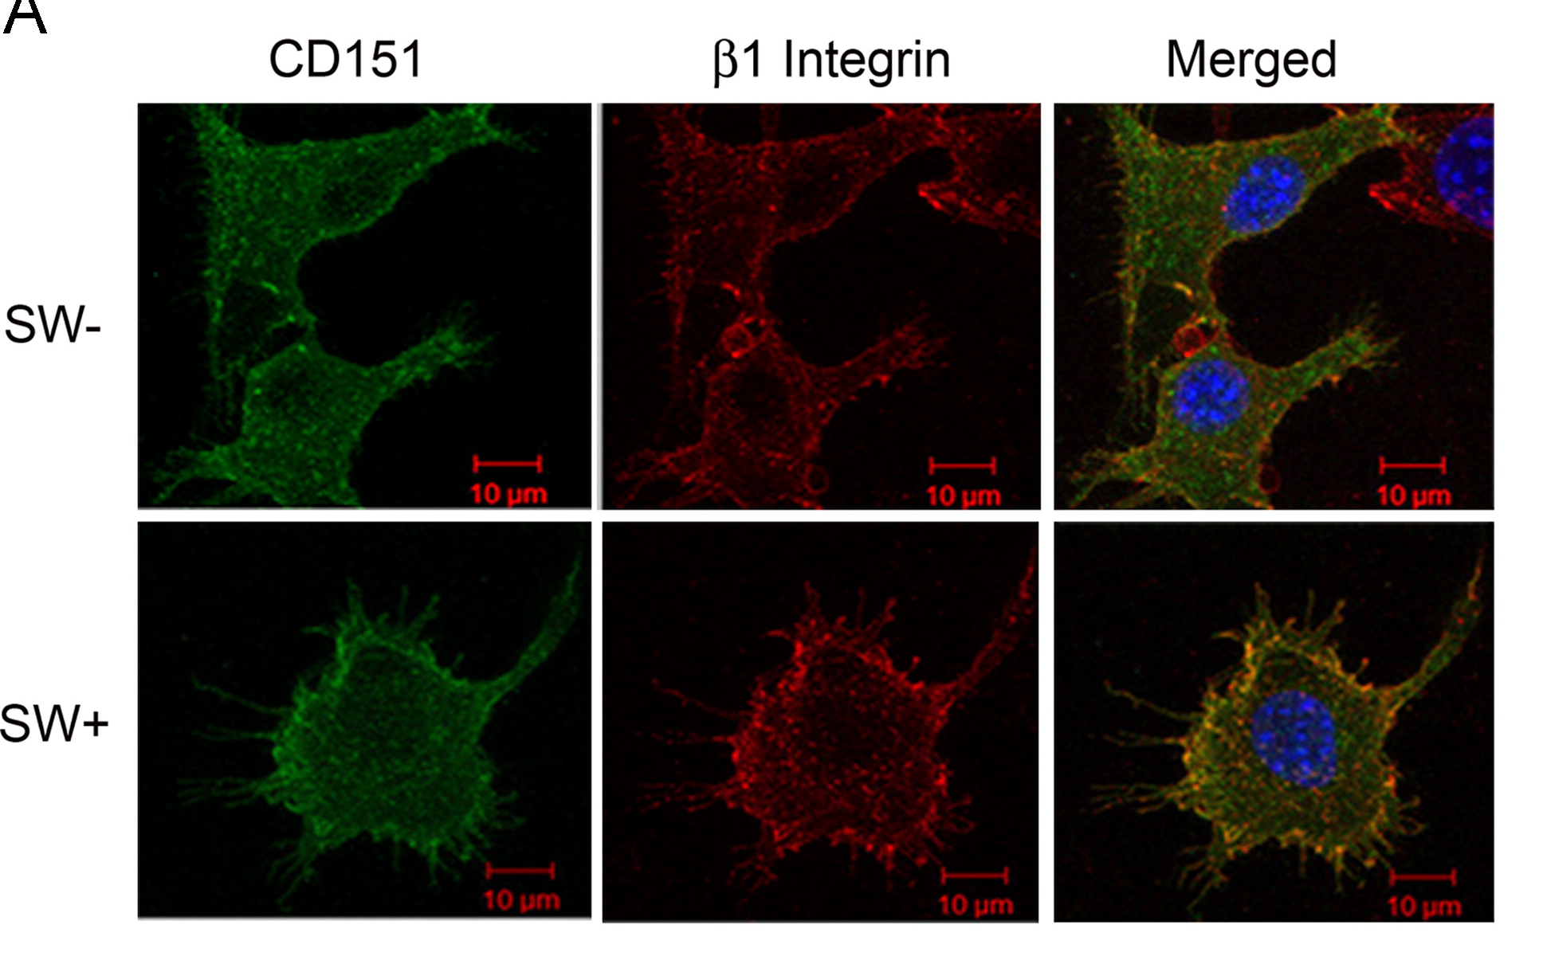
Glycosylation of a3b1 regulates its association with CD151
Green: f-actin
B16BL6 (murine melanoma)
Same results with SW inhibition as well as shRNA to GnT-V enzyme
CD151 transfected
SW treatment → increased colocalization
Transwell coated with matrigel
Ranjan et al., Experimental Cell Research, 2014
Notes:
To explore the mechanism and to evaluate the significance of these observations in terms of invasion, highly invasive B16BL6 cells were compared with the parent (B16F10) cells or B16BL6 cells in which glycosylation was inhibited.
Further, both the subunits of integrin receptors for fibronectin (α5β1) and laminin (α3β1) on B16BL6 cells were shown to carry these oligosaccharides. Although, glycosylation of receptors had no effect on their surface expression, it had same differential effect on cell spreading as haptotactic motility.
Here we show that glycosylation on α3β1 impedes its association with CD151 and modulates spreading and motility of cells apparently to reach an optimum required for invasion of BM.
Normally, the integrin function is regulated by their lateral association with another family of cell surface proteins known as tetraspanins (TSPs)
Area – inverse response depending on ECM
GntV transfection has same effect
Tetraspanins are the key regulators of integrin receptor localization and functions. Most tetraspanins except CD151 and CO-029 are downregulated in invasive cells.
No change in expression of tetraspanin CD82 and CD151 which regulate fibronectin and laminin receptors respectively were compared in B16F10 and B16BL6 cells during treatment
Immunoprecipitated α6 integrin from these lysates showed that it possibly exists as α6p form (70 kDa protein) which was found to be associated mainly with β1 integrin but not with β4 integrin as immunoprecipitates did not show β4 integrin even on longer exposure (Supplementary Fig. 4B). Although α6p showed a marginal reduction in size in SW treated cells, showed no reactivity to L-PHA in the immuno- precipitates of the lysates from untreated cells (Supplementary Fig. 4C). The association of α6 integrin (α6p form) with CD151 thus appears to be largely independent of their glycosylation status
lysates of cells expressing FLAG tagged CD151 were used for immunoprecipitation employing FLAG M2 affinity gel, and the bound protein was eluted with 3 FLAG
peptide. Immunoprecipitates from cell lysates of SW treated and untreated cells indeed showed that SW treatment significantly augments the association of CD151 with both α3 and β1 integrin subunits of the major laminin receptor (
Haptotaxis graph: Comparison of the haptotactic motility of untreated (−SW) and SW treated (+SW) vector control and GFP-tagged CD151 transfected B16BL6 cells (CD151) on 24 well transwell units coated with matrigel.

Slide 11
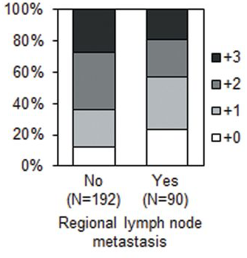
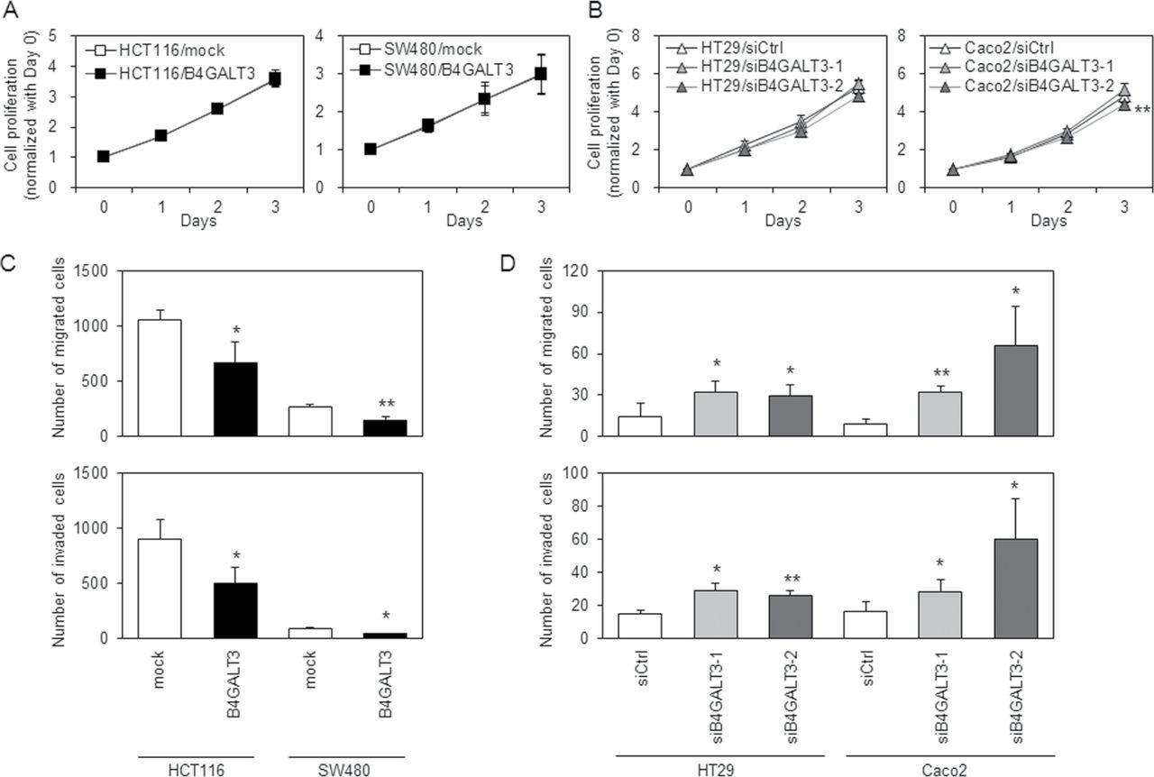
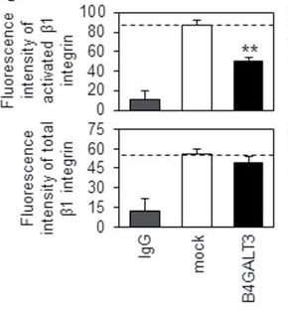
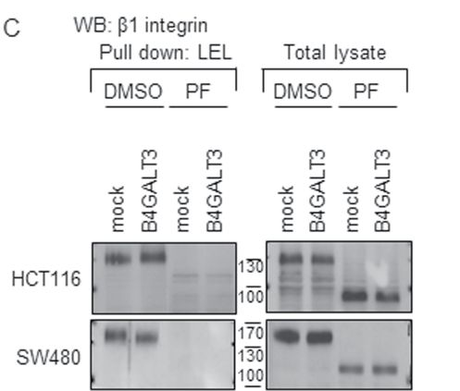
β-1,4-Galactosyltransferase III suppresses β1 integrin-mediated invasion
β-1,4-Galactosyltransferases III (B4GALT3) catalyzes the biosynthesis of poly-N-acetyl lactosamines
Overexpress B4GALT3
Also decreases adhesion to Lam, FN, CIV
Opposite effect if you knockdown in high expressing cells
Higher B4GALT3 expression, better prognosis
(IHC tissue microarray)
Lectin pull down, Use PNGase F to remove N-Glycans → no longer pull down b1 integrin
LEL: b1-4 linkages
Similar effect in downstream molecules (pFAK, p-paxillin)
Chen et al., Carcinogenesis, 2014
Notes:
B4GALTs transfer galactose (Gal) from uridine diphosphate galactose to N-acetylglucosamine (GlcNAc)-terminated oligosaccharides to form N-acetyllactosamine.
we chose HCT116 and SW480 to overexpress B4GALT3 because the two cell lines expressed B4GALT3 relatively low. HT29 and Caco2 were used for B4GALT3 knockdown because the B4GALT3 expression in these cells was relatively high among all cell lines.
To verify the glycosylation changes on β1 integrin, three lec- tins recognizing different Gal-related glycan structures were used in a lectin pull-down assay. RCA I binds preferentially to termi- nal Gal, ECL recognizes N-acetyllactosamine and LEL prefers poly-N-acetyllactosamines.
PNGase F was used to remove N-glycan from glycoproteins. The binding of LEL to β1 integrin was almost com- pletely eliminated by PNGase F treatment in all cells

Slide 12
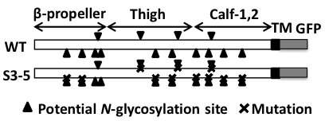

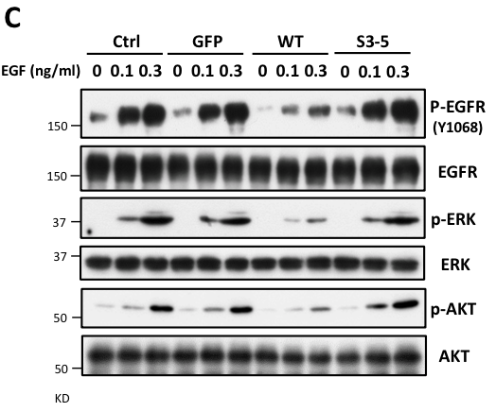
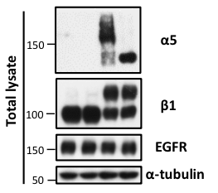
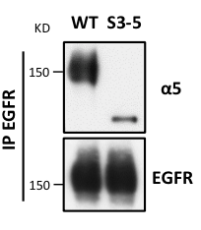
Integrin α5 suppresses the phosphorylation of EGFR via N-glycosylation
CHO cells:
-express EGFR
-alpha5 or mutant alpha5 (S3-5, only 3 of 14 glycosylation sites)
Expression of WT a5 limits EGFR activation, glycoslyation mutant does not
Hang et al., JBC, 2015
Notes:
To increase sensitivity for detection, primaquine, a receptor recycling inhibitor,
WT cells – slower EGFR internalization
These results clearly indicated that EGFR internalization was delayed by α5 via N-glycosylation, which might explain why the EGFR signaling was inhibited in the WT cells.
Reciprocal immunoprecipitates with anti-GFP agarose and anti-EGFR antibody showed that integrin α5 indeed interacted with EGFR (Fig. 6A), which was consistent with previous reports (44). This interaction was significantly decreased in the S3-5 cells, by comparison with WT (Fig. 6A).
These results strongly suggested that the interaction of EGFR and integrin α5 restricts EGFR activation and decreases EGFR responsiveness upon EGF treatment.

Slide 13
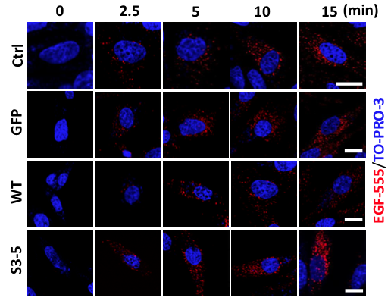
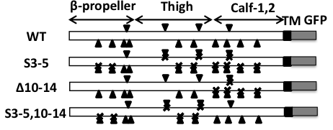
Integrin α5 suppresses the phosphorylation of EGFR via N-glycosylation
EGFR and a5 associate together more in WT cells
Affects localization, complex formation on membrane, recycling
Restoring sites 10-14 completely restores cells to WT state
Hang et al., JBC, 2015
Notes:
To increase sensitivity for detection, primaquine, a receptor recycling inhibitor,
WT cells – slower EGFR internalization
These results clearly indicated that EGFR internalization was delayed by α5 via N-glycosylation, which might explain why the EGFR signaling was inhibited in the WT cells.
Reciprocal immunoprecipitates with anti-GFP agarose and anti-EGFR antibody showed that integrin α5 indeed interacted with EGFR (Fig. 6A), which was consistent with previous reports (44). This interaction was significantly decreased in the S3-5 cells, by comparison with WT (Fig. 6A).
These results strongly suggested that the interaction of EGFR and integrin α5 restricts EGFR activation and decreases EGFR responsiveness upon EGF treatment.

Slide 14
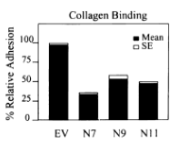
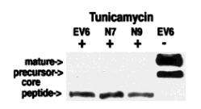
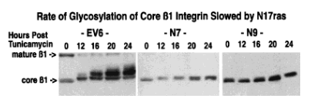
β1 integrin glycosylation mediated by TGFβ1 signaling through Ras
N17Ras: dominant negative variant
TGFb1
TGFbR2
TGFbR1
R1-R2 complex
Not rescued by supplementing or autocrine TGFb1 in transfected cells like in control cells
SMAD family
Primary pathway
Ras
Integrin maturation
Functionally: TGFb stimulation alters proliferation, differentiation, cell-matrix adhesion, matrix production
Bellis et al., J Cell Phys, 1999
Notes:
Tunicamycin: inhibits N-glycosylation

Slide 15
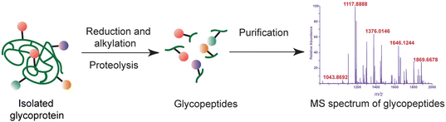
Mass spec is the most accurate way to determine specific glycans

Slide 16
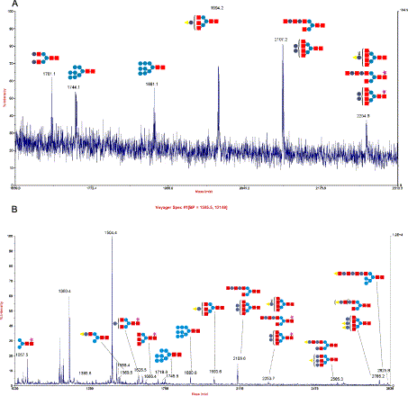
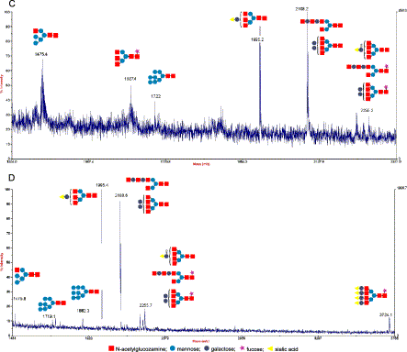
Mass spec is the most accurate way to determine specific glycans
WM35 (non-metastatic)
A375 (metastatic)
a3
a3
b1
b1
Pochec Biochim Biophys Acta, 2003
Notes:
Positive-ion MALDI MS mass spectrum of N-glycans obtained by PNGase F digestion of: α₃ subunit from WM35 cell line (A), β₁ subunit from WM35 cell line (B), α₃ subunit from A375 cell line (C), β₁ subunit from A375 cell line (D).
Characterisation of carbohydrate moieties of α₃ and β₁ subunits from non-metastatic (WM35) and metastatic (A375) human melanoma cell lines was carried out on peptide-N-glycosidase F-released glycans using matrix-assisted laser desorption ionization mass spectrometry (MALDI-MS).
β₁ integrin subunit from both cell lines displayed tri- and tetraantennary oligosaccharides complex type glycans, but only in A375 cell line was the sialylated tetraantennary complex type glycan (Hex₇HexNAc₆FucSia₄) present. In contrast, only α₃ subunit from metastatic cells possessed β1–6 branched structures.
In direct ligand binding assays, α₃β₁ integrin from both cell lines binds strongly to fibronectin and to much lesser degree to placental laminin. No binding to collagen IV was observed. Enzymatic removal of sialic acid residues from purified α₃β₁ integrin stimulates its adhesion to all examined ECM proteins.

Slide 17
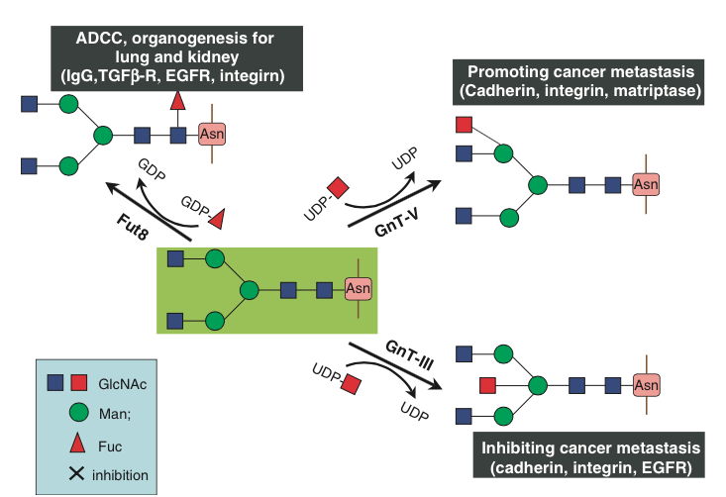
Summary & Conclusions
Glycosylation is complex, yet specific
Easy to compare global changes (eliminate all N-glycosylation), harder to determine effect of specific sites, specific oligosaccharides on specific proteins in living cells
Can either promote or inhibit function or phenotype

