Slide 1
Systems modeling and statistical analysis allows comparison in the response to cold shock in Saccharomyces cerevisiae between Δhap4-derived and randomly generated networks
Kristen M. Horstmann
Departments of Biology and Mathematics
Loyola Marymount University
Undergraduate Research Symposium
March 25, 2017

Slide 2
Outline
Yeast respond to cold shock by changing gene expression.
Microarray data was generated for yeast under cold shock conditions.
Data from the Δhap4 strain was used to create gene regulatory networks generated from the YEASTRACT database.
Random networks were generated based on this network using an R-script.
The dynamics of each gene in each network was modeled using ordinary differential equations.
Gephi was used to analyze connectivity and statistics of nodes in Δhap4 data-derived network.
Betweenness centrality seems to be a better indicator of connectivity than eccentricity.
Random networks are likely not biologically relevant.

Slide 3
Outline
Yeast respond to cold shock by changing gene expression.
Microarray data was generated for yeast under cold shock conditions.
Data from the Δhap4 strain was used to create gene regulatory networks generated from the YEASTRACT database.
Random networks were generated based on this network using an R-script.
The dynamics of each gene in each network was modeled using ordinary differential equations.
Gephi was used to analyze connectivity and statistics of nodes in Δhap4 data-derived network.
Betweenness centrality seems to be a better indicator of connectivity than eccentricity.
Random networks are likely not biologically relevant.

Slide 4
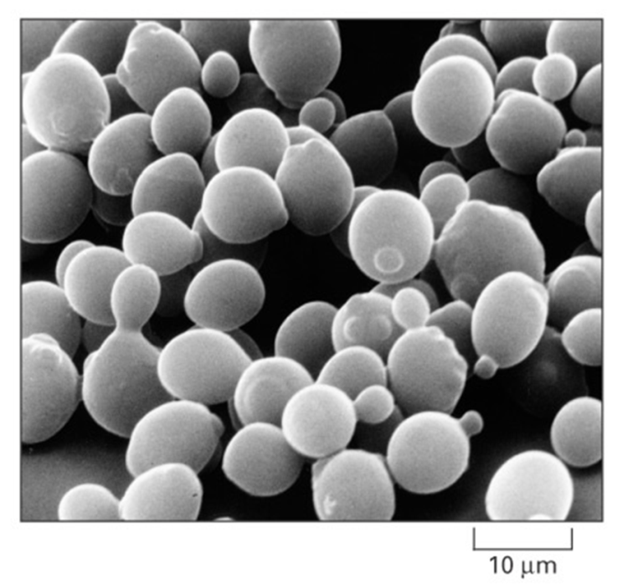
Saccharomyces cerevisiae is an ideal model organism for systems biology
Yeast has a small genome size of approximately 6000 genes.
These genes are regulated by ~250 transcription factors, which can increase or decrease gene expression.
Yeast deletion strains and other molecular genetic tools are readily available.
Cold shock (10-18 °C) response is not as well-documented or previously studied as heat shock
Alberts et al. (2004)

Slide 5
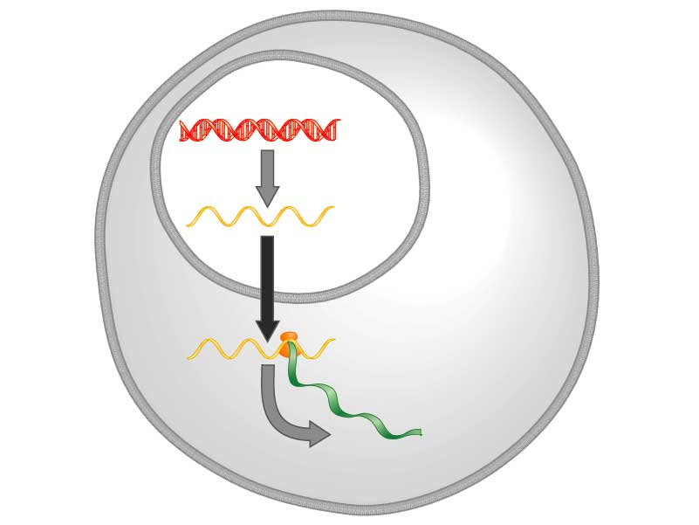
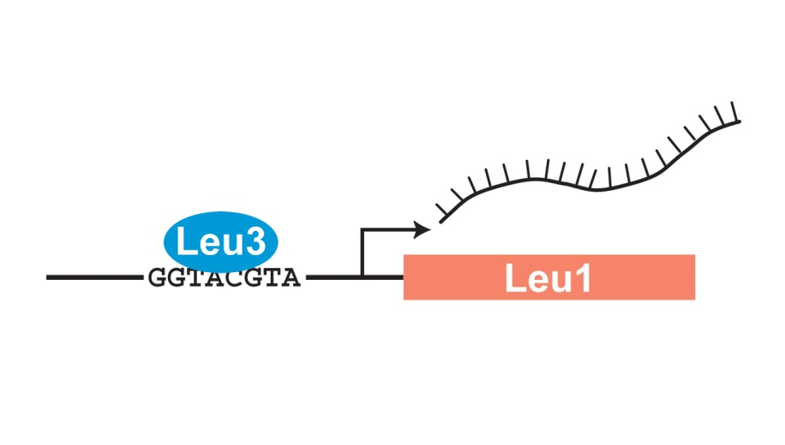
Yeast respond to cold shock by changing the level of gene expression
Transcription factors control gene expression by binding to regulatory DNA sequences.
Activators increase expression while repressors decrease expression
Transcription factors are themselves proteins encoded by genes.
A gene regulatory network (GRN) is a set of transcription factors that control the expression of genes encoding other transcription factors.
DNA
Transcription
mRNA
Translation
Protein
Freeman (2003)

Slide 6
Outline
Yeast respond to cold shock by changing gene expression.
Microarray data was generated for yeast under cold shock conditions.
Data from the Δhap4 strain was used to create gene regulatory networks generated from the YEASTRACT database.
Random networks were generated based on this network using an R-script.
The dynamics of each gene in each network was modeled using ordinary differential equations.
Gephi was used to analyze connectivity and statistics of nodes in Δhap4 data-derived network.
Betweenness centrality seems to be a better indicator of connectivity than eccentricity.
Random networks are likely not biologically relevant.

Slide 7
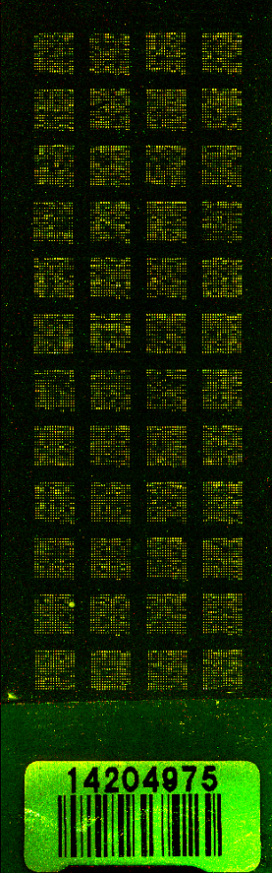
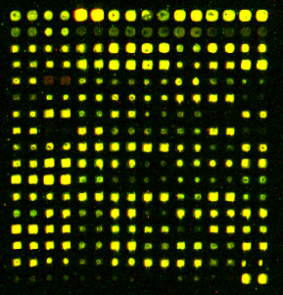
Microarray data is used to observe changes in gene expression for all 6000 genes in yeast
Each spot contains DNA from one gene.
  For each spot:
    Increase Expression
    Decrease Expression
    No Change in Expression
DNA microarray experiments were performed for the wild type and five transcription factor deletion strains (Δcin5, Δgln3, Δhap4, Δhmo1, and Δzap1).
For this analysis, only the Δhap4 data was used.
Sample Microarray Slide from the Dahlquist Lab

Slide 8
The Δhap4 strain microarray data was used to derive a GRN from the YEASTRACT database
Indicates which genes had significant changes in expression at any time point
YEASTRACT Database
These genes were submitted to the YEASTRACT database, which returned a list of candidate regulatory transcription factors that potentially regulate those target genes, in order of significance.
Within-strain ANOVA
Generate “Family” of Related Networks
Notes:
Change title

Slide 9
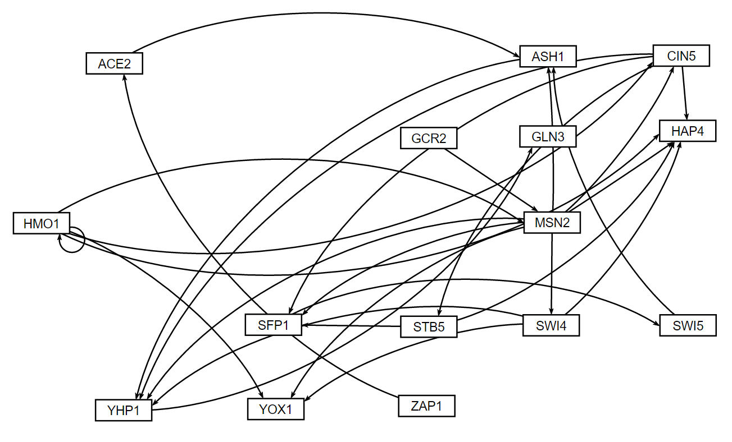
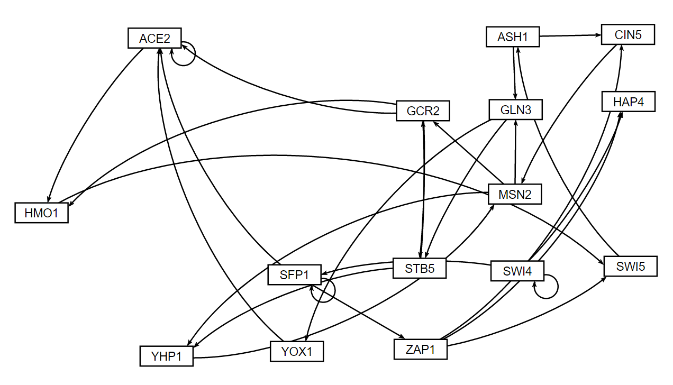
15-gene, 28-edge network was used as template for random networks
Δhap4 data-derived network (db5)
15 nodes, 28 edges
Randomized network 1
15 nodes, 28 edges
30 random networks were generated with an R script.
A random network has the same genes and the same number of edges, but the edges are randomized.
Notes:
Change tital, diont mention pared network

Slide 10
Outline
Yeast respond to cold shock by changing gene expression.
Microarray data was generated for yeast under cold shock conditions.
Data from the Δhap4 strain was used to create gene regulatory networks generated from the YEASTRACT database.
Random networks were generated based on this network using an R-script.
The dynamics of each gene in each network was modeled using ordinary differential equations.
Gephi was used to analyze connectivity and statistics of nodes in Δhap4 data-derived network.
Betweenness centrality seems to be a better indicator of connectivity than eccentricity.
Random networks are likely not biologically relevant.

Slide 11
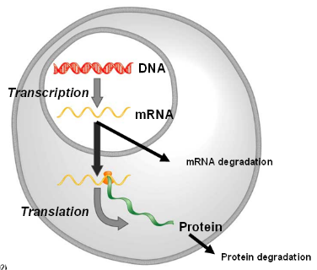
GRNmap uses ordinary differential equations to model the dynamics of each gene
The MATLAB code and executable are available under an open source license at: https://github.com/kdahlquist/GRNmap/.
The expression levels of the transcription factors were modeled using mass balance ordinary differential equations with a sigmoidal production function.
The change in expression of a gene is production - degradation.
Notes:
“production minus degradation”

Slide 12
GRNmap uses ordinary differential equations to model the dynamics of each gene
Weight parameter, w, gives the direction and the magnitude of regulatory relationship.
Positive weights are activation.
Negative weights are repression.
The magnitude of the weight represents the strength of the regulation.
expression of gene
mRNA production rate
mRNA degradation rate
weight term
threshold unique
to each gene

Slide 13
Outline
Yeast respond to cold shock by changing gene expression.
Microarray data was generated for yeast under cold shock conditions.
Data from the Δhap4 strain was used to create gene regulatory networks generated from the YEASTRACT database.
Random networks were generated based on this network using an R-script.
The dynamics of each gene in each network was modeled using ordinary differential equations.
Gephi was used to analyze connectivity and statistics of nodes in Δhap4 data-derived network.
Betweenness centrality seems to be a better indicator of connectivity than eccentricity.
Random networks are likely not biologically relevant.

Slide 14
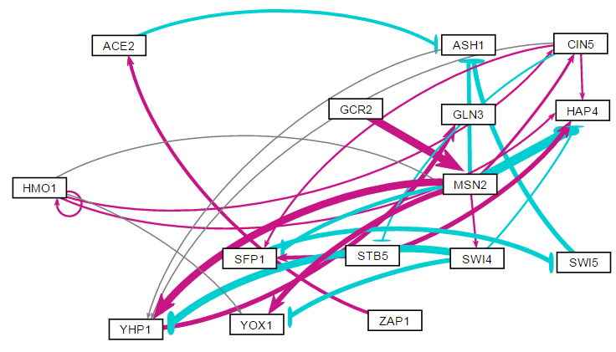
GRNsight helps visualize the weight parameters
Magenta arrows represent activation
Cyan blunt arrows represent repression
The thickness of the edge shows the strength of the relationship
Thin, grey edges have weak influence

Slide 15
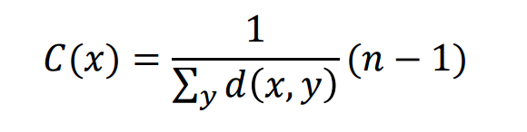
Eccentricity centrality shows how accessible a node is from others by finding the “longest” shortest path
Higher value means other nodes are in proximity and it has a greater impact.
High eccentricity also means that node will be more highly influenced by other nodes.
Highest eccentricity found in db5 was for
  STB5: 5
  ZAP1: 4
  SFP1: 4

Slide 16
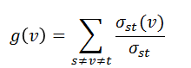
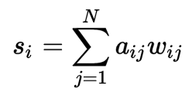
Betweenness centrality measures how often a node is found on the shortest path between two other nodes
The value given is the number of all the shortest paths that passes through this specific vertex.
In weighted networks, the strength is determined by the sum of the weights of its adjacent edges
The three greatest betweenness values were by
  MSN2: 14
  YHP1: 11
  ASH1: 10

Slide 17
Betweenness centrality may be better indicator of a node’s importance than eccentricity
ID | Total Degree | Eccentricity | Betweeness centrality
ACE2 | -0.005 | 3 | 3
ASH1 | -4.128 | 2 | 10
CIN5 | 1.750 | 3 | 5
GCR2 | 3.224 | 3 | 0
GLN3 | 1.799 | 0 | 0
HAP4 | -1.669 | 0 | 0
HMO1 | 2.087 | 3 | 0
MSN2 | 2.459 | 2 | 14
SFP1 | -1.219 | 4 | 9
STB5 | 3.005 | 5 | 0
SWI4 | -4.455 | 2 | 0
SWI5 | -3.570 | 3 | 7
YHP1 | 1.830 | 1 | 11
YOX1 | 0.448 | 0 | 0
ZAP1 | 0.917 | 4 | 0
Betweenness centrality measures how often a node is within another’s shortest path, while eccentricity measures how close it is to others.

Slide 18
Betweenness centrality may be better indicator of a node’s importance than eccentricity
ID | Total Degree | Eccentricity | Betweeness centrality
ACE2 | -0.005 | 3 | 3
ASH1 | -4.128 | 2 | 10
CIN5 | 1.750 | 3 | 5
GCR2 | 3.224 | 3 | 0
GLN3 | 1.799 | 0 | 0
HAP4 | -1.669 | 0 | 0
HMO1 | 2.087 | 3 | 0
MSN2 | 2.459 | 2 | 14
SFP1 | -1.219 | 4 | 9
STB5 | 3.005 | 5 | 0
SWI4 | -4.455 | 2 | 0
SWI5 | -3.570 | 3 | 7
YHP1 | 1.830 | 1 | 11
YOX1 | 0.448 | 0 | 0
ZAP1 | 0.917 | 4 | 0
Betweenness centrality measures how often a node is within another’s shortest path, while eccentricity measures how close it is to others.
STB5 and ZAP1: close to others but not used often in paths
MSN2: Major “station” in shortest paths although low eccentricity
Notes:
“ for our network “
Few spaces before eery number and word

Slide 19
Outline
Yeast respond to cold shock by changing gene expression.
Microarray data was generated for yeast under cold shock conditions.
Data from the Δhap4 strain was used to create gene regulatory networks generated from the YEASTRACT database.
Random networks were generated based on this network using an R-script.
The dynamics of each gene in each network was modeled using ordinary differential equations.
Gephi was used to analyze connectivity and statistics of nodes in Δhap4 data-derived network.
Betweenness centrality seems to be a better indicator of connectivity than eccentricity.
Random networks are likely not biologically relevant.

Slide 20
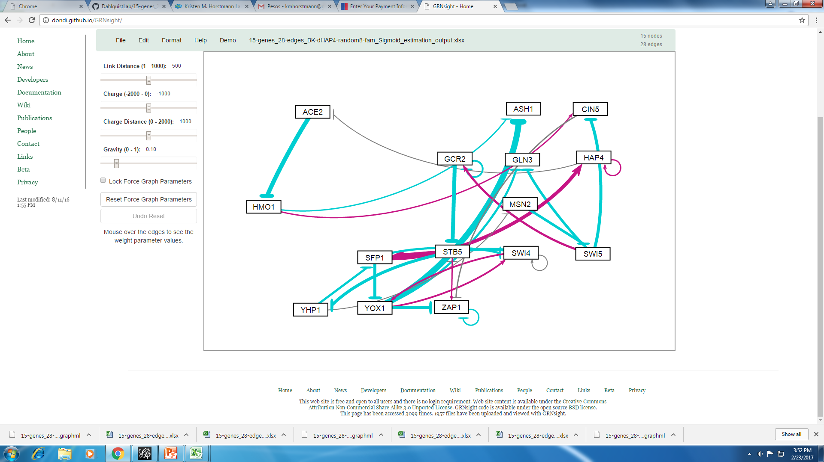
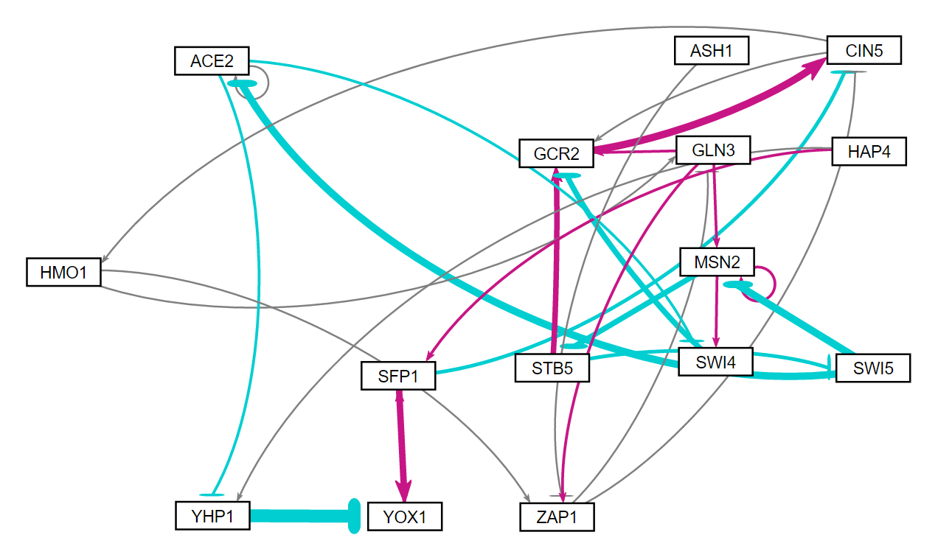
Betweenness centrality values were much higher in random networks
Random network 8
Random network 10
Network | ID | In Degree | Out Degree | Total Degree | Betweenness Centrality
8 | SFP1 | 2.262 | -0.731 | 1.531 | 99
8 | STB5 | -3.204 | 4.053 | 0.849 | 84
10 | CIN5 | 1.958 | 0.258 | 2.215 | 78
10 | GLN3 | 0.073 | 1.513 | 1.586 | 74
10 | MSN2 | -1.952 | -0.832 | -2.784 | 73.33
Notes:
Betweenness centrality and Total Degree
Say something about in and out degrees

Slide 21
Comparison between random network 8 and Δhap4 network
Random network 8
db5
Degree values similar between two networks.
Natural networks are less likely to put individual genes in such important roles in case of malfunction or mutation.
There are biological factors in the natural networks that have not or cannot be coded for the random networks.
Network | ID | In Degree | Out Degree | Total Degree | Betweenness Centrality
8 | SFP1 | 2.262 | -0.731 | 1.531 | 99
8 | STB5 | -3.204 | 4.053 | 0.849 | 84
db5 | MSN2 | 3.325 | -0.866 | 2.459 | 14
db5 | YHP1 | 0.032 | 1.799 | 1.830 | 11
db5 | ASH1 | -4.231 | 0.103 | -4.128 | 10
Notes:
-mention similarity between two networks in/out degrees

Slide 22
Conclusions
Betweenness centrality was most indicative of a node’s importance in a network than eccentricity.
MSN2, YHP1, and ASH1 were found to be most highly connected and used as “stepping stones” in Δhap4 -derived network.
Random networks do not share the same properties as the database-derived network, similar to previously studied larger networks.
Random networks have a much higher betweenness centrality for certain genes.
Natural networks are less likely to put individual genes in such important roles in case of malfunction.
Notes:
- Discuss how it relates with large random networks

Slide 23

Acknowledgements
GRNmap data analysis team: Margaret J. O’Neil, Natalie E. Williams, Brandon J. Klein
GRNmap coding team: Trixie A. Roque, Chukwuemeka (Edward) Azinge, Justin Torres, Jen Shin
GRNsight team: Nicole A. Anguiano, Anindita Varshneya, Mihir Samdarshi, Eileen Choe, Edward Bachoura
Wet-lab team: Monica Hong, Katherine Scheker, Nika Vafadari
Mentors: Dr. Kam Dahlquist and Dr. Ben Fitzpatrick

Slide 24
References
“Betweenness Centrality." University of Chieti-Pescara, Science Department, n.d. Web. 16 Mar. 2017. https://www.sci.unich.it/~francesc/teaching/network/betweeness.html
Dahlquist, K., Fitzpatrick, B., Camacho, E., Entzminger, S., & Wanner, N. (2015). Parameter Estimation for Gene Regulatory Networks from Microarray Data: Cold Shock Response in Saccharomyces cerevisiae. Bulletin Of Mathematical Biology, 77(8), 1457-1492. http://dx.doi.org/10.1007/s11538-015-0092-6.
Dário Abdulrehman, Pedro T. Monteiro, Miguel C. Teixeira, Nuno P. Mira, Artur B. Lourenço, Sandra C. dos Santos, Tânia R. Cabrito, Alexandre P. Francisco, Sara C. Madeira, Ricardo S. Aires, Arlindo L. Oliveira, Isabel Sá-Correia, Ana T. Freitas (2011). YEASTRACT: providing a programmatic access to curated transcriptional regulatory associations in Saccharomyces cerevisiae through a web services interface Nucl. Acids Res., 39: D136-D140, Oxford University Press.
"Eccentricity." Center for Biomedical Computing, University of Verona, n.d. Web. 18 Mar. 2017. http://www.cbmc.it/fastcent/doc/Eccentricity.htm
Freeman, S. (2002). Biological science. Upper Saddle River, NJ: Prentice Hall.
GRNsight. (n.d.). Retrieved February 28, 2017, from http://dondi.github.io/GRNsight/
Gephi. (n.d.). Retrieved November 28, 2016, from https://gephi.org/

